Slide 1
Interpreting GPT-2’s Zero-Shot Sequence Completion Ability
Rahul Chowdhury, Prof. Dr. David Bau

Slide 2
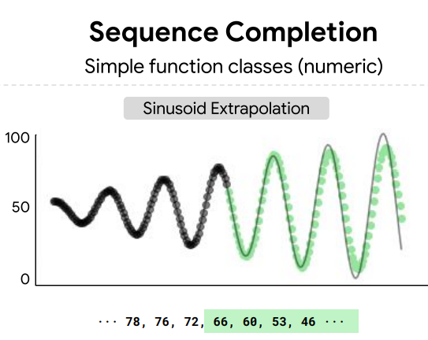
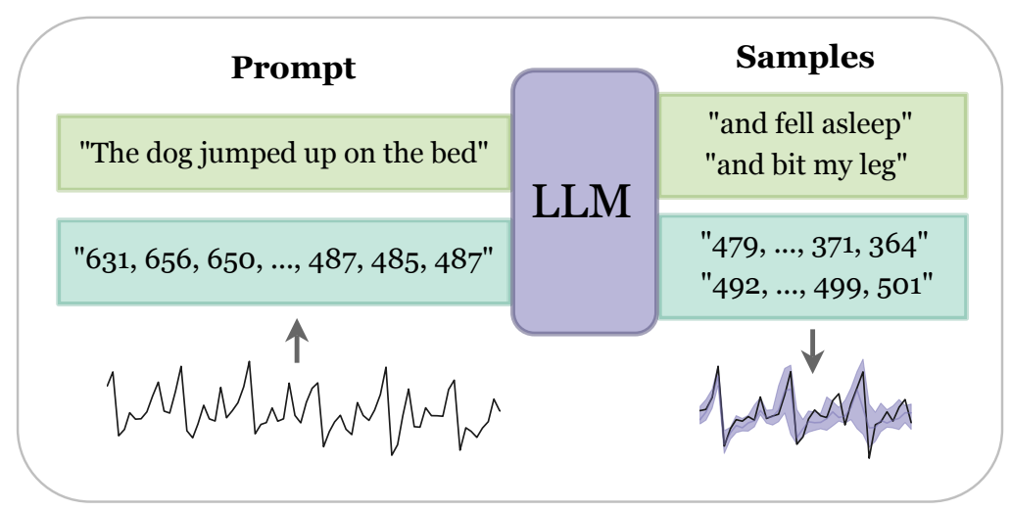
Introduction
Fig 1 Sequence completion task performed on GPT-2 [1]
Fig 2 Sequence completion task as observed in Large Language Models [2]

Slide 3
Probing
Linear Regression Using The Activations
Logistic Regression Using The Activations
GPT-2

Slide 4
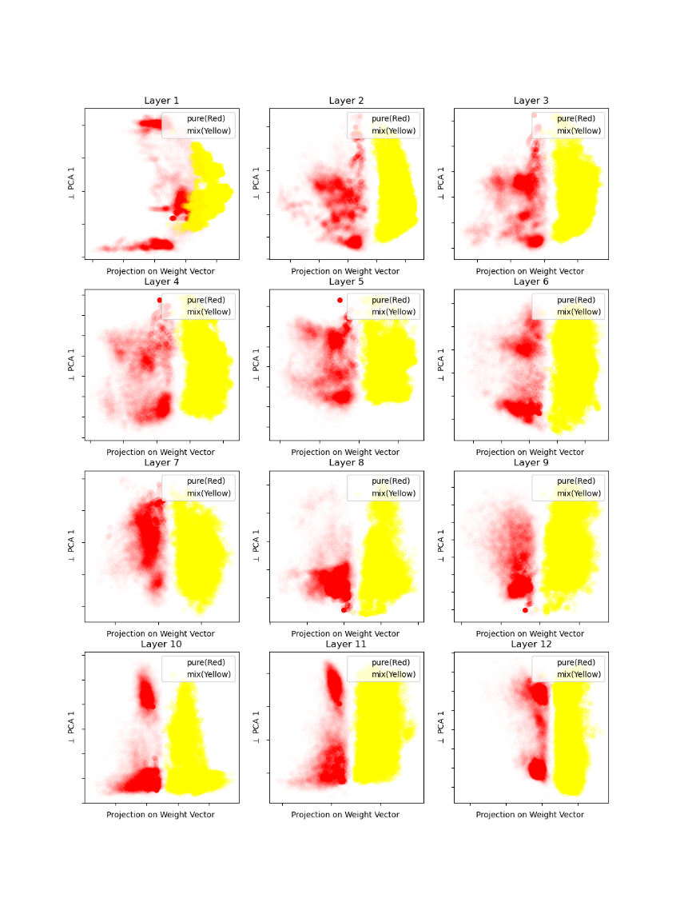
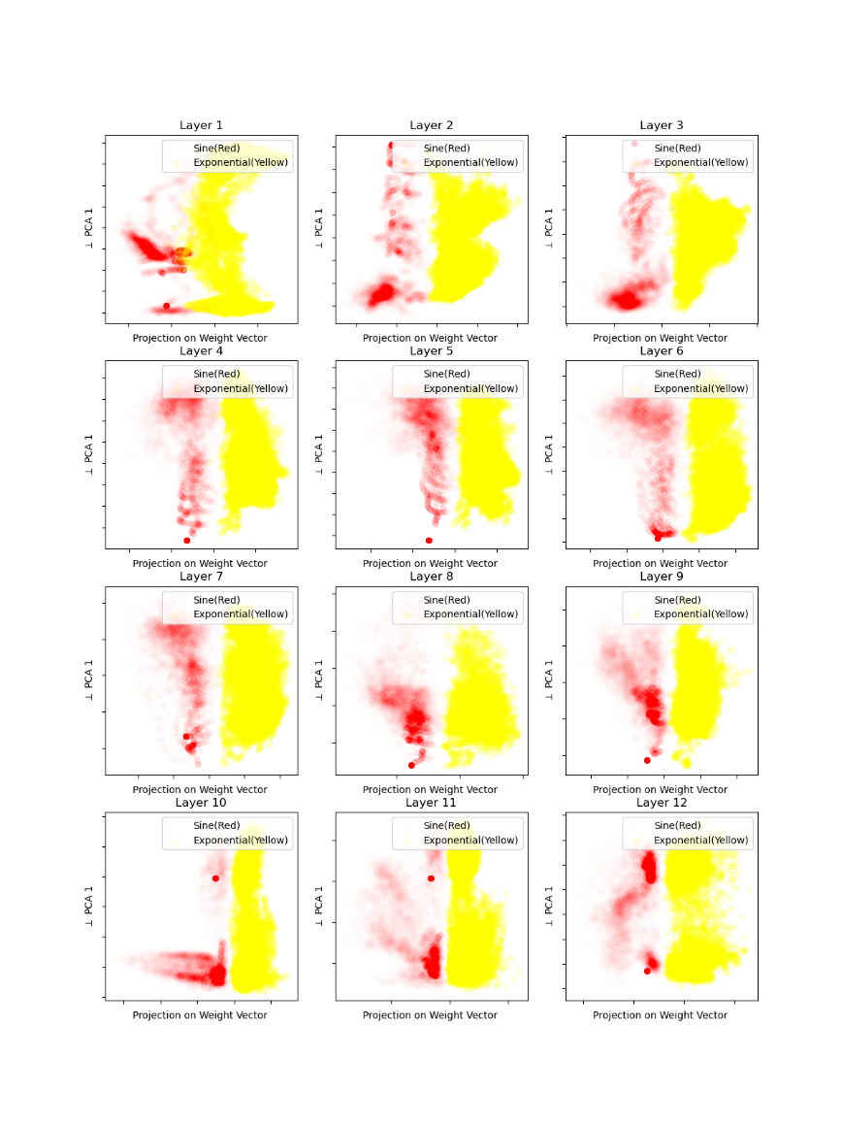
Probing for exponential, sinsuoids and mixture of both
Figure 3. Linearly classifiable activation projection of mixture and pure sinusoids/ exponential signals at each layer of GPT-2
Figure 4. Linearly classifiable activation projection of sinusoidsand exponential signals at each layer of GPT-2

Slide 5
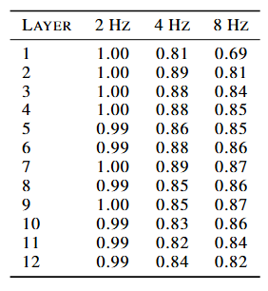
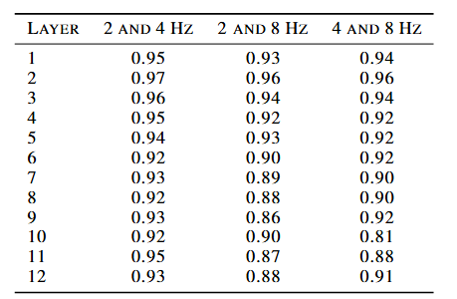
Probing For Basic Time Series Elements
Table 1. Classification accuracies of three frequencies from waves containing pure and composition of different frequencies using activations of GPT-2 from each layer
Table 2. Regression scores of peaks of waves composed of multiplefrequencies using activations of GPT-2 from each layer

Slide 6
Counterfactual Inputs
GPT-2
Clean
Noise
GPT-2
Clean
Noise
Clean
Clean
Clean
Clean
Clean
GPT-2
GPT-2
Noise
Clean

Slide 7
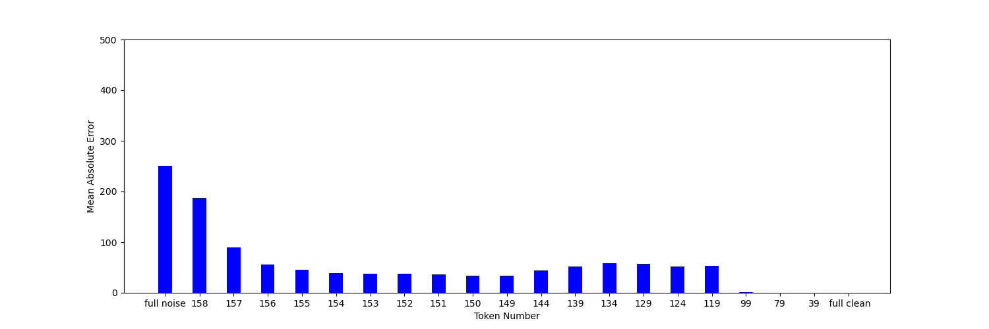
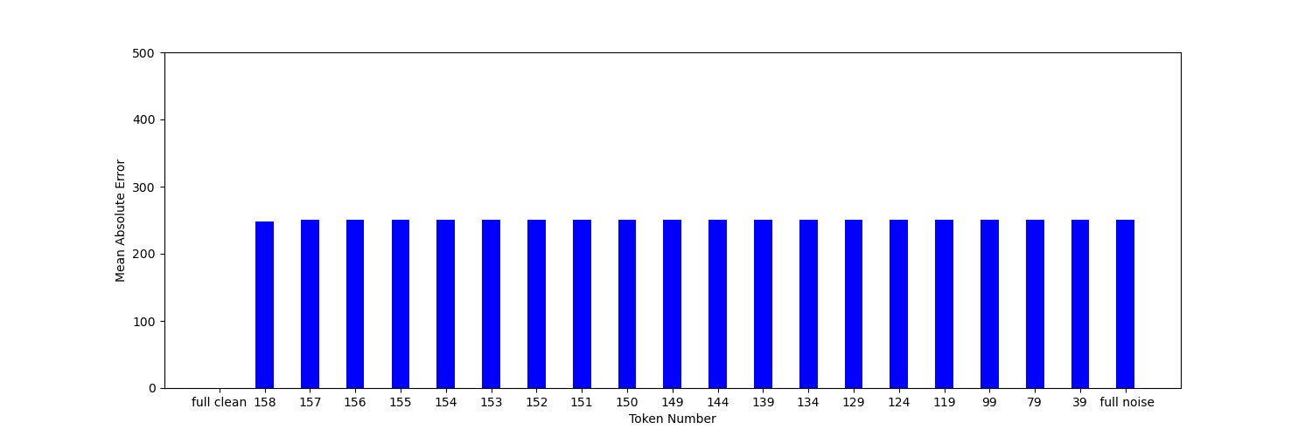
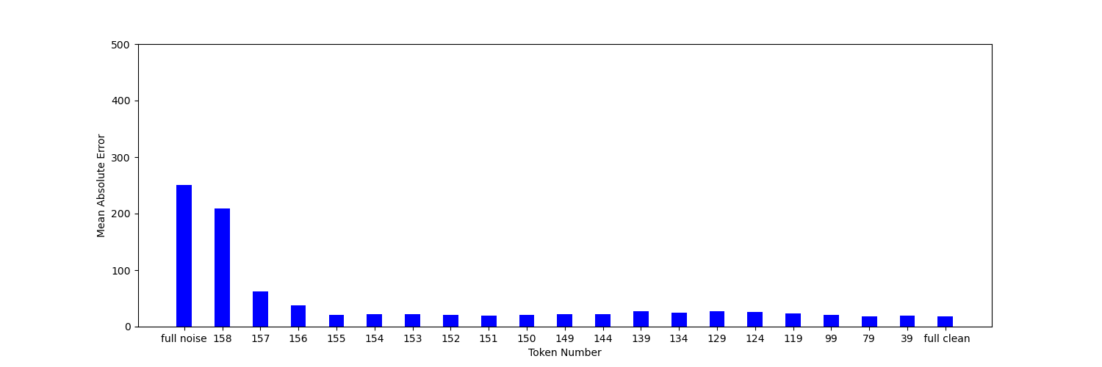
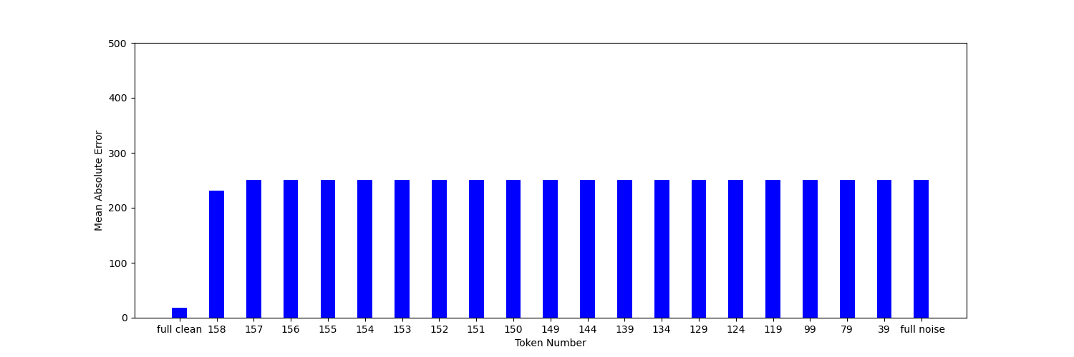


Counterfactuals-Contiguous Noise From First Token (left column) and From Last Token (right column)
2 Hz
2 Hz
$\sqrt{5}$ Hz
$\sqrt{5}$ Hz
Fig 5 Shows the mean absolute error with respect to the original output after counterfactual signals are fed along with partial noise and vice verse

Slide 8
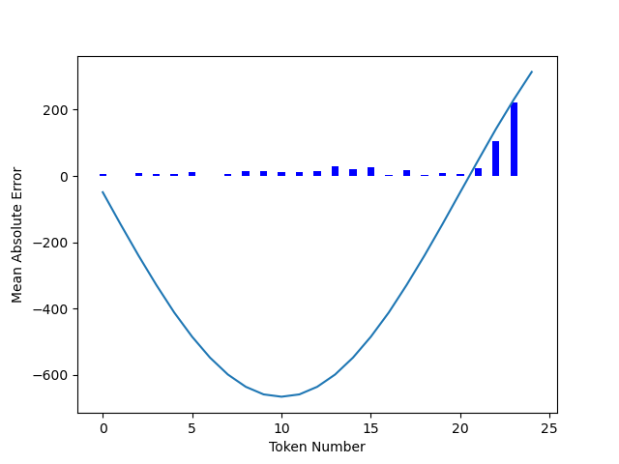
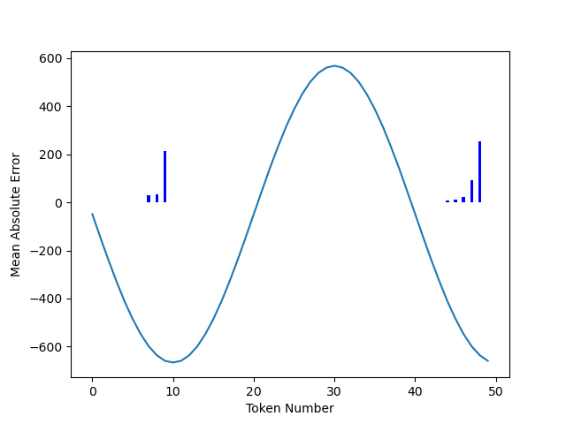
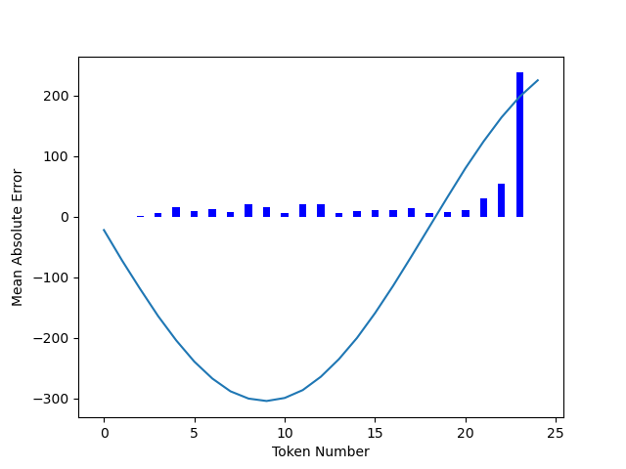
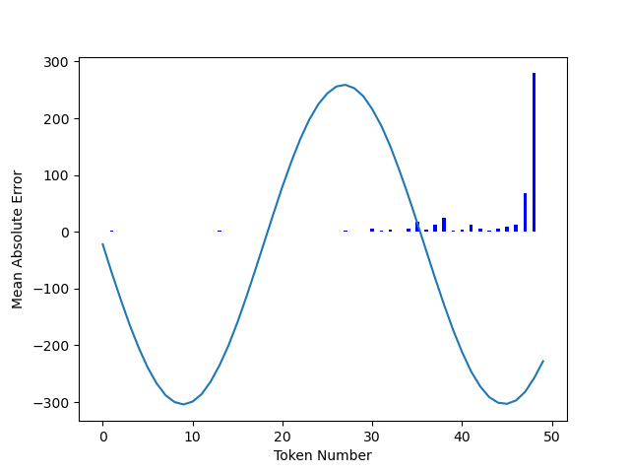
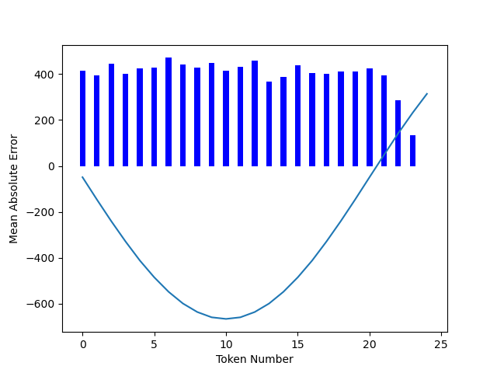
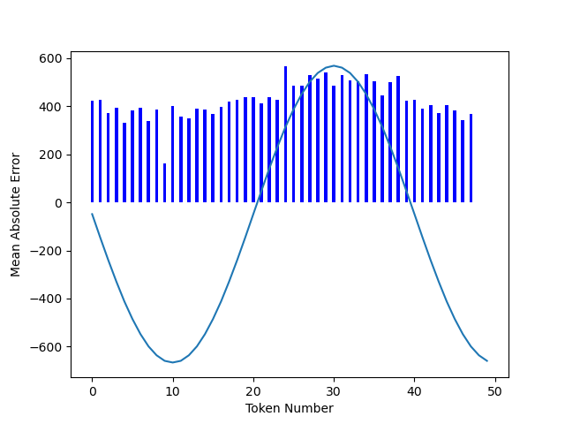
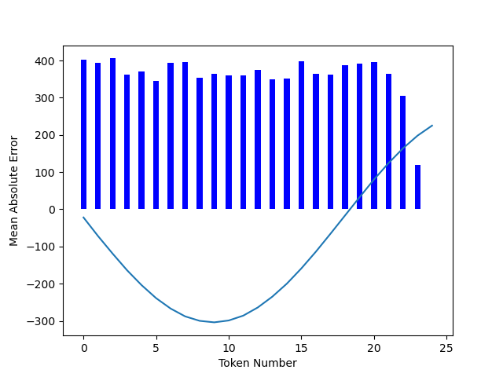
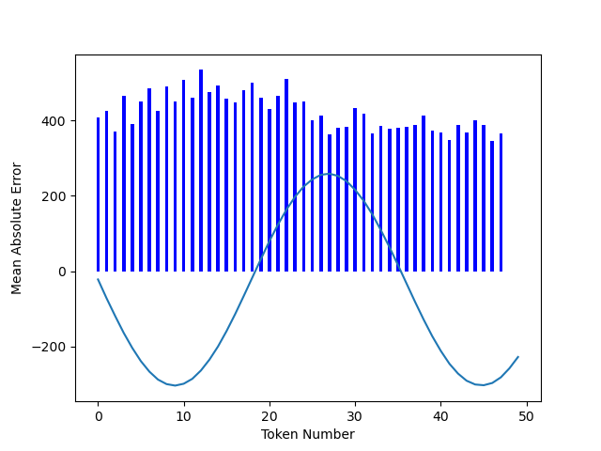




Counterfactuals-Single Token Noise
2 Hz
2 Hz
$\sqrt{5}$ Hz
$\sqrt{5}$Hz
Fig 6 Shows the mean absolute error with respect to the output of the GPT-2 after counterfactual signal is fed at each token position
2 Hz
2 Hz
$\sqrt{5}$ Hz
$\sqrt{5}$ Hz
Fig 7 Shows the mean absolute error with respect to the counterfactual input to the GPT-2 at each token position to measure the alignment of the output to that noisy token

Slide 9
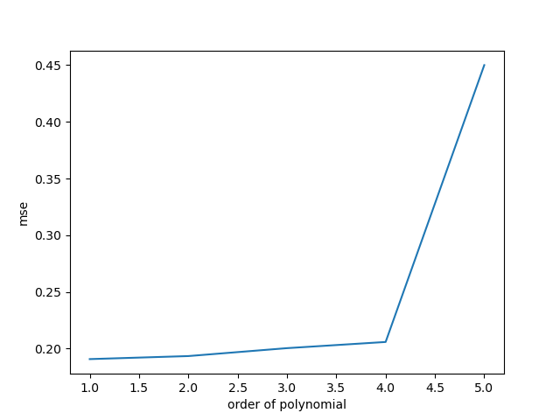
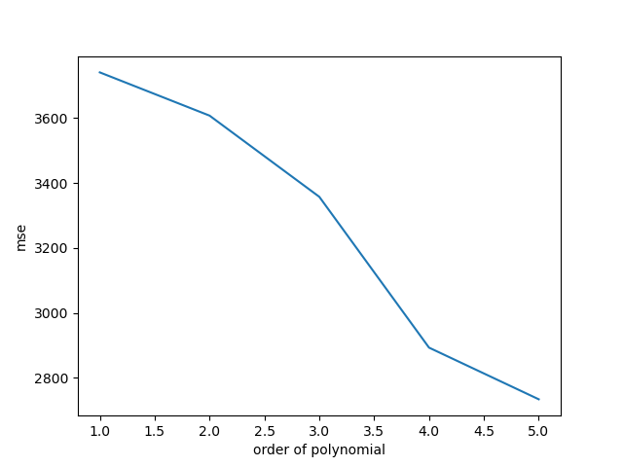

What Model Could GPT-2 Be Using?
For a length of 50 tokens the 46-49th tokens (last 3 tokens) were used to train a linear model to estimate a model of GPT-2’s prediction
2 Hz
$\sqrt{5}$ Hz
A Toy Experiment

Slide 10
References
[1] Mirchandani, S., Xia, F., Florence, P., Ichter, B., Driess, D., Arenas, M. G., Rao, K., Sadigh, D., and Zeng, A. Largelanguage models as general pattern machines. arXiv preprint arXiv:2307.04721, 2023.
[2] Gruver, N., Finzi, M., Qiu, S., and Wilson, A. G. Large language models are zero-shot time series forecasters. Advances inNeural Information Processing Systems, 36, 2024.

