Slide 1
Autoregressive Transformer Architecture (GPT)
residual stream
Miles
hidden state vector
Davis
attention heads
perceptron
plays
the
Trumpet
(1) translate tokens to vectors
(2) execute a few dozen rounds of arithmetic
(3) translate vector to next token

Slide 2
Cloze prompt (fill-in-the-blank)
The capital of the state of Vermont is the city of
incomplete sentence
next-word prediction
In-context learning (by-example)
New York: Albany; Montana: Helena; Vermont:
demonstrations
Explicit instruction-style prompt
Tell me the capital of Vermont.
direct instruction

Slide 3


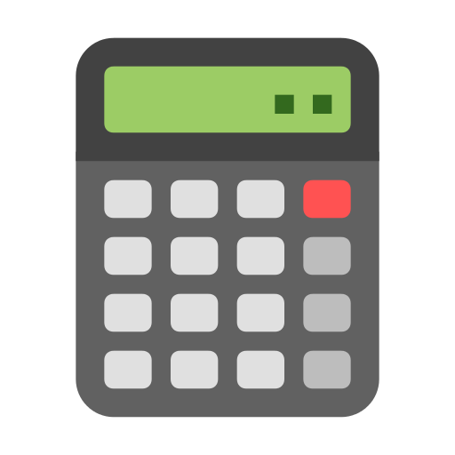
User instruction
How many shares of MSFT can I buy for $10,000?
[invoke search MSFT]
Microsoft Corp, NASDAQ: MSFT.
Market Summary > Microsoft Corp
280.57 USD
+2.91 (1.05%) today
Mkt Cap 2.09T
P/E ratio 31.19
Div yield 0.97%
[response complete]
[invoke calculator 10000 / 280.57]
35.6417293367
[response complete]
At today’s price of 280.57, you can buy 35 shares.
next word predictions
tool responses
search tool
next word predictions
tool responses
final next word predictions
calculator tool

Slide 4
Cloze prompt (fill-in-the-blank)
The opposite of the word “noisy” is the word “
In-context learning (by-example)
big : small ; slow : fast ; fresh : stale ; noisy :
Explicit instruction-style prompt
Give me a word that is the opposite of “noisy.”

