Slide 1
Convolutional Neural Networks and you
Does that Tesla see me?

Slide 2
Datascience Workflow
Definition
Data harvesting
Exploration
Modeling
Evalutating
Answers
Notes:
The data science problem
Often seen

Slide 3
Problem
Can a computer tell a motorcycle from a car?
Notes:
I like motorcycles
I like neural networks
Computer vision in cars
Semi and autonous vehicles
Safe - no new ground to cut

Slide 4
Free Range Data Hunting
MIOvision Traffic Camera Data
Notes:
MIOvision traffic management company using cameras and computer vision

Slide 5
Free Range Data Hunting
MIOvision Traffic Camera Data
519, 982 images in 11 categories

Slide 6
Free Range Data Hunting
MIOvision Traffic Camera Data
519, 982 images in 11 categories
Training and Testing Images
Notes:
Train sets labeled,
Test sets are not.

Slide 7
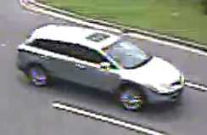
Look! Pictures!
Articulated Truck | 10,346
background | 160,000
bicycle | 2284
bus | 10,316
car | 260,518
motorcycle | 1982
non-motorized vehicle | 1751
pedestrian | 6262
pick-up truck | 50,906
single-unit truck | 5120
work van | 9697
Notes:
Sample image of a car
Distribution of images

Slide 8
One model to rule them all...
Binary
Input (input size based on image size)
15 hidden layers
Output (sigmoid activation)
Multiclass
Input (input size based on image size)
15 hidden layers
Output (softmax activation)
Notes:
Binary model
Worked!
Bored.
Mutliclass model
meh

Slide 9
Does it work?
Notes:
Can my computer see a motorcycle in a picture?

Slide 10
NO
Not even close

Slide 11
Data Issues
Notes:
Several types of issues
Data
Modeling
Machine

Slide 12
Issues
Solutions
Out of balance
Different sizes
Different shapes
Size (3GB)
Selective image imports
Resize
Reshape
Bigger/better computer
Libraries:
Pillow - friendly version of Pythom Image Library (PIL)
keras ImageDataGenerator
Notes:
Massively out of balance classes
Balanced them
size/shape
Keras wants a standard array size
Pillow
Keras ImageDataGenerator (Thanks, patrick!)

Slide 13
Modeling Issues
Notes:
Main issues:
Data, Data, Data
Type of models
Data size

Slide 14
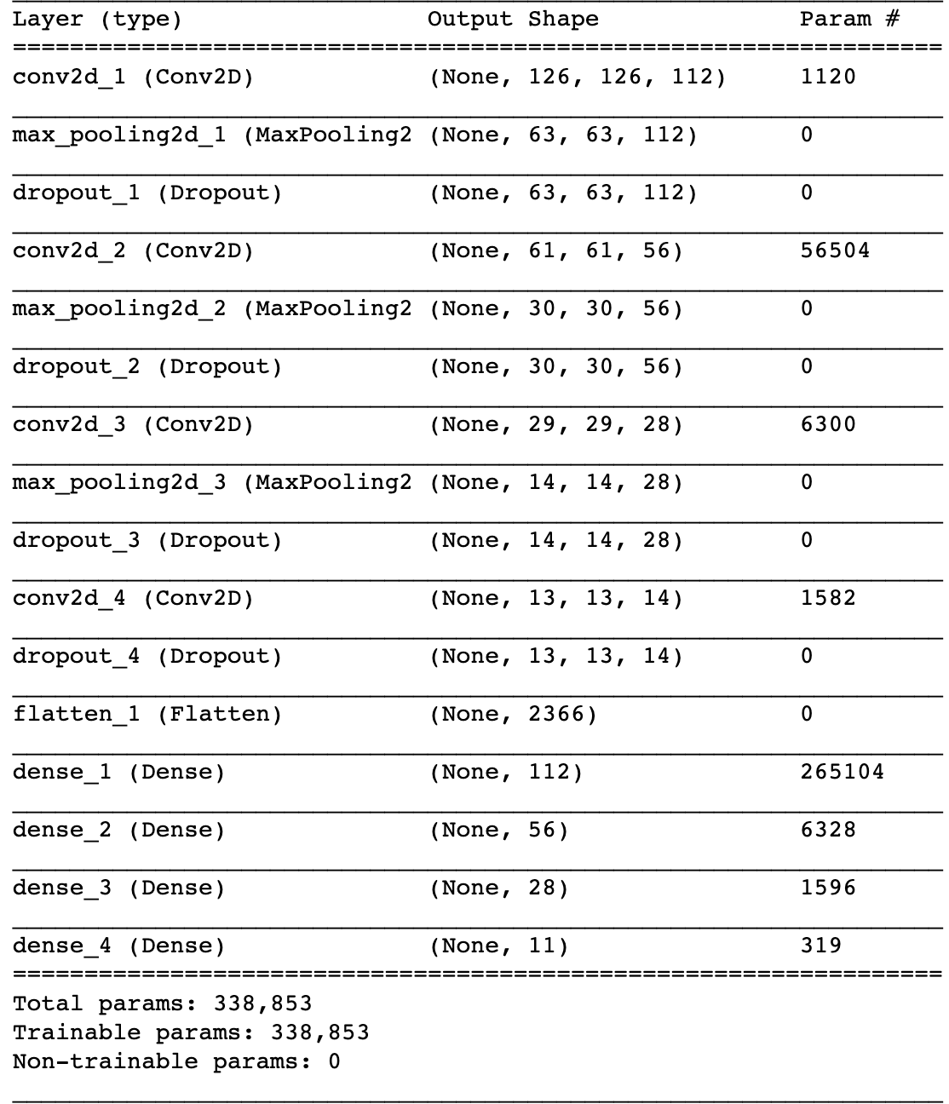
Get your geek on!
4 convolution layers
3 pooling layers
4 dropout layers
1 flatten layer
4 dense layers

Slide 15

Models
all the models

Slide 16
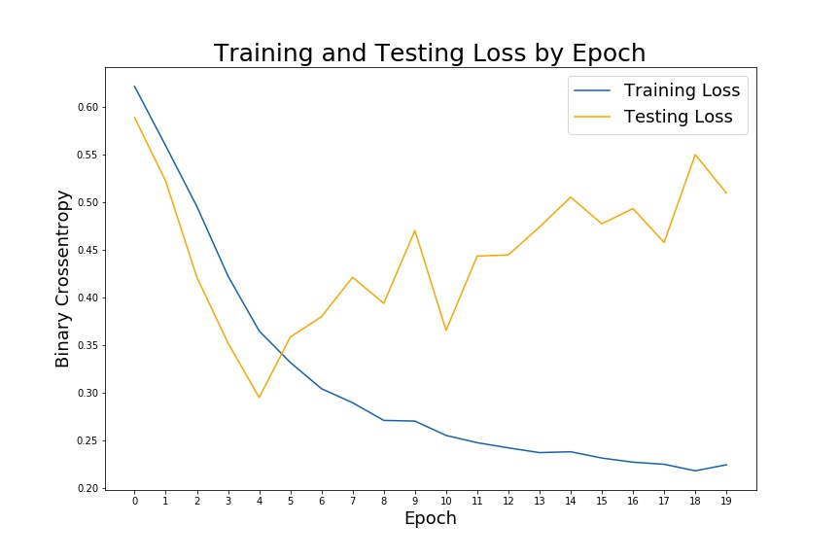
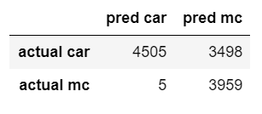
Unbalanced, Binary, 28x28 pixels
Accuracy: 75.04%
Notes:
4k cars 2k mc

Slide 17
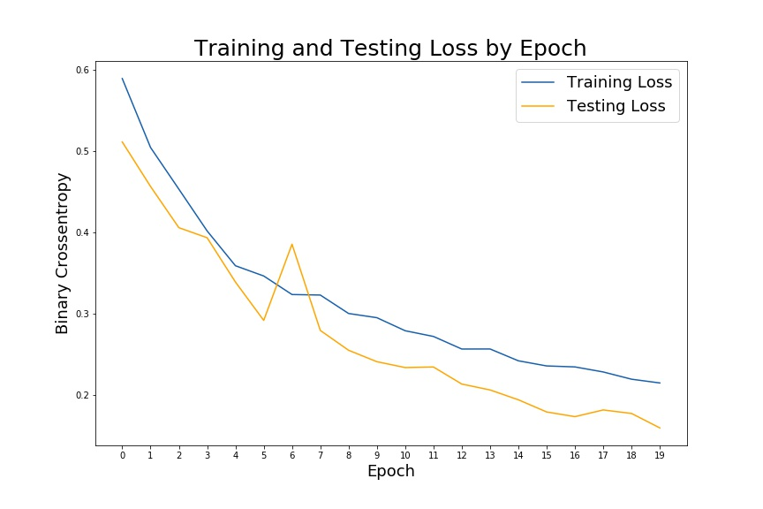
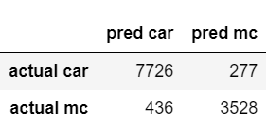
Unbalanced, Binary, 64x64 pixels
Accuracy: 94.92%
Notes:
4k cars 2k mc

Slide 18
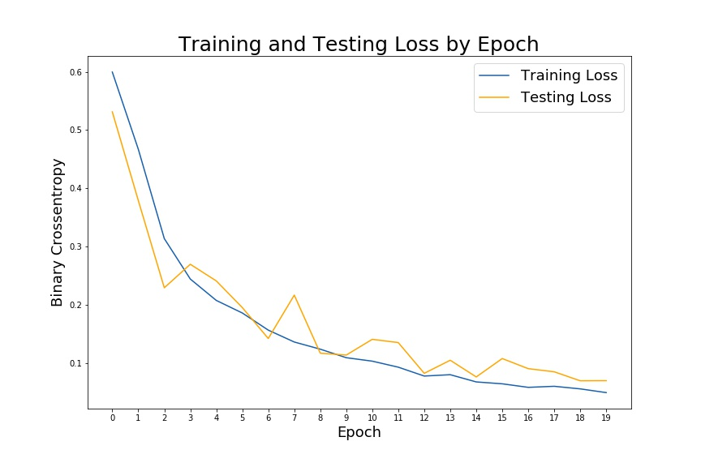
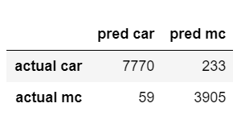
Unbalanced, Binary, 128x128 pixels
Accuracy: 97.91%
Notes:
4k cars 2k mc

Slide 19
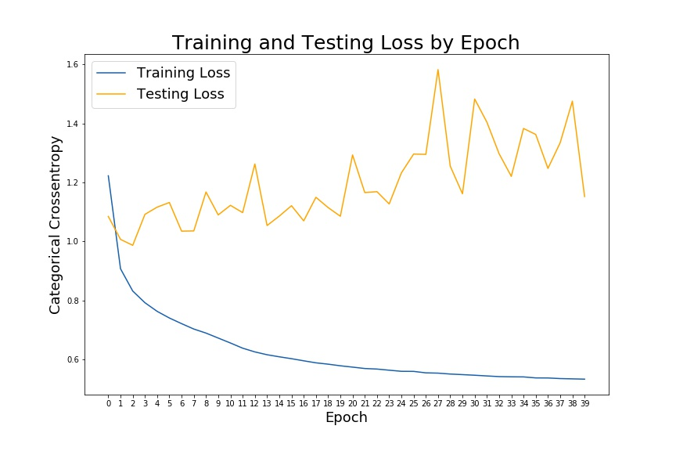
Full Dataset, 28x28
Notes:
All the data at 28x28

Slide 20
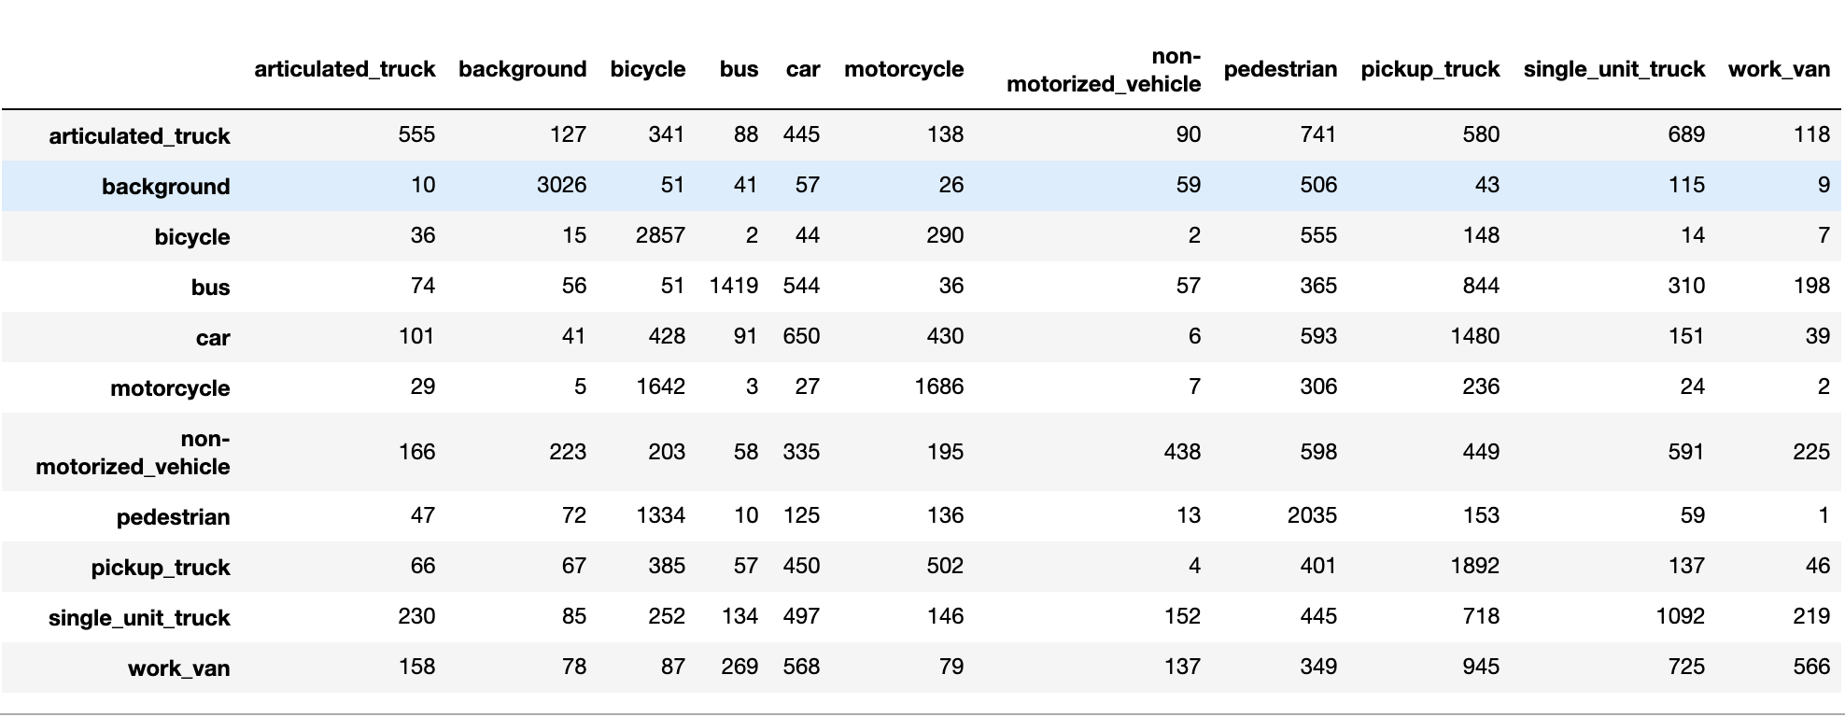
Full Dataset, 28x28

Slide 21
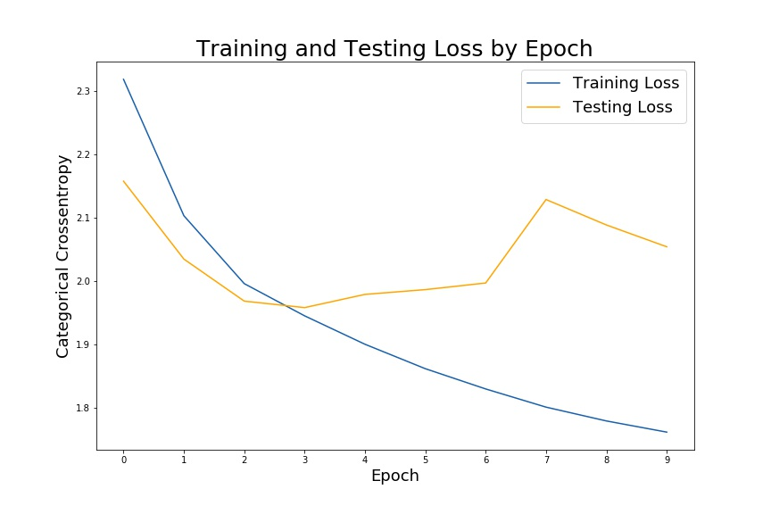
Balanced Full Dataset 28x28
Notes:
2k of everything

Slide 22
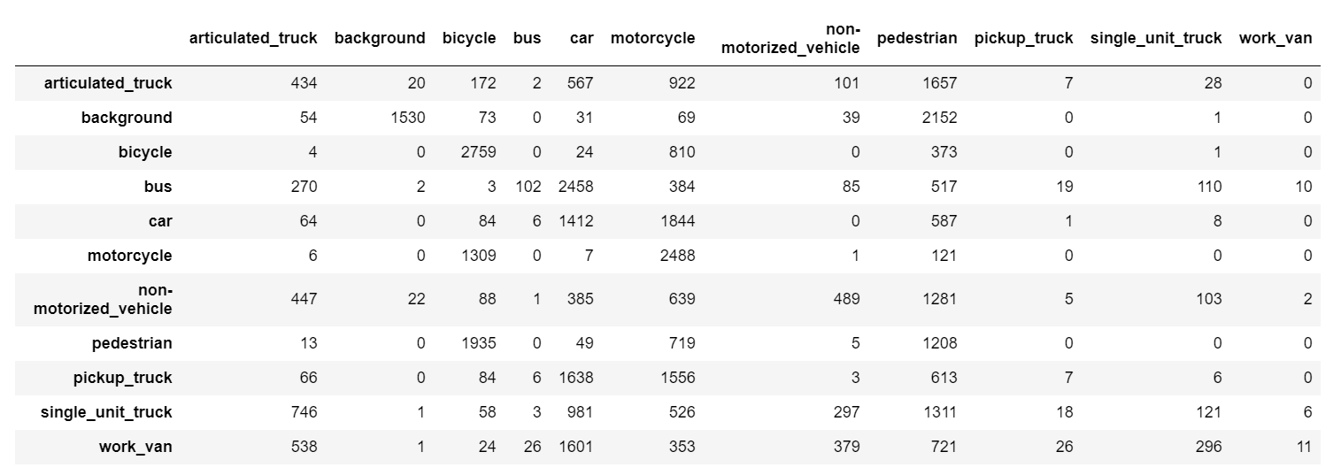
Balanced Full Dataset 28x28

Slide 23
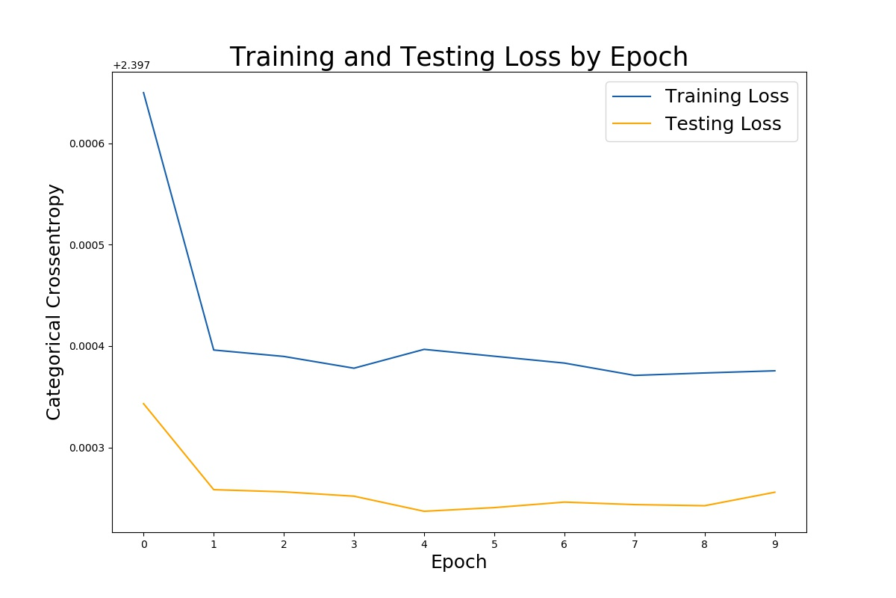
Balanced Full Dataset 64x64
Notes:
2k of everything

Slide 24
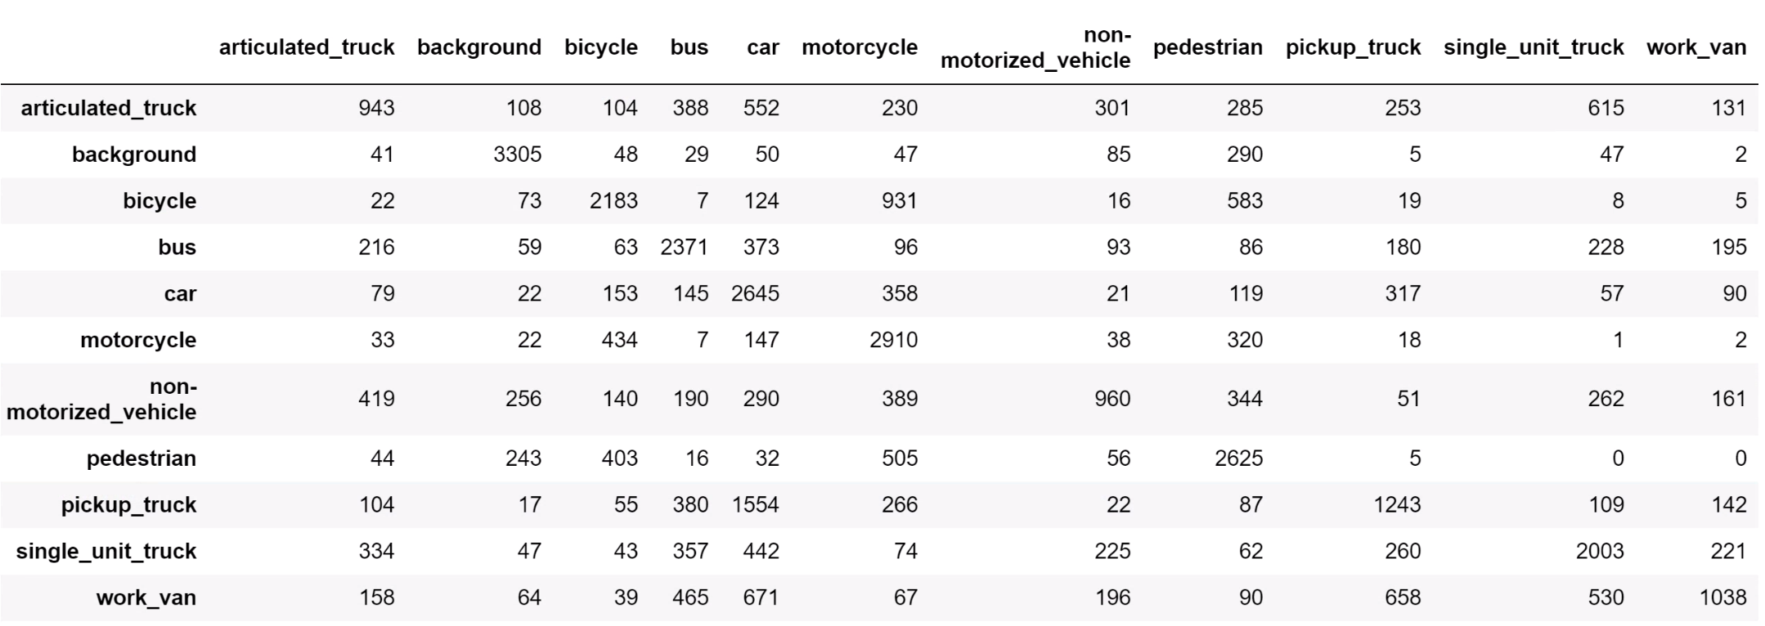
Balanced Full Dataset 64x64

Slide 25
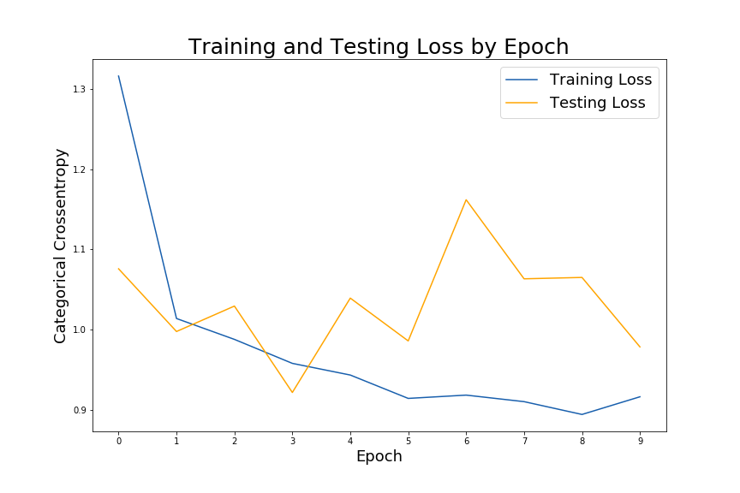
ImageDataGenerator, 28x28
Notes:
Generate object
Flow from directory method

Slide 26
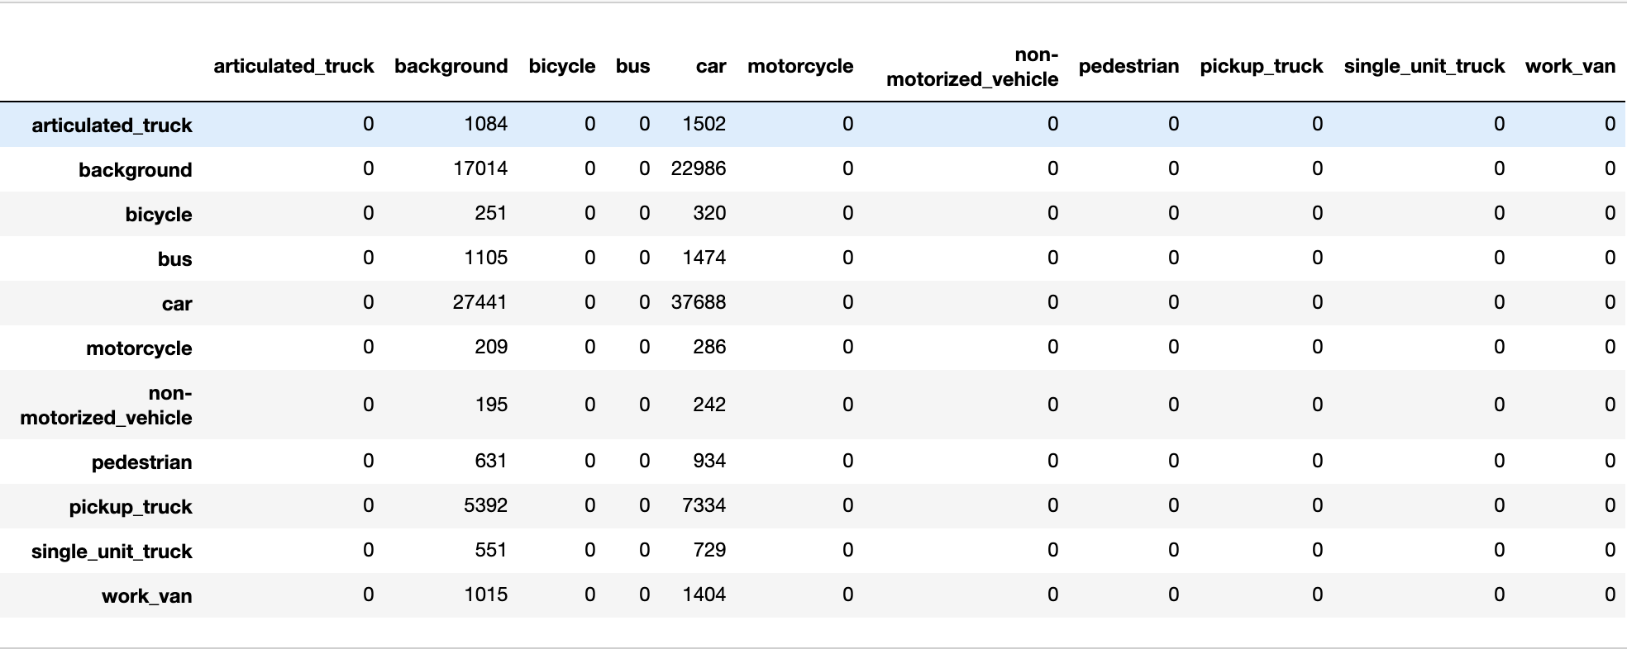
ImageDataGenerator, 28x28

Slide 27
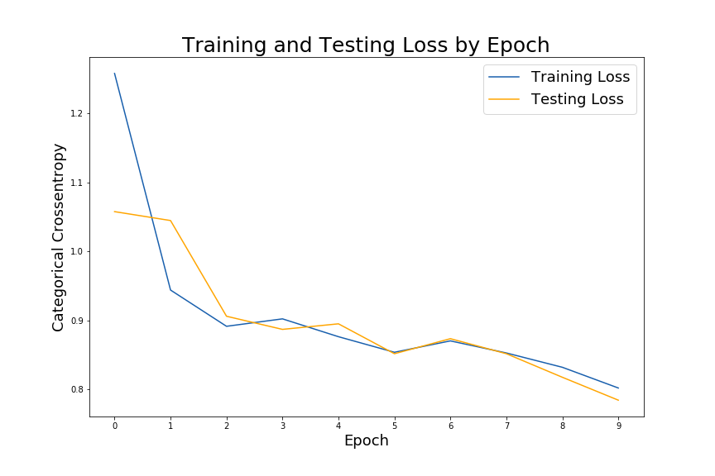
ImageDataGenerator, 64x64

Slide 28
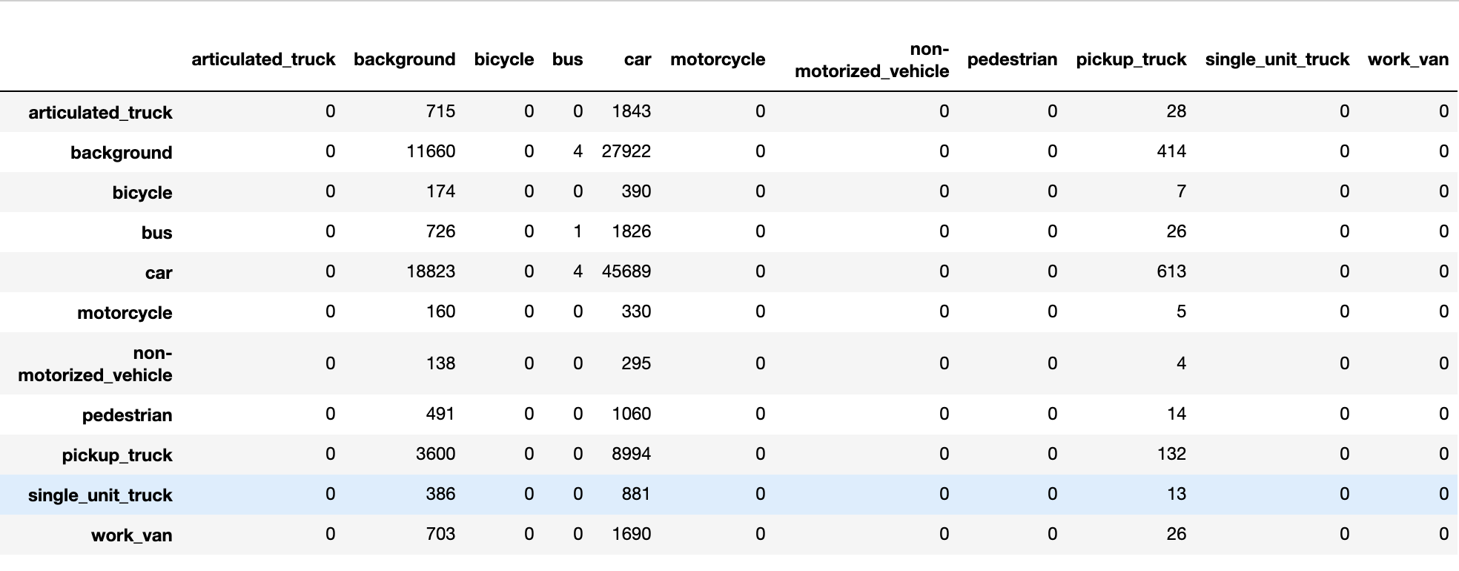
ImageDataGenerator, 64x64

Slide 29
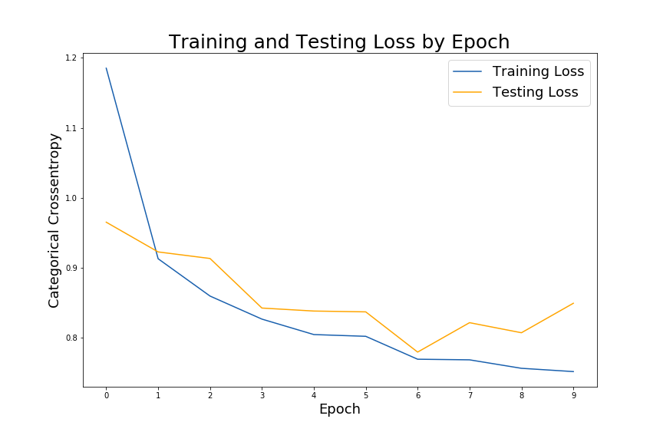
ImageDataGenerator, 128x128

Slide 30
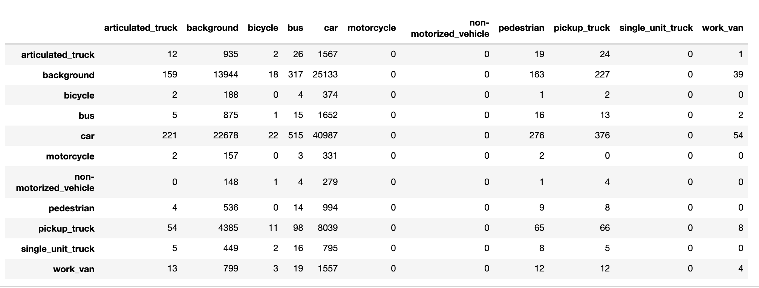
ImageDataGenerator, 128x128

Slide 31


Got CUDA?
Notes:
Compute Unified Device Architecture
Since dropped
Only nvidia
cuDNN CUDA Deep Neural Networks

Slide 32
Affect of CUDA enabled GPU*
 | CPU s/epoch | GPU s/epoch
Binary 28 | 59 | 2.65
Binary 64 | 130 | 9
Binary 128 | 1548 | 37
Full Dataset 28 | 350 | 19
Full Dataset 64 |  | 97.3
ImageGen 28 | 310
ImageGen 64 | 405
ImageGen 128 | 760
*This slide brought to you by my long suffering CFO

Slide 33
Affect of Image Size
Accuracy Score
 | 28x28 | 64x64 | 128x128
Binary Unbalanced | 75.04 | 94.92 | 97.91
ImageGen | 37.90 | 43.20 | 42.40
Full Data | 76.38 | 88.26 | NaN
Spoiler: bigger is better
Notes:
Thanks Maithili!
MNIST Digits
MNist fashion

Slide 34
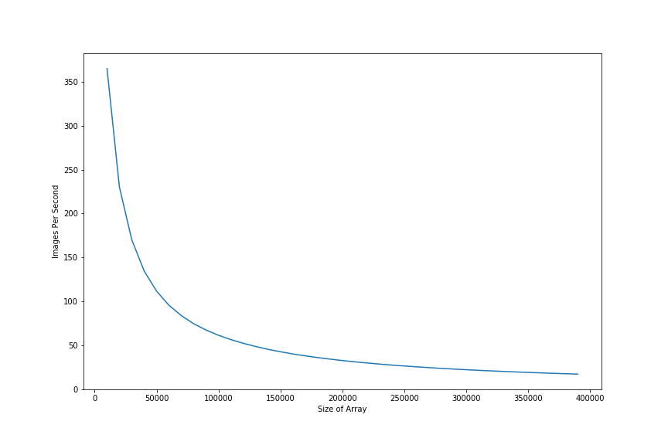
Pre fix Image Processing
Notes:
Massive memory bottle neck in image processing

Slide 35
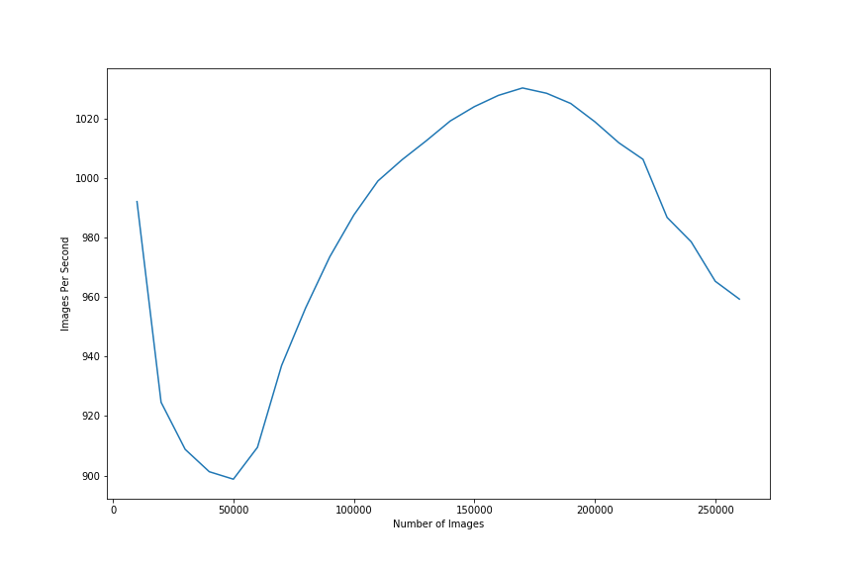
Post fix Image Processing
Notes:
Fixed it, Thanks veronica

Slide 36

Issues.
What’s the big deal? We all have them…
Some more than others

Slide 37
Issues
Solutions
ImageDataGenerator CPU block
128x128 full test memory issues
Image Processing time
Get a bigger CPU, workers=4 didn’t help
AWS, pickles
Solved! Changed code

Slide 38
Moving Forward
Understand the affect of Pooling and Dropout layers
Understand the affect of batch size and epoch steps
Understand and modify the weights
Vizualize the layers via keras and tensorboard
AWS
Ubuntu install
Notes:
Hill I choose to die on: playing with image sizes in the two models.
Issue: processing time.

