Slide 1
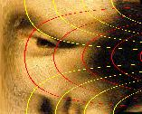
Function-Structure Integration:
Retinotopy

Slide 2

What does your brain do to Mona?

Slide 3
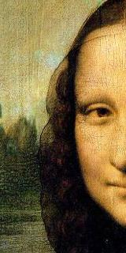
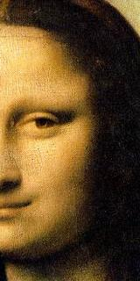
Left Cortical
Hemisphere
Right Cortica
Hemisphere

Slide 4
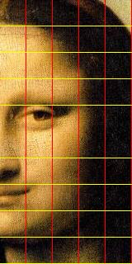
Map Function
VMU
Cartesian
Cortex
log(k(x+iy)+a)
HM
HM – Horizontal Meridian
VML
VMU – Vertical Meridian, Upper Field
VML – Vertical Meridian, Lower Field

Slide 5
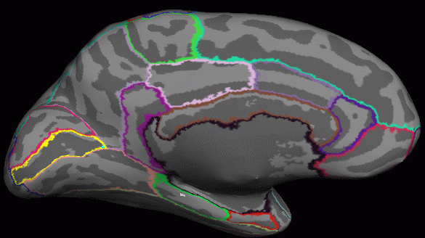
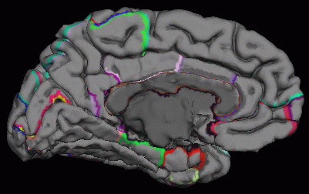
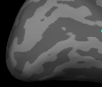
V1 – Primary Visual Cortex
VML
HM
VMU

Slide 6
Cortex
Cartesian
V3 (Non-Mirrored)
V2- (Mirrored)
V1 (Non-Mirrored)
V2+ (Mirrored)
VP+ (Non-Mirrored)

Slide 7
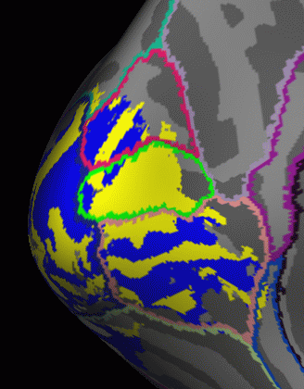
V3d (Non-Mirrored)
V2d (Mirrored)
V1 (Non-Mirrored)
V2v (Mirrored)
Field Sign Map:
Sign of Determinant of Map Function
V3v (Non-Mirrored)

Slide 8
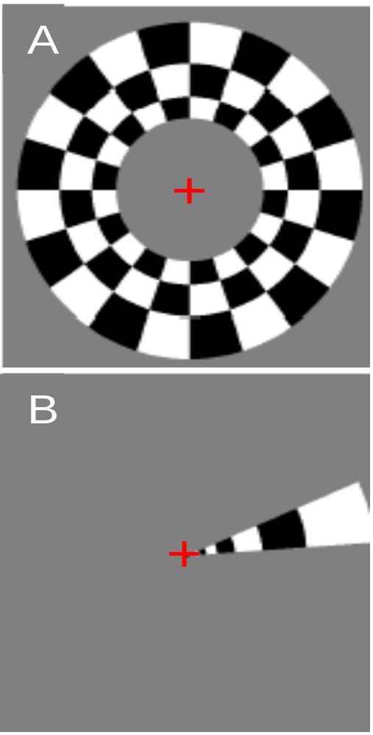
Retinotopic fMRI
Ring (Exp/Con)
(Eccentricity)
Wedge (Rot)
(Azimuth)

Slide 9
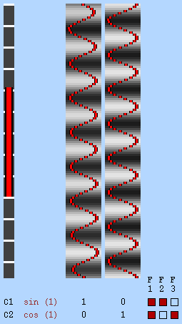
Retinotopic fMRI Analysis
β1=Asin(ϕ)
β2=Acos(ϕ)
-1
ϕ = tan (β1/β2)
ϕ
Eccentricity

Slide 10
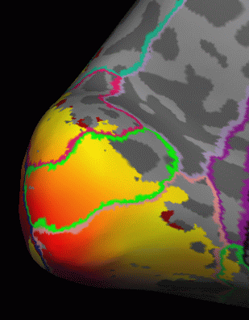
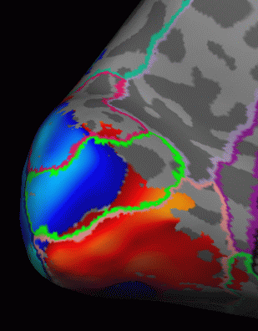
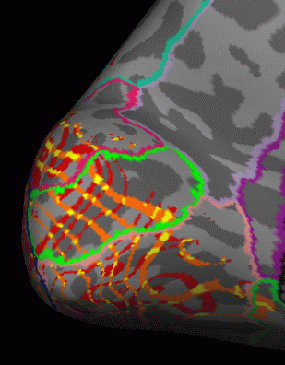
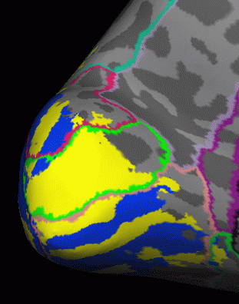

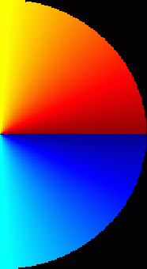
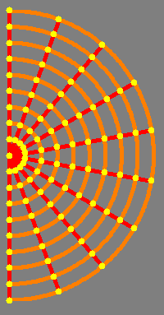
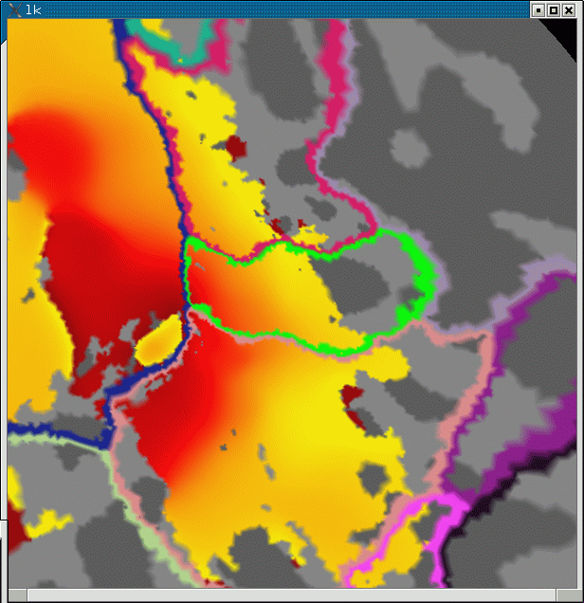
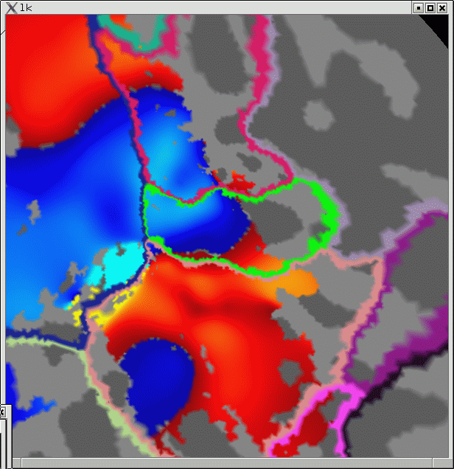
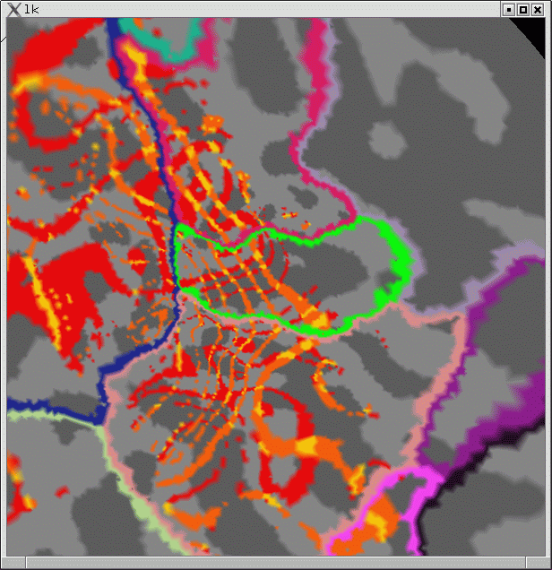
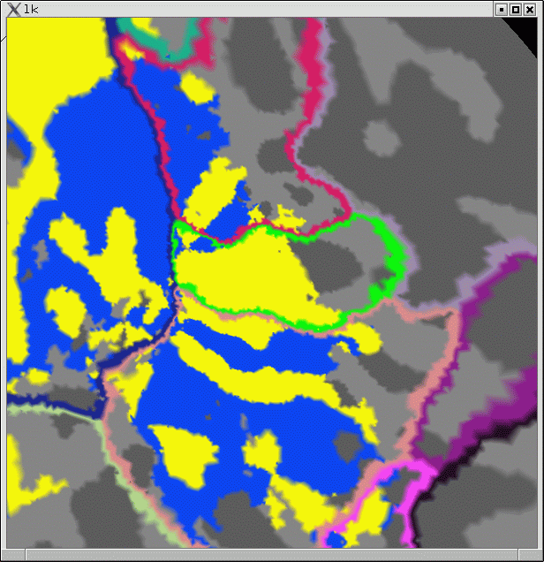





A.1
Eccentricity
B.1
Azimuth
C.1
Isoclines
D.1
Field Sign
Eccentricity
Non-Mirror
Azimuth
Mirror
A.2
Eccentricity
B.2
Azimuth
C.2
Isoclines
D.2
Field Sign
dorsal
Eccentricity
Non-Mirror
Azimuth
Mirror
*
*
*
*
lateral
*
medial
inferior

