Slide 1

The wolf pack
David Johnston ben Lamkin
Joshua cohen nick sain

Slide 2

A machine learning Sector study of the s&p 500

Slide 3
Objective
To design an algorithm that will define the sector of a stock by reading the following criteria:
Price
P/E
P/B
P/S
Dividend Yield
Market Cap
EBITDA
EPS
52 Wk High/Low

Slide 4
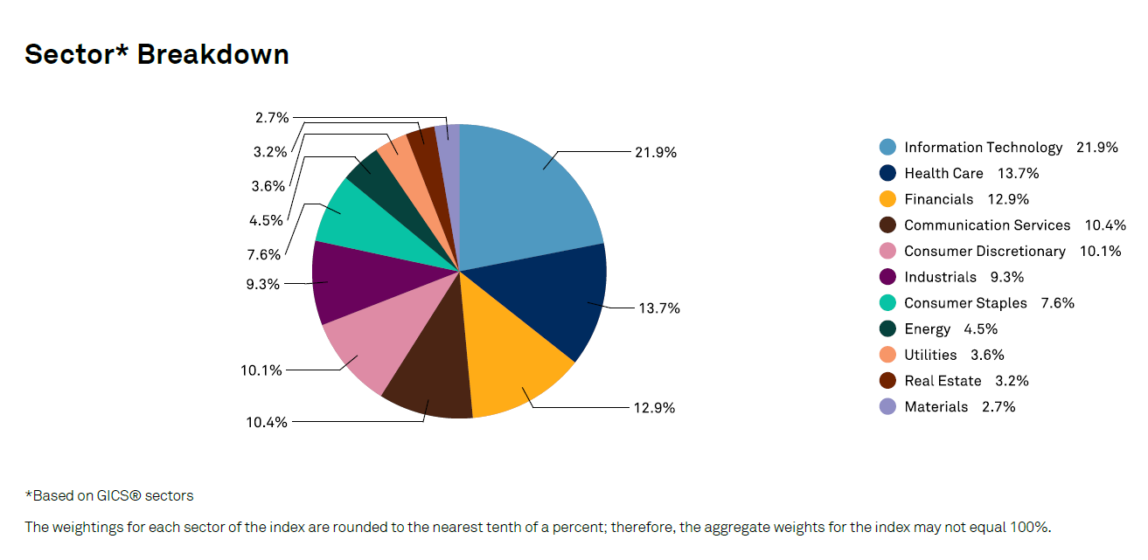
SECTOR BREAKDOWN

Slide 5


Slide 6
PLAN OF ACTION
We calculated and applied the fundamental classification algorithms: Neural networking, Decision trees, and Random forests.
We quantified and validated classification models and with calculating a classification report.
We pulled these specific performance measures for each of the stocks under the S&P 500.
We utilized Peak to Trough and Trough to Peak performance measures on select stocks from three different sectors to see if to see how well a machine model can make predictions of the sector based on the performance changes. We started out by only using Price and Market Cap as our feature measures.

Slide 7

Data difficulties

Slide 8
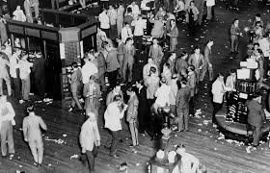
Historical data

Slide 9
Frustrations with stock data
We found difficulties in finding consistent historical stock data

Slide 10
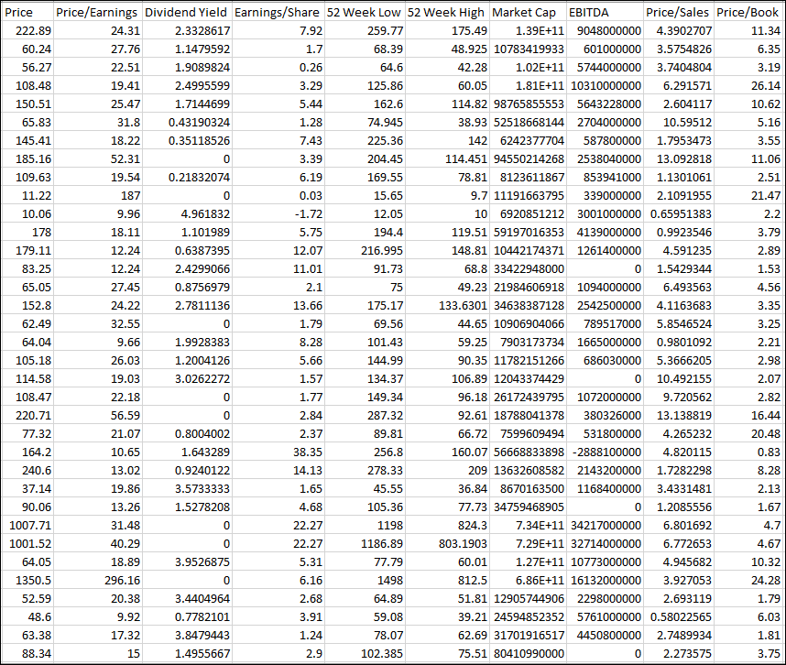
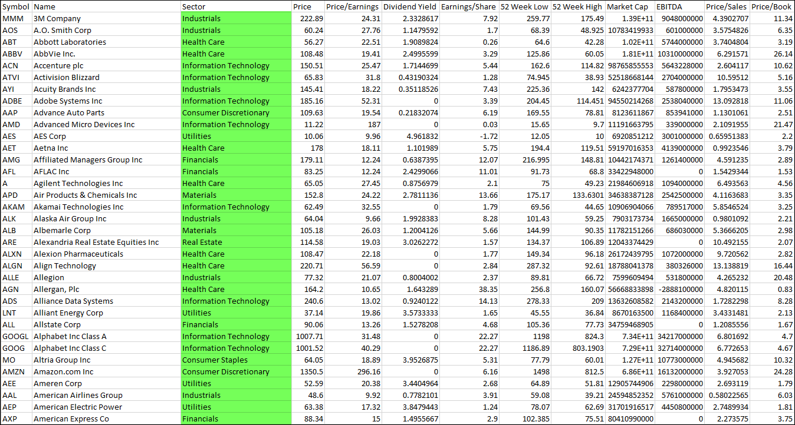
Test data
Financials w/sector data
Financials only valuations no sector data

Slide 11

Code utilized to run effectiveness calculations

Slide 12
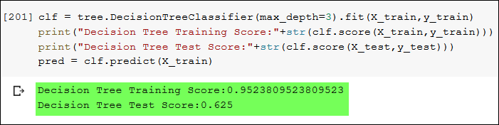
Decision tree

Slide 13
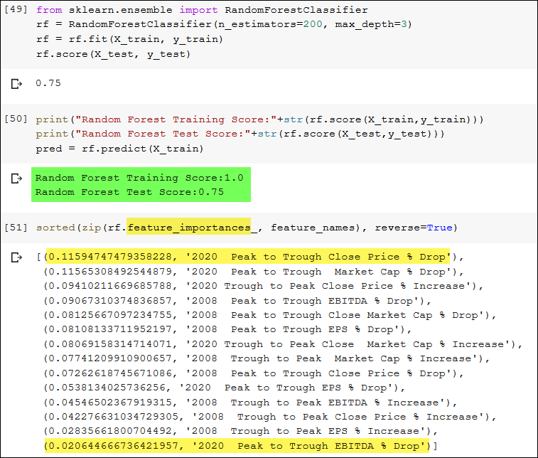
Random forest

Slide 14

Results

Slide 15
We were able to build, train and test a Decision Tree model with a test score of about 63%
We were able to build, train and test a Random Forest model with a test score of about 75%
We also built a Neural Network Model that went through 1,000 iterations that got up to 73% accurate but in testing for making predictions through this model the score was only around 35% so the Random Forest Model was actually better for making predictions.

Slide 16
Decision importance rating
https://public.tableau.com/profile/ben.l7231#!/vizhome/ImportanceRatio_15887149327000/Sheet2?publish=yes

Slide 17

Questions?

Slide 18

Congratulations from the wolf pack

