Slide 1
Coupling a 3D Finite-Volume Left Ventricular Model with 0D Lumped Parameter Circulation using OpenFOAM
David Kelly

Slide 2



23rd & 24th January 2026
BinI 2026 Conference
Hodson Bay Hotel
Athlone, Ireland
Coupling a 3D Finite-Volume Left Ventricular Model with 0D Lumped Parameter Circulation using OpenFOAM
David Kelly
Chanikya Valeti
Philip Cardiff
School of Mechanical and Materials Engineering
University College Dublin

Slide 3
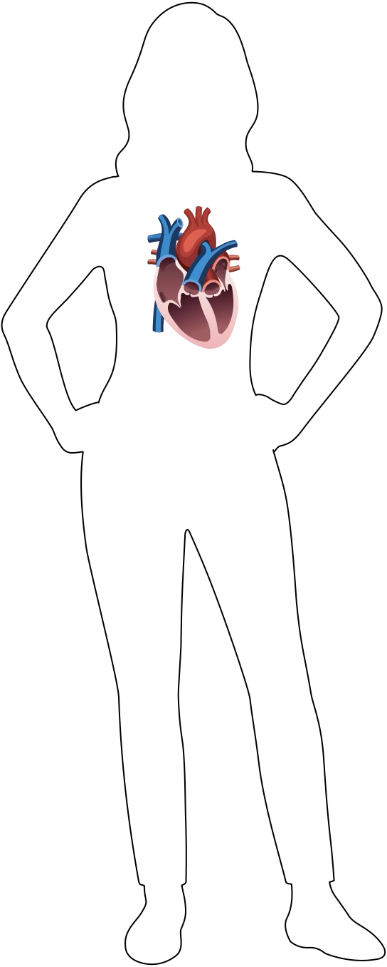
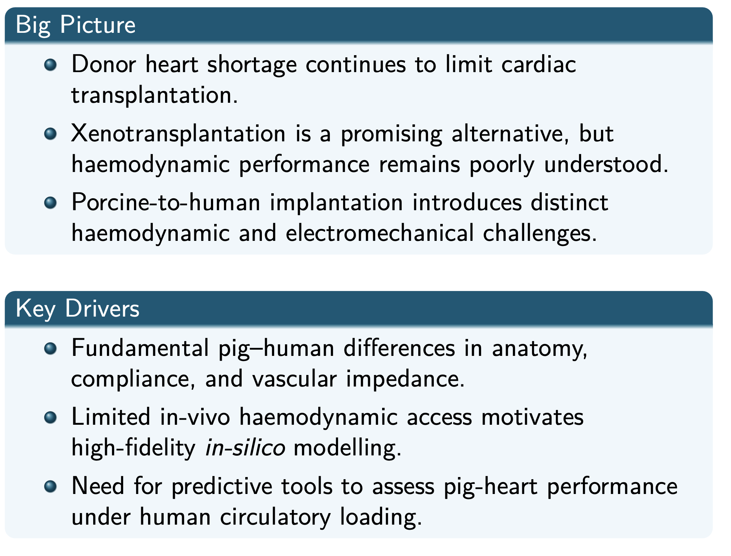
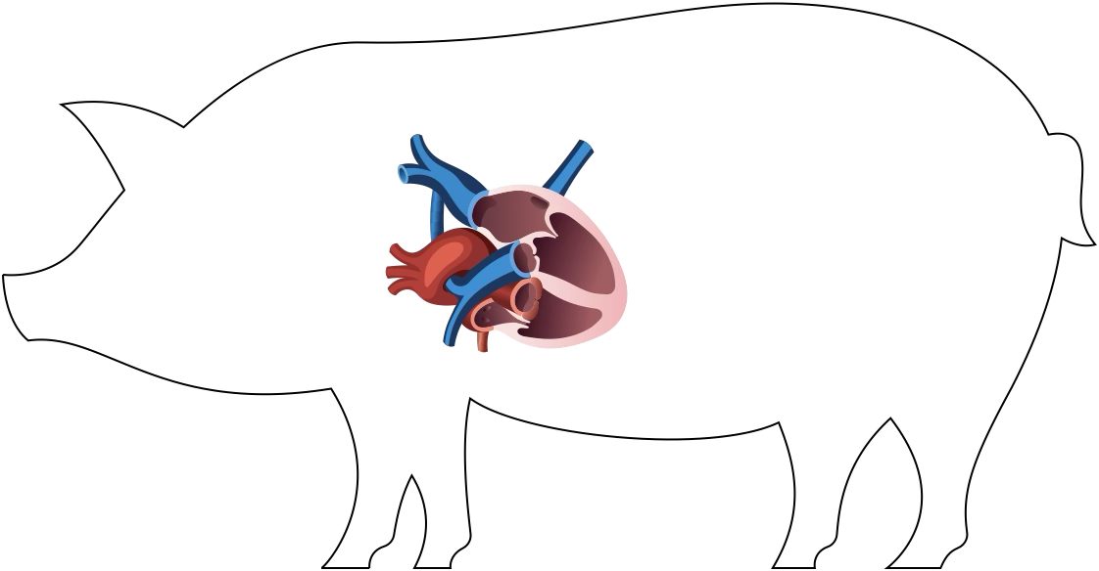
Background & Motivation

Slide 4
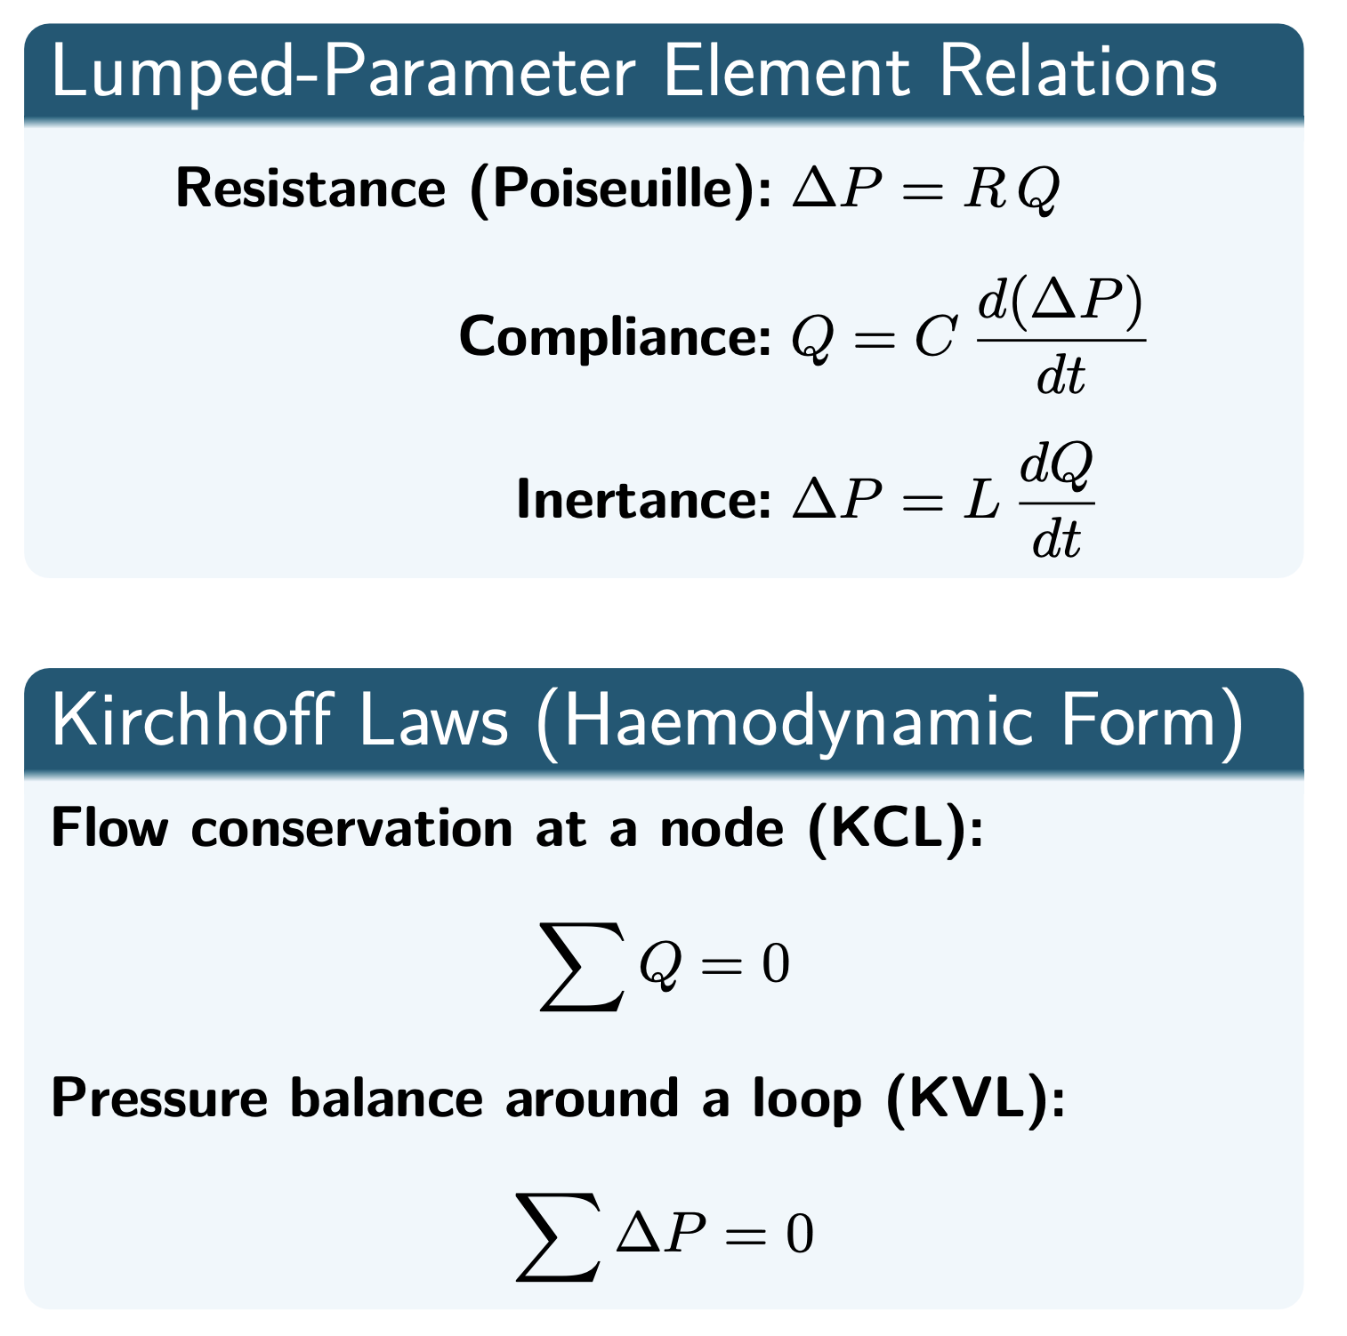
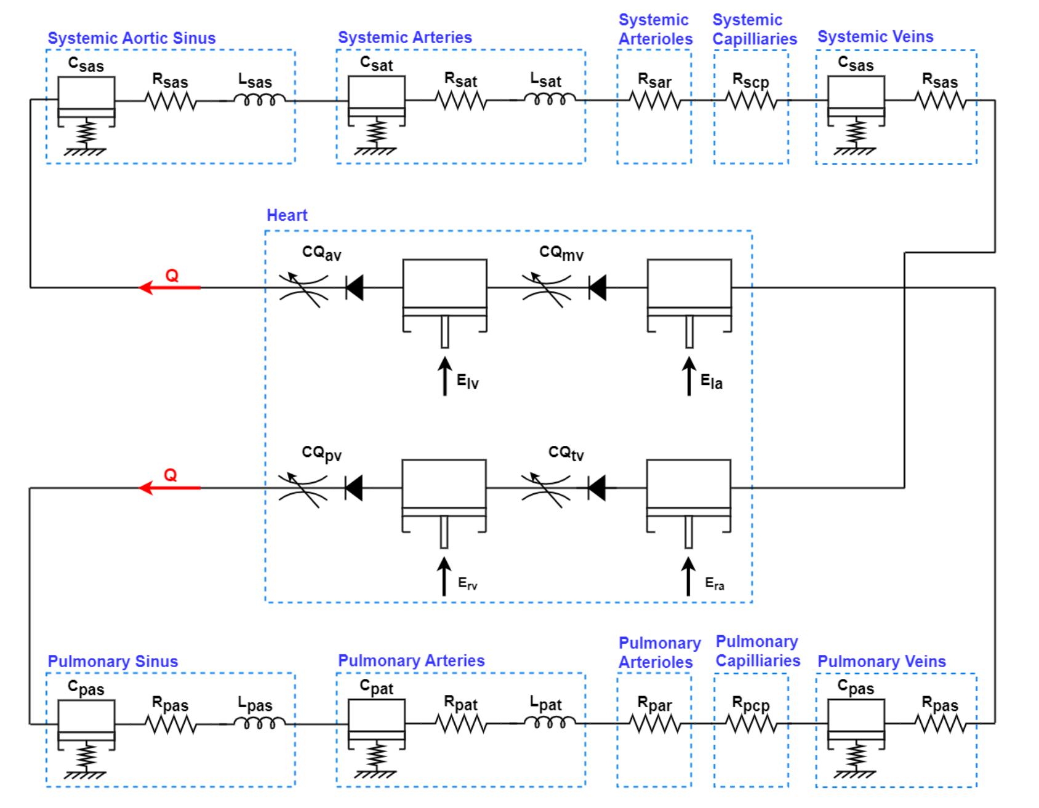
Completely Lumped System

Slide 5
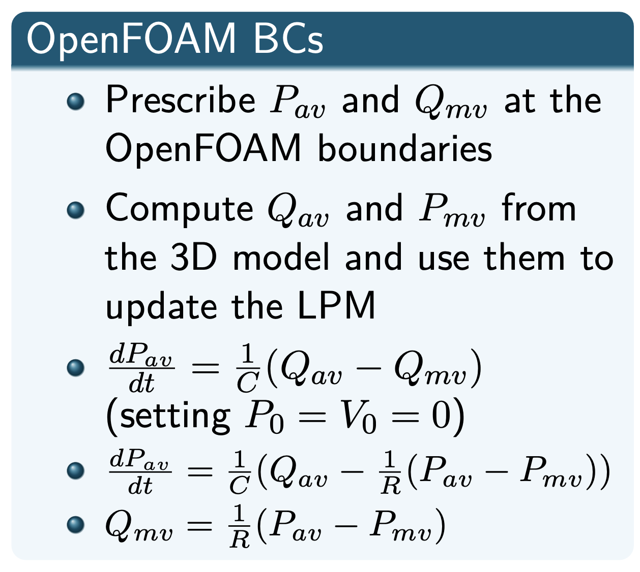
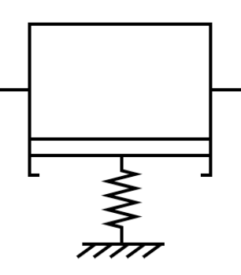

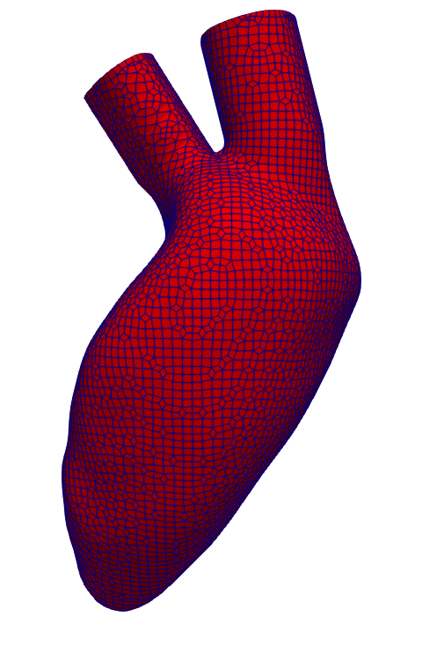

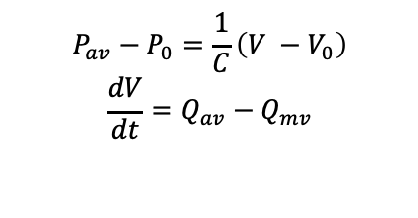



Coupling 3D Ventricle to 0D Circulation
$$P_{av}−P_{0}=\frac{1}{C}\left(V −V_{0}\right)$$
$$\frac{dV}{dt}=Q_{av}−Q_{mv}$$
$$P_{av}$$
$$Q_{mv}$$
$$P_{av} −P_{mv}=Q_{mv}R$$
$$Q_{mv}$$
$$P_{mv}$$
$$Q_{av}$$
$$P_{av}$$

Slide 6
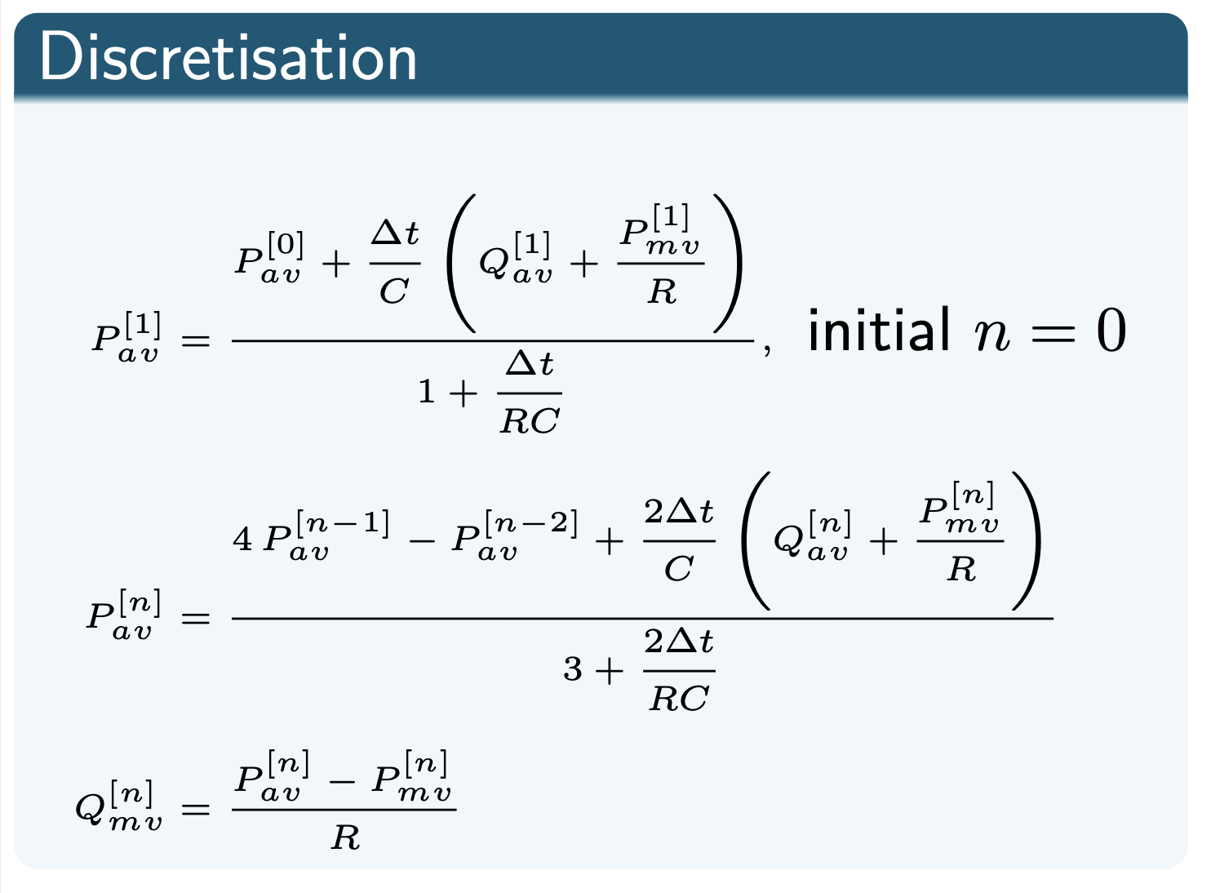
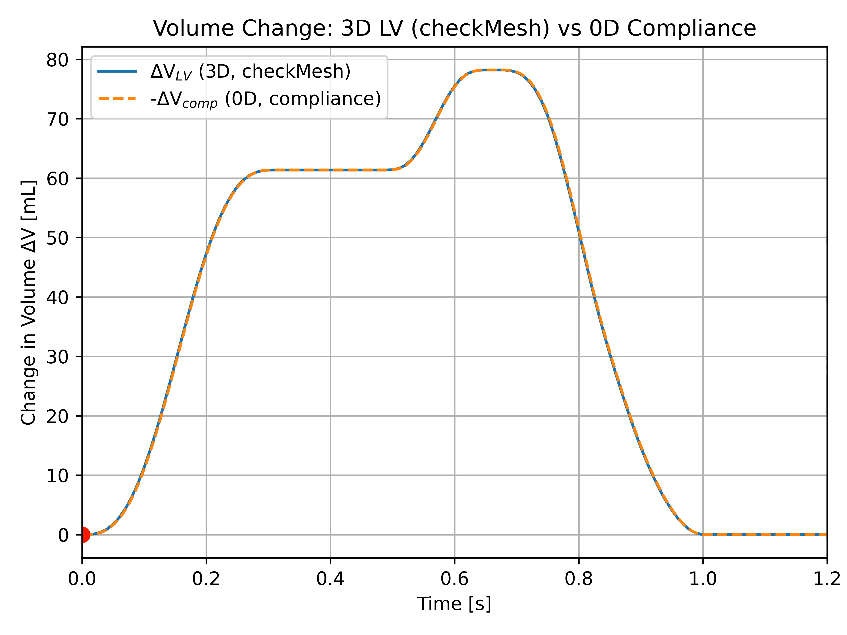
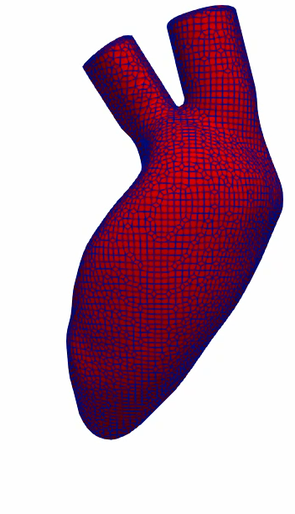
Discretisation and Verifying Closed Loop

Slide 7
3D Moving Left Ventricle

Slide 8
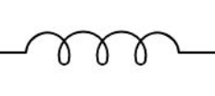
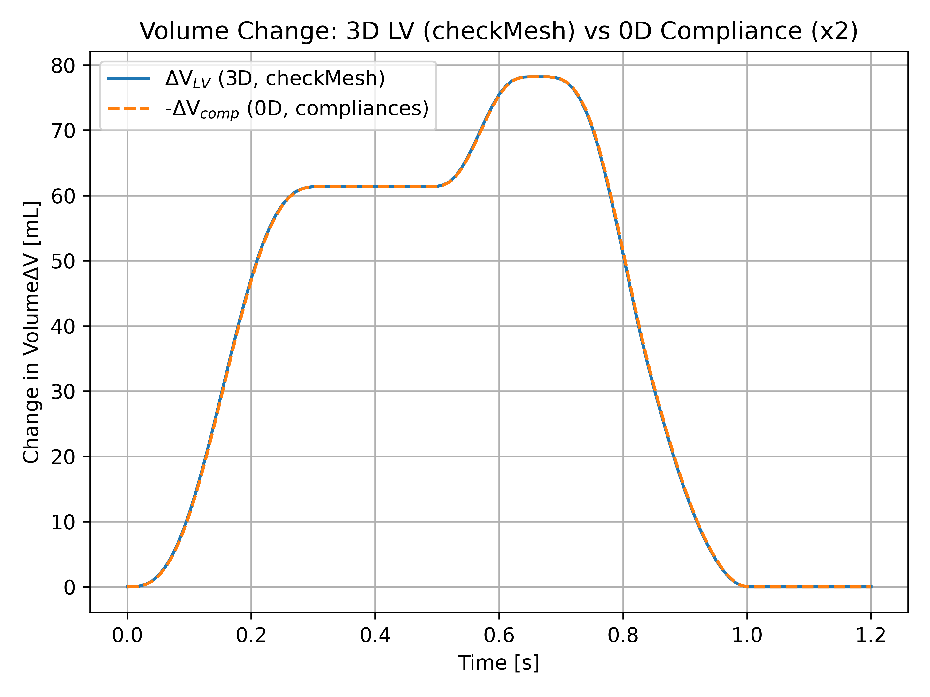






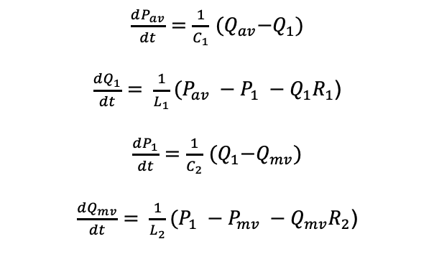





Coupling to a CLR System
$$L_{1}$$
$$R_{1}$$
$$L_{2}$$
$$R_{2}$$
$$C_{1}$$
$$C_{2}$$
$$P_{av}$$
$$Q_{1}$$
$$P_{1}$$
$$Q_{1}$$
$$P_{1}$$
$$Q_{mv}$$
$$Q_{mv}$$
$$P_{mv}$$
$$Q_{av}$$
$$P_{av}$$
$\frac{dP_{av}}{dt}=\frac{1}{C_{1}}$ ${(Q}_{av}−Q_{1})$
$\frac{dQ_{1}}{dt}= \frac{1}{L_{1}}(P_{av} −P_{1} −Q_{1}R_{1}$)
$\frac{dP_{1}}{dt}=\frac{1}{C_{2}}$ ${(Q}_{1}−Q_{mv})$
$\frac{dQ_{mv}}{dt}= \frac{1}{L_{2}}(P_{1} −P_{mv} −Q_{mv}R_{2}$)

Slide 9
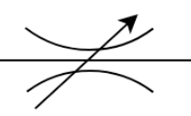

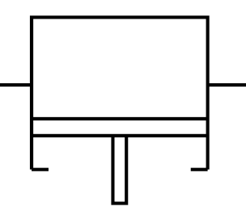
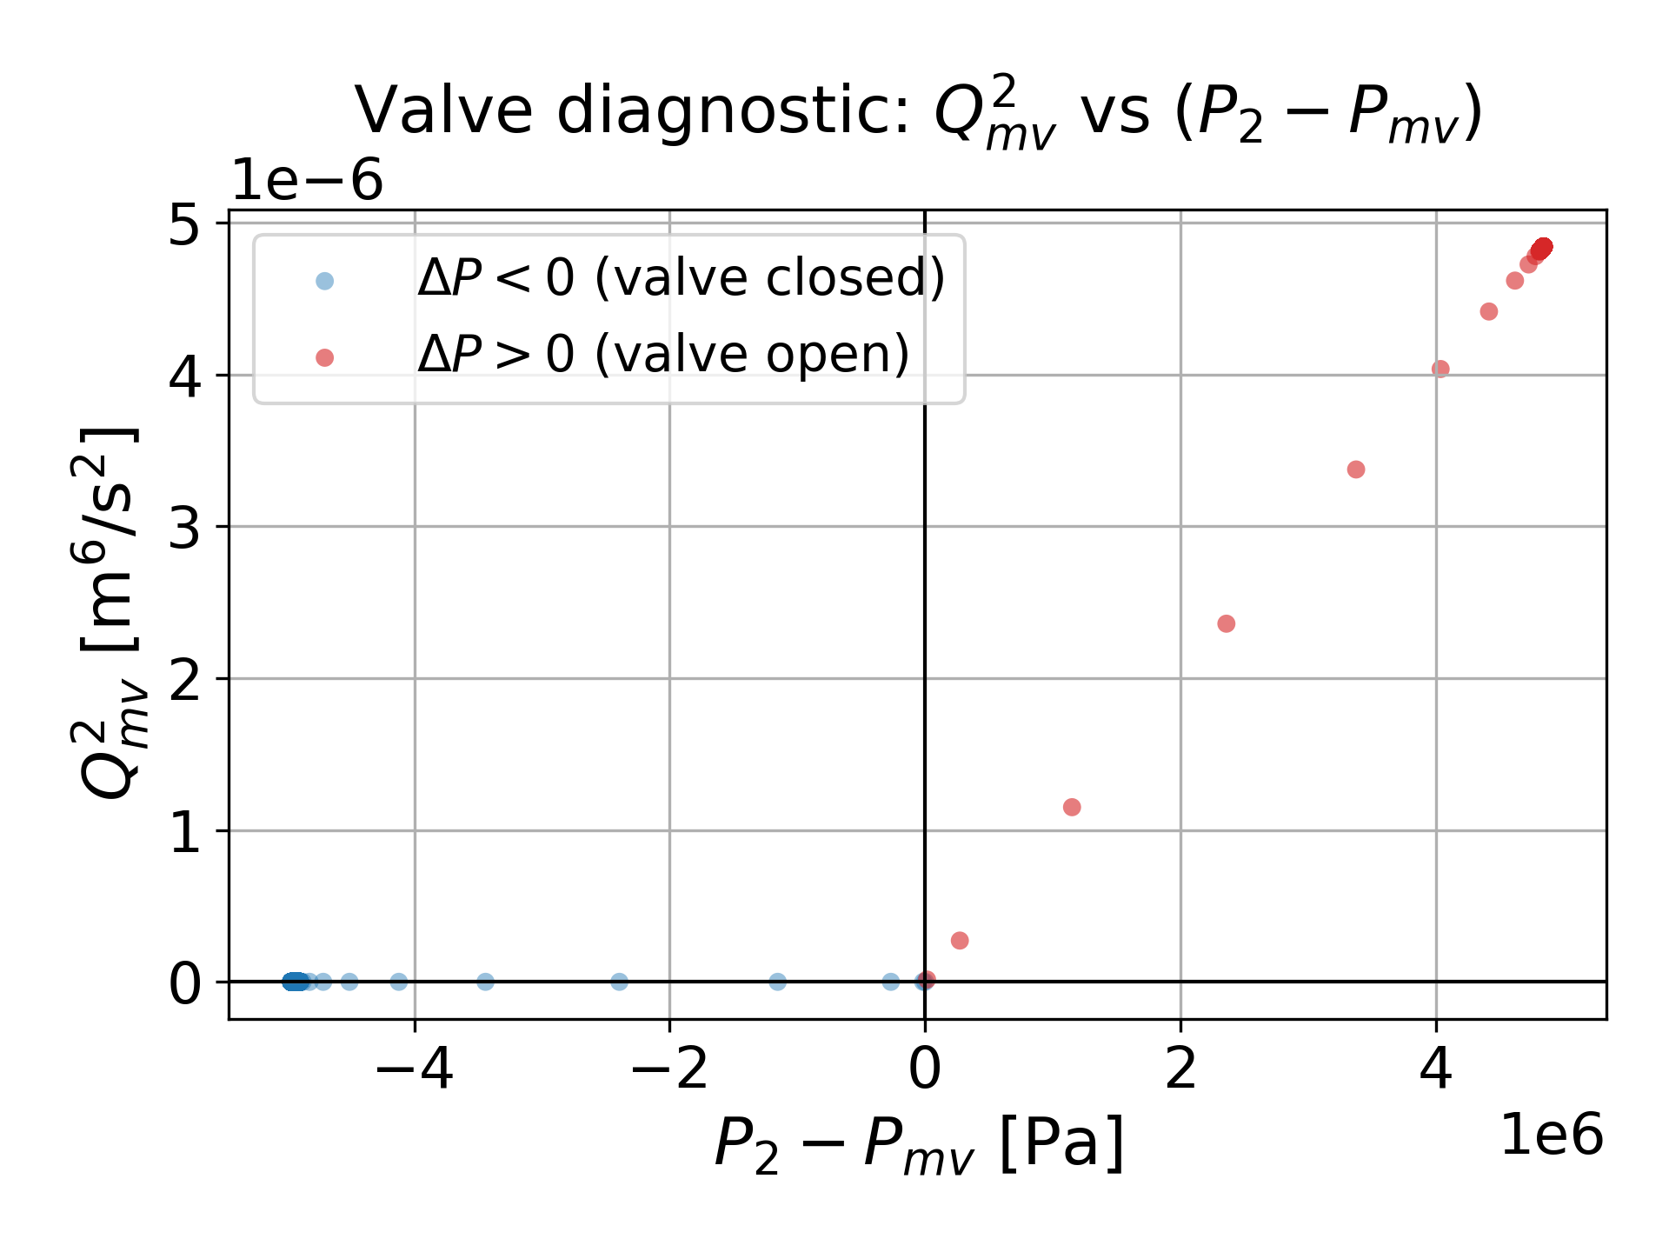

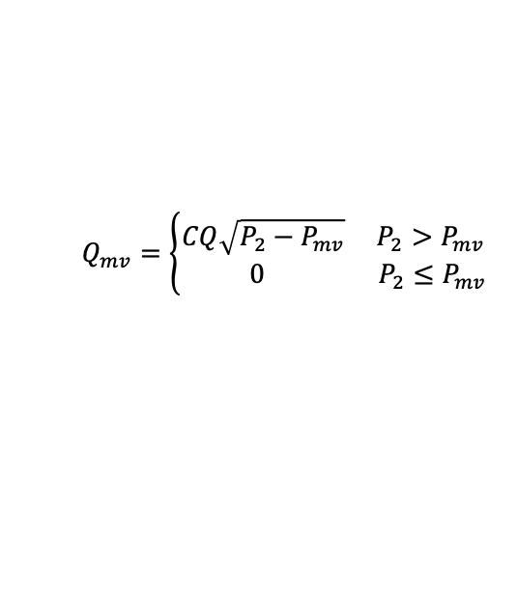
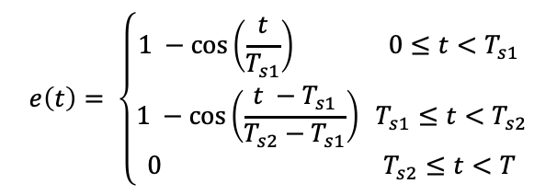







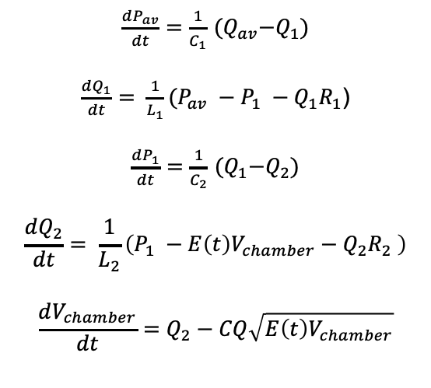








Adding in 0D Chamber and Valve
$\frac{dP_{av}}{dt}=\frac{1}{C_{1}}$ ${(Q}_{av}−Q_{1})$
$\frac{dQ_{1}}{dt}= \frac{1}{L_{1}}(P_{av} −P_{1} −Q_{1}R_{1}$)
$\frac{dP_{1}}{dt}=\frac{1}{C_{2}}$ ${(Q}_{1}−Q_{2})$
$$\frac{dQ_{2}}{dt}= \frac{1}{L_{2}}\left(P_{1} −E\left(t\right)V_{chamber}−Q_{2}R_{2} \right)$$
$$\frac{dV_{chamber}}{dt}=Q_{2}−CQ\sqrt{E\left(t\right)V_{chamber}}$$
$$L_{1}$$
$$R_{1}$$
$$L_{2}$$
$$R_{2}$$
$$C_{1}$$
$$C_{2}$$
$$P_{av}$$
$$Q_{1}$$
$$P_{1}$$
$$Q_{1}$$
$$P_{1}$$
$$Q_{2}$$
$$Q_{mv}$$
$$P_{2}$$
$$Q_{2}$$
$$P_{2}$$
$$Q_{mv}$$
$$P_{mv}$$
$$Q_{av}$$
$$P_{av}$$
$$E_{chamber}$$
$$P_{2}=E\left(t\right)V_{chamber}$$
$$E\left(t\right)=E_{min}+ \frac{E_{max} −E_{min}}{2} e(t)$$
$$e\left(t\right)= \left\{\begin{aligned}1 −\cos\left(\frac{t}{T_{s1}}\right) 0≤t<T_{s1} \\ 1 −\cos\left(\frac{t −T_{s1}}{T_{s2}−T_{s1}}\right) T_{s1}≤t<T_{s2} \\ 0{ T}_{s2}≤t<T\end{aligned}\right.$$
$$Q_{mv}=\left\{\begin{aligned}CQ\sqrt{P_{2}−P_{mv}} P_{2}>P_{mv} \\ 0 { P}_{2}≤P_{mv}\end{aligned}\right.$$

Slide 10
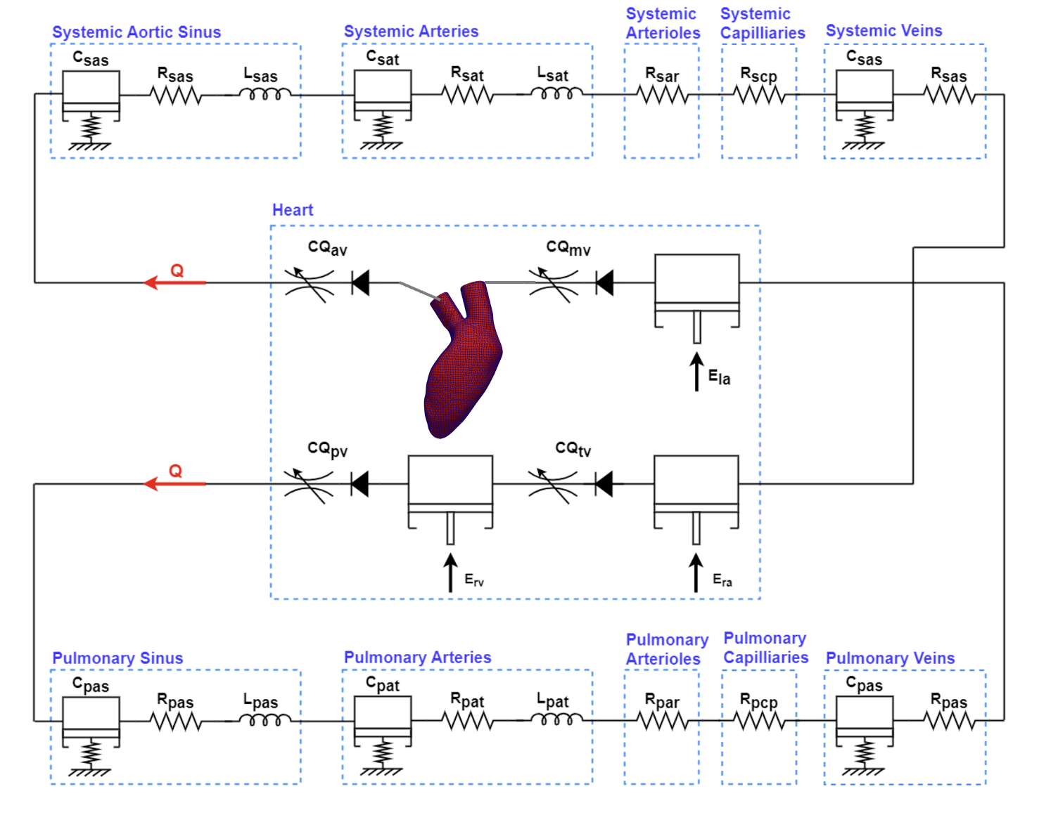
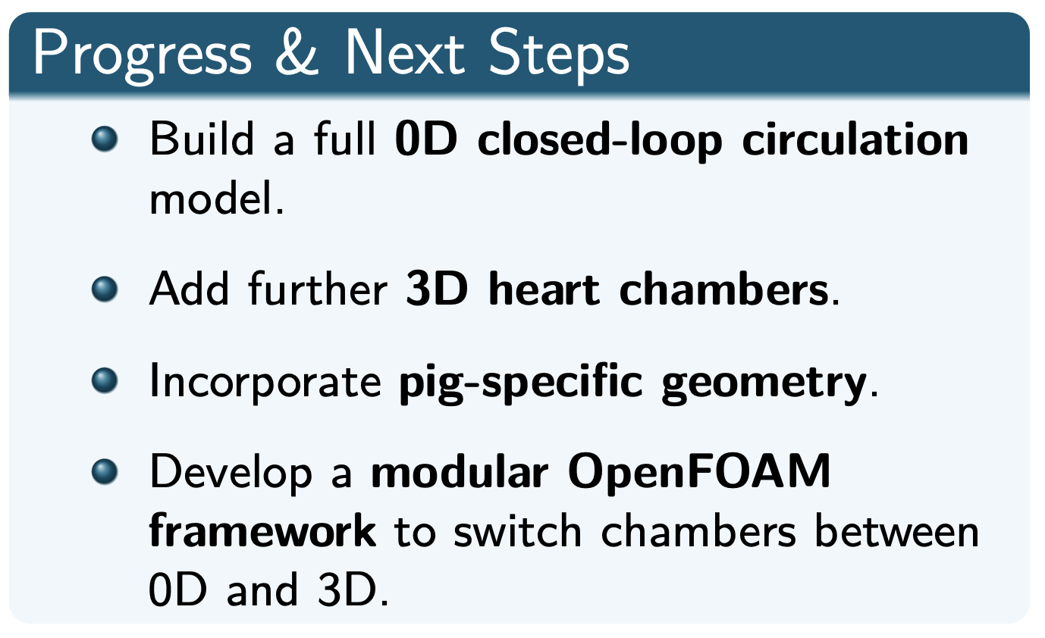
Limitations and Future Work

Slide 11
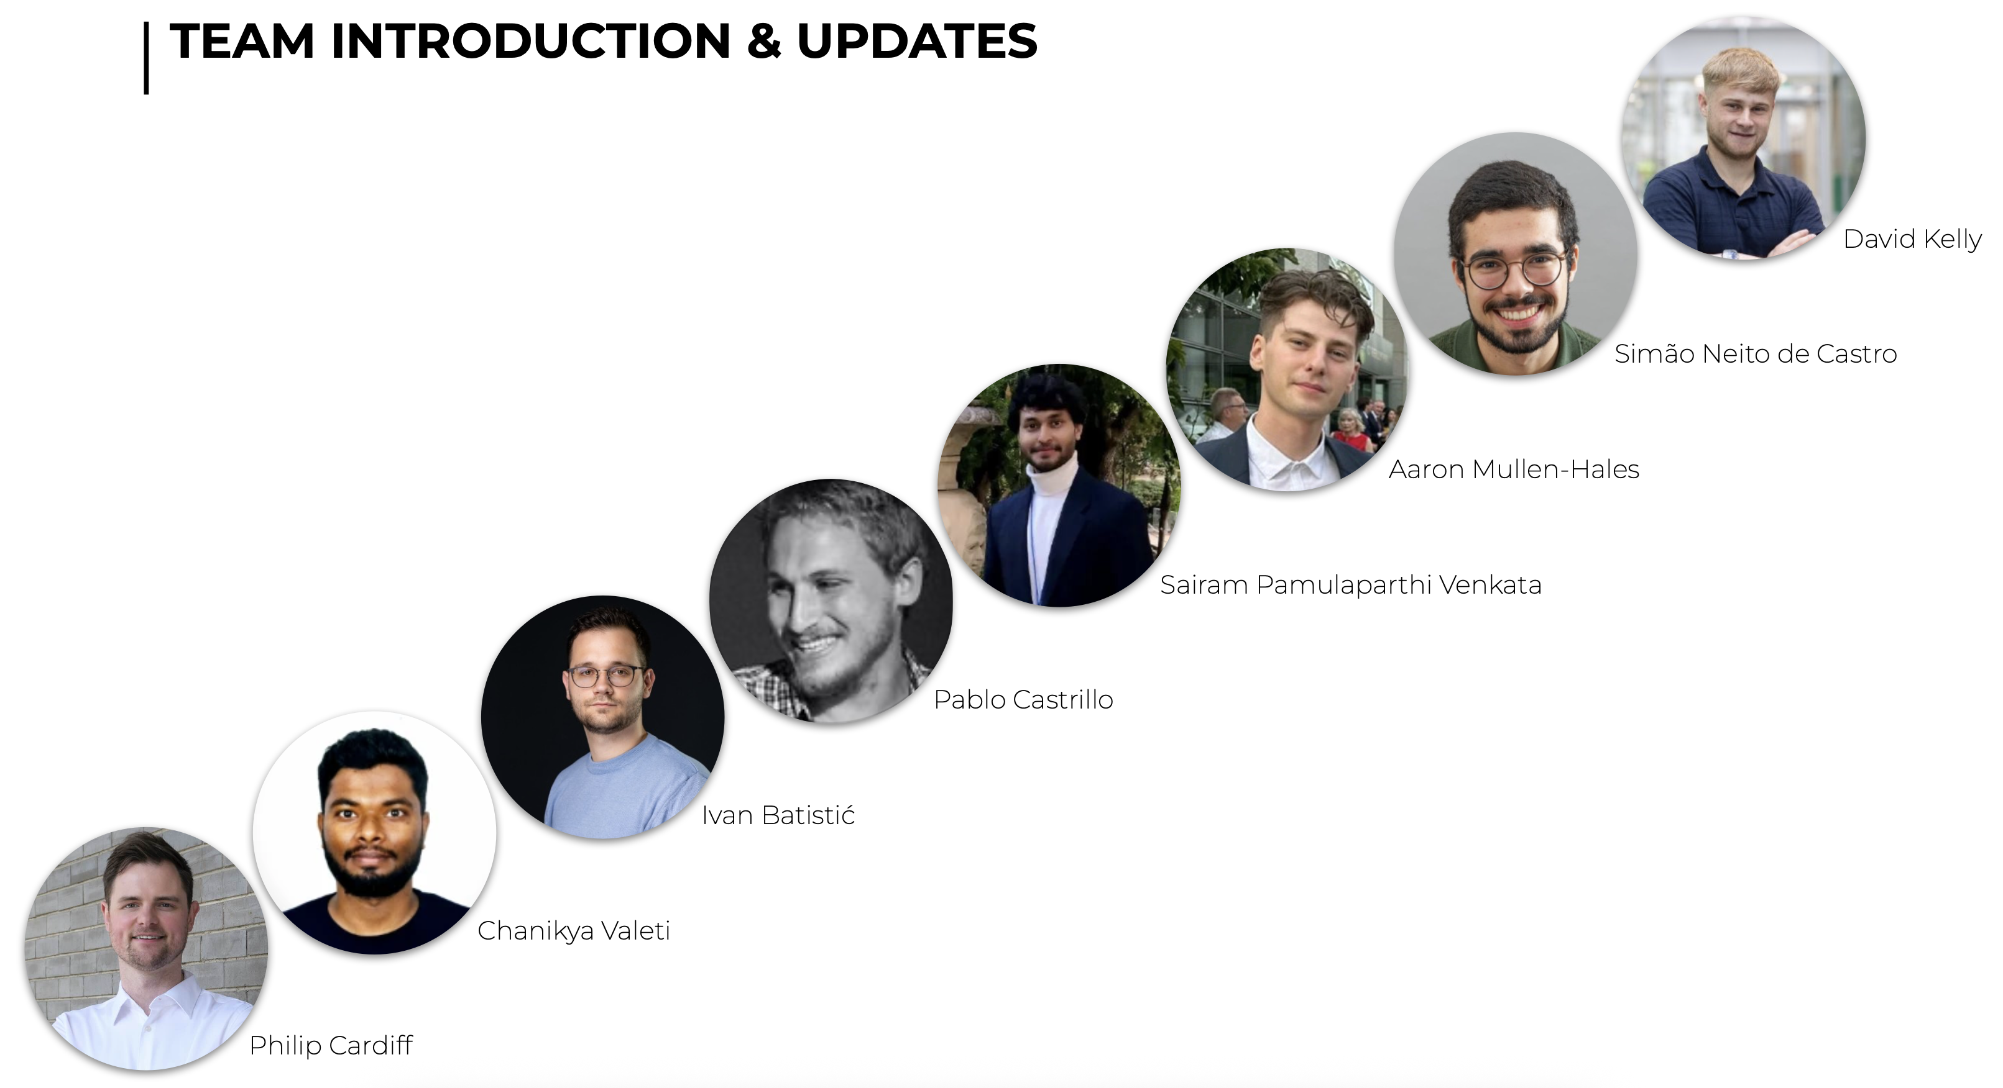
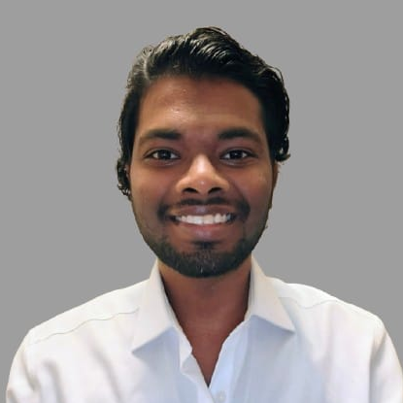

Acknowledgements
This project has received funding from the European Research Council (ERC) under the European Union’s Horizon 2020 research and innovation programme (Grant Agreement No. 101088740). In addition, Financial support is gratefully acknowledged from I-Form, funded by Research Ireland (formerly SFI) Grant Number RC2302 2, co-funded under European Regional Development Fund and by I-Form industry partners.

Slide 12
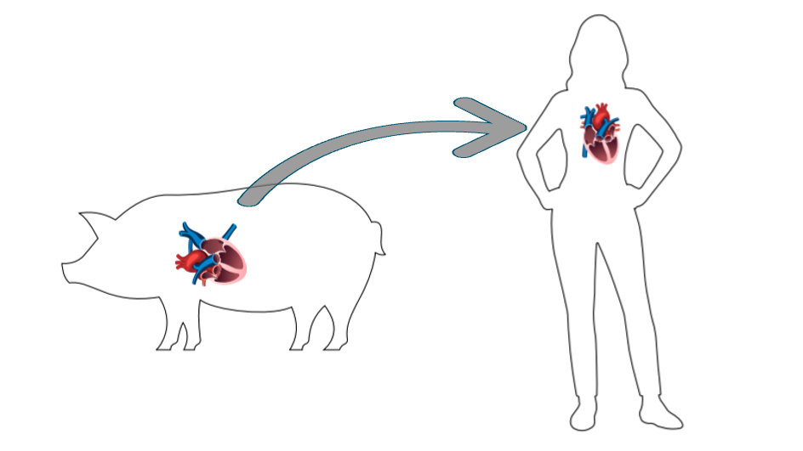
Thank you!
Happy to take questions

