Slide 1
Elasticsearch
A short introduction
- David Kemp

Slide 2
What Is Elasticsearch?
Document Store
Search Engine
Scalable to many servers
Free and open source
Very widely used (Netflix, Facebook, Uber…)

Slide 3
Elasticsearch Features
Word analysis

Slide 4
Elasticsearch Features
Word analysis
So that searches for: “garden”

Slide 5
Elasticsearch Features
Word analysis
So that searches for: “garden”
Can match: “gardening”

Slide 6
Elasticsearch Features
Phrase matching

Slide 7
Elasticsearch Features
Phrase matching
So searches for: “gas cooking”

Slide 8
Elasticsearch Features
Phrase matching
So searches for: “gas cooking”
Will NOT match:
“.. has gas heating and electric cooking”

Slide 9
Elasticsearch Features
Synonym matching

Slide 10
Elasticsearch Features
Synonym matching
So searches for: “spacious living room”

Slide 11
Elasticsearch Features
Synonym matching
So searches for: “spacious living room”
Will match: “large lounge room”

Slide 12
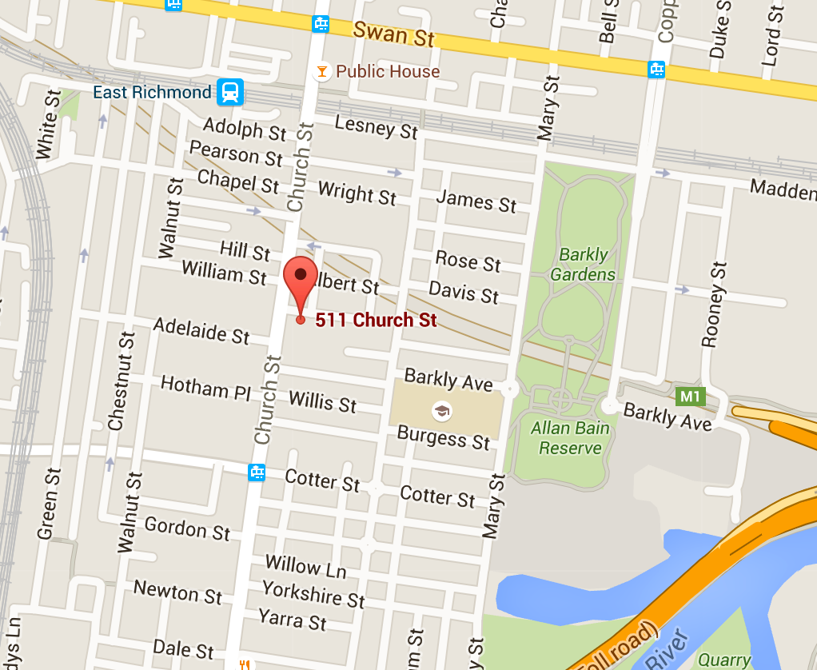
Geospatial Queries
Bounding box search

Slide 13
Geospatial Queries
Radial search

Slide 14
Geospatial Queries
Polygon search

Slide 15
What it isn’t
Not a relational database (no table joins)
No atomic transactions

Slide 16
Documents are JSON based
JavaScript Object Notation
{ "title": "Renovator's delight", "soldPrice": 812500.00,
"propertyFeatures": ["Garage", "Gym"]
"address": { "state": "Vic", "postcode": "3941", "suburb": "Rye", "fullAddress": "31 Smith Rd, Rye, Vic 3941" } }}

Slide 17
The word “index” is very overloaded
An index is a collection of documents
You index a document into an index.
A document field may be indexed

Slide 18
Inverted Indexes
Documents:
{"_id": 1, "title": "Large kitchen, stylish bathrooms", …}
{"_id": 2, "title": "Stylish features and lovely garden", …}
{"_id": 3, "title": "Large stylish kitchen", …}

Slide 19
Inverted Indexes
Documents:
{"_id": 1, "title": "Large kitchen, stylish bathrooms", …}
{"_id": 2, "title": "Stylish features and lovely garden", …}
{"_id": 3, "title": "Large stylish kitchen", …}
Inverted Index for “title”:
large | 1, 3
kitchen | 1, 3
stylish | 1, 2, 3

Slide 20
Index Mappings
A bit like a Database schema:
{
"listing": {
"properties": {
"title": {"type": "text"},
"description": {"type": "text"}
}
}
}

Slide 21
Searches
{
"query": {
"match": {
"title": {
"query": "Gas Coiking",
"fuzziness": "AUTO"
}
}
}
}

Slide 22
Nodes, shards, clusters, etc.

Slide 23
An index may be sharded across multiple nodes
Node 1
Node 2
Node 3
Doc1
Doc2
Doc3
Shard 1
Doc4
Doc5
Doc6
Shard 2
Doc7
Doc8
Doc9
Shard 3

Slide 24
Shards may be replicated
Node 1
Node 2
Node 3
Doc1
Doc2
Doc3
Shard 1
(primary)
Doc4
Doc5
Doc6
Shard 2
(primary)
Doc7
Doc8
Doc9
Shard 3
(primary)
Doc7
Doc8
Doc9
Shard 3
(replica)
Doc1
Doc2
Doc3
Shard 1
(replica)
Doc4
Doc5
Doc6
Shard 2
(replica)

