Slide 1
Elasticsearch
A short introduction
- David Kemp

Slide 2
What Is Elasticsearch?
Document Store
Search Engine
Scalable to many servers
Free and open source
Very widely used (Netflix, Facebook, Uber…)

Slide 3
Elasticsearch Features
Word analysis

Slide 4
Elasticsearch Features
Word analysis
So that searches for: “garden”

Slide 5
Elasticsearch Features
Word analysis
So that searches for: “garden”
Can match: “gardening”

Slide 6
Elasticsearch Features
Phrase matching

Slide 7
Elasticsearch Features
Phrase matching
So searches for: “gas cooking”

Slide 8
Elasticsearch Features
Phrase matching
So searches for: “gas cooking”
Will NOT match:
“.. has gas heating and electric cooking”

Slide 9
Elasticsearch Features
Synonym matching

Slide 10
Elasticsearch Features
Synonym matching
So searches for: “spacious living room”

Slide 11
Elasticsearch Features
Synonym matching
So searches for: “spacious living room”
Will match: “large lounge room”

Slide 12
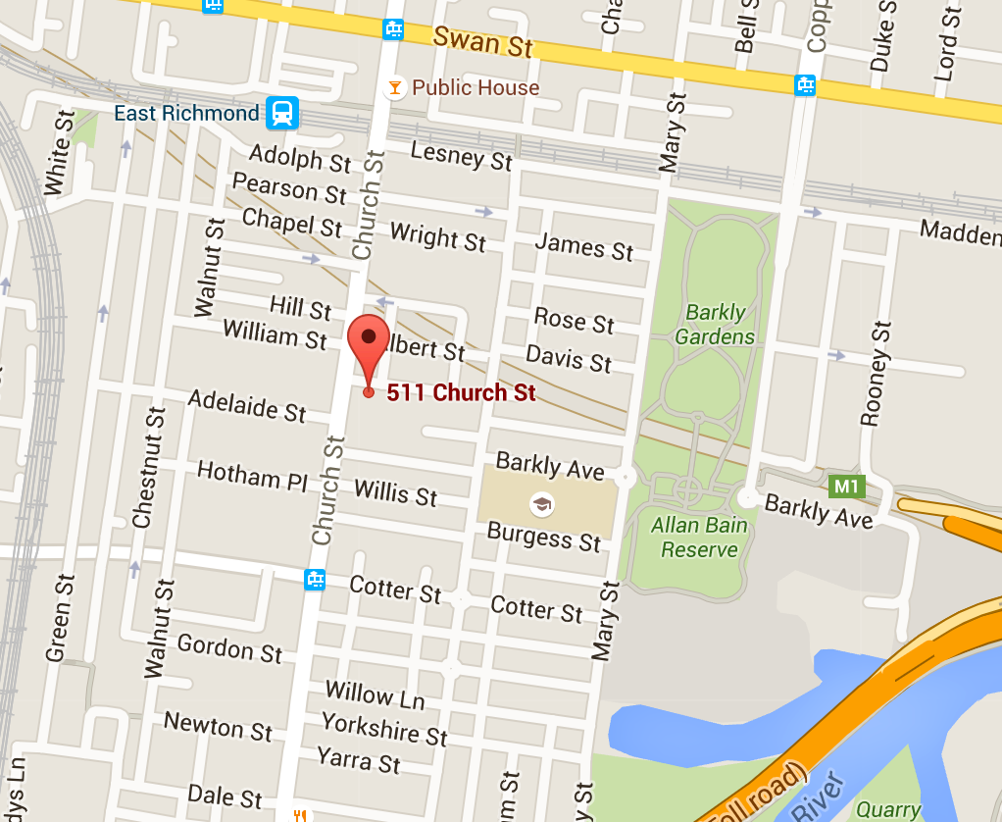
Geospatial Queries
Bounding box search

Slide 13
Geospatial Queries
Radial search

Slide 14
Geospatial Queries
Polygon search

Slide 15
When should you use Elasticsearch
Full text searches
Care about relevancy of documents
Can easily scale out to many nodes

Slide 16
What it isn’t
Difference to a Relation DB
No table joins, query on a single “table”
No atomic transactions
No data schema

Slide 17
Documents are JSON based
JavaScript Object Notation
{ "title": "Renovator's delight", "soldPrice": 812500.00,
"propertyFeatures": ["Garage", "Gym"]
"address": { "state": "Vic", "postcode": "3941", "suburb": "Rye", "fullAddress": "31 Smith Rd, Rye, Vic 3941" } }

Slide 18
The word “index” is very overloaded
An index is a collection of documents
You index a document into an index.
A document field may be indexed

Slide 19
Inverted Indexes
Documents:
{"_id": 1, "title": "Large kitchen, stylish bathrooms", …}
{"_id": 2, "title": "Stylish features and lovely garden", …}
{"_id": 3, "title": "Large stylish kitchen", …}

Slide 20
Inverted Indexes
Documents:
{"_id": 1, "title": "Large kitchen, stylish bathrooms", …}
{"_id": 2, "title": "Stylish features and lovely garden", …}
{"_id": 3, "title": "Large stylish kitchen", …}
Inverted Index for “title”:
large | 1, 3
kitchen | 1, 3
stylish | 1, 2, 3

Slide 21
Index Mappings
A bit like a Database schema, but describes how to index each field:
{
"listing": {
"properties": {
"title": {"type": "text"},
"description": {"type": "text"}
}
}
}

Slide 22
Searches
{
"query": {
"match": {
"title": {
"query": "Gas Coiking",
"fuzziness": "AUTO"
}
}
}
}

Slide 23
Nodes, shards, clusters, etc.

Slide 24
An index may be sharded across multiple nodes
Node 1
Node 2
Node 3
Doc1
Doc2
Doc3
Shard 1
Doc4
Doc5
Doc6
Shard 2
Doc7
Doc8
Doc9
Shard 3

Slide 25
Shards may be replicated
Node 1
Node 2
Node 3
Doc1
Doc2
Doc3
Shard 1
(primary)
Doc4
Doc5
Doc6
Shard 2
(primary)
Doc7
Doc8
Doc9
Shard 3
(primary)
Doc7
Doc8
Doc9
Shard 3
(replica)
Doc1
Doc2
Doc3
Shard 1
(replica)
Doc4
Doc5
Doc6
Shard 2
(replica)

