Slide 1
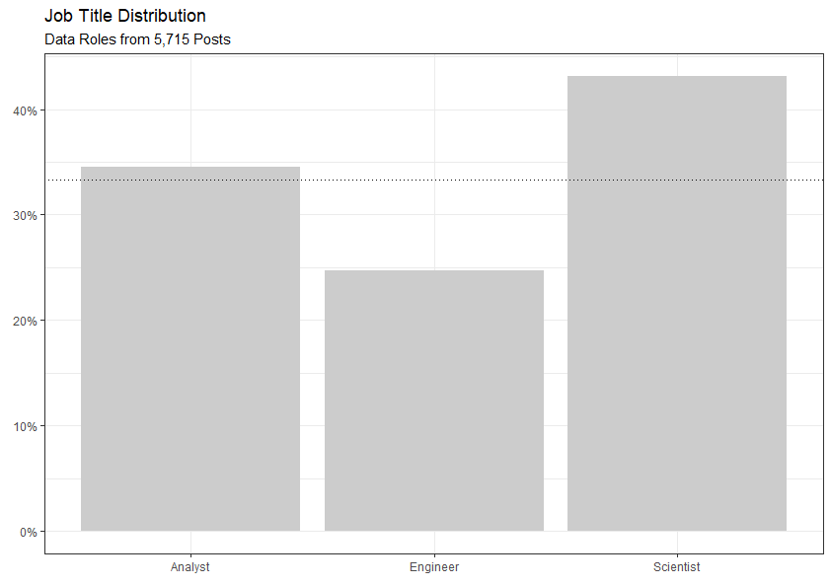
What Types of Roles Are Out There?
5,715 Job Posts
Data Science in highest relative demand
Analysts nearly a third of posts
Generalized title

Slide 2
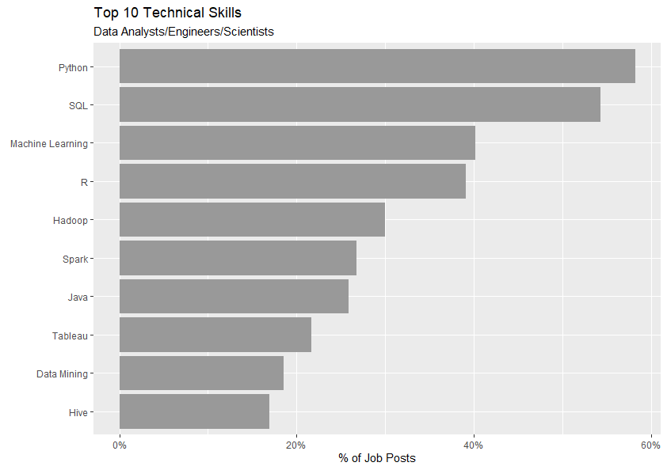
Top Skill for All Data Roles
Python and SQL in high demand
Machine Learning and R are 2nd Tier

Slide 3
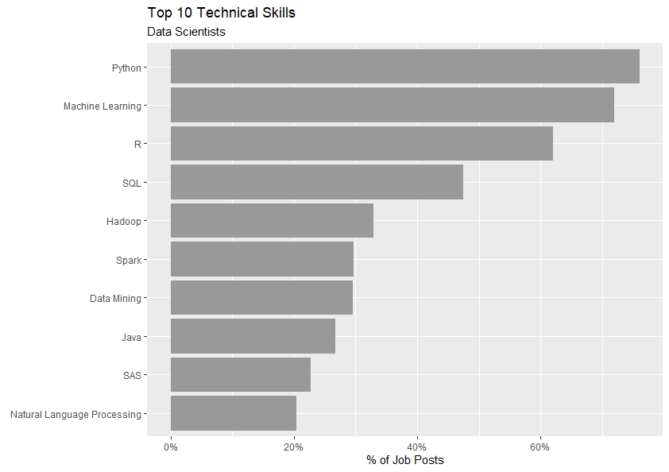
Hard Skills for Data Scientists
More than half of post seeking top 3 skills
Python mentioned in about ¾ of posts
SQL also in high demand

Slide 4
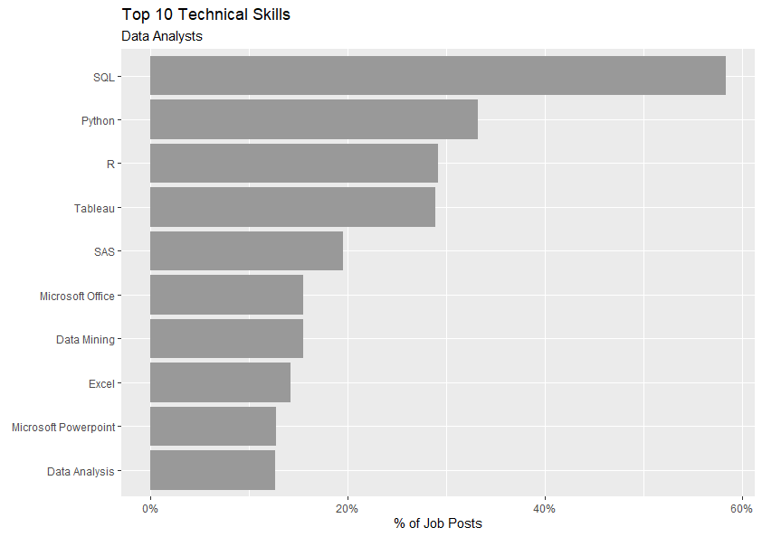
Hard Skills for Data Analysts
SQL seems to define this role
Python, R, Tableau suggest tools for analysis and visualization

Slide 5
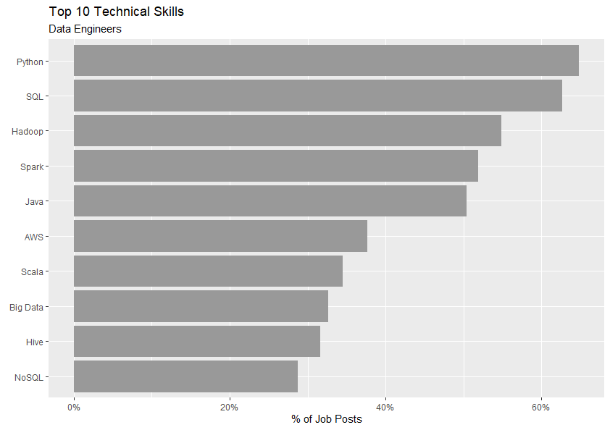
Hard Skills for Data Engineers
Half of all posts seeking 5 skills
Highly skilled role
R is #16

Slide 6
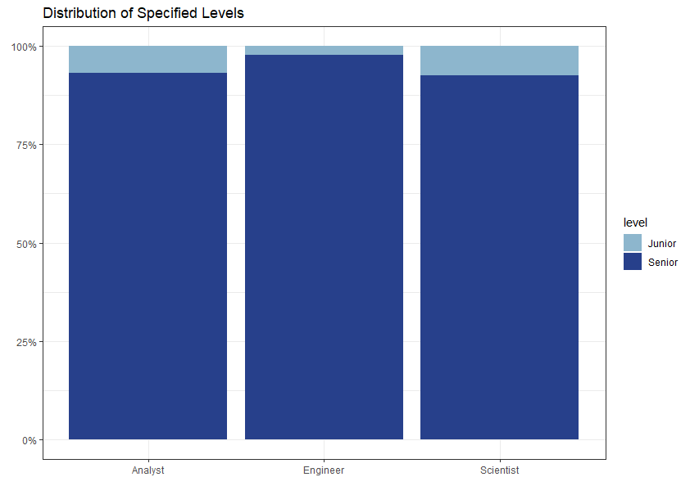
Junior vs Senior Data Roles
About 7.5% of Data Scientist postings are for junior roles
Junior Engineers are rarest
Data roles are mostly seeking seniors, which suggests the demand for experience

Slide 7
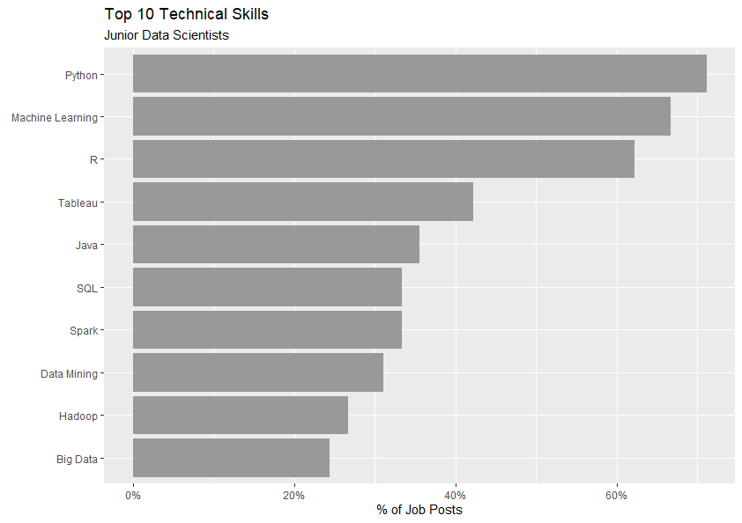
Junior Data Scientists
More than 60% of roles mention top 3
Tableau is #4
SQL ranked relatively lower

Slide 8
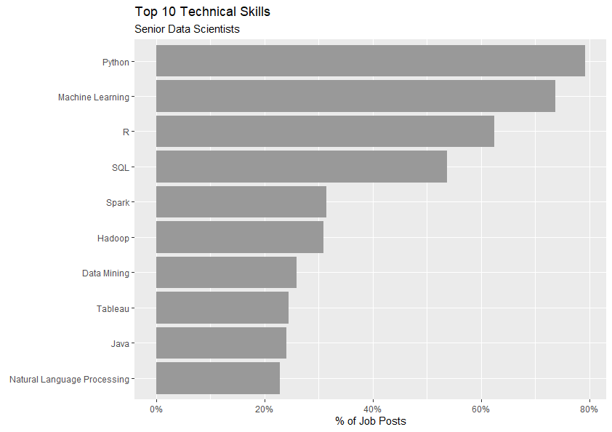
Senior Data Scientists
More than 60% of roles mention top 3
SQL mentioned in more than half of posts
Tableau #8

Slide 9
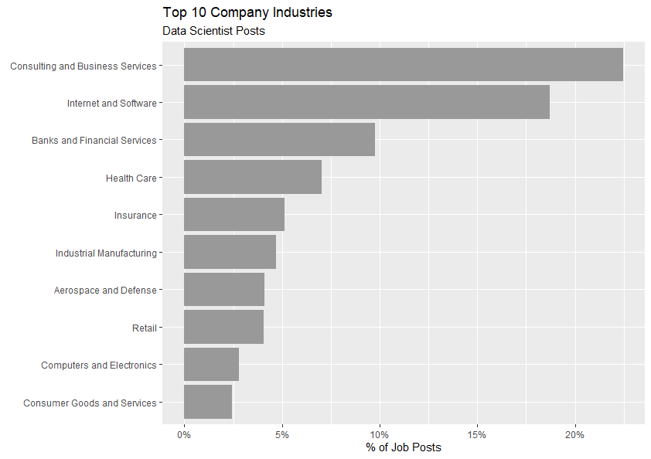
Industry Overview
Data Science is essentially a business service
Internet and Software have massive amounts of data
Banks and Financial Services have a lot to gain with incremental benefits

