Slide 1




Project 3- Indeed Dataset on Job Posting on Data Science related Jobs
Data 607 – MSDS 2020
LEO YI
DAVID BLUMENSTEIL
MANOLIS MANOLI
VINAYAK KAMATH

Slide 2
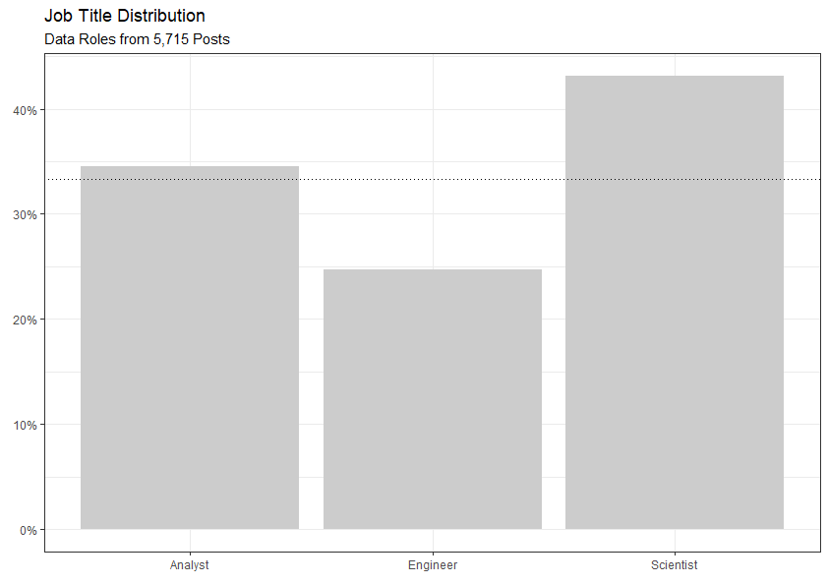
What Types of Roles Are Out There?
5,715 Job Posts
Data Science in highest relative demand
Analysts nearly a third of posts
Generalized title

Slide 3
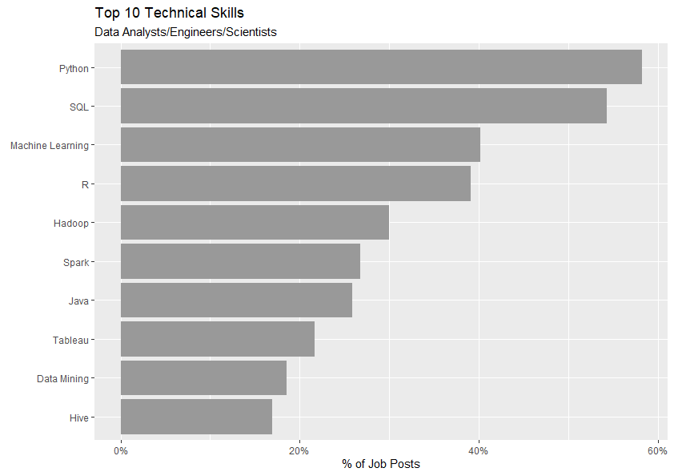
Top Skill for All Data Roles
Python and SQL in high demand
Machine Learning and R are 2nd Tier

Slide 4
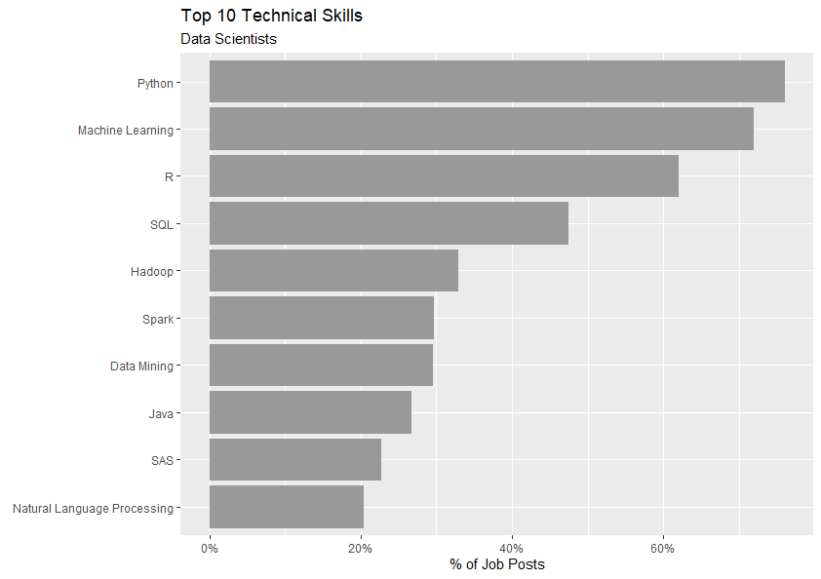
Hard Skills for Data Scientists
More than half of post seeking top 3 skills
Python mentioned in about ¾ of posts
SQL also in high demand

Slide 5
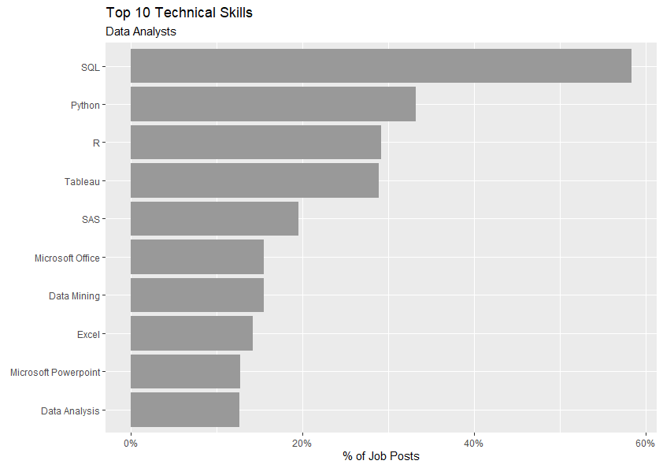
Hard Skills for Data Analysts
SQL seems to define this role
Python, R, Tableau suggest tools for analysis and visualization

Slide 6
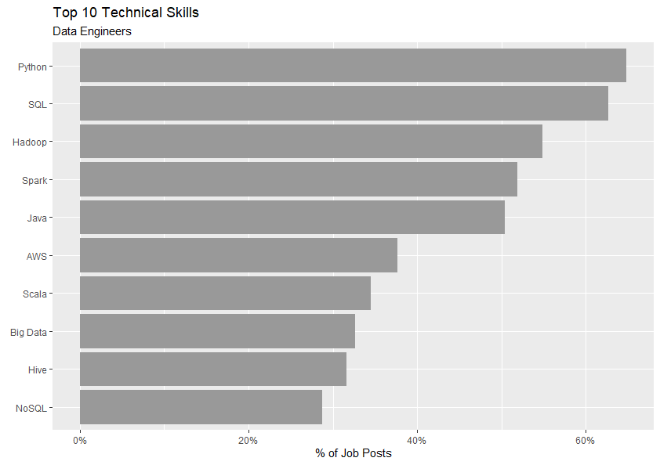
Hard Skills for Data Engineers
Half of all posts seeking 5 skills
Highly skilled role
R is #16

Slide 7
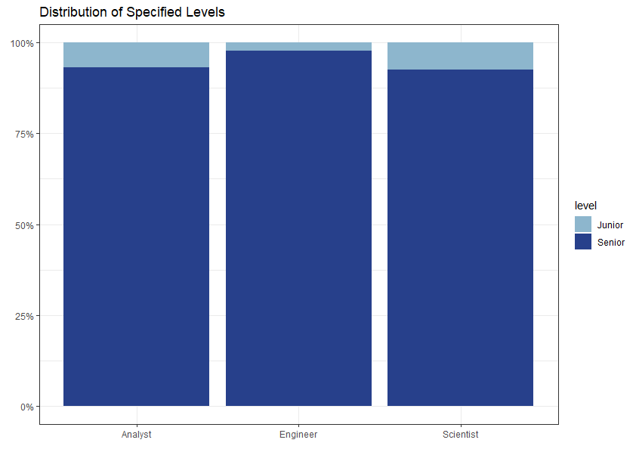
Junior vs Senior Data Roles
About 7.5% of Data Scientist postings are for junior roles
Junior Engineers are rarest
Data roles are mostly seeking seniors, which suggests the demand for experience

Slide 8
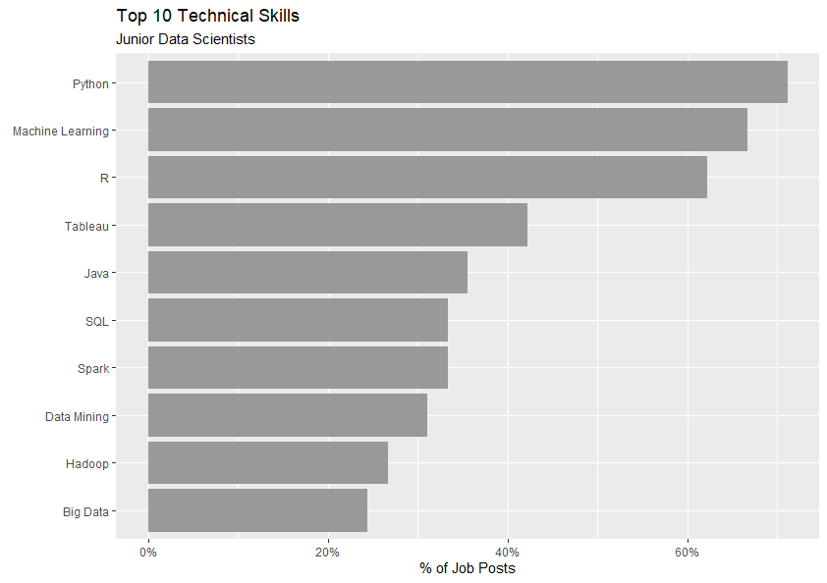
Junior Data Scientists
More than 60% of roles mention top 3
Tableau is #4
SQL ranked relatively lower

Slide 9
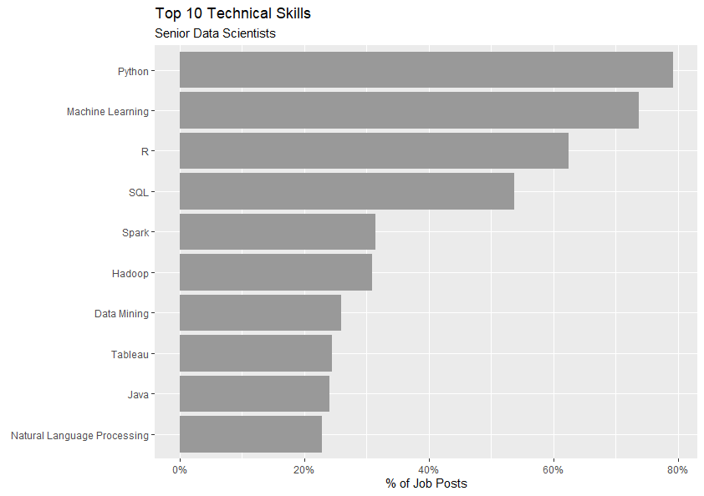
Senior Data Scientists
More than 60% of roles mention top 3
SQL mentioned in more than half of posts
Tableau #8

Slide 10
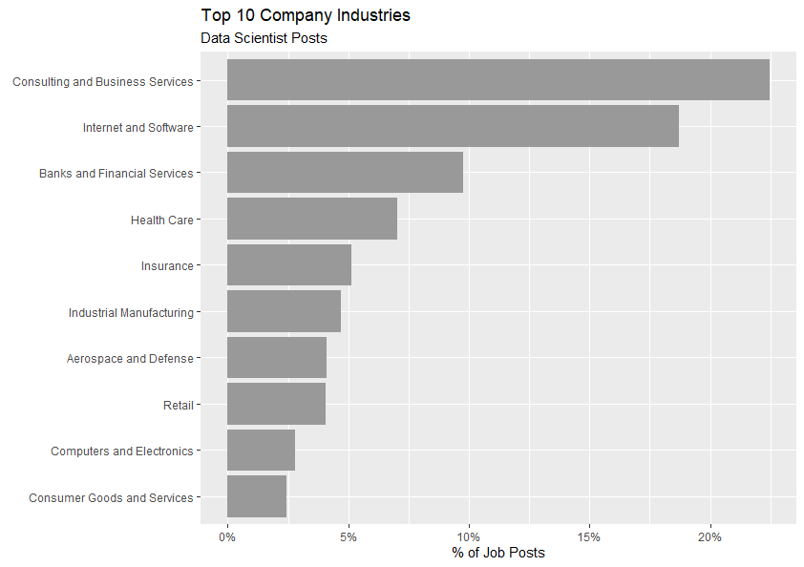
Industry Overview
Data Science is essentially a business service
Internet and Software have massive amounts of data
Banks and Financial Services have a lot to gain with incremental benefits

Slide 11
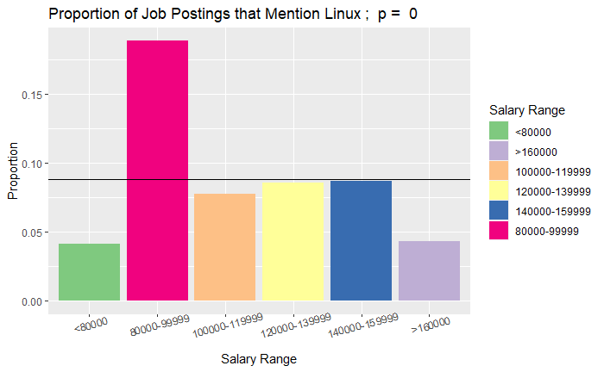
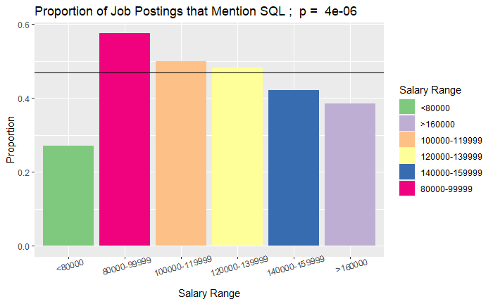
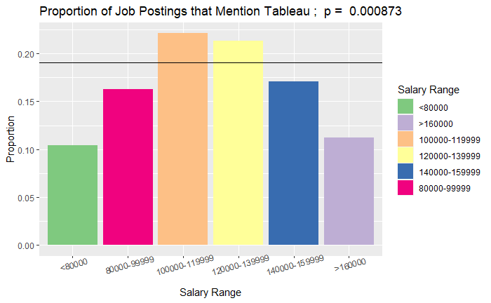
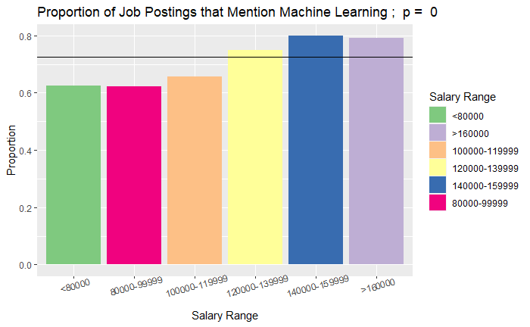
Proportion of Postings Requiring a Skill By Salary
Highlights Differences in Proportions Requiring a Skill Across Salary
P > 0.05, n > 200
About 20 Skills

Slide 12
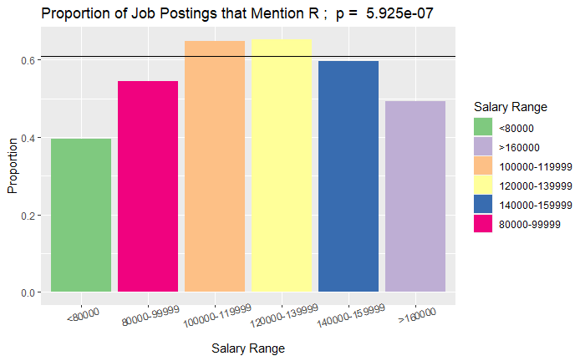
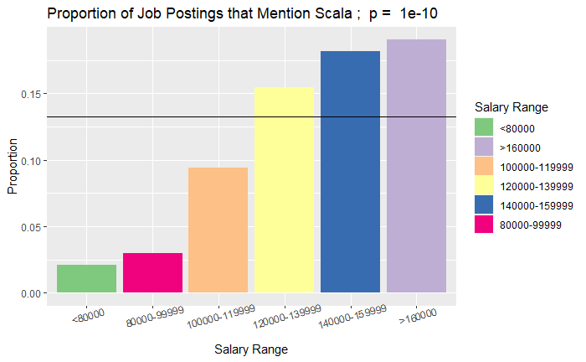
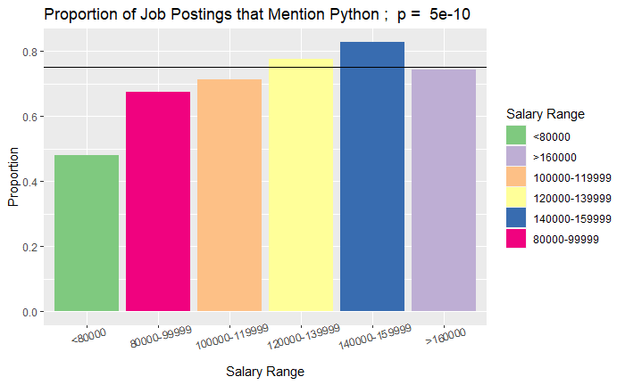
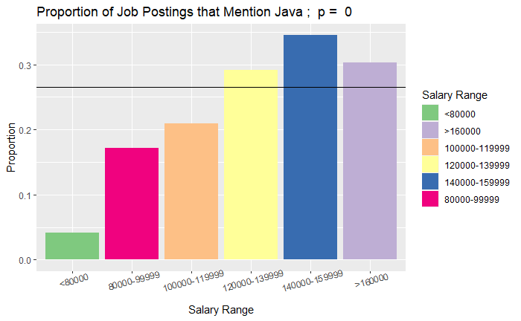
How do Programing Languages Perform

Slide 13
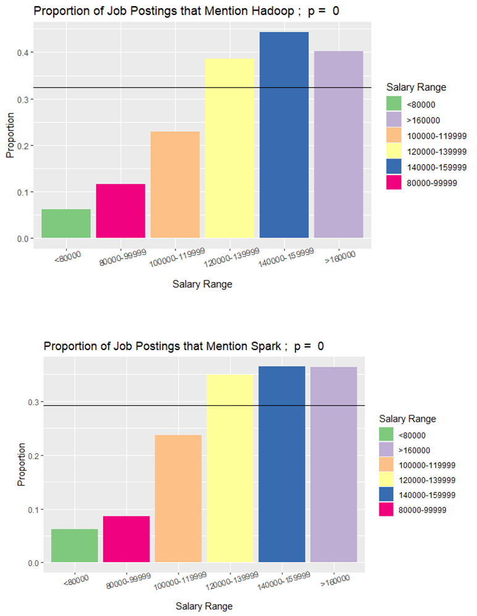
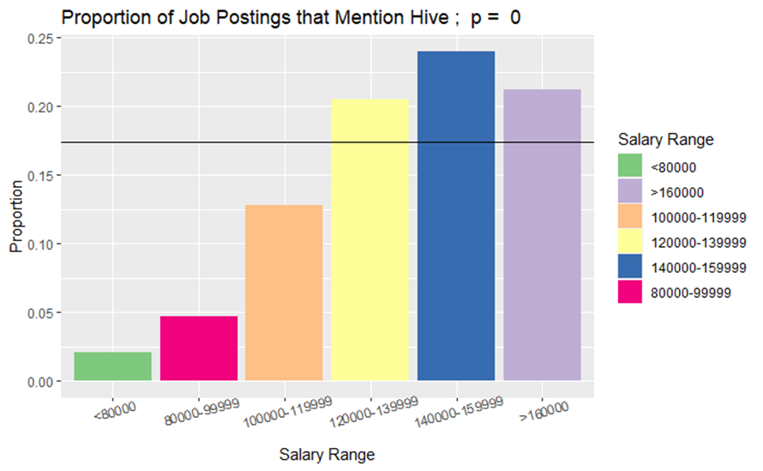
What Do High Paying Jobs Require (Specifically)?
C/C++, Hadoop, Hive, Java, NLP, Scala, Spark, and TensorFlow

Slide 14
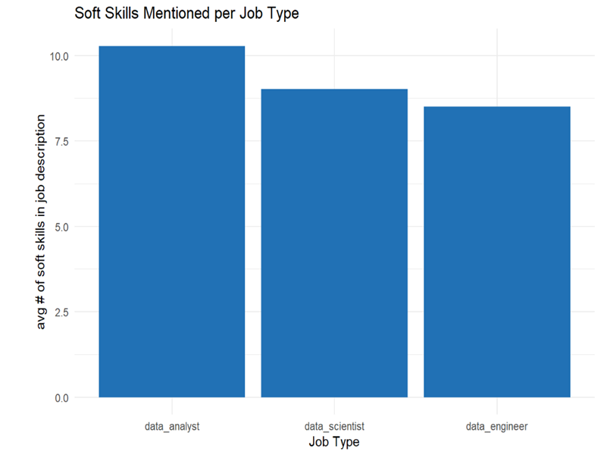
How many soft skills are mentioned in the 3 Job Types
Average number of soft skills mentioned in job description:
Data Analyst
Data Scientist
Data Engineer

Slide 15
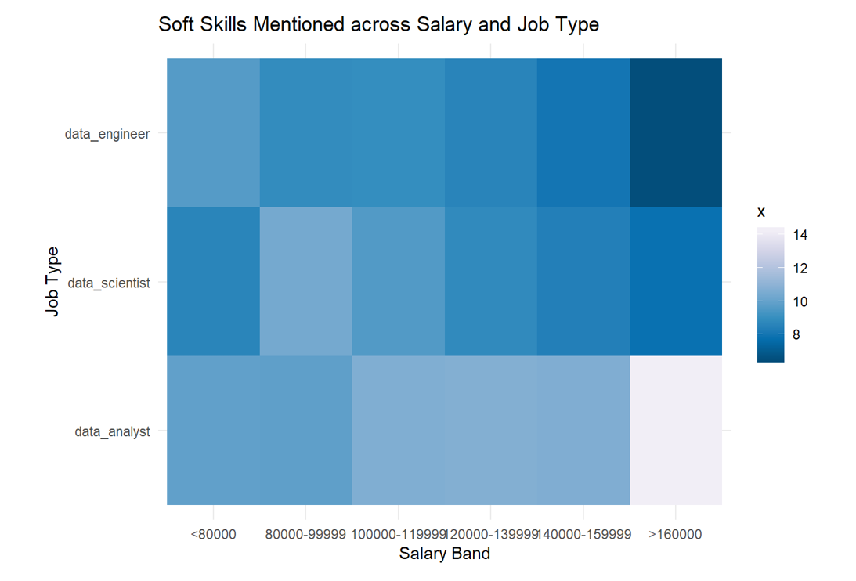
Impact of salary to soft skills mentioned?
Increasing # soft skills mentioned for Data analysts with increasing pay
Decreasing # soft skills mentioned for Data engineers with increasing pay

Slide 16
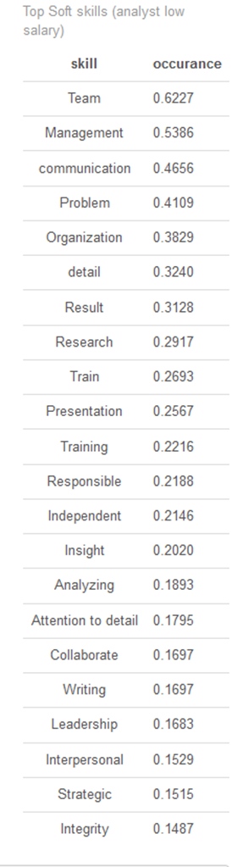
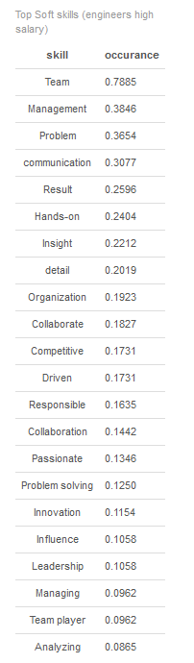
Soft Skills required in either “extreme” cases
Highest amount of soft skills in data analyst jobs with low salaries
Lowest amount of soft skills in data engineer jobs with high salaries
Similar soft skill priorities overall, however, less number of soft skill mentions for high salary data engineers

Slide 17
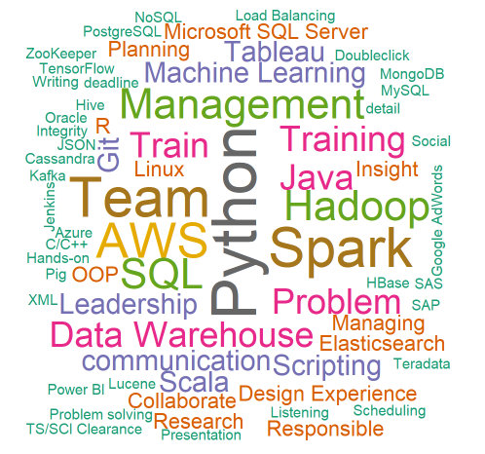
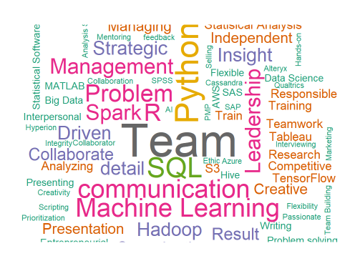
Work Cloud- Engineers
Hard and Soft Skill that Companies look for in Engineer vs. Analyst/Scientist
From the Word Cloud we can see Engineers are asked for more hard skills like Python, Hadoop, SQL, AWS, etc..
From the Word Cloud we can see Analyst and Scientist are asked for more soft skills like Team, Communication, management, Leadership, etc..
Quite few skills are common on both hard and soft skill that both these roles are expected to have.
Work Cloud- Analyst/ Scientist

Slide 18
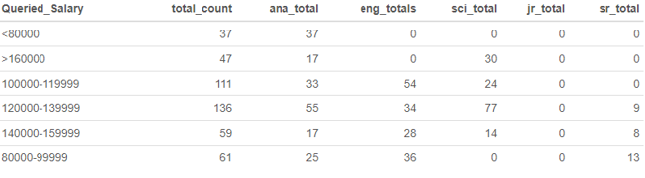
Looking at Salary Range at the different role and junior/senior position; that top rated companies look for.
Salary Range by Top rated Companies
No Junior Level roles
Top bracket salary of 160,000 USD are more in scientist roles and none in engineers.
Analysts nearly a third of posts
Generalized title

Slide 19
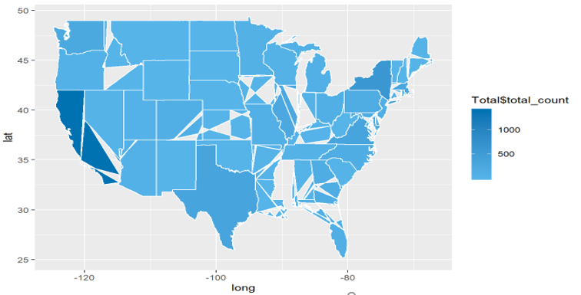
Data Science Openings by US State
Salary Range by Top rated Companies
California Leads in the overall opening for Data Science related roles.
New York comes second to California.
There were few REMOTE roles as well; not tagged on the map.

Slide 20

Closing ?

