Slide 1
Project 3- Indeed Dataset on Job Posting on Data Science related Jobs
Data 607 – MSDS 2020
LEO YI
DAVID BLUMENSTEIL
MANOLIS MANOLI
VINAYAK KAMATH

Slide 2
Data Transformation and Tidying

Slide 3
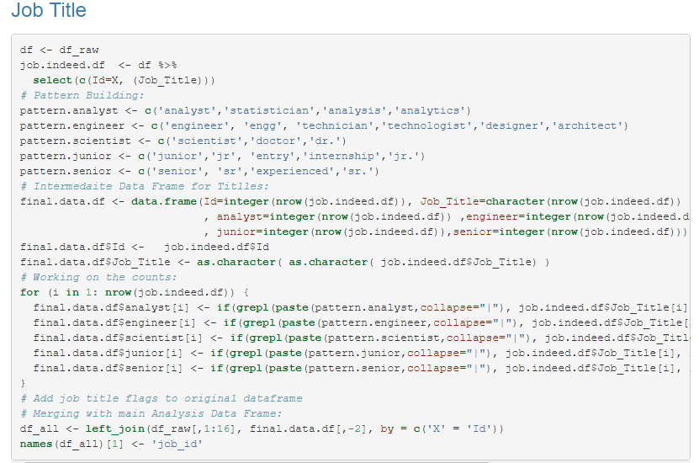
Scraping the ‘Job Title’ attribute to get a the job classification as being a Analyst, Engineer or Scientist. Also to check if the role is a Junior or senior level job.
Patterns of different texts that would represent the particular context of ‘Analyst’, ‘Engineer’, ‘Scientist’, ‘Junior’, or ‘Senior’
For Loop used to parse through the attribute ‘Job Title’ in the dataset against the patterns. Capturing a value of 1 when respective the pattern string is found; else set to 0.
Joining the interim data frame with the main data frame using the ‘left_join’ function.

Slide 4
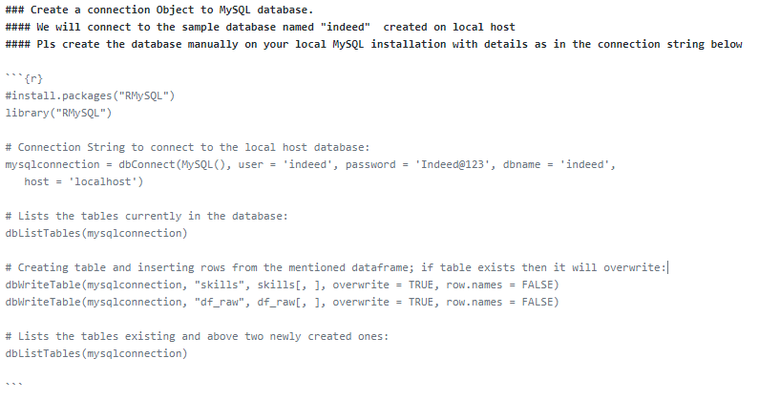
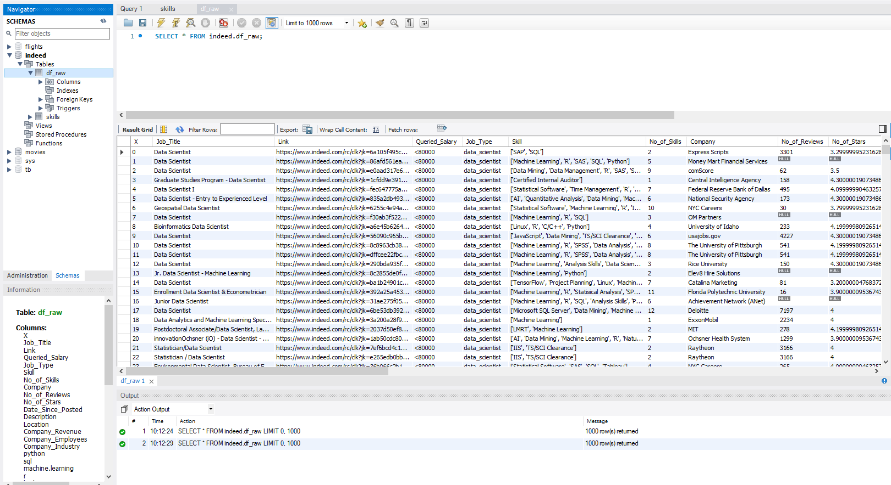
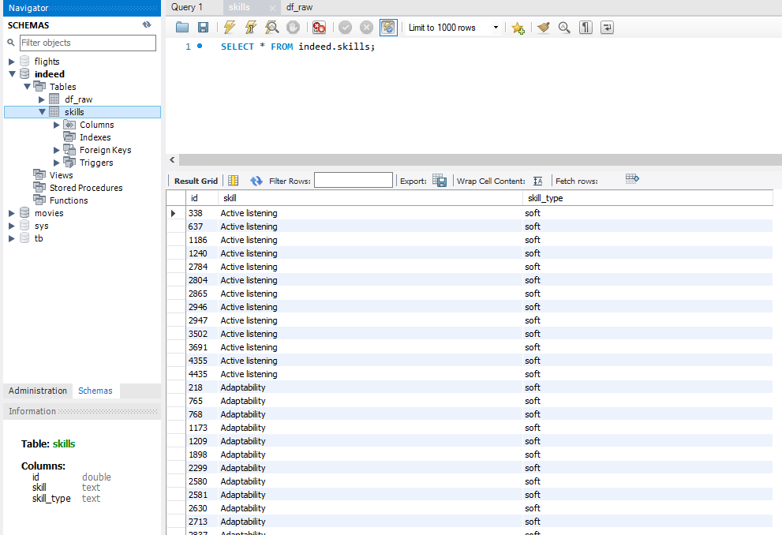

Slide 5
Data Analysis

Slide 6
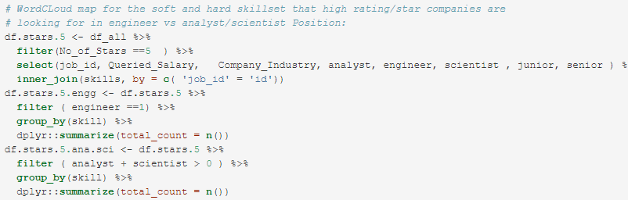
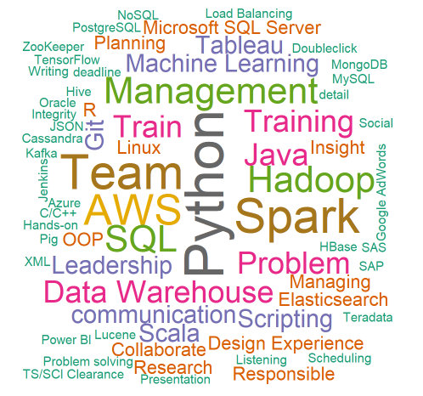
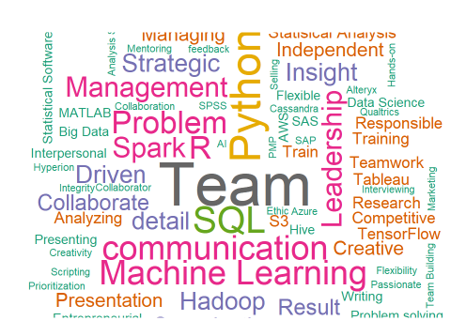

Slide 7
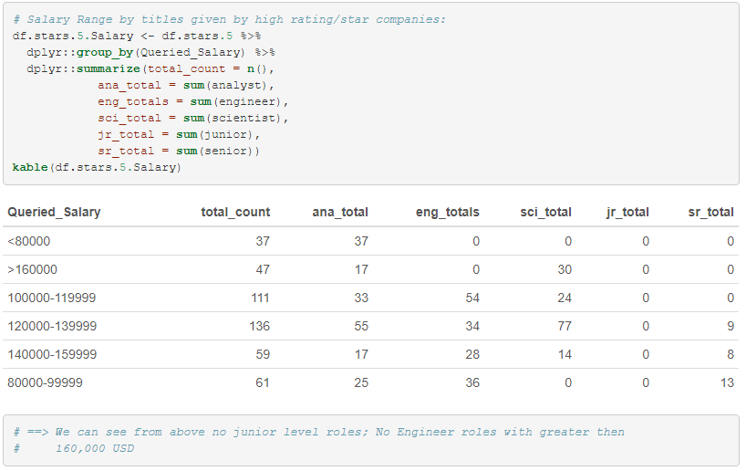

Slide 8
