Slide 1
Message Passing Interface (MPI)
Standard for message passing between processes in high performance computing (HPC) applications.
Parallel distributed computing model.
Processes are executed in parallel
As separated processes in the same host.
As separated processes in different hosts.
Primitives for point-to-point and multicast communication
send/recv
broadcast
scatter
gather

Slide 2
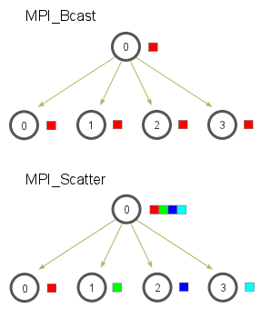
Message Passing Interface (MPI)
Broadcast (bcast)
Scatter
Source: mpitutorials.com

Slide 3
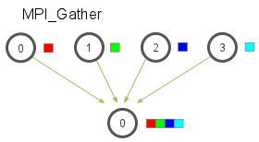
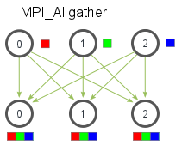
Message Passing Interface (MPI)
Gather
Allgather
Source: mpitutorials.com

Slide 4
Message Passing Interface (MPI)
Mac/Linux: Install OpenMPI (current version 4.1.5)
Windows: Install Microsoft MPI
https://docs.microsoft.com/en-us/message-passing-interface/microsoft-mpi
Set C:\Program Files\Microsoft MPI\Bin to PATH
Python package mpi4py
mpirun (mpiexec) –h hostfile –n N python script.py
Hostfile
Tells MPI where to run processes
Syntax <hostname> <number_of_processors>

Slide 5
Exercises
DS_Examples/mpi/mpi_example.py
Change the example so that each tasks includes a command to be executed by the worker
ADD if worker adds all parameters
SUB if worker substracts the last two parameters from the first one
POW if worker should sum the first two parameters and elevate it to the power given by the third one
The worker will then execute the operation and send the result back, along with its rank. If the operation is not known, it will return the string ‘UNKNOWN’

Slide 6
Exercises
Change the example so the root node can cope with any number of processors
If there are fewer data than processors, fill the rest with None
If there are more data than processors, distribute the data among the processors
Hint: use lists

