Slide 1

Exercises: DHT
Today’s goal: (implement and) run a p2p network using a distributed hash table.
DHT: Kademlia
Used in file sharing networks (BitTorrent) and blockchain (Ethereum).
pip install kademlia
Similar to Chord, but uses another distance function.
Nodes and values live in an m bit space.
distance(node1, node2) = (uint) XOR(id(node1), id(node2))
Keys and values are stored redundantly over the network.
Lookup operation takes $O(\text{log}\left(n\right))$ steps.
Notes:
https://medium.com/coinmonks/a-brief-overview-of-kademlia-and-its-use-in-various-decentralized-platforms-da08a7f72b8f

Slide 2

Kademlia
Each node keeps a routing table where lists of nodes are stored.
Routing table has $m$ entries
i-th entry includes those nodes that have the previous i-1 bits equal to the node that is being sougth.
The further into the list, the closer the nodes in the list are.
Lookup first using the closest nodes in the list.
If key not present, use nodes further away.
… until key found.

Slide 3
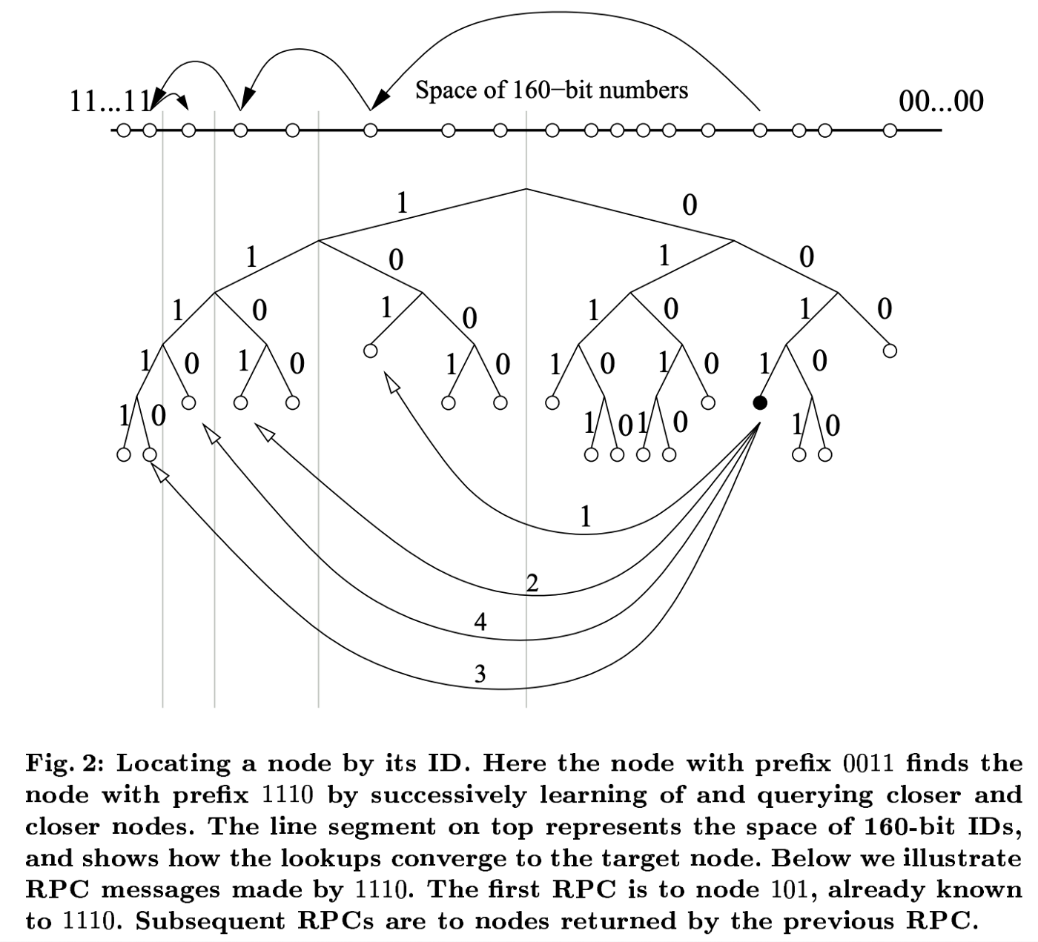
Kademlia

Slide 4
Exercises
Pull DS_Examples
DS_Examples/p2p/p2pnode_exercise.py
Implement a coroutine (async) that waits for user input and implements two operations
Set the value for a given key (Server.set)
Get the value of a given key (Server.get)
Hint: Use the aioconsole package and the ainput function

Slide 5
Execises
Modify the program so that in case that no parameters are given for “join”, the IP address of the neighbour will be read form the P2P_REMOTE_HOST environment variable
If this variable is empty, then a “create” and not a “join” will be made
Hint: Environment variables are stored in the os.environ dictionary
Write a Dockerfile that exposes the default port

Slide 6
Docker: Advanced Networking
We will create a user network for our p2p network
Types of networks
Bridge: default type
Containers in a bridge network can communicate between themselves, but not with containers in other bridge networks
User-created bridge networks provide name resolution
bridge0
container0
container1
host
user-bridge
container2
container4
container3

Slide 7
Docker: Advanced Networking
Bridge networks can only communicate inside the same Docker daemon
Overlay networks: containers can communicate with other Docker daemons
Macvlan: can assign MAC addresses to containers
None: container runs isolated
Third party plugins: custom functionality

Slide 8
Exercises
Create your own p2p network (p2p_setup.md) and set and get values on the network

