Slide 1
Deploying Ruby on Rails
How to make your application actually serve
Dan Buettner
drbuettner@gmail.com
18 Oct 2007

Slide 2
Starters
Rails includes WEBrick to get you started
WEBrick is: easy, reliable, slow
WEBrick is not: threaded, scalable, fast
If you’re doing something very, very simple,
a single WEBrick might work well for you to deploy with

Slide 3
But …
How many of you will have the luxury of deploying
something very very simple?

Slide 4
Something more realistic
Most common setup:
• "regular" HTTP server frontend for static content
• load-balancing to other processes that do Rails
Why:
• load
- HTTP servers serve static content FAST
• software built to serve Rails can serve static too, but:
- not as fast
- not as many nifty features

Slide 5
Pieces and Parts
Apache
Lighttpd
nginx
WEBrick
pound
Mongrel
FastCGI
IIS (no, really!)

Slide 6
Common model of
RoR application deployment
Pack of Mongrels
(Rails)
Apache
Server
(static)
Mongrel
5000
Client
Mongrel
5001
Mongrel
5002
Mongrel
5003
Mongrel
5004
Mongrel
5005

Slide 7
Details
Example Apache 2.2 config with 8 mongrels serving a production app
# We are using rewrites to pass to the proxy
<Proxy balancer://prod_app>
BalancerMember http://127.0.0.1:5000
BalancerMember http://127.0.0.1:5001
BalancerMember http://127.0.0.1:5002
BalancerMember http://127.0.0.1:5003
BalancerMember http://127.0.0.1:5004
BalancerMember http://127.0.0.1:5005
BalancerMember http://127.0.0.1:5006
BalancerMember http://127.0.0.1:5007
</Proxy>
RewriteEngine On
# if request is not a file on the filesystem, send to the proxy
RewriteCond %{DOCUMENT_ROOT}/%{REQUEST_FILENAME} !-f
RewriteRule ^/(.*)$ balancer://prod_app%{REQUEST_URI} [P,QSA,L]

Slide 8
More Details
How to install Mongrel:
download and install RubyGems,
at command line (UNIX/Linux/Mac OS X/Win32):
gem install mongrel
How to install Mongrel cluster or service:
download and install RubyGems,
at command line (UNIX/Linux/Mac OS X):
gem install mongrel_cluster
Win32*:
gem install mongrel_service
*Mongrel cluster supposedly works on Windows, but I haven’t been able to make it happen

Slide 9
Cluster Information
Mongrel cluster configuration is covered in detail in docs on the Web; configuration specifics vary widely depending on your platform’s notion of ‘services’.

Slide 10
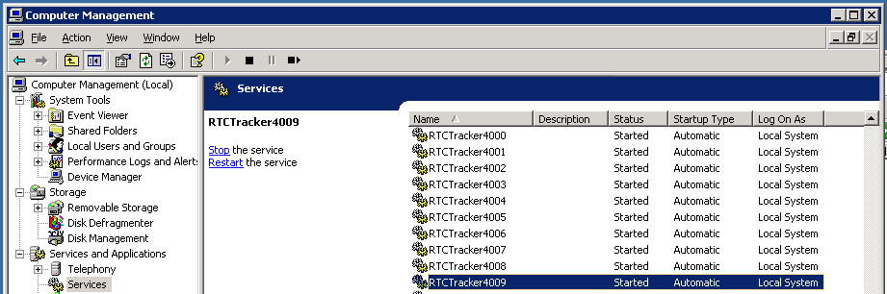
Hacking together a pack of mongrels on Windows
Cluster on Windows seems hit-or-miss
Instead, install independent mongrels as services
Then load balance from Apache as if you had a cluster
mongrel_rails service::install -N RTCTracker4000 -c C:\web\rtc_tracker -p 4000 -e production
.
.
mongrel_rails service::install -N RTCTracker4009 -c C:\web\rtc_tracker -p 4009 -e production

Slide 11
More Windows hacks
Mongrel clusters have nifty cluster start, stop and restart commands on Unixes. If you’re rolling your own on Windows, build it yourself…
@echo off
echo Stopping Apache2.2 service
net stop Apache2.2
echo Stopping RTCTracker4xxx mongrel services...
net stop RTCTracker4000
..
net stop RTCTracker4009
echo Starting RTCTracker4xxx mongrel services...
net start RTCTracker4000
..
net start RTCTracker4009
echo Starting Apache2.2 service ...
net start Apache2.2
echo Waking up the database connections
rem this is a cheap hack
C:\apache\bin\ab.exe -n 200 -c 10 "http://server_address/rtc_tracker/"
echo All done.

Slide 12
Resources
Rails: http://www.rubyonrails.org
RubyGems: http://docs.rubygems.org/
Apache: http://httpd.apache.org
Mongrel: http://mongrel.rubyforge.org/
nginx: http://nginx.net/
Lighttpd: http://www.lighttpd.net/
pound: http://www.apsis.ch/pound/
FastCGI: http://www.fastcgi.com/
Rails Wiki on deployment:
http://wiki.rubyonrails.org/rails/pages/HowtosDeployment
An interesting approach to an always-on site with Apache & Mongrel:
http://synaphy.com.au/2007/8/20/seesaw

