Slide 1
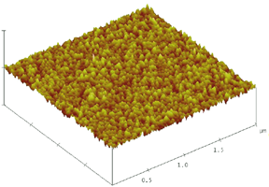
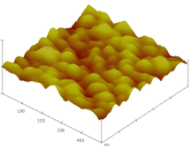
2×2μm
(a)
0.5×0.5μm
(b)

