Slide 1
AVL Trees (balanced BST)
Haitao Wang
Utah State University
CS 2420 – 001, Spring 2016

Slide 2
AVL trees
An AVL tree T is a binary search tree in which the heights of the left and right subtrees of each node differ by at most one
AVL: invented by Adelson-Velsky and Landis in 1962 (paper name: “An algorithm for organization of information”)

Slide 3
The height
If n is the total number of nodes in an AVL tree T
the height h of T is O(log n)
Each search, insert, remove, findMin, findMax operations can be performed in O(log n) time

Slide 4
Insertions
insert (int x): insert a node with x as the key to T; if x is already in T, do nothing
Unbalanced: A node is unbalanced if the heights of the left and right rights subtrees of the node differ by at least two
After inserting x, only nodes that are on the path from x to the root might have their heights changed
Let v be the lowest unbalanced node in T after inserting x

Slide 5
Left-left (LL) case:
x is in the left subtree of the left child of v,
x is in v->left->left
50
unbalanced
v
20
70
10
30
60
80
6
15
8
x

Slide 6
Solution to Left-left case: right rotation
The height of the left subtree of 50 does not change (comparing with its height before inserting x)
50
50
v
20
10
right rotation
10
30
6
20
6
15
8
15
30
8

Slide 7
Left-left case and right rotation
w
w
v
k₂
k₁
right rotation
k₁
Z
k₂
x
x
Y
Y
Z

Slide 8
Right-right (RR) case:
x is in the right subtree of the right child of v,
x is in v->right->right
50
v
20
70
10
30
60
80
26
40
35
x

Slide 9
Solution to the RR case: left rotation
The height of the left subtree of 50 does not change after the rotation
50
50
v
20
30
left rotation
10
30
20
40
26
40
35
10
26
35

Slide 10
Right-right case and left rotation
w
w
v
k₁
k₂
left rotation
Z
k₁
k₂
x
Z
Y
Y
x

Slide 11
An example
insert the following numbers: 1 2 3 4 5 6 7
v
2
1
1
1
left rotation
2
2
1
3
3

Slide 12
2
2
2
left rotation
v
4
3
1
3
1
1
4
3
5
4
v
5
2
4
left rotation
4
1
2
5
3
5
1
3
6
6

Slide 13
4
4
left rotation
v
2
5
2
6
1
3
6
1
3
5
7
7

Slide 14
Left-right (LR) case:
x is in the right subtree of the left child of v,
x is in v->left->right
50
v
20
70
10
30
60
80
6
15
12

Slide 15
Solution to Left-right case: double rotation (left-right)
v
v
20
20
left rotation
10
30
30
15
6
15
10
right rotation
12
6
12
15
left-right double rotation
10
20
the height of the entire subtree
does not change after the rotation
6
12
30

Slide 16
Left-right case and left-right double rotation
w
w
v
k₃
k₂
left-right
double rotation
k₁
k₃
k₁
D
k₂
Z
Y
Z
x
D
Y
x

Slide 17
Right-left (RL) case:
x is in the left subtree of the right child of v,
x is in v->right->left
50
v
20
70
10
30
60
80
26
40
28

Slide 18
Solution to right-left case: double rotation (right-left)
v
20
20
right rotation
10
30
10
26
30
26
40
left rotation
28
40
28
right-left double rotation
26
20
30
the height of the entire subtree
does not change after the rotation
10
28
40

Slide 19
right-left case and right-left double rotation
w
w
v
k₁
k₂
right-left
double rotation
k₃
k₁
k₃
Z
k₂
D
Z
Y
x
D
Y
x

Slide 20
An example (cont.)
keep inserting the following numbers: 16 15 14 13 12 11 10 8 9
4
4
right-left
double rotation
2
6
2
6
1
3
5
15
1
3
5
7
v
7
16
16
15

Slide 21
right-left
double rotation
4
4
2
v
2
7
6
1
3
5
15
1
3
6
15
7
16
5
14
16
14

Slide 22
4
v
7
left rotation
2
7
4
15
1
3
15
2
16
6
6
14
5
14
16
1
3
5
13
13

Slide 23
7
7
right rotation
4
4
15
15
2
v
2
16
6
14
16
6
13
1
3
1
3
5
5
13
12
14
12

Slide 24
7
7
4
v
4
15
13
2
16
2
6
13
6
12
15
1
3
5
12
1
3
14
5
14
16
11
11

Slide 25
Implementation
Comparing with the ordinary BST, we need the following extra work
keep track of the height of each node
make the tree balanced again after each insert/remove

Slide 26
Defining an AvlNode
struct AvlNode
{
int key;
AvlNode *left, *right;
int height;
}
balance factor of a node v: v->left->height – v->right-height
we will not use this term in this class, but some books may use it

Slide 27
Defining an AvlNode
struct AvlNode
{
int key;
AvlNode *left, *right;
int height;
AvlNode(int key_input, int height_input = 0, AvlNode *left_input = NULL,
AvlNode * right_input = NULL)
{
key = key_input;
height = height_input;
left = left_input;
right = right_input;
}
}

Slide 28
The height of a node v
If v is a leaf
v->height is 0
If v is has at least one child
v->height is 1 + the larger value of v->left->height and v->right->height
If v is NULL
consider v->height as -1

Slide 29
The getHeight() function
//given a node v, return its height
int getHeight(AvlNode * v)
{
if (v == NULL)
return -1;
else
return v -> height;
}
For any node v:
v->height = 1 + max{getHeight(v->left), getHeight(v->right)}

Slide 30
Insertions
void insert(AvlNode * & v, int x)
{ if v == NULL
v = new AvlNode(x);
else if x == v->key
return;
else if x < v->key
insert(v->left, x);
else
insert(v->right, x);
balance(v);
}

Slide 31
void balance(AvlNode * & v)
{ if v == NULL return;
if getHeight(v->left) – getHeight(v->right) > 1
if getHeight(v->left->left) ≥ getHeight(v->left->right)//left-left
rightRotate(v);
else//left-right case
doubleLeftRightRotate(v);
if getHeight(v->right) – getHeight(v->left) > 1
if getHeight(v->right->right) ≥ getHeight(v-right->left)//right-right
leftRotate(v);
else//right-left case
doubleRightLeftRotate(v);
v->height = 1+max{getHeight(v->left), getHeight(v->right)};
}

Slide 32
Left-left (LL) case: remove(80)
v->left->height – v->right->height > 1
v->left->left->height ≥ v->left->right->height
“==” is possible
v
50
unbalanced
20
70
10
30
80
6
20
40

Slide 33
Left-left (LL) case: right rotation
v
50
20
20
70
50
10
10
30
right rotation
6
20
30
70
6
20
40
40

Slide 34
Left-right (LR) case: remove(80)
v->left->height – v->right->height > 1
v->left->left->height < v->left->right->height
v
50
20
70
10
30
80
26
40

Slide 35
Left-right (LR) case: left-right double rotation
v
50
30
20
70
20
50
left-right
double rotation
10
30
10
26
40
70
26
40

Slide 36
The other two cases
v->right->height – v->left->height > 1
v->right->right->height ≥ v->right->left->height
The right-right case: left rotation
v->right->right->height < v->right->left->height
The right-left case: right-left double rotation

Slide 37
Is a single rotation or double rotation always sufficient?
Yes for insertion!
No for remove!

Slide 38
remove(15)
unbalanced
v
50
50
v
20
70
30
70
left rotation
30
60
80
20
40
60
80
10
55
65
74
90
10
25
45
55
65
74
90
15
25
40
45
68
78
85
95
68
78
85
95
98
98

Slide 39
v
70
50
30
70
left rotation
50
80
20
40
60
80
60
74
90
30
10
25
45
55
65
74
90
20
40
55
65
78
85
95
68
78
85
95
10
25
45
68
98
98

Slide 40
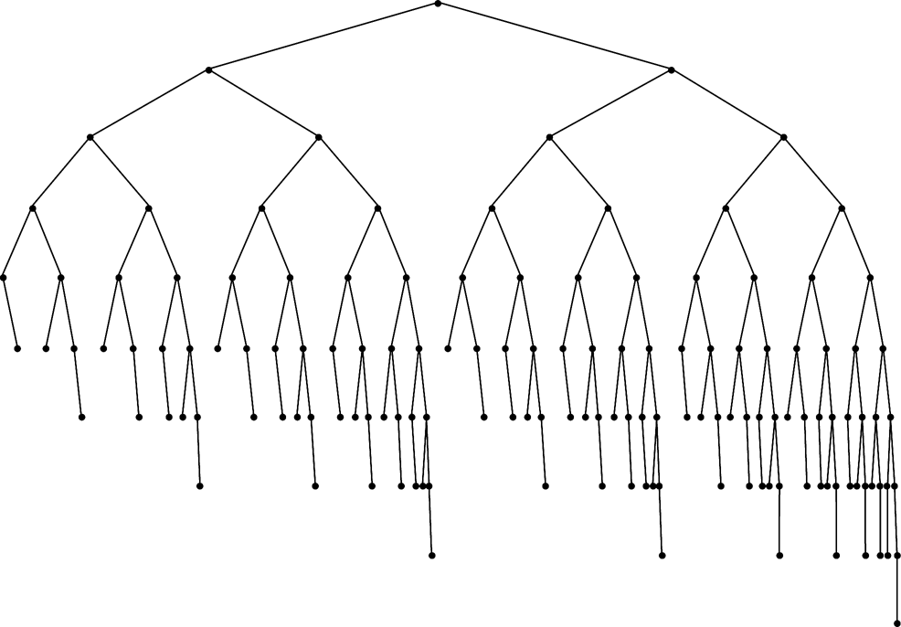
A general case

Slide 41
Remove a non-leaf node: remove(7)
8
change 7 to 8 and remove the lower 8
4
10
2
15
7
6
9
4
1
3
5
14
16
10
2
15
18
6
8
1
3
5
9
14
16
18

Slide 42
8
4
15
left rotation
2
6
10
16
8
4
1
3
5
9
14
18
10
v
2
15
6
9
1
3
5
14
16
18

Slide 43
void balance(AvlNode * & v)
{ if v == NULL return;
if getHeight(v->left) – getHeight(v->right) > 1
if getHeight(v->left->left) ≥ getHeight(v->left->right)//left-left
rightRotate(v);
else//left-right case
doubleLeftRightRotate(v);
if getHeight(v->right) – getHeight(v->left) > 1
if getHeight(v->right->right) ≥ getHeight(v-right->left)//right-right
leftRotate(v);
else//right-left case
doubleRightLeftRotate(v);
v->height = 1+max{getHeight(v->left), getHeight(v->right)};
}

Slide 44
remove(x)
void remove (AvlNode * & v, int x)
{ if (v == NULL) return;
if (x < v->key) remove(v->left, x);
else if (x > v->key) remove(v->right, x);
else // x == v->key
if (v->left == NULL or v->right == NULL) //v has at most one child
AvlNode * temp = v;
if (v->right == NULL)
v = v->left;
else v = v->right;
delete temp;
else // x has two children, replace v by the largest key in v->right
AvlNode * u = v->right;
while (u->left != NULL)
u = u->left;
v->key = u->key;
remove(v->right, u->key);
balance(v);
}

