Slide 1
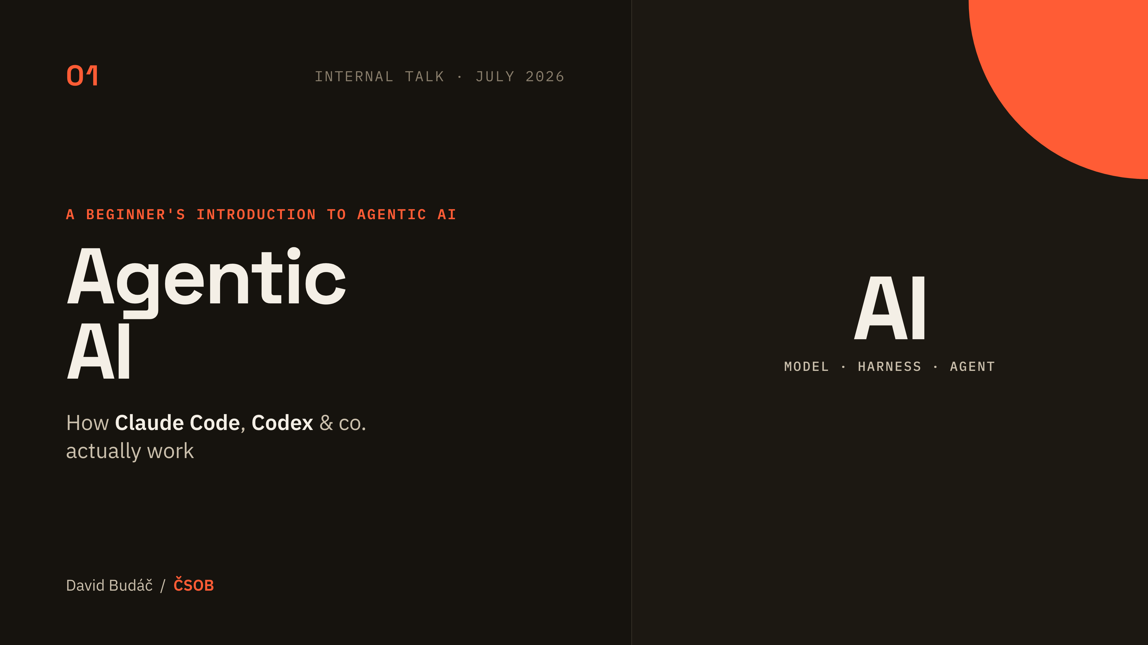
Notes:
[Title]
Open warm and low-jargon: this is the beginner deck, no coding background needed. Promise the one thing they will leave with — model, harness, agent, and the loop that ties them together. Mention there is a live agent running during the talk, so they know to look out for the LIVE markers.

Slide 2
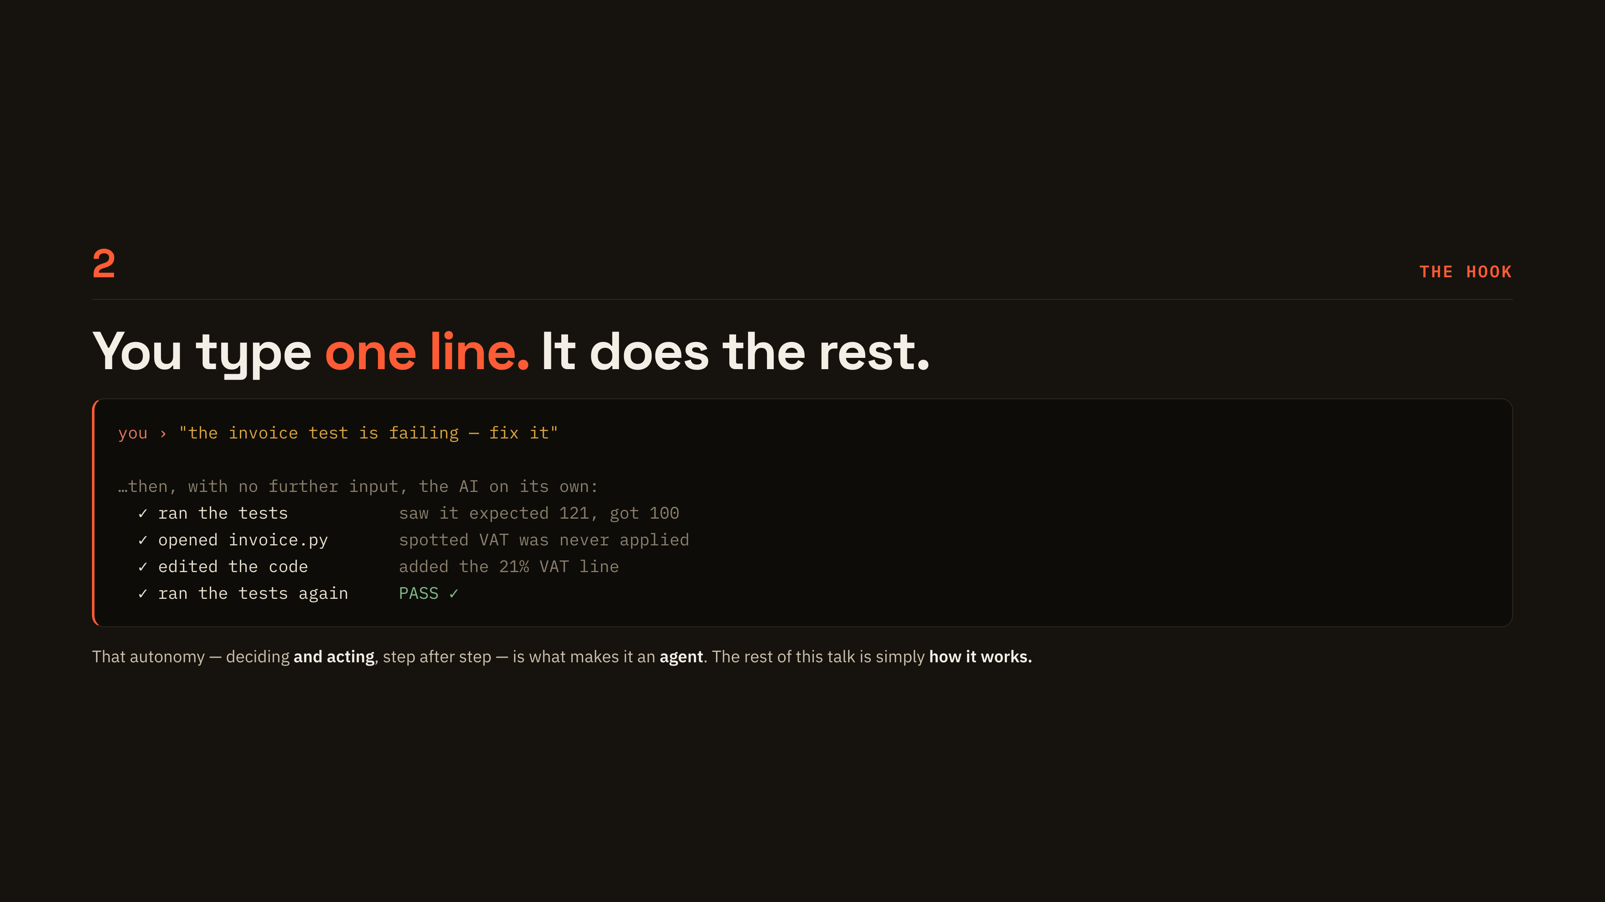
Notes:
[The hook]
Read the one-line prompt out loud, then walk the four ticks slowly — tests, file, edit, tests again. The point to land is that nobody typed anything after the first line. That autonomy, deciding and then acting, is the definition of an agent, and the rest of the talk is just how it works.

Slide 3
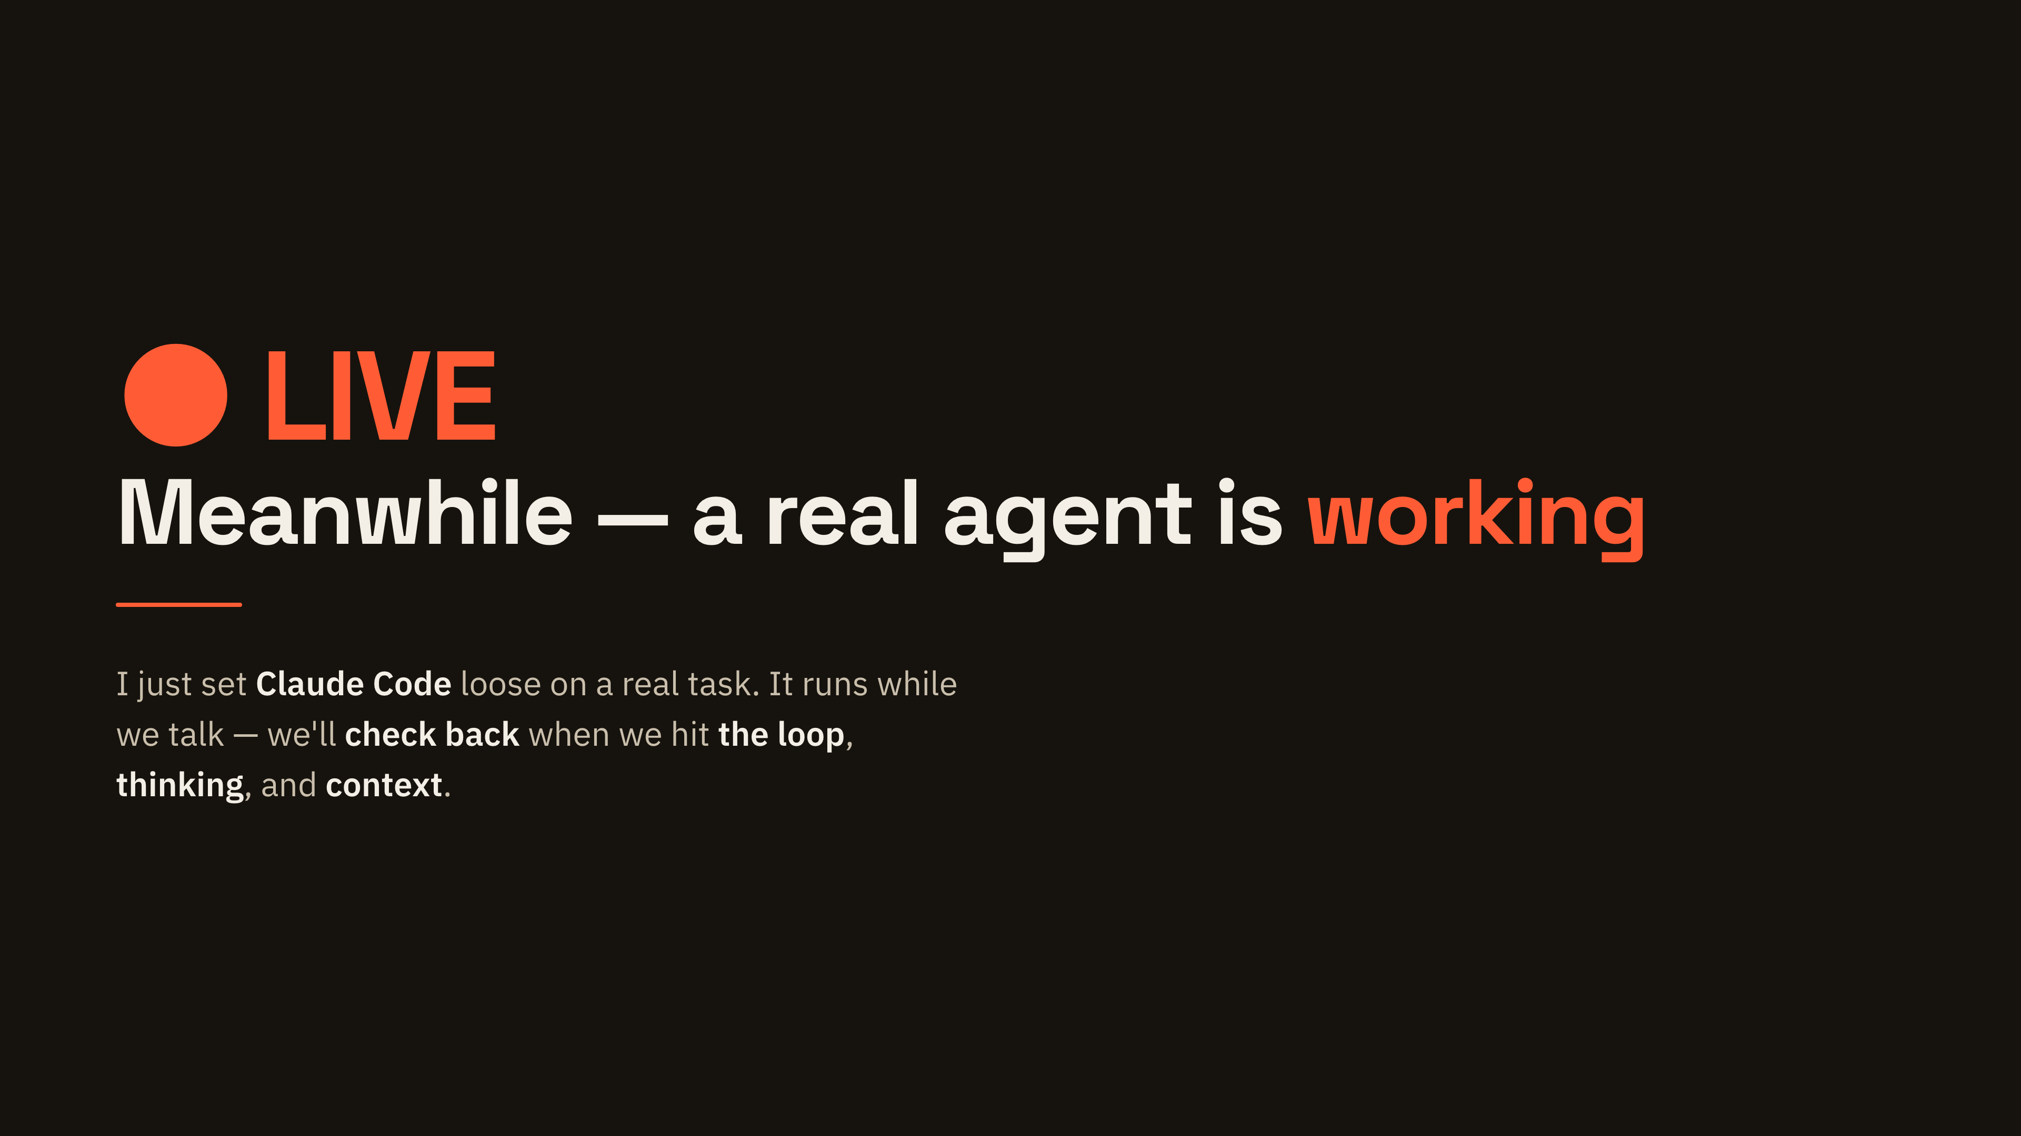
Notes:
[Live demo anchor]
Switch to the terminal here and actually kick off the task, in auto mode so it will not stop to ask. Say plainly that it will keep working in the background while we talk. Tell them we come back to it three times — at the loop, at thinking, and at context — so they know the markers are real, not decoration.

Slide 4
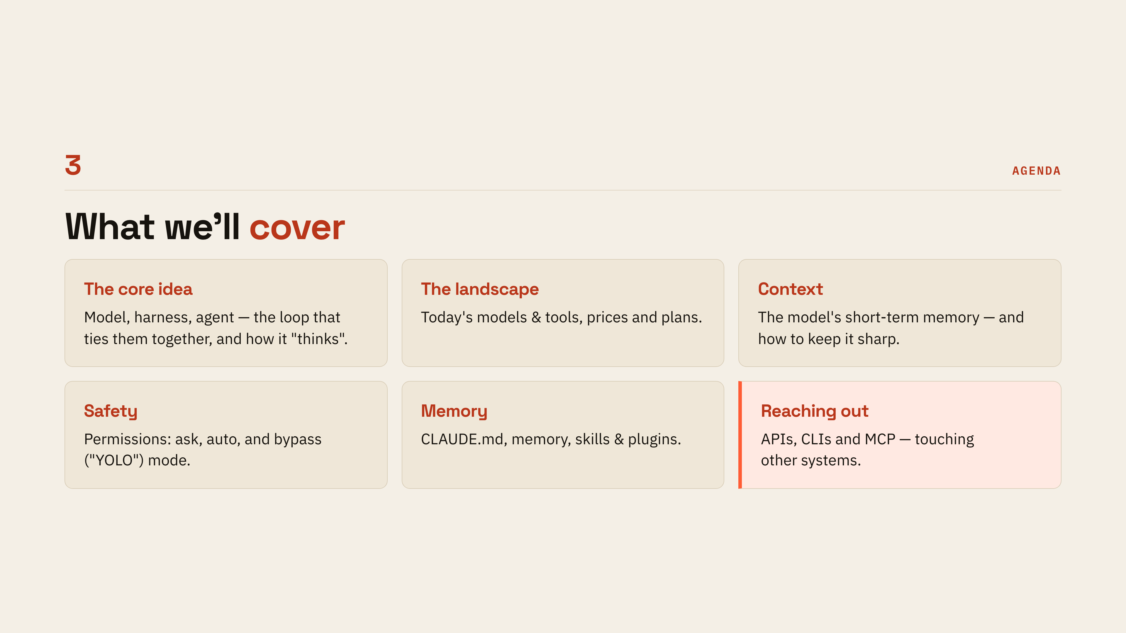
Notes:
[Agenda]
Twenty seconds per tile at most — this is a map, not content. Say the first three are how the thing works, the last three are how you live with it day to day. Point at Reaching out as the payoff tile, because that is where it stops being a chat window and starts touching real systems.

Slide 5
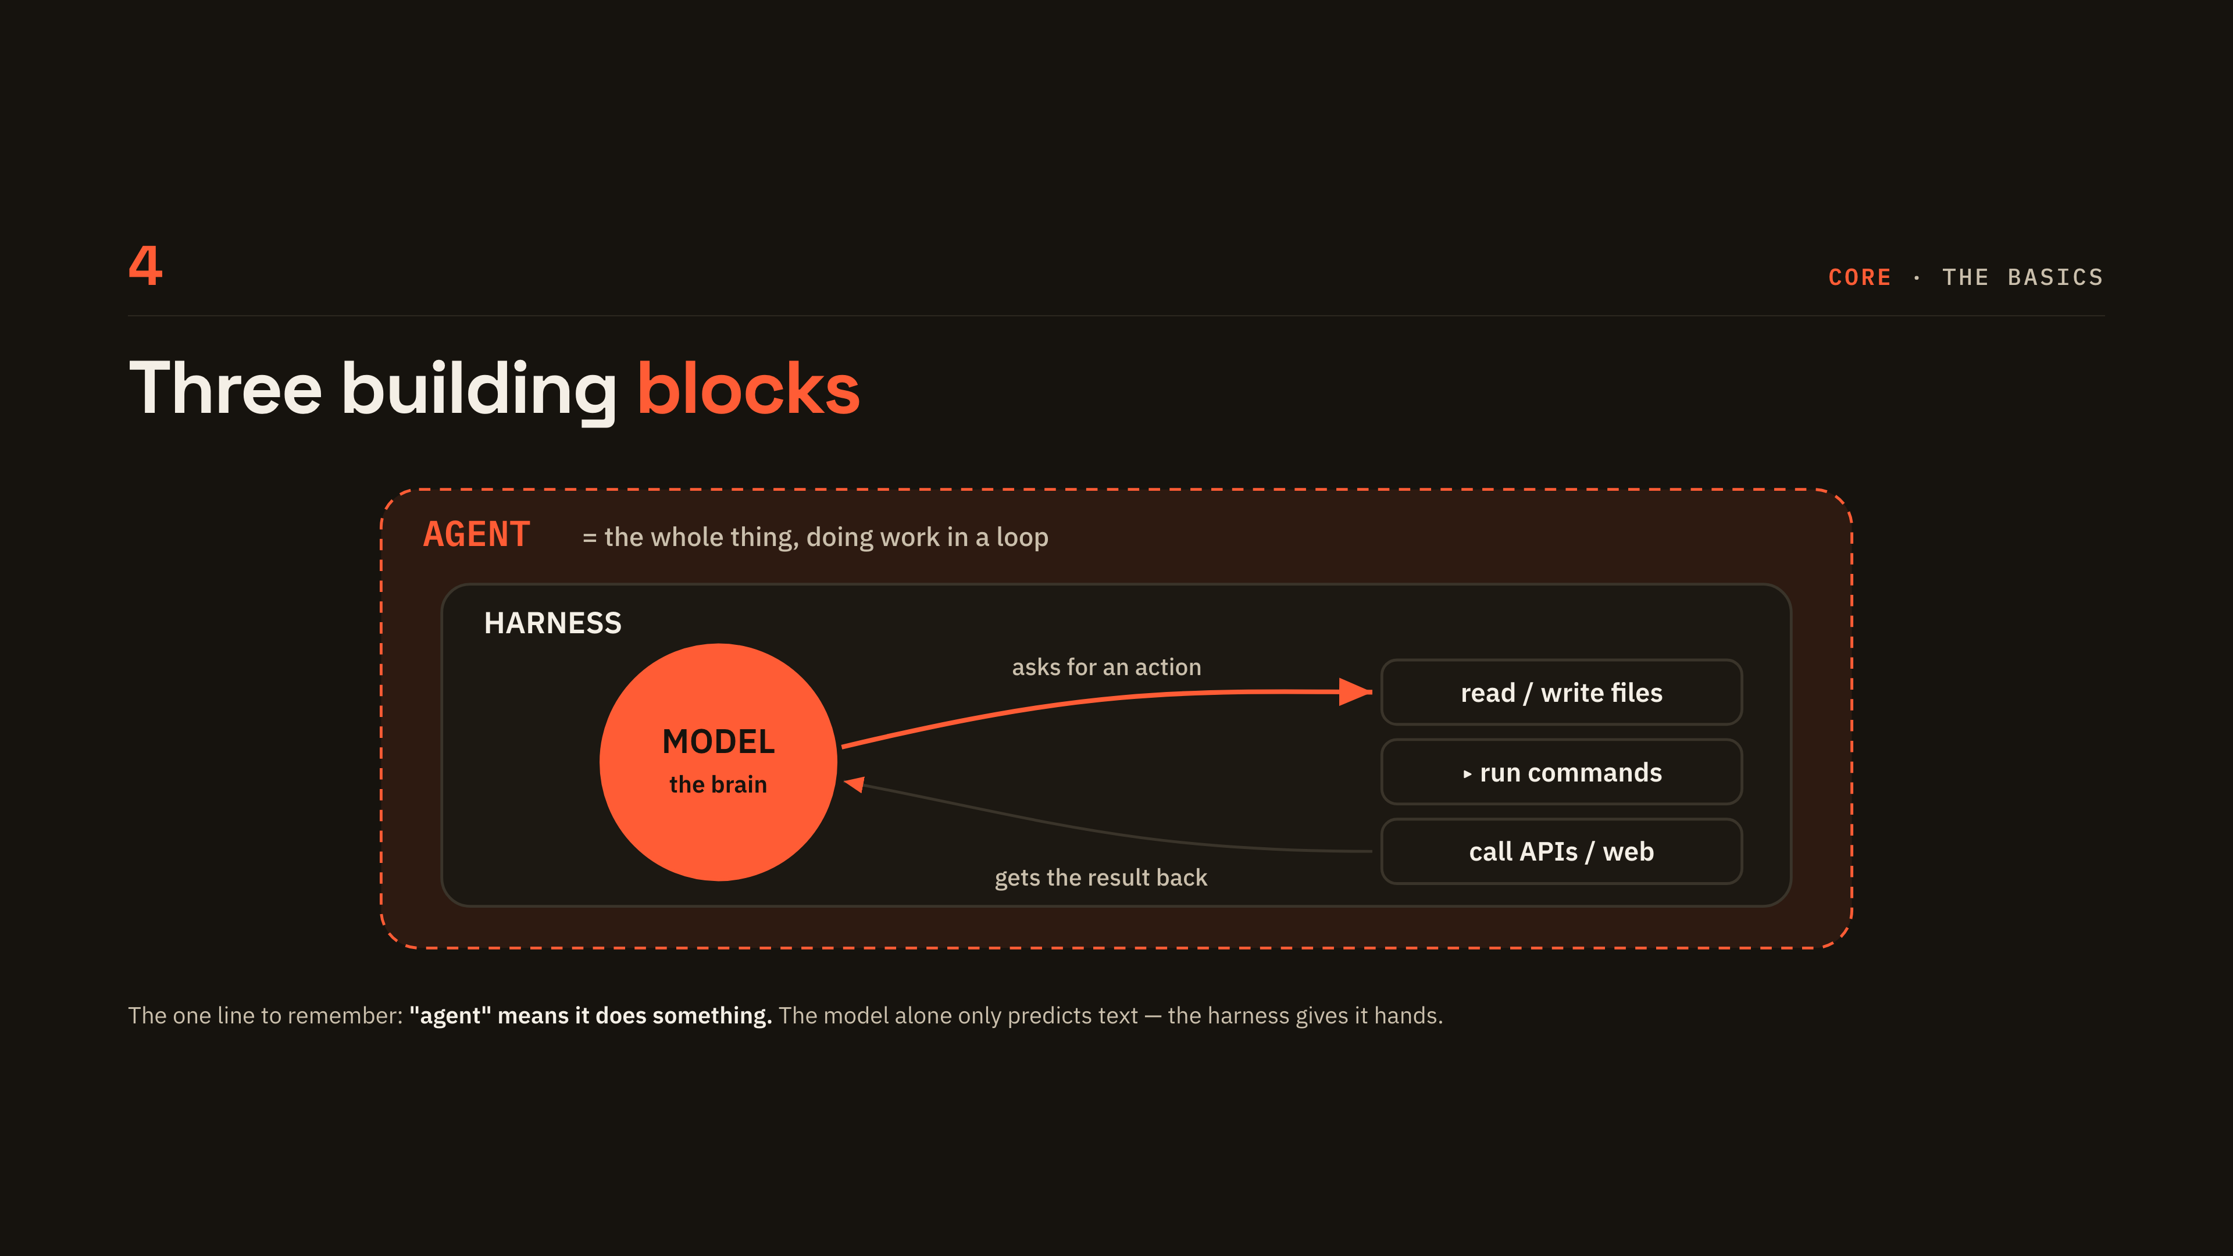
Notes:
[Three building blocks]
Walk the diagram from the inside out: the model is the brain, the harness is the program around it with the tools, and agent is the name for the whole thing doing work in a loop. Trace the two arrows out loud — it asks for an action, it gets the result back. The one line to leave them with is that a model alone only predicts text; the harness gives it hands.

Slide 6
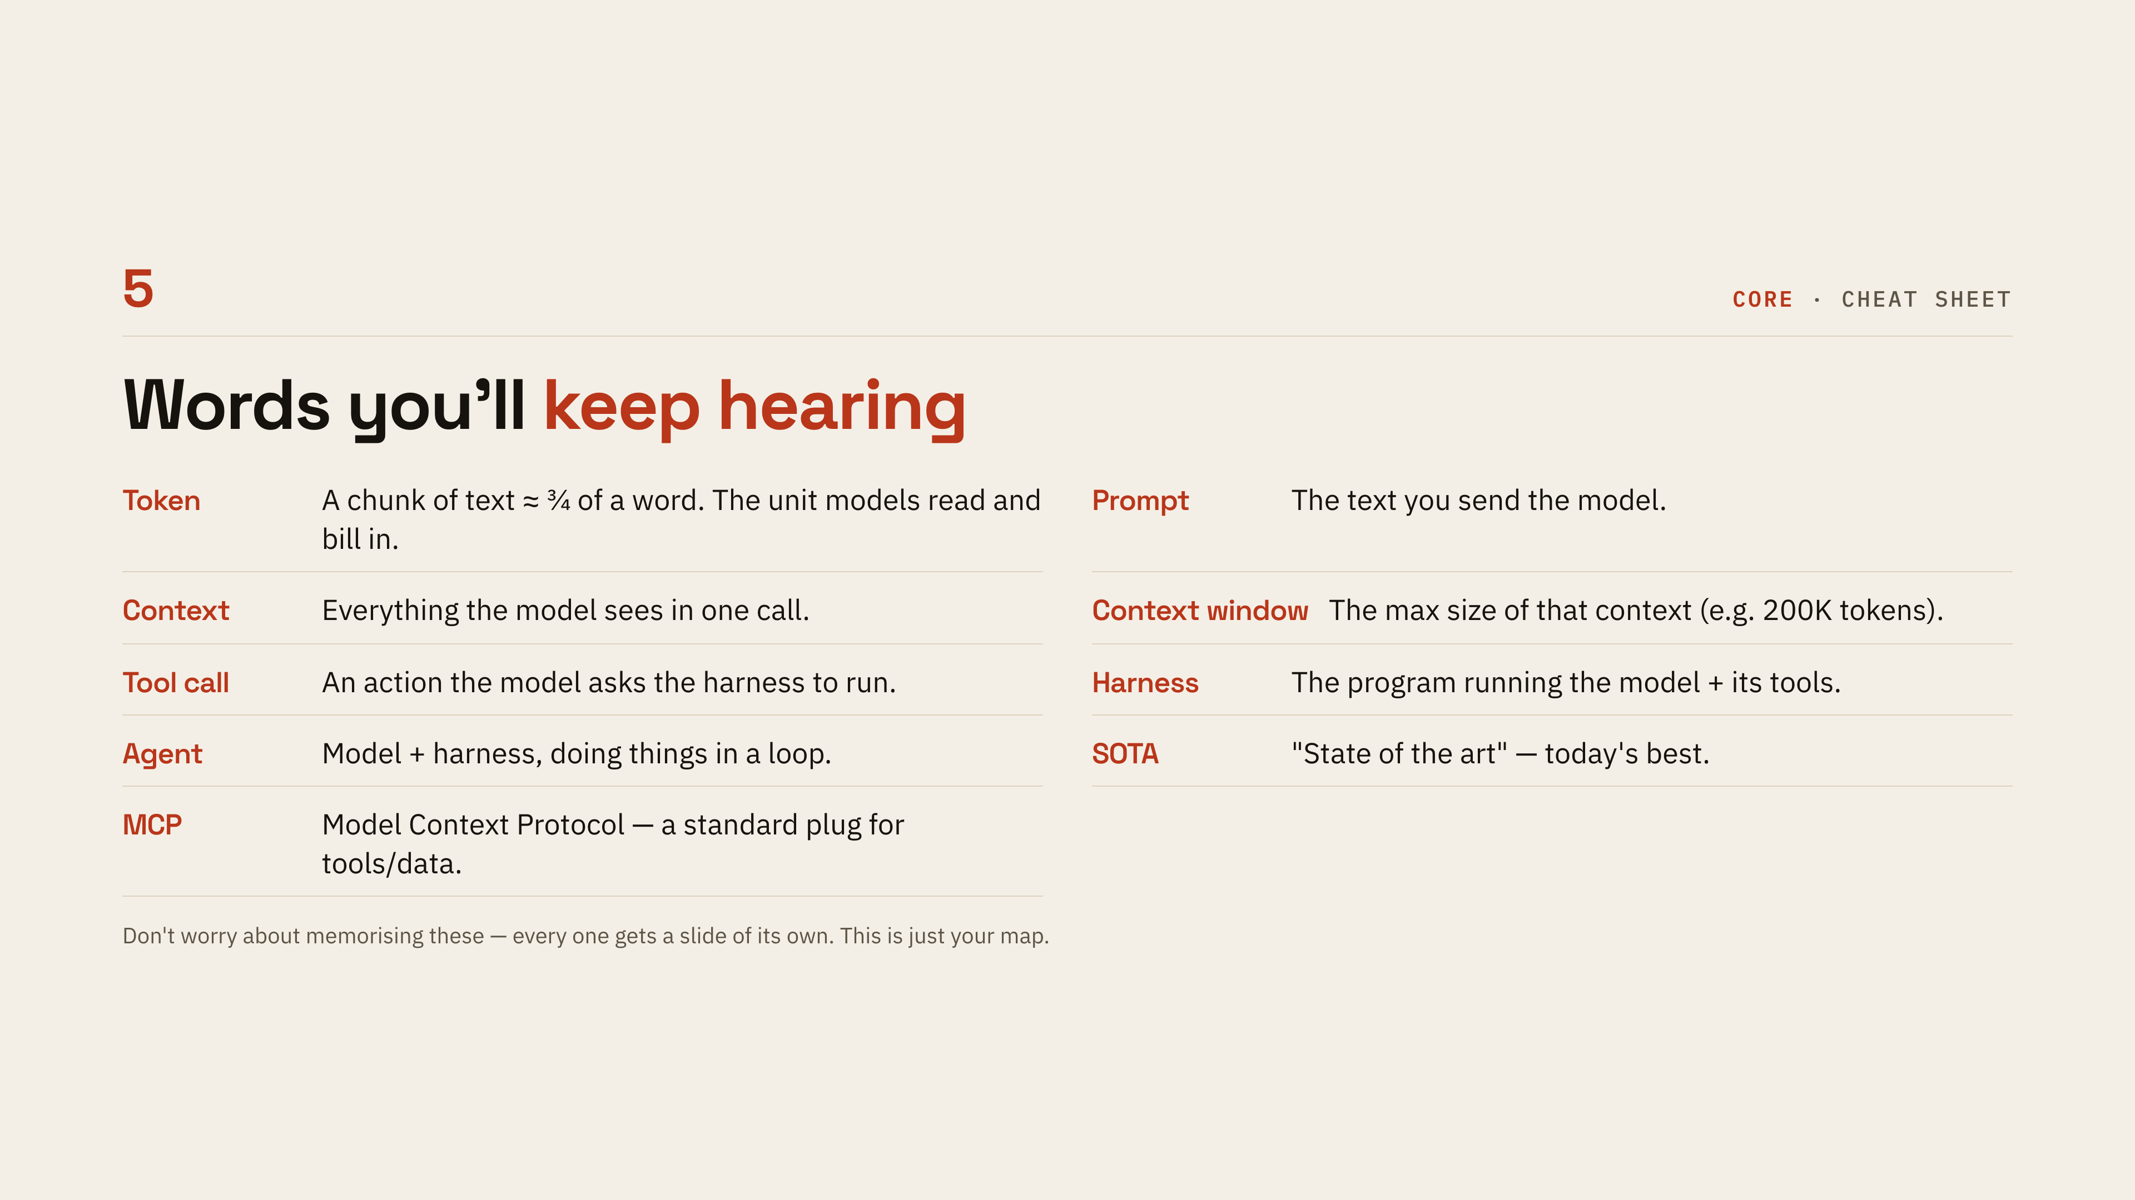
Notes:
[Glossary]
Do not read all nine — read Token, Context and Agent, and tell them the rest each get their own slide later. This exists so nobody spends the next twenty minutes quietly wondering what a token is. Say it out loud: this is a map, not a memory test.

Slide 7
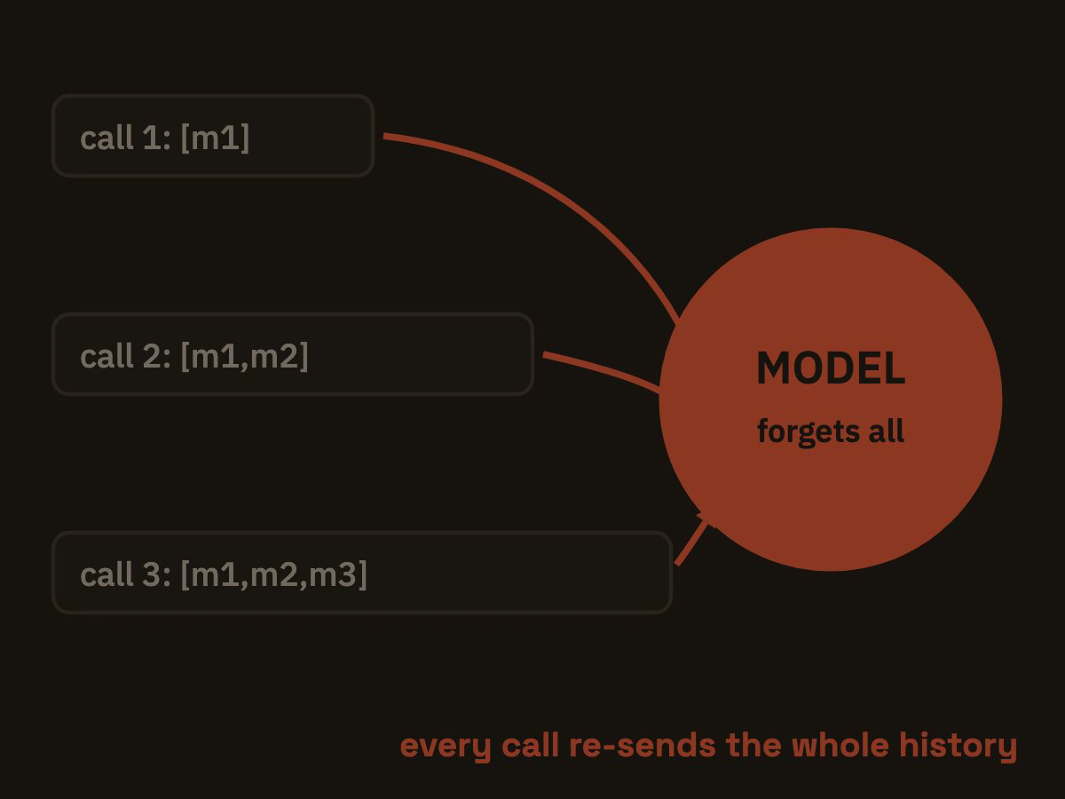
Notes:
[The model has no memory]
This is the single most surprising fact for a non-technical audience, so slow down. The Memento comparison usually does the work: every call, the model starts from nothing. Let the animation run a full cycle while you say the consequence — the harness has to re-send everything it should know, every single time.

Slide 8
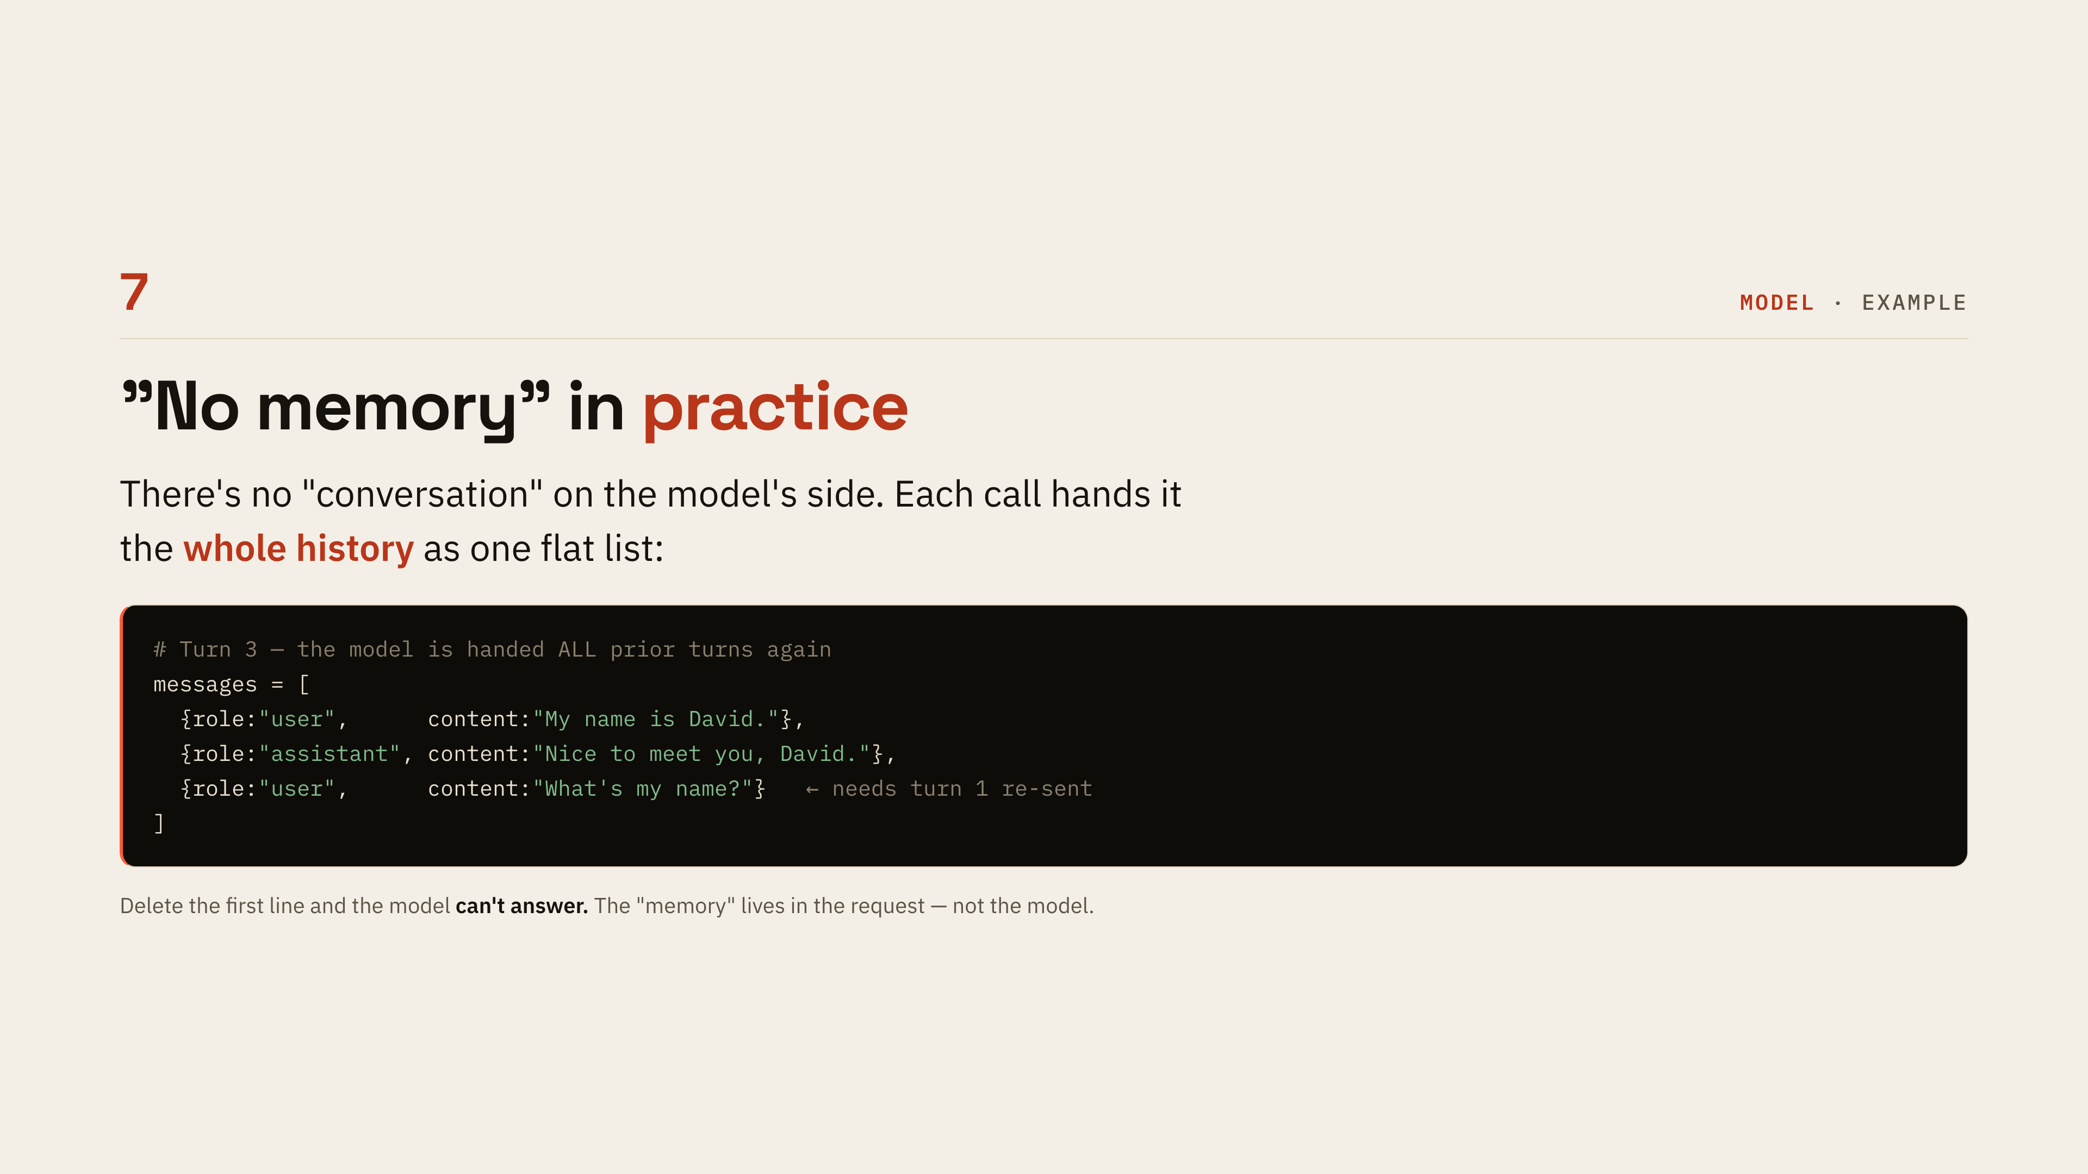
Notes:
[No memory in practice]
Make the abstract concrete: there is no conversation on the model's side, just a flat list handed over again each turn. Point at the arrow on the last line and say that turn 1 is only there because it was re-sent. Then the punchline — delete the first line and it genuinely cannot answer, so the memory lives in the request, not in the model.

Slide 9
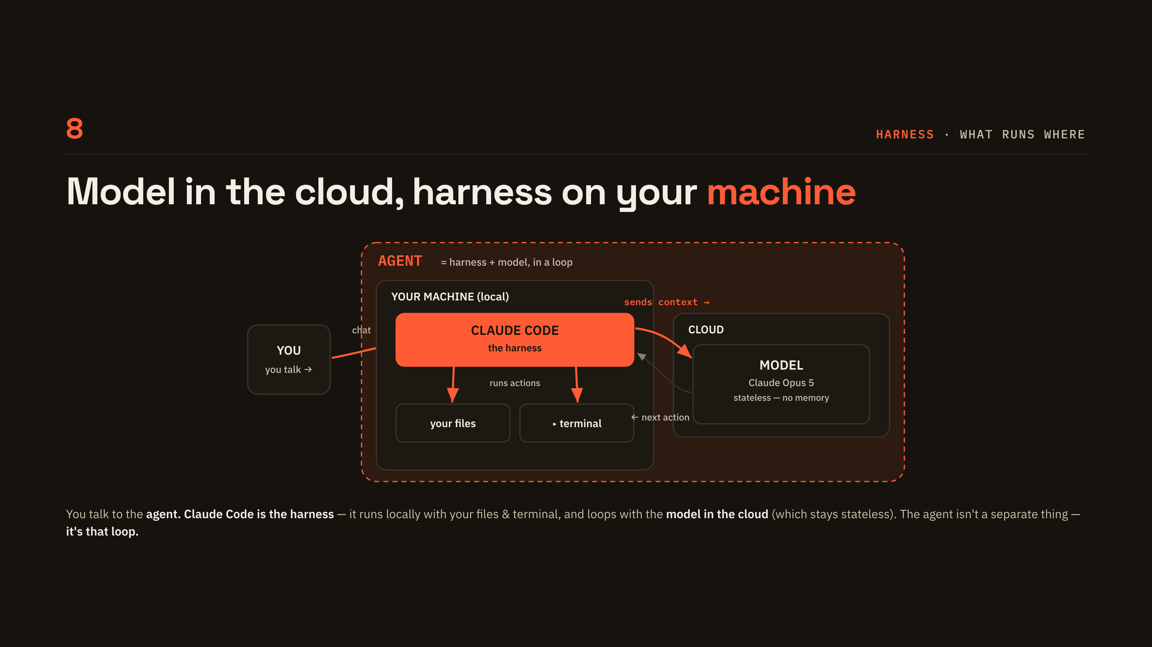
Notes:
[Model in the cloud]
Answer the question everyone has: where does this actually run? Claude Code sits on your machine with your files and terminal; the model is a service in the cloud that stays stateless. Trace the loop arrows once and land the closing line — the agent is not a separate thing, it is that loop.

Slide 10
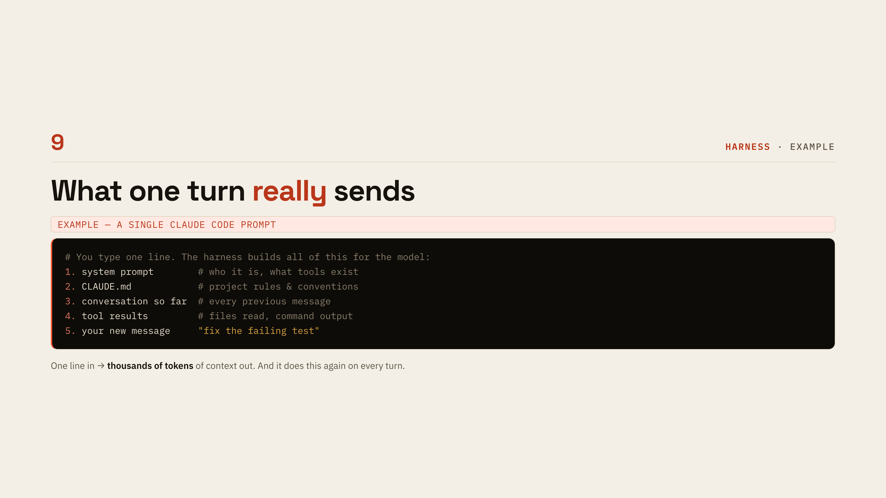
Notes:
[What one turn sends]
Read the five numbered items top to bottom — this is everything the harness quietly assembles around the one line you typed. Stress item 3 and 4: the whole conversation and every file it has read go along for the ride. Close with the scale, one line in, thousands of tokens out, and it happens again on every turn.

Slide 11
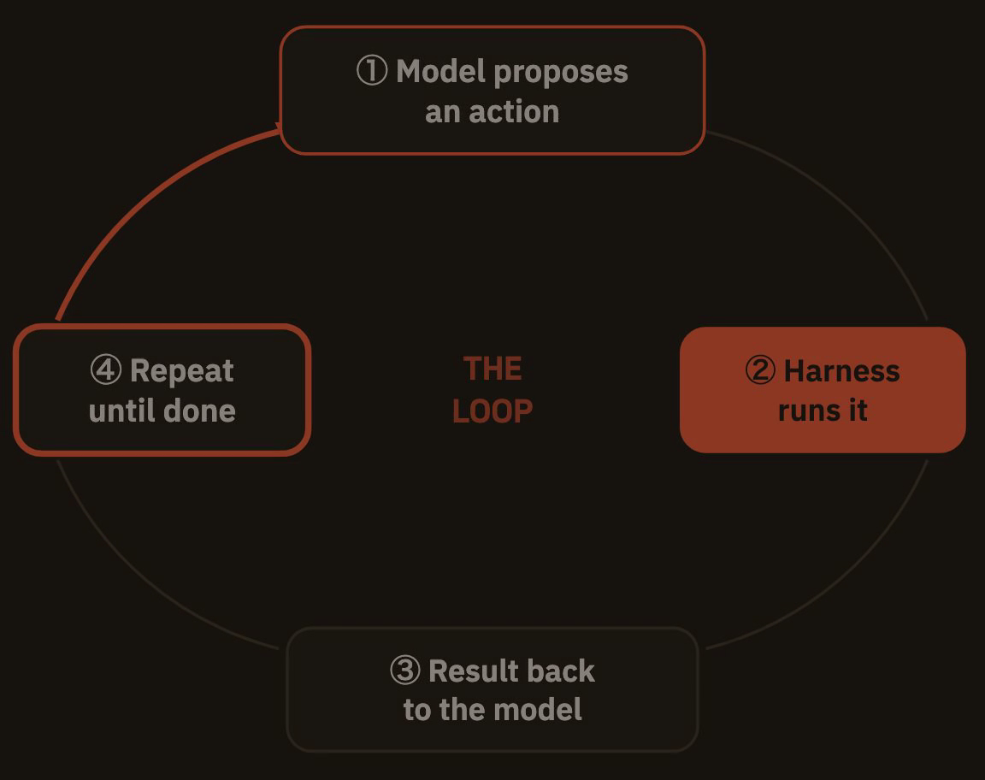
Notes:
[The agent loop]
This is the centrepiece of the whole talk — model proposes, harness acts, result comes back, repeat until done. The cook analogy lands well: read the recipe, do a step, taste, adjust. This is the first LIVE checkpoint, so switch to the terminal and point at the scrolling tool calls as the same loop, for real.

Slide 12
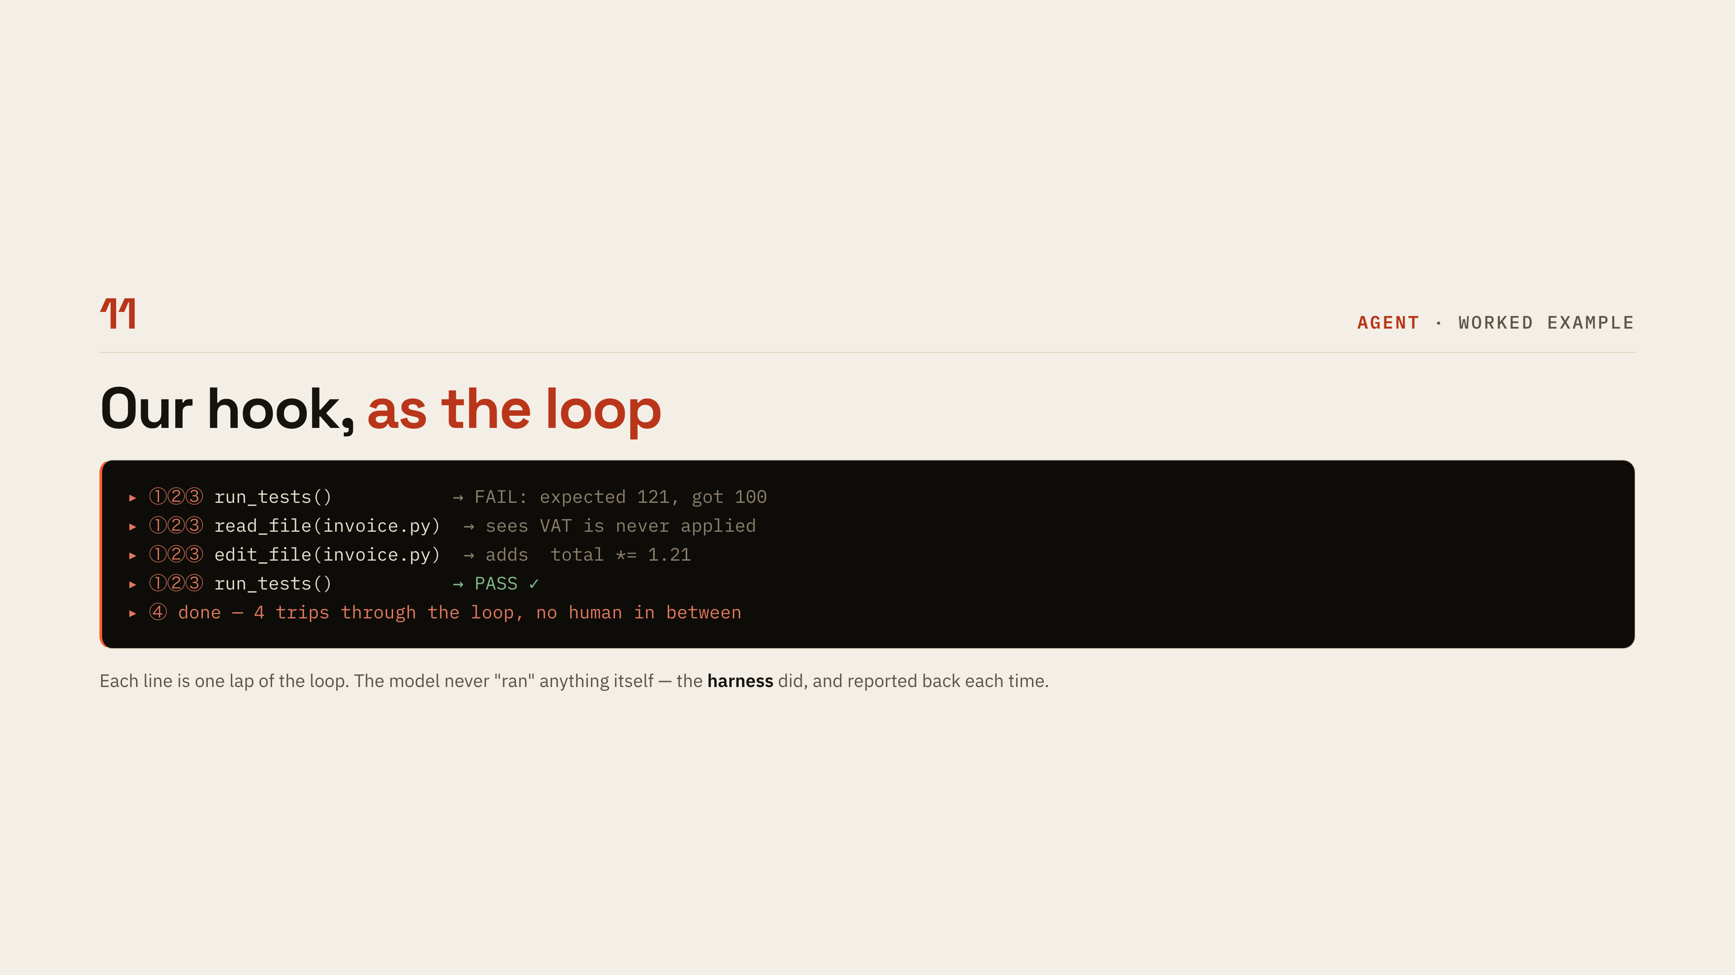
Notes:
[The loop, worked example]
Tie the hook back to the loop: each of these four lines is one lap. Read them across — the action on the left, what came back on the right. The correction worth making explicitly is that the model never ran anything itself; the harness did, and reported back each time.

Slide 13
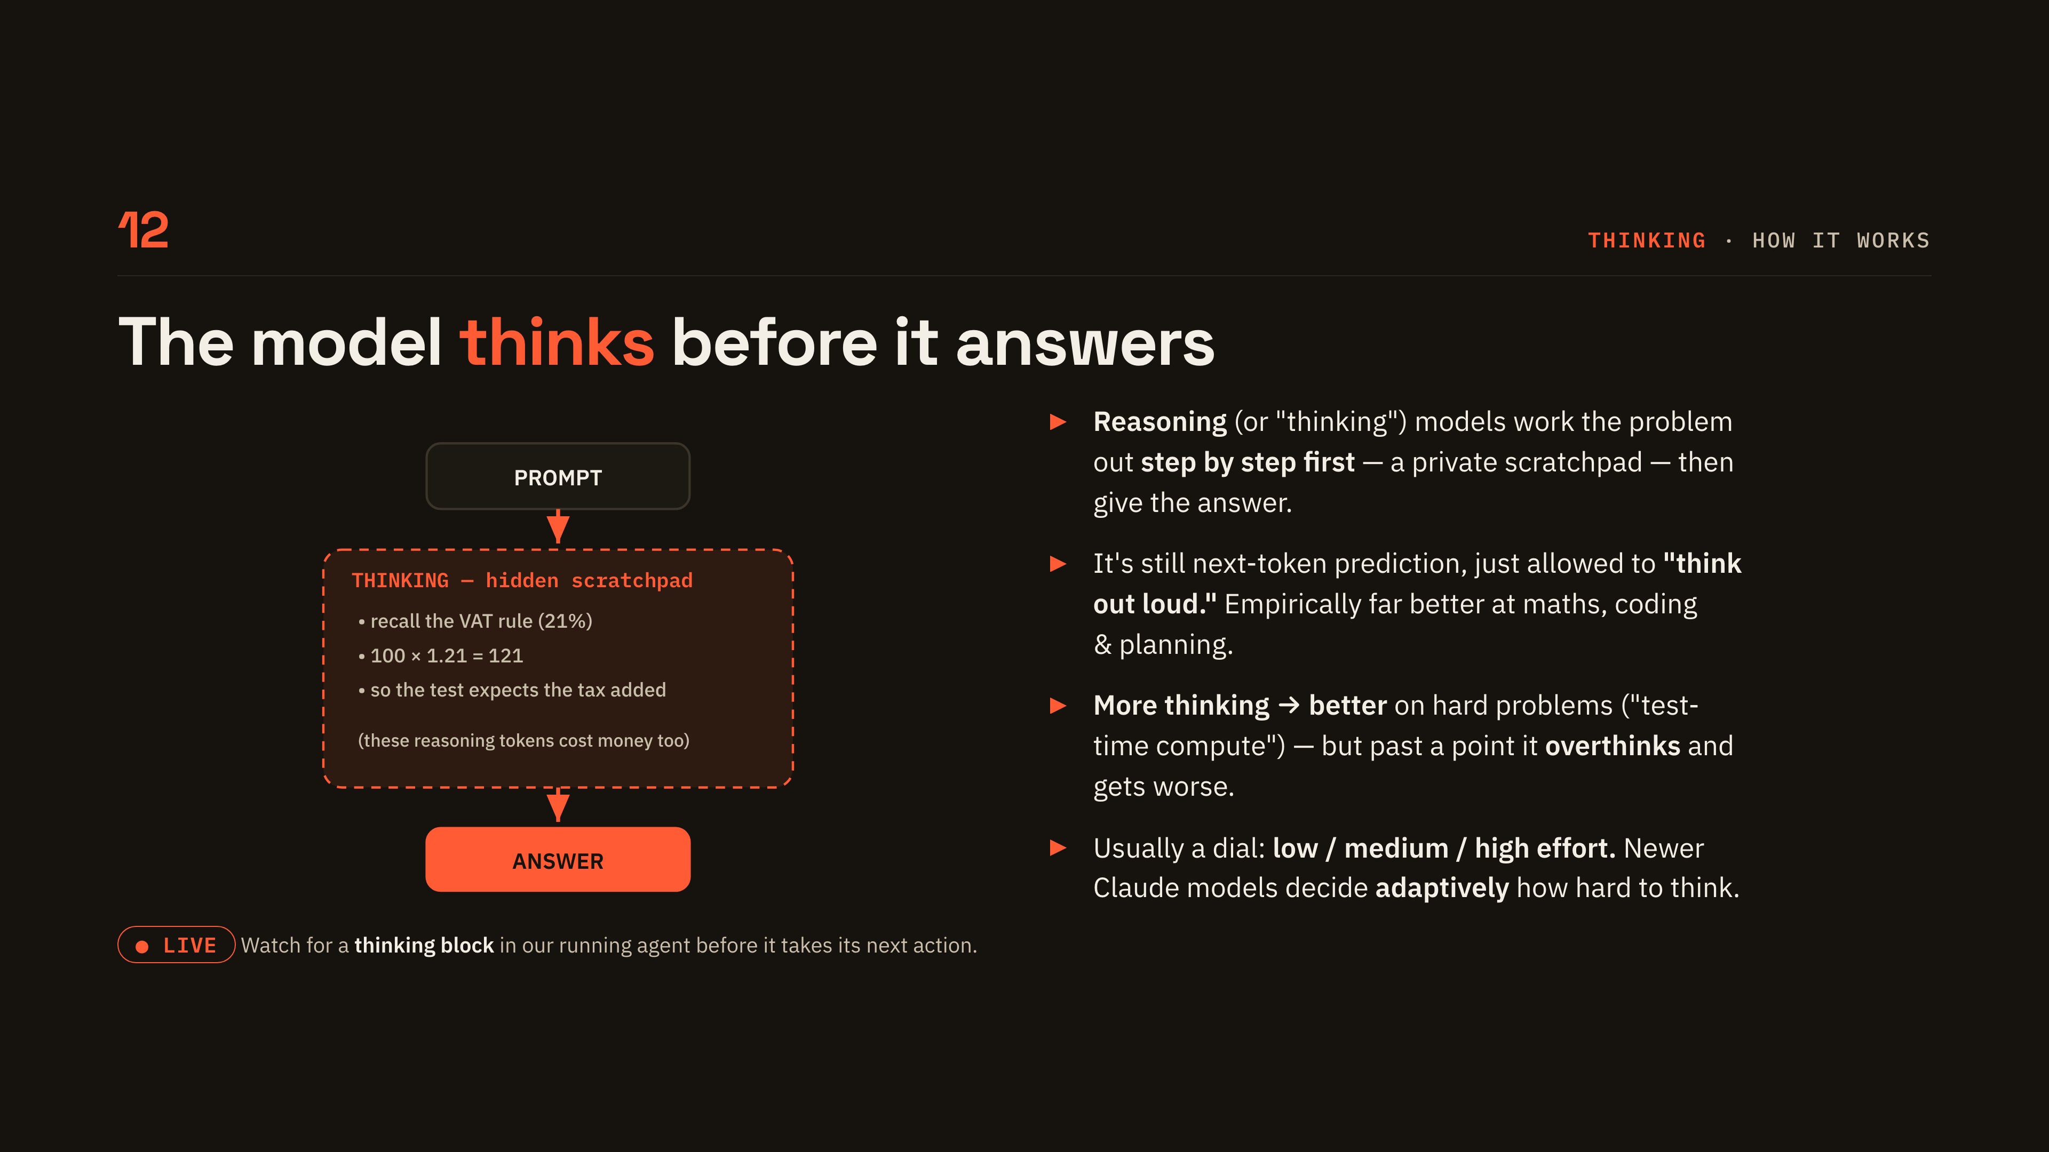
Notes:
[Thinking]
Explain thinking as a private scratchpad the model writes before answering — still next-token prediction, just allowed to think out loud. Read the three scratchpad lines in the diagram; the VAT arithmetic makes it concrete. Mention the dial (low, medium, high) and note that more thinking helps on hard problems but can tip into overthinking. This is the second LIVE checkpoint, so look for a thinking block in the running agent.

Slide 14
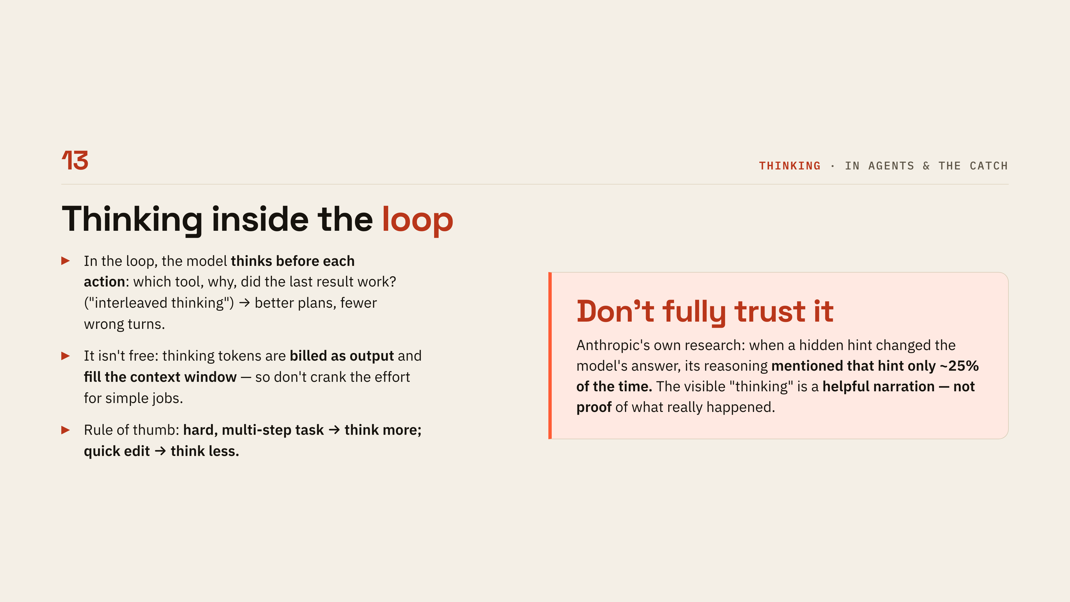
Notes:
[Thinking in the loop]
Inside the loop the model thinks before each action — which tool, why, did the last result work. Give the practical rule: hard multi-step task, think more; quick edit, think less, because thinking is billed as output and fills the window. Then take the callout seriously — Anthropic's own research found the visible reasoning mentioned a decisive hidden hint only about a quarter of the time, so treat it as helpful narration, not proof.

Slide 15
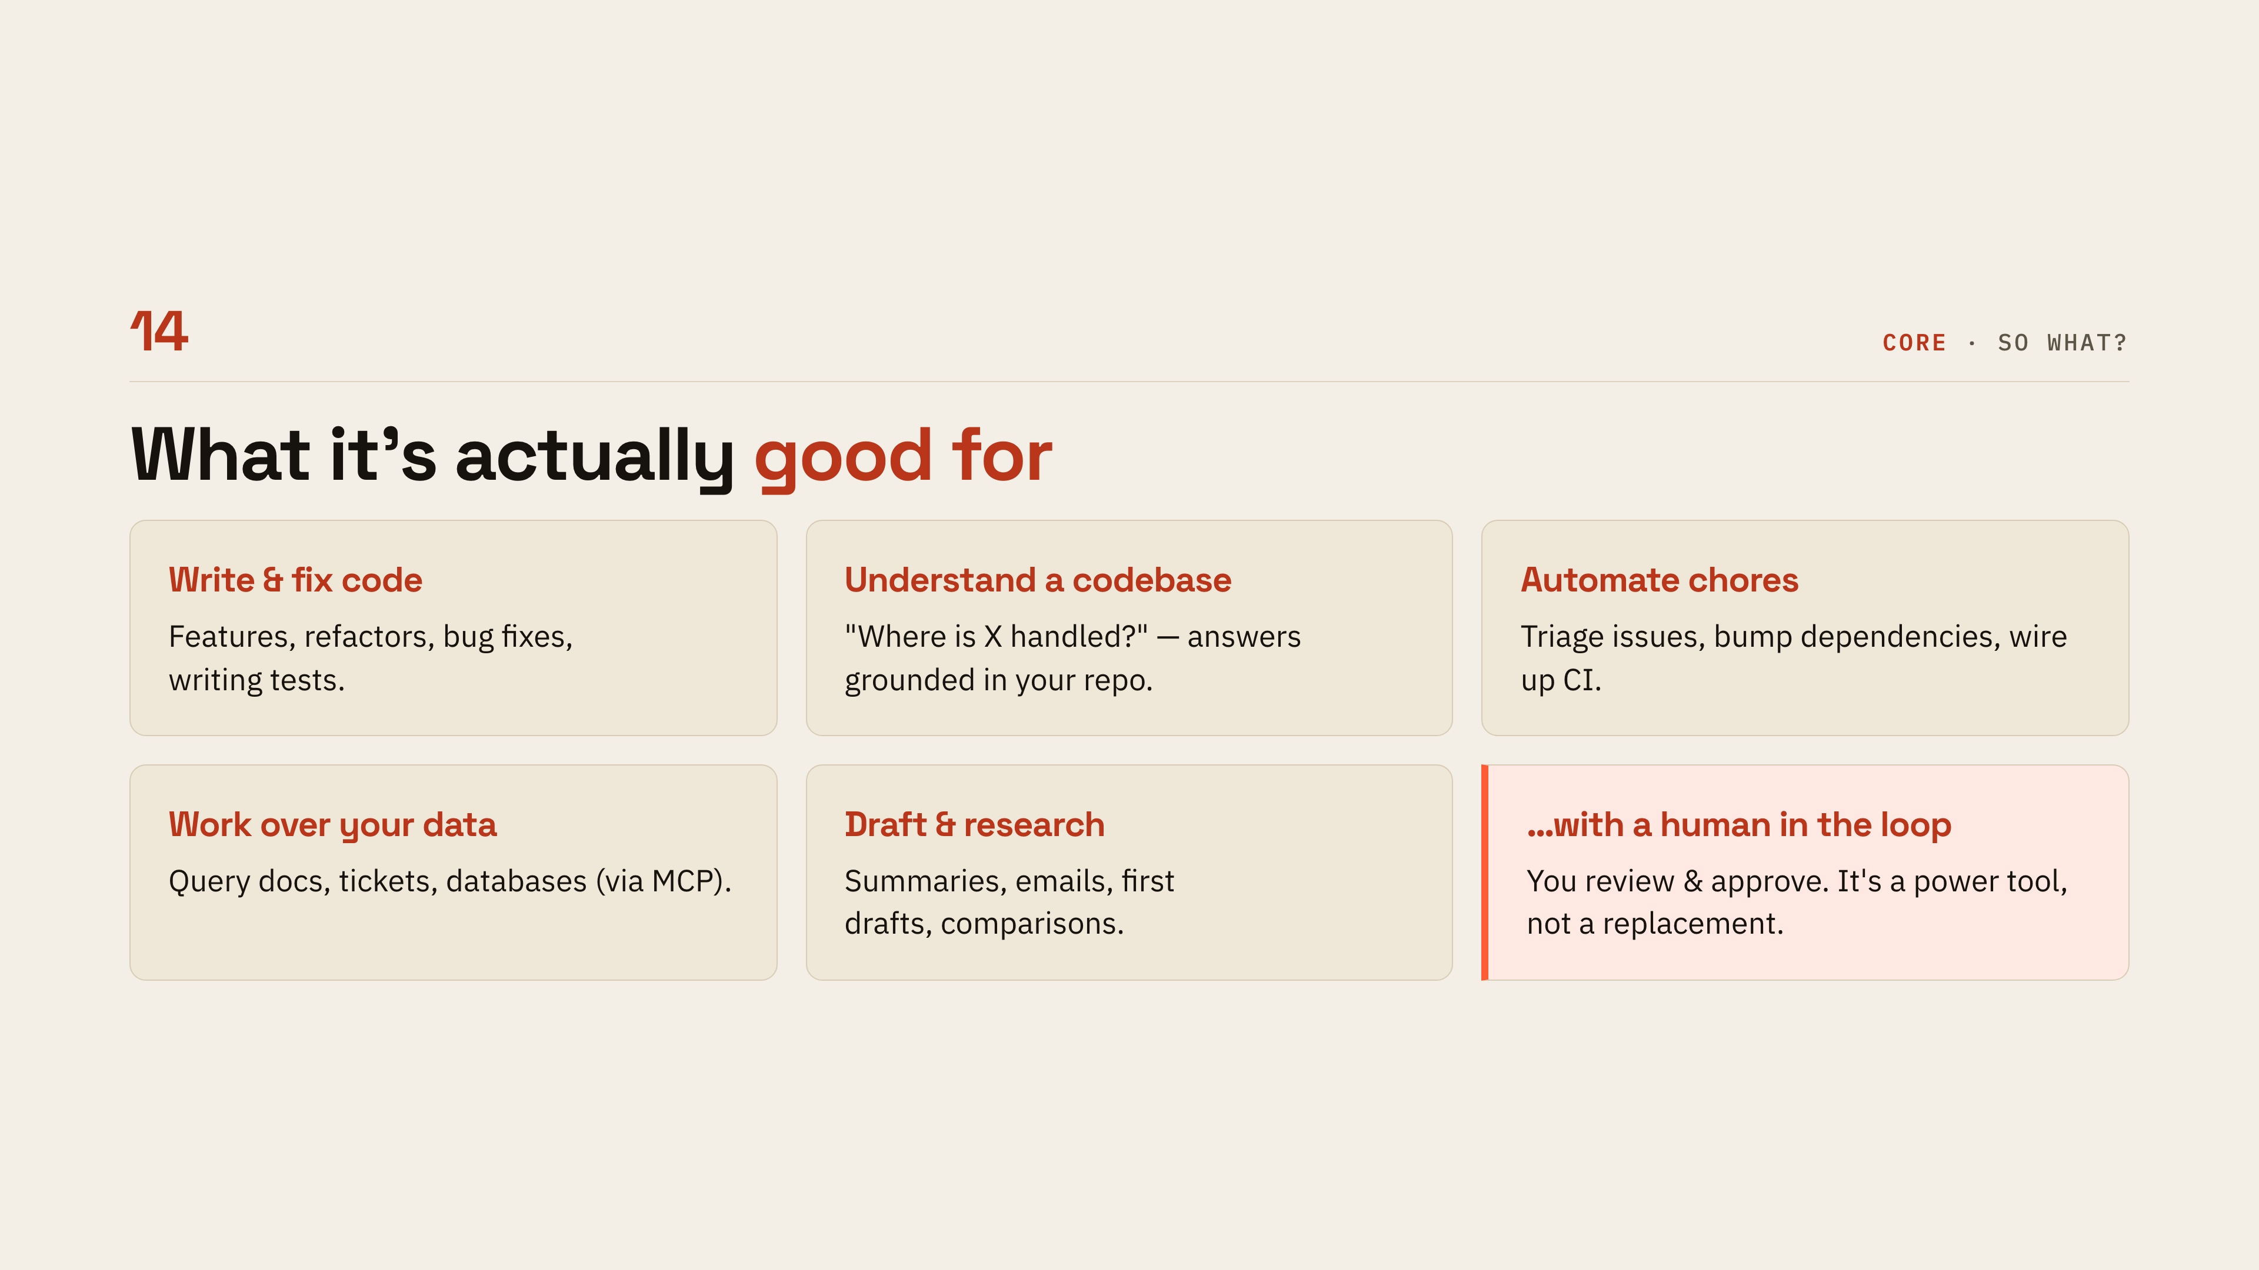
Notes:
[What it is good for]
This is the so-what slide for a mixed audience, so pick the two tiles closest to the room's job and give a concrete example of each. Note that Work over your data is the one that surprises non-developers most. End on the last tile: a human still reviews and approves, it is a power tool, not a replacement.

Slide 16

Notes:
[The landscape]
Signpost the detour: a few slides on who makes what and what it costs, then straight back to mechanics. Say it is a snapshot that will be stale within months, so nobody writes the model names down as gospel. Two sentences and move on.

Slide 17
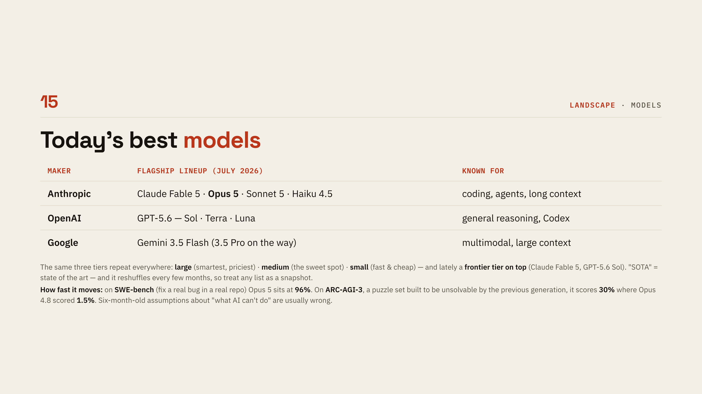
Notes:
[Today's models]
Do not read the table row by row — the pattern below it is the actual content. The same three tiers repeat at every maker: large, medium, small, plus a frontier tier on top lately. Say clearly that this reshuffles every few months, so treat any such list as a snapshot rather than a recommendation.

Slide 18
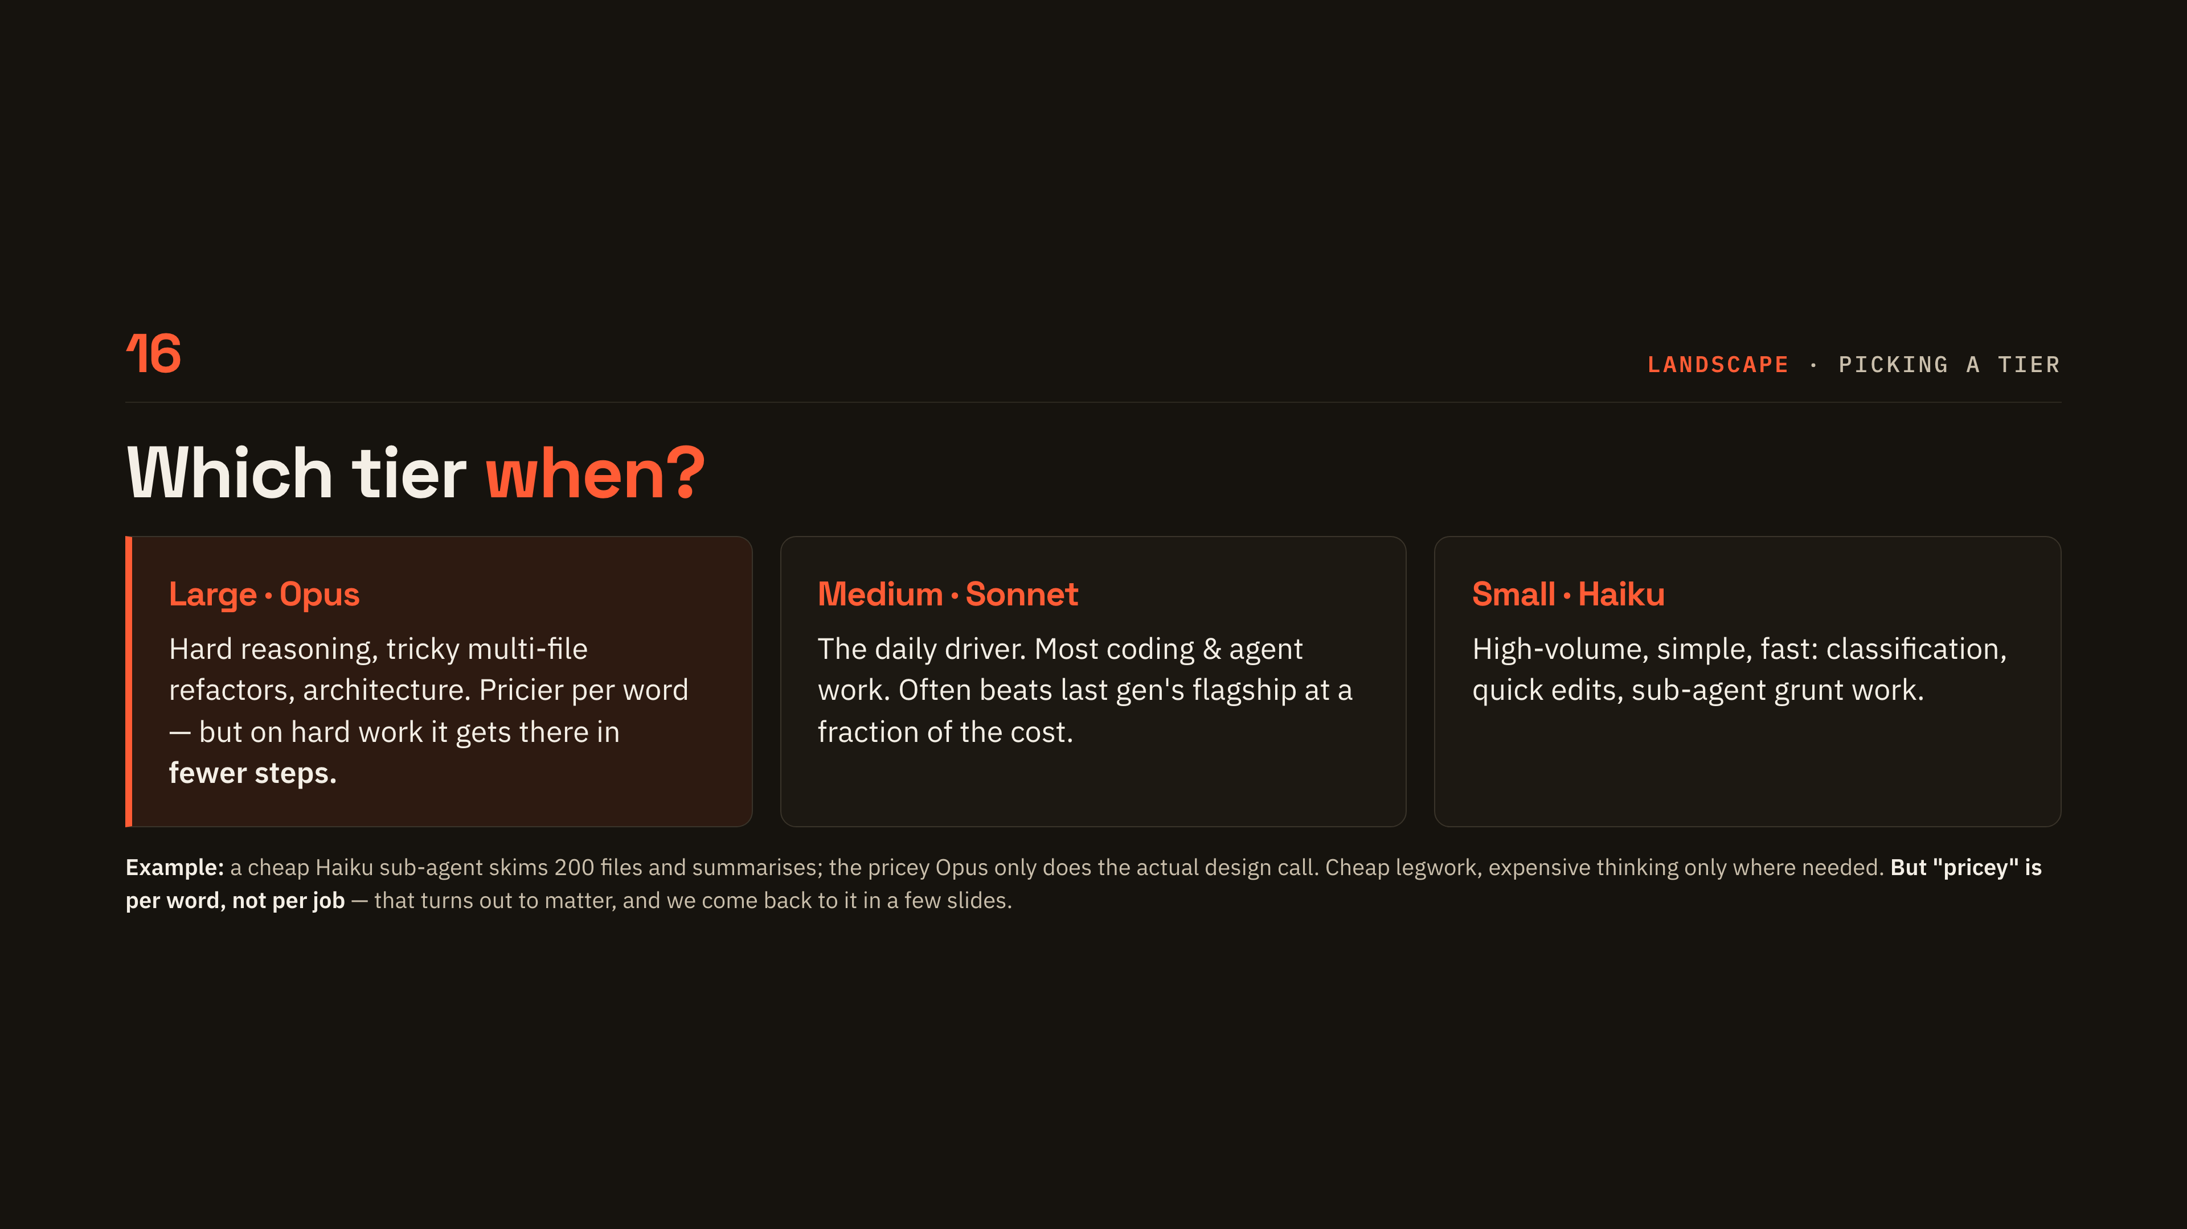
Notes:
[Which tier when]
Give them the practical version: medium is the daily driver, large is for when it really matters, small is for volume. The example at the bottom is the one to dwell on — cheap legwork by a small model, expensive thinking only where it counts. Mention that today's medium often beats last year's flagship, which is why defaults keep shifting.

Slide 19
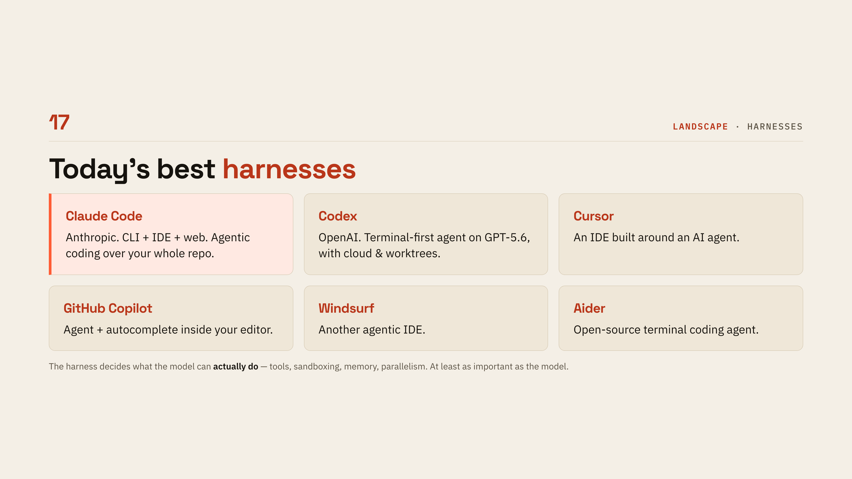
Notes:
[Today's harnesses]
Name the two most people will meet — Claude Code and Codex — and treat the rest as a list, not a review. The line that matters is underneath: the harness decides what the model can actually do, so it is at least as important as the model. If someone asks which to pick, say most models run in most harnesses and the choice is mostly about how you like to work.

Slide 20
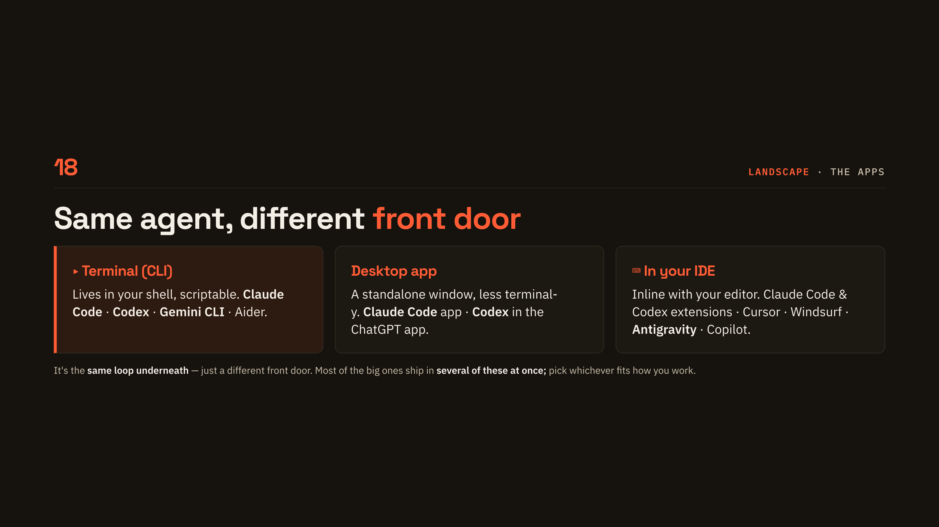
Notes:
[Front doors]
Head off the confusion between products and front doors: terminal, desktop app and IDE are three ways into the same loop. Say that the big ones ship in several of these at once, so choosing is about habit, not capability. If the room is non-developer, point at the desktop app as the least intimidating entry point.

Slide 21
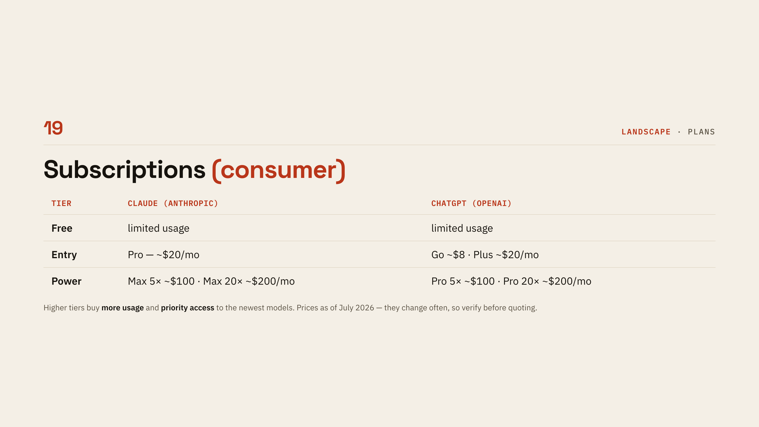
Notes:
[Subscriptions]
Keep this brisk: free, roughly twenty a month for entry, roughly a hundred or two hundred for heavy use. What the higher tiers buy is more usage and earlier access to the newest models, not a different product. Flag the date, prices move, so verify before quoting any of this outside the room.

Slide 22
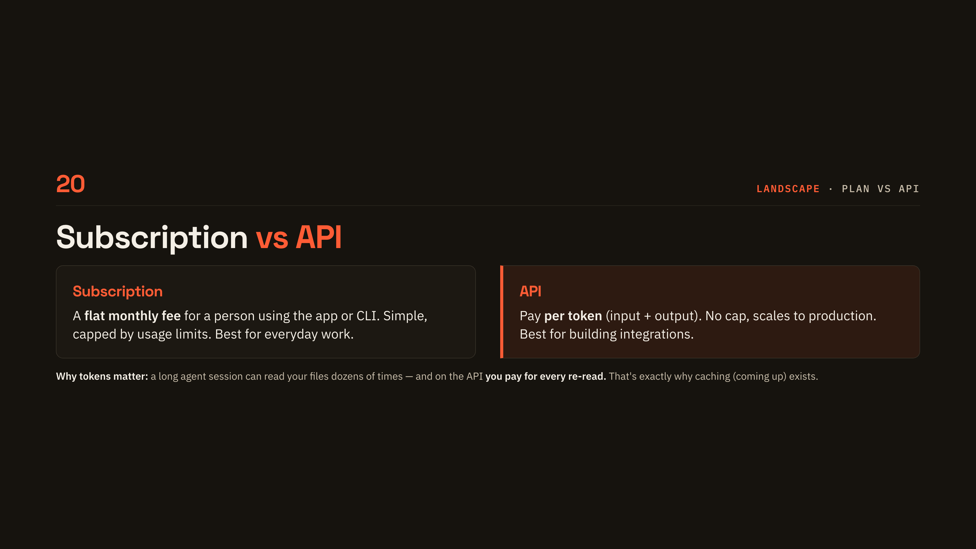
Notes:
[Subscription vs API]
Two different billing worlds: a flat fee for a person using the app, versus per-token pricing for software you build. Use the note to make tokens tangible — a long session re-reads your files dozens of times, and on the API you pay for every re-read. That is the setup for caching, which comes a few slides later.

Slide 23
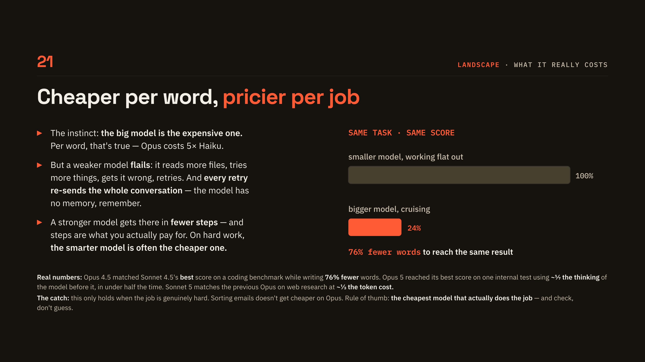
Notes:
[Smarter can be cheaper]
This is the counter-intuitive slide of the money section, so slow down. Everyone walks in assuming the big model is the expensive one, and per word that is exactly right. Per job it is often backwards. Read the three bullets in order, and land the middle one hard: a weaker model flails, and every retry re-sends the entire conversation, which is the no-memory point from earlier coming back to bite. Then the chart, same benchmark score, seventy-six percent fewer words. Give one more number if the room is engaged, Opus 5 reaching its best score on about a seventh of the thinking of the model before it. Finish on the caveat so nobody leaves thinking the answer is always the biggest model, because for simple jobs it genuinely is not.

Slide 24
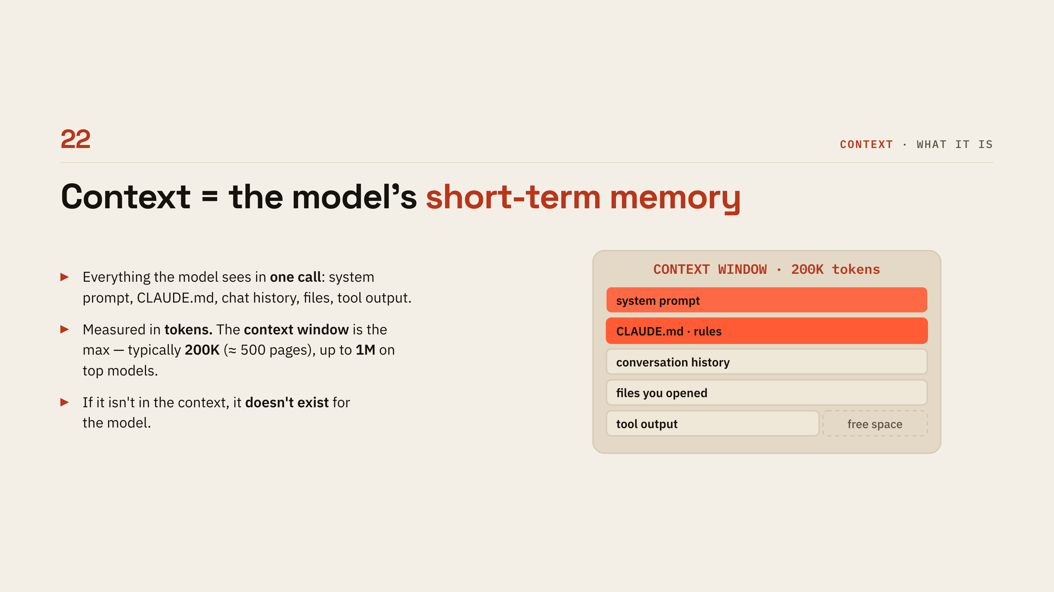
Notes:
[What context is]
Define context plainly as everything the model sees in one call, and point at the stacked bars as that one call's payload. Give them the scale: two hundred thousand tokens is roughly five hundred pages, up to a million on top models. The sentence to repeat is that if it is not in the context, it does not exist for the model.

Slide 25
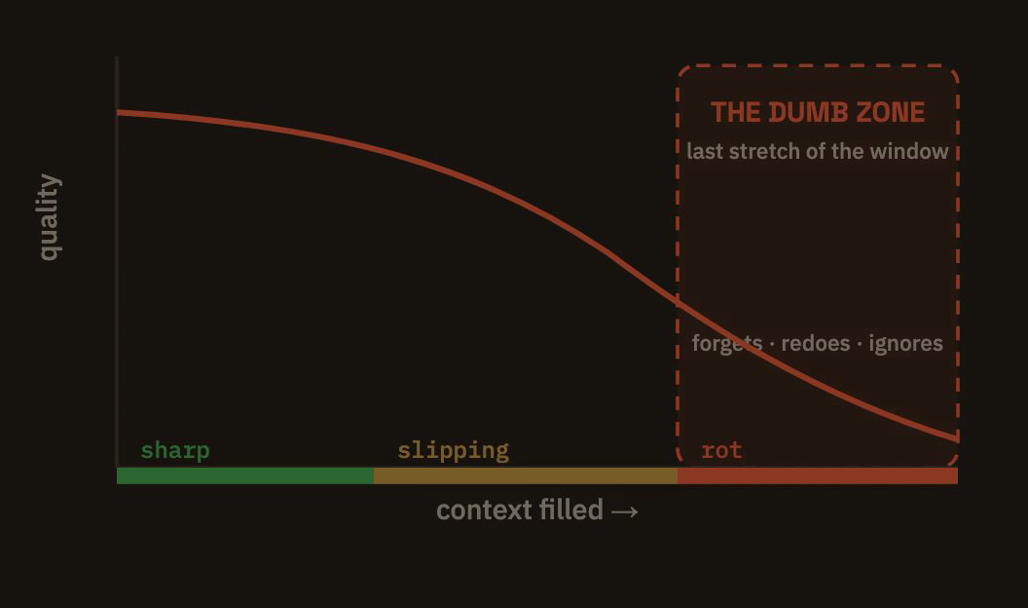
Notes:
[Context rot]
The counter-intuitive bit: a fuller window makes the model worse, not better. Cite the two studies briefly — Chroma found all eighteen frontier models degraded as input grew, Stanford found facts buried in the middle get missed. Be honest that the forty percent threshold is folklore; the lesson that survives is to keep the window well under full, because curation beats capacity.

Slide 26
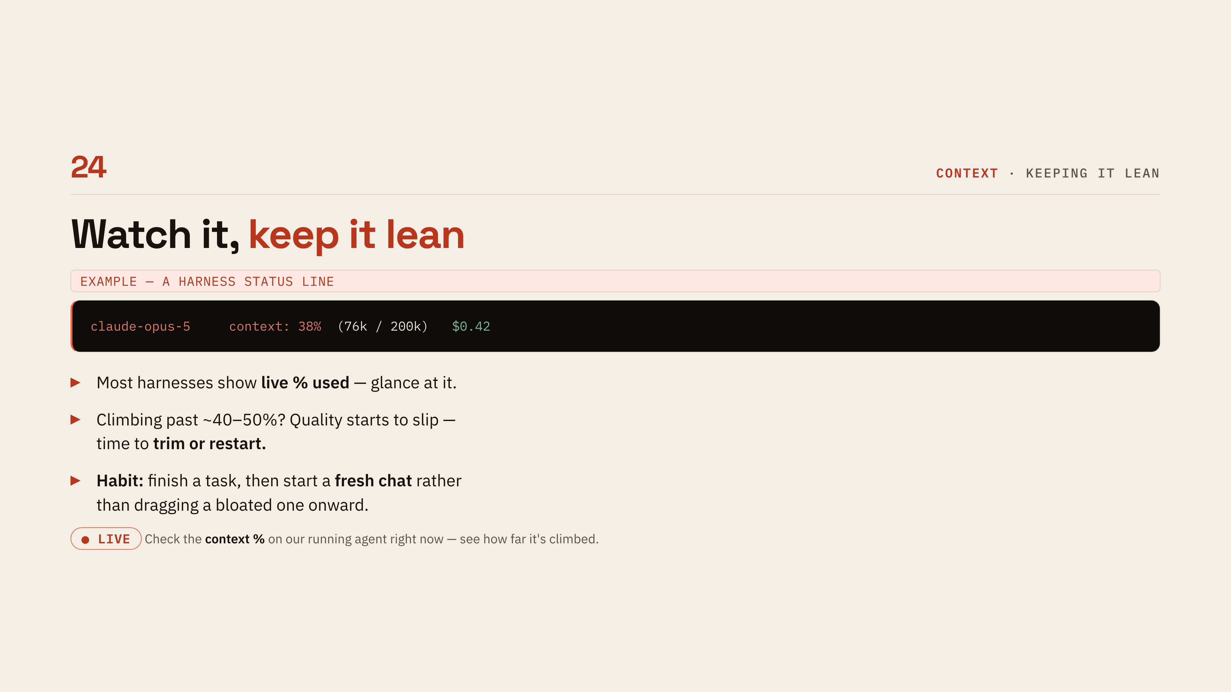
Notes:
[Keep it lean]
This is the most immediately useful slide for beginners, so give them the habit: glance at the context percentage the harness shows you. Past roughly forty or fifty percent, quality starts slipping, so trim or start fresh. This is the third LIVE checkpoint — show the real percentage on the running agent and note how far it has climbed.

Slide 27
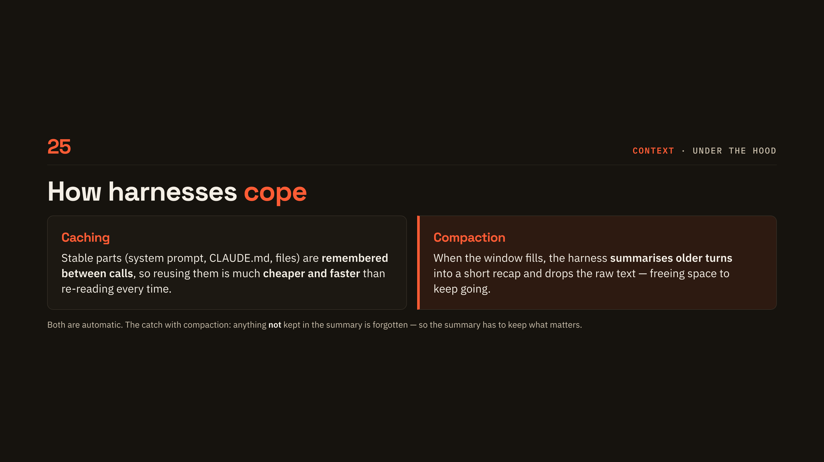
Notes:
[Caching and compaction]
Two things the harness does for you automatically. Caching remembers the stable parts between calls so re-using them is cheaper and faster; compaction summarises older turns when the window fills. Land the catch — whatever the summary leaves out is simply gone, which is why the summary has to keep what matters.

Slide 28
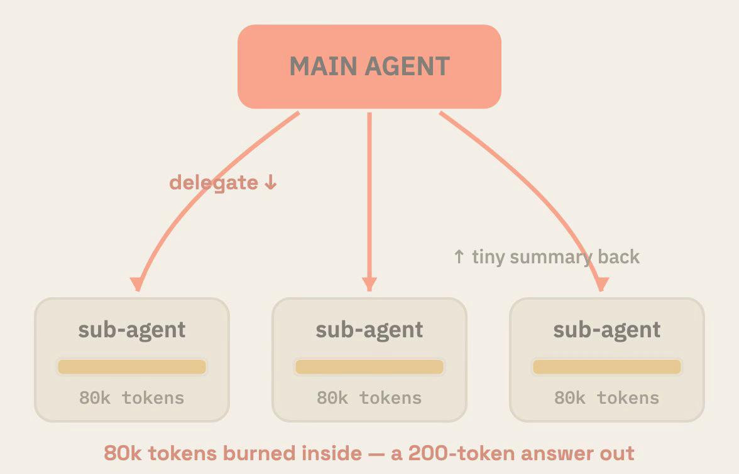
Notes:
[Sub-agents]
A sub-agent is just another agent with its own fresh context, sent off to do one messy job and report back a conclusion. The numbers make it click: eighty thousand tokens burned inside the sub-agent, two hundred tokens land in the main chat. Mention they can run in parallel, which is why big tasks finish faster than you would expect.

Slide 29
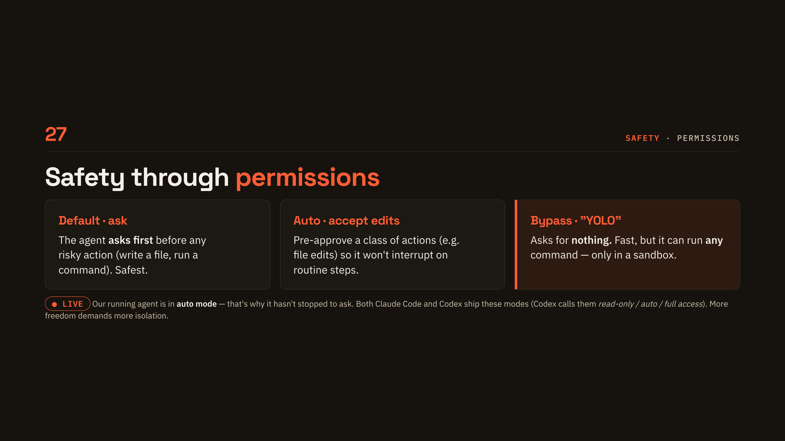
Notes:
[Permissions]
Three modes, increasing freedom: ask before anything risky, pre-approve a class of actions, or ask for nothing at all. This is the fourth LIVE checkpoint — say which mode the running agent is in and why it has not interrupted us. Note that Codex has the same three under different names, and close on the rule that more freedom demands more isolation.

Slide 30
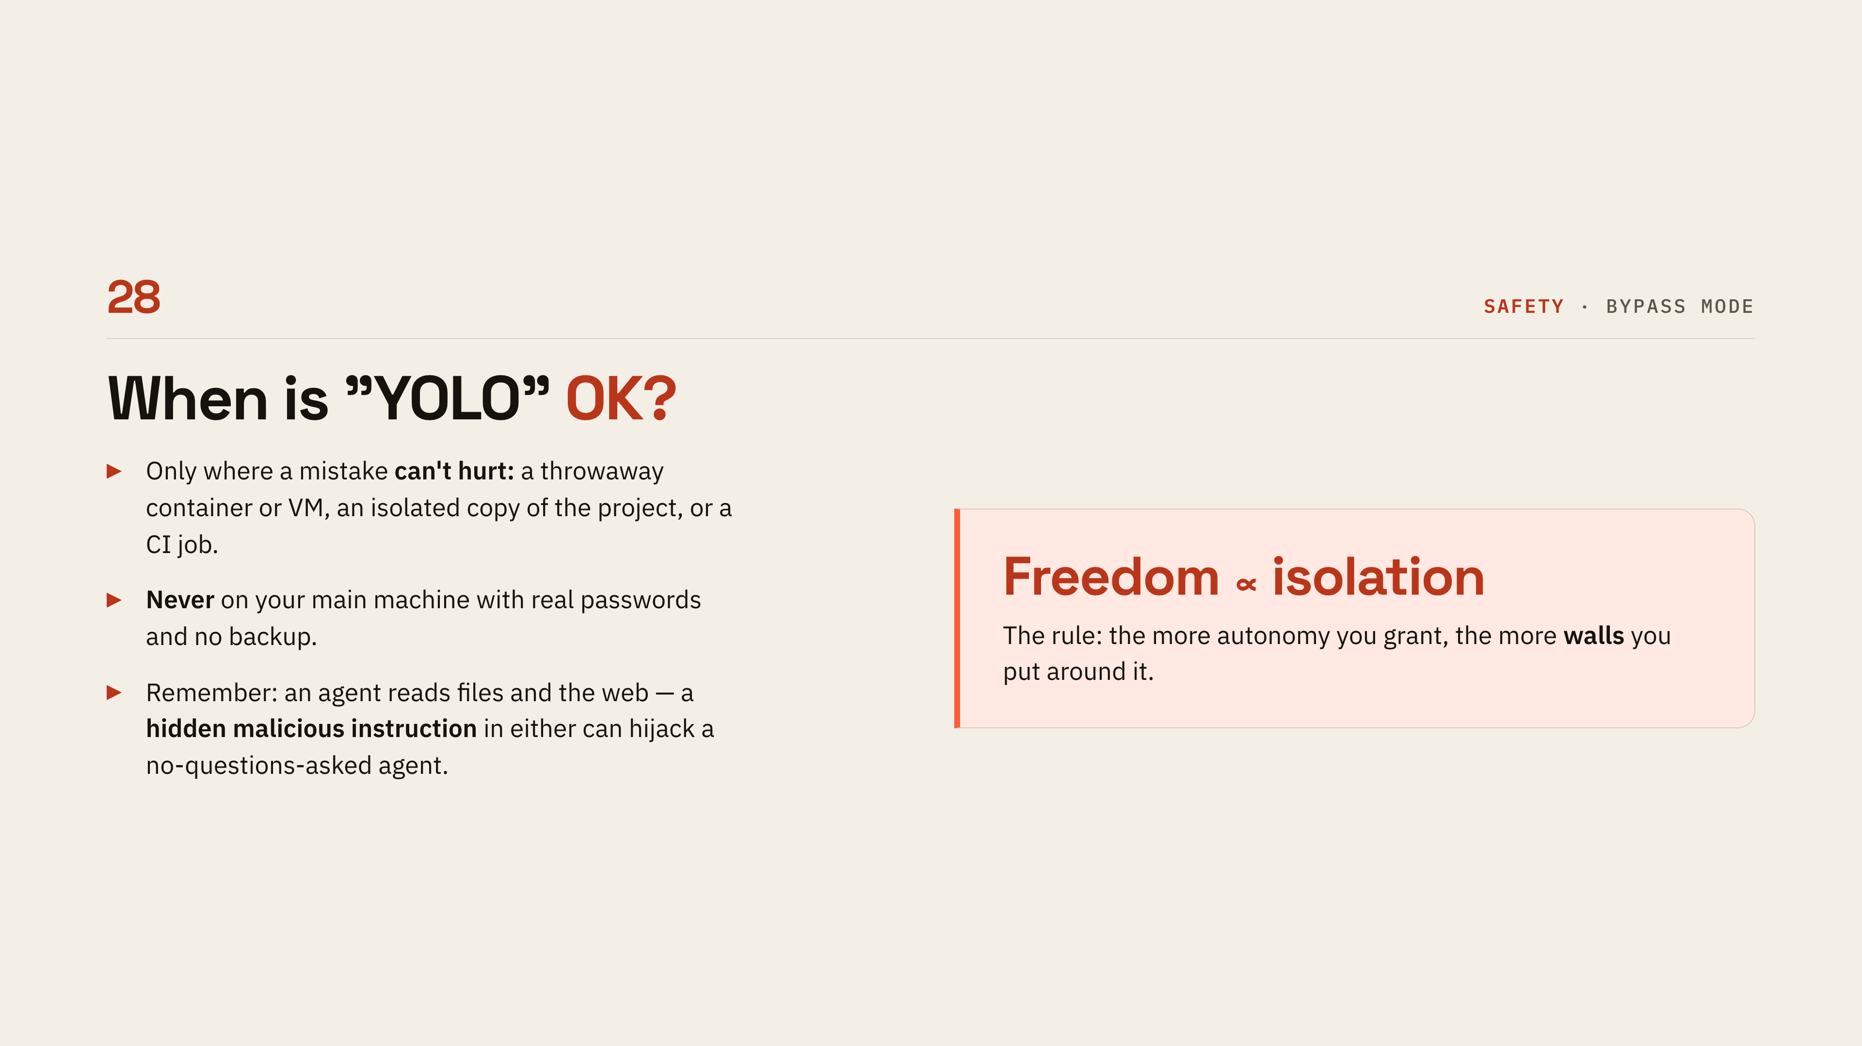
Notes:
[Bypass mode]
Be concrete about when no-questions-asked mode is fine: a throwaway container, an isolated copy, a CI job. Be equally concrete about when it is not — your main machine, with real credentials and no backup. The prompt-injection point is worth spelling out for beginners: the agent reads files and web pages, and a hidden instruction in either can steer it.

Slide 31
Notes:
[Back to no memory]
Call back to Memento deliberately — this is the setup for the last section. Pose the question the way they would: how do we give it knowledge that survives across sessions without stuffing the window full and rotting it. Then name the four answers coming up, so the next three slides feel like a list being completed.

Slide 32
Notes:
[CLAUDE.md and memory]
Read two lines of the example file — package manager and never edit generated — and say this is just a plain text file in the repo root. It gets read at the start of every session, so it is where standing rules and conventions belong. Add that memory files are the same idea but written by the agent itself, and some harnesses do it automatically.

Slide 33
Notes:
[Skills and plugins]
A skill is just a folder with instructions in it, and the key property is that it loads only when a task matches. That is why you can keep dozens around for almost no context cost — it is the answer to the rot problem from two slides back. Use the make-slides example: dormant until you ask for a deck, then the full playbook loads. Plugins are how a team shares all of that.

Slide 34
Notes:
[Touching other systems]
Three ways an agent reaches beyond your files: call an API, run a command-line tool like a human would, or connect through MCP. The reassuring part for beginners is that CLIs and APIs already exist everywhere and the agent simply uses them. MCP is the newer, agent-native option, and it gets the next slide.

Slide 35
Notes:
[MCP]
Point at the left half of the diagram first — every app needing custom glue to every tool — then the right, where each side connects once through a shared standard. Say it is Anthropic's open standard from late 2024 and thousands of MCP servers now exist. The calendar-plus-email example is the one that lands for non-developers: two systems, one agent, no glue code.

Slide 36
Notes:
[Three things to remember]
If they forget everything else, these three should stick. Just talk to it like a colleague — natural language beats over-engineered prompts. Remember Memento, because the agent only knows what is in front of it. And feed it well, keep a CLAUDE.md, and ask it to write a summary when handing work on. Close on the note: most of prompting skill is really managing what the agent can see.

Slide 37
Notes:
[Summary]
Recite the first bullet as the spine of the talk: stateless brain, harness as body and memory, agent as the loop. Then the three practical takeaways — mind the context, permissions are the safety net, and CLAUDE.md, skills and MCP give a forgetful model durable knowledge. Wrap up the live demo here by showing what it finished, then open the floor.

Slide 38
Notes:
[Sources 1 of 2]
Leave this up while questions run rather than reading it. Point out the two most useful starting places for a beginner — the Claude models overview and the pricing page — and say the rest are there for anyone who wants the primary source. Mention the deck lives in the repo, so nobody needs to photograph the links.

Slide 39
Notes:
[Sources 2 of 2]
These are the papers behind the claims made earlier — context rot, lost in the middle, and the reasoning-faithfulness research from the thinking section. Point at them if anyone challenges a number. Repeat the closing caveat: everything here was verified in July 2026 and moves fast, so re-check before quoting.

