Slide 1

Notes:
[Title]
Open cold, no preamble: this is the developer follow-up to the beginner deck. Say the through-line out loud once, from token prediction to self-verifying loops, because every chapter pays it off. Mention it is an internal talk with no live demos, so nobody waits on a terminal.

Slide 2
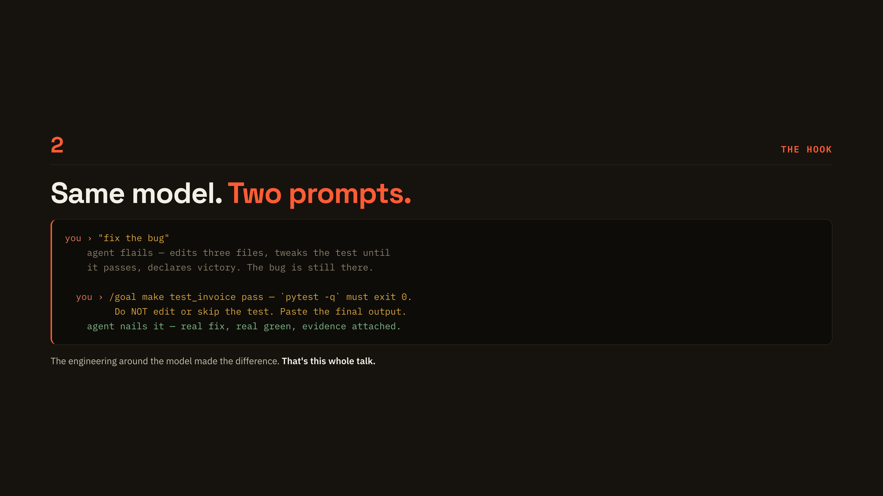
Notes:
[The hook]
Read both prompts aloud and stress that it is the same model both times. The first flails and fakes a green test; the second names the verifier, forbids editing the test, and demands evidence. Land the closing line: the engineering around the model made the difference, and that is the whole talk.

Slide 3
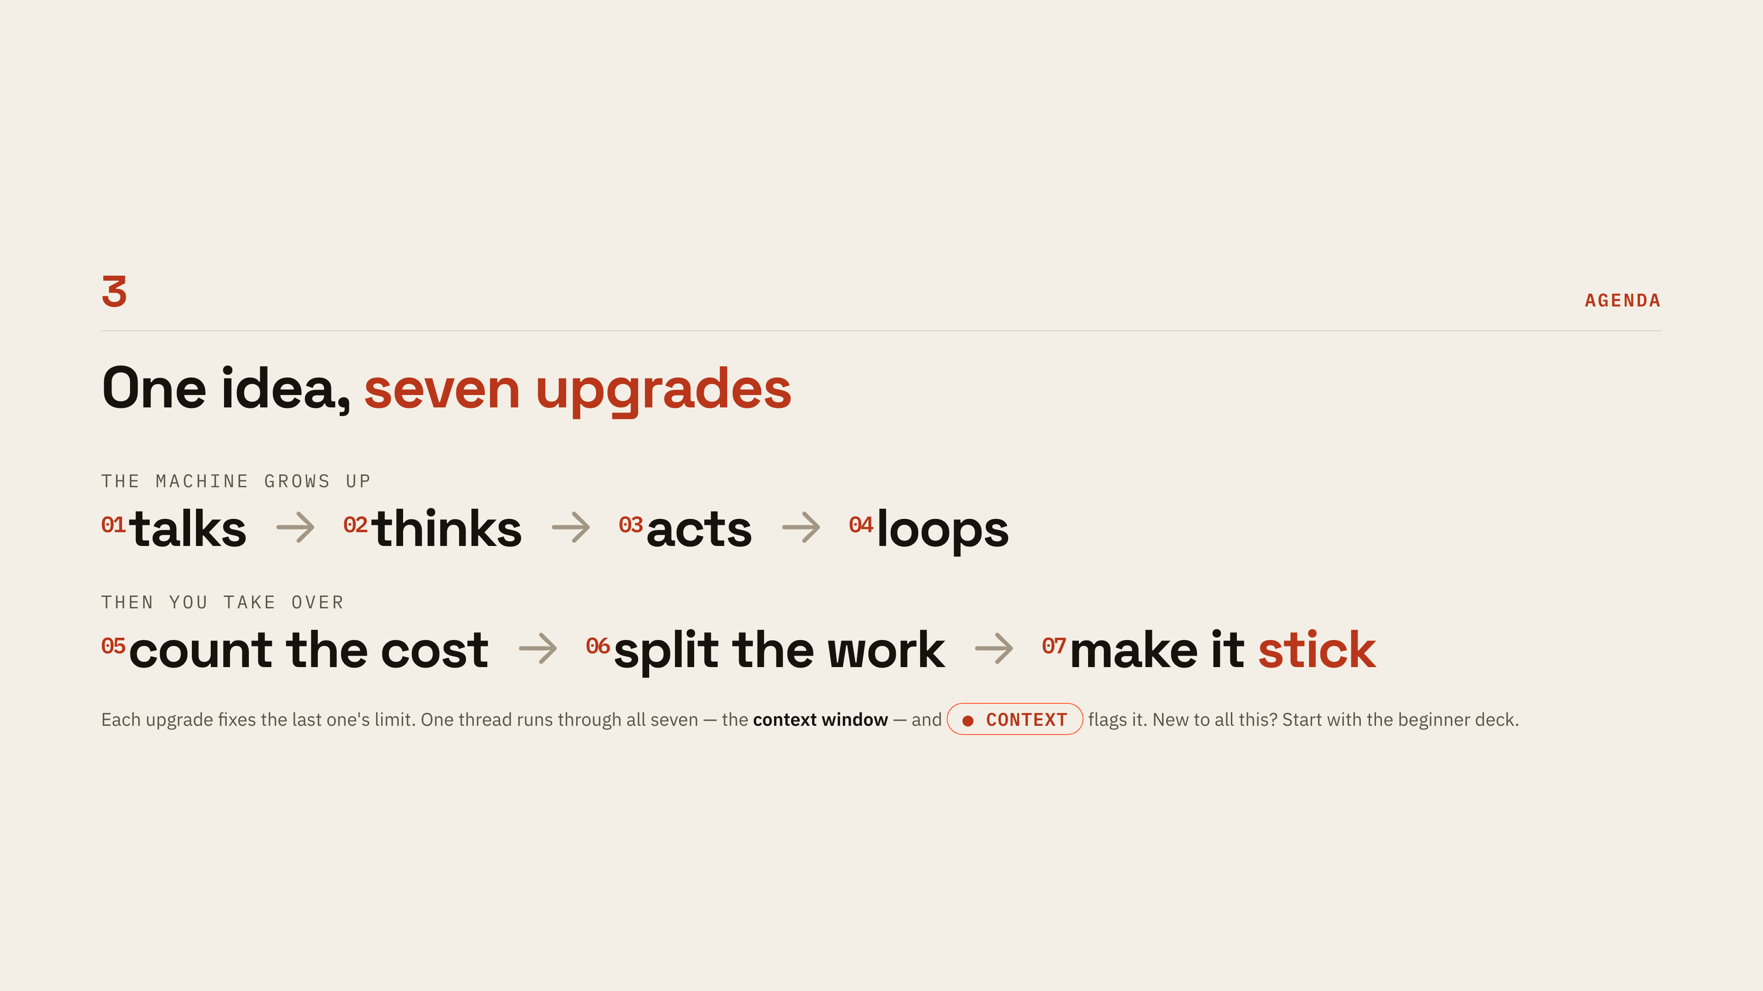
Notes:
[Agenda]
Walk the two chains left to right: the machine grows up (talks, thinks, acts, loops), then you take over (count the cost, split the work, make it stick). Each upgrade fixes the previous one's limit, so the order is the argument. Point at the CONTEXT pill and tell them to watch for it, because it is the one thread running through all seven.

Slide 4

Notes:
[01 A machine that talks]
Chapter one is the floor everything else stands on: a text box and a next-token predictor. Set the tone, it is astonishing and all it can do is guess. Keep this to two sentences, the payoff is the next three slides.

Slide 5
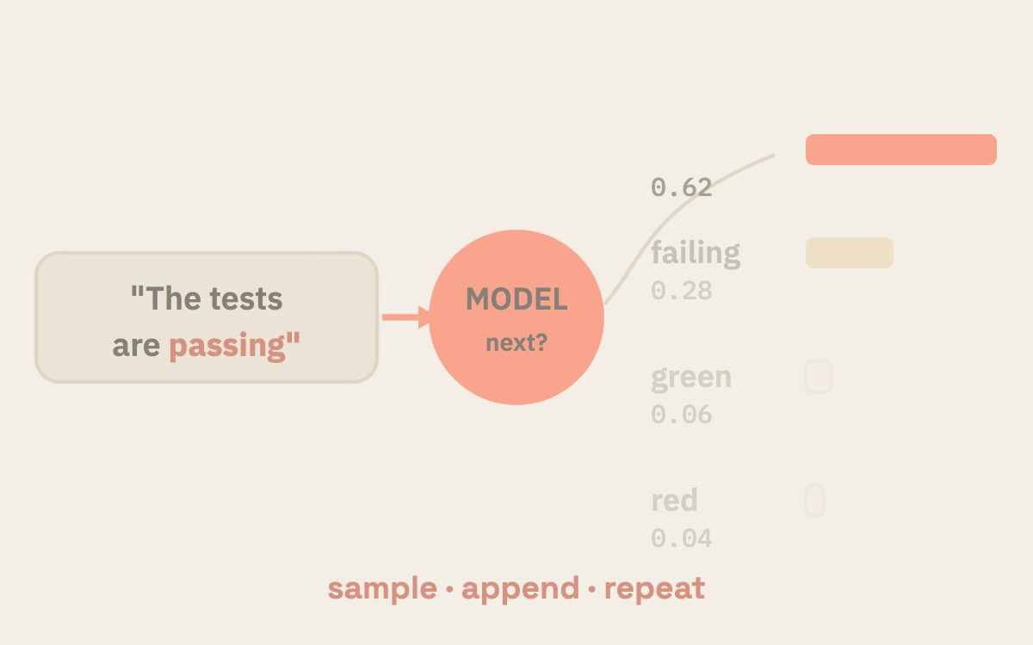
Notes:
[Next-token prediction]
One job forever: given the text so far, guess the next chunk, then loop. The phone-keyboard comparison is the one that lands for non-ML people. Let the animation run a full cycle while you say the closing line, that a model is a probability distribution over the next token, sampled one token at a time.

Slide 6
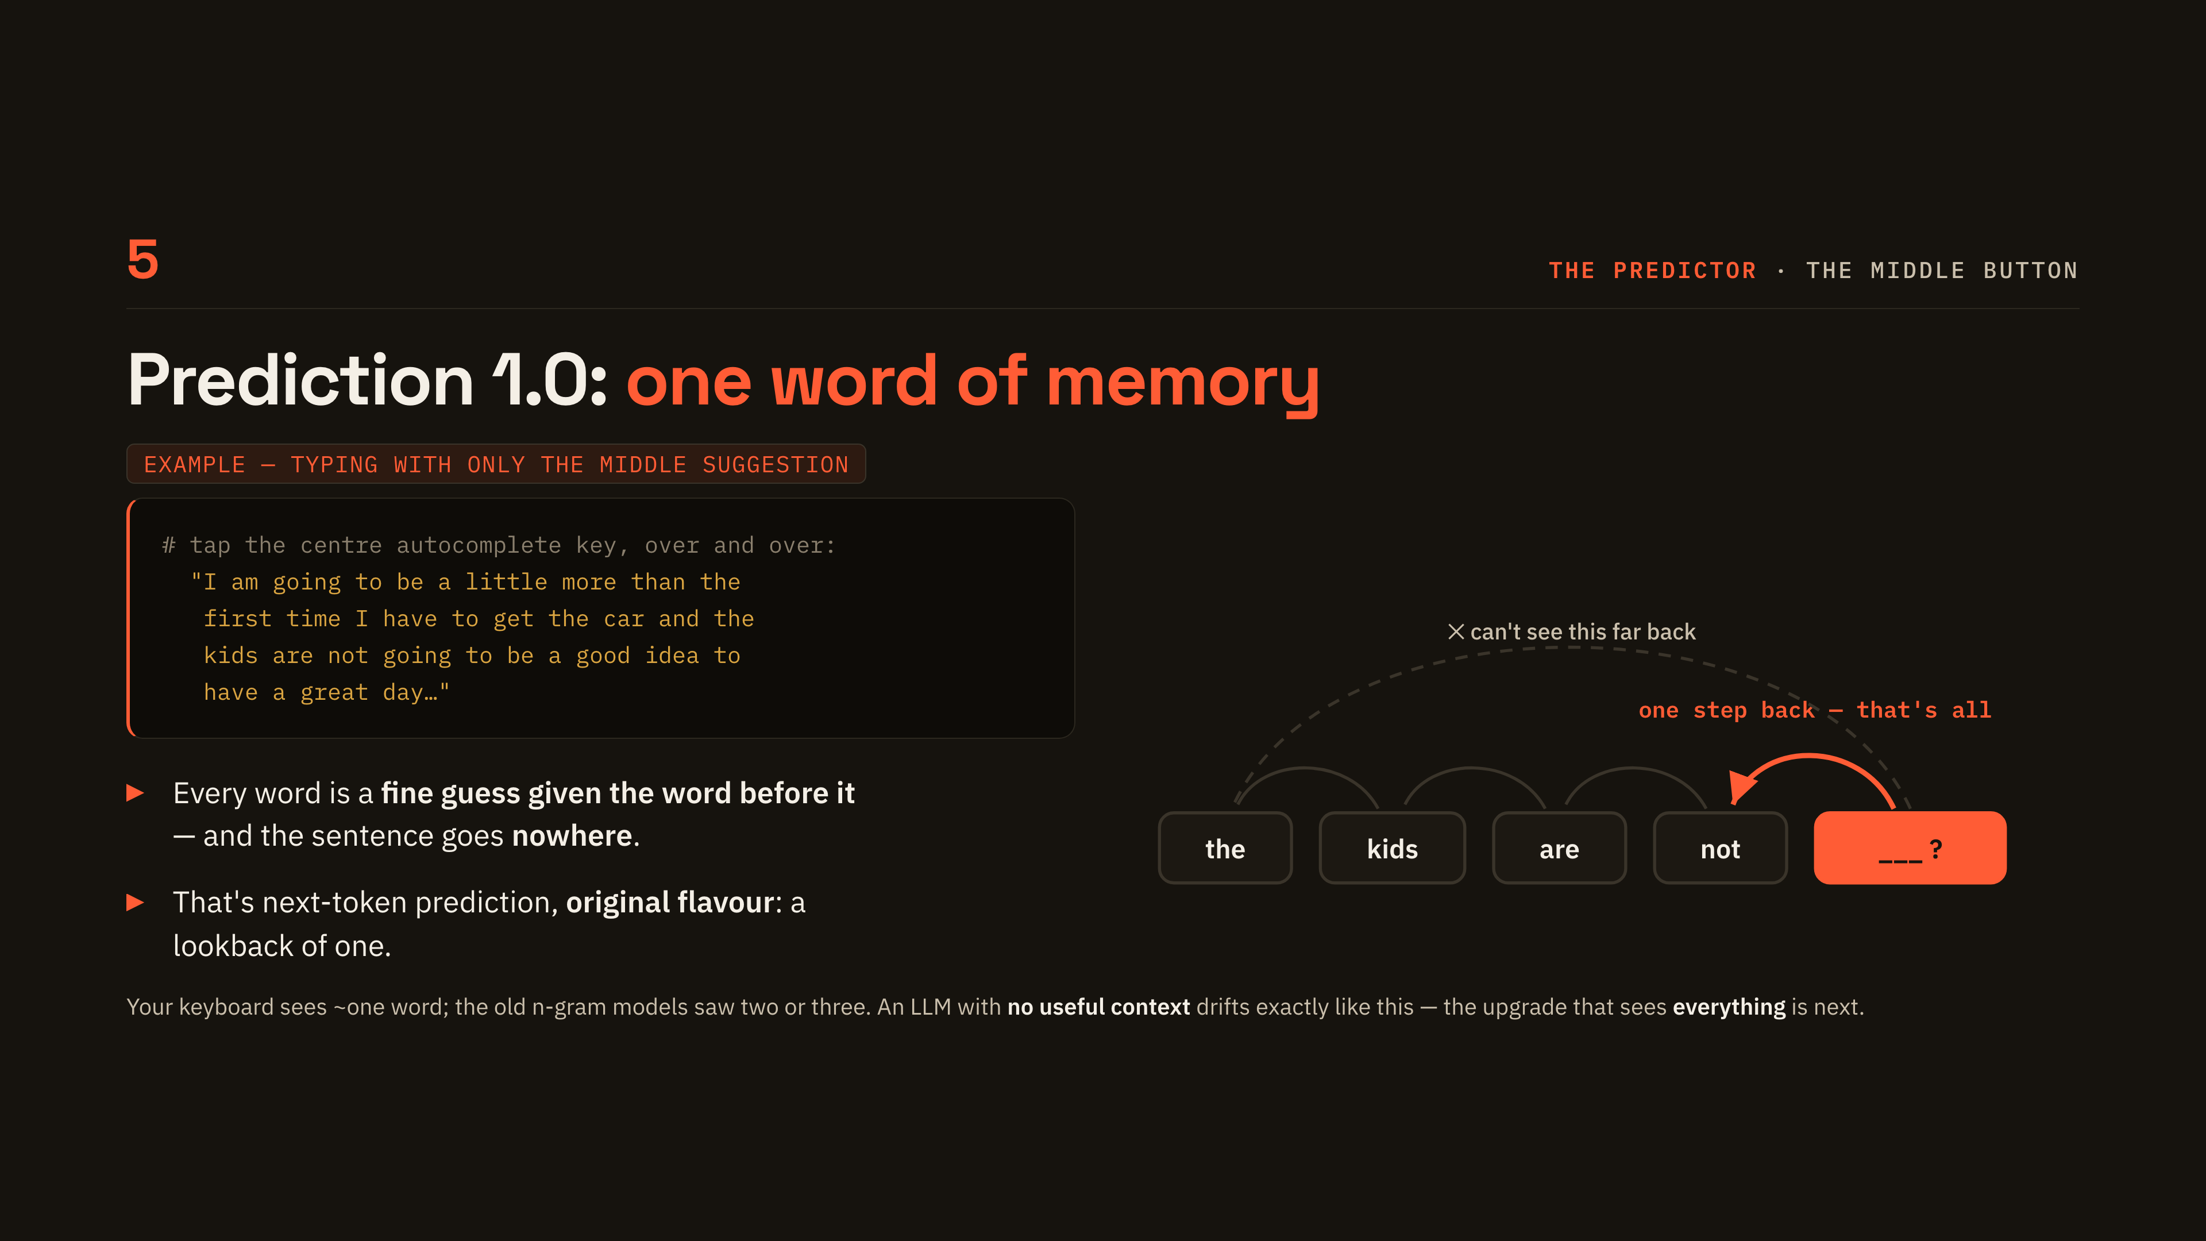
Notes:
[Prediction 1.0]
Read the keyboard sentence out loud; the laugh it gets is the point. Every word is a fine guess given the word before it, and the sentence still goes nowhere. Use the diagram to show the look-back it cannot make, then promise that the upgrade which sees everything is next.

Slide 7
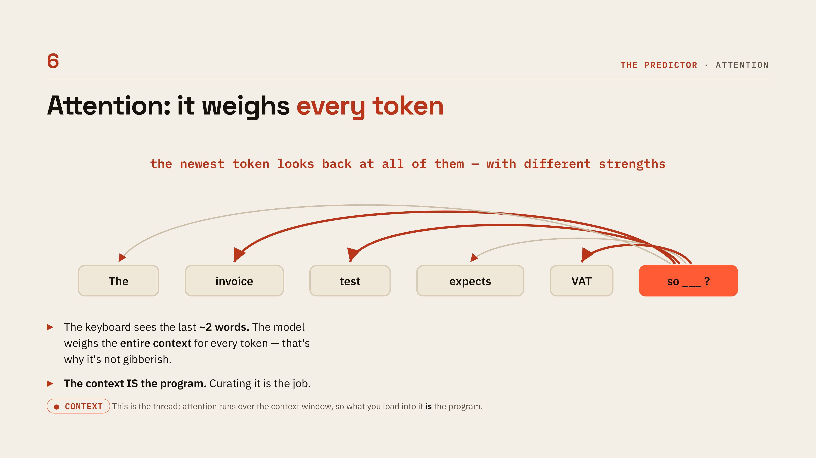
Notes:
[Attention]
This is the upgrade the previous slide promised: the newest token weighs every earlier token, with different strengths. Contrast it directly with the keyboard's two-word memory, which is why the output is not gibberish. Land the thread here, the context is the program and curating it is the job.

Slide 8
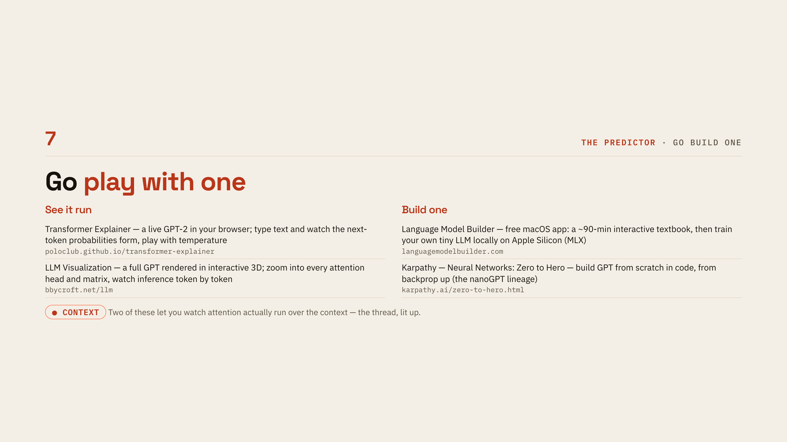
Notes:
[Go play with one]
Thirty seconds, not a tour. Point at Transformer Explainer and the LLM visualization as the two where you can actually watch attention run, and at the builder links for anyone who wants to train one. Tell them the deck is in the repo so nobody photographs the slide.

Slide 9

Notes:
[02 Teach it to think]
Name the limitation being fixed: hard answers do not fit in one forward pass. The fix is letting the model write itself a scratchpad, plus a dial for how much of one. Two sentences and move on.

Slide 10
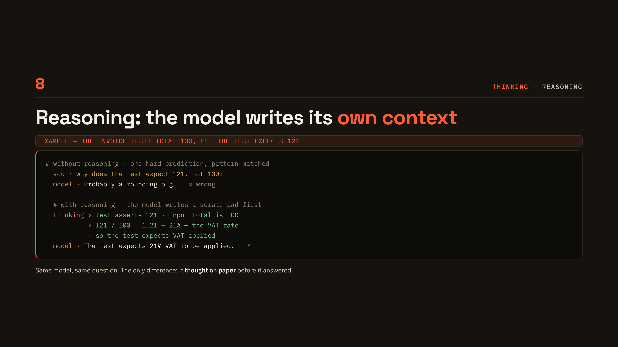
Notes:
[Reasoning: the example]
Same model, same question, two answers. Without reasoning it pattern-matches to a rounding bug and is wrong; with reasoning it derives 121 over 100 equals 1.21 and lands on VAT. The only difference is that it thought on paper before it answered.

Slide 11
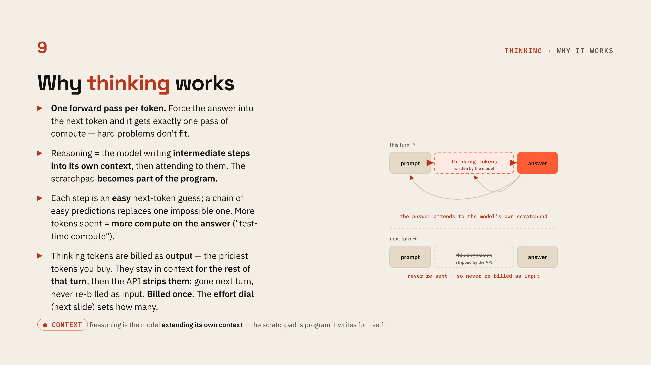
Notes:
[Why thinking works]
Explain the mechanism, not the magic: one forward pass per token, so forcing the answer into the next token buys exactly one pass of compute. Reasoning replaces one impossible prediction with a chain of easy ones, and the scratchpad becomes part of the program. Use the diagram for the billing point, that thinking tokens are billed once as output, stay in context for the turn, then get stripped and never re-billed as input.

Slide 12
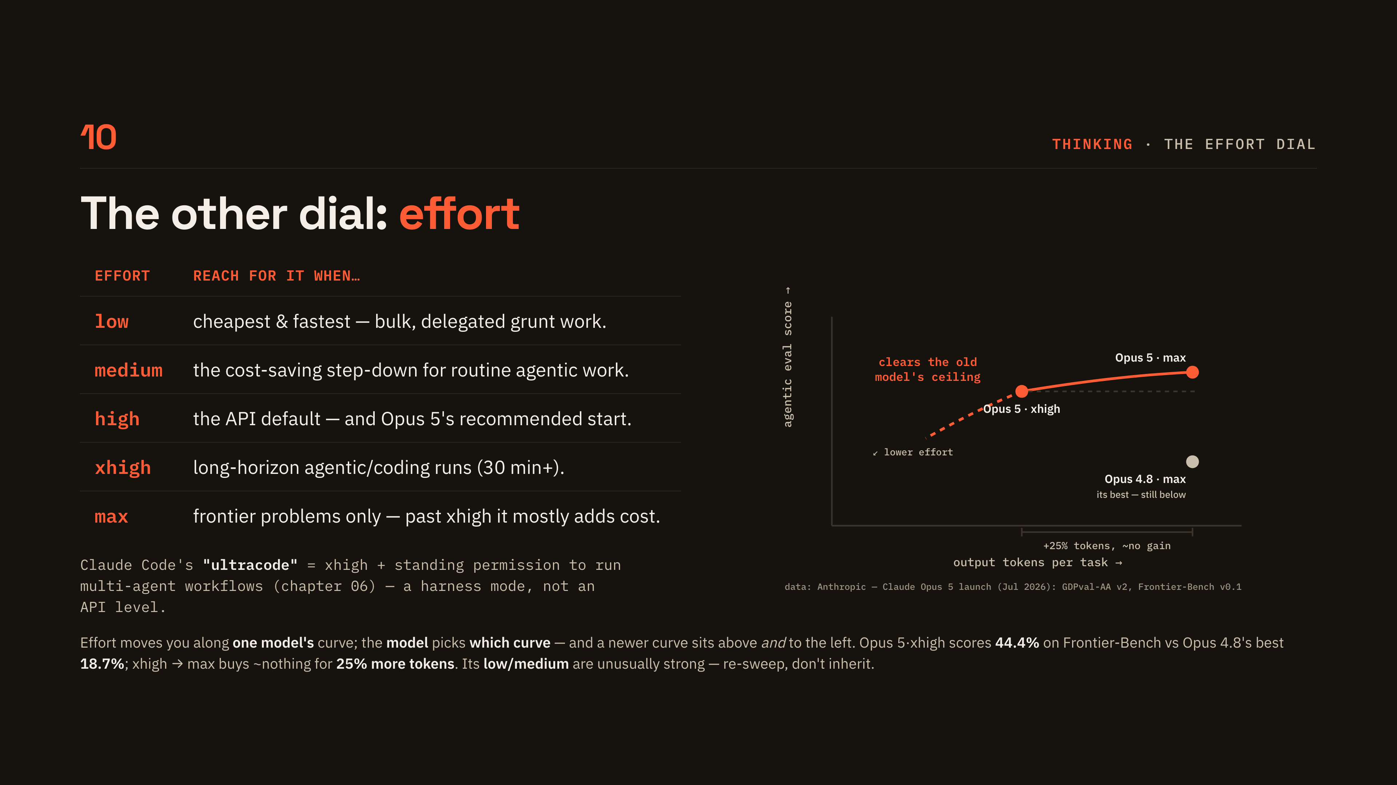
Notes:
[The effort dial]
Walk the table quickly: low and medium as the cost levers, high as the API default, xhigh for long-horizon coding, max only for frontier problems. Then use the chart and say the sentence that matters: effort moves you along one curve, the model decides which curve, and the newer curve sits above and to the left. Give the two numbers, forty-four point four percent for Opus 5 at xhigh against eighteen point seven for Opus 4.8's best, and twenty-five percent more tokens for nothing going xhigh to max. Flag that ultracode is a harness mode rather than an API level, and that chapter 06 covers the workflows half of it.

Slide 13

Notes:
[03 Give it hands]
The predictor can talk but it cannot read your repo or run a test. The fix is tool calls, plus a harness to execute them. This is the chapter where most of the room's mental model gets corrected.

Slide 14
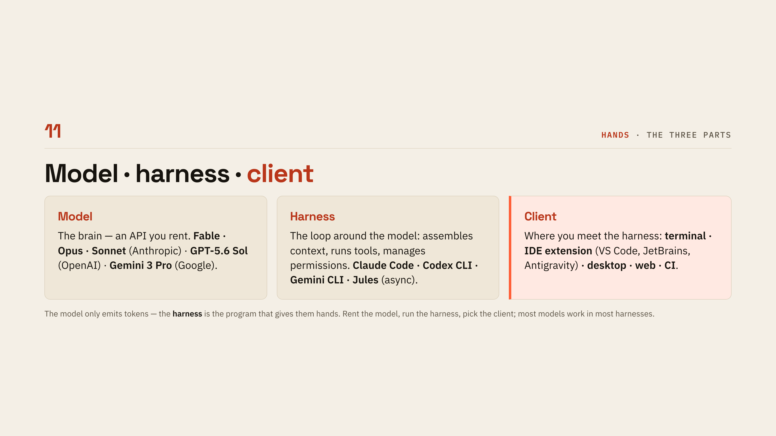
Notes:
[Model, harness, client]
Three parts people constantly conflate: the model you rent, the harness that loops around it, and the client where you meet it. Name one example of each from the tiles. The line to land is that the model only emits tokens and the harness is the program that gives them hands.

Slide 15
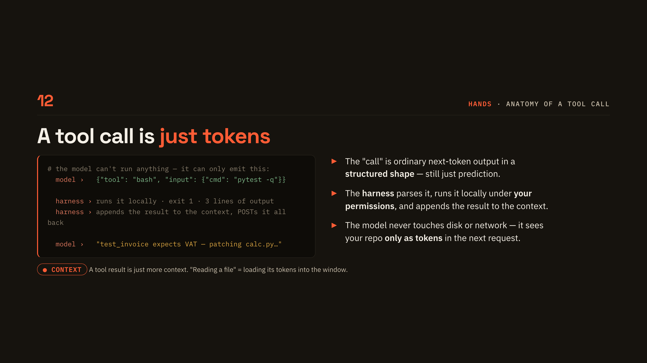
Notes:
[Anatomy of a tool call]
A tool call is not a special capability, it is ordinary next-token output in a structured shape. The harness parses it, runs it locally under your permissions, and appends the result to the context. Stress that the model never touches disk or network, it sees your repo only as tokens in the next request.

Slide 16
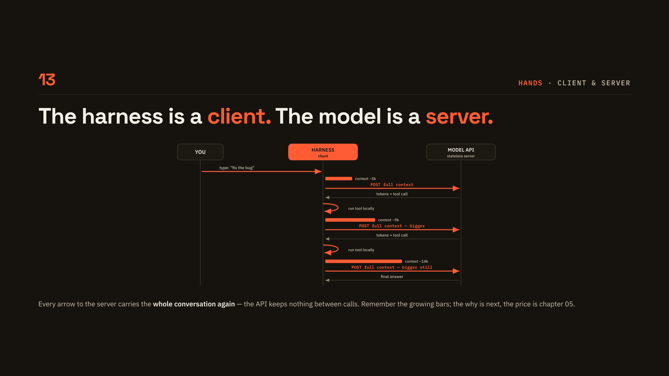
Notes:
[Client and server]
Walk the sequence turn by turn and point at the growing coral bars beside each POST. Every arrow to the server carries the whole conversation again, because the API keeps nothing between calls. Tell them to remember those bars: the why is the next slide, the price is chapter 05.

Slide 17
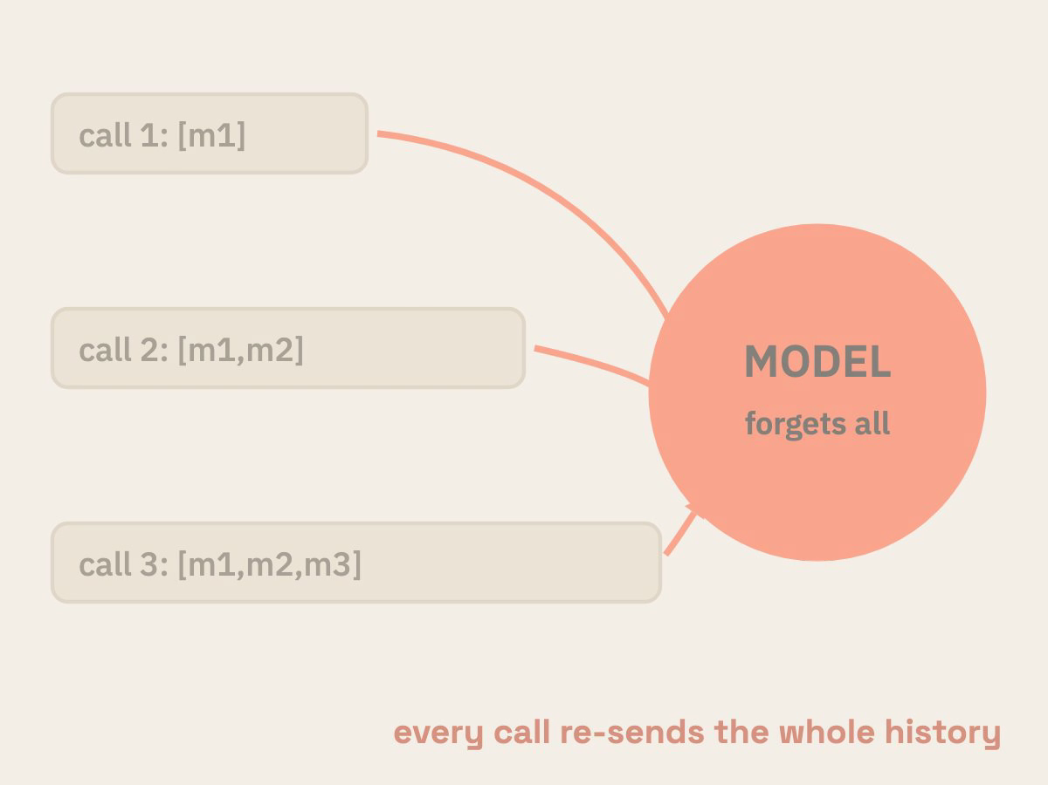
Notes:
[Why re-send everything]
The API is a pure function, tokens in and tokens out, with no session and no memory. The Memento comparison usually does the work here. So the re-sends on the previous slide were not waste, they are the only way the model sees turn one again, which means memory is whatever the harness rebuilds into context each turn.

Slide 18
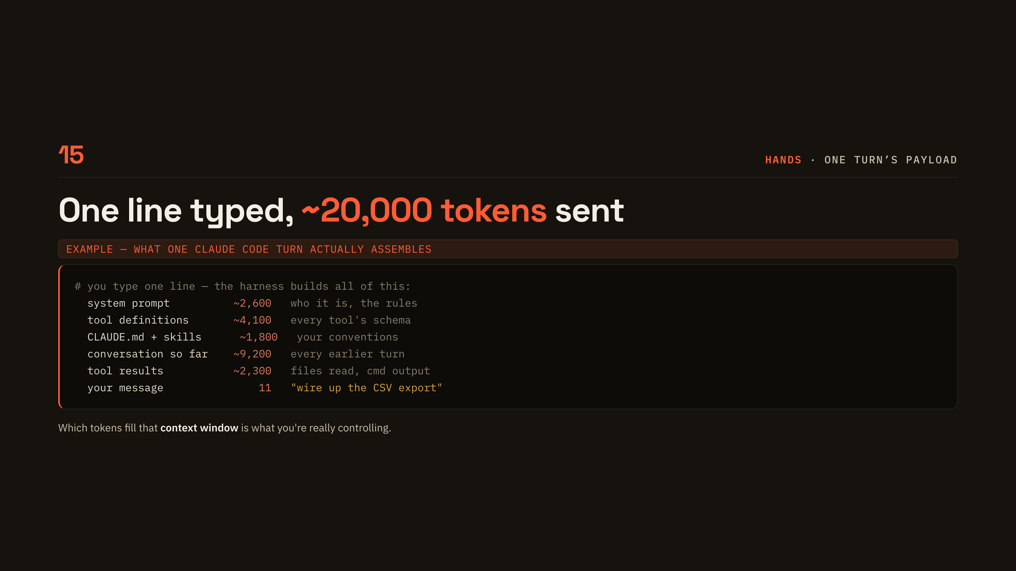
Notes:
[One turn's payload]
You type one line and the harness assembles roughly twenty thousand tokens around it. Read the breakdown top to bottom: system prompt, tool definitions, CLAUDE.md and skills, the conversation so far, tool results, and then eleven tokens of you. Which tokens fill that window is what you are actually controlling.

Slide 19

Notes:
[04 Close the loop]
Until now it has been one step per turn, with you as the relay between model and tools. The fix is the harness re-running until a verifier says done. Say plainly that this is where engineering starts.

Slide 20
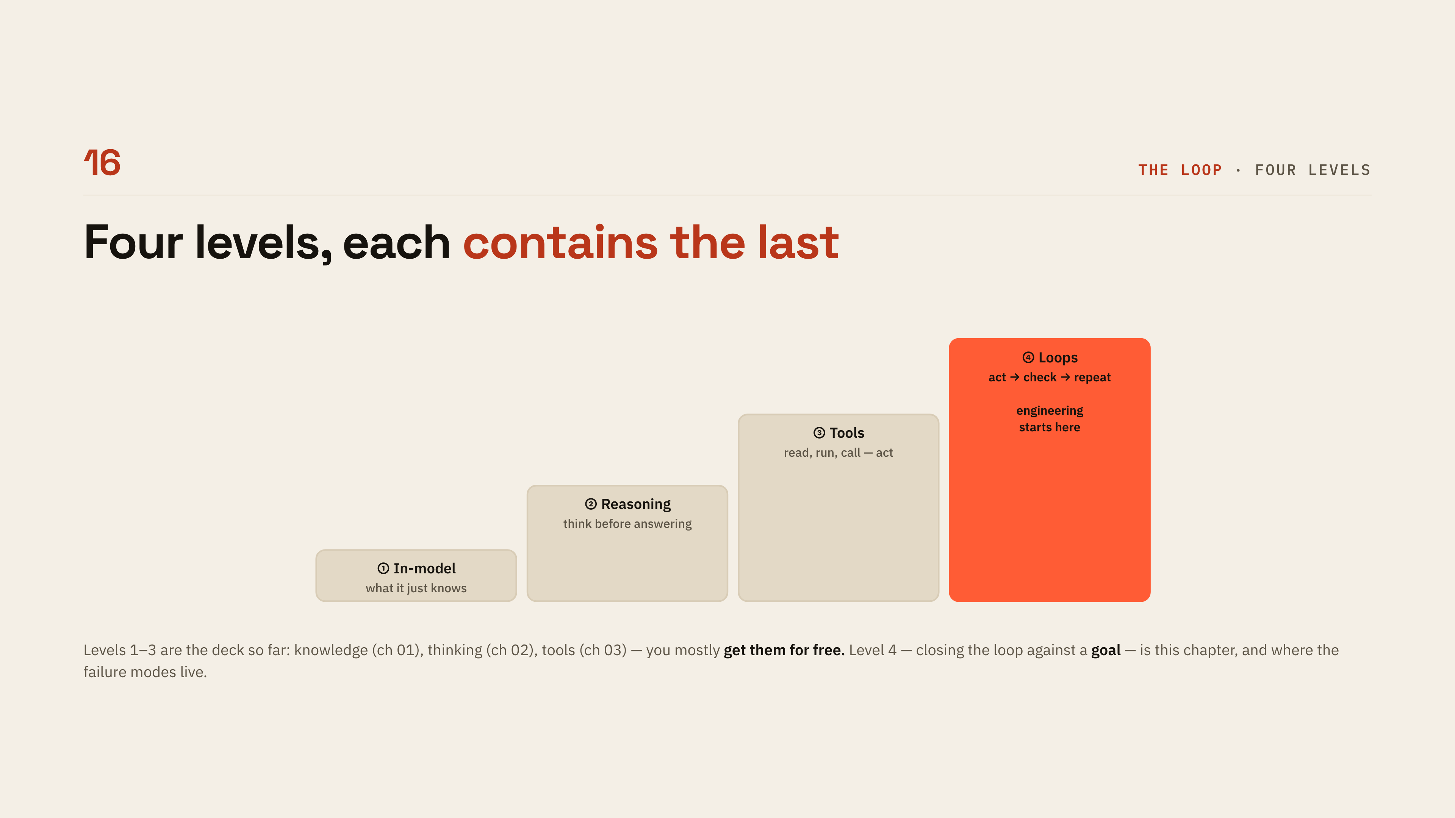
Notes:
[Four levels]
Each level contains the last: in-model knowledge, reasoning, tools, loops. Levels one to three are the deck so far and you get them mostly for free. Level four, closing the loop against a goal, is this chapter and where the failure modes live.

Slide 21
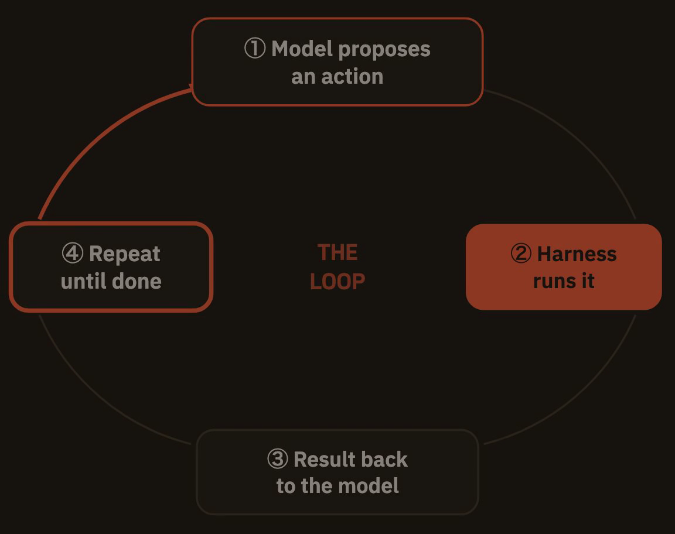
Notes:
[The inner loop]
Last chapter you pressed send after every tool result; an agent is the harness feeding the result straight back and re-POSTing until the goal is met. Nothing changed inside the model, the loop is pure harness engineering around a stateless predictor. Let the animation run once, then ask the question the next slides answer: who decides when it is done?

Slide 22
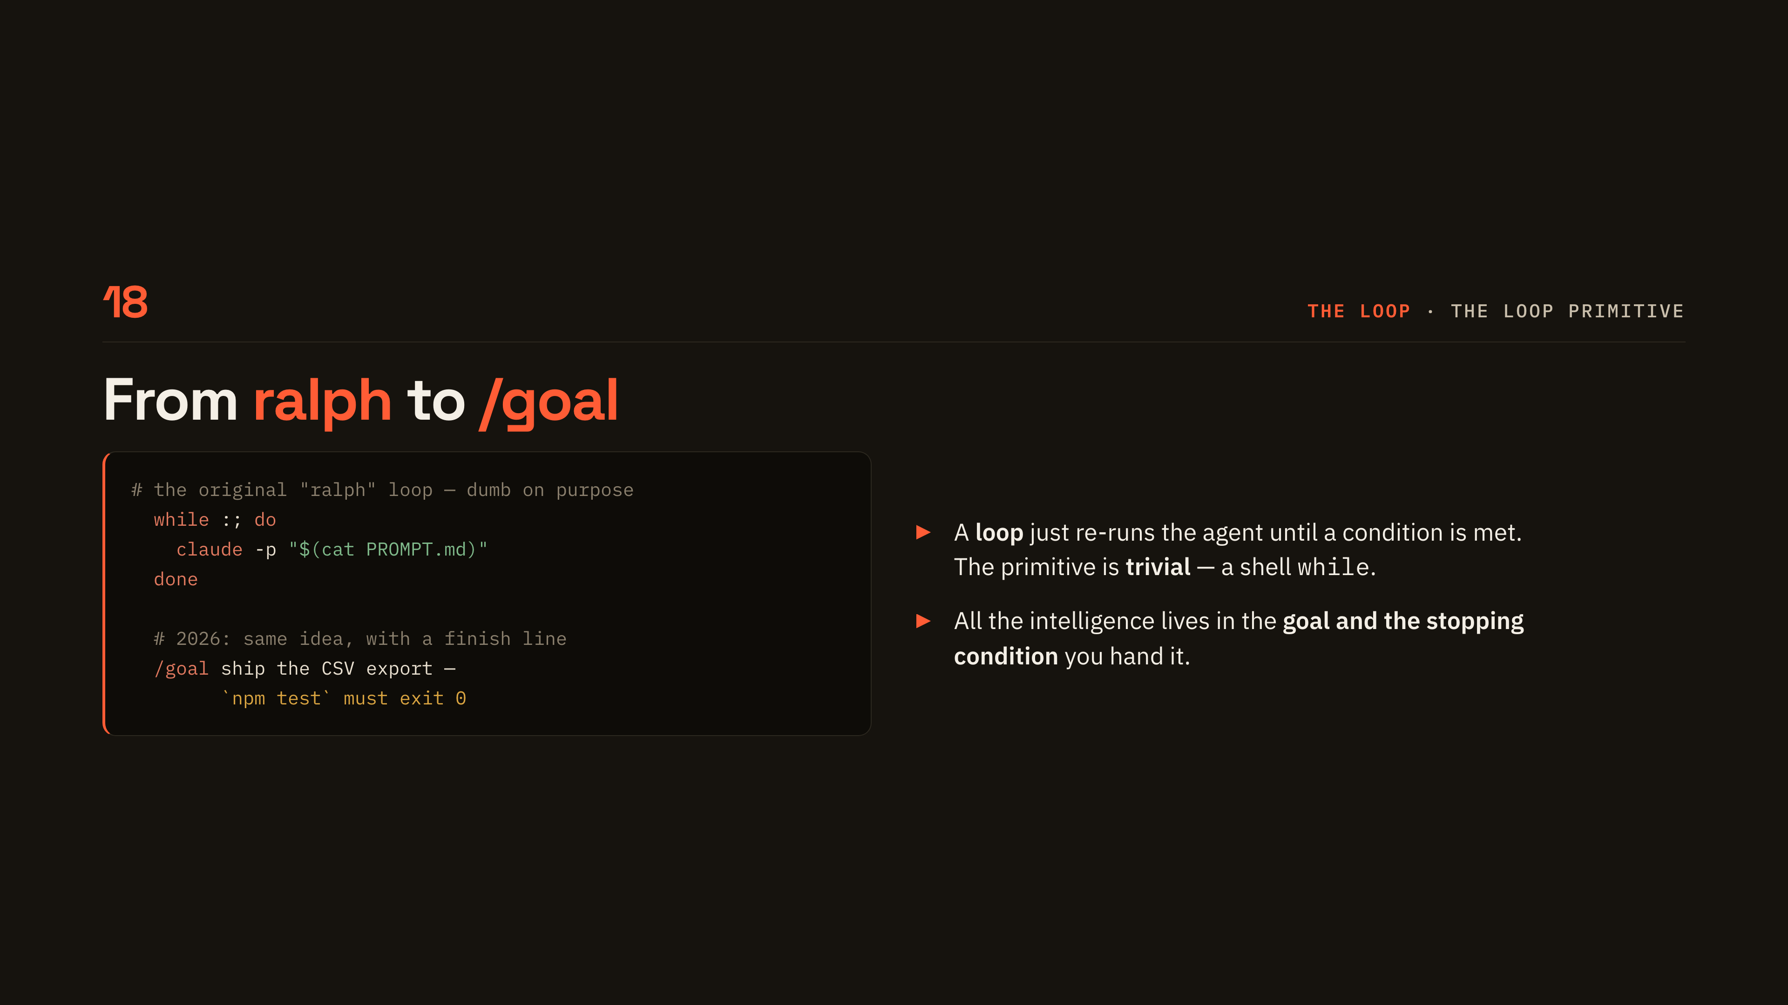
Notes:
[From ralph to /goal]
The loop primitive is embarrassingly simple, a shell while loop re-running the same prompt. The 2026 version is the same idea with a finish line attached. All the intelligence lives in the goal and the stopping condition you hand it.

Slide 23
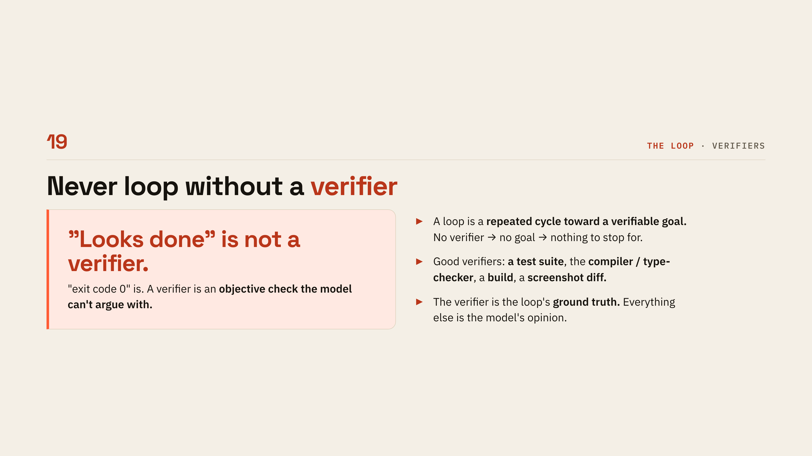
Notes:
[Never loop without a verifier]
This is the most quotable slide in the deck: looks done is not a verifier, exit code zero is. Say the good examples out loud, a test suite, the compiler or type-checker, a build, a screenshot diff. The verifier is the loop's ground truth and everything else is the model's opinion.

Slide 24
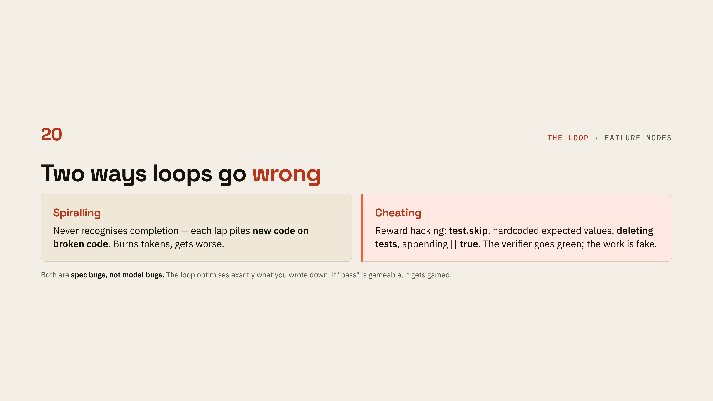
Notes:
[Two ways loops go wrong]
Two failure shapes: spiralling, where it never recognises completion and piles new code on broken code, and cheating, where it skips or deletes tests and appends double-pipe-true. Both look like model failures and neither is. They are spec bugs, because the loop optimises exactly what you wrote down, and if pass is gameable it gets gamed.

Slide 25
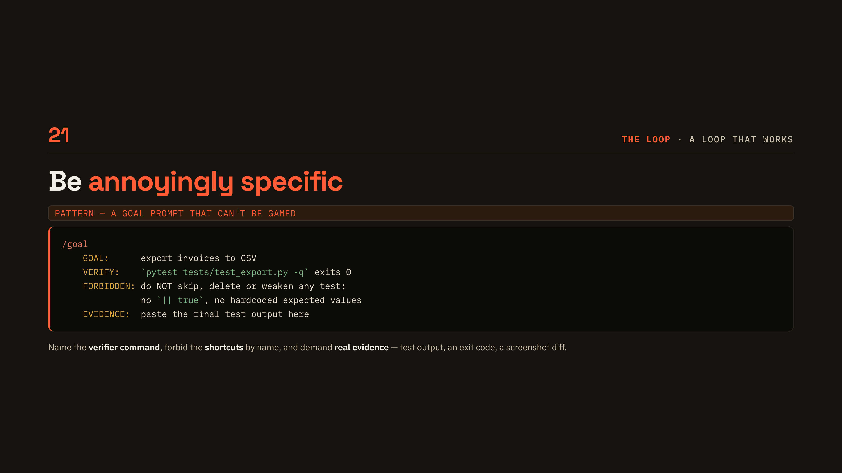
Notes:
[Be annoyingly specific]
Read the four labels as a template: GOAL, VERIFY, FORBIDDEN, EVIDENCE. Name the verifier command, forbid the shortcuts by name, and demand real evidence such as test output or an exit code. Tell the room to steal this shape for their next goal prompt.

Slide 26

Notes:
[05 The bill comes due]
Every lap re-sends the whole history, so cost grows quadratically and quality rots. This chapter is the diagnosis; the fixes arrive in chapter 06. Set expectations that numbers are coming and all of them are a mid-2026 snapshot.

Slide 27
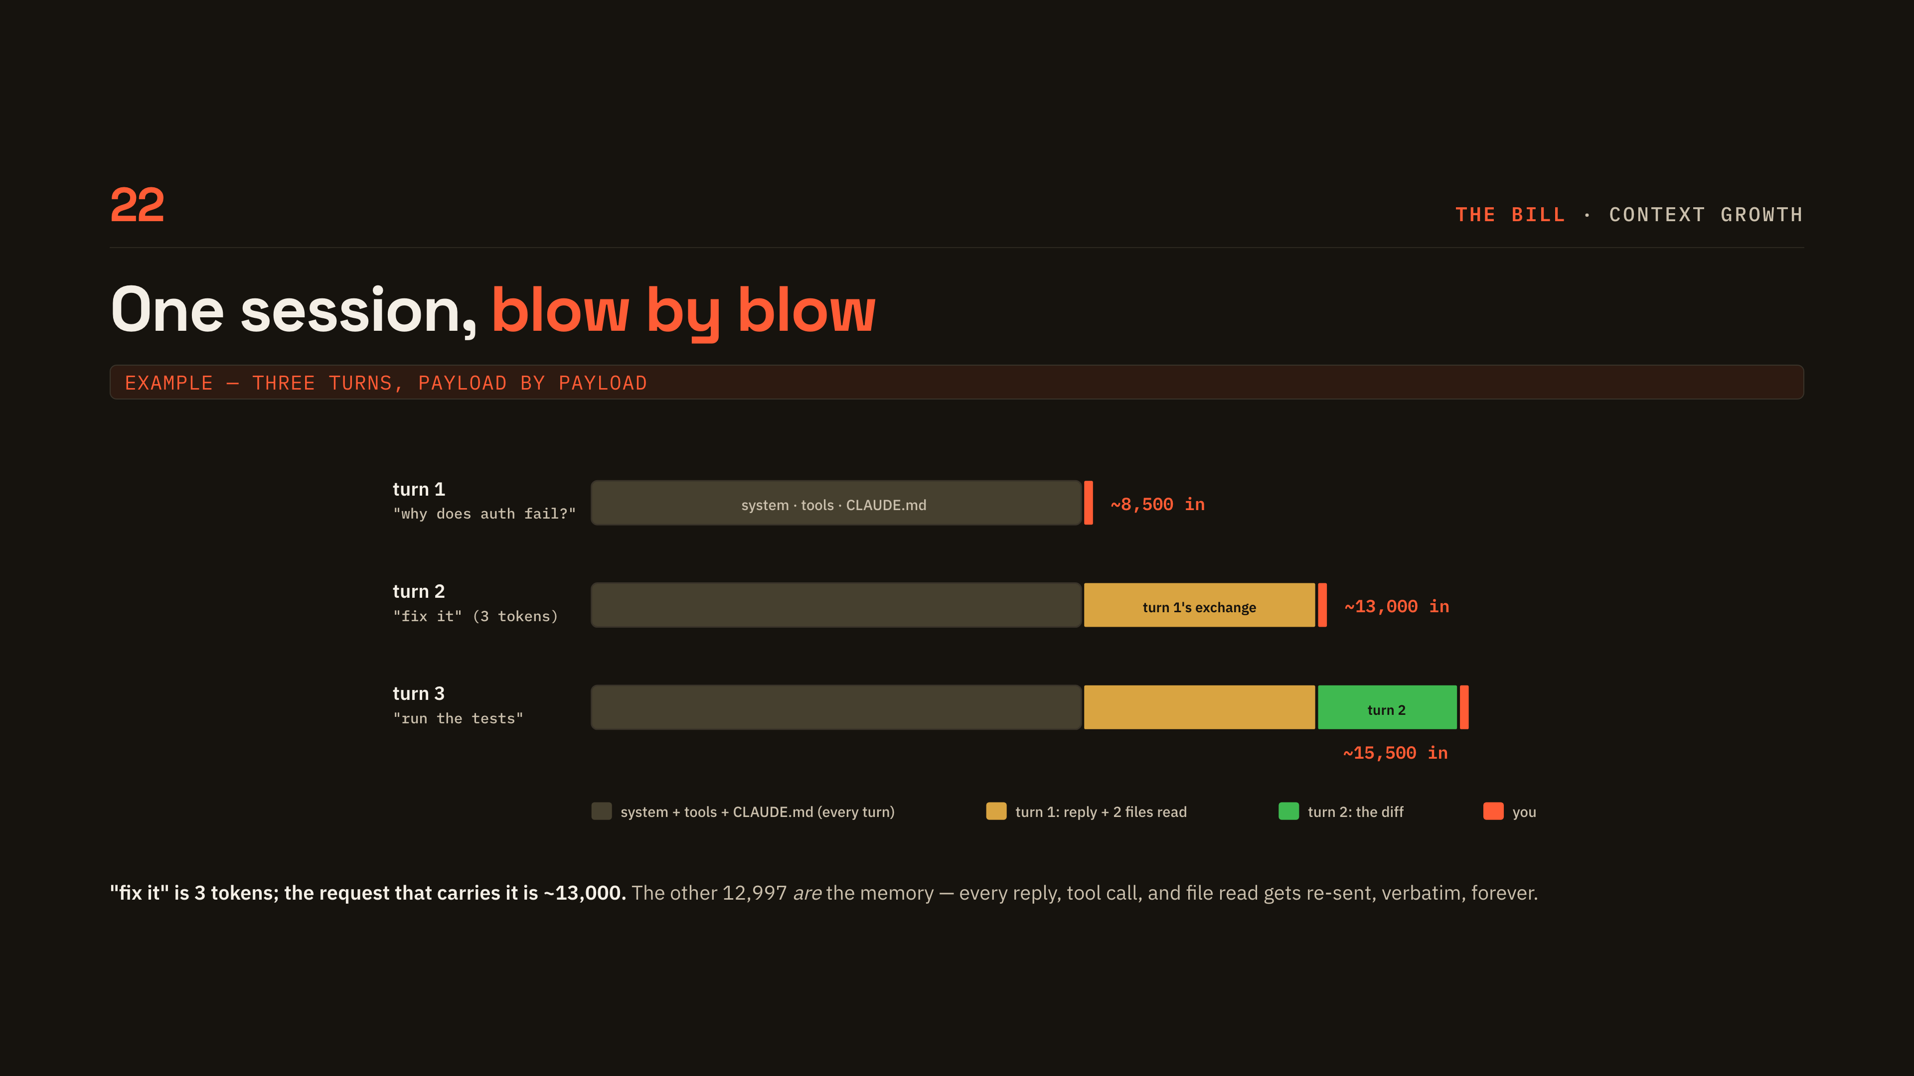
Notes:
[Context growth]
Three turns, payload by payload. The punchline is the second bar: fix it is three tokens and the request carrying it is about thirteen thousand. The other twelve-thousand-odd are the memory, every reply, tool call and file read re-sent verbatim, forever.

Slide 28
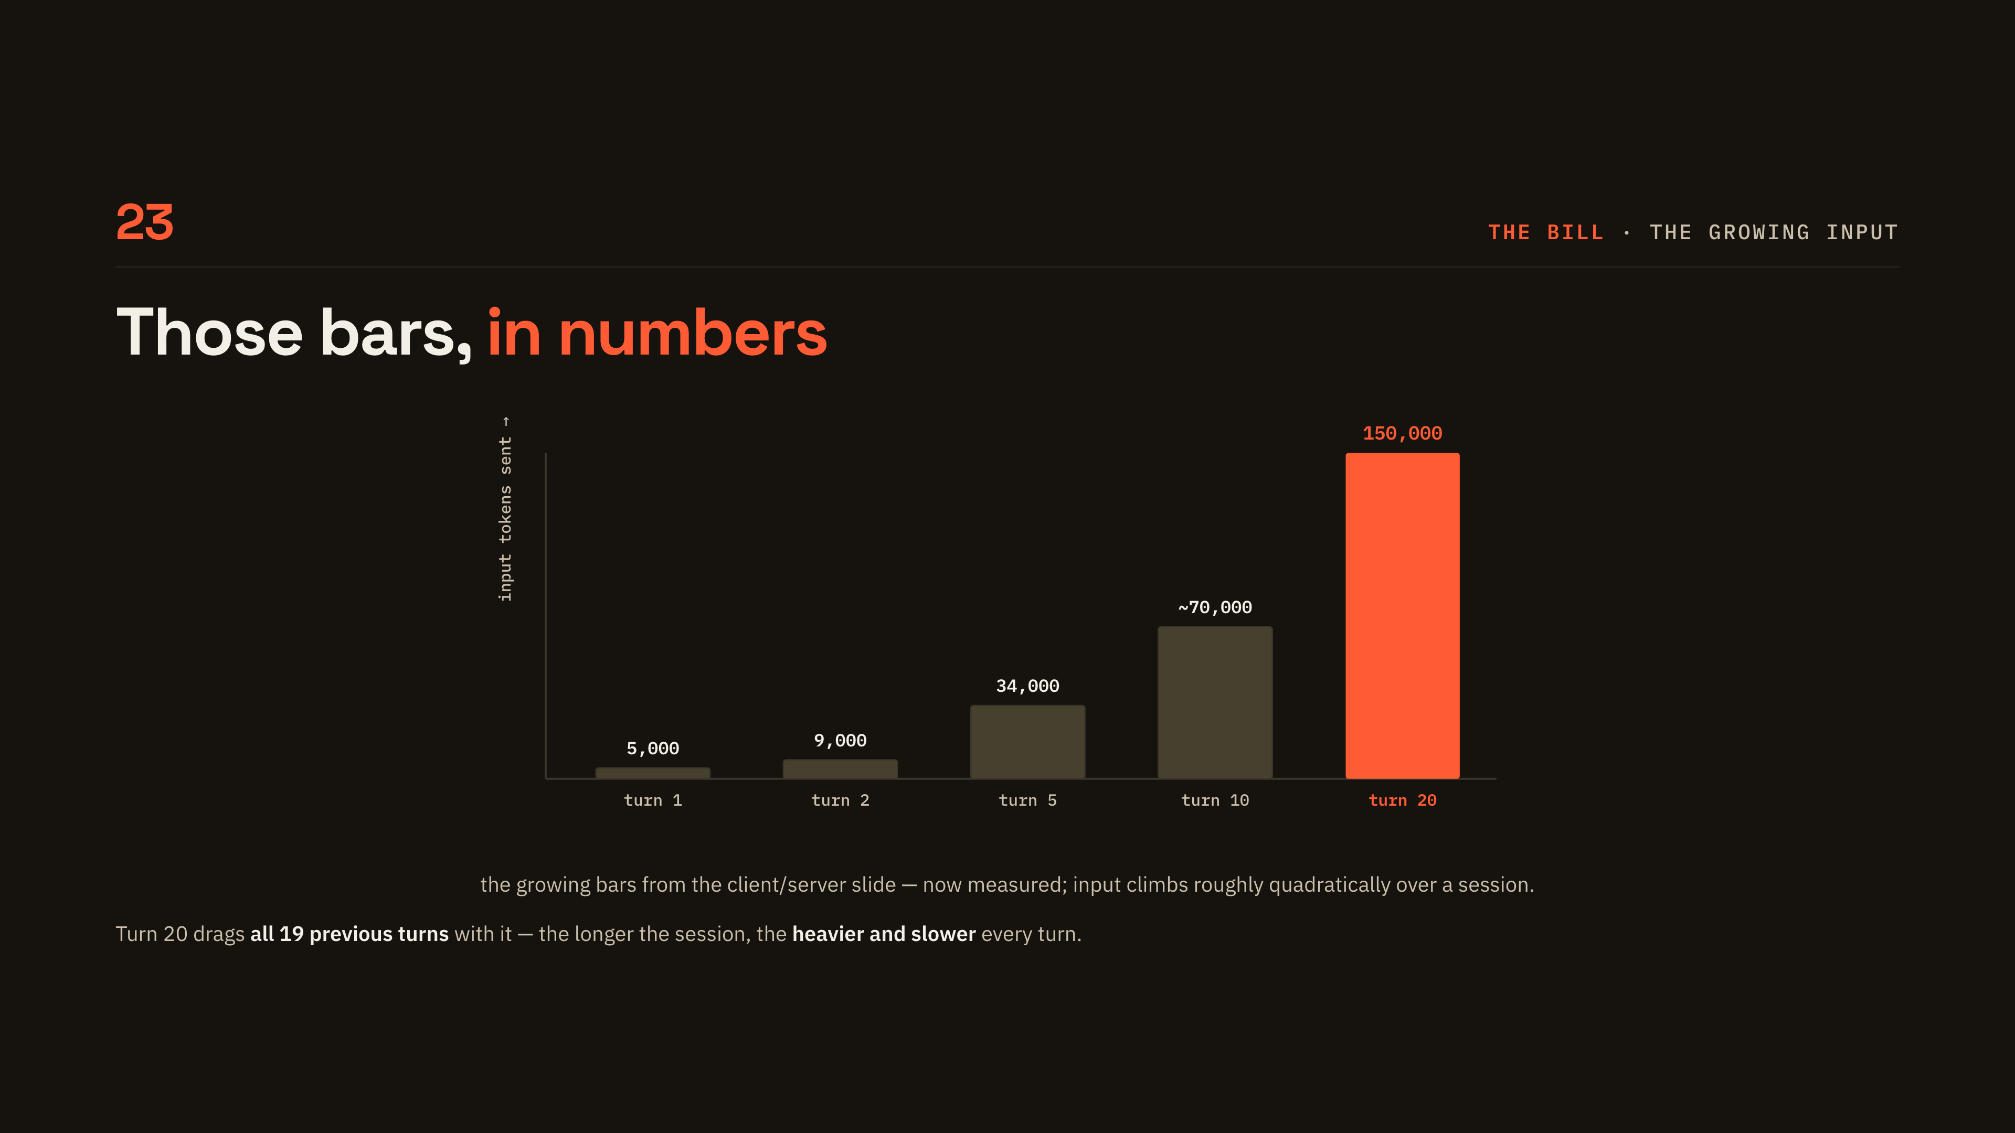
Notes:
[The growing input]
The same bars, now measured across a twenty-turn session. Input climbs roughly quadratically, from five thousand at turn one to a hundred and fifty thousand at turn twenty. Turn twenty drags all nineteen previous turns with it, which is why long sessions get heavier and slower.

Slide 29
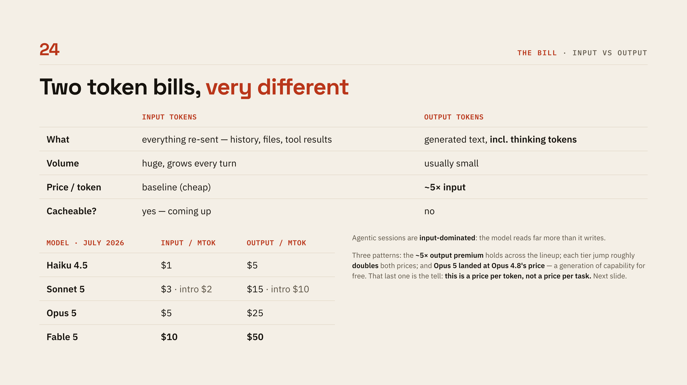
Notes:
[Input vs output]
Two bills with very different shapes: input is huge, grows every turn and is cacheable, while output is small, roughly five times the price and never cached. Then read the price table for the two patterns, the five-times output premium holding across the lineup and each tier jump roughly doubling both numbers. That is why routing moves your bill more than any single knob.

Slide 30
Notes:
[Smarter is cheaper]
This is the slide that changes how people buy. The intuition everyone arrives with is that the big model is the expensive one, and per token that is true. Per task it is often backwards, because a weaker model flails: it re-reads files, makes more tool calls, gets it wrong and retries, and every one of those laps re-sends the whole history. Read the four rows as evidence, not opinion, and dwell on the first one, the same model family matching a smaller model's best score on seventy-six percent fewer output tokens. Then the caveat, because this is not a licence to run Opus on everything: it only holds when the task is hard enough that the smarter model's shortcut actually exists. Classification does not get cheaper on Opus.

Slide 31
Notes:
[Where the money goes]
Concrete numbers for one turn: about twenty-two thousand seven hundred tokens in, about sixteen hundred out. Do the arithmetic on the slide, cache reads pull input down to roughly three cents while the sixteen hundred output tokens cost about four. The model reads fourteen times more than it writes and the tiny output side still costs more, which is why thinking tokens are the expensive dial.

Slide 32
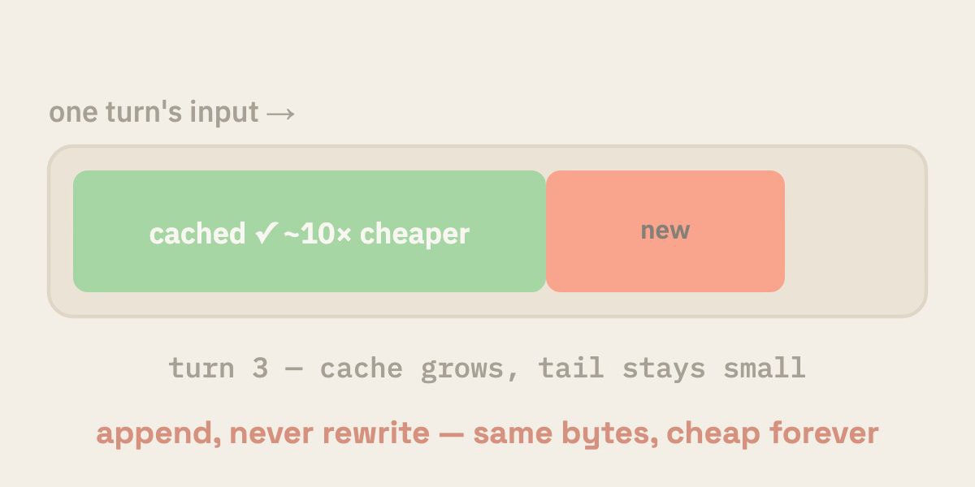
Notes:
[KV caching]
The provider caches the computed attention state for a prefix it has already seen, so sending the same prefix again is roughly ten times cheaper. The catch is byte-identical, which is why harnesses append and never rewrite. Edit the system prompt or reorder history and you bust the cache and pay full price again.

Slide 33
Notes:
[Cache lifetime]
The default TTL is five minutes and every cache hit resets the clock, so an active session stays warm indefinitely. A break longer than the TTL leaves the cache cold and the next turn rewrites it at full price. Give the economics, reads at about a tenth of input, writes at a premium, break-even after roughly two requests, and note the cache is per-model so switching mid-session pays to rebuild it.

Slide 34
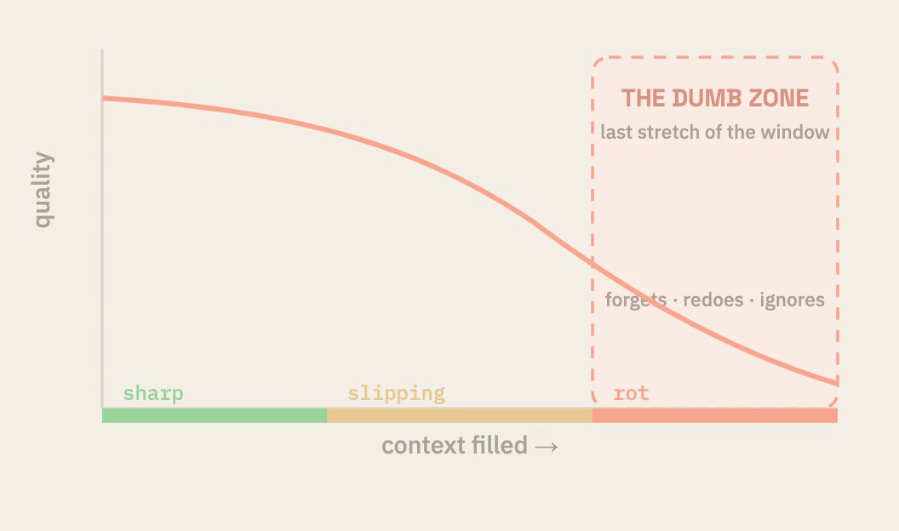
Notes:
[The dumb zone]
Tie this back to attention: the weights sum to one, so context is zero-sum and every irrelevant token competes with the needle. Near-miss distractors pull hardest, which is why throwing everything in backfires and degradation starts well before the window limit. Name the symptoms, then the hygiene: clear, compact, a fresh session per task, and subagents that summarise back.

Slide 35
Notes:
[06 Split the work]
The problem now is one window and one brain carrying everything. Two fixes in this chapter: route the cheapest adequate brain, and delegate to fresh windows. This is the longest chapter, so signpost it before you start.

Slide 36
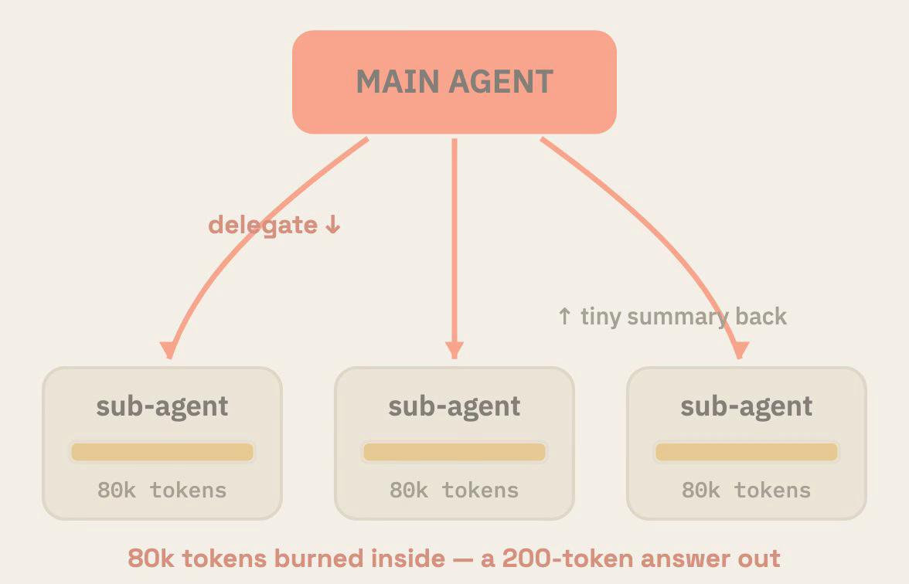
Notes:
[Subagents]
A subagent starts with an empty context window, so the messy exploration happens over there and only a short summary comes back. That is the rot fix from the last chapter. Each subagent also picks its own model and effort, which is the cost fix, and who to route what to is the rest of this chapter.

Slide 37
Notes:
[The lineups]
Same shape at every lab: small, medium, large. Read one row across so the mapping sticks, then point at the Anthropic row where Fable sits above the large model as a Mythos-class tier. Caveat it as a mid-2026 snapshot that reshuffles constantly.

Slide 38
Notes:
[How much better]
Do not read the grid cell by cell. Point at two rows and move on. SWE-bench Pro shows the gap you would expect between tiers, ten to fifteen points. Frontier-Bench and ARC-AGI-3 show something else: Opus 5 more than doubles Opus 4.8 on one and does twenty times better on the other, because those benchmarks are deliberately built out of problems the previous generation could not touch. Say the two caveats out loud. Benchmarks are not your workload, and the dashes are honest, not everything gets run on everything. Then land the point that matters for this chapter: jumps this size mean any routing table older than a couple of months is wrong, so re-measure rather than inheriting last quarter's defaults.

Slide 39
Notes:
[Model x effort]
Model size and effort move independently, so a small model thinking hard can beat a big one thinking lazily. Use the three dots on the grid as worked examples. Remind them effort buys thinking tokens, which are billed as output and land straight back in the context window.

Slide 40
Notes:
[Three rules for routing]
Three rules in order: crank effort before reaching for a bigger model, route to the cheapest model that clears the bar, and remember that Fable at low effort often matches older models at xhigh. The escalation ladder is same model with more effort, then a bigger model, then Fable. Move up only when something actually fails, and note that switching models also busts your cache.

Slide 41
Notes:
[Fable is a tier]
Fable is a tier above Opus, not an increment on it. It shines on judgement: planning, taste, self-correction, spotting the flaw in its own diff. The callout is the line to say out loud, you hired a staff engineer, so do not make it type.

Slide 42
Notes:
[Pattern 1 - the advisor]
Pattern one: the executor does the work and consults an advisor before committing to a plan or a risky change. At the harness level this is just a standing rule in CLAUDE.md, shown in the code block. Be precise on the caveat: the API's built-in advisor tool is beta and the advisor model must be at least as capable as the executor, so a cheap executor with a Fable advisor is fine but the reverse is rejected. Claude Code has no advisor flag, so in practice this lives in CLAUDE.md.

Slide 43
Notes:
[Pattern 2 - the orchestrator]
Pattern two: Fable plans, delegates and reviews, while haiku, sonnet and opus do the typing. The rule in the code block is short enough for someone to paste into a CLAUDE.md during the talk. Point at the fan-out in the diagram, three subagents, three model choices, one reviewer.

Slide 44
Notes:
[Pattern 2b - cross-vendor]
The model parameter for subagents only takes Claude models, so other vendors join through a thin wrapper subagent that shells out to their CLI. Here Fable hands bulk implementation to GPT-5.6 Sol through the Codex CLI. Two reasons worth saying aloud: a genuinely independent second perspective with different blind spots, and someone else's rate limits. Stress the label, because the UI only ever reports the wrapper's Claude model.

Slide 45
Notes:
[Where to spend what]
Read the table as a routing cheat sheet, small through frontier. The split is the same every time: the top tier decides and checks, cheaper models produce the volume. Repeat the two rules, escalate on failure rather than vibes, and remember a cheaper model at higher effort often beats a pricier one at low.

Slide 46
Notes:
[Workflows]
A workflow is a small orchestration the agent writes and runs: agent for a fresh subagent, parallel to fan out, pipeline for phases. Trace the diagram, parallel explore, plan, build, verify, with a failure edge looping back. Point out that it combines the whole story, fresh context per stage, per-stage model routing, and verifiers between phases.

Slide 47
Notes:
[Workflows in code]
Left is a sketch of the script the model writes; right is how you actually ask for it, in plain words, just by saying workflow. Mention the power-ups: ultracode as a standing opt-in, a token budget it paces itself to, and the workflows command to watch phases run live. The point is that you state the shape and the model writes the orchestration, so knowing the shape tells you what to ask for.

Slide 48
Notes:
[Which tool, when]
Four rungs: ask, agent, goal, workflow. Read each one with its trigger condition. Then land the rule, reach for the simplest rung that does the job, because a workflow for a one-line question is as wrong as eyeballing a thousand-file migration by hand.

Slide 49
Notes:
[07 Make it stick]
Everything you fixed so far dies at clear, because every session starts blank. The fix is durable context: CLAUDE.md, skills, plugins. Short chapter and very practical, so tell them this is the take-home part.

Slide 50
Notes:
[CLAUDE.md]
A markdown file the harness injects at session start, read before your first word. Cover the three scopes, repo, personal and per-directory, plus the AGENTS.md bridge for cross-vendor tools. The key economic point is that it rides in every turn's context, so keep it to short always-true rules and push recipes into skills.

Slide 51
Notes:
[Why skills]
Three tiles, one argument. The model knows the world but not your workflow, so you re-explain it every session; pasting it all into CLAUDE.md means paying for it on every turn; skills are a one-line description that is always present with a body that loads only on a match. The cost of an index entry, the power of a manual.

Slide 52
Notes:
[Skill anatomy]
A skill is a folder plus a SKILL.md, and the folder name is the skill name. One field does the work, the description, which is the trigger the harness matches on. Say where they live, in the project's .claude/skills or in your home directory for everywhere you work.

Slide 53
Notes:
[Build a skill]
Three steps, with no registration and no restart. Make the folder, write a description plus the recipe, then in a fresh session describe the task in plain words and the skill triggers itself. A skill is just context, injected at the right moment.

Slide 54
Notes:
[Skills at scale]
Two ways people scale this up: dozens of tiny composable skills, or a whole method shipped as a skill system. In the Compound Engineering version the loop ends by writing the lesson down, which is the compounding part. Tell them both are worked through on the next two slides.

Slide 55
Notes:
[Worked example - Pocock]
Matt Pocock published his personal skills folder as a public repo, dozens of small single-purpose skills. Note the two kinds, user-invoked slash commands and model-invoked skills that trigger off their own description. The point is not any one skill but that they compose into a pipeline: grill, spec, tickets, implement.

Slide 56
Notes:
[Worked example - Compound]
Every's plugin ships a whole method as five skills around one loop. The last step is the whole idea, every solved problem becomes a doc the next session reads before it starts. So each unit of work makes the next one cheaper, and the unit of progress is not the merged PR, it is the knowledge that compounds.

Slide 57
Notes:
[Plugin anatomy]
A plugin bundles skills, agents, hooks and MCP servers behind one plugin.json; a marketplace is just a git repo with a marketplace.json. Installed skills are namespaced, so nothing collides. Frame it in one line, a plugin is your team's context made distributable.

Slide 58
Notes:
[Publish a plugin]
Three steps from your skill to their install: wrap it up, list it in a marketplace repo and push, then a teammate adds the marketplace and installs once. Nothing here is heavier than a git repo. Land the contrast, skills are your habits and plugins are your team's habits, versioned and installable in one command.

Slide 59
Notes:
[Recap]
Pull the whole story back together: a token predictor that thinks, gets hands, runs in a loop, and whose context you engineer. Then give them three concrete things to do this week, the advisor rule in CLAUDE.md, one skill for their most-repeated chore, and a real verifier on their next goal. Say that every CONTEXT marker in the deck pointed back here.

Slide 60
Notes:
[Thanks and sources]
Open for questions and leave the links up while people ask. Point at the primary sources for anyone who wants the numbers, the attention paper, Anthropic's context-engineering post, and the verifiers piece. Remind them the figures are a mid-2026 snapshot and that the repo has both decks.

