Slide 1

Screen Space Ambient Occlusion versus
Ambient Occlusion Maps
David Clarke
0802352
Technical Supervisor: Grant Clarke

Slide 2
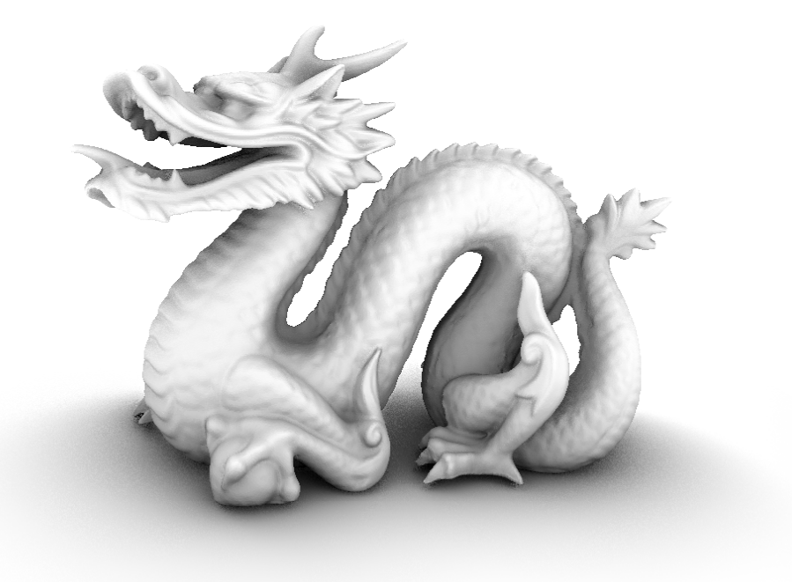
What & Why
Ambient Occlusion in real time
Two methods
Screen Space Ambient Occlusion
Ambient Occlusion Maps
Why?
Enhances visual quality
Adds depth

Slide 3
How
Implemented SSAO into a DirectX 9.0c application. SSAO algorithm provided by José Maria Mendez via GameDev.net
Adapted to work with HLSL and DX9
Constructed all other buffers for use with the SSAO shader

Slide 4

SSAO

Slide 5
How
Created a basic scene in Maya (and their UV maps)
Created the ambient occlusion maps in Maya for the scene and the characters
Exported them to textures (.TGA files)
Applied the textures to the geometry in the honours project application

Slide 6
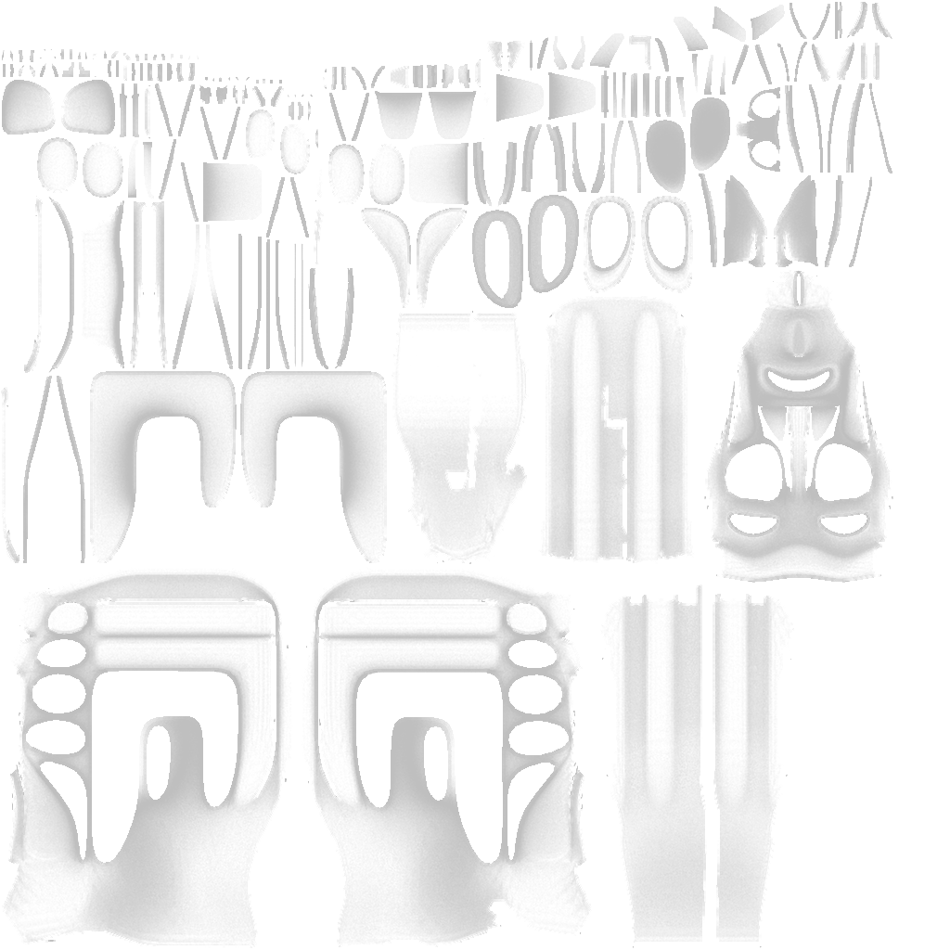
Ambient Occlusion Map

Slide 7
What happened
SSAO can copes with animations and moving objects
AO maps can’t but produce better looking results

Slide 8
Recommendations
SSAO for dynamic scenes that feature animations and moving objects
Ambient occlusion maps can be used for scenes with little to no interaction and create good looking results

Slide 9
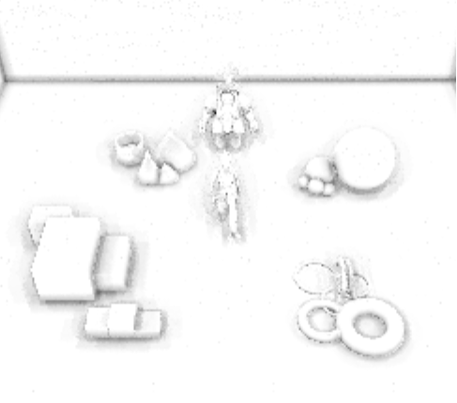
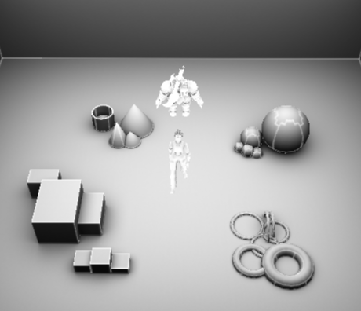
SSAO vs AO Maps

Slide 10
Links
A simple and practical approach to SSAO
http://tinyurl.com/668oldo

