Slide 1
Student Life
MScAC Orientation Week
David — MScAC (Applied Math) 2025-2026

Slide 2
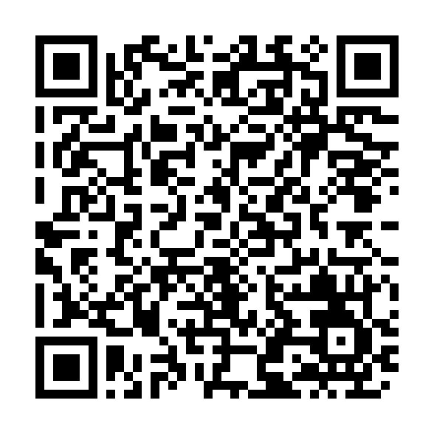
Before we start... where in the GTA are you?
Scan the QR code or open the link to join the live map
Duplicate a pin, drag it onto your neighbourhood
Live GTA map

Slide 3
Weekends in Toronto

Slide 4
Weekends in Toronto: Summer/Fall
Parks & waterfront: High Park (cherry blossoms in spring), Toronto Islands (ferry ~$10 return), Waterfront Boardwalk
Neighbourhoods: Chinatown, Koreatown (Bloor & Christie), Greektown (the Danforth), Little Italy (College St)
Niagara Falls (day trip, GO train or bus or car) + Niagara-On-The-Lake
Blue Jays game at Rogers Centre
Canadian National Exhibition (late August)

Slide 5
Weekends in Toronto: Spring
Ice Skating at U of T Varsity Arena ($3.30 rental)
Earl Bales Ski & Snowboard Center (North York)
Blue Mountain Ski Resort
Culture: Royal Ontario Museum (student rate, also free on Tuesdays)
Cards to get: PRESTO, Toronto Public Libraries
Notes:
This is a starting list, not exhaustive — ask upper years, everyone has their own favourite spot.

Slide 6
MScAC Student Initiative Fund

Slide 7
A few things the cohort has run this year
Event | What it was | Funded
Ski Trip (Blue Mountain) | Full-day ski/snowboard trip, bus + lift tickets subsidized | $2,760
Bouldering & Social Mixer | Climbing + dinner, peer mentorship for beginners | $1,050
Board Game Nights | 4-week recurring series | $650
CNY Celebration & Alumni Mixer | Dinner, Lo Hei, karaoke, alumni invited back | $2,315
ML Trivia Night | Dinner + trivia ahead of recruiting season | $960
Notes:
These span the full range of format — one-off outings, recurring series, cultural events, alumni-inclusive events. The fund isn't just "pizza and a room."

Slide 8
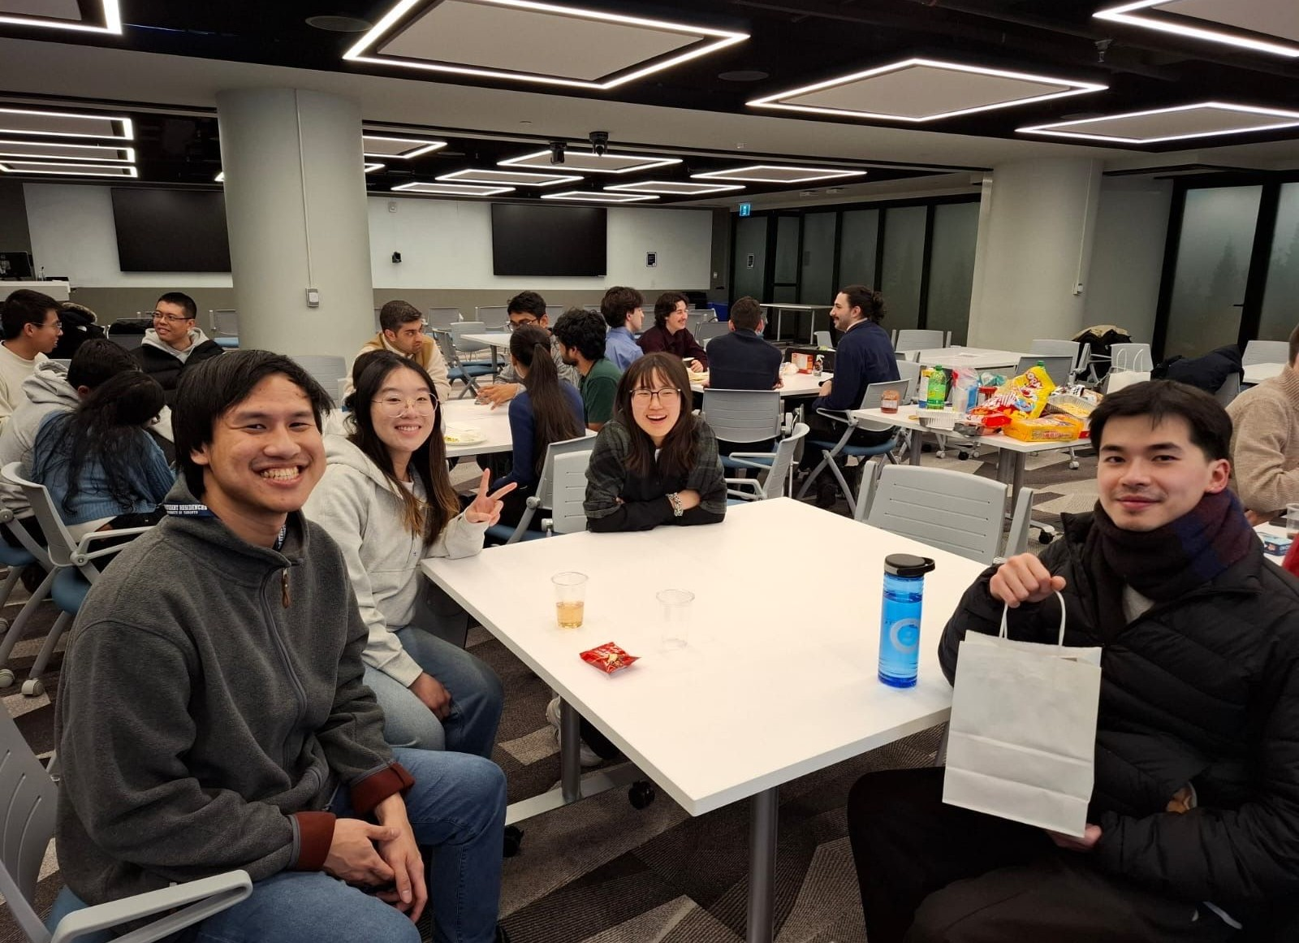
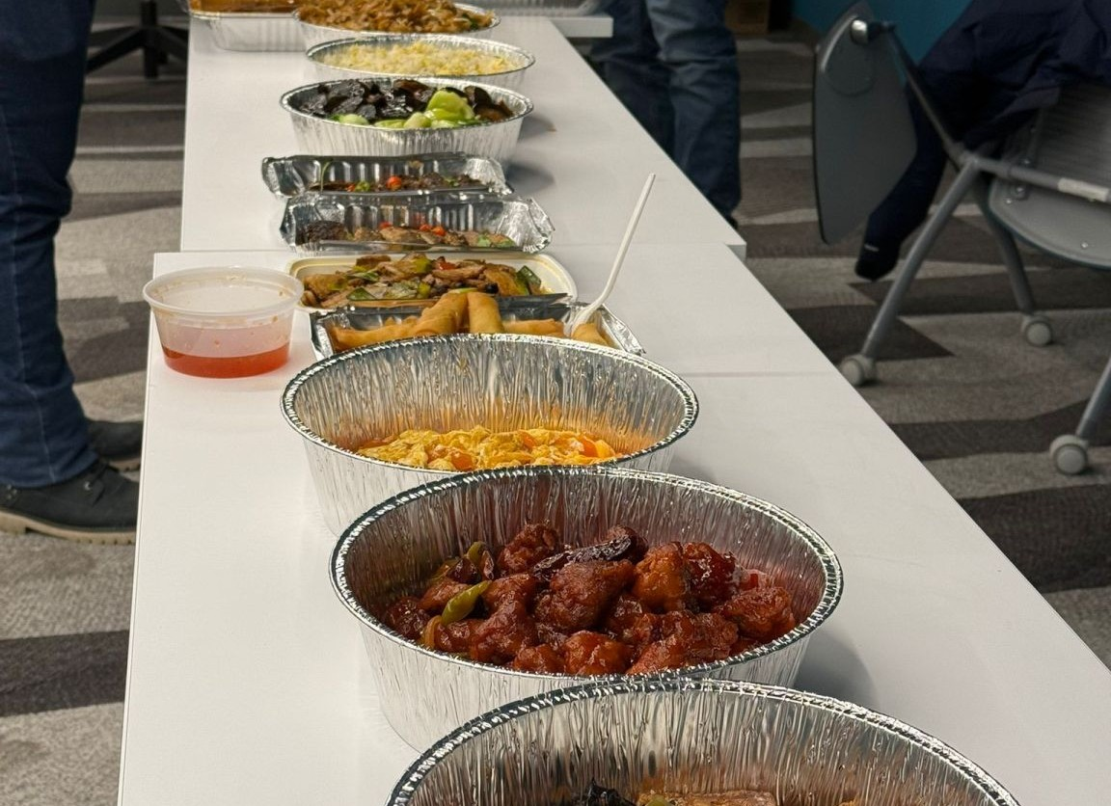
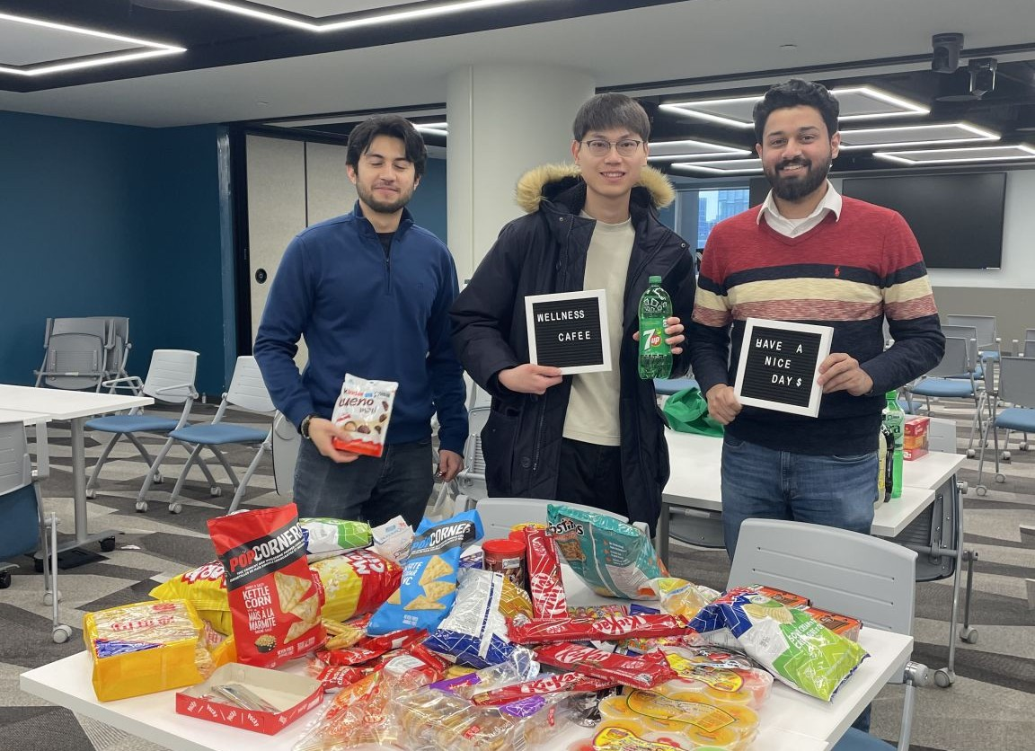
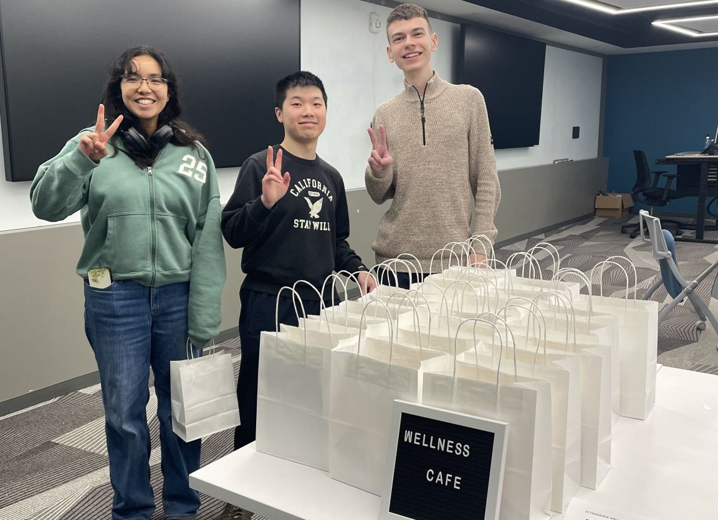
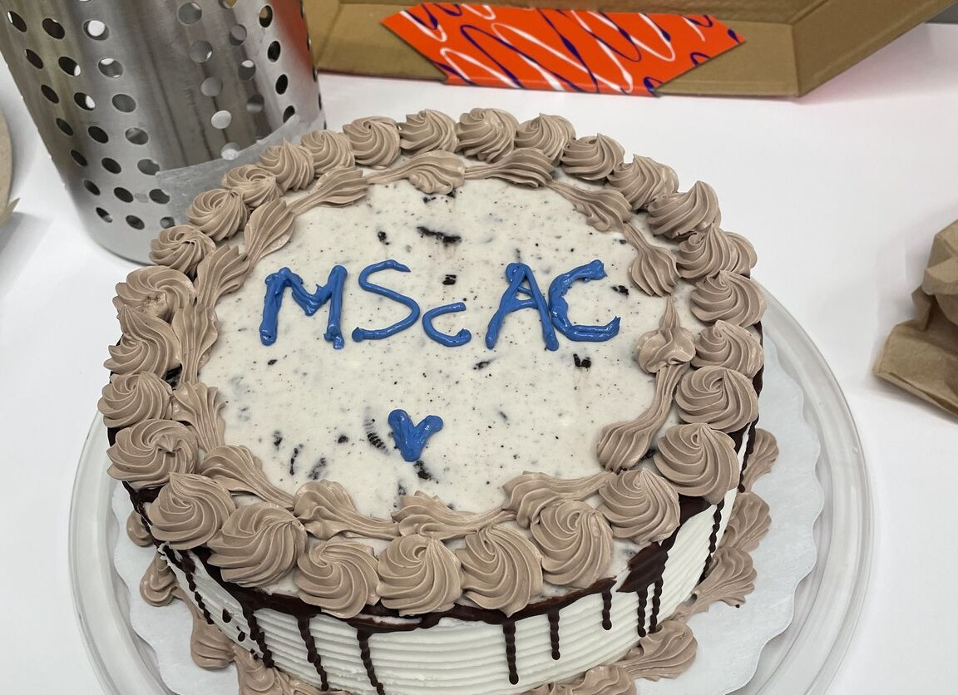
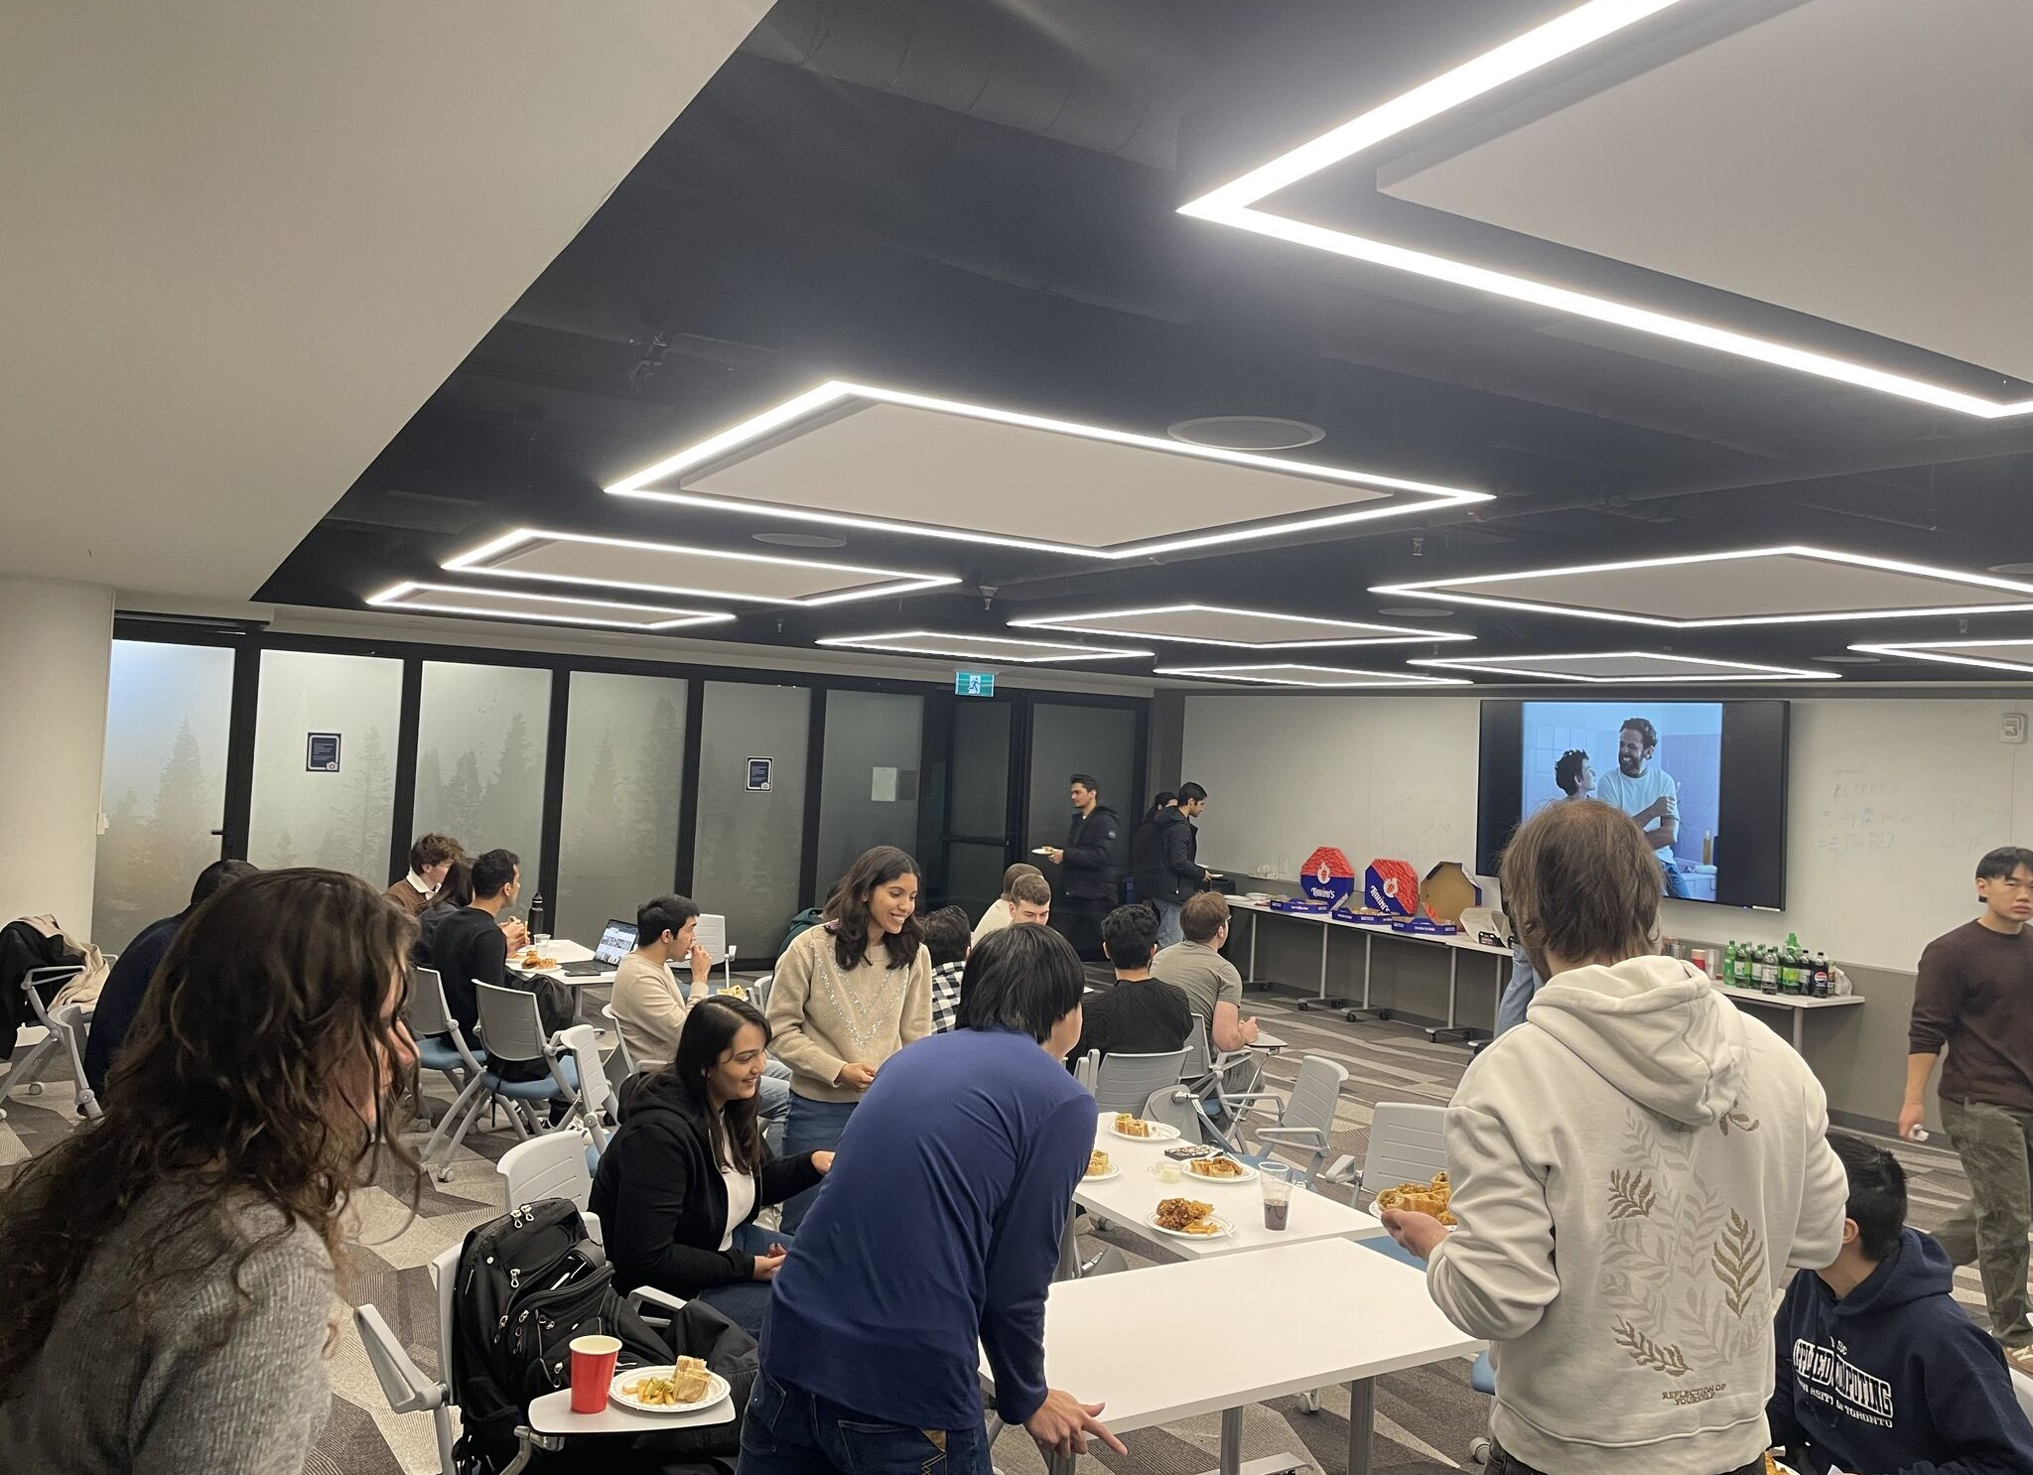
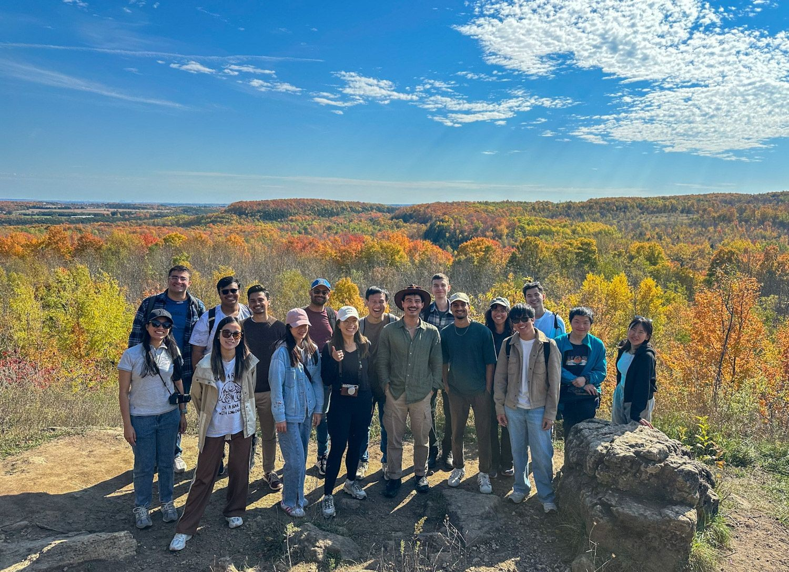
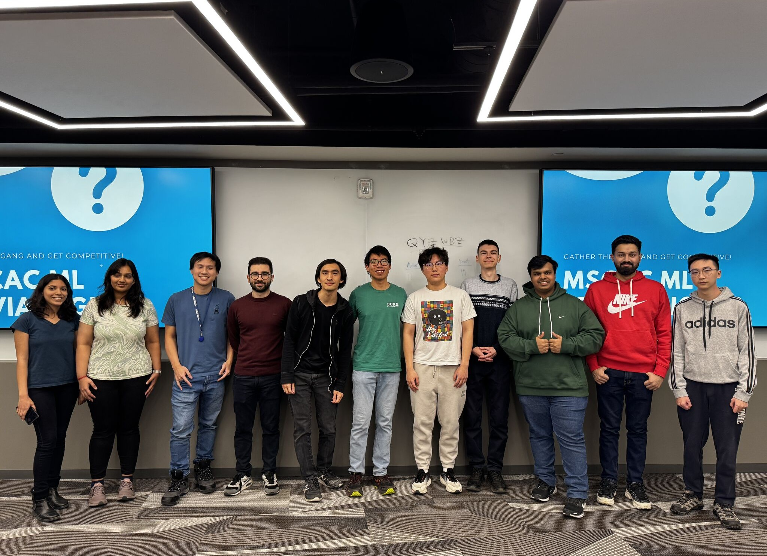
Look at all the fun we've had

Slide 9
Other ideas to start you off this Fall
Idea | Description | Cost
K1 Speed Go-Karting (North York) | Great fun near the Downsview Park TTC | $82/person
Basecamp Climbing (Queen West) | Self-explanatory and we had dinner subsidised too | $35/person
Canada's Wonderland | The GTA's rollercoaster park | $45/person
Activate Toronto (Stockyards) | All-ages arcade park; 75-min active session | $30/person
Notes:
These are priced per person so you can see the fund goes further than you'd think — none of these require a huge ask.

Slide 10
Running an event
In the office
Location: MScAC Office rooms like 9016
Food: order delivery where possible — Mother's Dumpling (Chinese), Tahini's (shawarma), pizza (you'll get sick of this)
Stock up on cutlery, plates and cups from Dollarama
Buy big bottles of drinks from Shoppers
Outside the office
Show up, snap a picture or two, have fun

Slide 11
Guidelines from MScAC
Open to the entire cohort
No alcohol, gambling / games of chance (stakes, betting pools, wagering)
Proposal is one page: summary, goals, benefits, timeline, itemized budget (just use my Claude Code repo or something)
You must be registered + in good academic standing (which is why us alumni need you to keep this up)
(Source: MScAC Student-led Initiatives Guidelines)

Slide 12
Typical timeline
Submit a proposal 2 weeks ahead (the start of the semester is always a little busier)
MScAC promises to confirm funding within 5 business days of your email
After event: submit the attendance list (Partiful / written attendance sheet / Google Form), receipts, copy of original invite, and photos if applicable
Expect reimbursement via cheque/direct deposit (if you're a TA) about 4-6 weeks after
Past asks have ranged $650 – $2,760 depending on format and scale

Slide 13
Student Initiatives Process
1. Discord poll — gauge interest before writing anything
2. Submit one-page proposal — real example at end of presentation
3. Partiful — collect RSVPs + dietary restrictions once confirmed
4. EVENT
5. Submit receipts + attendee list + invitation
6. Reimbursement lands in ~4-6 weeks

Slide 14
What a real proposal actually looks like
(switching to the actual Bouldering proposal document)

Slide 15
Want to run one yourself?

Slide 16
Pick one, co-run it with me:
K1 Speed Go-Karting (round 2)
Basecamp Climbing
Canada's Wonderland
Activate Toronto
I'll help with the proposal, the budget, and the logistics to get you started.
Sign up here: [Discord link — TBD]

Slide 17
Thanks!
[QR code to Discord signup — add once link is set]

