Slide 1
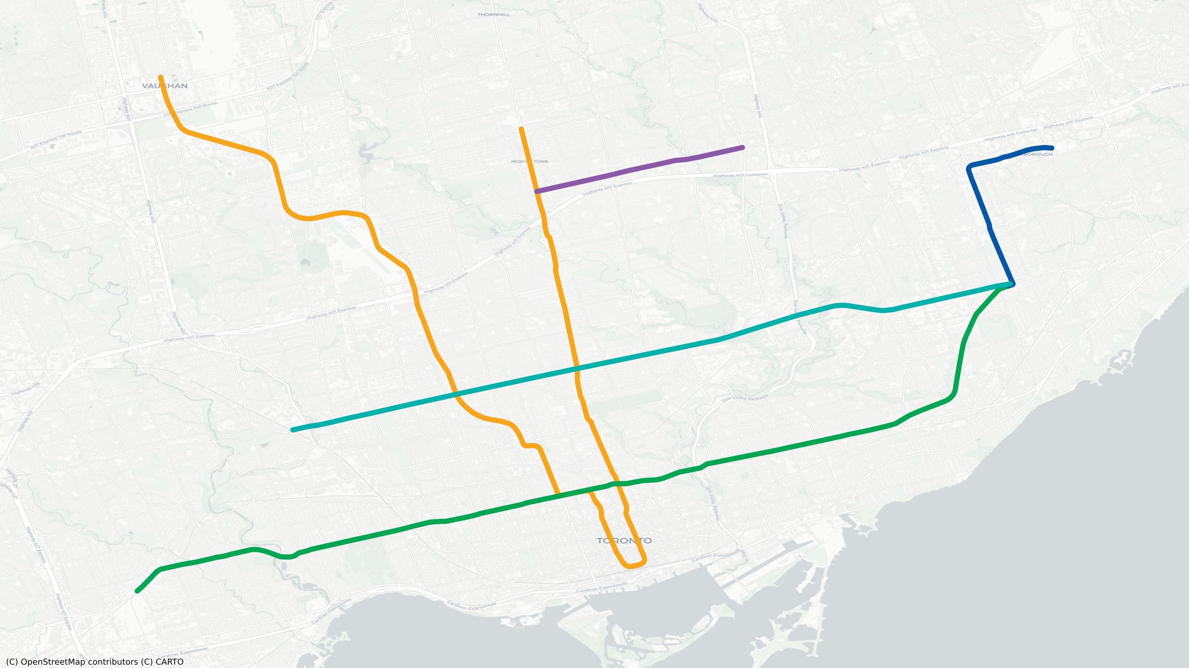
Where do you live?
● Line 1 Yonge-University
● Line 2 Bloor-Danforth
● Line 3 Scarborough
● Line 4 Sheppard
● Line 5 Eglinton
Duplicate the pin below (Ctrl/Cmd+D) and drag your copy onto your neighbourhood.
<- duplicate me

