Slide 1

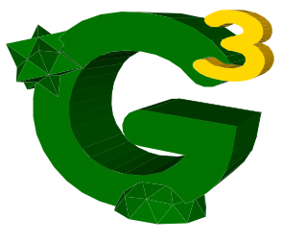

A Dimension-Independent and Extensible Framework for Huge Geometric Models
David CANINO – canino@disi.unige.it

Slide 2
Brief Description
The dimension of huge models often exceeds the RAM size in a common PC workstation. Thus, using an External Memory (EM) technique is mandatory.
In this poster, we define a dimension-independent and extensible framework, called Objects Management in Secondary Memory (OMSM).
The OMSM framework can be easily adapted to the users needs through dynamic plugins, integrating a lot of techniques in a storing architecture.
David CANINO – canino@disi.unige.it – Dept. of Computer Science, Genoa, IT

Slide 3
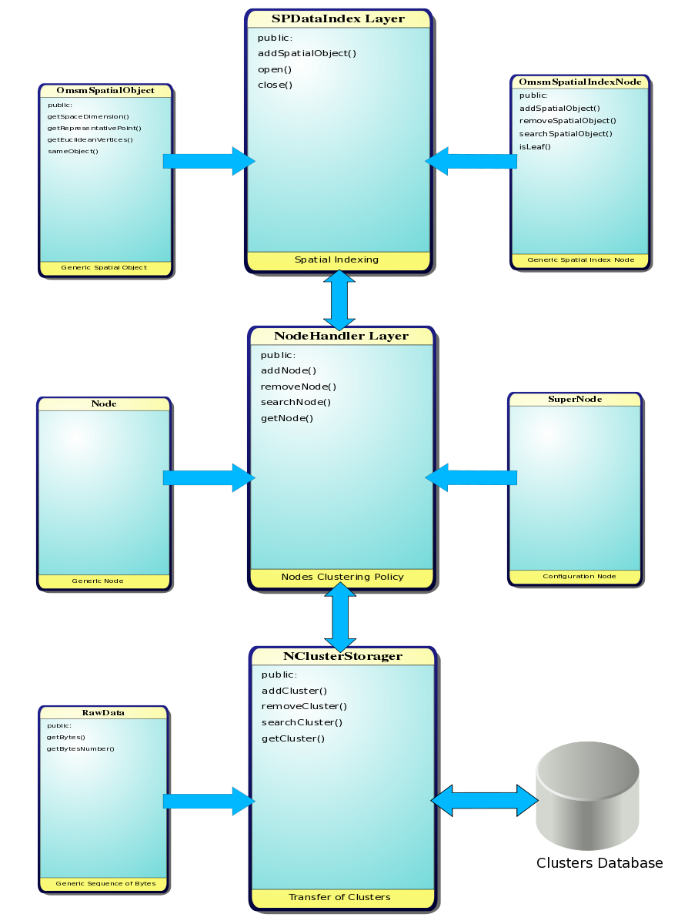
OMSM Organization
Independent aspects:
    Spatial indexing
    Clustering policy
    Clusters transfer
A layer for each aspect with a Common Interface
Independent data model for each layer
Interface and Dynamic Loading design patterns
David CANINO – canino@disi.unige.it – Dept. of Computer Science, Genoa, IT

