Slide 1

Escuela Politécnica Nacional
Chunk-based Malware Classifiers for Communication Networks
David Fabián Cevallos Salas
September, 2023

Slide 2

Schedule
Introduction
Related work
Background
CIC-MalMem-2022 Dataset
Methodology
Analysis and Results
Conclusion
Paper
2

Slide 3
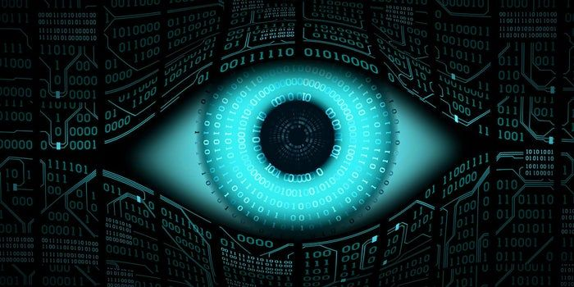

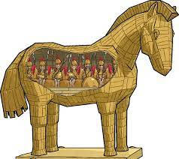
Introduction
Malware continue to affect to individuals, organizations, countries and communities.
Mainly three categories of chunk-based malware: Spyware, Ransomware and Trojan Horses.
Classify malware categories is a difficult task, even more malware families and strains.
Spyware
Ransomware
Trojan Horse
3

Slide 4
Introduction: Problem
Security controls act mainly before runtime:
Advanced Malware Protection (AMP)
Antivirus
E-mail protection,
Educating users,
Others.
At runtime is likely imposible to detect and interrupt an exploit.
This fact certainly produce data leakages.
Thus, recognizing patterns and behaviours at runtime (such as number
of thread, callbacks, handles, mutex, and semaphores)
might help to classify malware families.
4

Slide 5

Related work
AML with LSTM [1]
Chip multiprocessors [2]
Self learning DNN [3]
Heterogeneous Deep Neuronal Network [4]
Bidirectional Long Short-Term
Memory NN [5]
Parallel Computing [6]
Refereces
[1] I. Yilmaz, A. Siraj, and D. Ulybyshev, “Improving DGA-Based malicious domain classifiers for malware defense with adversarial machine learning,” 4th IEEE Conference on Information and Communication Technology, CICT 2020, 2020
[2] B. Kumar, S. Thakur, K. Basu, M. Fujita, and V. Singh, “A low overhead methodology for validating memory consistency models in chip multiprocessors,” Proceedings - 33rd International Conference on VLSI Design, VLSID 2020 - Held concurrently with 19th International Conference on Embedded Systems, pp. 101–106, 2020
[3] J. Yang and Y. Guo, “AEFETA: Encrypted traffic classification framework based on self-learning of feature,” 2021 IEEE 6th International Conference on Intelligent Computing and Signal Processing, ICSP 2021, no. Icsp, pp. 876–880, 2021.
[4] L. Yang, G. Liu, Y. Dai, J. Wang, and J. Zhai, “Detecting stealthy domain generation algorithms using heterogeneous deep neural network framework,” IEEE Access, vol. 8, pp. 82 876–82 889, 2020.
[5] Girinoto, H. Setiawan, P. A. W. Putro, and Y. R. Pramadi, “Comparison of LSTM Architecture for Malware Classification,” Proceedings - 2nd International Conference on Informatics, Multimedia, Cyber, and Information System, ICIMCIS 2020, pp. 93–97, 2020.
[6] D. Appello, P. Bernardi, A. Calabrese, S. Littardi, G. Pollaccia, S. Quer, V. Tancorre, and R. Ugioli, “Accelerated Analysis of Simulation Dumps through Parallelization on Multicore Architectures,” Proceedings - 2021 24th International Symposium on Design and Diagnostics of Electronic Circuits and Systems, DDECS 2021, pp. 69–74, 2021
5

Slide 6
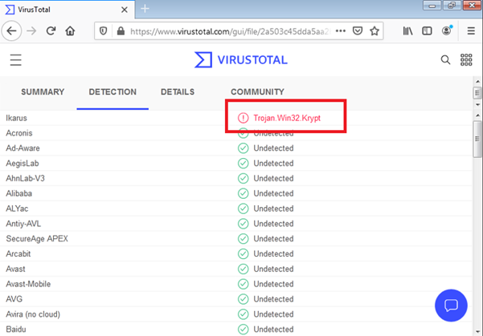
Background
Chunk-based malware is able to transmit small pieces of information.
Reconstruction takes place at the target.
Once one node is infected, it tries to replicate to another node.
6

Slide 7

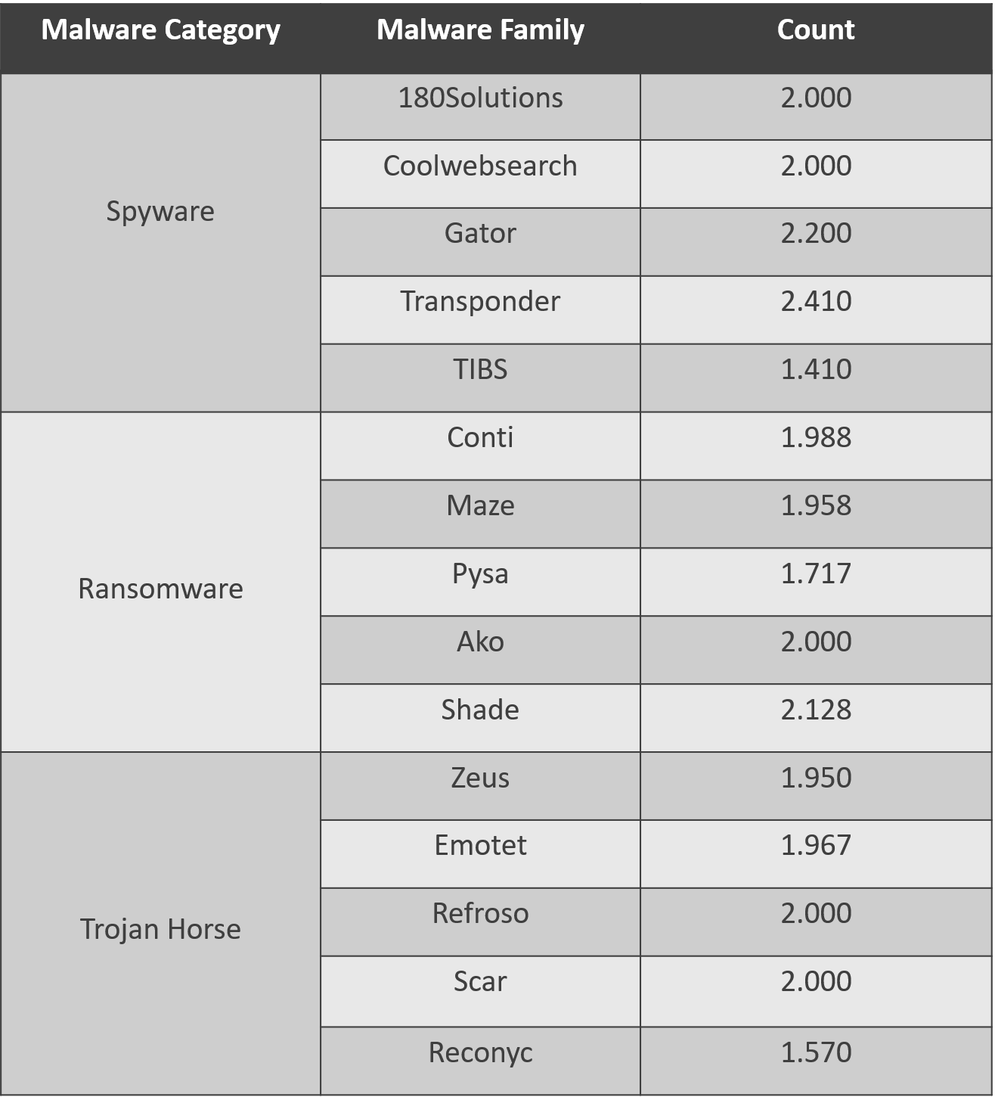
Methodology: Dataset
Created by the Canadian Institute for Cybersecurity of the University of New Brunswick (CICUNB).
29.298 benign processes and 29.298 malicious processes
55 features including (Number of threads, number of handles, callbacks, mutex, semaphores, etc)
7

Slide 8
Methodology
5. Conclusion and reporting
4. Unsupervised Learning
3. Multiclasses classifiers
2. Data cleaning and preprocessing
1. Data acquisition
8

Slide 9
Methodology
General techniques:
Stratified splitting
Stratified 10-Folds
Training, Cross validation and Evaluation datasets
Machine Learning Algorithms:
Support Vector Machine Classifier (SVC)
Decision tree (DT)
Random Fores (RF)
Linear Discriminant Analysis (LDA)
Naive Bayes (NB)
Deep Neuronal Network (DNN)
Adaptive Neuro Fuzzy Inference System (ANFIS)
SMOTED Deep Neuronal Network (S-DNN)
9

Slide 10
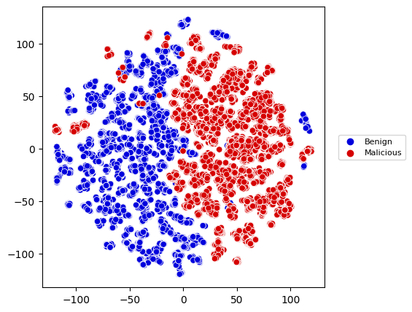
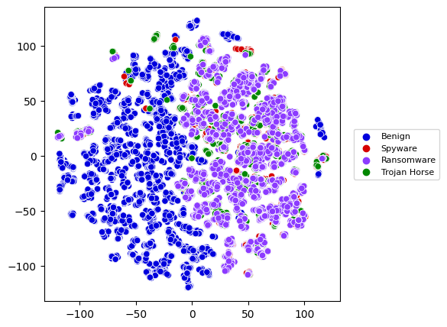
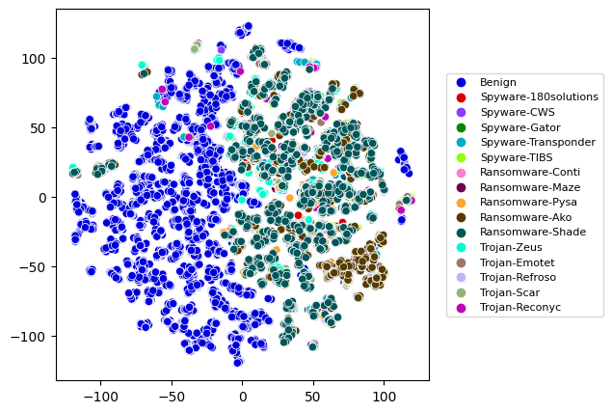
Analysis and Results
Families classification
Binary classification
Categories classification
10

Slide 11
Analysis and Results
Cross-validation average metrics
Algorithm | Precision | Recall | F1-score | Accuracy | Error | Specificity | False Positive Rate | AUC
SVC | 0,4315 | 0,2879 | 0,2908 | 0,6215 | 0,3785 | 0,9755 | 0,0245 | 0,8760
DT | 0,4850 | 0,4759 | 0,4749 | 0,7200 | 0,2800 | 0,9819 | 0,0181 | 0,8855
RF | 0,5443 | 0,5284 | 0,5229 | 0,7484 | 0,2516 | 0,9837 | 0,0163 | 0,9541
LDA | 0,3325 | 0,2457 | 0,2387 | 0,5970 | 0,4030 | 0,9738 | 0,00262 | 0,8547
NB | 0,2944 | 0,2006 | 0,1492 | 0,5647 | 0,4352 | 0,9718 | 0,0282 | 0,8321
DNN | 0,6202 | 0,6202 | 0,6202 | 0,6202 | 0,3798 | 0,9867 | 0,0133 | 0,8981
ANFIS | 0,2031 | 0,0941 | 0,2406 | 0,3115 | 0,6885 | 0,9246 | 0,0754 | 0,7078
S-DNN | 0,6830 | 0,6830 | 0,6830 | 0,6830 | 0,3170 | 0,9921 | 0,0079 | 0,9344
Test metrics
Algorithm | Precision | Recall | F1-score | Accuracy | Error | Specificity | False Positive Rate | AUC
SVC | 0,4277 | 0,2814 | 0,2845 | 0,6184 | 0,3819 | 0,9752 | 0,0248 | 0,8752
DT | 0,4836 | 0,4729 | 0,4723 | 0,7189 | 0,2811 | 0,9818 | 0,0182 | 0,8856
RF | 0,5429 | 0,5241 | 0,5209 | 0,7464 | 0,2536 | 0,9836 | 0,0164 | 0,9546
LDA | 0,3251 | 0,2411 | 0,2337 | 0,5949 | 0,4051 | 0,9737 | 0,0263 | 0,8541
NB | 0,2956 | 0,2016 | 0,1491 | 0,5660 | 0,4340 | 0,9719 | 0,0281 | 0,8319
DNN | 0,6788 | 0,6220 | 0,6201 | 0,6220 | 0,3780 | 0,9853 | 0,0147 | 0,8981
ANFIS | 0,1110 | 0,0766 | 0,1266 | 0,1918 | 0,8082 | 0,9494 | 0,0506 | 0,7077
S-DNN | 0,7115 | 0,6788 | 0,6815 | 0,6788 | 0,3212 | 0,9901 | 0,0099 | 0,9344
11

Slide 12
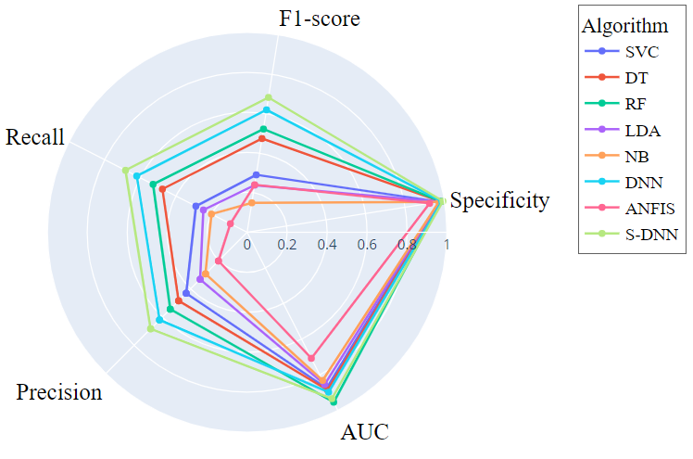
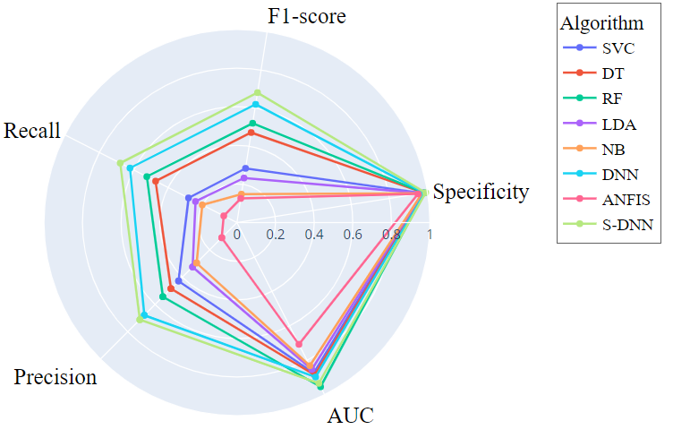
Analysis and Results
CROSS-VALIDATION METRICS
TEST METRICS
12

Slide 13
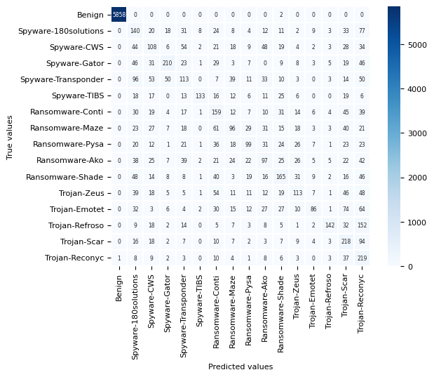
Analysis and Results
TEST S-DNN CONFUSION MATRIX
13

Slide 14
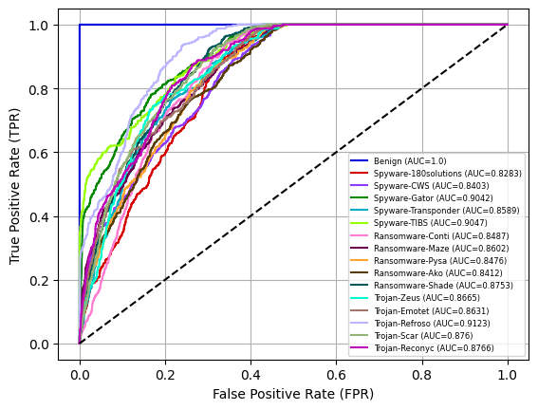
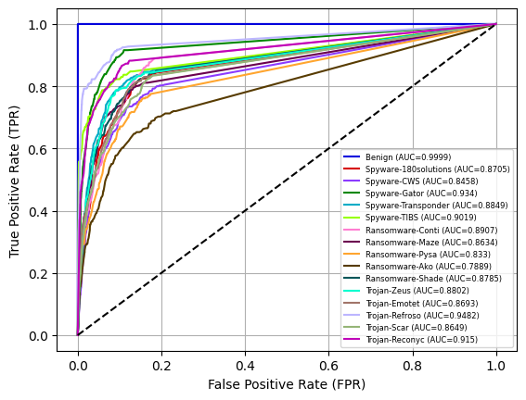
Analysis and Results
TEST ROC CURVES
SVC
DT
14

Slide 15
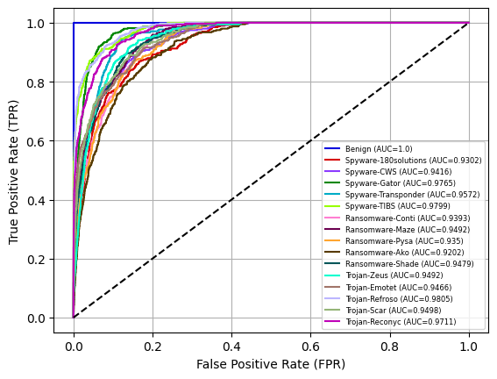
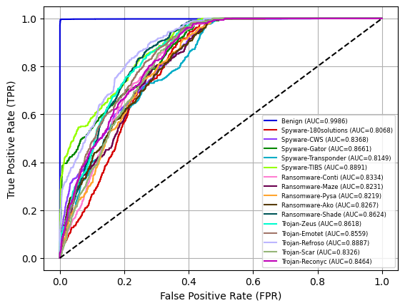
Analysis and Results
RF
LDA
15

Slide 16
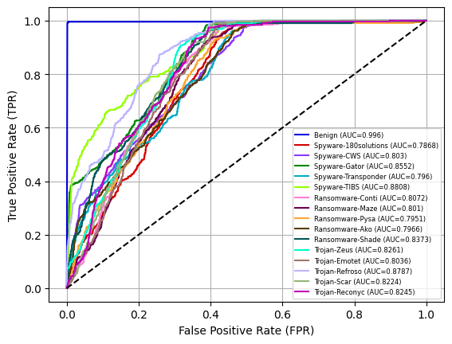
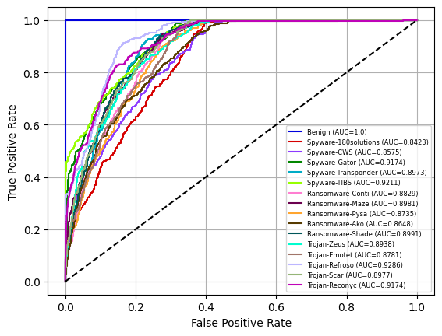
Analysis and Results
NB
DNN
16

Slide 17
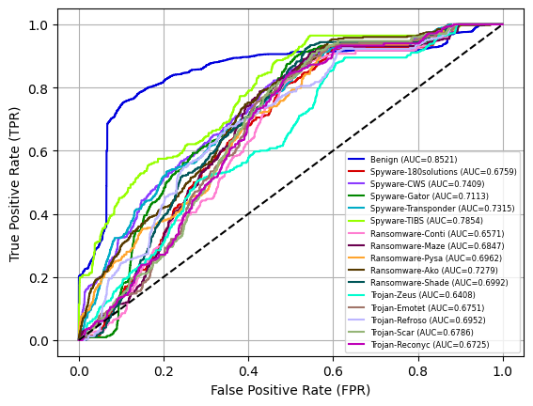
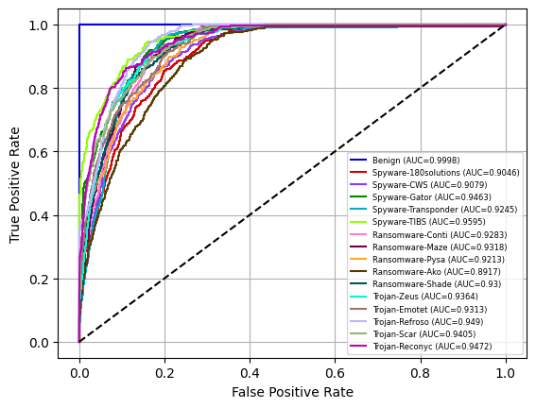
Analysis and Results
ANFIS
S-DNN
17

Slide 18
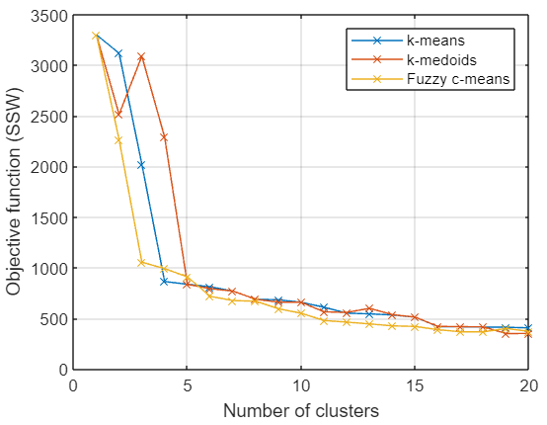
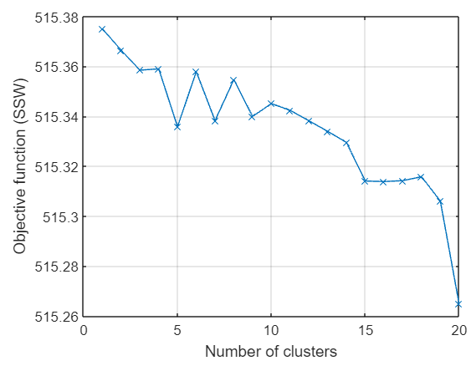
Analysis and Results
Unsupervised Learning
Elbow diagram
Hierarchical clustering
Parameters values
k-means:
k = 16
K-medoids:
k = 16
DBSCAN:
min_neighbors = 3
epsilon = 2.049,1
Hierarchical clustering:
Nro. clusters = 16
Single linkage
Fuzzy c-means:
c = 16
18

Slide 19
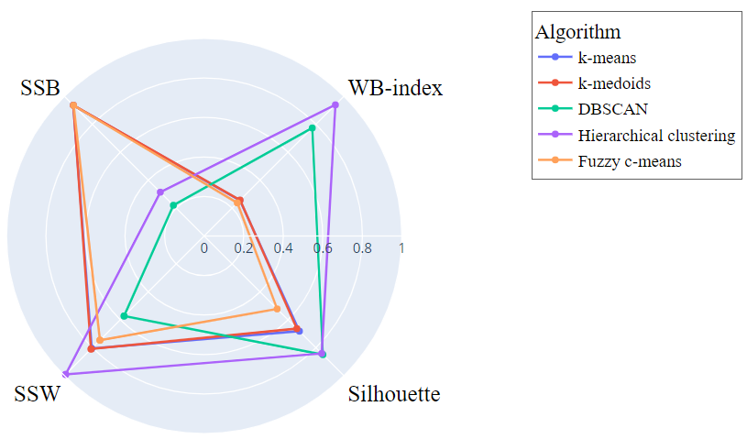
Analysis and Results
Unsupervised Learning
Algorithm | SSW | SSB | WB-index | Silhouette
k-means | 418,5362 | 3.276,6000 | 2,0437 | 0,6815
k-medoids | 420,7788 | 3.275,8000 | 2,0552 | 0,6631
DBSCAN | 297,8611 | 770,2884 | 6,1870 | 0,8945
Hierarchical clustering | 515,3139 | 1.097,8000 | 7,5107 | 0,8410
Fuzzy c-means | 387,7675 | 3.273,2000 | 1,8955 | 0,5233
19

Slide 20

Conclusion
Deep neural networks comprise a much more robust technique for the identification and classification of chunk-based
malware families in comparison to traditional machine learning algorithms such as SVC, decision trees, random forest,
among others
Deep neural networks achieved precision and recall values balanced and almost equal.
Oversampling helps substantially to reach better metrics in chunk-based malware classification.
CIC-MalMem-2022 is able to classify malware, but can be improved.
20

Slide 21
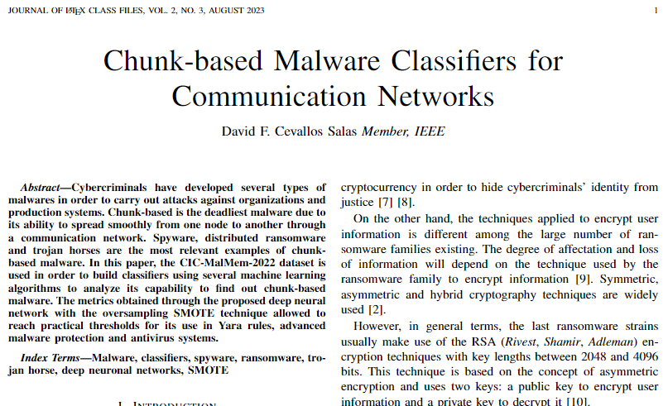
Paper
21

Slide 22
Thanks…
David Fabián Cevallos Salas
david.cevallos03@epn.edu.ec
22

