Slide 1
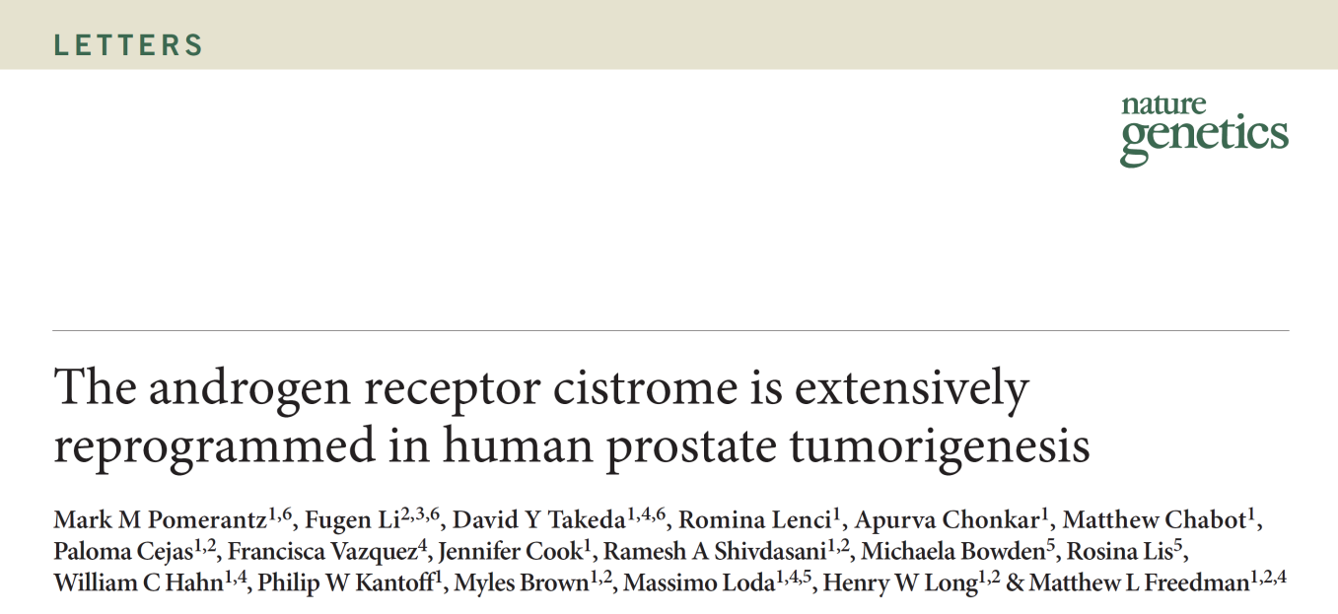
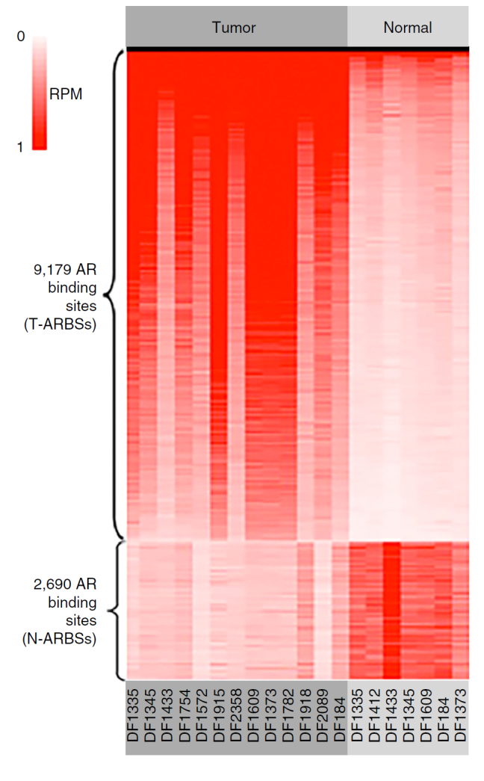
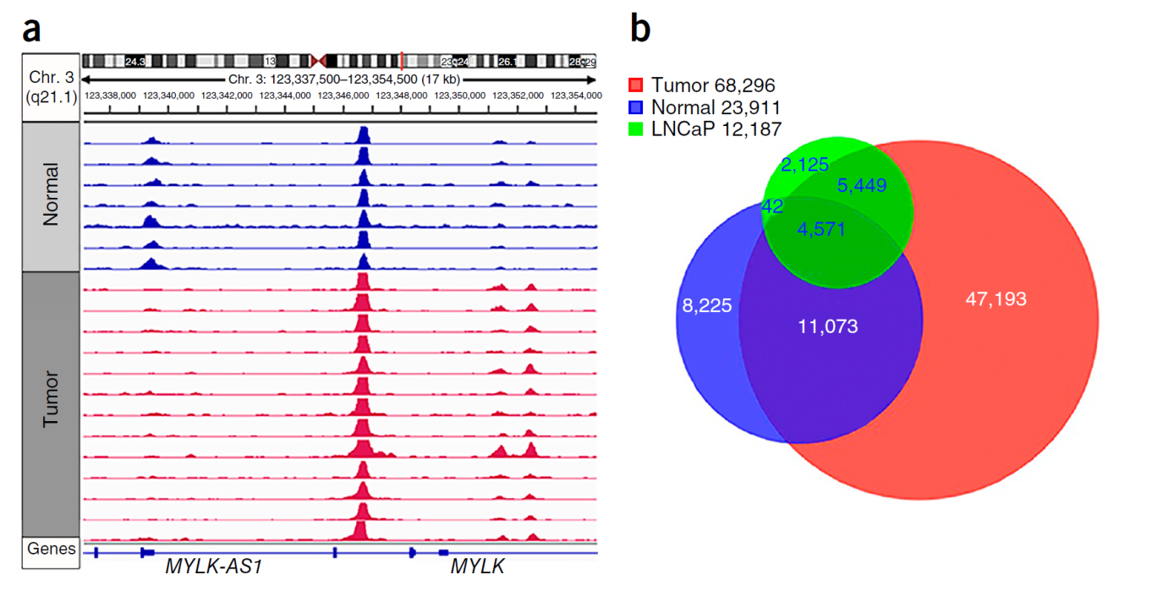
Pomerantz et al., 2015 Nat. Gen.

Slide 2
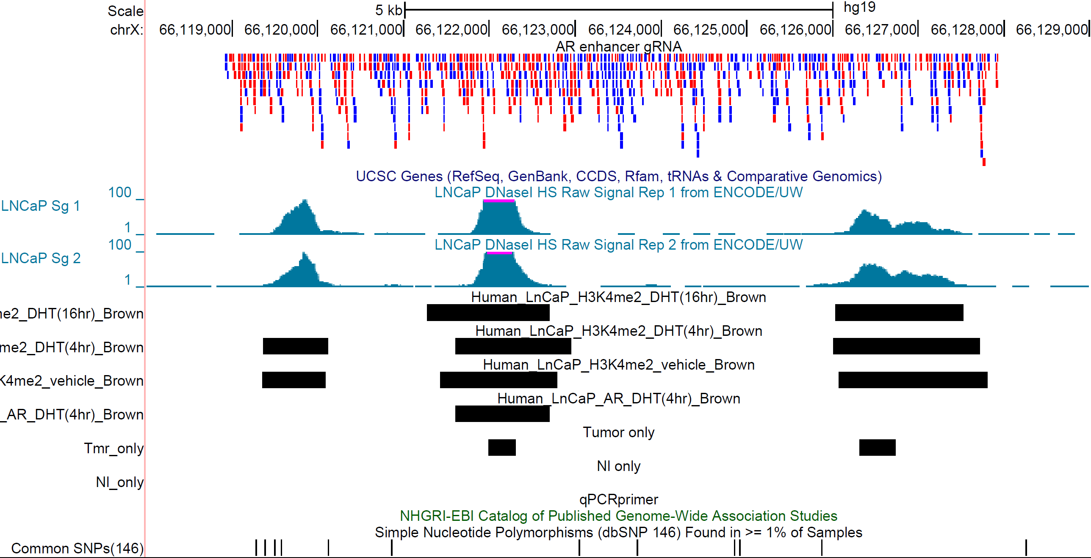
Acquired enhancer in prostate metastatic disease
H3K27Ac – mark of active enhancers/promoters
650 kb
DNase hypersensitivity peaks in LNCaP
9 kb

Slide 3
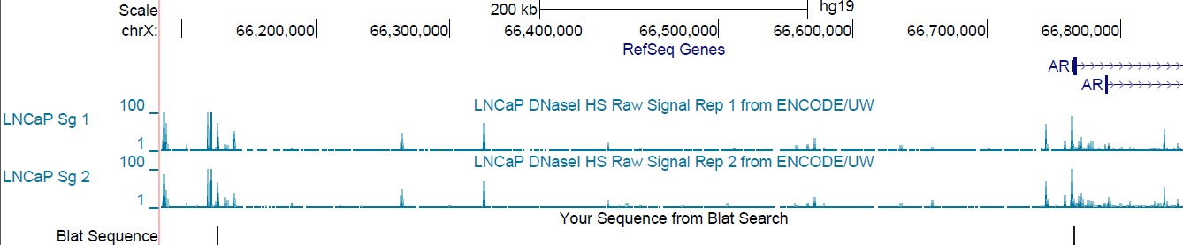
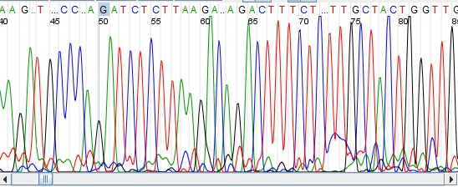
Chromosome conformation capture(3C) reveals interaction between enhancer and AR promoter
AR enhancer candidate
AR
Ligated
Bglii
TGTCTCTTAATACTTGAAGGGTAGATTCAAAAGATGCCCAGATCTCTTAAGACAGACTTTCTCTTGCTACTGGTTGGTTTGGCCTATTGGGTTTTTTTATAATTA

Slide 4
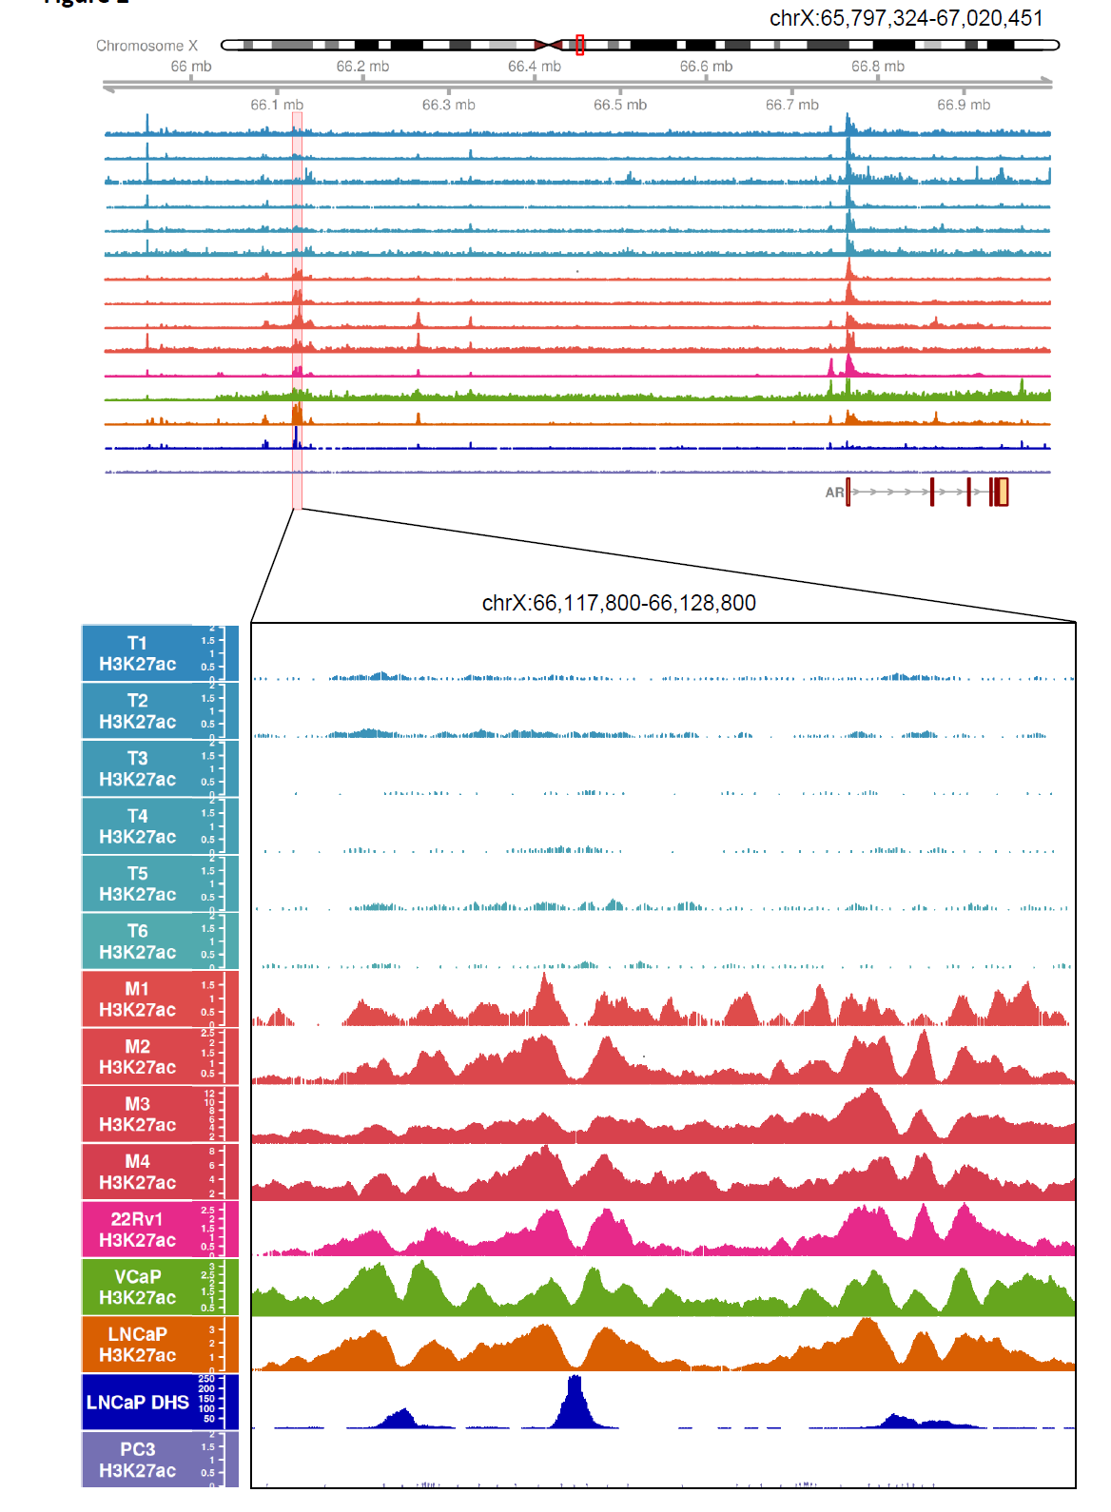
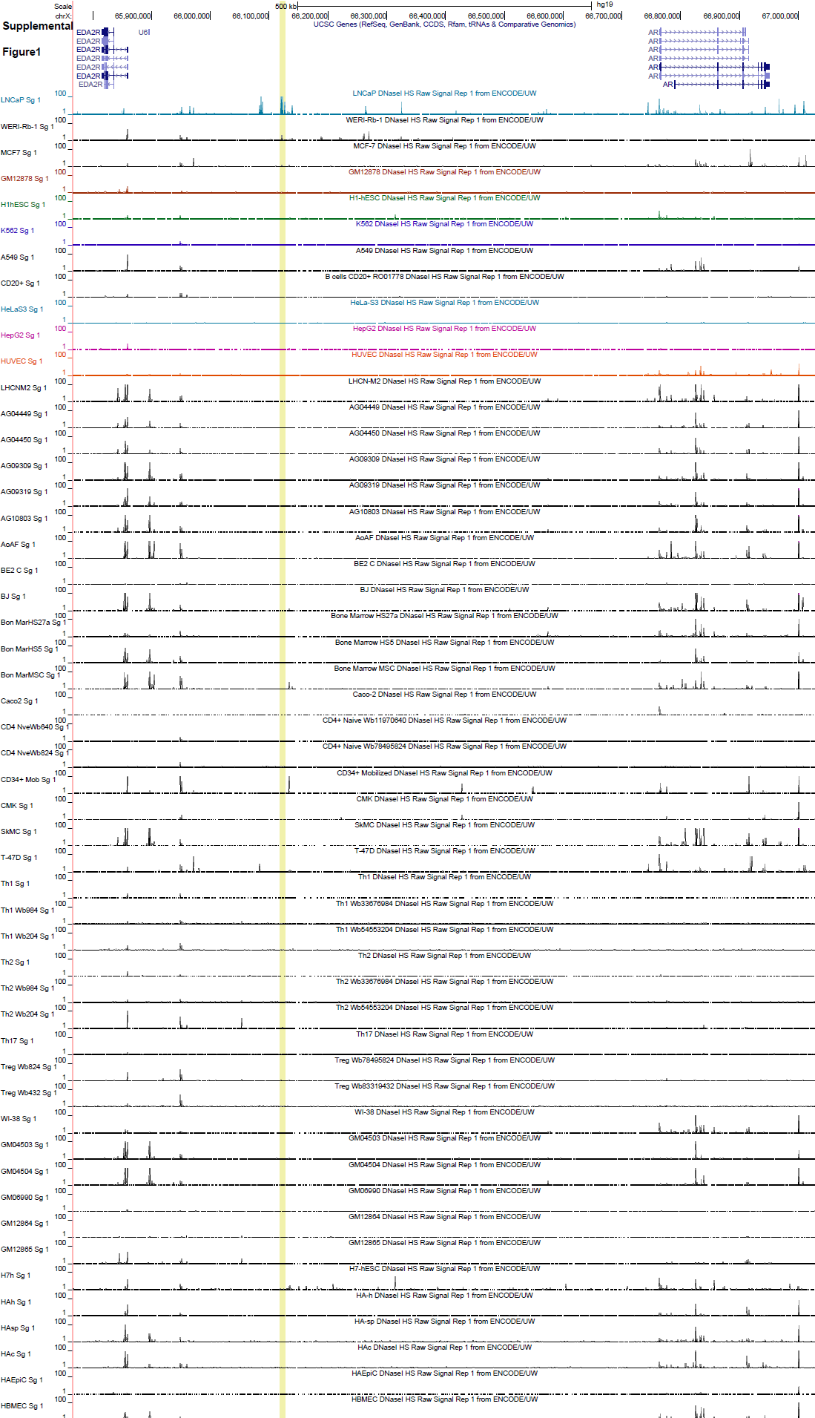
ENCODE DHS
Takeda & Spisak et. al., 2018 Cell

Slide 5
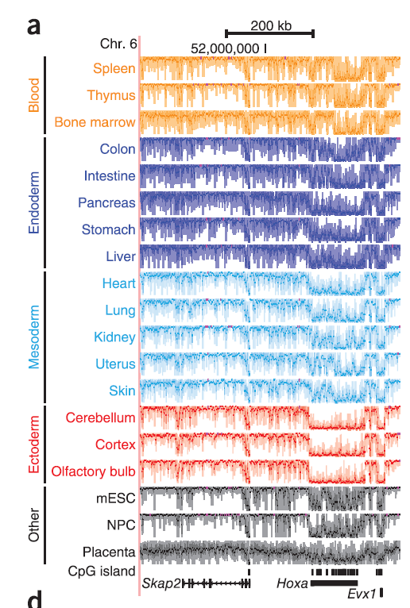
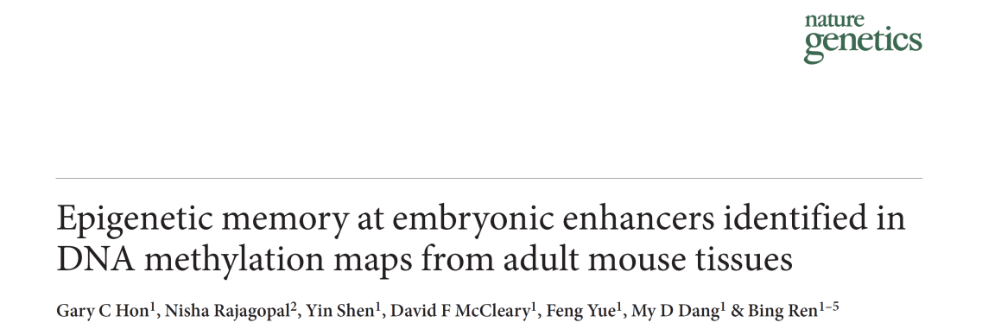
Epigenetic Memory
DNA methylation is a heritable epigenetic mark of cellular memory and responsible for tissue specific gene expression
Almost the entire genome - including gene bodies –
is methylated
~7% of the genome has different DNA methylation pattern (tsDMR)
tsDMRs are enriched in cis regulatory elements
Vestigial enhancers are hypomethylated
And
have NO active histone marks (H3K27ac) in adult tissue
2013

Slide 6
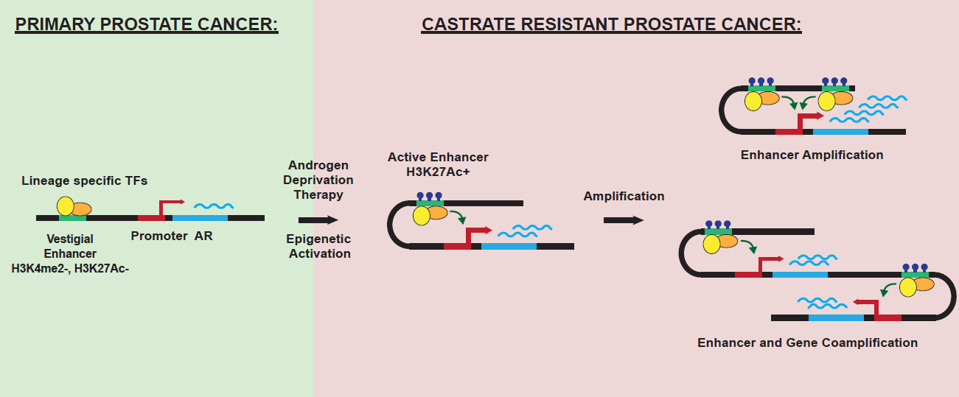
Enhancer Model
There are no germline variants in this region
Why this enhancer become active only in metastasis?
Takeda & Spisak et. al., 2018 Cell

Slide 7
Regulatory Element Screen

Slide 8
Hypothesis
Modification of AR enhancer candidates via CRISPRi and CRISPR-Cas9 influences cell proliferation via modulation of AR levels
+
x
AR
x
proliferation
LNCaP prostate cancer cell
line is AR-dependent

Slide 9
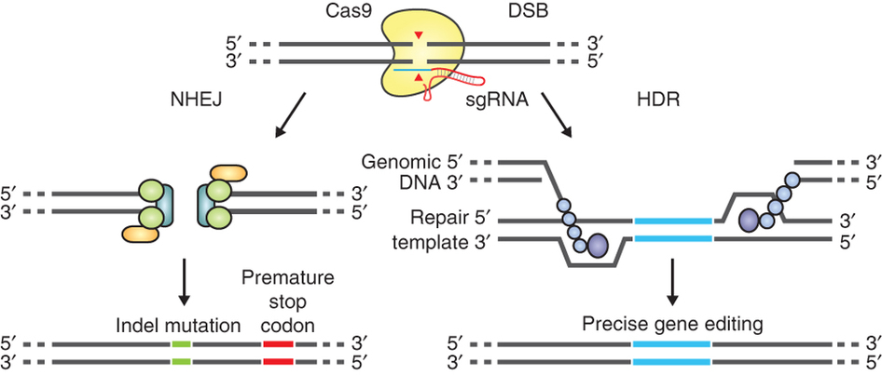
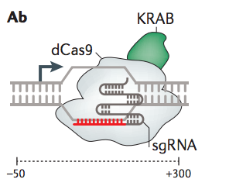
AR Regulatory Element Drop Out Screen
Fw
Rev
878 target gRNA
140 CTRL gRNA
100 non human target gRNA
40 positive CTRL gRNA, targeting
essential human genes (EIF4A3, SF3B3, RPL23, AR)
Test with both Cas9 nuclease and dCas9-KRAB
(CRISPRi) system
Cleavage → indels
Trnascriptional repression

Slide 10
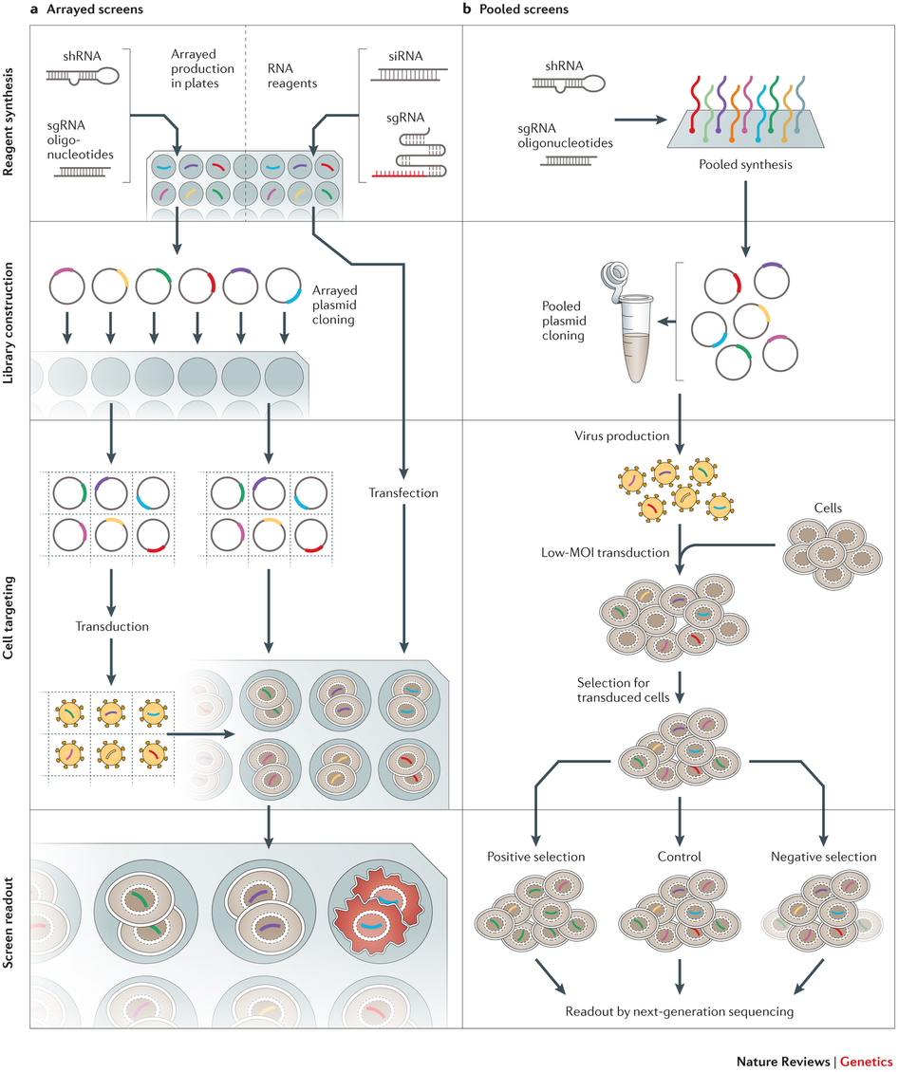

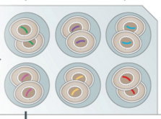
Experimental Design
Pooled
Plasmid
cloning
1
2
3
4
5
…
1018
1018x gRNAs
time 0
~1000x
Virus production
LNCaP
enhancer
AR expression
Low-MOI transduction
SpCas9
dCas9-KRAB
time 1
Antibiotic selection
~1M cells
enhancer
AR expression
Phenotypic
selection
time 2
enhancer
PCR of gRNAs followed by high-throughput sequencing
AR expression
Figure adapted from Nat Rev Genet. 2015 May;16(5):299-311.

Slide 11
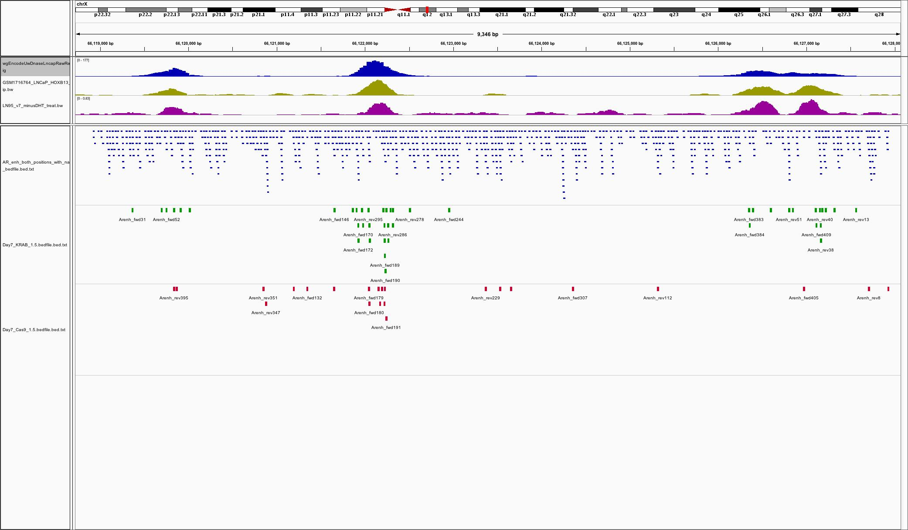
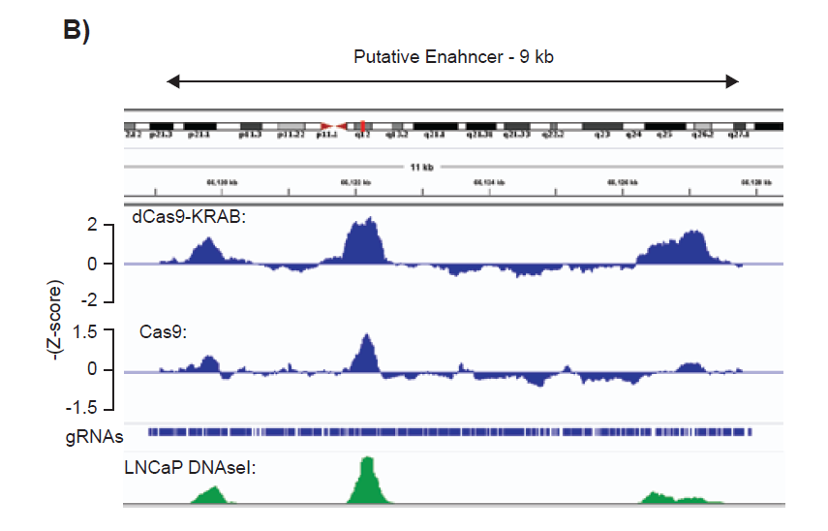
TOP gRNA positions based on –Z score
D
N
a
s
e
H
O
X
B
1
3
A
R
v
7
A
l
l
g
u
i
d
e
s
K
R
A
B
s
c
r
e
e
n
C
a
s
9
s
c
r
e
e
n

