Slide 1
Miniscreen05 Update
February 25, 2021
David Chen

Slide 2
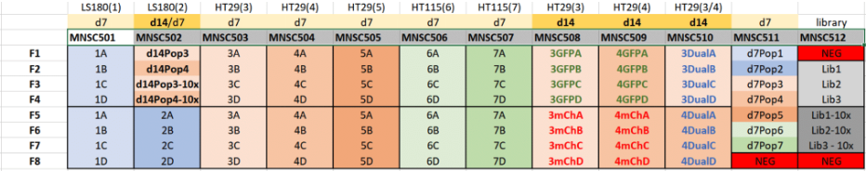
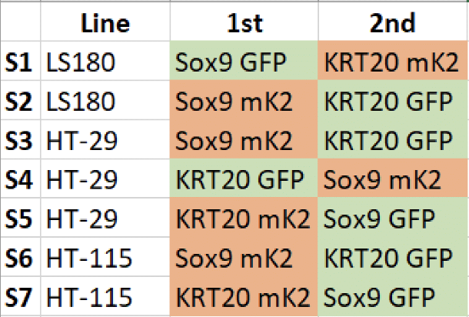
Cell Line Nomenclature
Dual
Single Channel
Dual
S1
S2
S3
S4
S5
S6
S7
S8
S9
S10
Replicate I
Replicate II
For example, Cell Line 5B refers to:
Cell Line
Properties
Notes:
76 fractions each with 76 gRNA read counts

Slide 3
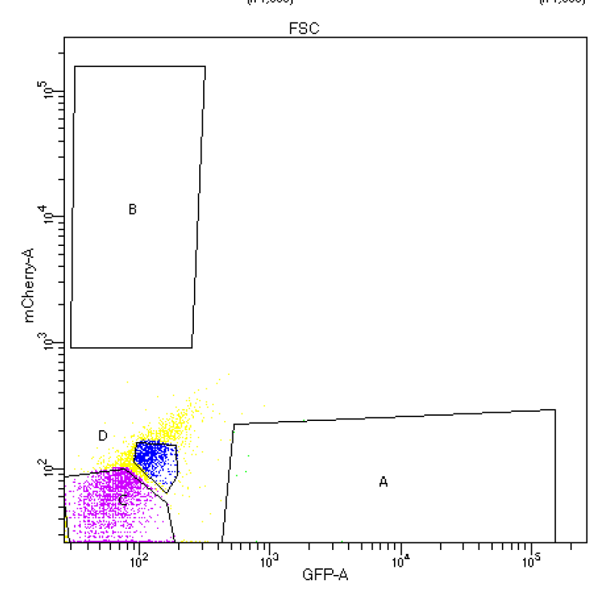
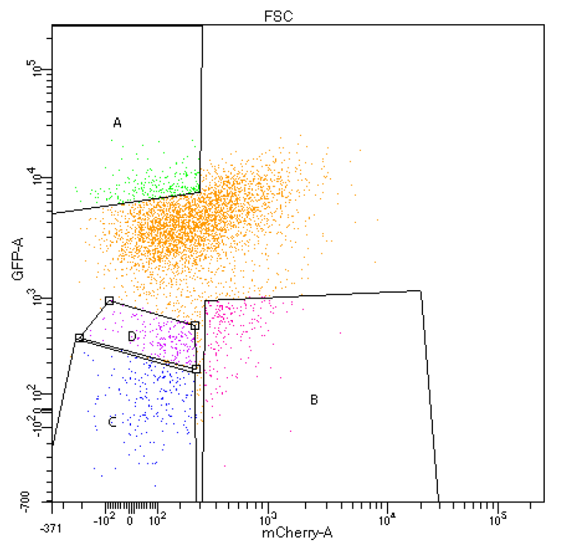
Dual Reporter System Overview
High GFP Intensity
Negative
LS180 S1
Cell Lines
No Fluorescent Intensity
High mCherry Intensity

Slide 4
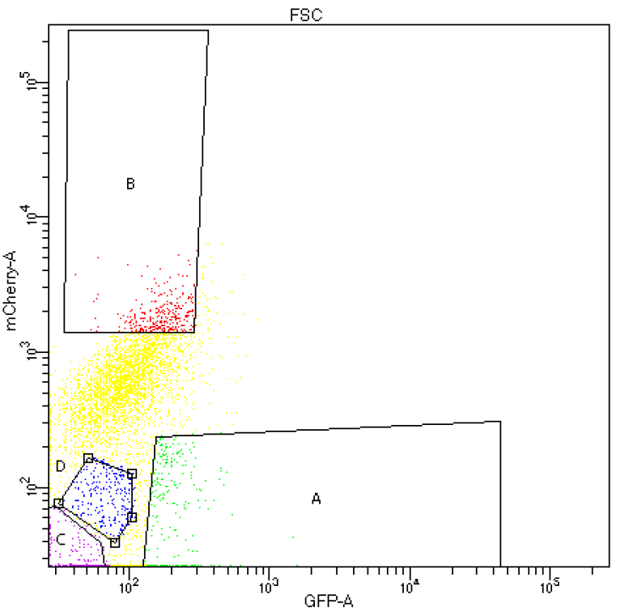
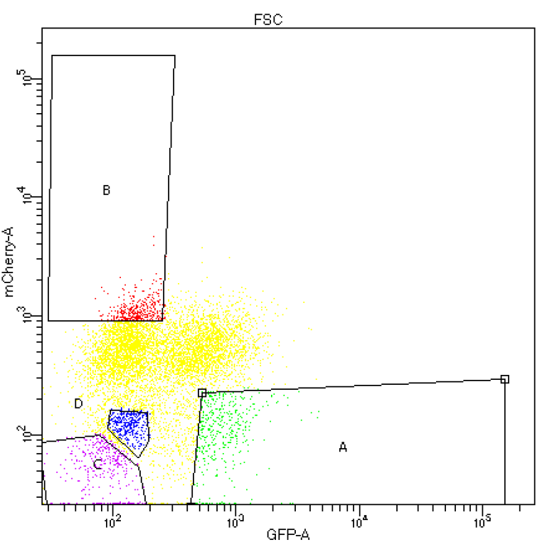
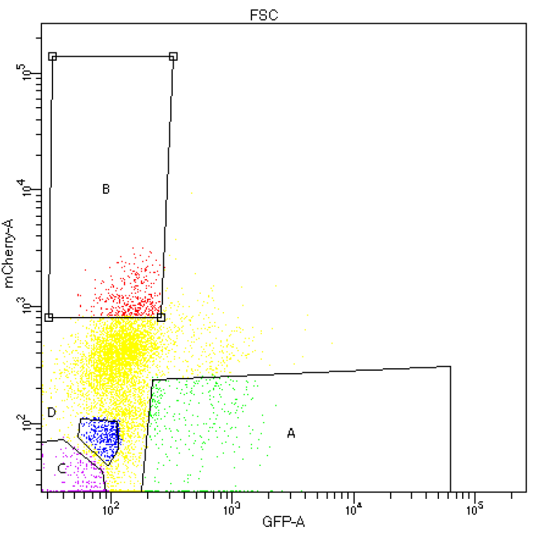
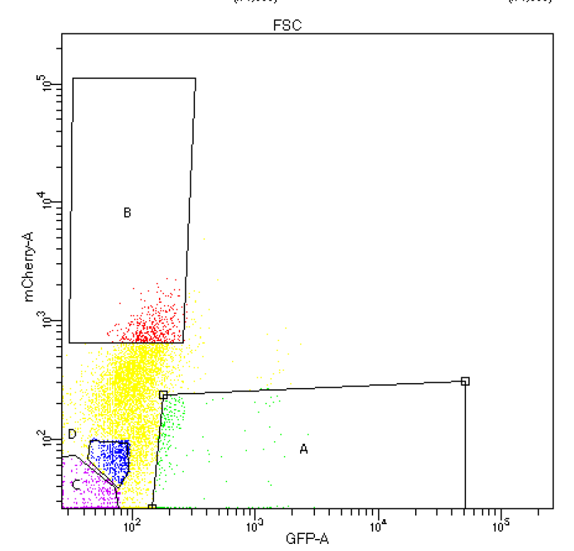
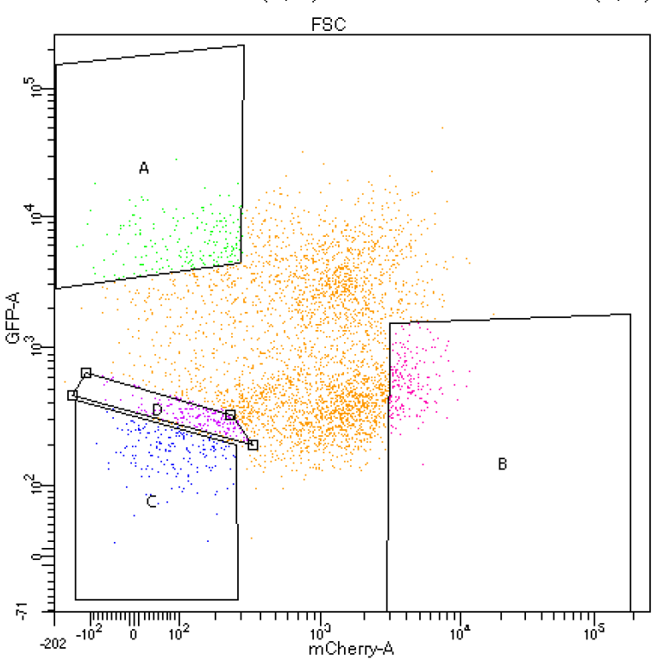
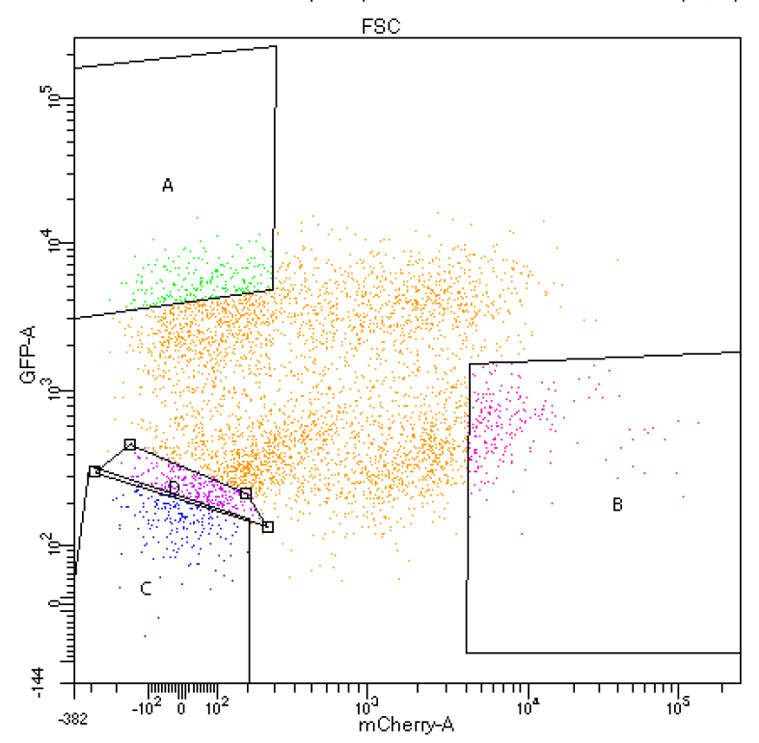
Fractions of Dual Reporter Cell Lines at Day 7
NEG
LS180(1)
LS180(2)
HT29(3)
Cell Lines
HT29(4)
HT29(5)
HT115(6)
HT115(7)
5 way comparison:
A vs. B
A vs. C
A vs. D
B vs. C
B vs. D

Slide 5
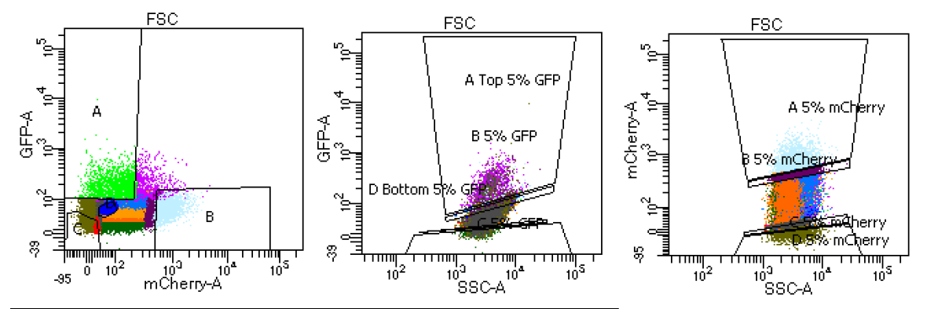
Single Channel Measurement Fractions at Day 14
Dual
Single
Single
Notes:
fix graphs, use the same graphs

Slide 6
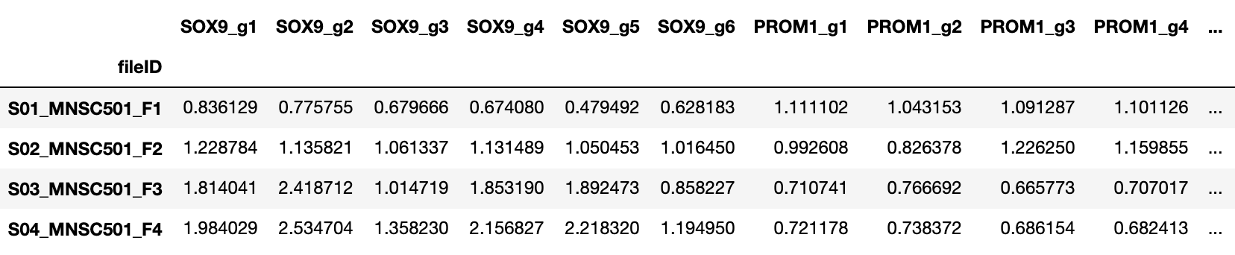
Data Normalization Pipeline
Total Read Normalization
Library Pool Normalization
 | SOX9 Guide 1 | SOX9 Guide 2 | SOX9 Guide 3 | Row Sum
Fraction 1 | 10 | 15 | 25 | 50
TRM Fraction 1 | 0.2 | 0.3 | 0.5 | 1.0
76 gRNA
Normalized Read Counts of 76 gRNA
Population Normalization
Notes:
fix graphs, use the same graphs

Slide 7
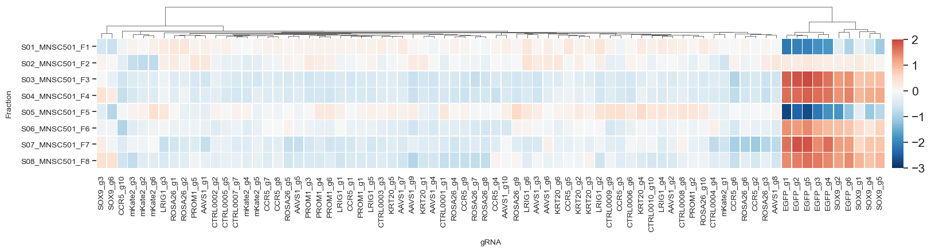
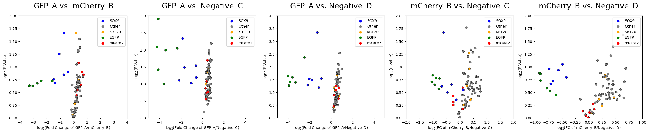
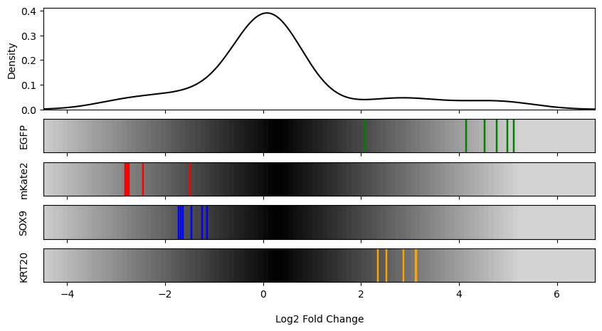
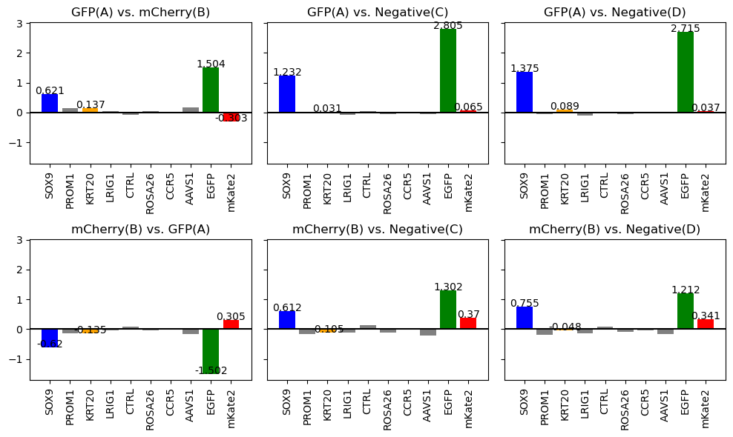
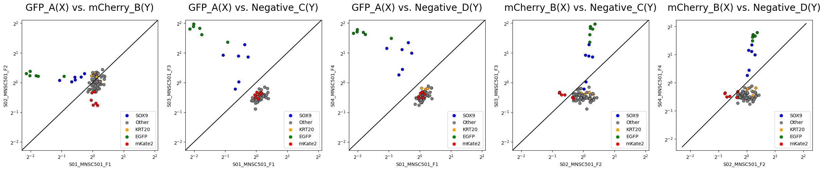
Data Processing and Visualization Pipeline
Normalized Read Counts of 76 gRNA
Heatmap
Volcano Plot
LFC Density
MaGeCK Beta Score
Scatter Plot
Notes:
fix graphs, use the same graphs

Slide 8
Objectives
Which reporter system produced a stronger effect (single vs dual)?
What is the optimal timepoint to conduct the screen (Day 7 vs Day 14)?
Which system within each cell produced a stronger effect?
Goal: Determine if and under what conditions a dual reporter system produces a stronger effect than a single reporter system.
I will demonstrate my analytical pipeline using 7 double knock-in cell lines:
LS180
SOX9 GFP, KRT20 mK2
SOX9 mK2, KRT20 GFP
HT-29
SOX9 mK2, KRT20 GFP
KRT20 GFP, SOX9 mK2
KRT20 GFP, SOX9 GFP
HT-115
SOX9 mK2, KRT20 GFP
KRT20 mK2, SOX9 GFP
Notes:
add in cell line images,
1. which was the better cell line
2. which system within a cell line was better
day 7 vs day 14

Slide 9
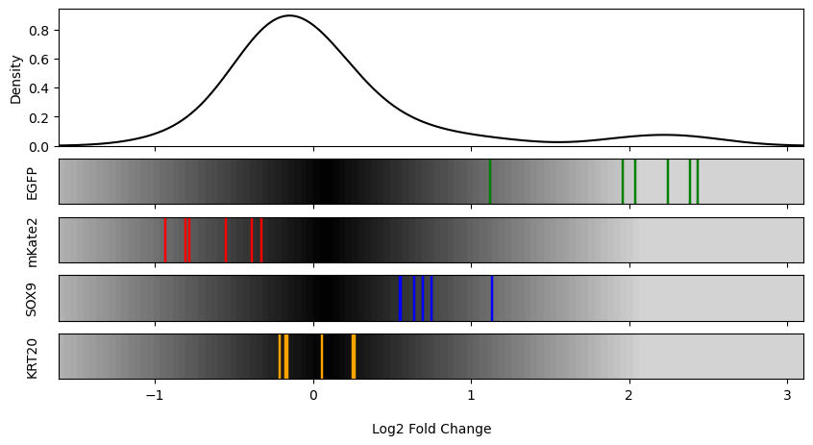
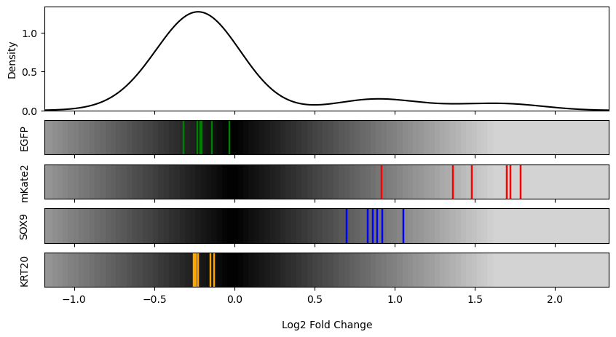
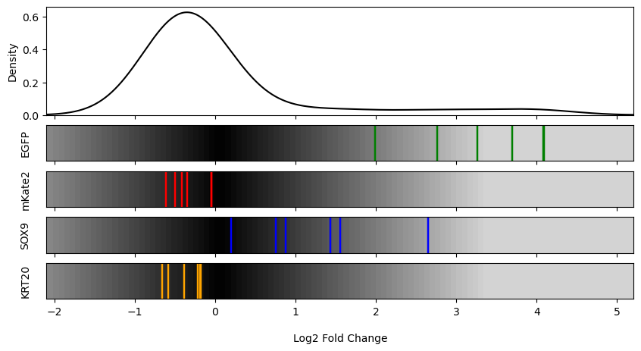
LS180 S1 vs. S2: GFP(A) | mCherry (B)
S1
S2
I
II
Notes:
change replicate name to roman numerals

Slide 10
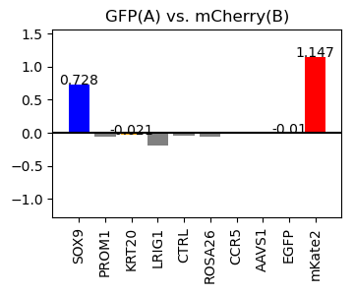
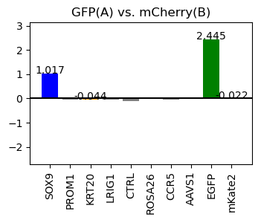
LS180 S1 vs. S2 Beta Score
S1
S2
I
II

Slide 11
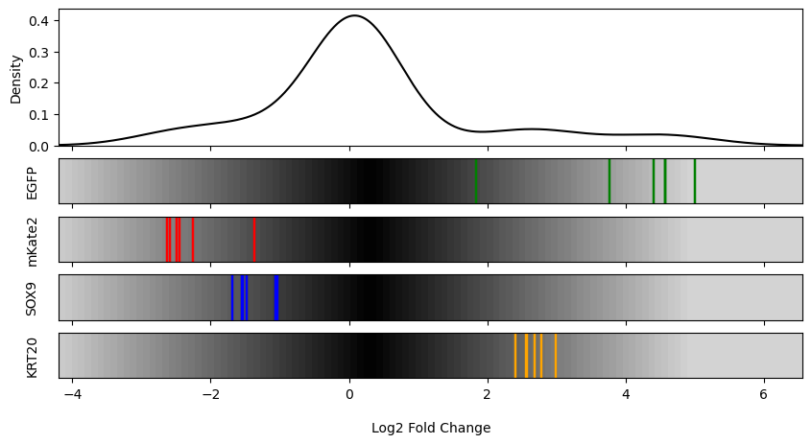
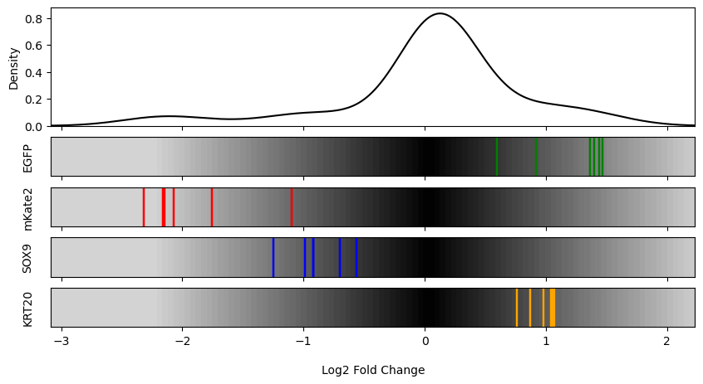
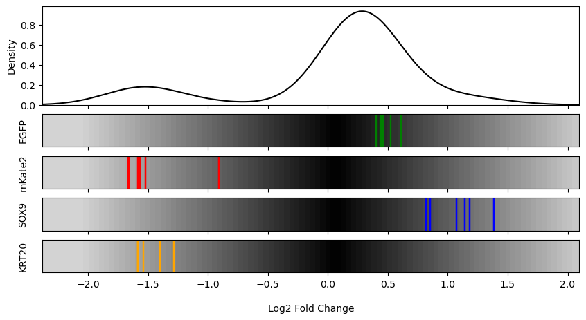
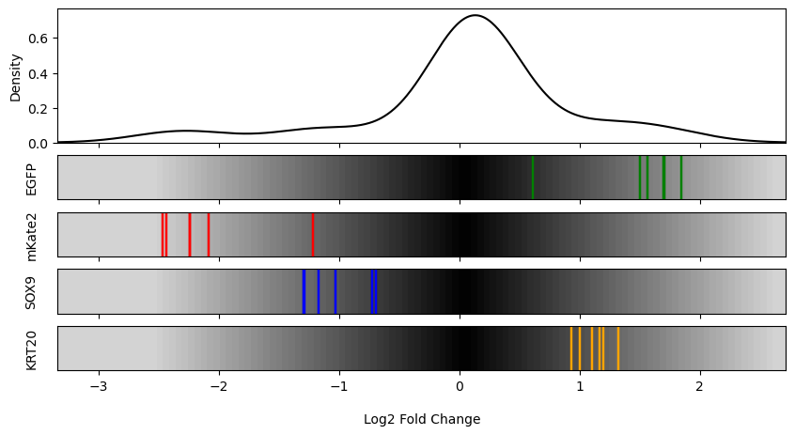
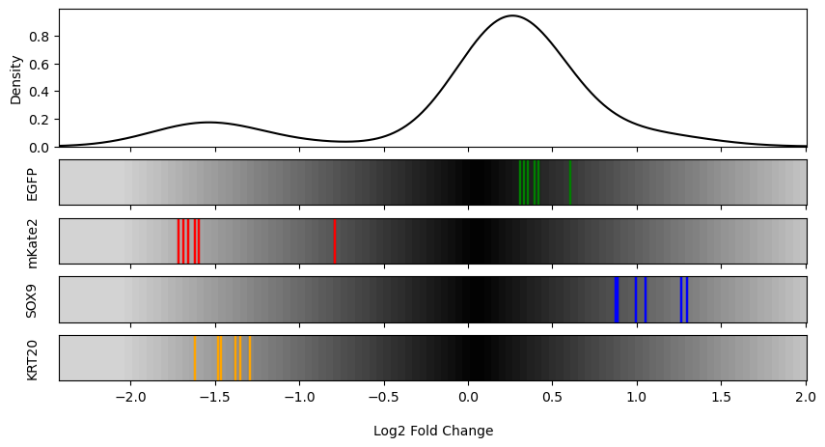
HT-29 S3 vs. S4 vs. S5: GFP(A) | mCherry (B)
S3
S4
S5
I
II

Slide 12
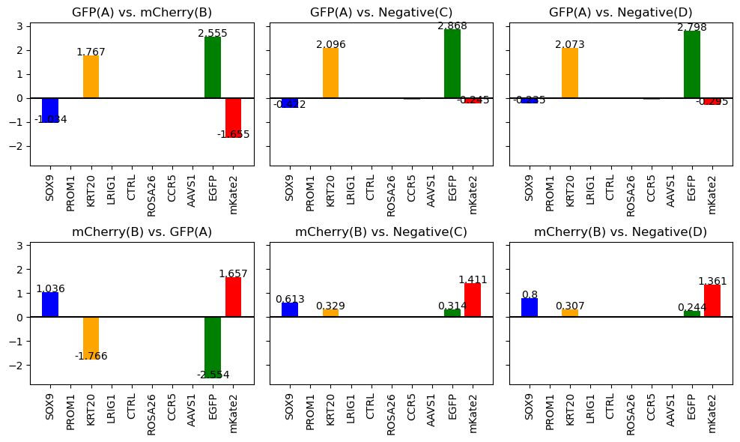
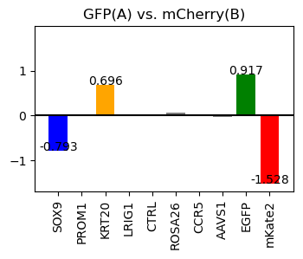
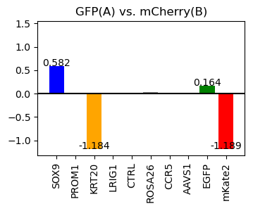
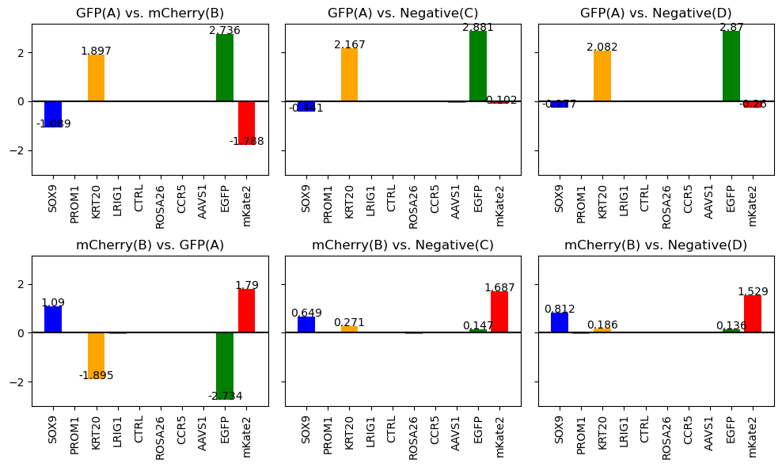
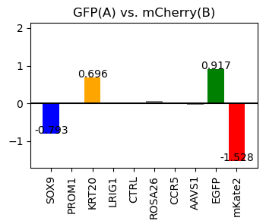
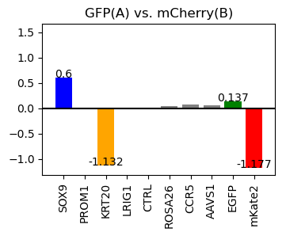
S3 vs. S4 vs. S5 Beta Score
S3
S4
S5
I
II

Slide 13
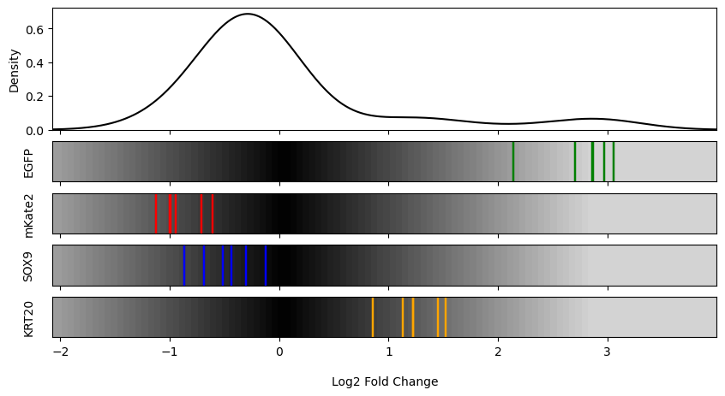
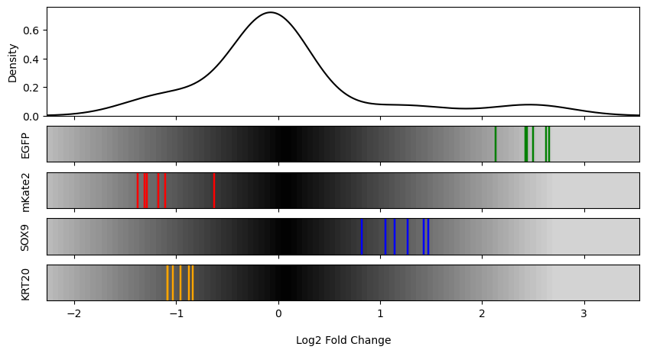
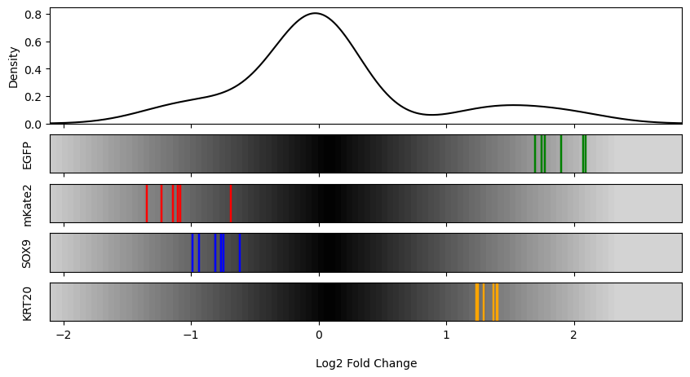
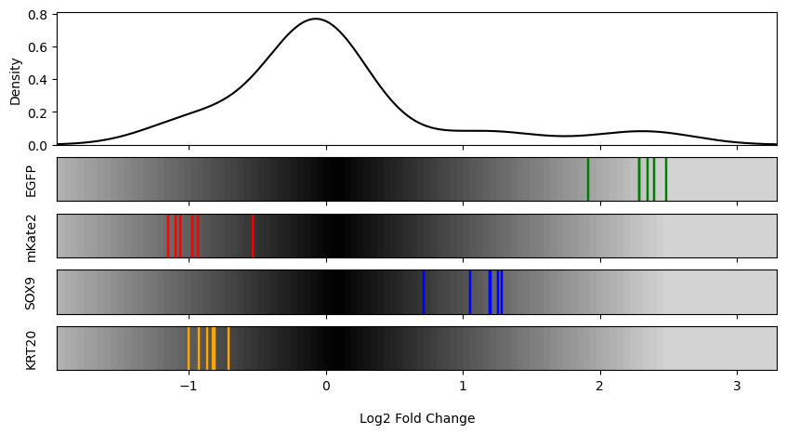
HT-115 S6 vs. S7: GFP(A) | mCherry (B)
S6
S7
I
II
Notes:
moderate magnitude of effect but expected effect is observed in expected directions

Slide 14
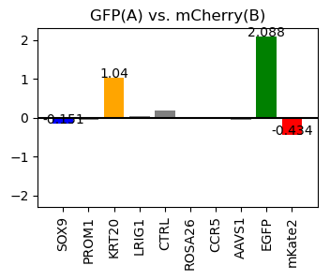
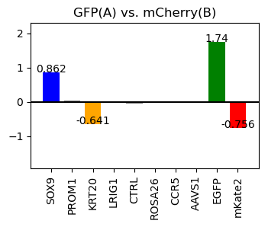
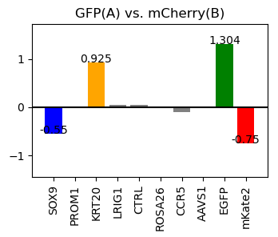
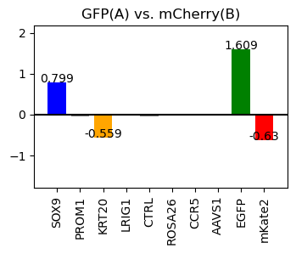
S6 vs. S7 Beta Score
S6
S7
I
II

Slide 15
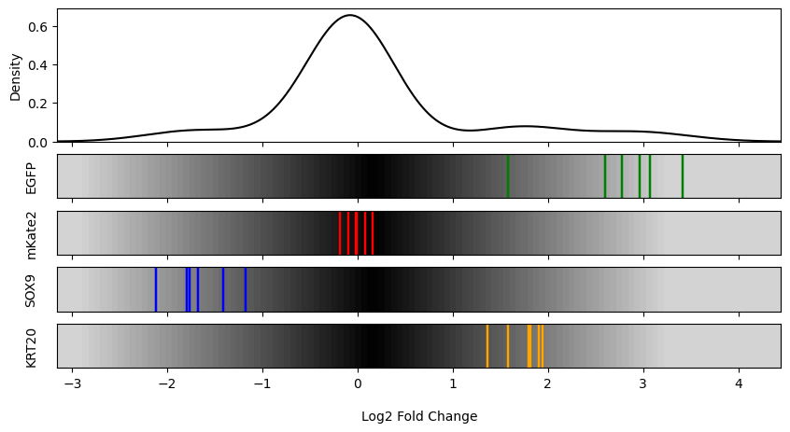
S3 (Dual at Day 7) vs. Primer 4 (Single at Day 7): GFP(A) | mCherry (B)
S3
Primer 4
Primer 4 at Day 7 (Top 2.5 vs Bottom 2.5)
I
II

Slide 16
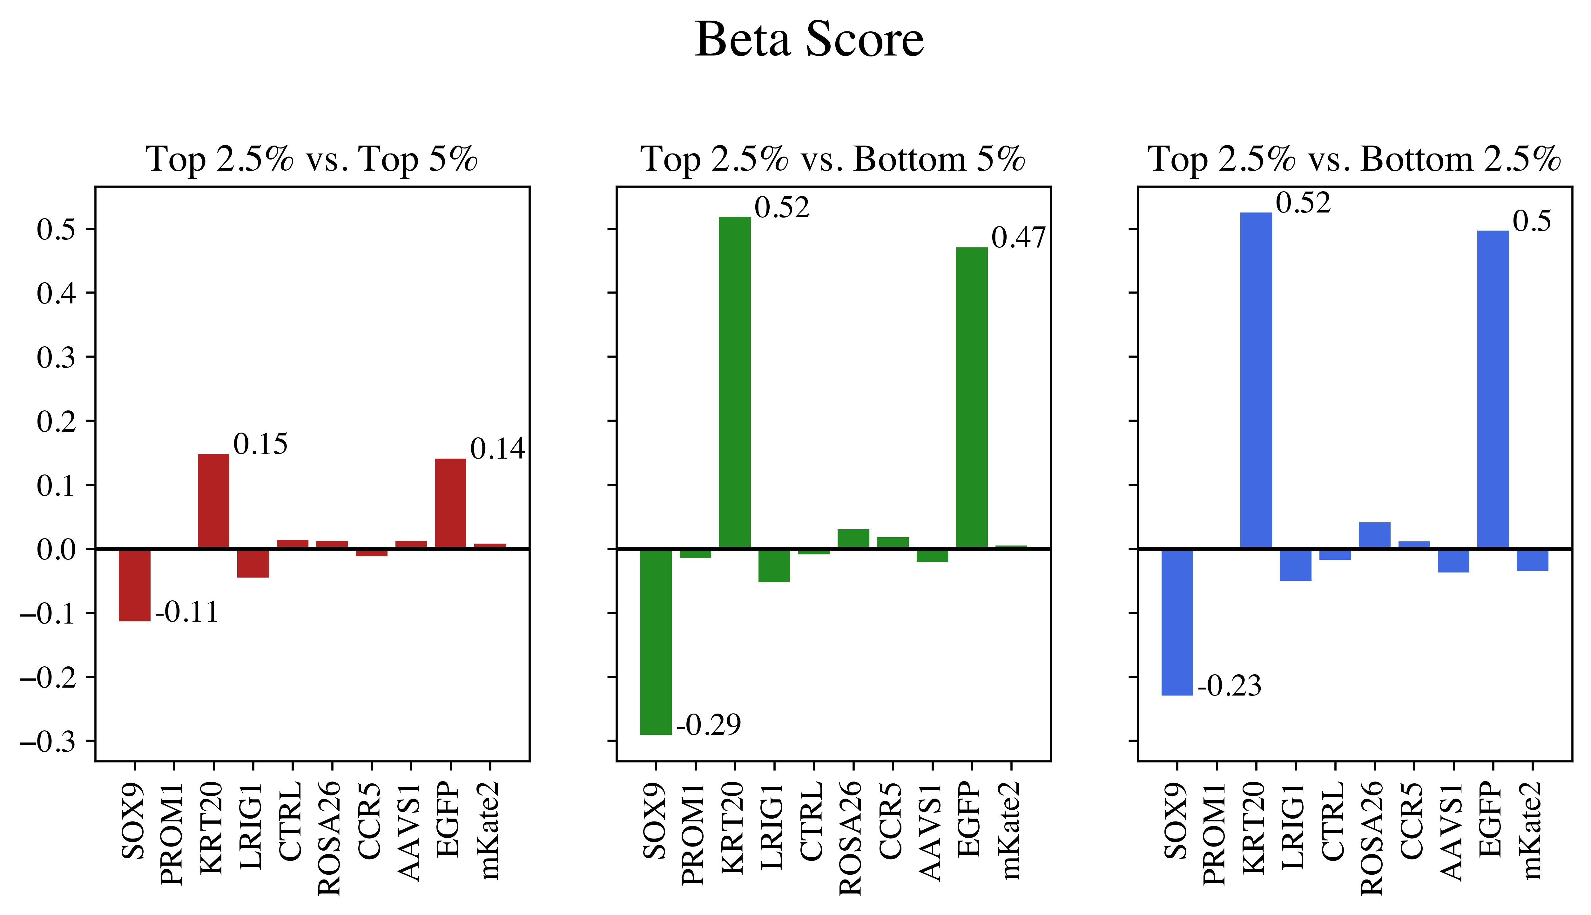
S3 vs. Primer 4 Beta Score
S3
Primer 4 at Day 7 (Top 2.5 vs Bottom 2.5)
I
II

Slide 17
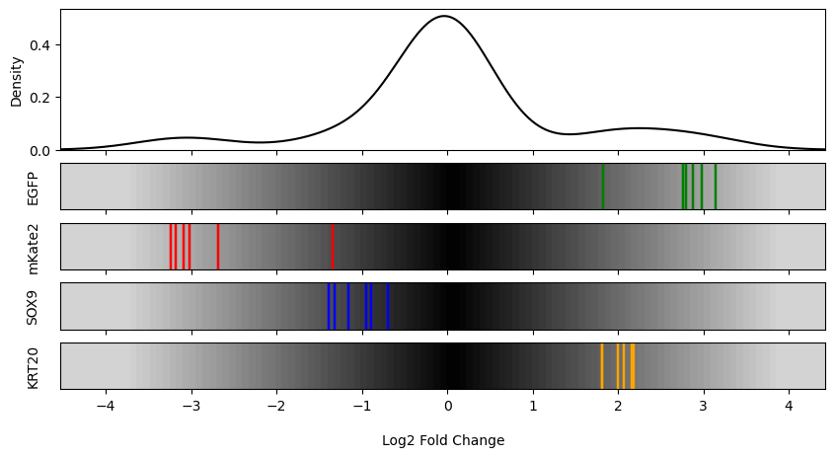
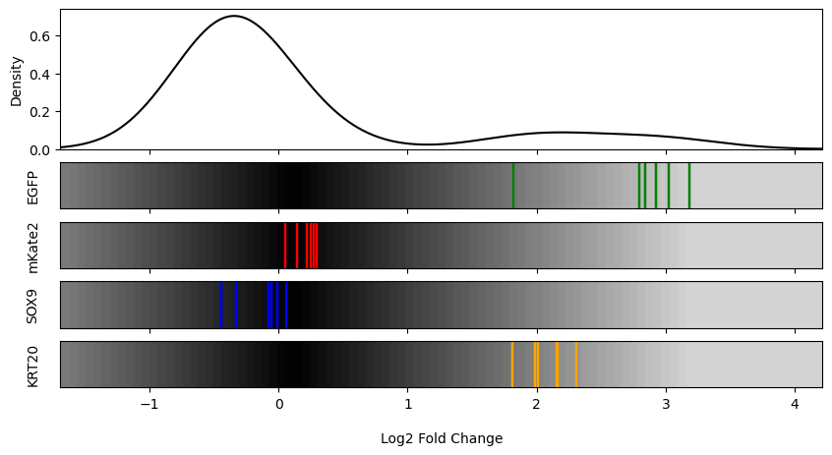
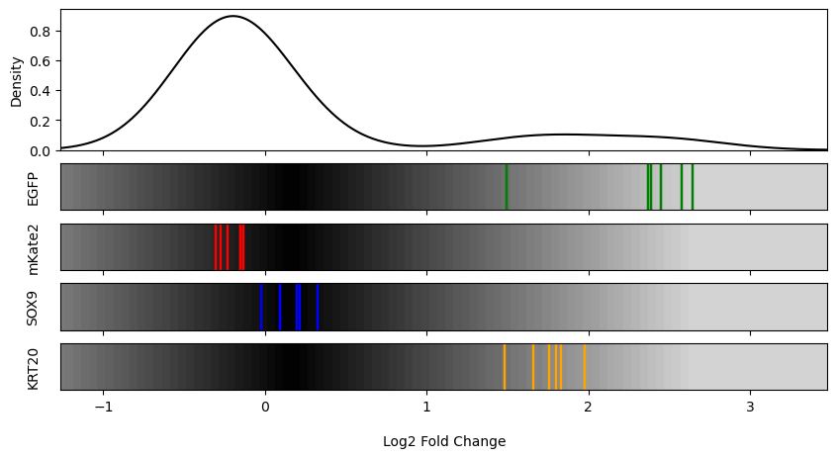
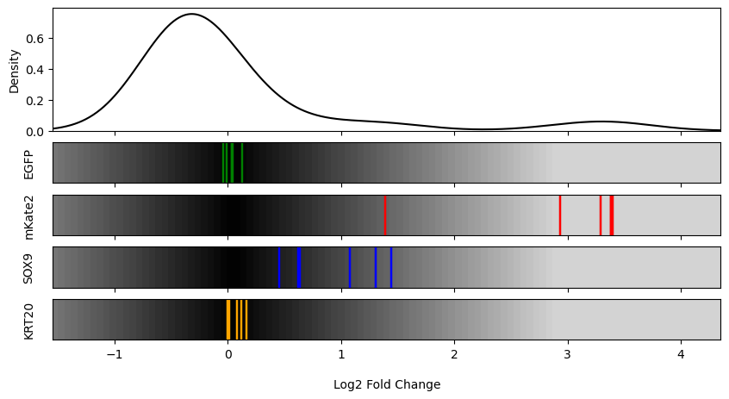
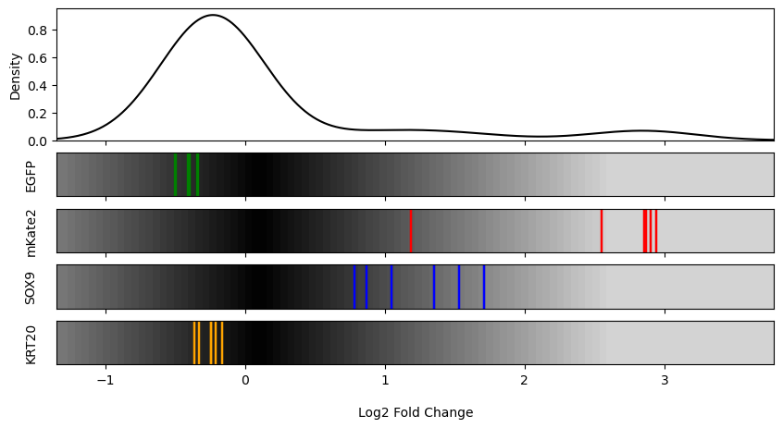
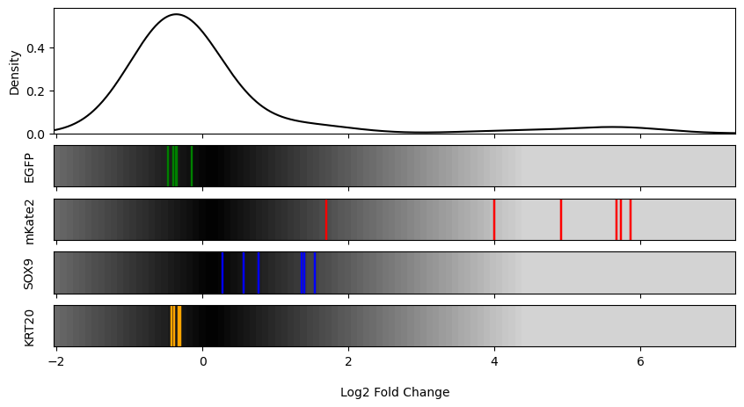
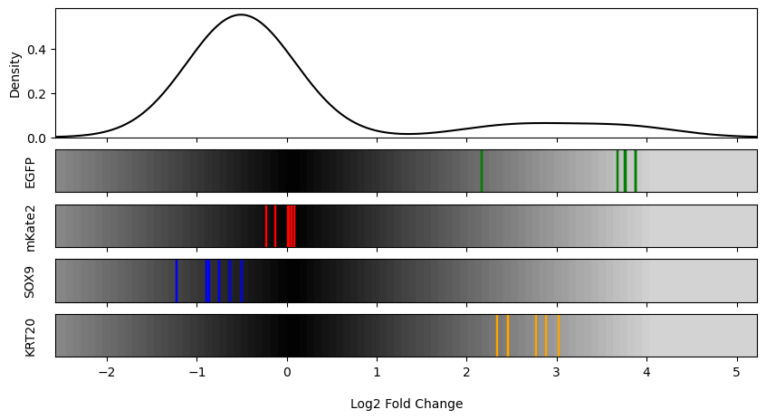
HT-29(3) S10A vs S8 at Day 14: Dual Reporter vs Single Channel mCherry vs Single Channel GFP
GFP_A vs. mCherry_B
GFP_A vs. Negative_C
GFP_A vs. Negative_D
mCherry_B vs. Negative_C
mCherry_B vs. Negative_D
mCherry Top 5% vs Bottom 5%
GFP Top 5% vs Bottom 5%

Slide 18



HT-29(3) S10A vs S8 at Day 14: Dual Reporter vs Single Channel mCherry vs Single Channel GFP
Dual
Single Channel GFP
Single Channel mCherry

Slide 19







HT-29(4) S10B vs S9 at Day 14: Dual Reporter vs Single Channel mCherry vs Single Channel GFP
GFP_A vs. mCherry_B
GFP_A vs. Negative_C
GFP_A vs. Negative_D
mCherry_B vs. Negative_C
mCherry_B vs. Negative_D
mCherry Top 5% (A) vs Bottom 5% (B)
GFP Top 5% (A) vs Bottom 5% (B)

Slide 20



HT-29(4) S10B vs S9 at Day 14: Dual Reporter vs Single Channel mCherry vs Single Channel GFP
Dual
Single Channel GFP
Single Channel mCherry

Slide 21


S3 (Dual at Day 7) vs. S8 (Single at Day 14): GFP(A) | mCherry (B)
S3
S8
GFP
I
mCherry
II

Slide 22
S3 vs. S8 Beta Score
S3
S8
I
II

Slide 23
S3 (Dual at Day 7) vs. S10A (Dual at Day 14): GFP(A) | mCherry (B)
S3
S10
I
II

Slide 24
S3 vs. S10 Beta Score
S3
S10
I
II

Slide 25
Summary
Cell Line with the Strongest Effect
S1 vs S2
LS180 (SOX9 GFP, KRT20 mK2)
S3 vs S4 vs S5
HT-29 (SOX9 mK2, KRT20 GFP)
S6 vs S7
HT-115 (SOX9 mK2, KRT20 GFP) or HT-115 (KRT20 mK2, SOX9 GFP)
S3 vs Primer 4
Dual Reporter at Day 7 > Single Channel at Day 7
S8 vs S10A
Single Channel at Day 14 > Dual Reporter at Day 14
Cell Lines
S9 vs S10B
Single Channel at Day 14 > Dual Reporter at Day 14
S3 vs S8
Dual Reporter at Day 7 > Single Channel at Day 14
S3 vs S10A
Dual Reporter at Day 7 > Dual Reporter at Day 14
Notes:
s3 vs primer 4
fix slide
answer the 3 questions

Slide 26
Conclusion
Which reporter system produced a stronger effect (single vs dual)?
What is the optimal timepoint to conduct the screen (Day 7 vs Day 14)?
Which system within each cell produced a stronger effect?
Dual Reporter system produces a stronger effect on Day 7
Single Channel produces a stronger effect on Day 14
Day 7 consistently produced the expected enrichment and depletion profiles of target gRNA with greater magnitude than Day 14
S1 vs. S2
LS180 (SOX9 GFP, KRT20 mK2)
S3 vs. S4 vs. S5
HT-29 (SOX9 mK2, KRT20 GFP)
S6 vs. S7
HT-115 (SOX9 mK2, KRT20 GFP) or
HT-115 (KRT20 mK2, SOX9 GFP)
Notes:
s3 vs primer 4
fix slide
answer the 3 questions

