Slide 1
Progress Update
1/30/2021

Slide 2
Overview
Normalization Pipeline Overview
Scatterplot coloured by Target Gene
2 Volcano Plot Versions
Cumulative Density Plot for Fold Change
Kernel Density Estimate Plots for Clustering

Slide 3
Normalization Pipeline

Slide 4
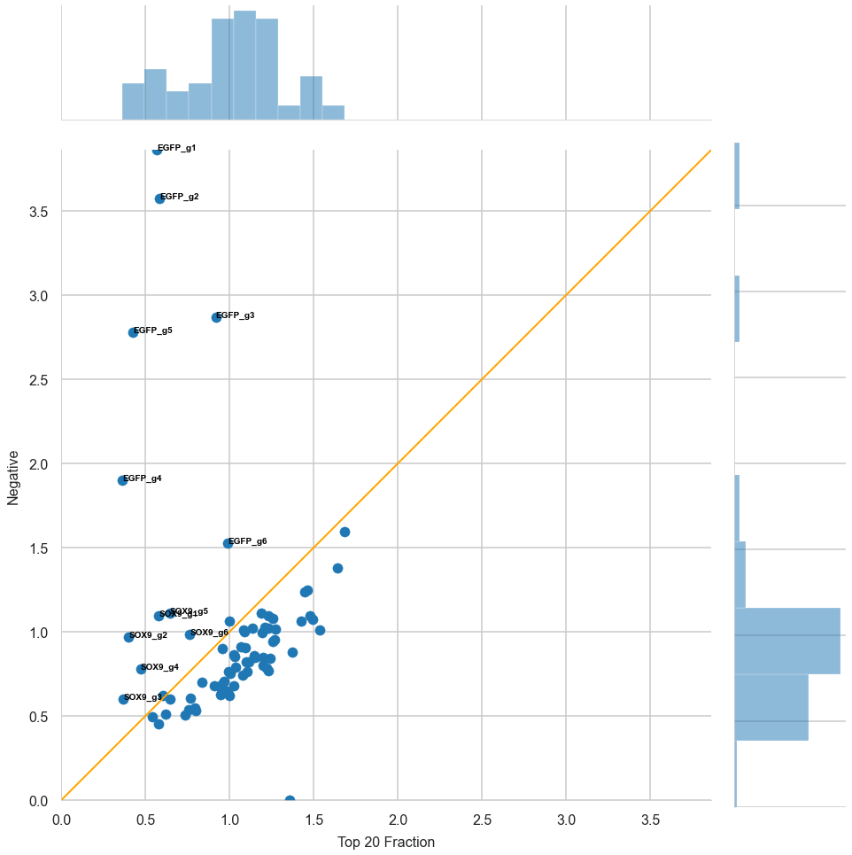
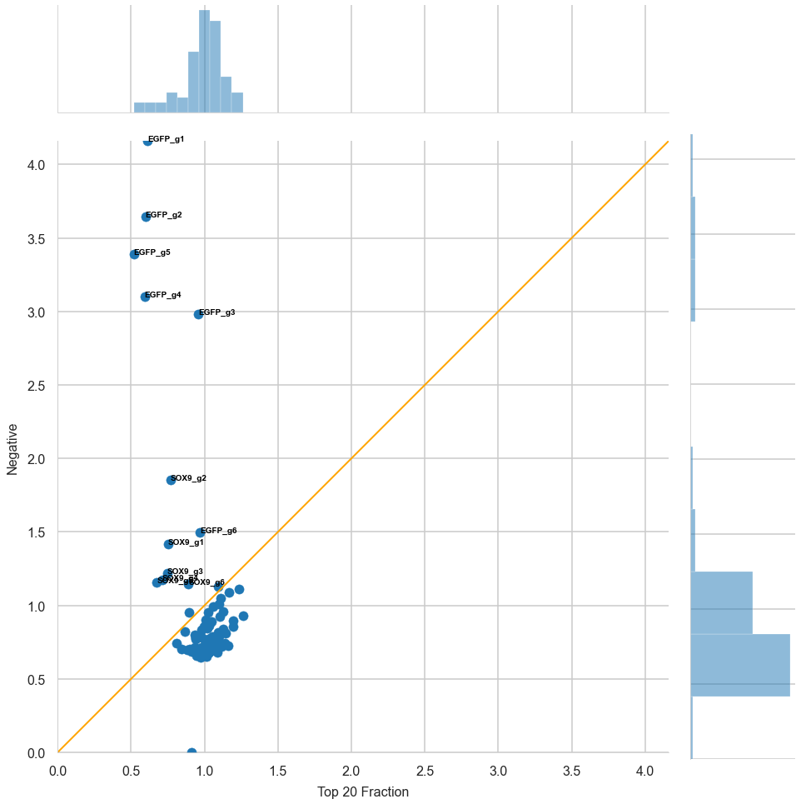
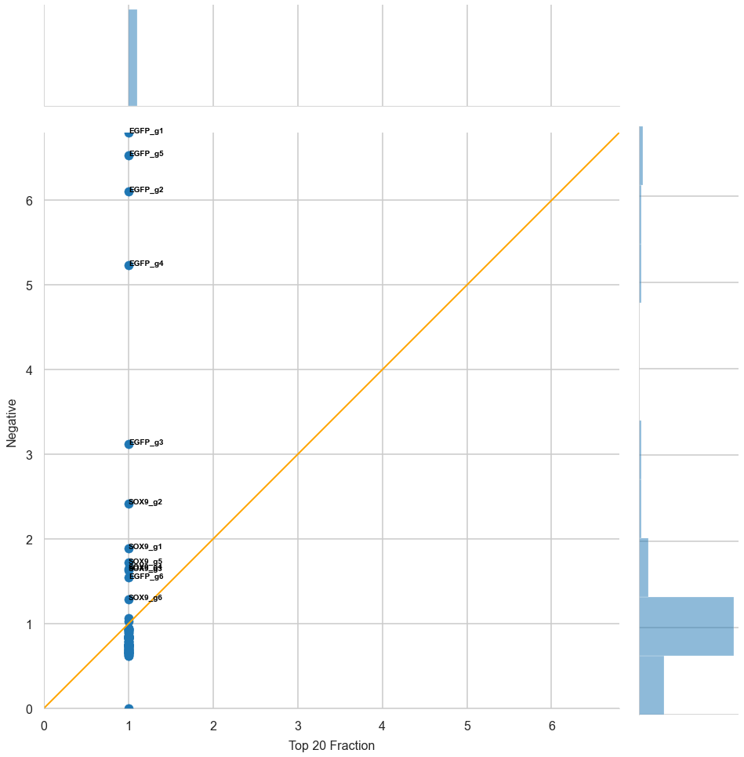
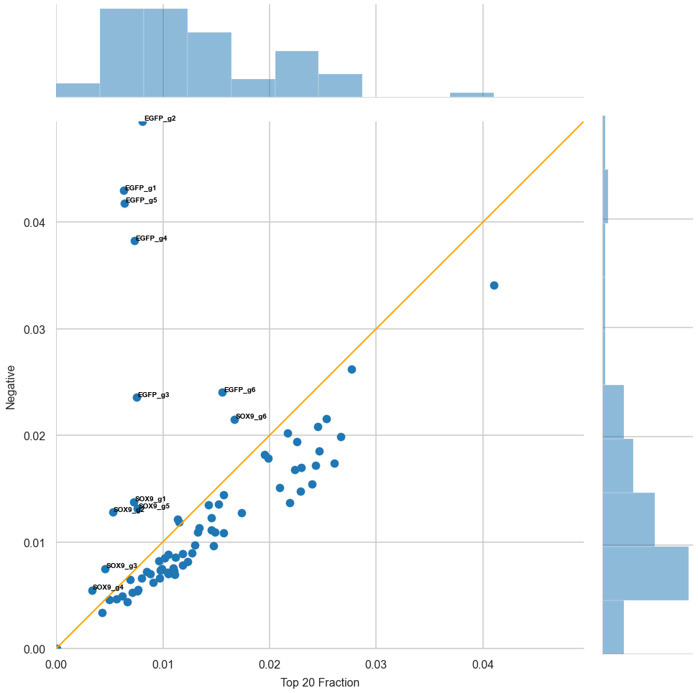
Population 1
Total Read Normalization
Library Pool Normalization
Population Normalization
Top Fraction Fold Change

Slide 5
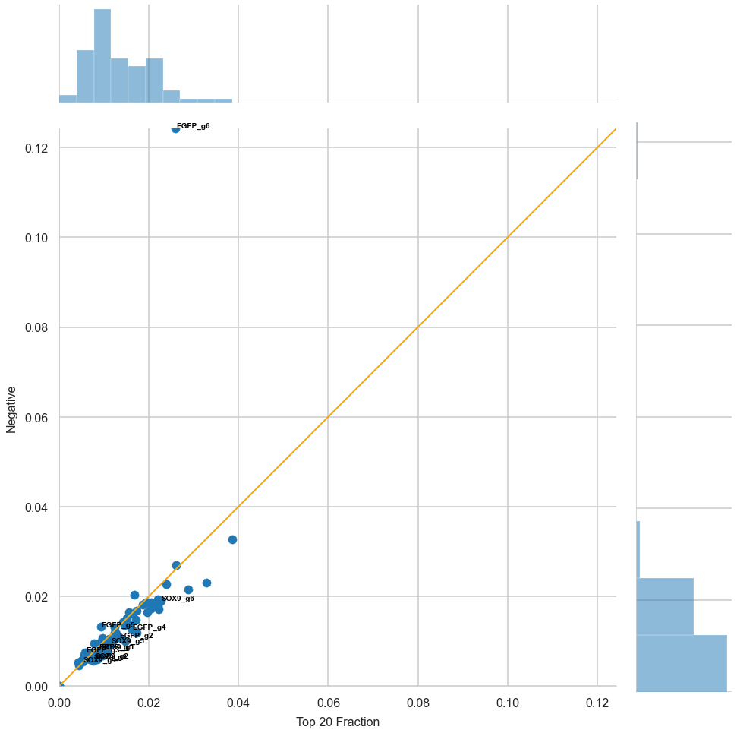
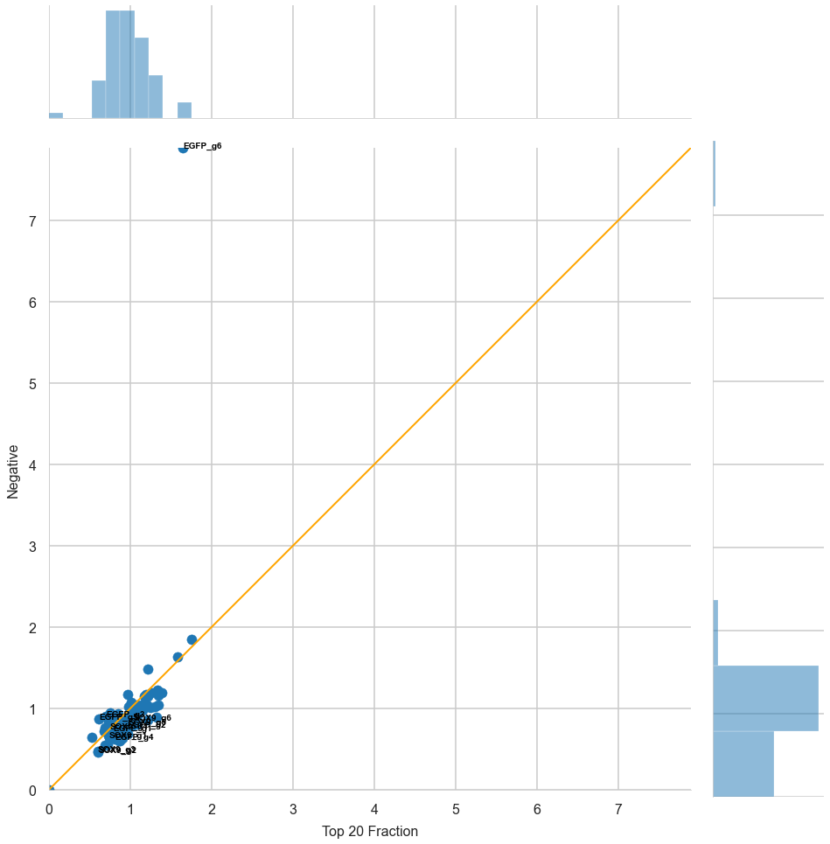
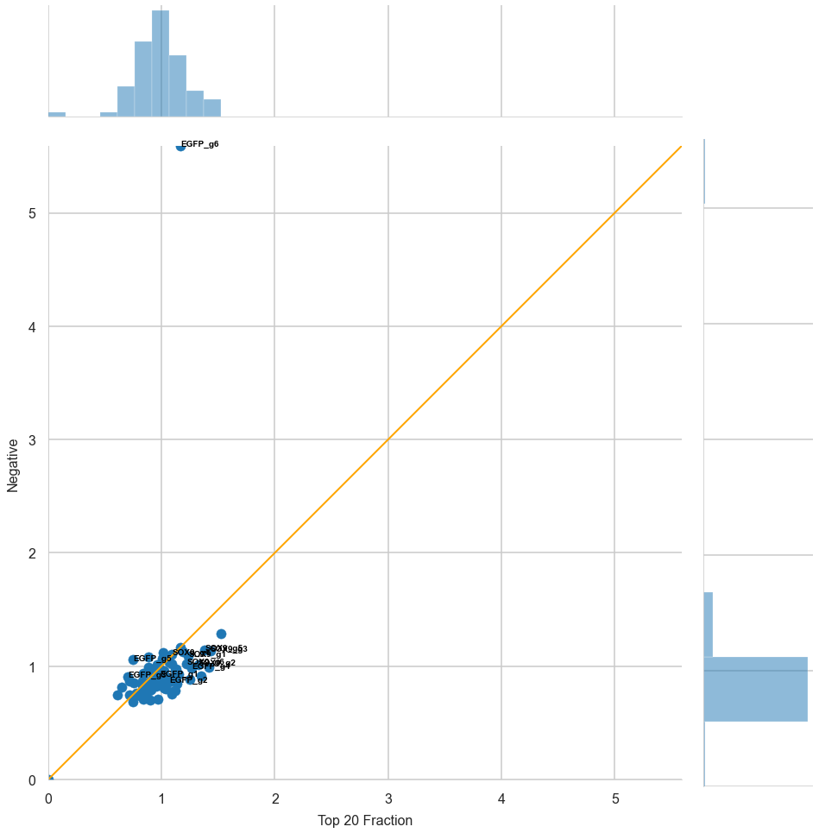
Population 2
Total Read Normalization
Library Pool Normalization
Population Normalization

Slide 6
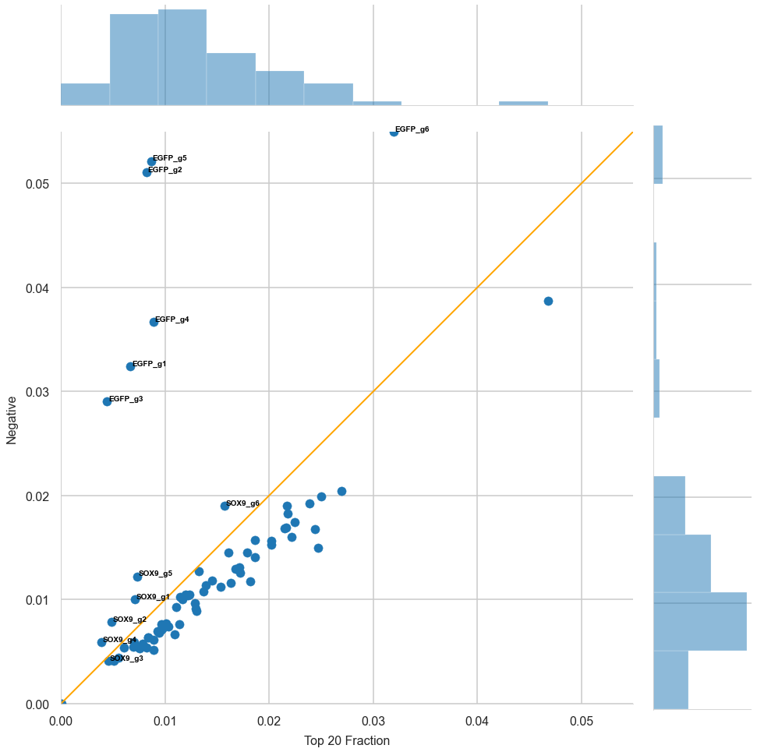
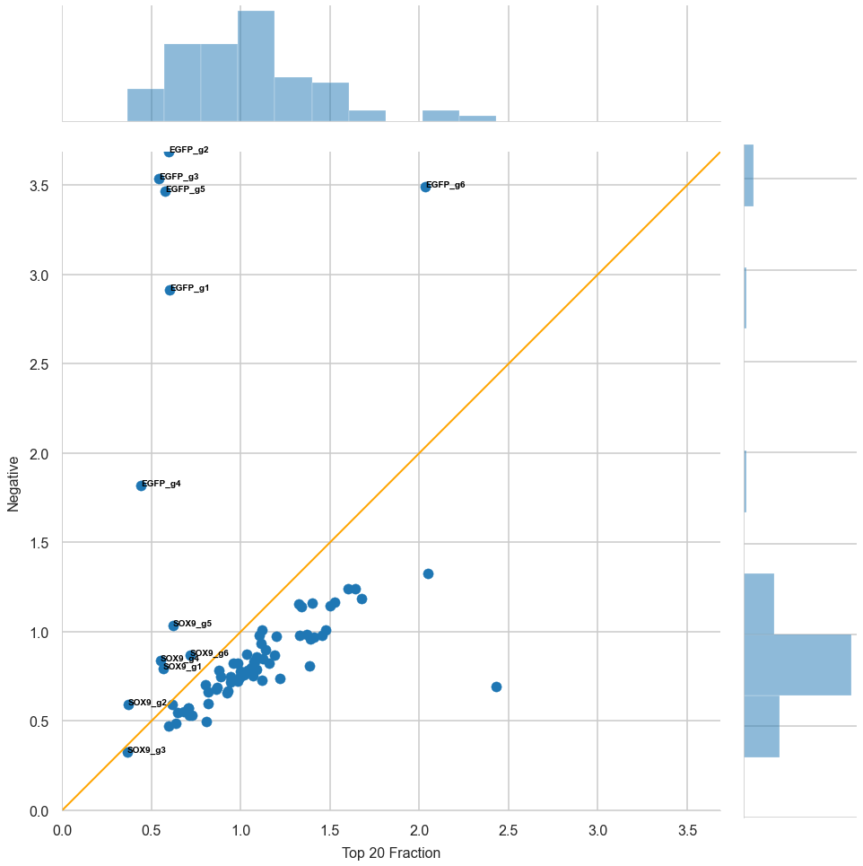
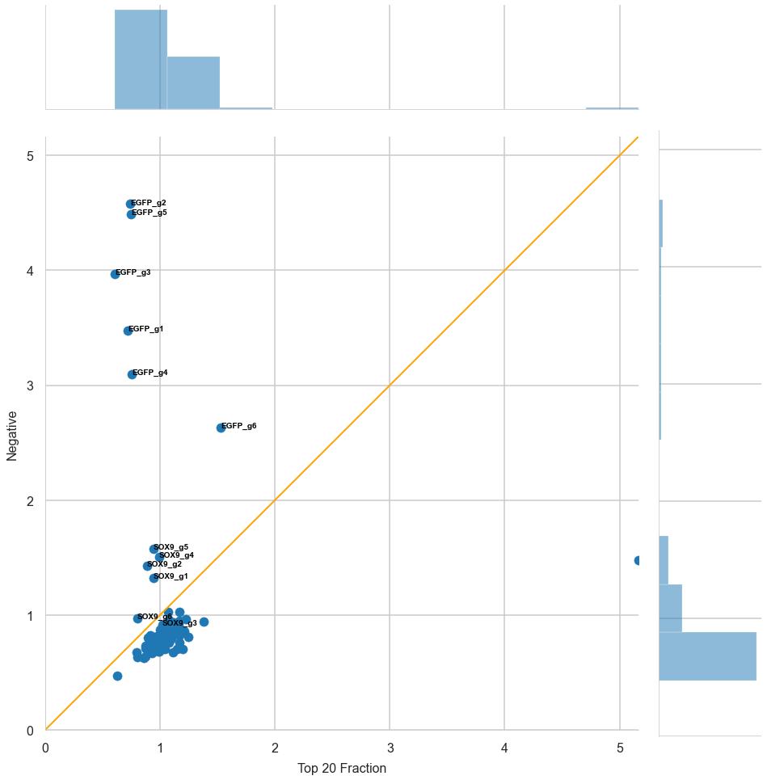
Population 3
Total Read Normalization
Library Pool Normalization
Population Normalization

Slide 7
Scatter plot coloured by Target Gene

Slide 8
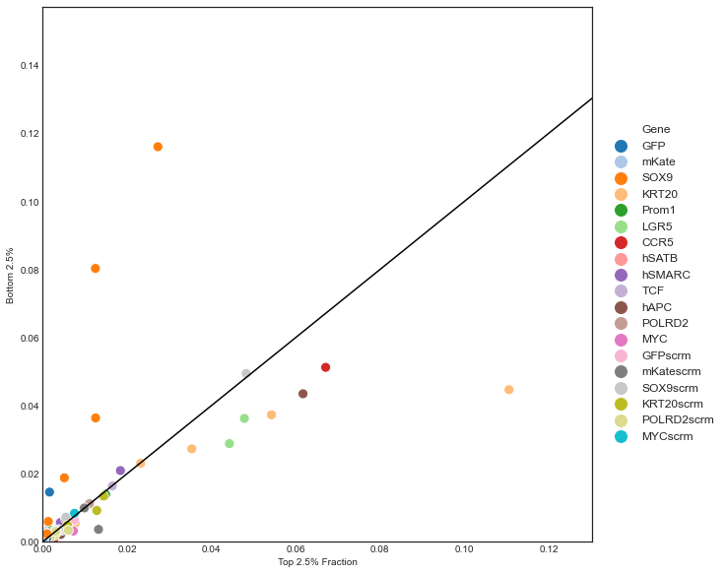
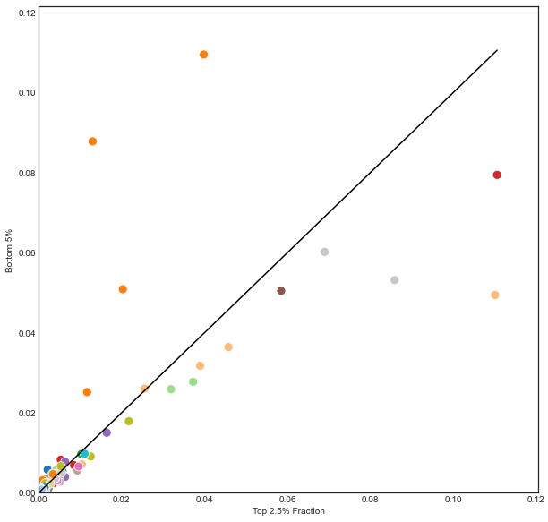
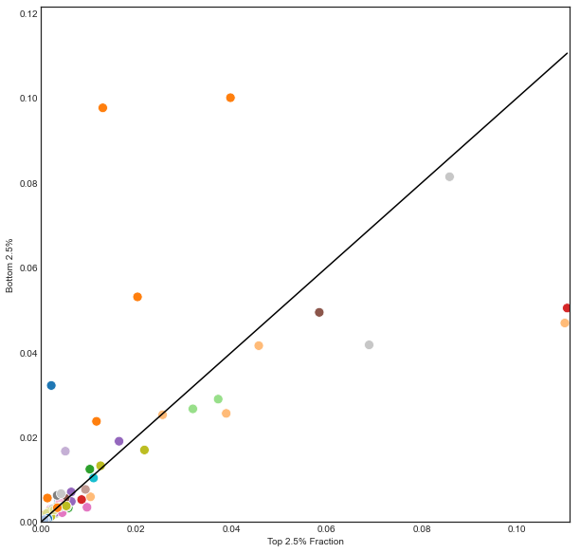
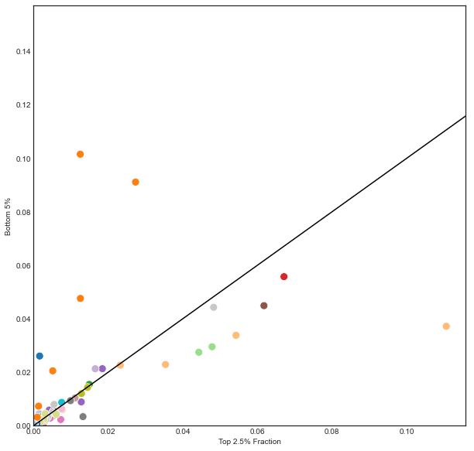
Primer 1
Day 3
Day 7
Bottom 5%
Bottom 2.5%
Bottom 5%
Bottom 2.5%

Slide 9
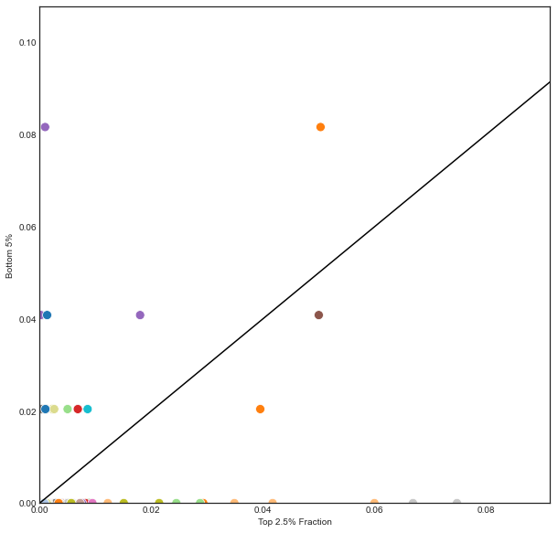
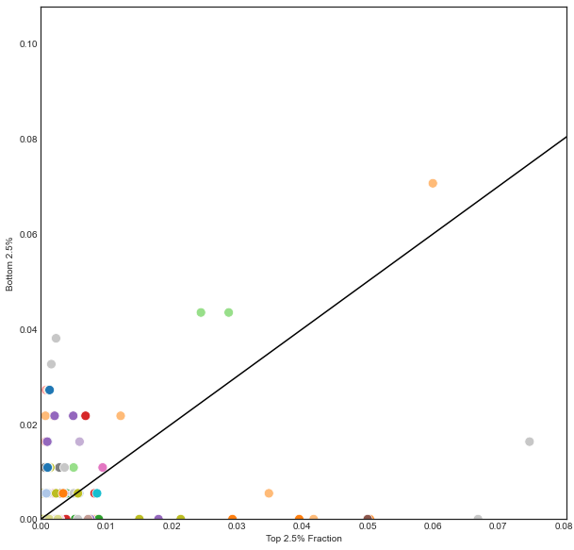
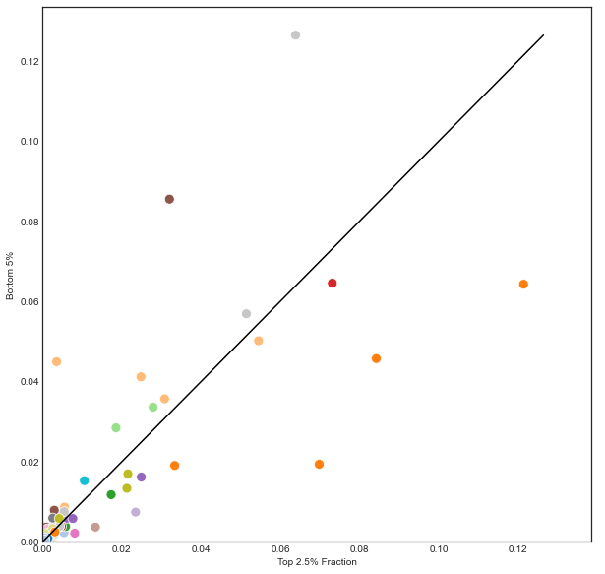
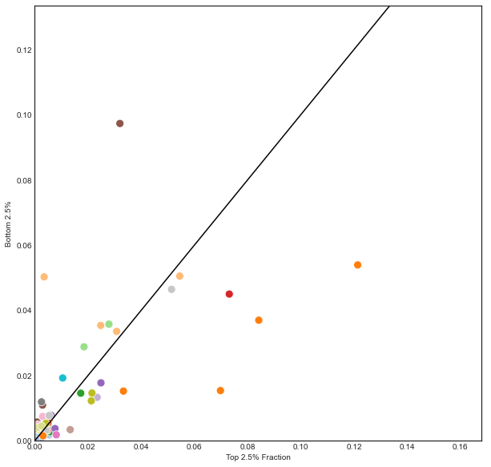
Primer 2
Day 3
Day 7
Bottom 5%
Bottom 2.5%
Bottom 5%
Bottom 2.5%

Slide 10
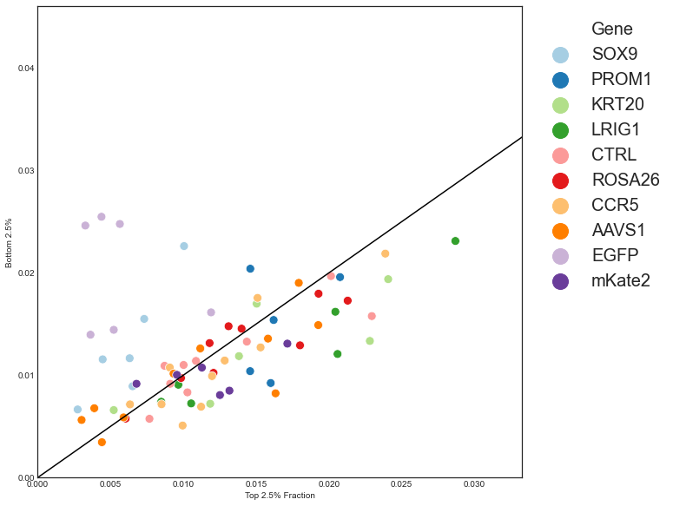
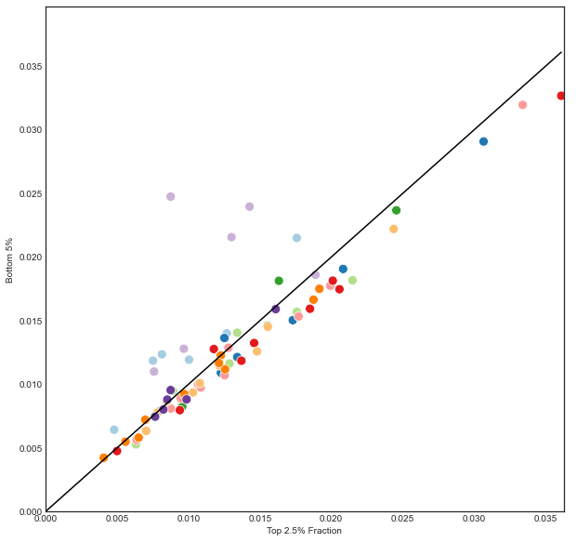

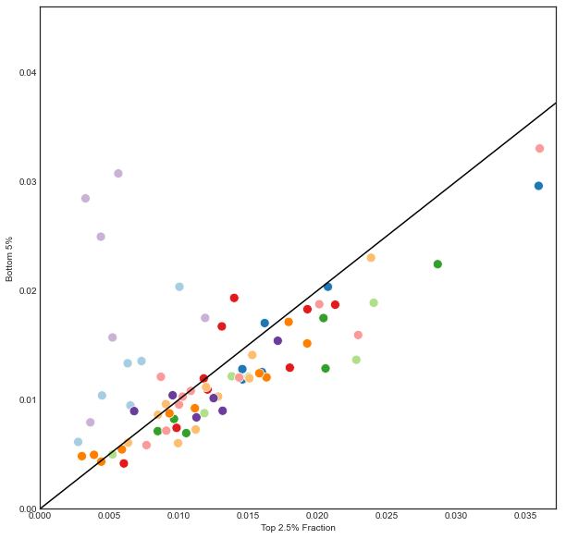
Primer 3
Day 3
Day 7
Bottom 5%
Bottom 2.5%
Bottom 5%
Bottom 2.5%

Slide 11
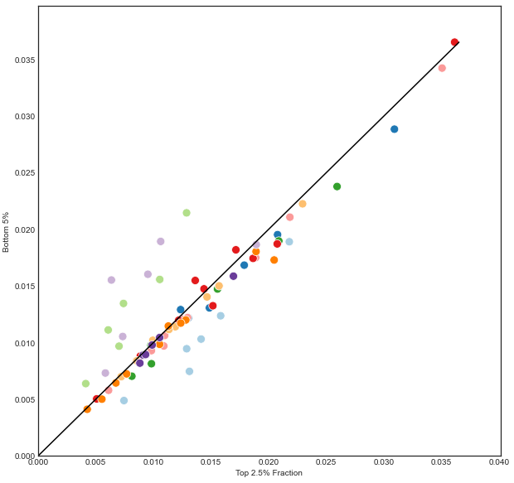

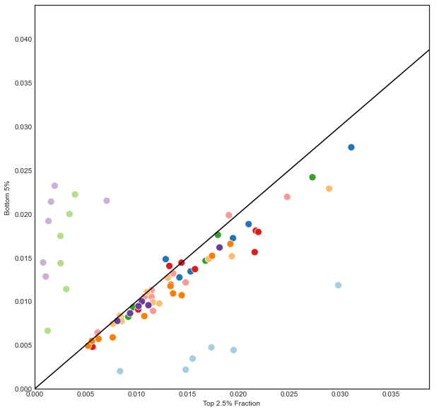
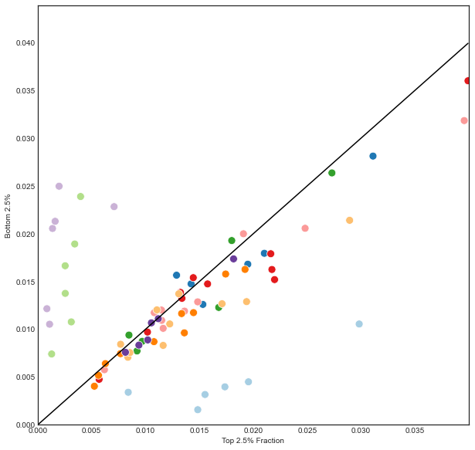
Primer 4
Day 3
Day 7
Bottom 5%
Bottom 2.5%
Bottom 5%
Bottom 2.5%

Slide 12
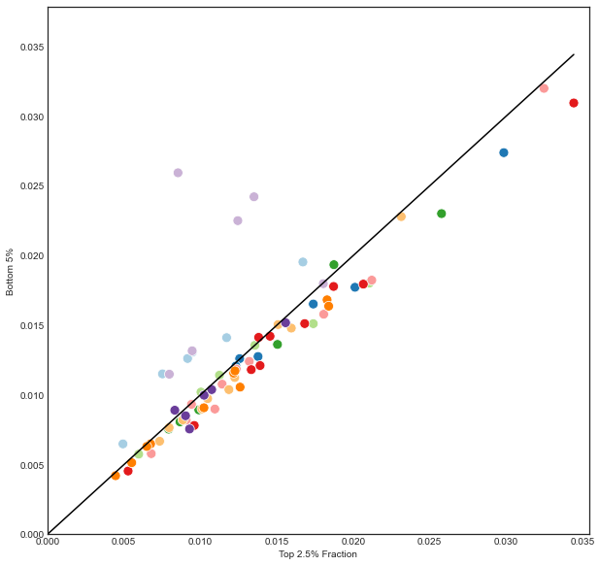
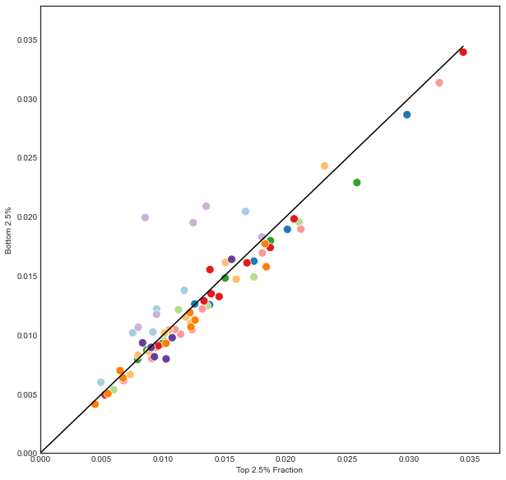
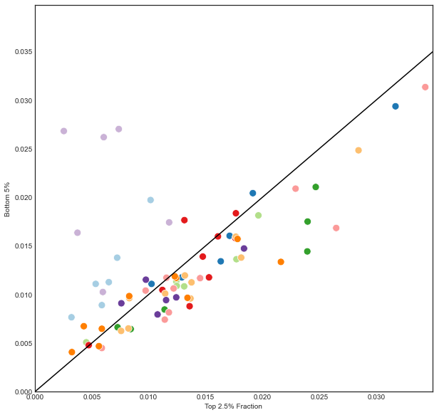
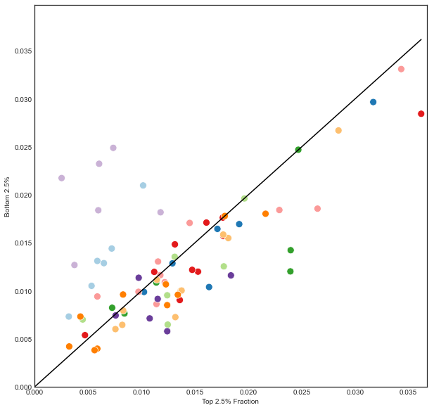
Primer 5
Day 3
Day 7
Bottom 5%
Bottom 2.5%
Bottom 5%
Bottom 2.5%

Slide 13
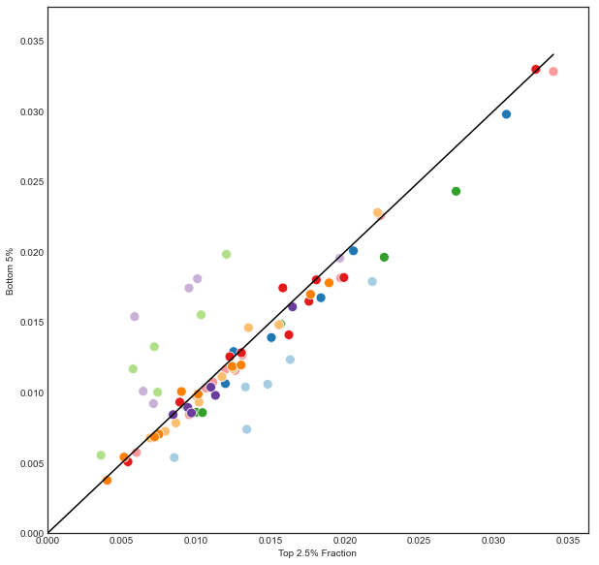
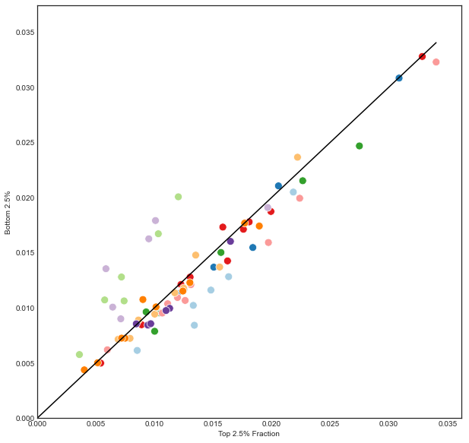
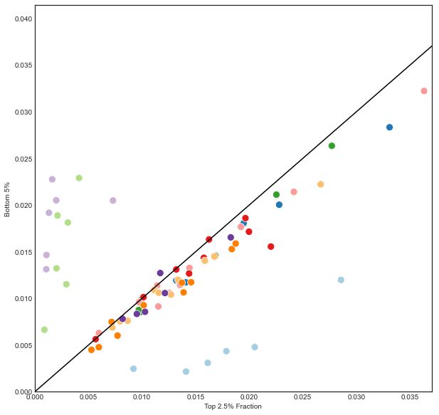

Primer 6
Day 3
Day 7
Bottom 5%
Bottom 2.5%
Bottom 5%
Bottom 2.5%

Slide 14
Volcano Plot

Slide 15
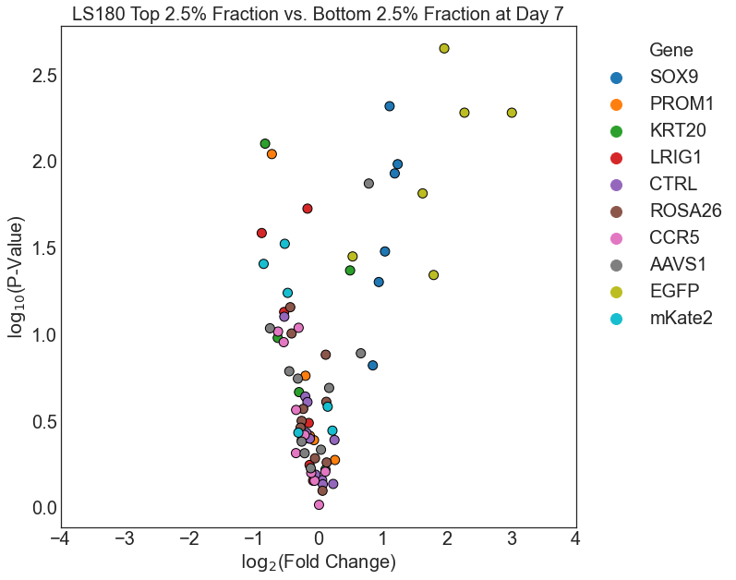
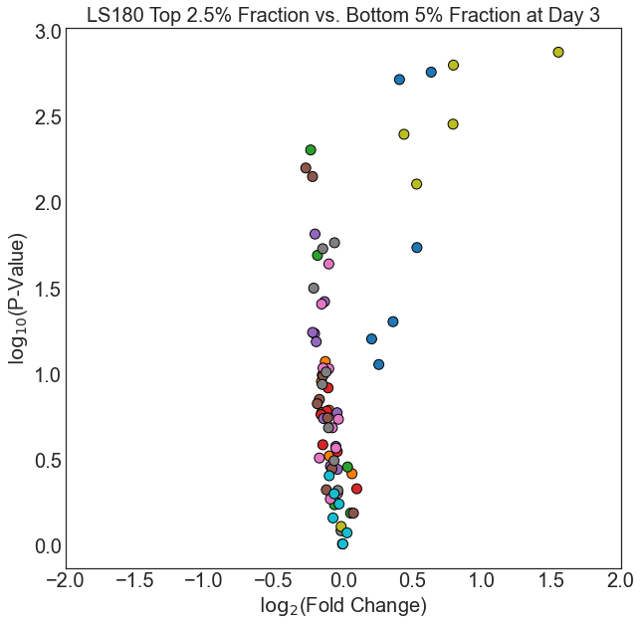
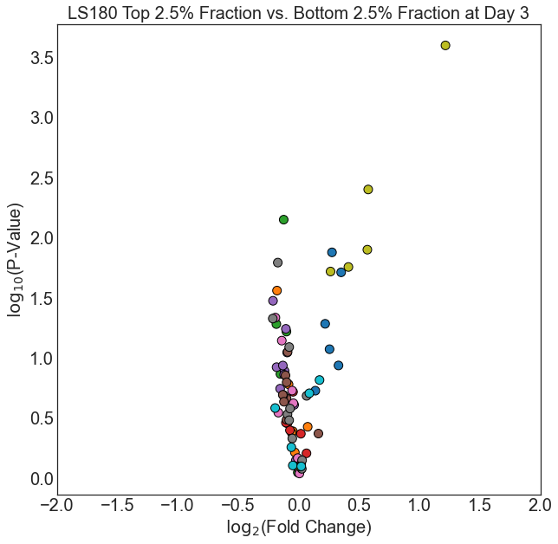
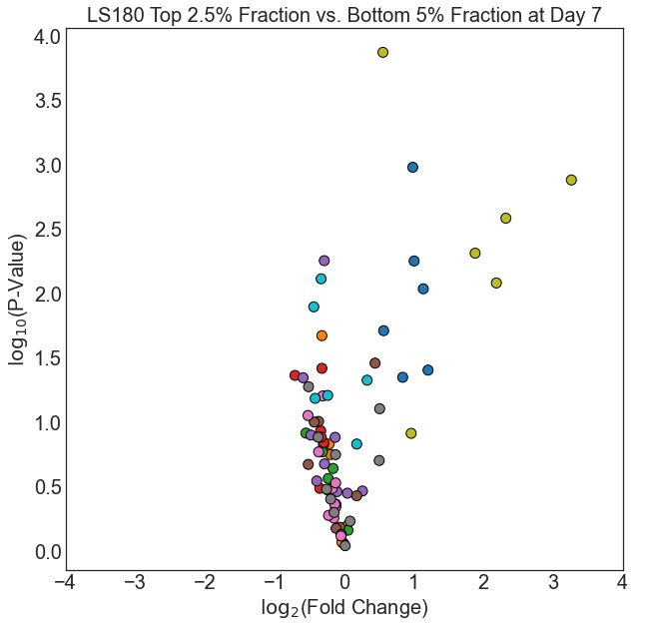
LS180 (Primer 3 + Primer 5)
Day 3
Day 7
Bottom 5%
Bottom 2.5%
Bottom 5%
Bottom 2.5%
*
Correction to y-axis label: -log₁₀ (P-value)

Slide 16
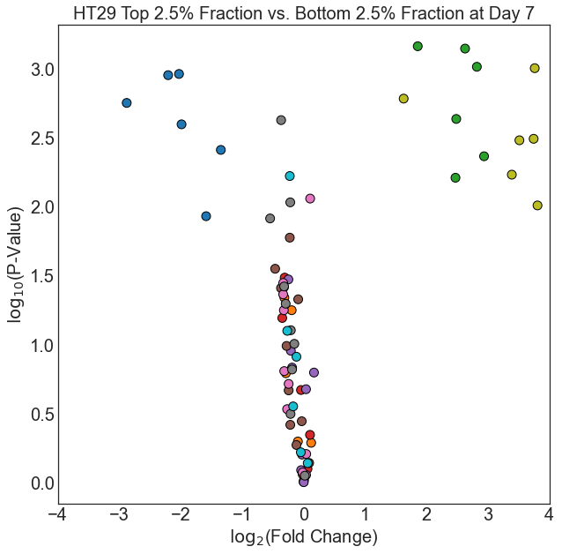
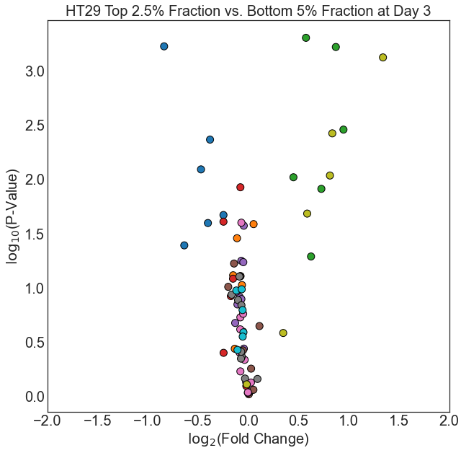
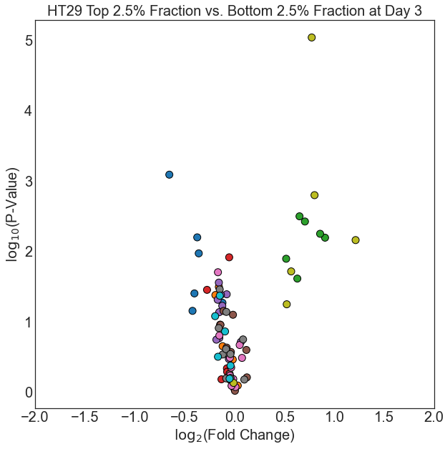
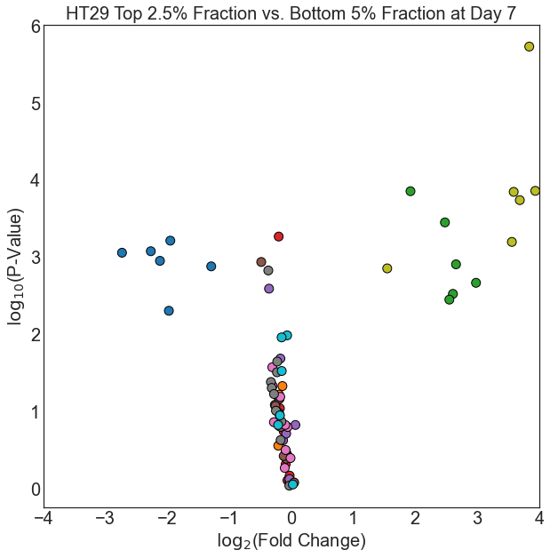
HT29 (Primer 4 + Primer 6)
Day 3
Day 7
Bottom 5%
Bottom 2.5%
Bottom 5%
Bottom 2.5%
*
Correction to y-axis label: -log₁₀ (P-value)

Slide 17
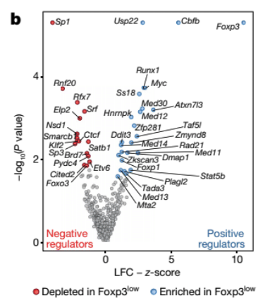
Volcano Plot using Z score

Slide 18
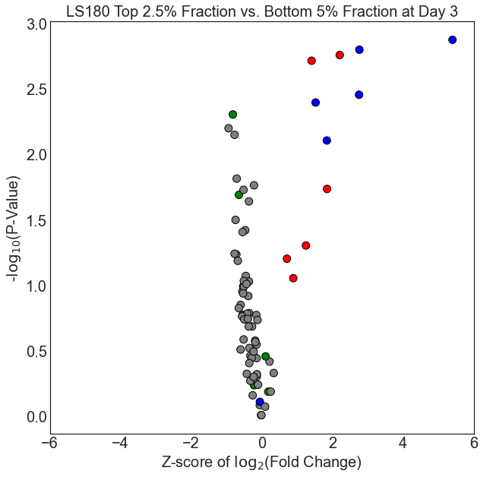
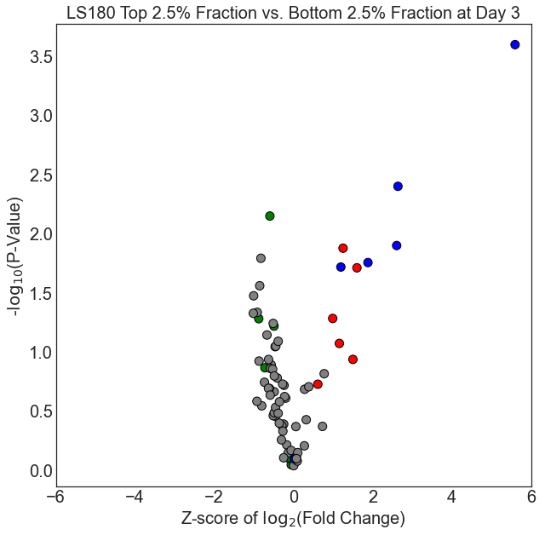
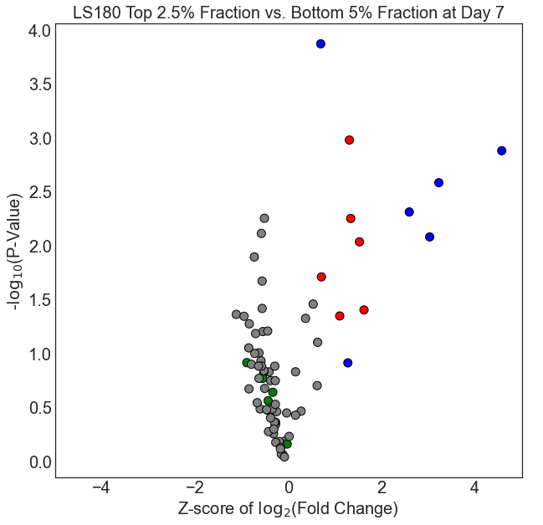
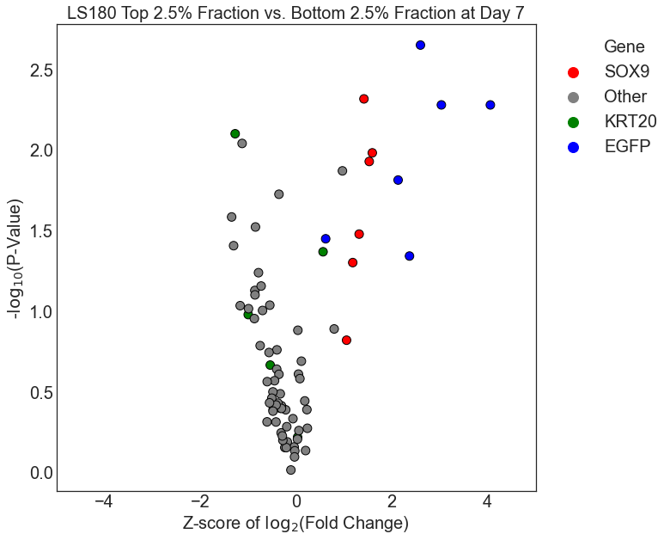
LS180 (Primer 3 + Primer 5)
Day 3
Day 7
Bottom 5%
Bottom 2.5%
Bottom 5%
Bottom 2.5%

Slide 19
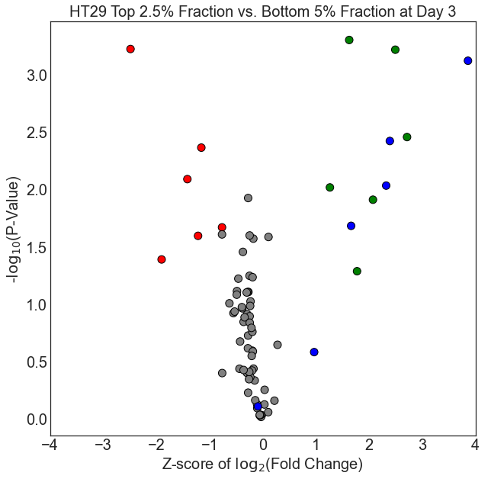
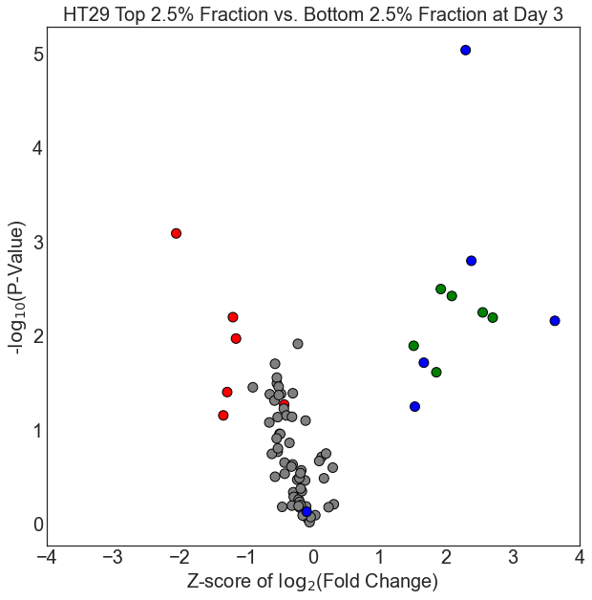
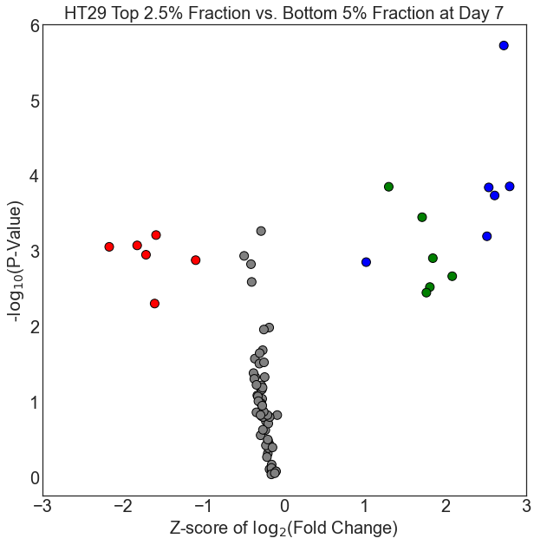
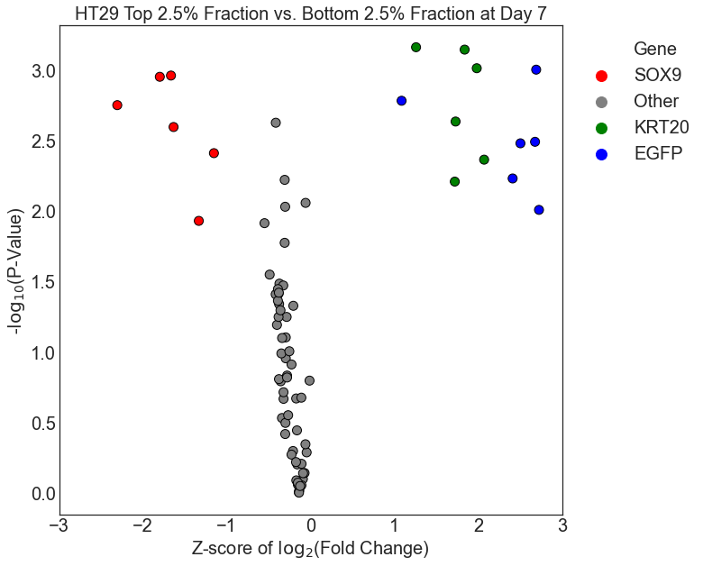
HT29 (Primer 4 + Primer 6)
Day 3
Day 7
Bottom 5%
Bottom 2.5%
Bottom 5%
Bottom 2.5%

Slide 20
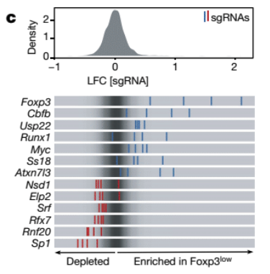
Cumulative Density Plots of Fold Change

Slide 21
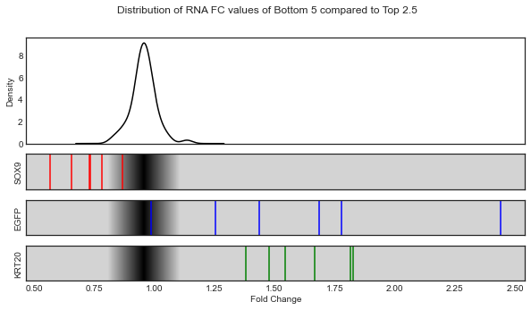



Primer 4
Day 3
Day 7
Bottom 5%
Bottom 2.5%
Bottom 5%
Bottom 2.5%

Slide 22
Kernel Density Estimate Plots

Slide 23




Primer 4
Day 3
Day 7
Bottom 5%
Bottom 2.5%
Bottom 5%
Bottom 2.5%
*

Slide 24


KDE using different levels
Primer 4: Top 2.5 vs. Bottom 2.5 at Day 7
Level: 5
Level: 20
Level: 100

