Slide 1
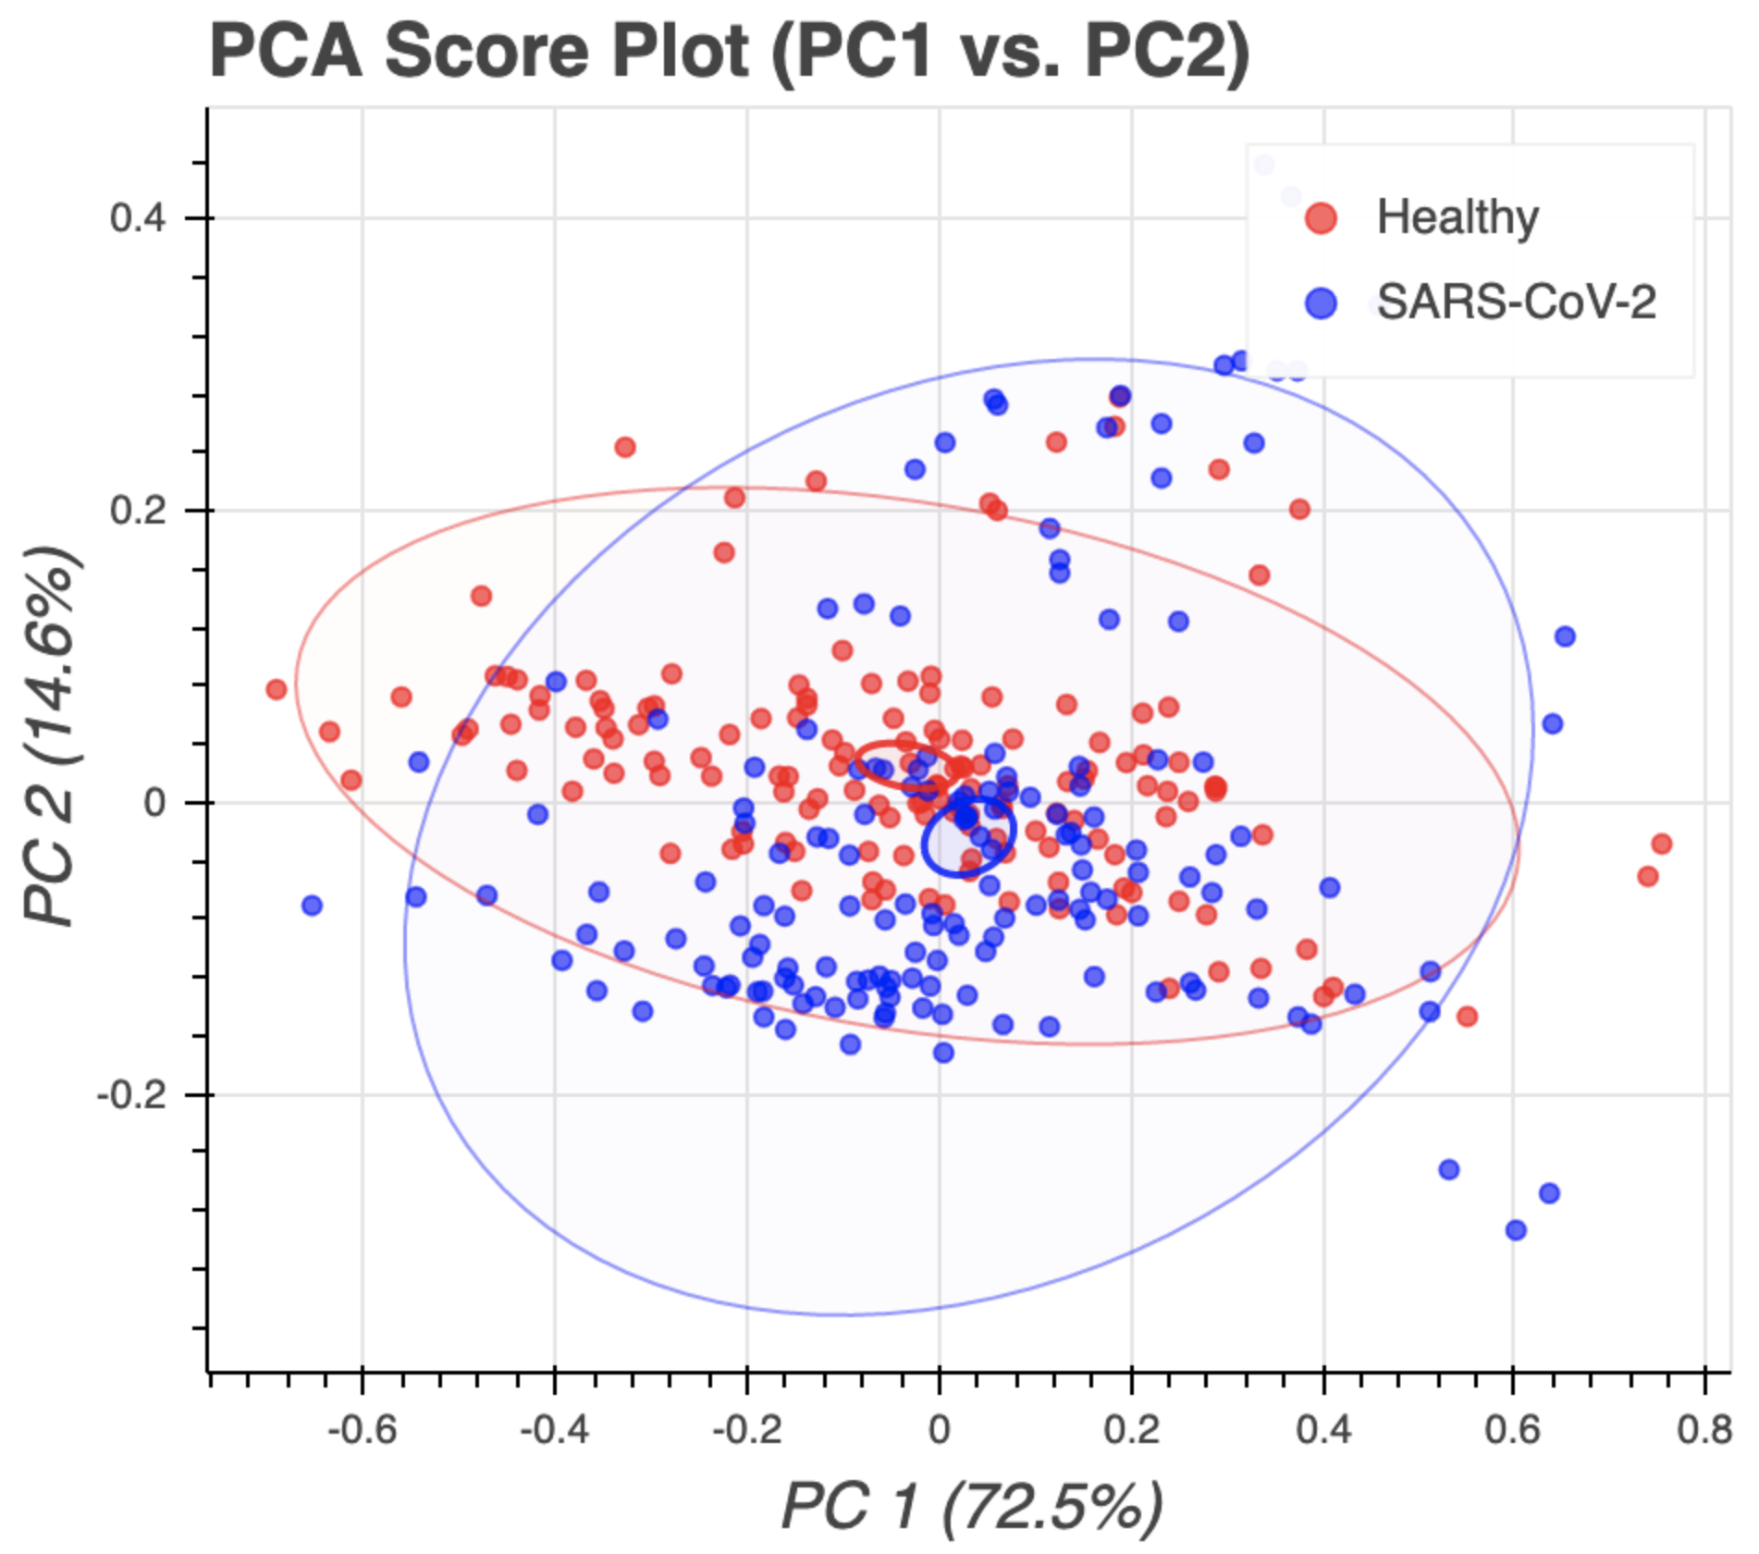
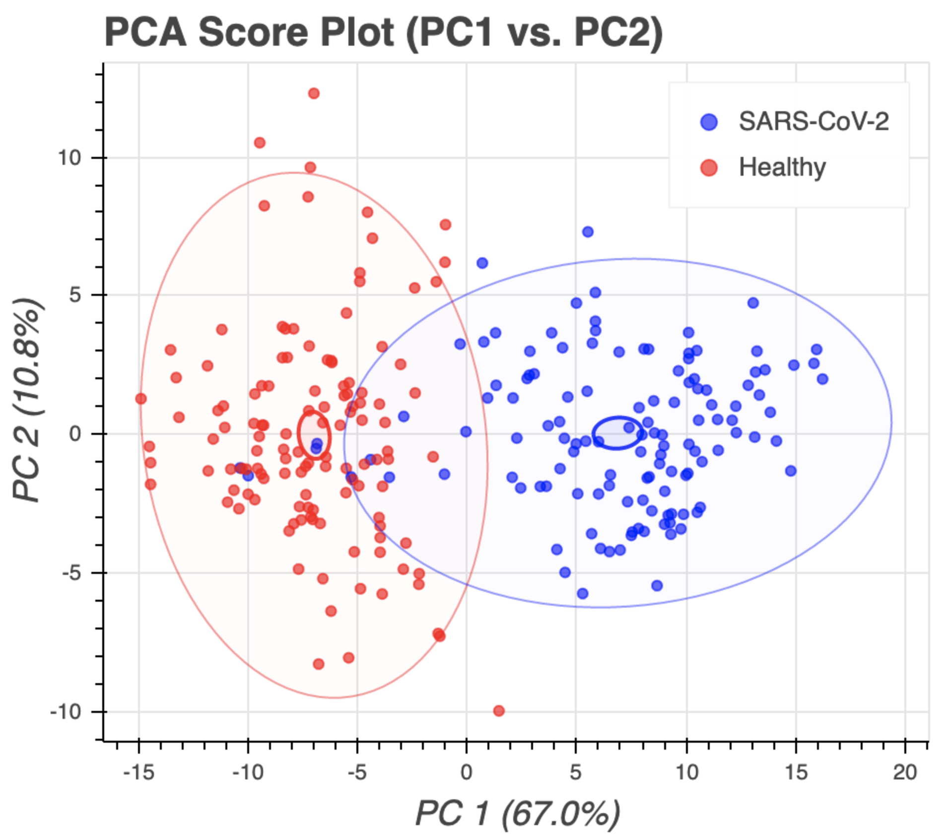
A
PCA Scores Plot of Pre-processed Data
B
PCA Scores Plot of Processed Data

