Slide 1

=
Yale New Haven Hospital

Slide 2

Ruby Memorial Hospital

Slide 3
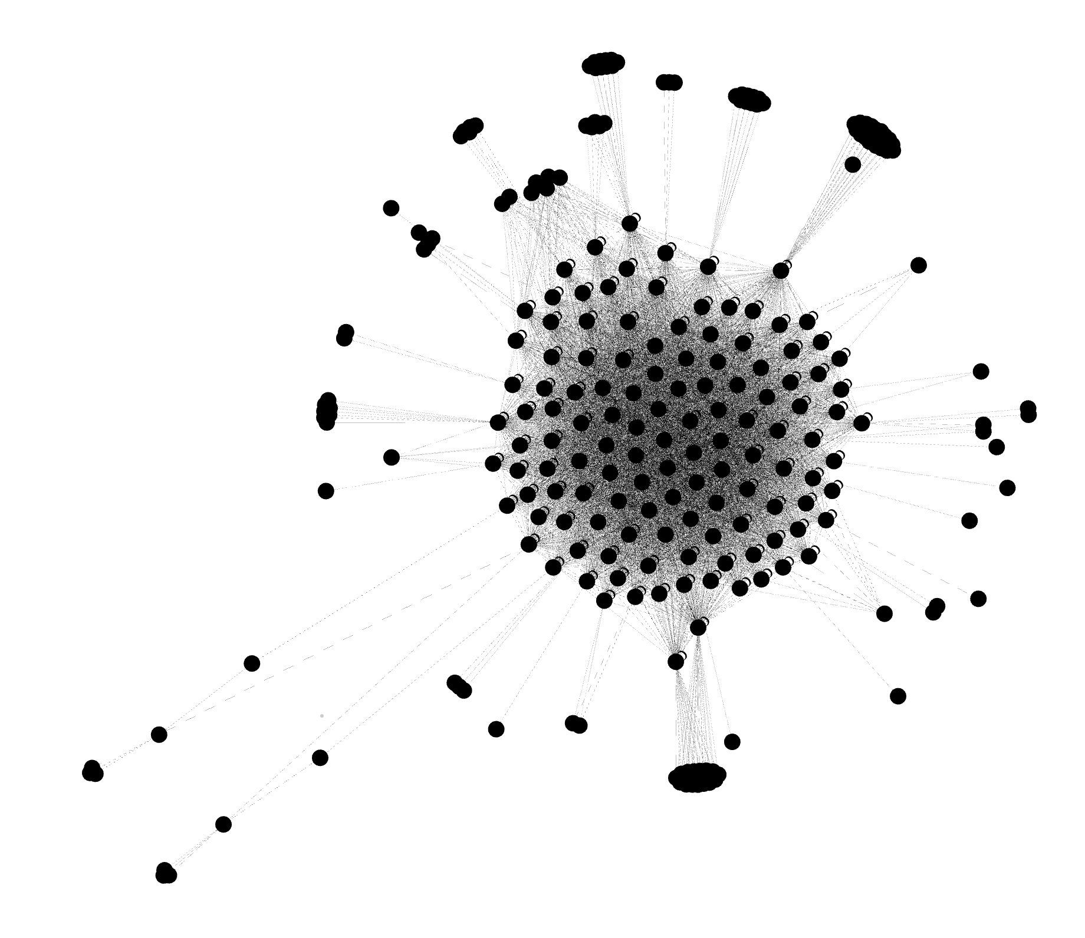
UCF Lake Nona Medical Centre

Slide 4
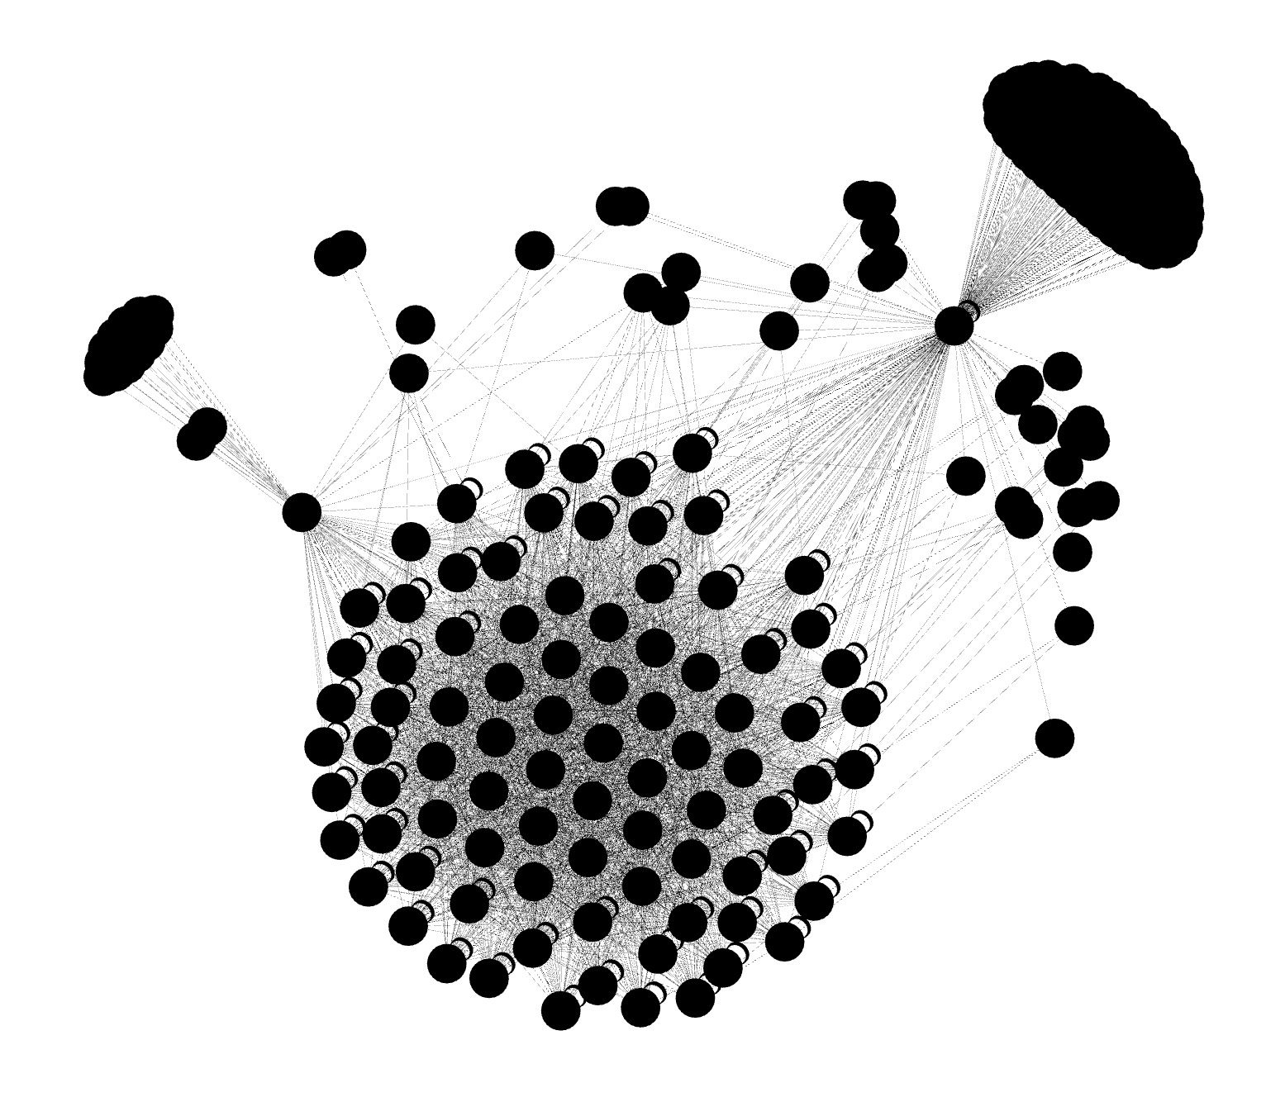
Vanderbilt University
Medical Center

Slide 5
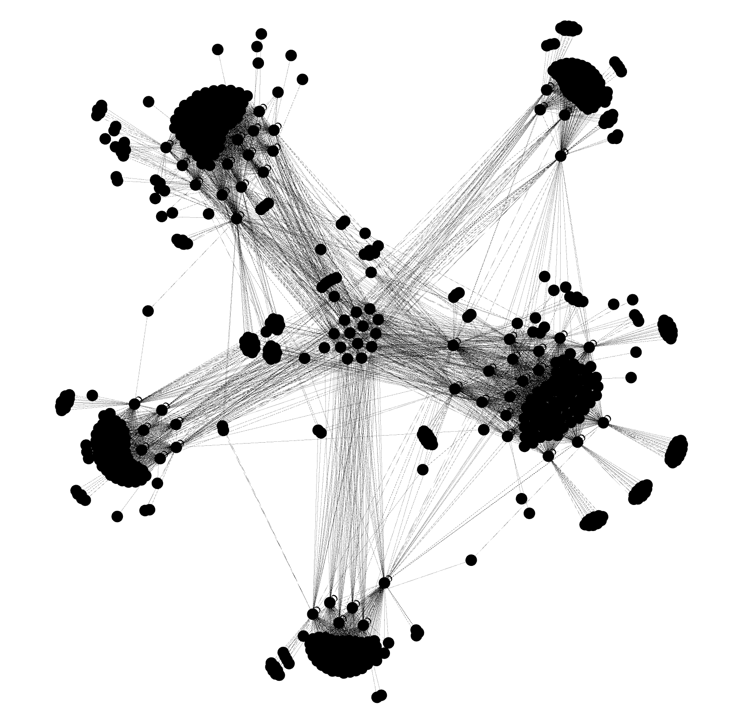
Western Health

