Slide 1
Machine Communication of Spatial Natural Languages
Wei Chen, MS student CSE
Advisor: Dr. Rajov Ramnath

Slide 2
Introduction
Geometric idealizations
Linguistic patterns of motions
Linguistic patterns of spatial relations
Syntactic and semantic analysis
Integration of NLP, machine learning and GIS

Slide 3
Spatial Abstraction of English
verbs+prepositions structure
  A person walked towards the street. A point (object) moving towards (spatial relation) another point (object).
  A person walked along the street. A point (object) moving along (spatial relation) a line (object).
  A person ran across the street. A point (object) moving across (spatial relation) a polygon (object).
Notes:
A NL parser abstracts away from irrelevant geometric details such as the length or orientation of the path
representing each spatial scene using a spatial model schema,a NL interpreter in turn is able to recreate the scenes from the schema.

Slide 4
  A person walking towards the street.
  A person walking along street.
  A person walking cross the street.

Slide 5
Spatial Abstraction Cont.
Preposition and participle structure
  A restaurant on campus. A point (obj) in (sp.rel.) a polygon (obj).
  A restaurant near campus. A point (obj) outside (sp.rel.) a polygon (obj).
  A road leading towards the campus. A line (obj) disjointing (sp.rel.) a polygon (obj).
  A road leading into the campus. A line (obj) intersecting (sp.rel.) a polygon (obj).

Slide 6
  restaurant on campus
  restaurant near campus
  road leading towards campus
  road leading into campus
Notes:
In this case, both topological and geometrical relations count.
In the case of near, topological relationship determines that A should be outside B and geometrical relationship requires that the distance should be as short as possible.

Slide 7
Communication and Modeling of Space
Geometrical vs topological relations?
  It depends. Human cognition is vague.
  Some cases require only topological relationship to count. (on)
  Some cases require only geometrical relationship to count. (500 meters away from)
  Other cases require both. (near)
Granularity of space
  County, state, city
  Place, organization, facility
  On different level and given different spatial relations, same entity is modeled differently
Weak AI vs strong AI?
  First, can computers extract spatial indicators and entities.
  Further, can computers understand a question involving them.
  If so, how reliable are the results.

Slide 8
Syntactic Details of Space
Syntactic components indicating spatial relations.
  Verbs/verb phrase:
    Many, open form
    go (to), come (from), fly (over)
  Prepositions:
    Some, closed form
    Around, next to, in front of.
  Adverbs:
    eastward, locally, homeward
Syntactic components indicating spatial objects.
  Nouns/nominals: Restaurant, campus, city, Ohio State, Columbus, OH
Syntactic components indicating spatial quantities/constraint
  Cardinal numeral+noun: Five miles, 5 miles,
  Adverb+(adverb): Far, far away, very far away

Slide 9
Syntactic Analysis
Sentence parsing:
  Your query
    Find the nearest Chinese restaurant to Ohio State campus.
  Tagging
    Find/VB the/DT nearest/JJS Chinese/JJ restaurant/NN to/TO Ohio/NNP State/NNP campus/NN ./.
  Parse
    (ROOT
    (S
    (VP (VB Find)
    (NP (DT the) (JJS nearest) (JJ Chinese) (NN restaurant))
    (PP (TO to)
    (NP (NNP Ohio) (NNP State) (NN campus))))
    (. .)))

Slide 10
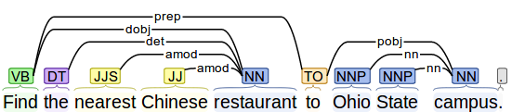
Semantic Details of Space
The meaning of linguistic components
  (VB Find)?
  (NP (DT the) (JJS nearest) (JJ Chinese) (NN restaurant))?
  (TO to)?
  (NP (NNP Ohio) (NNP State) (NN campus))?
  (ROOT
  (S
  (VP
  (NP)
  (PP
  (NP)))
  (. .)))

Slide 11
Semantic Analysis
Meaning interpretation is always subjective.
Computers are GIVEN human knowledge and reasoning skills.
How do we go about this?
  Ontologies
  Machine learning
  GIS

Slide 12
  Ontologies
  Classes, objects and relationships
    Ohio State is a University, which is a type of Organization, which is a type of Place
    Chinese restaurant is a Restaurant, which is type of Facility, which is a type of Place
    A to B is a Distance Relation, which is a type of Spatial Relation between any type of geometries
    Nearest A [to B] is a Spatial Constraint, which is a type of Constraint
  Computers need to be given and LEARN all these during its service cycle
  Then, computers can work via formal language such as SQL
    SELECT r.name, r.location, r.description FROM restaurant r, university u
    WHERE r.type='Chinese'
    ORDER BY DIST(r.geom, u.geom)
    LIMIT 1

Slide 13
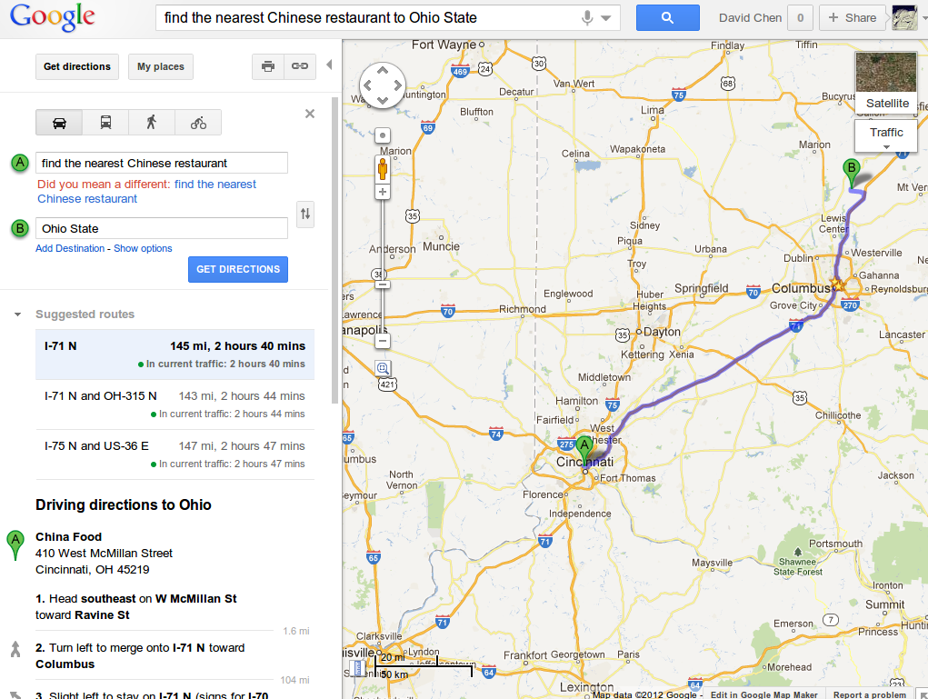

Slide 14
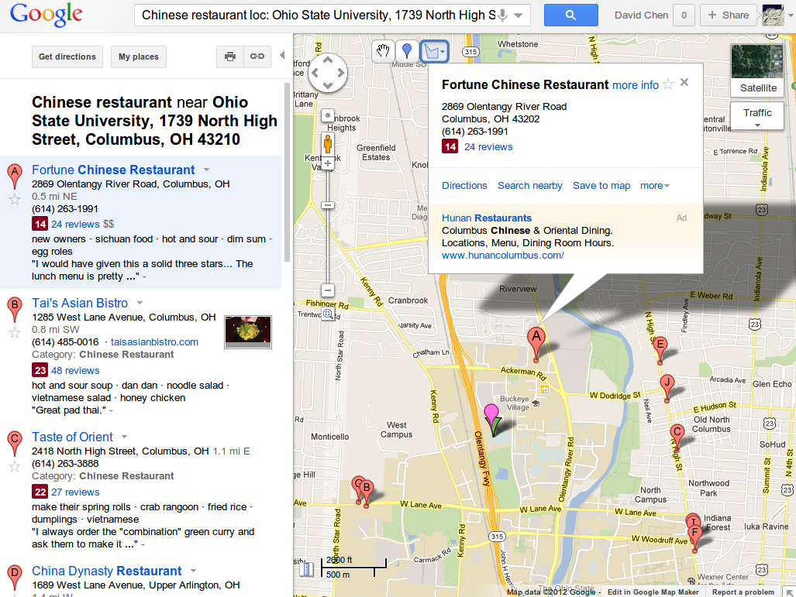

Slide 15
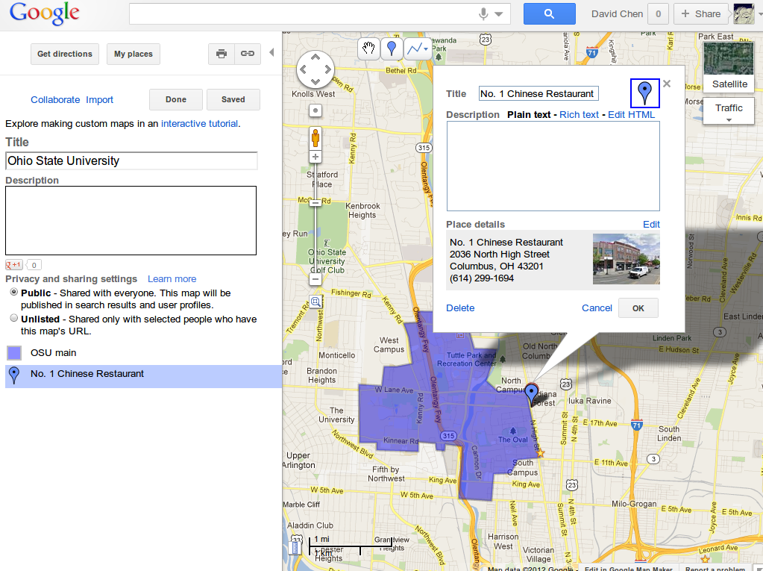

Slide 16
Another Example
Find the best Asian food near OSU
  Best? Positive review, high rank, awesome, delicious, etc
  Asian? Chinese, Indian, etc
  Food? Restaurant, bistro, cafe, etc
  OSU? Ohio State Univerisity, Oregon State University, etc
Computers become more confused.

Slide 17
How to Approach
Interrogation
  Ask the speaker to clarify.
  Do you mean Asian like Japanese? (“Yes, but I also mean Chinese” from the speaker)
  The speaker may be getting impatient...
Rules by default
  SELECT r.name, r.location, r.description FROM restaurant r, university u
  WHERE u.name like 'OSU' and r.type like 'Asian' and DIST(r.geom,u.geom)<500m
  HAVING r.rank=MAX(r.rank)
  ORDER BY r.rank
OR
  SELECT r.name, r.location, r.description FROM restaurant r, university u
  WHERE u.name like 'OSU' and r.type like 'Asian' and DIST(r.geom,u.geom)<500m
  HAVING Setiment_Polarity(r.review)=MAX(Setiment_Polarity(r.review))
  ORDER BY r.rank

Slide 18
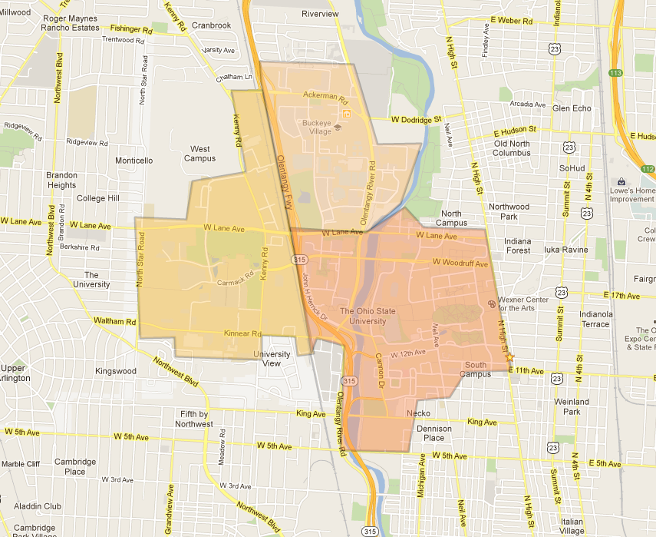
Fortune Chinese
Moy's Chinese
Yau's Chinese
NO.1 Chinese
China Dynasty

Slide 19
Fortune Chinese
Moy's Chinese
Yau's Chinese
NO.1 Chinese
China Dynasty

Slide 20
GIS
Thematic mapping is only one of the capabilities GIS has.
The backend geoprocessing facility is more powerful.

Slide 21










A Vista of Web Application
Socialization is hot.
  Facebook, Twitter, Foursquare, Google+, Sina Weibo, Renren
Spatialization is hot.
  Share location, check in, photo maps
A Web enabled by NLP and GIS can be even hotter.

Slide 22
Summary
Conclusion
  NL is understandable to computers
  Knowledge can be given and learned
  Computational linguistic methods and machine learning are the way to go
  GIS can provide sophisticated spatial reasoning and help communicate results on a map
Down the pike
  Universal vs domain specific
  Efficiency vs accuracy

