Slide 1


LandPro Equipment Telephony Traffic Project Report
Team 1 - The Aces
Simon Business School | University of Rochester
Spring 2021
Notes:
Yuchen

Slide 2
Road Map
Data Cleaning and Merging
Analysis Design and Approaches
Insights & Findings
Solutions
Notes:
Yuchen
Mention the solutions first.
Reemphasize the sponsor's expectation

Slide 3
Executive Summary
Peak season is defined as April to July
Missing rate for cross calls is lower than target calls
2 Approaches to allow analysis from multiple angles
Macedon, NY / Niagara Falls, NY / East Palestine, OH have the highest overall MR
Branch performance varies on different weekdays in different months
Most calls are answered by departments other than the intended target
Small branches suffer more on cross missing calls
Notes:
Yuchen (change color to classify df1 and 2, make this slide before data cleaning)
Peak season is defined as April to July
2 Approaches to allow analysis from multiple angles
Macedon, NY / Niagara Falls, NY / East Palestine, OH have the highest overall MR
Branch performance varies on different weekdays in different months
Most calls are answered by departments other than the intend target
Missing rate for cross calls is lower than target calls
Small branches suffer more on cross missing calls

Slide 4
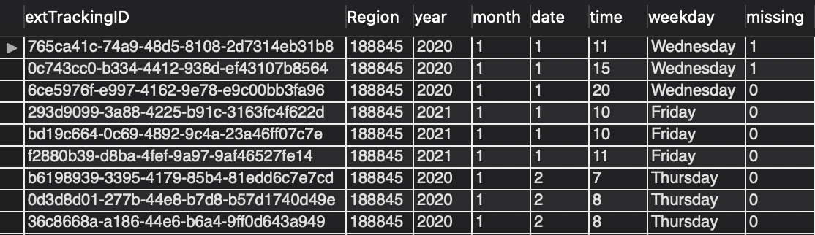
Data Cleaning and Merging
Data Frame 1
Attributes include:
CallID
Region
Year
Month
Date
Time
Weekday
Missing
Notes:
Xiaotian
Different Approaches, this is the first DF and it is used at approach 1
Focus on Customer’s perspective,
only external calls recorded here.
Tracking ID, location, time, missed or not
One record holds one row to focus on the missing.

Slide 5
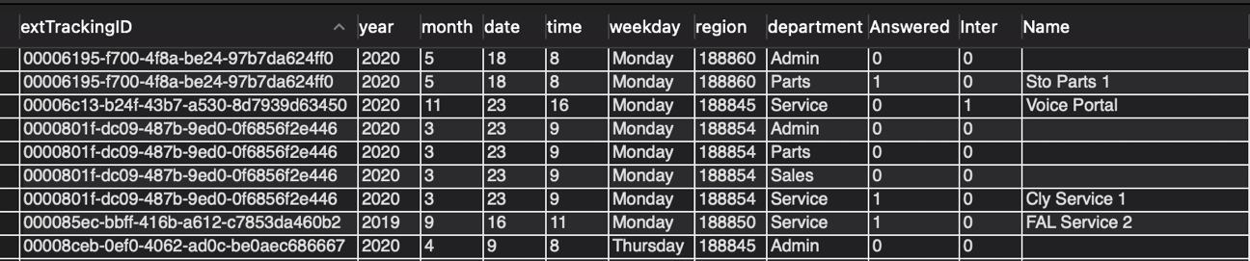
Data Cleaning and Merging
Data Frame 2
On Top of DF 1
Additional attributes include:
Department
Internal/External
Name of Recipients
Notes:
Xiaotian
Company’s perspective.
One record holds multiple rows here since we kept more info here,
departments, Internal/External, Names, answered.
So we would be able to break into details for every department in every store.

Slide 6
Data Cleaning and Merging
Original data
Data Frame 1
Data Frame 2
Department
Weekday
Regions
Months
Internal/ External
Staffing Condition
Notes:
Xiaotian
Direction of usage
DF1 for analysis focused on Weekday, Region, Month
DF2 for analysis focused on Department, Internal/External, Staffing Condition

Slide 7
Size of Store
Branch with Employee > 15 | Branch with Employee <= 15
Falconer | Clymer
Hall | Savannah
Avon | Macedon
Brockport | Fairmount City
Alexander | Niagara Falls
Oakfield | Edinboro
Halifax | East Palestine
Watsontown | Harrisburg
Stoneboro | Centre Hall
Springville | Mifflintown
Notes:
Xiaotian
Store size based on the number of employees.
15 was the median, we used this number to divide stores as small stores and large stores.

Slide 8
Approach #1
Call Volume
Missing Call Rate
Weekday and Weekend
Region
Notes:
Mei Yin

Slide 9
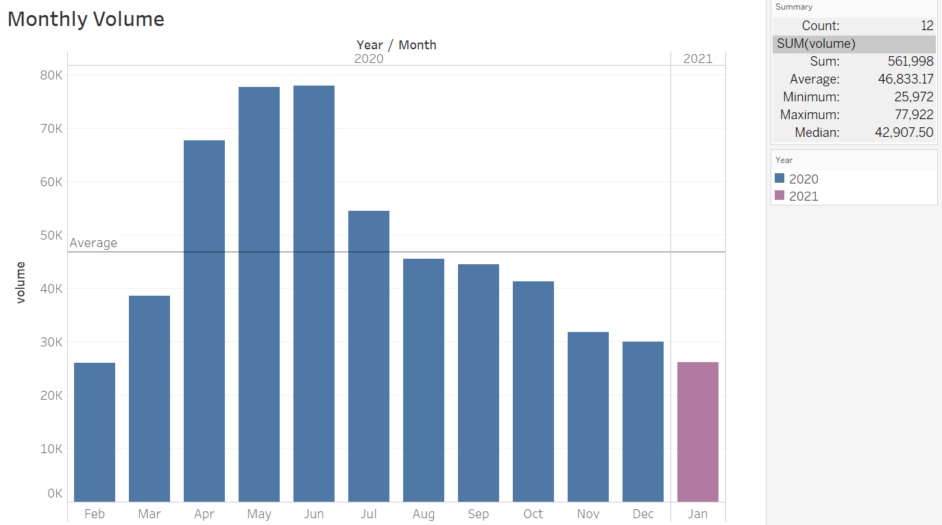
Monthly Call volume
April to July have the highest call volume
The average call volume of the entire year is around 47,000
Data is excluded from Sep 2019 ~ Jan 2020 due to incompleteness
Notes:
Mei Yin

Slide 10
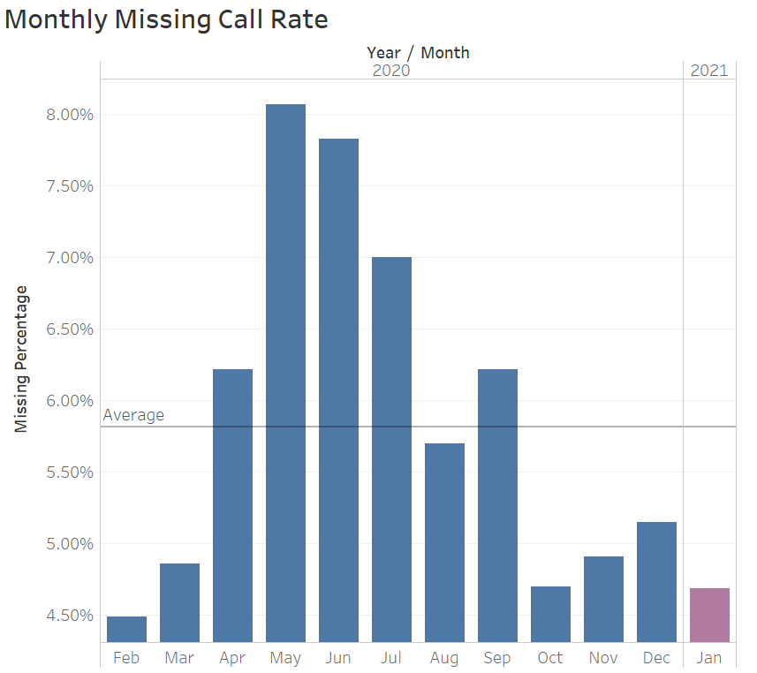
Monthly Missing Call rate
April to July have the highest missing call rate. The highest missing call rate is in May - 8.07%
The average missing call rate in the entire year is 5.82%
Notes:
Mei Yin (sep need to mention, average line highlight)
We can define April to July are the peak season
Thickening the average line)

Slide 11
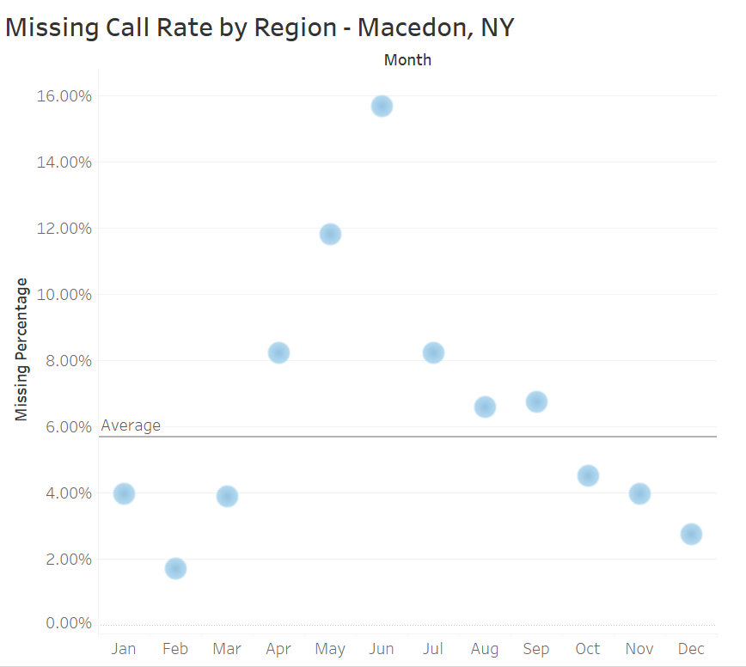
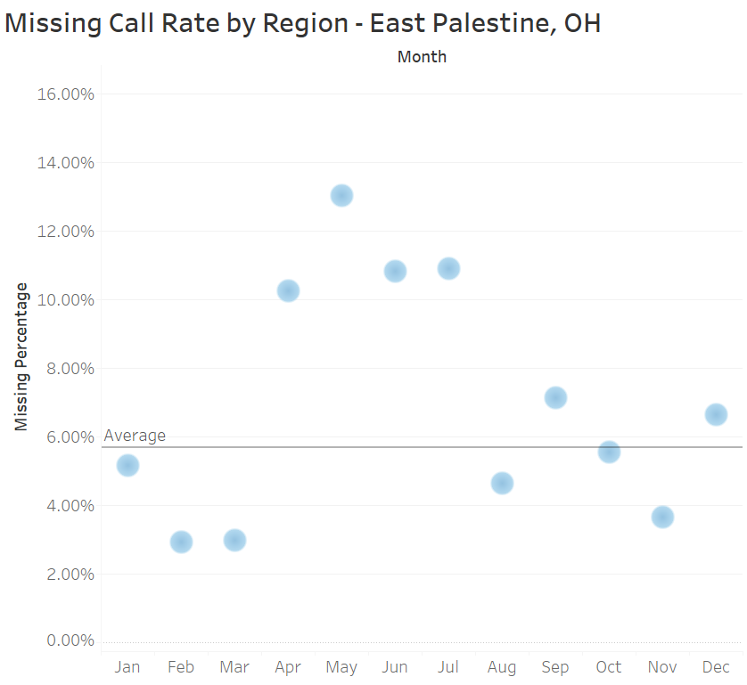
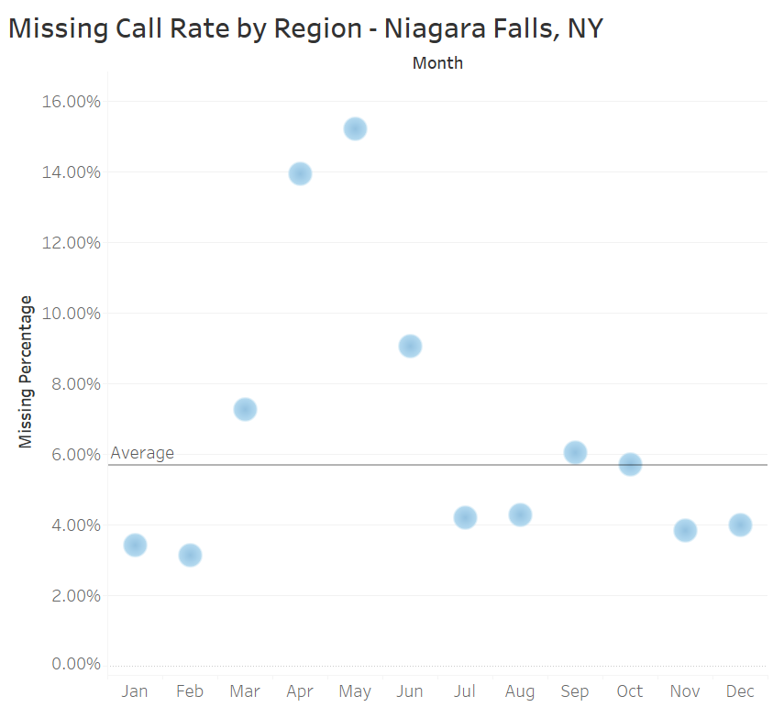
Missing Call Rate – By region
The TOP 3 regions that have highest missing call rate are Macedon, NY (15.7%), Niagara Falls, NY (15.21%), East Palestine, OH (13.03%)
Notes:
Mei Yin
we extract those three out because later on we weill talk more about these three regions.

Slide 12
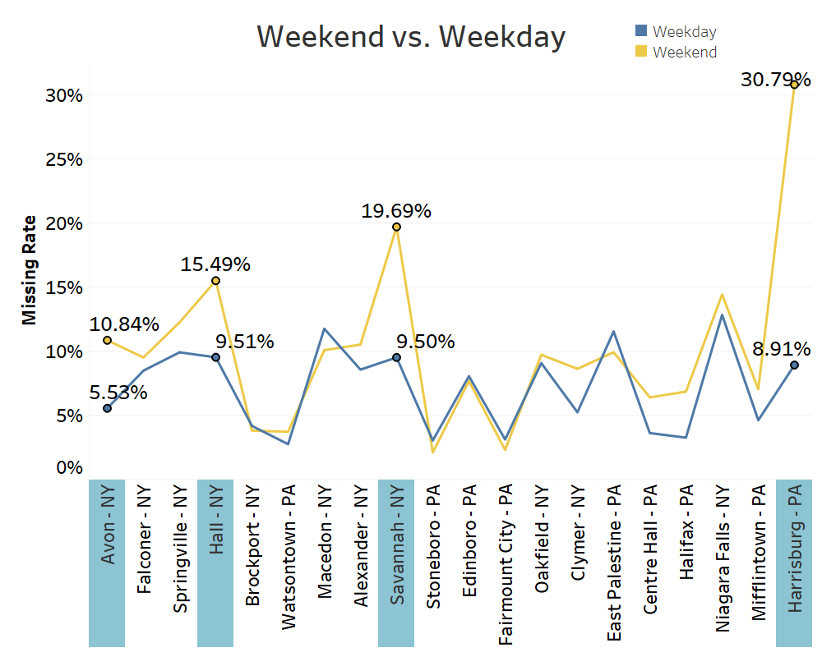
Missing Call Rate during weekends Vs. WEEKDAYs in the Peak Season
Descending order of total call volume from the left to the right
Big gap of missing rate between weekends and weekdays in Avon, Hall, Savannah, and Harrisburg
Office hour is from Monday to Saturday but phone calls are still picked up on Sunday
Notes:
Di (can make animation of descending order of total call)
Reduce the complexity of the graph/visualization
Take out decimals
Only show numbers of region we concentrate on
Highlight the

Slide 13
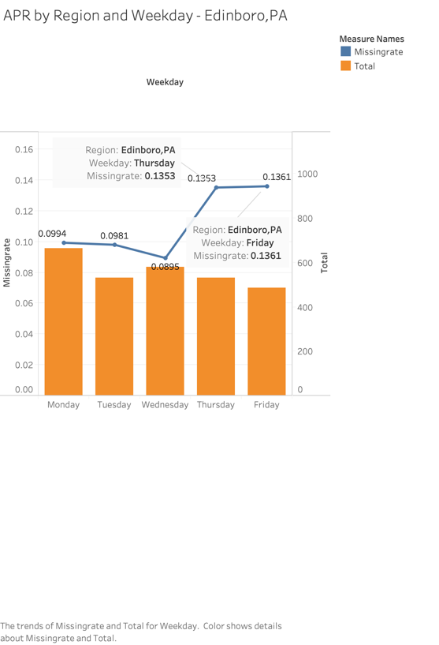
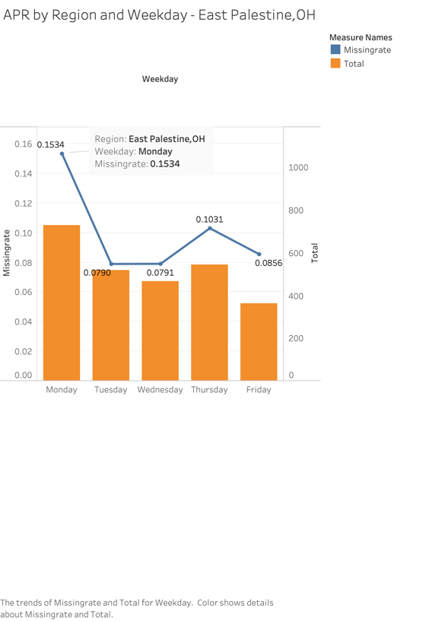
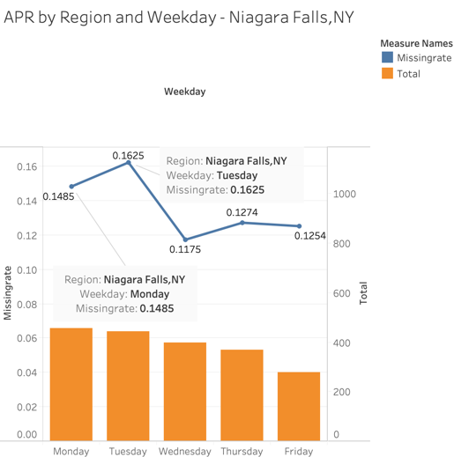
Missing rate and total volume BY WEEKDAYs in peak season
Edinboro, PA
THU&FRI
East Palestine, OH
MON
Niagara Falls, NY
MON&TUE
Top 3 branches of highest missing rate in April:
Notes:
Di (still difficult to read the graphs, highlight the specific bars, delete the upper right text box)
Enlarge the graphs

Slide 14
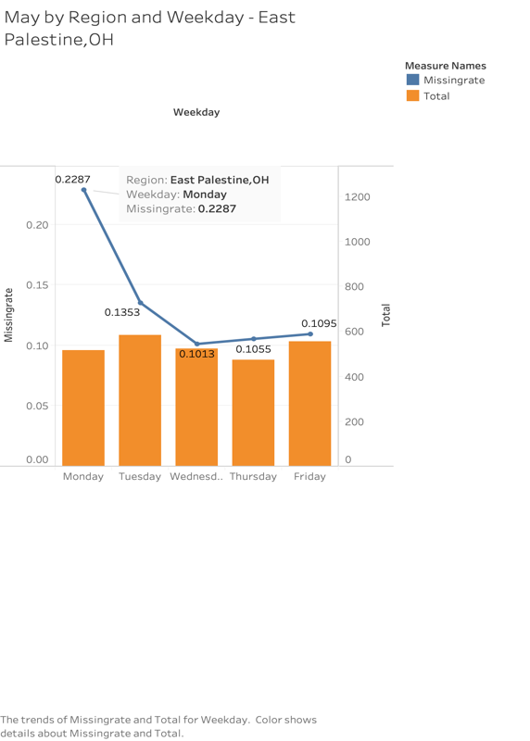
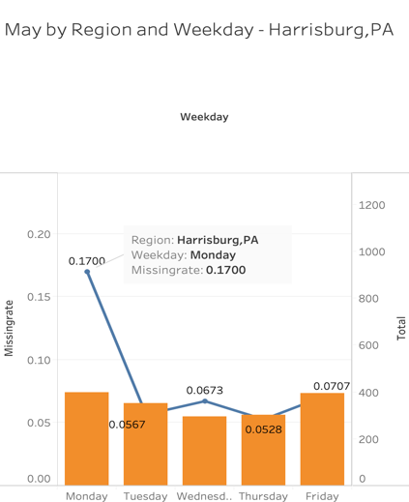
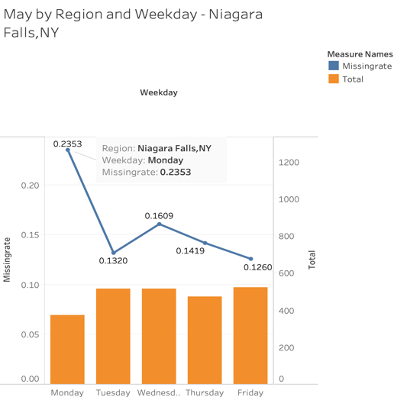
Missing rate and total volume BY WEEKDAYs in peak season
East Palenstine, OH
MON
Harrisburg, PA
MON
Niagara Falls, NY
MON&WED
Top 3 branches of highest missing rate in May:
Notes:
Di

Slide 15
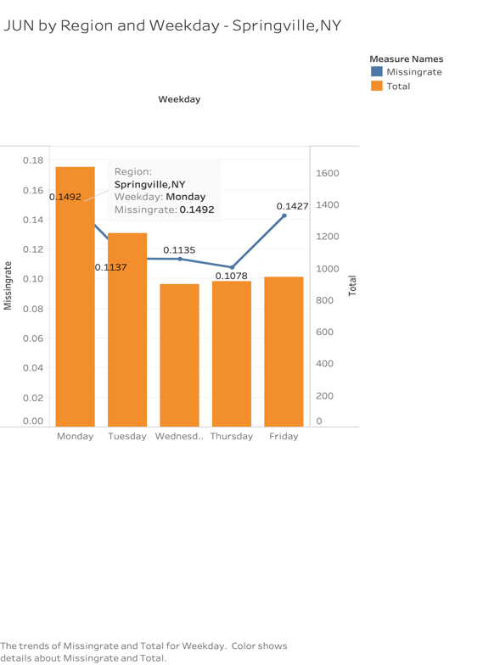
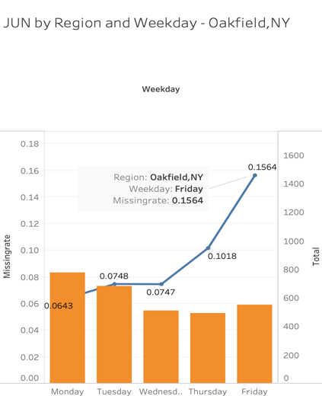
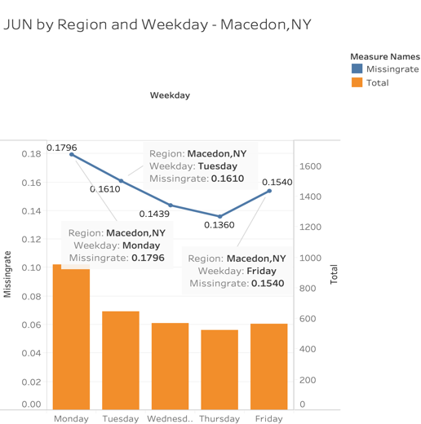
Missing rate and total volume BY WEEKDAYs in peak season
Springville, NY
MON&FRI
Oakfield, NY
FRI
Macedon, NY
MON&FRI
Top 3 branches of highest missing rate in June:
Notes:
Di

Slide 16

Shifts rescheduling
More available answering or shut down phone receiving system during weekends
Work shifts during weekdays
Work efficiency on Mondays and Fridays
Notes:
Di (should specific or general?)

Slide 17

Staff Deployment
Relocate staffs from one region to another
Flexible working locations in the same state
Notes:
Mei Yin
e.g. a WFH staff can help Mecedon and Niagara Falls stores to answer calls, of course, the prerequisite is the staff is familiar with the operations of each store.

Slide 18
Approach #2
Department
Call Type
Answer Rate
Staffing
Notes:
Jerry

Slide 19
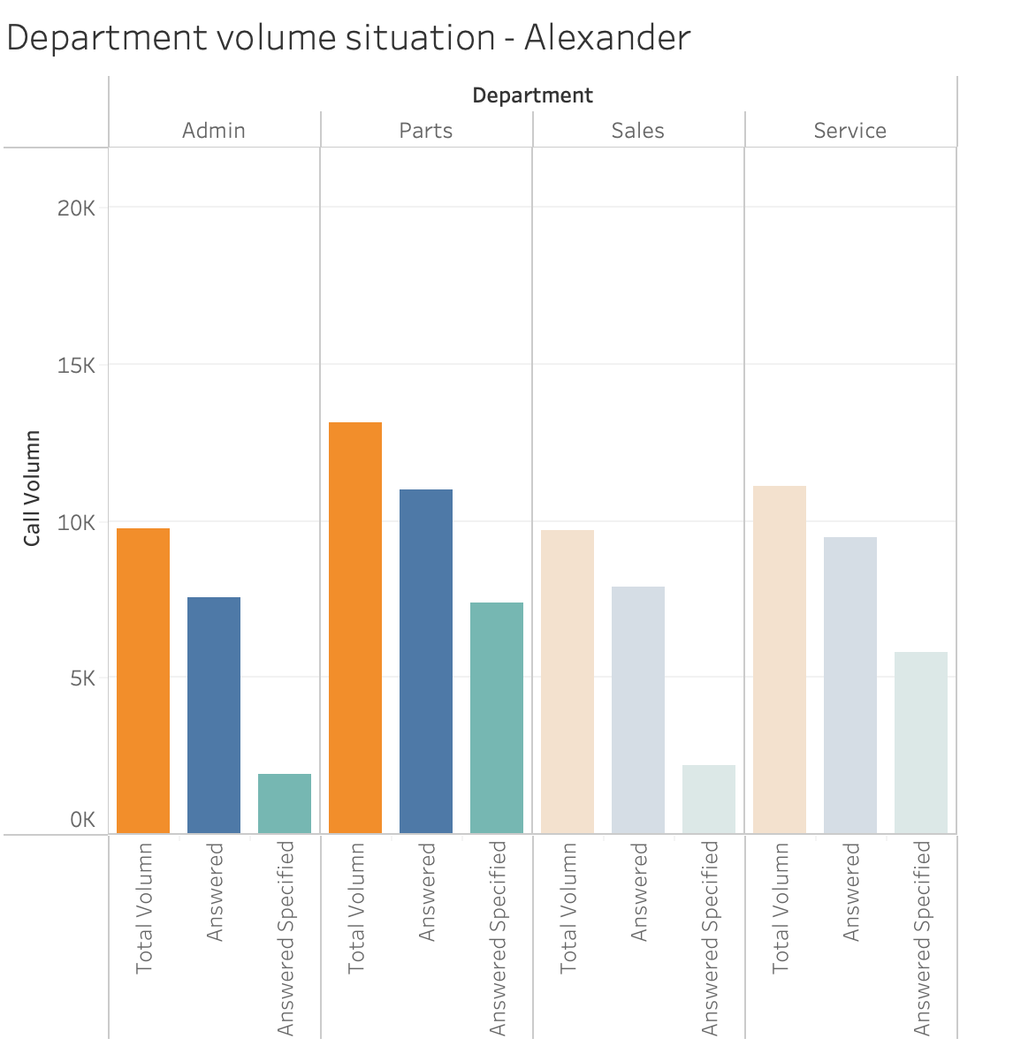
Volume during peak season
Stores have higher volumes are more popular, particularly Avon, Falconer, Hall, Springville
For most stores, Admin has the least number of calls, Parts has the largest number of calls
For Niagara Falls, all department's call volumes are equal
Notes:
Jerry
Enlarge the graphs, fix 0 and 1 to internal and external
* Reduce complexity
* separate into parts/ animation
* Use color and fonts

Slide 20
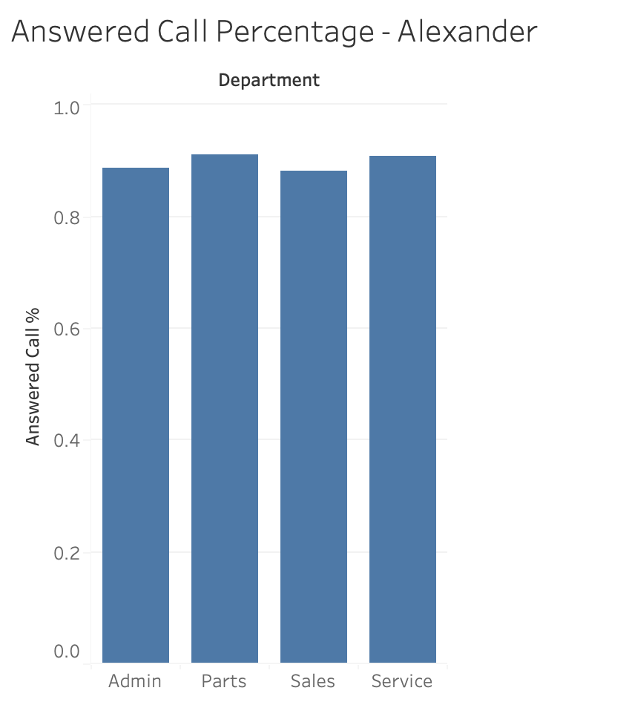
Answer rate
Among most stores, Parts has the most answered call %
Given Admin call volume is the least, its answer call % is still relatively low compared to other departments.
Avon has most call volume, its answered call % is relatively high compared to other stores
For Niagara Falls, all answered call % are equal
Notes:
Jerry

Slide 21
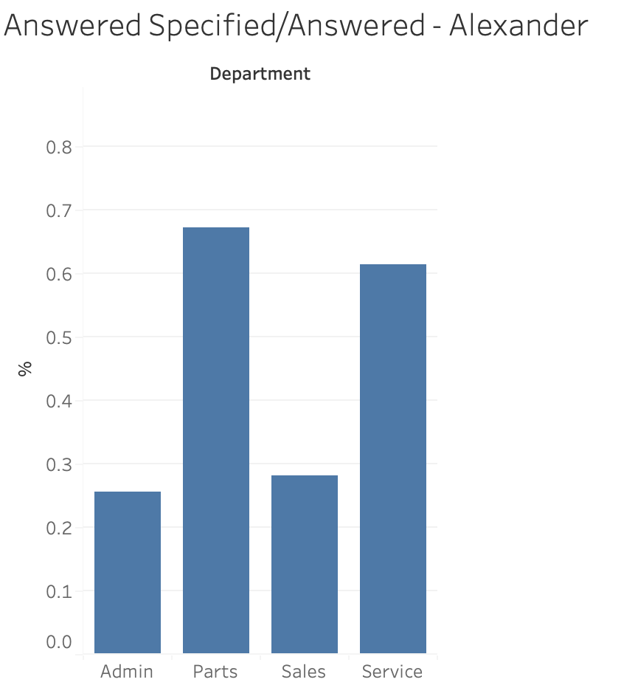
Department capacity
Graph means how much help that other departments assist answering the call, higher % means less help
By %, we can tell the amount of people and their expertise in each department under each store
Across all the stores, Admin has relatively low capacity answering its own call compared to other depart while Parts has high capacity.
Notes:
Jerry (reframe the meaning)

Slide 22
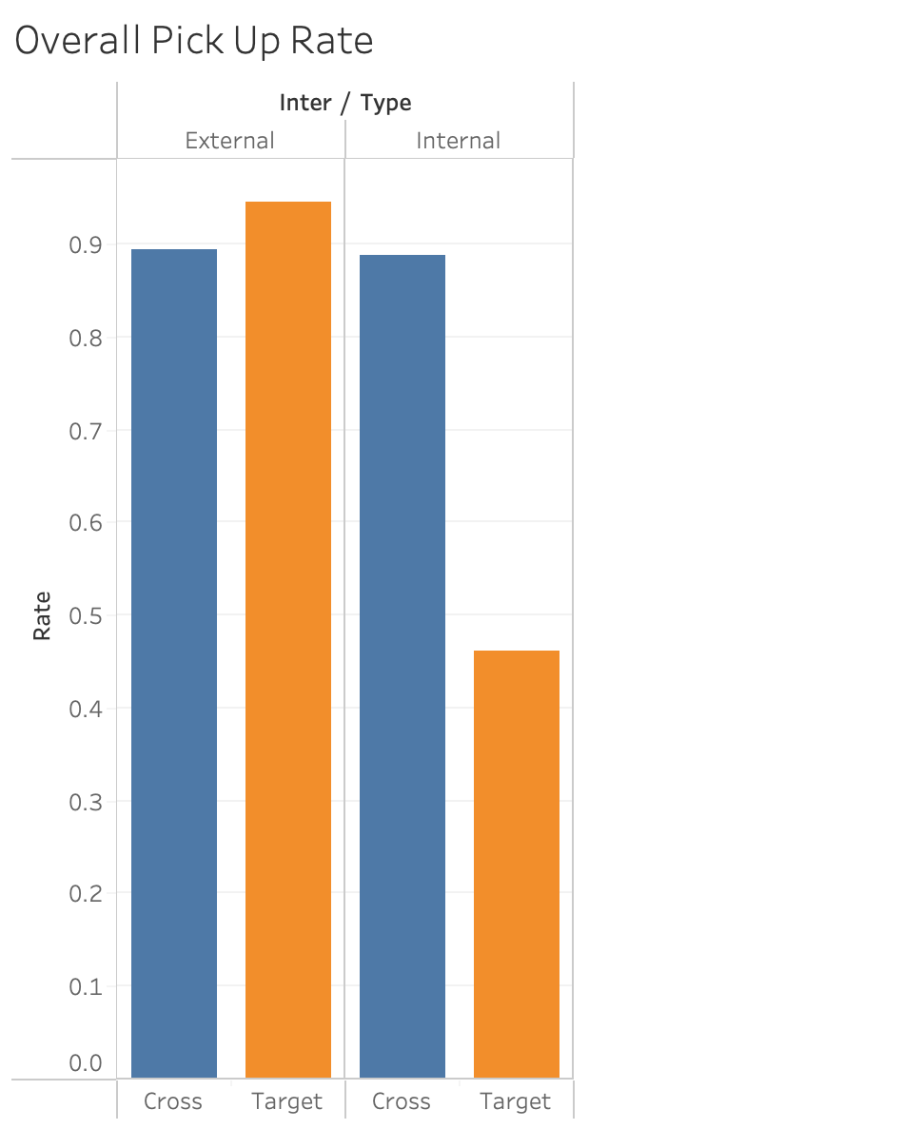
Type of call rate
External call’s answer rate is higher than internal call
When consumer calls to a specific department, answer rate is higher
Notes:
Jerry
Fix the 0 and 1 to internal and external for better understanding
Define what is cross and what is target
Change the axis “Rate” to “Answer Rate”
Remove the legend

Slide 23
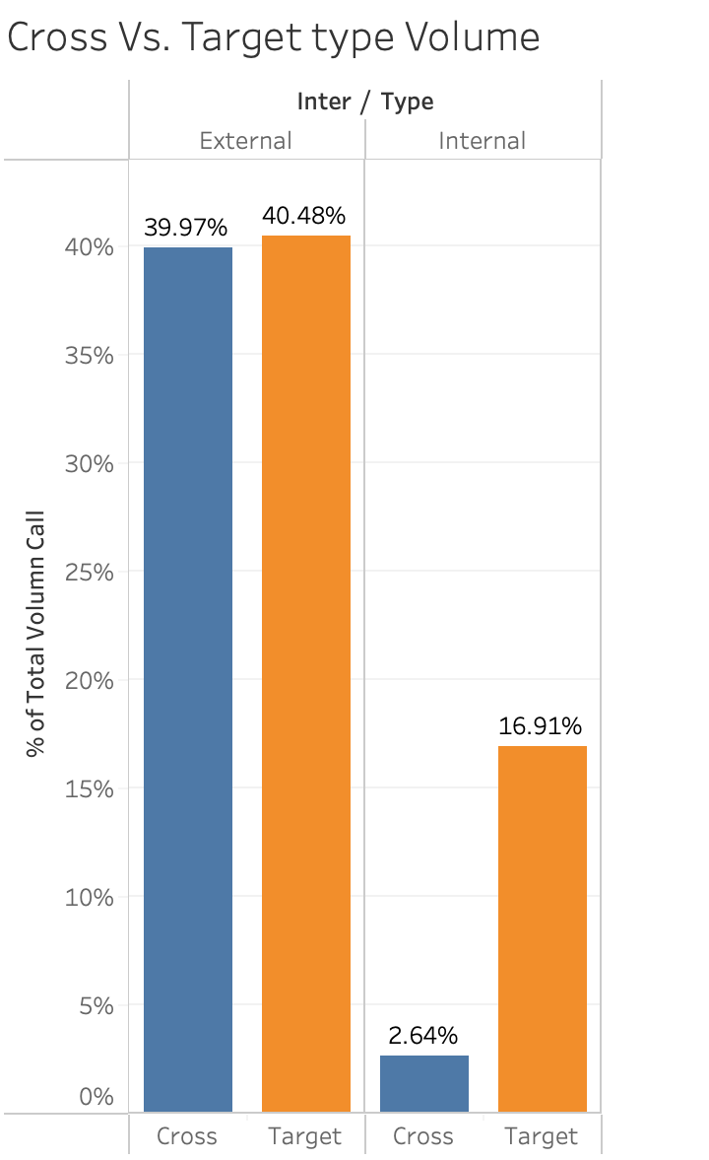
Type of Call volume
Most of the company external calls go to specifically targeted departments
Cross represents calls that go to multiple departments. Target represents calls that go to one department by customer.
Notes:
Jerry
Should we keep this or not? What’s the insight we can acquire from this slide?
Remove the legend

Slide 24
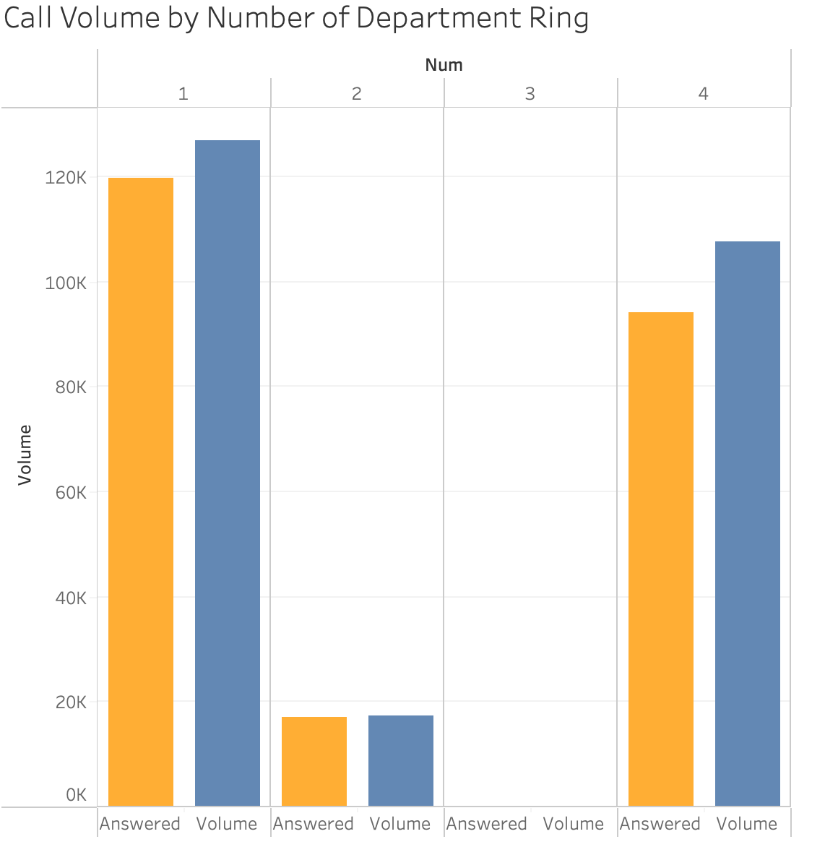
Volumes by number of department rang
The missing call rate for 4 department is more than 10%, which is larger than 1 and 2 department which were around 5%
The initial department miss the call
=>none of other departments is able to answer the calls
Notes:
Jerry (fix volumn on graph)
The number of department rings in same call may indicate the efficiency of store dealing with client issues.
Legend remove

Slide 25
Call Volume by number of department
East Palestine, Harrisburg, Macedon suffer missing call issues in cross call type
20% of missing calls while the call rang all 4 departments
In small store, if one department cannot answer the call, probably no other department can answer for that.
Cross branches | Target branches
Avon | Brockpot
Stoneboro | Halifax
Falconer | Watsontown
Hall | Oakfield
Niagara Falls | Fairmount City
Savannah | Harrisburg
East Palestine | Mifflintown
 | Clymer
 | Centre Hall
Notes:
David

Slide 26
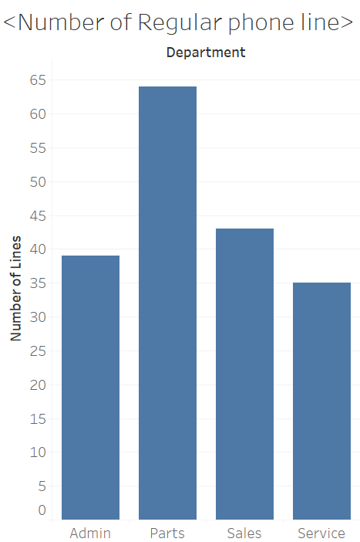
Regular phone line
Line pick out more than 5 calls monthly
Probability to answer phone call would be higher if regular line exist and function well
Parts department has most regular line but second most employees
Service and Admin department have more employees but less Regular phone line

Slide 27
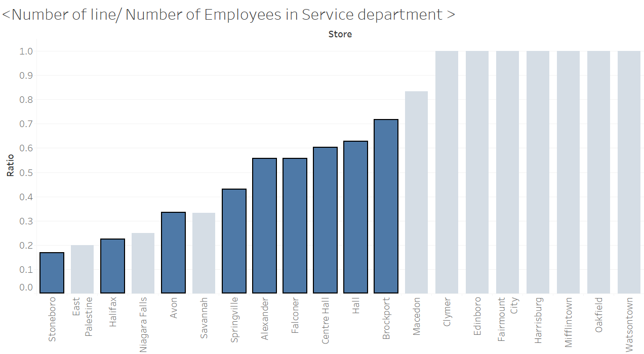
Regional Difference on Phone Line
Service department:
Exclude employee who cannot constantly present in store (Driver)
Ratio of line and employee differs in each branch
Big branches are more likely to suffer low ratio
=> Multiple tasks requirement (Cannot focus on phone call)
Notes:
David (thicker / bold of the words)
Order by ration/ HighlightBig Branches

Slide 28
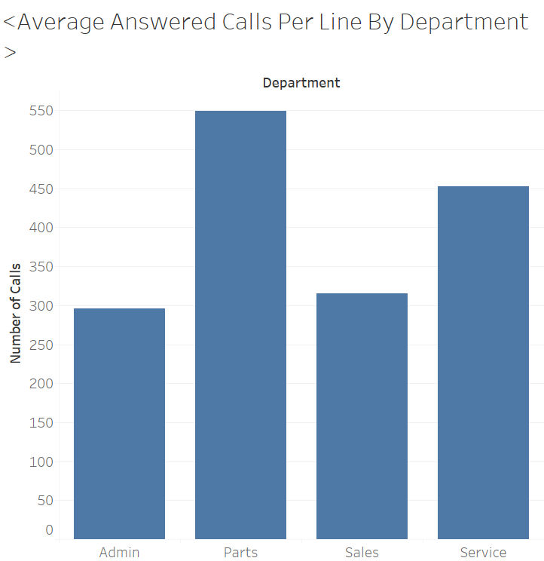
Average call volume per regular line
Parts department has highest average answered calls
Admin and Sales department has less total phone call and average answered calls
For Service department, the average call volume is high. This may result from the low regular line in this department
Notes:
David

Slide 29
HIGHEST AVERAGE VOLUME IN DEPARTMENT
 | Large Branches | Small Branches
Service | Brockport Hall Falconer Watsontown | Edinboro Fairmount City Macedon Savannah
Parts | Hall Brockport Avon | Fairmount City Macedon Savannah
Sales | Springville Watsontown | Clymer Edinboro
Admin | Avon Falconer Stoneboro | Niagara Falls
For Parts and Service, it depends more on the region.
For Sales depart, the variation on average answer calls is more stable
3 small size stores have higher average call on Service and Parts department
The burden on phone call volume in these areas was high during peak season
Notes:
David
Large branches have large amount of average calls

Slide 30

Staff training
Allow employees to answer overall questions from different departments
Assign employees to Admin department
Increase regular phone lines in Service department
Especially target on Small size branches
Evaluate at regional level
Notes:
David

Slide 31
branch Example - Niagara Falls
Niagara Falls
Parts
Service
No regular lines
Admin
High average answered calls
Picked up most of the calls
No regular lines
Item | Number
Call Volume | 34,289
Missed Call | 28,923
Missing Rate | 84.4%
Notes:
David
Small size store with relatively low answered call rate to other stores
Almost all incoming call rang overall all department during peak season
Inefficient call transfer or lack of employee on answering the call
May consider train staff to answer general questions
#Call were mostly picked up by Parts department
#No regular lines in Parts and Service department
#High average answered calls in Admin department

Slide 32

Call Center
Establishment for general questions
Easing the pressure, especially for regions like Niagara Falls
Splitting call stream to other branches/departments
Notes:
Yuchen

Slide 33
Thank you
Team 1 - The Aces
Simon Business School | University of Rochester
Spring 2021
Notes:
Yuchen
1. One person take charge the entire section and instead having the switch in between.
2. Take out

