Slide 1

商業分析作品集
01
陳李瑋

Slide 2
作品概述
02
強鹿公司相關企業
電話系統效率評估
連鎖超市顧客分析
玩具公司顧客與定價模型分析
房貸風險預測實例
網路討論文本分析
汽水定價與競爭者分析

Slide 3
作品一: 強鹿公司相關企業 電話系統效率評估 Data Cleaning & Descriptive Analysis
03

Slide 4

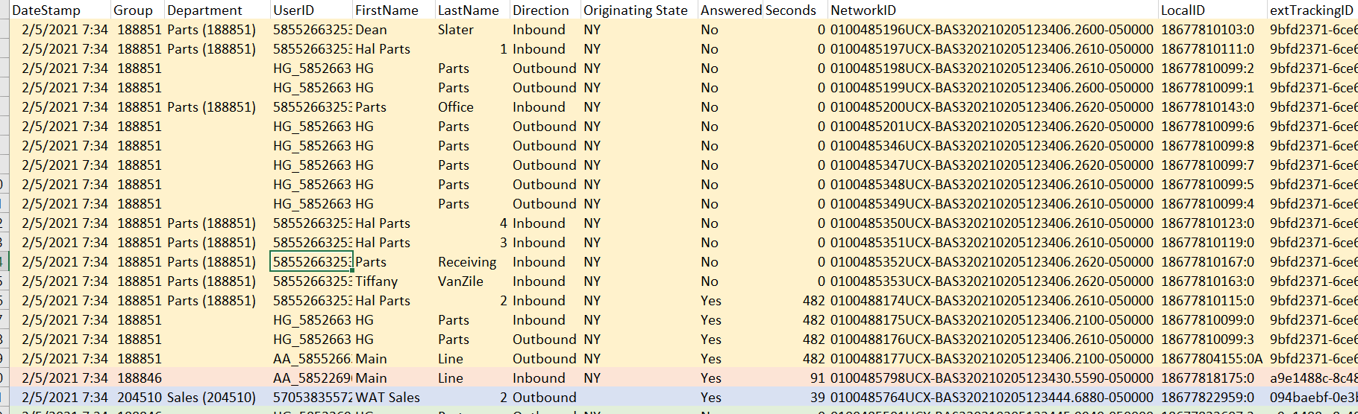
Raw Data
04

Slide 5
Data Cleaning
05
Original data
Data Frame 1
Data Frame 2
Department
Weekday
Regions
Months
Internal/ External
Staffing Condition

Slide 6
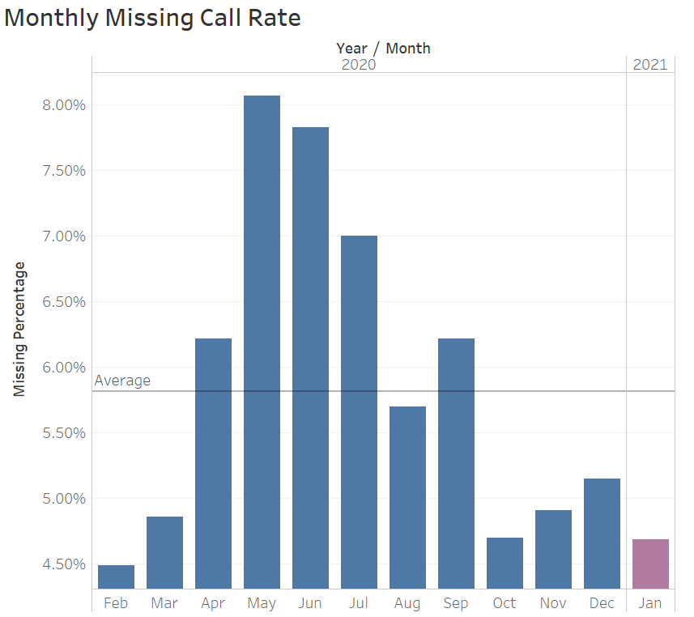
06
Average Missing Call Rate
April to July have the highest missing call rate. The highest missing call rate is in May - 8.07%
The average missing call rate in the entire year is 5.82%

Slide 7
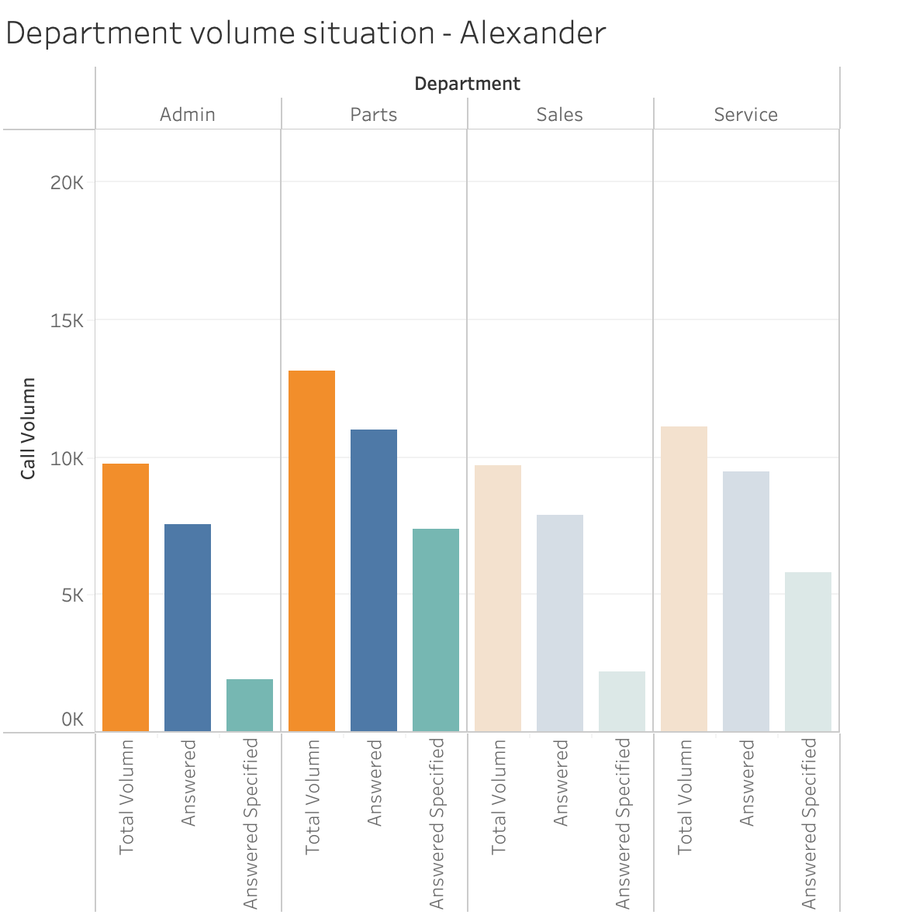
Volumes During Peak Season
07
Stores have higher volumes are more popular, particularly Avon, Falconer, Hall, Springville
=> Large branches
For most stores, Admin has the least number of calls, Parts has the largest number of calls
For Niagara Falls, all department's call volumes are equal

Slide 8
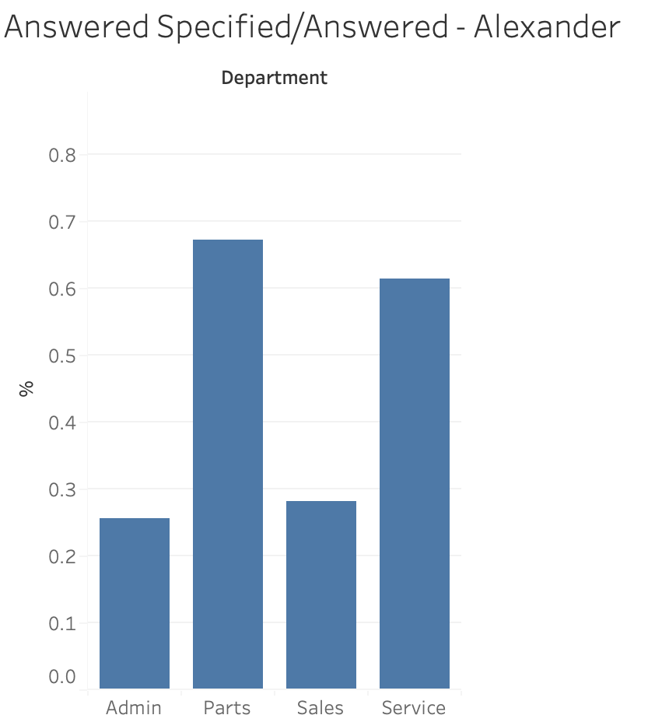
08
Department Capacity
The percentage that the departments can answer their own call
Admin has relatively low capacity answering its own call while Parts has highest capacity.

Slide 9
09
Average Volumes by Department
 | Large Branches | Small Branches
Service | Brockport Hall Falconer Watsontown | Edinboro Fairmount City Macedon Savannah
Parts | Hall Brockport Avon | Fairmount City Macedon Savannah
Sales | Springville Watsontown | Clymer Edinboro
Admin | Avon Falconer Stoneboro | Niagara Falls
For Parts and Service, it depends more on the region.
For Sales depart, the variation on average answer calls is more stable
3 small size stores have higher average call on Service and Parts department
The burden on phone call volume in these areas were high during peak season

Slide 10
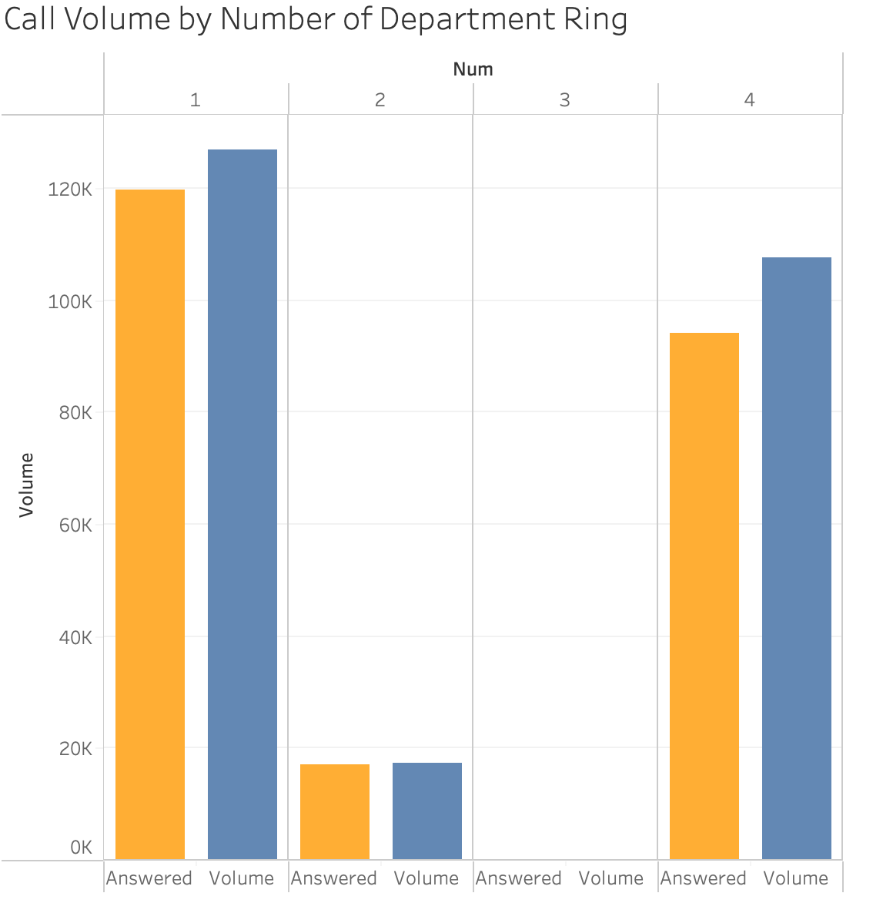
Volumes by Number of Department Rang
10
The missing call rate for 4 department is more than 10%, which is larger than 1 and 2 department which were around 5%
The initial department miss the call
=>none of other departments can answer the calls

Slide 11
Call Volume by Number of Department
11
Cross branches | Target branches
Avon | Brockpot
Stoneboro | Halifax
Falconer | Watsontown
Hall | Oakfield
Niagara Falls | Fairmount City
Savannah | Harrisburg
East Palestine | Mifflintown
 | Clymer
 | Centre Hall
East Palestine, Harrisburg, Macedon suffer missing call issues in cross call type
20% of missing calls while the call rang all 4 departments
In small branches, if one department cannot answer the call, probably no other department can answer for that.

Slide 12
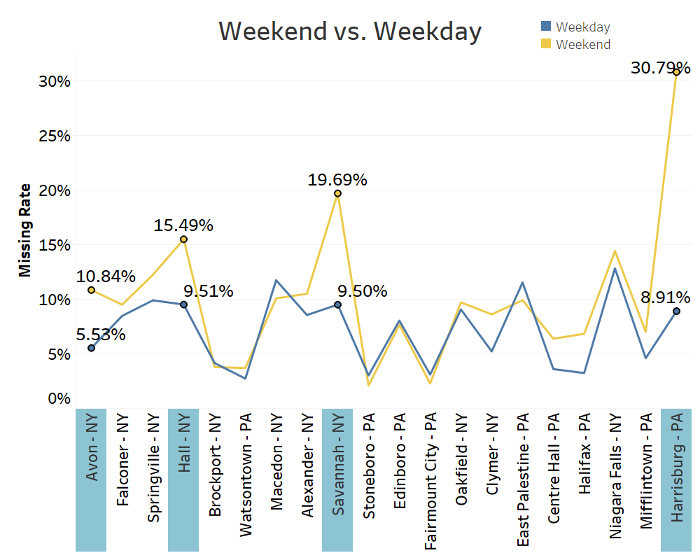
Missing Call Rate Weekend Vs. Weekday
12
Descending order of total call volume from the left to the right
Big gap of missing rate between weekends and weekdays in Avon, Hall, Savannah, and Harrisburg
Office hour is from Monday to Saturday, but phone calls are still picked up on Sunday

Slide 13
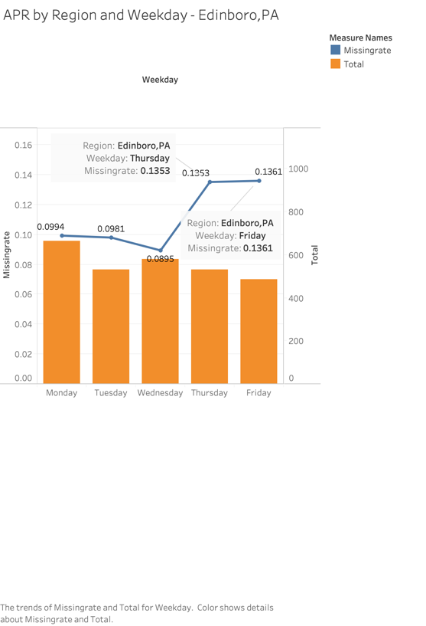
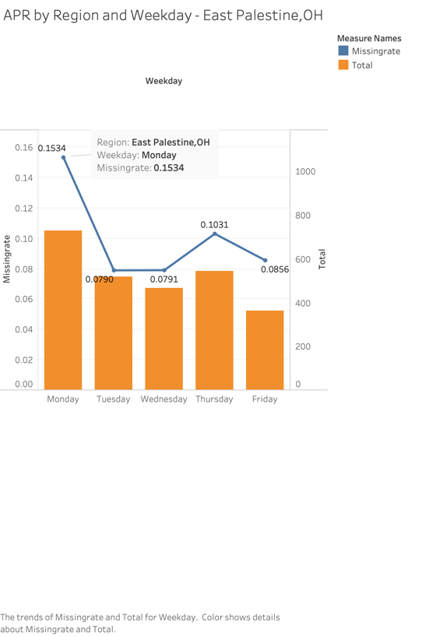
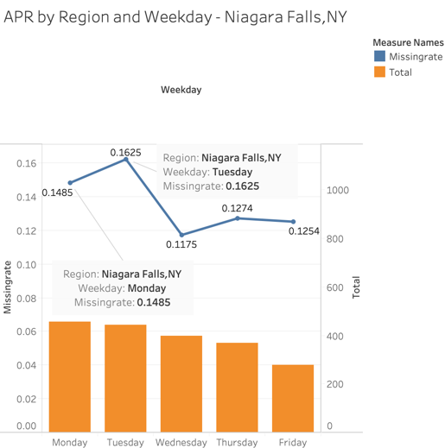
Missing rate and total volume by weekdays
Edinboro, PA
THU&FRI
East Palestine, OH
MON
Niagara Falls, NY
MON&TUE
13
Top 3 branches of highest missing rate in April:

Slide 14
Executive Summary
14
Missing rate for cross calls is higher than target calls
Small branches suffer more on cross missing calls
Most calls are answered by departments other than the intended target
Branch performance varies on different weekdays in different months

Slide 15
Recommendation
15
Staff training
Allow employees to answer overall questions
Staff Deployment
Especially target on Small size branches
Evaluate at regional level
Relocate staffs from one region to another
Flexible working locations in the same state
Call Center
Establishment for general questions
Easing the pressure for small branches
Splitting call to other branches/departments
Shifts rescheduling
Shut down phone system during weekends
Work shifts during weekdays
Work efficiency on Mondays and Fridays

Slide 16
作品二: 連鎖超市顧客分析 Data Warehouse & Visualization
16

Slide 17
Raw Data Summary
17
Users
UserID
Longitude
chains
Venues
VenueID
visits
UserID
VenueID
Chain
Latitude
VenueName
latitude
longitude

Slide 18
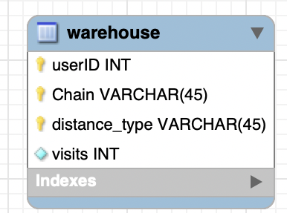
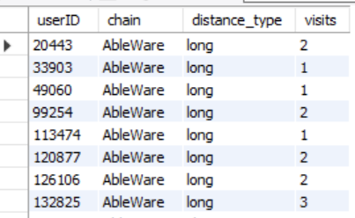
Data Warehouse Procedure
18
1. Based on our ERM diagram, we were able to gather our information
2. Then we used engine FEDERATED to create our datahouse table on our local server

Slide 19
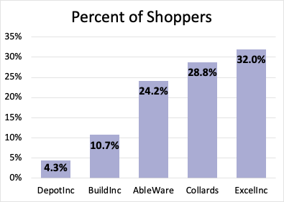
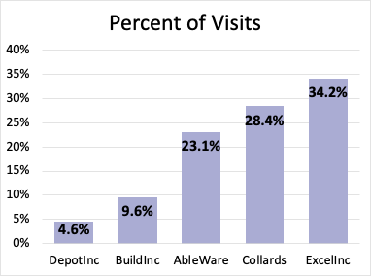
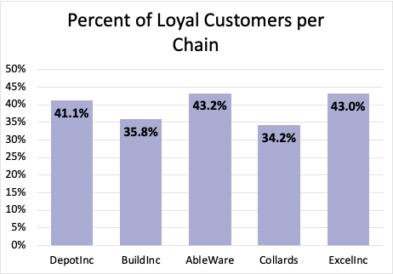
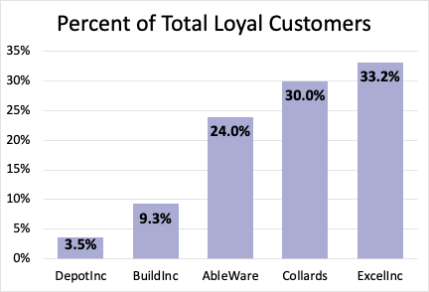
19

Slide 20
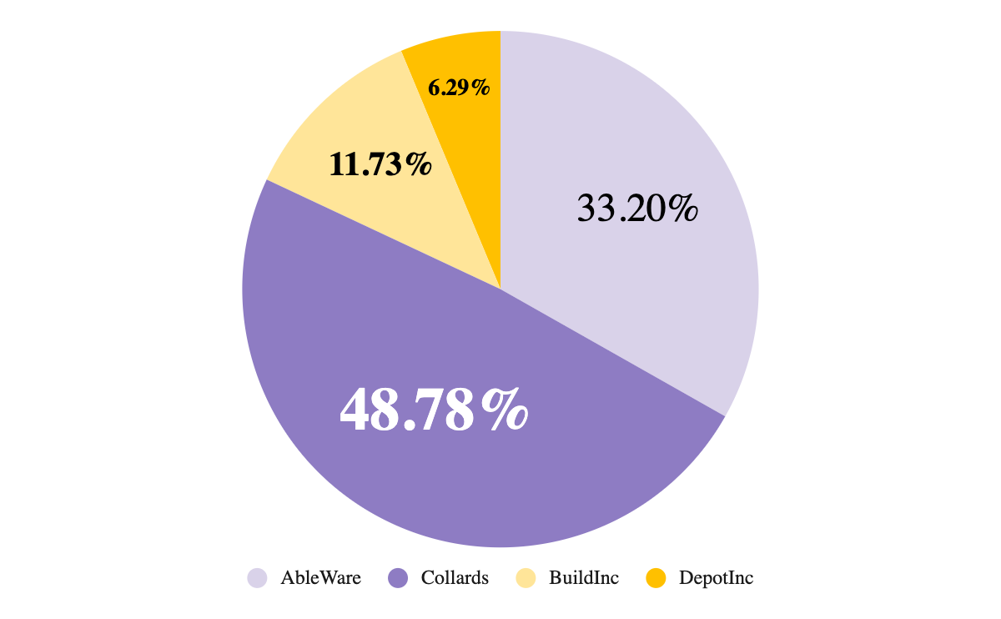
ExcelInc’s Biggest Competitors are Collards and AbleWare
20

Slide 21
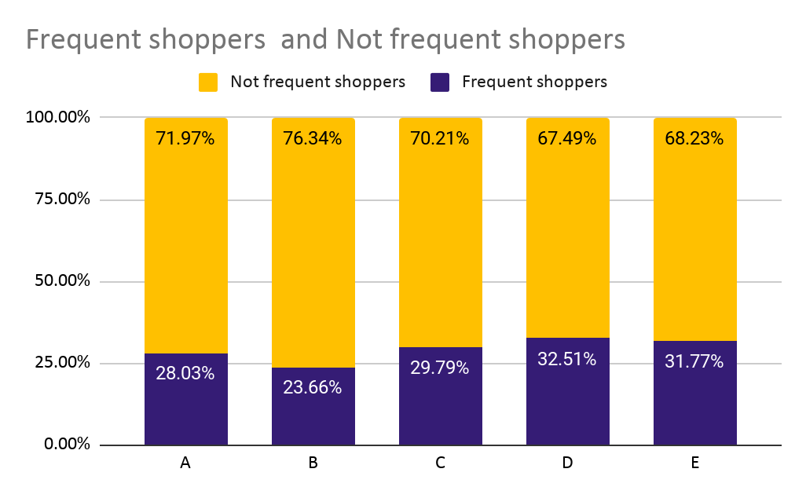
Segmentation of Frequency
21
Non frequent shoppers is more than frequent shoppers.
DepotInc has largest percentage of frequent shoppers while Buildinc has the smallest.
Notes:
Thank you Mike for explaining the cross shopping bahvious. I am Jessica Zhang. And I am going to talk about our segmentation analysis.
For the frequency part, as we can see in the table and the graph, for all the chains, not frequent shoppers, which are around 70%, presented in the yellow bar, takes larger proportion. And among the 5 chians, D has the largest percentage of frequent shoppers while Buildinc has the smallest.

Slide 22
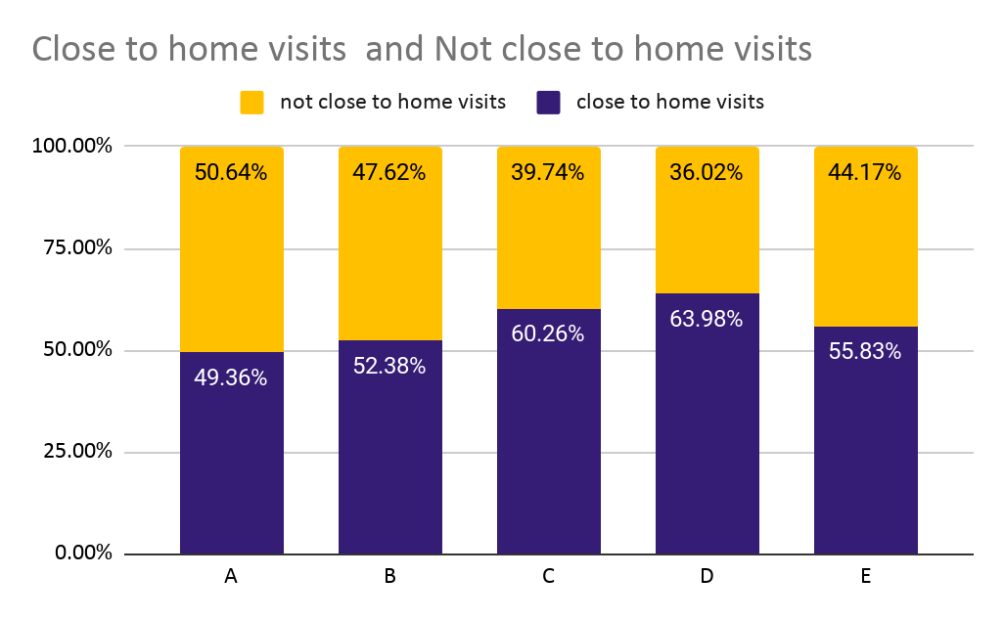
Segmentation of distance
22
Except Ableware, all stores had more short-term visits
This may correspond to the analysis that Ableware has the largest percentage of loyal customers.

Slide 23
Summary
23
Excel Inc
More customers and visits
More loyal customer
Albleware and Collards
55% of short visits
More Frequent Shopper

Slide 24
作品三: 玩具公司顧客與定價模型分析 Cluster & Conjoint Analysis
24

Slide 25
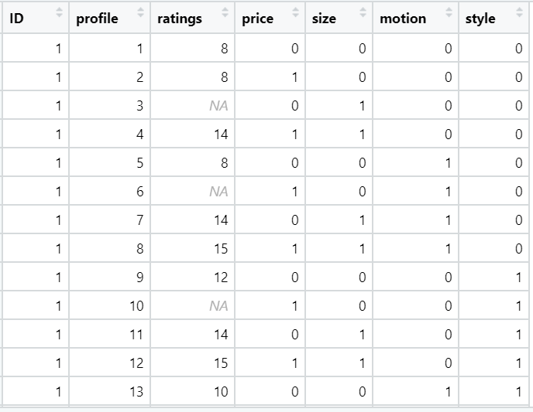
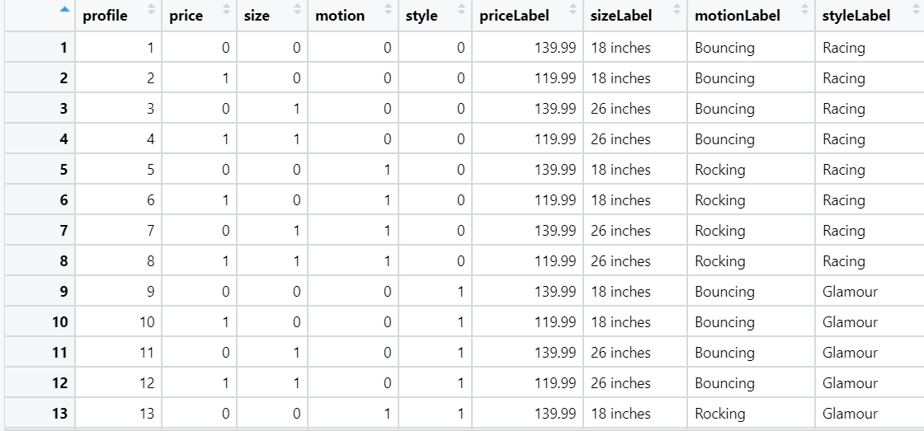
25
Raw Data
Total 200 customers data were included in this analysis

Slide 26
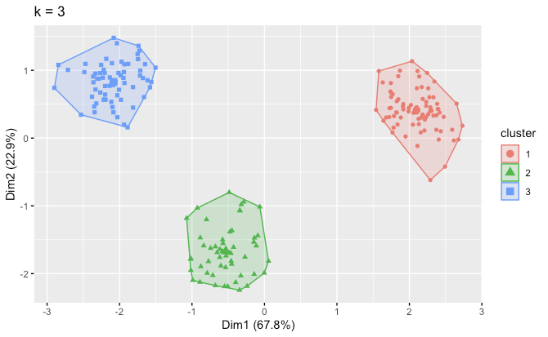
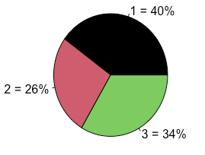
26
Cluster Analysis
1. Using regression model to obtain each customer value for each attribute
2. Conduct cluster analysis to find potential segment

Slide 27
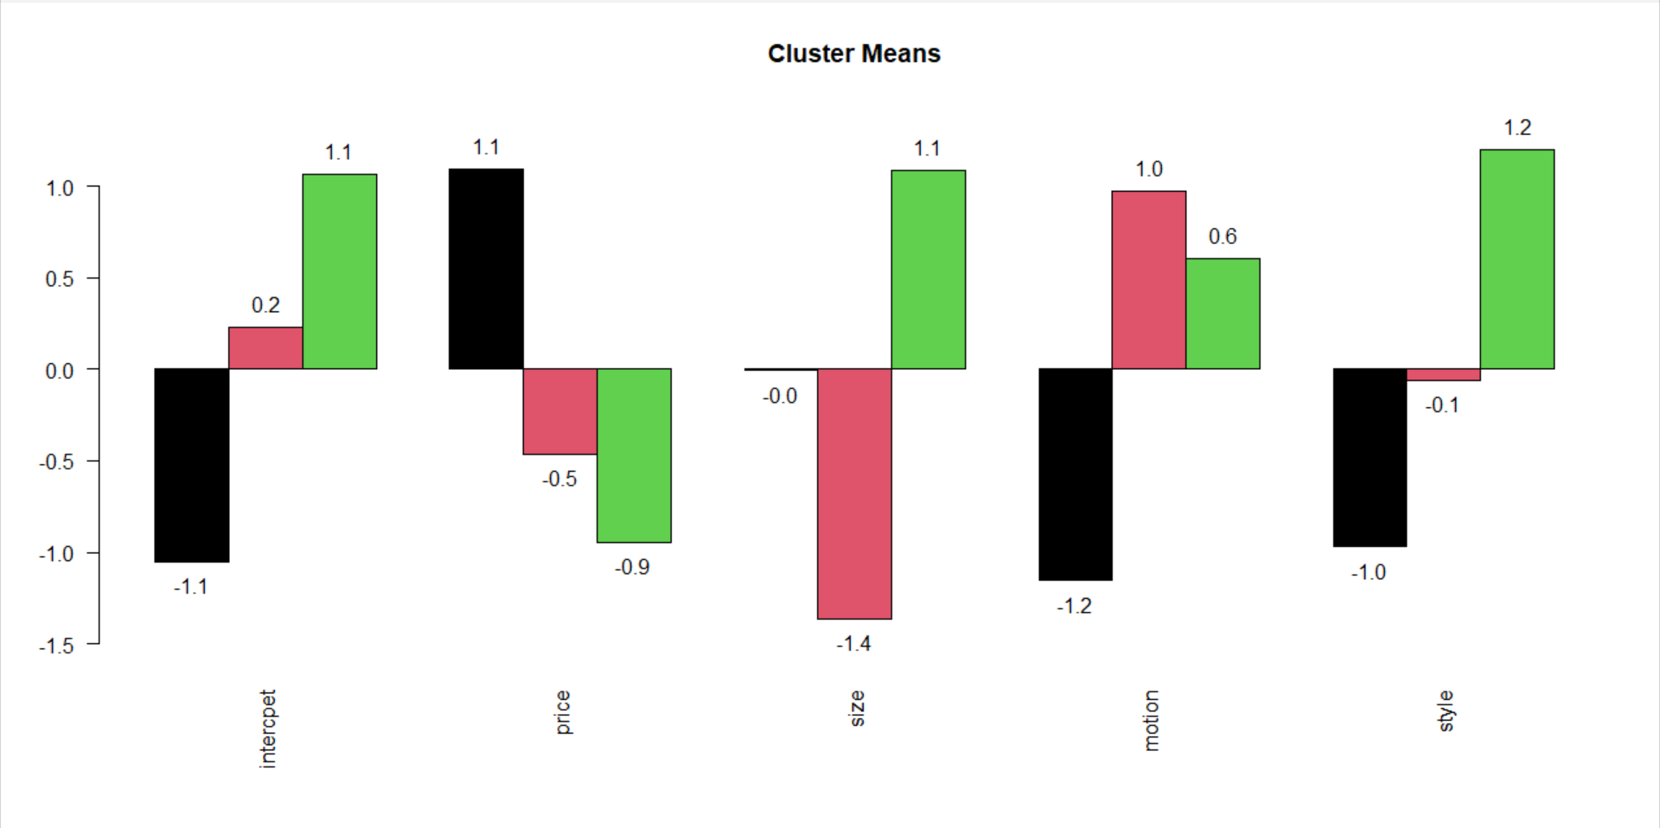
Segmentation Differences
27
Notes:
Further studying the coefficients of the respondents’ preference in each segment, we made the following observations. We can see that segment 1 which is in black, is more price sensitive than the others, relatively indifferent about size, prefers Bouncing motion and Racing style more. Segment 2 in red, is less price sensitive, prefers smaller size, Rocking motion, and Racing style more. Similarly segment 3 in green, is the least price sensitive, prefers larger size, Rocking motion, and Glamour style more. Now Michael will talk about the absolute preferences and demographics for each segment.

Slide 28
Segment Detail Information
28
Segmentation 1
3-4 Y/O Males
Prefers a Larger Horse
Segmentation 2
1-2 Y/O Child
Prefers a Smaller Horse
Segmentation 3
3-4 Y/O Females
Prefers a Larger Horse
Bouncing/Racing Horse
Highly Price Sensitive
Would like a Glamorous/Rocking Horse
Not Price Sensitive
Prefers a rocking horse as it can be less dangerous

Slide 29
Market Simulation
02
Profits
04
01
Market Simulation
03
Comparison
Scenario
29
Competitor: 26 inches Rocking Racing Horse with the price of 139.99.
Earlyriders: any other 15 combinations of 1 to 3 models.
Function that calculate and profits of Earlyriders and competitor under any scenario.
Function that can calculate the market share for every model under every scenario
Compare profits and market share between Earlyriders and competitor
Notes:
For our market simulation analysis, we firstly set the scenarios where our competitor would sell toy horse of Profile 7 and EarlyRiders can sell 1 to 3 models of any combination of the other 15 profiles. We input the scenarios to the market simulation function and get the market share and profits under each scenario.

Slide 30
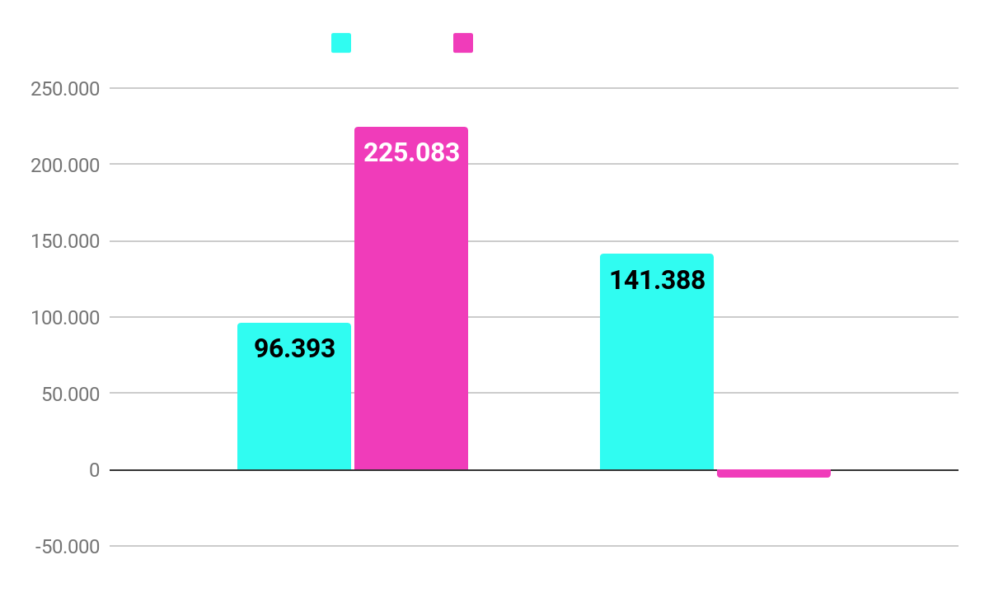
Recommended Policy from Market Simulation
30
Recommended Policy :
2 NEW products
· 18 inches Bouncing Racing Horse with the price of 119.99 dollars
· 26 inches Rocking Glamour with the price of 139.99 dollars.
Notes:
According to the analysis result, we found that when EarlyRider sell profile 2 and 15 toy horses, the profits would be highest among all the scenarios. So our recommendations policy is: EarlyRiders sell two new products. One is 18 inches Bouncing Racing Horse with the price of 119.99 dollars and the other one is 26 inches Rocking Glamour horse with the price of 139.99 dollars.

Slide 31
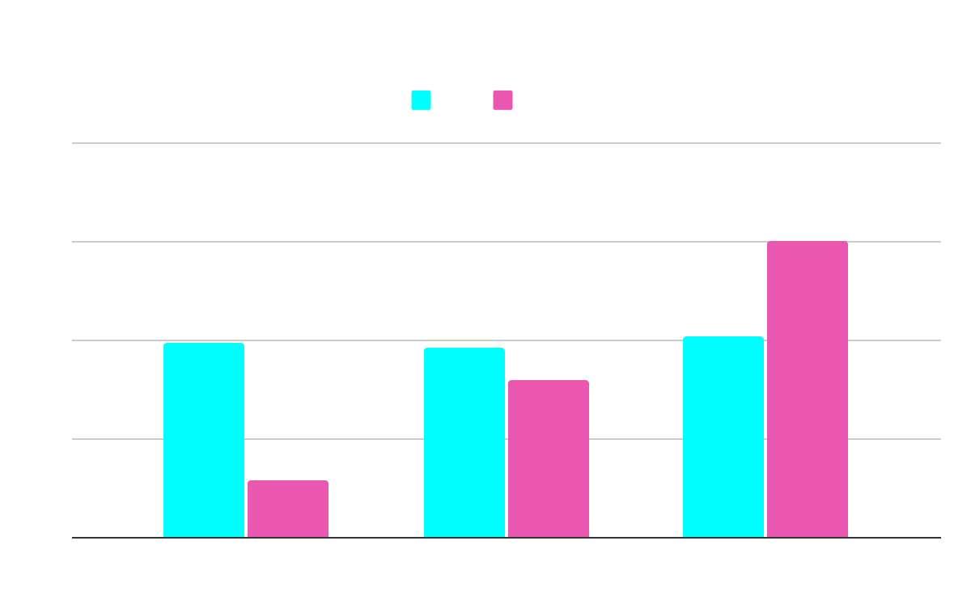
Insights from the Overall Analysis
31
General recommendation:
With our 2 new products, we will target the segmentation of 3-4 year old girls more.

Slide 32

Larger Horse
Rocking
Glamour
Low Price
Ideal Product for 3-4 Year Old Girls
32
Size
Motion
Style
Price

Slide 33
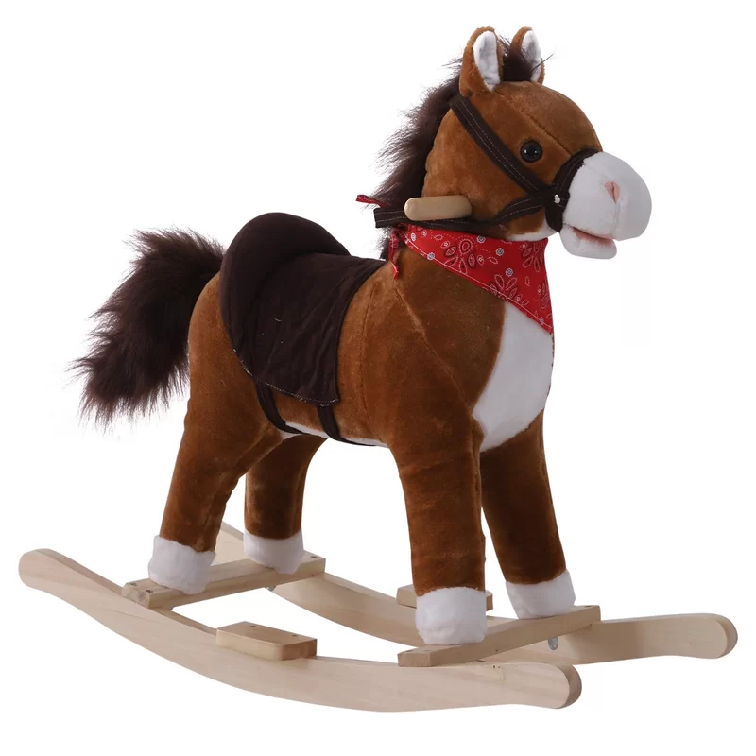
Overall Recommendations
33
There is no need for discounts, since our customer will be less price sensitive.
Make cute decorations to make the products more attractive to girls, since our target would be mainly be 3-4 years old girls.

Slide 34
作品四: 房貸風險預測實例 Predictive Analysis
34

Slide 35
Introduction
35
Objective
Create interface to support employees to evaluate the credit risk efficiently
Preprocessing of the Data
Transfer -7,-8,-9 as missing value and impute with column mean
Create binary variable indicating whether certain variable = -7, -8, -9
Transfer numbers under categorical variables to match each other, and create dummy variable for them
Finally, 72 variables input for analysis

Slide 36
Model Trained
36
KNN & ANN model
k-nearest neighbors
Artificial neural network
Linear based model
Linear Discriminant Analysis (LDA)
Negative Binomial Regression (NB)
Tree based Model
Decision Tree
Support Vector Classifier (SVC)
Logistic Regression
Random Forest
Boosting
Bagging

Slide 37
Training Result
37
Accuracy Comparisons
KNN - 66.9%
ANN - 67.2%
LDA - 70.84%
Log Penalty None -70.85%
Decision Tree -69.3%
Random Forest - 70%
Boosting Log - 71.2%
Bagging - 69%
Decision Criteria : Accuracy
Main training function : GridSearchCV, best_score_
Best one: Boosting Log
KNN&ANN < Linear Based Models < Tree Based Model
Reason:
-Want to ensure that we’re using the best model so we can obtain most customers without losing money from a bad credit consumer

Slide 38
Interface Demonstration
38
-Created using Streamlit
-Allows us to view past data on predictors and results for risk performance
-Can use a slider to view the percentage of good in the specific criteria
-Provide prediction using the pre-trained model to evaluate whether a customer with specific attributes inputted by the user will have a good or bad credit risk
-Allow users to save the data for further use
https://share.streamlit.io/davidchenli/credict-performance/main/Python_Project_final/demo.py

Slide 39
作品五: 網路討論文本分析 NLP / Text Mining / Topic Extraction
39

Slide 40
Objectives
40
Topic Extraction
12895 Twitter post
Finding potential topics inside
LSD/ NMF models were used
Volume Analysis
5 years Facebook Post
Calculate overall food discussion volume
Analyze discussion volume on cauliflower rice

Slide 41
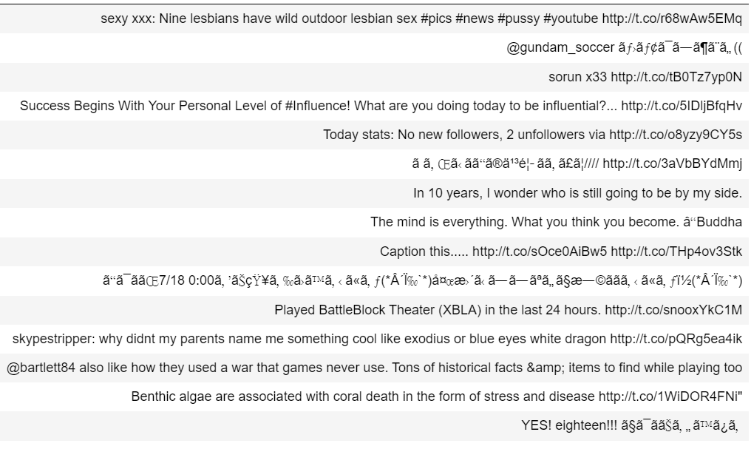
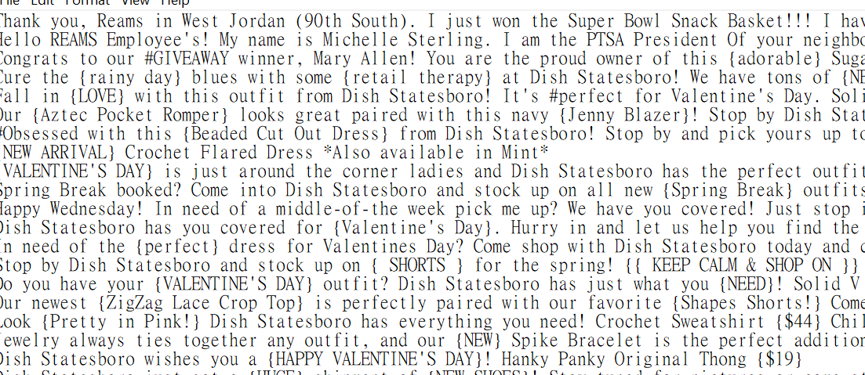
41
Data Cleaning
Remove Special character, URL, and Usernames
Split words by space
Remove stop words

Slide 42
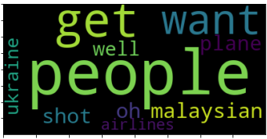
Topic Extraction
42
After cleaning, there were 11519 post and 1007 different word in dataset
LDA and NMF models were used to extract topics
Main topic found was related to the air crush for Malaysian airline

Slide 43
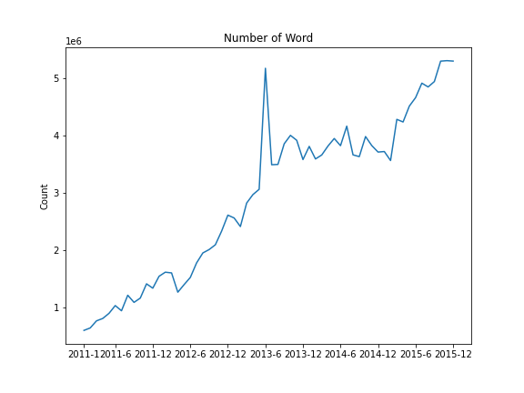
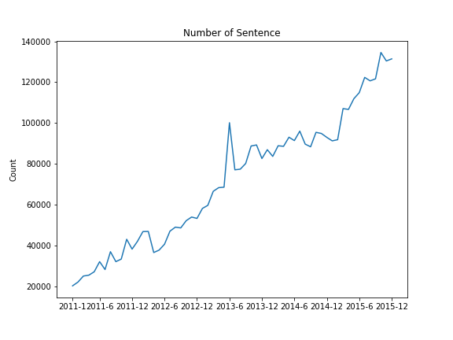

Volume Analysis - Word/Sentence Count through years
43
The discussion about food became more popular
Large numbers of discussion happened in the second half year in 2013

Slide 44
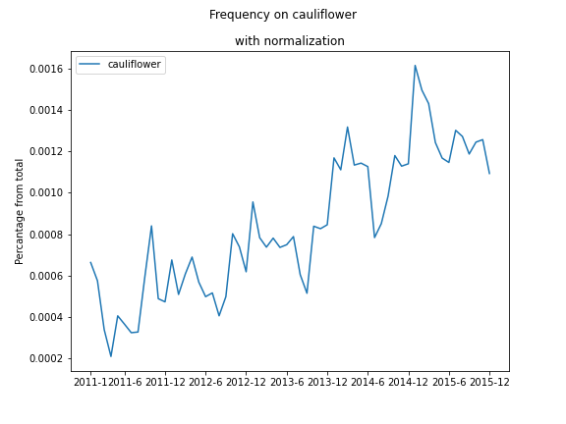
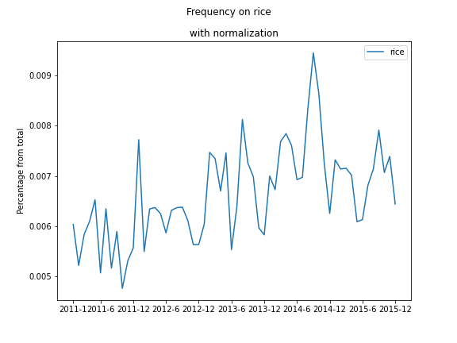
Volume Analysis – Normalization on Frequency Count
44

Slide 45
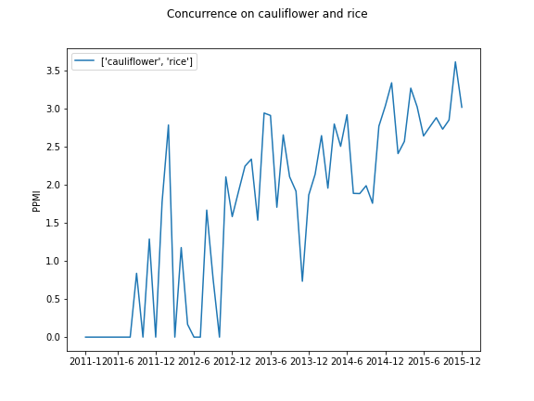
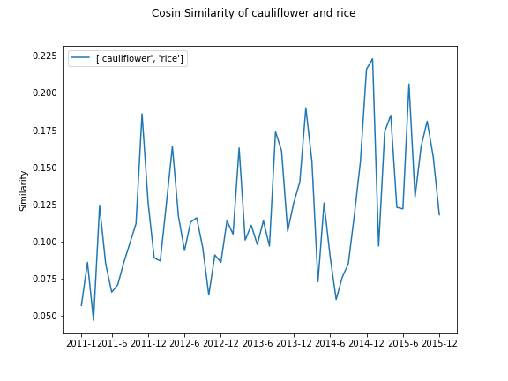
Volume Analysis – Similarity Analysis
45
First/ Second order similarity – Higher if discussion volume is higher

Slide 46
作品六: 汽水定價與競爭者分析 Choice Data Analysis / Profit Maximization / Competitor Analysis
46

Slide 47
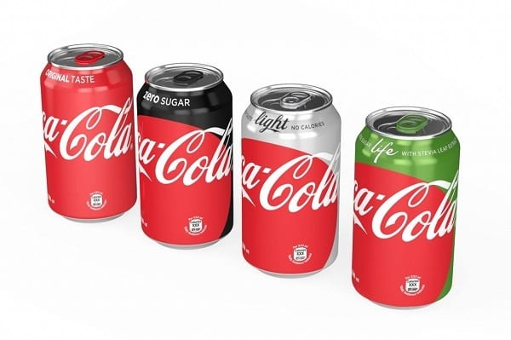
Introduction
47
There are two companies in the market: Kiwi / Mango
Analyzing on kiwi’s new product: KB
The market already exist two product: KR / MB
Cluster analysis were conducted with 8 groups for positioning purpose
Objective: Figuring out optimal price to maximize profit

Slide 48
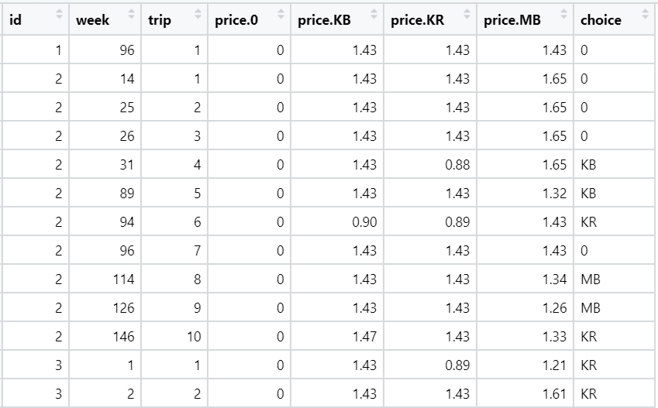
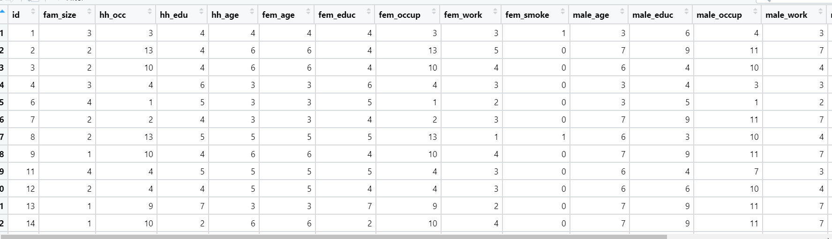
Raw Data
48
Purchasing Data
Demographic Data
Around 350 customers information were included

Slide 49
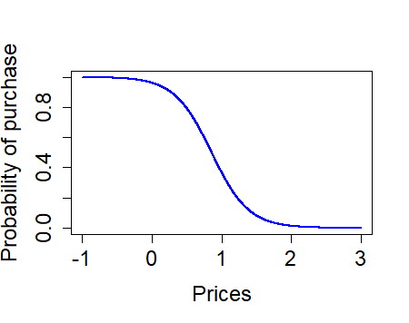
KB Elasticity & Probability
49
KB is price sensitive
The cannibalization effect existed
Kiwi’s product is more expensive than MB
KB would have less market share at mean price
The probability to buy KB start to increase significantly while price is around 1
Elasticity with product
KB | KR | MB
4.29 | 1.03 | 0.97
Probability to purchase at mean price
 | KB | KR | MB | Not Buy
Price | 1.38 | 1.38 | 1.35 | N/A
Prob | 0.17 | 0.2 | 0.2 | 0.47

Slide 50



Optimizing Price
50
 | KB | KR | MB | Kiwi | Mango
1 | 1.15 | 1.19 | 1.43 | 395.78
2 | 1.15 | 1.19 | 0.96 |  | 181.65
3 | 1.02 | 1.08 | 0.96 | 275.33
4 | 1.02 | 1.08 | 0.92 |  | 148.67
5 | 1.01 | 1.07 | 0.92 | 263
6 | 1.01 | 1.07 | 0.91 |  | 146
7 | 1 | 1.06 | 0.91 | 259
8 | 1 | 1.06 | 0.91 |  | 143
The competitor’s optimal price will change while our company adjust price
The company should lower the price to achieve highest profit
The profit would be overestimate if we ignore competitor effect

Slide 51
Thank You !
51

