Slide 1
Introduction to Offensive Security
CS-UY 3943-G / CS-GY 9223-H

Slide 2
Agenda for today
What is this course?
What is CTF?
Syllabus overview
Environment Setup
Start the first unit (Web)

Slide 3
What is this course?
This course aims to teach offensive security in the context of Capture-the-Flag (CTF) competitions.
We are:
  Brendan Dolan-Gavitt
  John Cunniff
Course originally developed by
  Nick Gregory
  Josh Hofing

Slide 4

What is CTF?
Learn security topics (mostly offensive) in a controlled, competitive environment
  Guide people to discovering tricks
Many categories of problems:
  Web, Reversing, Pwning, Crypto, PPC, Forensics, etc.
A large community of Security people trying to prove their skills

Slide 5
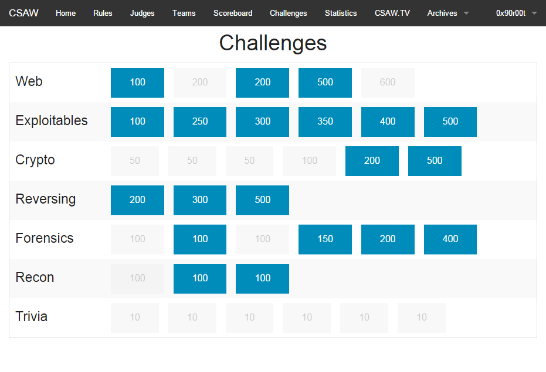
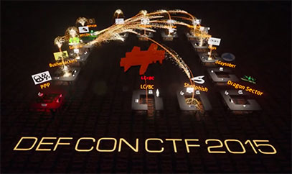
CTF Formats
Jeopardy
  A board of challenges divided into categories and point values
  Get a flag to complete a challenge, move on to the next one
Attack/Defense
  Each team has a server with vulnerable services
  Find bugs, Patch them, Exploit everyone else

Slide 6
CTF Culture Stuff
Generally, CTFs have IRC channels where you can ask questions from the admins
Problems that run on a remote service will frequently tell you where the service is hosted like:
  `nc some.server.address port`
You’ll see some magic numbers all over:
  1337
  0xdeadbeef
    and basically anything else you can spell with hex

Slide 7
What we’ll be covering
Web
RE
Pwning
Crypto

Slide 8
What we expect you to know
Basic Javascript
C/C++
Python
Basics of x86 (we will give a crash course)
Be quick at picking things up

Slide 9
Web Problems
Finding and exploiting bugs in websites
Sometimes, you get source, sometimes you don’t
Frequently PHP or Python servers
Usual vuln types:
  XSS
  SQLi
  Command Injection
  (Basically anything in the OWASP top 10)

Slide 10
Reversing (RE) Problems
Understanding code, systems
Usually compiled binaries
Typical problem types:
  Crackmes
  Bytecode Interpreters
  “Supercomputer” problems (Figure out the algo, rewrite it faster)
  Weird languages
  Weird architectures
  Weird machines

Slide 11
Pwning (Binary Exploitation) Problems
Exploit a vulnerable service
Usual goal is to read a file called “flag” or “flag.txt”
  Normally by getting a shell
Typical problem types:
  Stack-based buffer overflow
  Heap-based buffer overflow
  Write-What-Where
  Heap corruption
  Shellcoding
  Basically any other kind of memory corruption you could think of

Slide 12
Crypto Problems
Decrypt a message
Given encrypted message(s) (and usually what was used to create them), decrypt them by exploiting an issue in the cryptography
Typically
  Attacks against RSA
  Logic flaws
  Giving bad parameters to (otherwise-secure) algorithms
  Crazy math stuff

Slide 13
Programming Problems
Everyone likes implementing algorithms, right?
These are normally warmup problems
  Your homework this week has a programming problem
Typically implementing algorithms or such
Some examples:
  Provide a string that matches this regex
  Solve some math problems
  Basically anything you can imagine scripting

Slide 14
Forensics Problems
Given device/memory image, find something in it
File forensics – we’ve hidden stuff in some weird part of a file format, go find it!
We won’t really be covering this in detail, and it tends to be quite varied.

Slide 15
What does CTF not teach?
There are skills that playing in CTFs will not teach you:
  How to find vulnerable code in a large application
  Post-exploitation: what do you do once you’re inside?
  Communication: how do you report your findings responsibly and comprehensibly?
Also, outside of attack/defend classes, usually will not teach you much about defense
  Secure coding practices
  System administration / configuration

Slide 16
Homework
We will be running a CTF throughout the course
  https://class.osiris.cyber.nyu.edu
  Go there and login now, let us know if something doesn’t work
Homework will be a set of “hot” CTF problems each week
  Homework is Pass/Fail each week
  Pass = at least 300 CTF points
  You will have one week for each homework set
    We will tally the scores for a set at the beginning of class each week
  Problems stay up after, but you will not receive credit after they are due

Slide 17
CTF Participation
In addition to the class CTF, you will be required to participate in at least one other CTF
  The CTF must be ranked on ctftime.org
You must submit a writeup for at least one non-trivial problem that you solved during the CTF.
You may form teams – but we expect more hands make better writeups
Your writeup should be more than just a script
  You should explain the problem you solved well enough that someone who didn’t look at it would fully understand how it worked
You must submit a writeup to pass this class

Slide 18
Grading
90% Homework
10% CTF Participation + Writeup
  But this is required to pass the class
  Please don’t put it off to the end

Slide 19
Materials
You’ll need a reverse-engineering toolkit during the RE and Pwning sections of the class
  We recommend Binary Ninja, which is friendly and is cheap
  You can also use some free tooling, but it’s a lot less user-friendly
    objdump
    Radare2
We’re also providing a VM with a bunch of handy tools pre-installed
  See https://class.osiris.cyber.nyu.edu/vm for installation instructions

Slide 20
Office Hours
BDG’s office hours: 1pm-3pm Fridays, 2 Metrotech 10.081A
John Cunniff’s office hours
  Tuesdays & Thursdays RH 219, 11:30am-3:30pm
  Fridays RH 219 from 12:00pm-6:00pm
We are also available via e-mail!

Slide 21
Office Hours
We’re in the OSIRIS lab (RH 219)
  Office hours will be there
    Tuesdays & Thursdays: 11:30am – 3:30pm
    Fridays: 12:00pm - 6:00pm
  If our availability decreases, we’ll send an email.
  If that timing is bad for you, let us know, and we’ll work out another time we can be available that works for you.

Slide 22
Collaboration Policy
While CTF is a team sport, we believe that all members of a team should be able to solve problems
  Therefore, collaboration on homework assignments is not permitted
    Feel free to share answers and techniques after the homework is due
If we catch you cheating, we will report you to academic affairs.
  If you need to ask if it’s cheating, it probably is.
If you have questions about homeworks, show up to office hours, or send an email

Slide 23
Schedule
Schedule for the course:
  Weeks 2-4: Web
  Weeks 5-8: Reversing
  Weeks 9-11: Pwning
  Weeks 12-13: Crypto
  Week 14: Side Channels
Details for what we plan to cover in each section on the Syllabus

Slide 24
Questions?

Slide 25
What to do now
Log into the website
  https://class.osiris.cyber.nyu.edu
Solve the “Are you alive” problem
  It’s very, very easy :)
Let us know if there are any issues

Slide 26
Homework for this week
There will be 2 challenges put up at the end of class today
  One Warmup, one Programming
Due at the beginning of class next week
  These should be a pretty basic warmup for everyone

