Slide 1
Week 11 - Heap Exploitation
Introduction to Offensive Security

Slide 2
What is the heap?
Dynamically allocated memory
Request memory
Release memory
Allocated at runtime
Pointers used to reference data

Slide 3
Why use the heap?
Stack variables are local (can’t be accessed between functions)
Heap is persistent
Allocate as much as you want
Unsure at runtime how much space needed
Commonly used for larger objects

Slide 4
Heap Implementations
Many implementations have slightly different behavior
avrlibc
dlmalloc
tcmalloc
Different implementations have different tradeoffs
For class we’re focusing on the glibc implementation of malloc

Slide 5
How to use the heap?
malloc(size_t n)
Returns a pointer to newly allocated chunk of at least n bytes
Should align to 16 bytes (implementation specific)
Last nibble (4 bits) of malloc addresses should be 0
Includes heap metadata
Simplifies malloc internals

Slide 6
Malloc Chunk

Slide 7
Malloc Metadata
Last 3 bits of size contain flags
PREV_INUSE – Set when previous chunk is allocated
IS_MMAPPED – Set when chunk is mmap’d (for larger allocations)
NON_MAIN_ARENA – When using a thread specific arena
0x21 – Size is 0x20 and previous chunk is allocated

Slide 8
a = malloc(0x8)
b = malloc(0x28)
c = malloc(0x20)
d = malloc(0x14)

Slide 9
How to use the heap? (cont.)
free(void* p)
Release the chunk of memory pointed to by p
Can have unintended effects if p has already been freed
Expected that you null out p after
p = 0;

Slide 10
Freed Chunk

Slide 11
Free
free(a)
free(b)
free(c)
free(d)

Slide 12
Malloc First Fit
malloc tries to reuse space efficiently
freed chunks are placed in a linked list according to size
pointers in freed chunks point to forward and back chunk
small chunks are stored in singly-linked list (no back pointer)
d
a
0x20
c
b
0x30

Slide 13
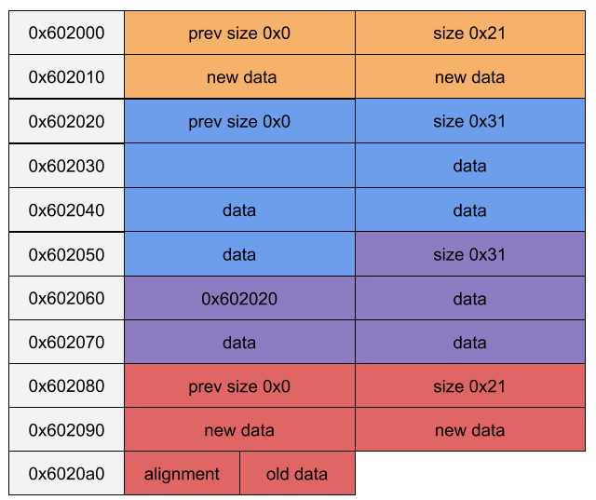
e = malloc(0x10)
f = malloc(0x10)

Slide 14
Use After Free (UAF)
What happens when pointers aren’t nulled out after a free?
Dangling pointers – leftover references to freed chunks
How can we abuse this?

Slide 15
UAF (cont.)
Structs are commonly stored on the heap
struct example {
void (* toUpper)(char *);
char buffer[16];
}
struct exploit{
int number;
int foo;
char bar[8];
}
Our example struct converts our buffer to uppercase characters and prints them out

Slide 16
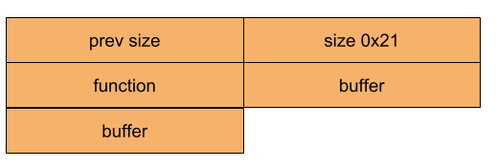
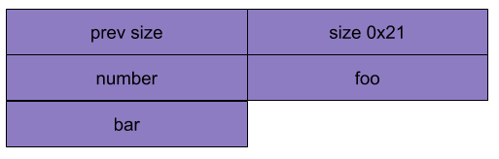
UAF (cont.)
Create an example struct on the heap
a = malloc(0x18)
Free the example struct and create exploit struct

Slide 17
Exploit
What can we write into the exploit struct
any arbitrary function (system?)
/bin/sh;
What happens if we still have a reference to the example struct?
Call system on /bin/sh;

Slide 18
UAF (cont.)
What if we don’t have a convenient function pointer?
Often there will be option to edit a value in the struct
Overwrite GOT? Return address?

Slide 19
UAF Info Leaks
Often string pointers will be stored on the heap
Overwrite with info you want to leak

Slide 20
UAF Mitigations
Don’t leave references to freed chunks

Slide 21
UAF in the wild
Popular vulnerability especially in browser exploits
Doesn’t require memory corruption
Can be used for info leaks
Detecting UAF in complex applications can be very difficult
Just not leaving dangling pointers is easy to say, hard in practice
Exist only in certain states of execution
Hard to detect statically

Slide 22
Heap overflows
Similar to buffer overflows but fewer protections
Canaries aren’t a thing in the heap
Similar to UAF, just need to write over function pointers or strings

Slide 23
Things to take into account
Heap is affected by ASLR
Typically only Read and Write
No shellcode

Slide 24
Heap Spray
Not an exploit, more of a technique to make exploits more reliable
Fill heap with large amount of data relevant to exploit
Helps assist with ASLR
On 32 bit systems, address space is 4GB
If we spray with 3GB of data, 75% chance that 0x23456789 (random address) exsits
64 bit system has 2⁶⁴ bytes of address space
Not realistic for spraying
Still useful if you can narrow down target to spray

Slide 25
Heap Grooming/Feng Shui
Heap allocations are predictable
Doing the same allocations and deallocations leads to same result
If malloc implementation is identical
Arrange chunks in such a way that makes exploiting easier

Slide 26
Metadata Exploits
Exploit the metadata of the chunk
Force malloc internal functions to give arbitrary write or read
Manipulate size of chunks to create overlaps
Overwrite forward and back pointers
Very popular in CTFs
Come to lab if you’re interested in learning more

Slide 27
Double Free
Expected that a freed chunk will not be freed again
What if we break the rules?
Check exists to prevent double freeing a chunk
What if we free another chunk in between a double free?

Slide 28
Double Free (cont.)
Create two chunks
Free List
A
B

Slide 29
Double Free (cont.)
Free A
Free List
B
A

Slide 30
Double Free (cont.)
Free B
Free List
A
B
B
A

Slide 31
Double Free (cont.)
Free A
Free List
A
B
A
B
A

Slide 32
Double Free (cont.)
Malloc new chunk
Free List
A
B
B
A

Slide 33
Double Free (cont.)
Malloc another chunk
Free List
A
B
A

Slide 34
Double Free (cont.)
Malloc another chunk
Free List
A
B
A
Two references to the same chunk

Slide 35
Double Free Exploit
We have two references to the same chunk
How to exploit?
Similar to UAF, you can write in an exploitable struct
Freeing a chunk places forward pointers in the chunk
Leads to heap leak

