Slide 1
Cryptography Week 2
Introduction to Offensive Security

Slide 2
Misc.
This is the last week of homework
Master challenge
Will open after next class
Extra credit (replaces 1 homework)
Multi-stage challenge incorporating all 4 CTF categories we've talked about

Slide 3
Misc.
Options for next week
Q&A "lecture"
What do you want to learn more about?
Impromptu 45-ish minute lectures on whatever
SECCON this weekend
24 hour – starts at 1a Saturday
Come to the lab, play, we'll be casting to the TV as we work through harder chals
If you haven't done a write-up, you can group up with others who haven't either and stake out a challenge
Not required
Opinions?

Slide 4
Misc.
https://superuser.com/questions/1268868/can-i-save-these-documents-on-a-dying-machine-from-oblivion

Slide 5
HW Overview
Quick demo

Slide 6
RSA Attacks (Cont'd)
Low e – see last lecture
Common modulus
Same message encrypted with the same n, but with different e
We'll discuss this in detail
Wiener's attack
Coppersmith's
Franklin-Reiter related message
And more!

Slide 7
RSA Common Modulus Attack
Same m, n different e
Public exponents have to be relatively prime
To solve:
Compute a,b such that e₁a * e₂b = 1 (extended Euclidean algorithm)
Then c₁ª * c₂^{b} = m (mod n)
Example on board

Slide 8
Hashes
Given arbitrary input bytes, generate a constant length "hash"
Ideally the hash changes a lot for a small input change
Ex.
md5("Hello") -> 8b1a9953c4611296a827abf8c47804d7
md5("Hellp") -> 62ac2dcdae264b4aac4e9b2631692514
Variety of algorithms
MD5
SHA1,2,3
BLAKE2

Slide 9
Cryptographic Hash Properties
Want three features:
Preimage reistance: given H(x), it's hard to find x
Second-preimage resistance: given x1, H(x1), it's hard to find x2 where H(x1) = H(x2)
Collision resistance: it's hard to find any pair x1, x2 where H(x1) = H(x2)
Note 1: these properties are listed in order of how hard they are to achieve (easiest to hardest)
Note 2: collisions are guaranteed to exist (why?)
Goal of a cryptographic hash function is to make them hard to find

Slide 10
MD5
32 byte hash output
Merkle–Damgård construction (more on this in a minute)
(Effectively) completely broken
Collisions (2 input strings with the same hash) are easy to find
No practical preimage attack though
Given hash, efficiently find input that hashes to the given value

Slide 11
Merkle–Damgård Hash Functions
MD5 and SHA1 are both constructed this way

Slide 12
Merkle–Damgård Hash Functions
The input is chunked into blocks of a constant size, padding if needed
MD5 uses 512 bit blocks and NULL padding
These are then "compressed" with the `f` function
And the results are mixed together
Could be XOR, could be bitwise masking, etc.

Slide 13
Merkle–Damgård Padding
MD based algorithms have to work on blocks
These blocks are the full internal state of the algorithm
The padding is predictable
Has to be otherwise hashing the same input twice would produce a different result!
Imagine a construction like this:
md5(SECRET + "username=asdf&is_admin=0")
Seemingly could be used as a MAC

Slide 14
Hash Length Extension
md5(SECRET + "username=asdf&is_admin=0")
The result of the hash fully determines the internal state of the algorithm
-> we can fully recover the internal state from the hash
Since we know the full internal state, we can "reset" to that point and add on whatever data we want
i.e. we can easily compute:
md5(SECRET + "username=asdf&is_admin=0" + "\x80\x00\x00…" + "arbitrary_data")
without knowing SECRET!
Relies on SECRET being prepended to the input though

Slide 15
Hash Length Extension Tooling
https://github.com/iagox86/hash_extender

Slide 16
CBC Padding Oracles
Last time we saw that to use a block cipher on arbitrary length data, you need to split it into blocks
Then use a construction like CBC to encrypt

Slide 17
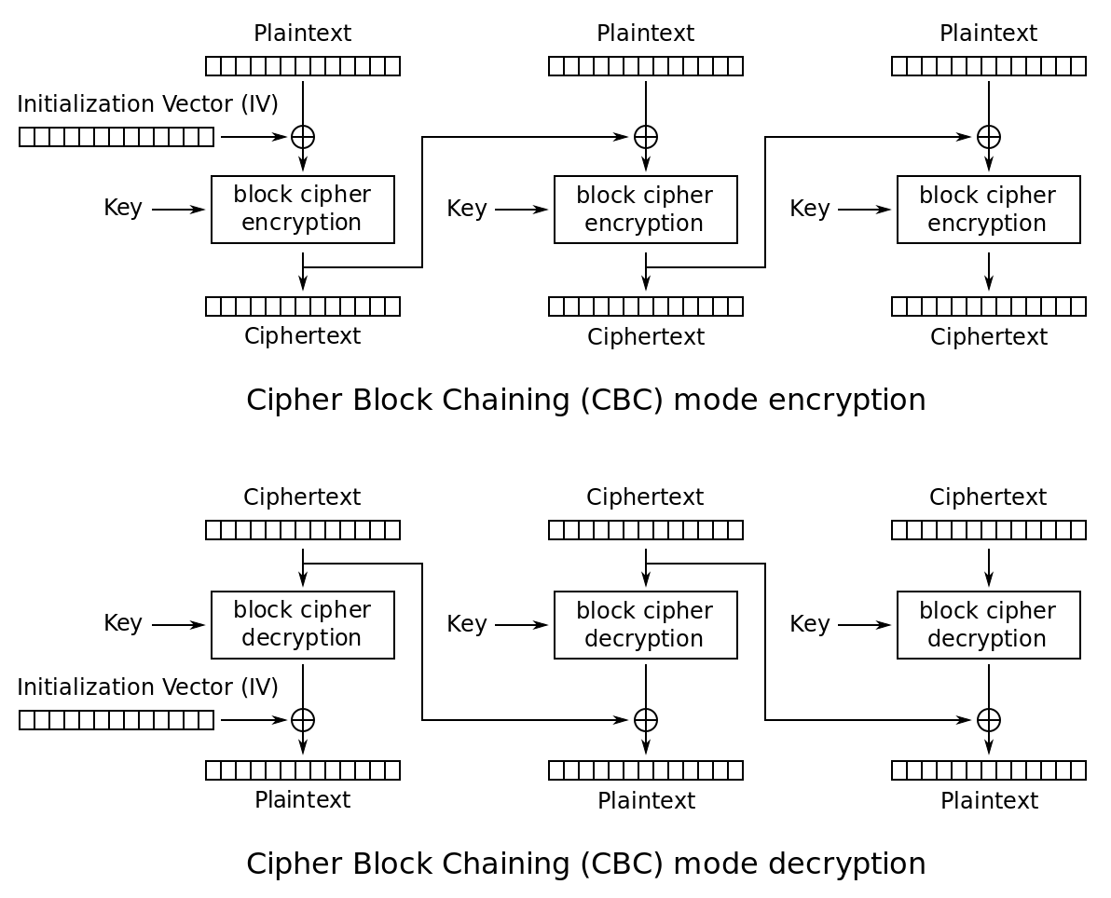

Slide 18
Padding
Most messages are not exact multiples of the block length
So we need to pad the last block out with extra data to make a full block
This data can be discarded after decryption

Slide 19
PKCS#7
There many ways messages could be padded, but one of the most popular is called PKCS#7
It's a standard: Public Key Crypto Standard #7
The padding character gives the number of bytes of padding used
Example: block length 4, message = "hello"
Padded: "hello\x03\x03\x03"
Padding is always used – if the message is an exact multiple, you add an entire block of padding
Example: block length 4, message = "blah"
Padded: "blah\x04\x04\x04\x04"

Slide 20
Validating Padding
When decrypting a message, we can check if the padding is correct
Strip off the padding and check that all pad bytes are equal to the pad length
What should we do if we discover bad padding?
Probably means something went wrong decrypting, or the message was corrupted somehow
Maybe we should present an error message to the user?

Slide 21
CBC Padding Oracle Attack
It turns out if we do anything different when the padding is incorrect vs correct, we can decrypt the message entirely!
How?
Basic idea:
If we change the second-to-last ciphertext block, we can control what the last plaintext block decrypts to
We will get different messages if that plaintext has correct padding or not
When we get the padding correct, we can use this information to figure out a bit about the message!
Let's work this out on the board…

Slide 22
Repeated Unmasking
If we know flag format and where it appears, we can discover part of the key
If that key happens to also be at a known place in the plaintext, we can recover another part of the key
Repeat until everything is decrypted
Walkthrough
https://github.com/isislab/CSAW-CTF-2017-Quals/tree/master/crypto/another_xor

