Slide 1
Week 3 – Misc. Things
Introduction to Offensive Security

Slide 2
Announcements
This is the last full week of web stuff; RE starts next week
Grab binja if you haven’t already
Or the IDA freeware version
Start looking for CTFs to play!
Email writeup to me and/or the TA within 1 week of the CTF
If it looks good, we’ll give you a flag for the newly created one point “CTF Writeup” challenge
Don’t leave this until the last minute!!

Slide 3
Errata
MySQL’s SUBSTR actually starts at index 1
SELECT IF(SUBSTR(name, 1, 1) = 'A', SLEEP(1), 0);
However OFFSET n still starts at 0
Who needs consistency in their database anyways…
String comparisons against INFORMATION_SCHEMA.SCHEMATA and INFORMATION_SCHEMA.TABLES are case sensitive
Most of the time
Depends on the underlying filesystem

Slide 4
Errata
Not mentioned, but if you want to leak result from GROUP_CONCAT:
SELECT … HAVING SUBSTR(GROUP_CONCAT(name SEPARATOR ','), 1, 1) = 'a'
The HAVING clause lets you filter after data has been "reduced"

Slide 5
Common HW Questions
Clarifying challenge types:
Log Me In – Simple SQLi; bypass email and password check to log in as 'admin'
Log Me In Again – Blind SQLi; discover and dump another table in the DB
SVG Text Extractor – XXE; read the flag file at '/flag.txt'
Some text editors are trying to format your SQL with "nice" single quotes (‘)
These will not work with MySQL! They need to be normal single quotes
Best solution is to use a text editor meant for coding
Need a space after --
Common solution is to put an extra char after so nothing strips the space
E.g. ; -- a

Slide 6
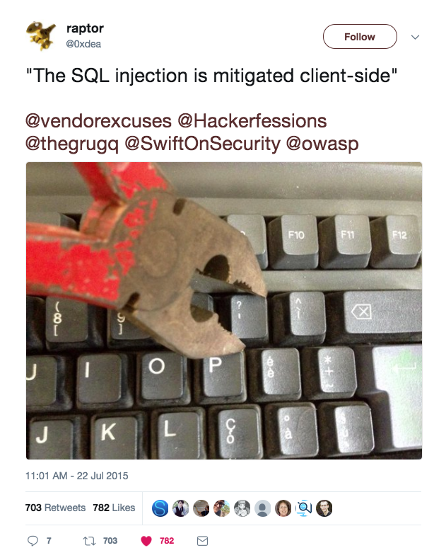
Log Me In (Again)

Slide 7
Log Me In (Again)
Source code is often not given for SQL challenges
Try to imagine what the query running server side looks like based off
The inputs you have
What a typical model for the object might look like
Number of columns
Determine by trying UNION SELECT 1 -- , UNION SELECT 1,1 -- , UNION SELECT 1,1,1 -- …

Slide 8
Log Me In (Again)
So you were supposed to need to change the email field to regular text
Never trust the client!
But admin'or'1'='1--@gmail.com actually works…
AND/OR precendence
AND is evaluated before OR

Slide 9
Log Me In (Again)
$hashpass = sha1($password);
SELECT id,email,password FROM users
WHERE email='$email'
AND password='$hashpass';

Slide 10
Nevernote CSP
Public note app – log in to post, anyone can see all posted notes
Vulnerable to XSS in both the title and content
But CSP disallows running most scripts…
Content-Security-Policy: script-src 'self' cdn.jsdelivr.net *.google.com; img-src *; default-src 'self'; style-src 'self' cdn.jsdelivr.net; report-uri /csp_report
Solving:
How can we inject JavaScript that will run despite the CSP?
How can we get the admin to visit a page with our injected XSS?
What should we inject to leak the flag somewhere we can see it?

Slide 11
SVG Text Extractor
A simple webapp that extracts the content of <text> tags from SVG images
SVG images are XML documents…
So this is an XXE challenge
The hardest part of this one is just finding a minimal, well-formed SVG that has a <text> tag
Then just add: <!DOCTYPE bar [ <!ENTITY foo SYSTEM "file:///flag.txt"> ]> <text> &foo; </text>

