Slide 1
Reverse Engineering
CS-UY 3943-G / CS-GY 9223-H
Josh Hofing

Slide 2

What the heck is RE?
Reverse Engineering is a broad field
  Hardware reversers
  Software reversers
  Firmware reversers
The field of understanding how things work
  Especially the things we’re not supposed to understand
    Every large piece of software has dark corners that they assume nobody will ever look at

Slide 3
What we’ll be focusing on
64-bit x86 binaries
  Running on Linux
  Without too much obfuscation involved

Slide 4
x86_64
AKA amd64, or i64, or x86 64-bit
  The unintended successor to Intel’s x86 architecture
    Intel had a thing called Itanium that they thought would go really well
      It didn’t
    AMD decided to extend Intel’s existing 32-bit architecture to 64-bits
      And here we are!

Slide 5
x86_64
This is a CISC, variable-length instruction set, multi-sized register access instruction set.
  CISC means Complex Instruction Set Computing
    A single instruction can do a bunch of different things at once
      Memory accesses, register reads, etc.
  Variable-length instruction set
    Different instructions can be different sizes
      x86_64 instructions can be anything from 1 to 16 bytes long
  Multi-sized register access means that you can access certain parts of a register which are different sizes

Slide 6
Registers
So what is a register?
Basically a local variable on the CPU
  The "64" in x86_64 means the registers are 64 bits
  Instantly accessible by the CPU
x86_64 has many
  rax, rbx, rcx, rdx, rdi, rsi, rsp, rip, r8-r15, and more!

Slide 7
Registers
Special registers
  RIP: the instruction pointer
  RSP: the stack pointer
  RBP: the base pointer

Slide 8
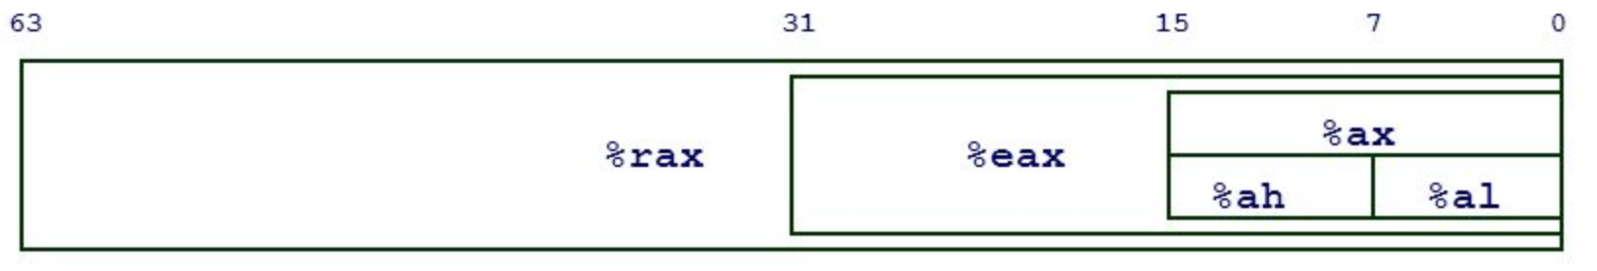
Registers
Sized accesses
http://slideplayer.com/slide/9428596/29/images/12/64-bit+registers+Multiple+access+sizes+%25rax,+%25rbx,+%25rcx,+%25rdx.jpg

Slide 9
Instructions
Represents a single operation for the CPU to perform*
Different types
  Data movement
    mov rax, [rsp - 0x40]
  Arithmetic
    add rbx, rcx
  Control-flow
    jne 0x80004000

Slide 10
Instructions
Represents a single operation for the CPU to perform*
Again, x86 is a CISC architecture
repne scasb
  Repeats up to ecx times over memory at edi looking for NULL byte, decrementing ecx each byte
  (Essentially) strlen() in a single instruction!
Notes:
About that asterisk...

Slide 11
Instructions
What should the CPU execute?
Determined by the RIP register
  IP = instruction pointer
Fetch the instruction at the address in RIP
Decode it
Run it
Notes:
About that asterisk...

Slide 12
Instructions
Example: mov rax, 0xdeadbeef
Immediate
Operation
Register
Notes:
About that asterisk...

Slide 13
Instructions
Example: mov rax, [0xdeadbeef + rbx * 4]
Operation
Effective address
Get the contents from this memory address
Register
Notes:
About that asterisk...

Slide 14
Example
0x0804000: mov eax, 0xdeadbeef
0x0804005: mov ebx, 0x1234
0x080400a: add, rax, rbx
0x080400d: inc rbx
0x0804010: sub rax, rbx
0x0804013: mov rcx, rax
Register Values:
rip = 0x0804000
rax = 0x0
rbx = 0x0
rcx = 0x0
rdx = 0x0

Slide 15
Example
0x0804000: mov eax, 0xdeadbeef
0x0804005: mov ebx, 0x1234
0x080400a: add, rax, rbx
0x080400d: inc rbx
0x0804010: sub rax, rbx
0x0804013: mov rcx, rax
Register Values:
rip = 0x0804005
rax = 0xdeadbeef
rbx = 0x0
rcx = 0x0
rdx = 0x0

Slide 16
Example
0x0804000: mov eax, 0xdeadbeef
0x0804005: mov ebx, 0x1234
0x080400a: add, rax, rbx
0x080400d: inc rbx
0x0804010: sub rax, rbx
0x0804013: mov rcx, rax
Register Values:
rip = 0x080400a
rax = 0xdeadbeef
rbx = 0x1234
rcx = 0x0
rdx = 0x0

Slide 17
Example
0x0804000: mov eax, 0xdeadbeef
0x0804005: mov ebx, 0x1234
0x080400a: add, rax, rbx
0x080400d: inc rbx
0x0804010: sub rax, rbx
0x0804013: mov rcx, rax
Register Values:
rip = 0x080400d
rax = 0xdeadd123
rbx = 0x1234
rcx = 0x0
rdx = 0x0

Slide 18
Example
0x0804000: mov eax, 0xdeadbeef
0x0804005: mov ebx, 0x1234
0x080400a: add, rax, rbx
0x080400d: inc rbx
0x0804010: sub rax, rbx
0x0804013: mov rcx, rax
Register Values:
rip = 0x0804010
rax = 0xdeadd123
rbx = 0x1235
rcx = 0x0
rdx = 0x0

Slide 19
Example
0x0804000: mov eax, 0xdeadbeef
0x0804005: mov ebx, 0x1234
0x080400a: add, rax, rbx
0x080400d: inc rbx
0x0804010: sub rax, rbx
0x0804013: mov rcx, rax
Register Values:
rip = 0x0804013
rax = 0xdeadbeee
rbx = 0x1235
rcx = 0x0
rdx = 0x0

Slide 20
Example
0x0804000: mov eax, 0xdeadbeef
0x0804005: mov ebx, 0x1234
0x080400a: add, rax, rbx
0x080400d: inc rbx
0x0804010: sub rax, rbx
0x0804013: mov rcx, rax
Register Values:
rip = 0x0804016
rax = 0xdeadbeee
rbx = 0x1235
rcx = 0xdeadbeee
rdx = 0x0

Slide 21
Control Flow
How to express conditionals in x86?
  Conditional jumps
    jnz <address>
    je <address>
    jge <address>
    jle <address>
    Etc
  They jump if their condition is true, and just go to the next instruction otherwise
  What are these checking to decide?

Slide 22
EFLAGS
EFLAGS is everyone’s favorite register to forget
  But it’s important
  As the name implies, flags are stored here
  Many instructions set them, for example…
    add rax, rbx sets the o (overflow) flag if the sum is greater than a 64-bit register can hold, and wraps around
      You can jump based on that with a jo instruction
    The most important thing to remember is the cmp instruction
      cmp rax, rbx
      jle error
      Jumps if rax <= rbx

Slide 23
Memory: It's All Just Bytes!

Slide 24
Memory
Instructions, numbers, strings, everything!
Always represented in hex
add rax, rbx == 48 01 d8
mov rax, 0xdeadbeef == 48 c7 c0 ef be ad de
mov rax, [0xdeadbeef] == 67 48 8b 05 ef be ad de
"Hello" == 48 65 6c 6c 6f
Notes:
About that asterisk...

Slide 25
Addresses
Memory ~= a big array
  Indices into this "array" are memory addresses
From earlier: mov rax, [0xdeadbeef]
  Square brackets means "get the data at this address"
  Analagous to the C/C++ syntax:
    rax = *0xdeadbeef;

Slide 26
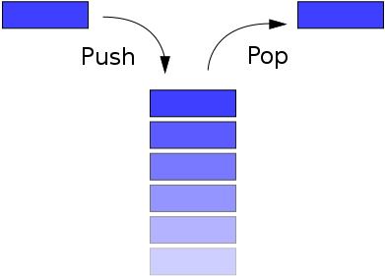
The Stack
From data structures
LIFO
  "Push" things on to the top
  "Pop" things off the top
Built in to most architectures
  Nothing fancy! Just memory, rsp, and rbp!

Slide 27
The Stack
rsp register is the "stack pointer"
  Points to the current top of the stack
push rax ends up decreasing rsp
pop rax ends up increasing rsp
Seems backwards?

Slide 28
THE STACK GROWS DOWN

Slide 29
The Stack
push rax
  Decrements rsp by 8
  Moves the contents of rax into memory at the new rsp
  sub rsp, 8
  mov [rsp], rax
pop rax
  mov rax, [rsp]
  add rsp, 8

Slide 30
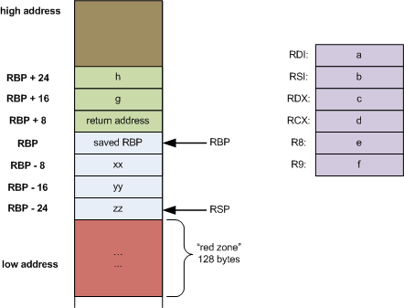
Calling Functions
What do functions look like in assembly?
  It’s just code that ends in a ret instruction
  Usually, it does stuff with the stack to create a Stack Frame
    push rbp
    mov rbp, rsp
    sub rsp, 0x100
  call <address>
    Pushes rip
    Jumps to <address>
  ret
    Pops rip
    Cleanup stackframe first!

Slide 31
Calling Conventions
How do I pass arguments into my functions?
  This is entirely by convention, so there’s no real rules
  However, everything we’ll touch is using the SystemV AMD64 ABI, so the following calling conventions hold:
    The first 6 arguments to a function are passed, from left-to-right, in these registers:
      rdi, rsi, rdx, rcx, r8, r9
    Further arguments are pushed to the stack
    The return value of the function is stored in rax when the function returns
It takes a long time for people to really remember this
  Don’t feel bad about needing a reference!

Slide 32
Please experiment!
The Compiler Explorer (at https://godbolt.org) is an excellent resource
  Type in some C (or C++), and it live-updates with the generated assembly, with corresponding lines highlighted
  Play around with it, and try to understand how various high-level constructs map into assembly
There’s a lot of other great resources about this stuff online, search around and learn!
Also, I really hope everyone has a disassembler they’re happy with by now. You’ll need it for the homework!

