Slide 1
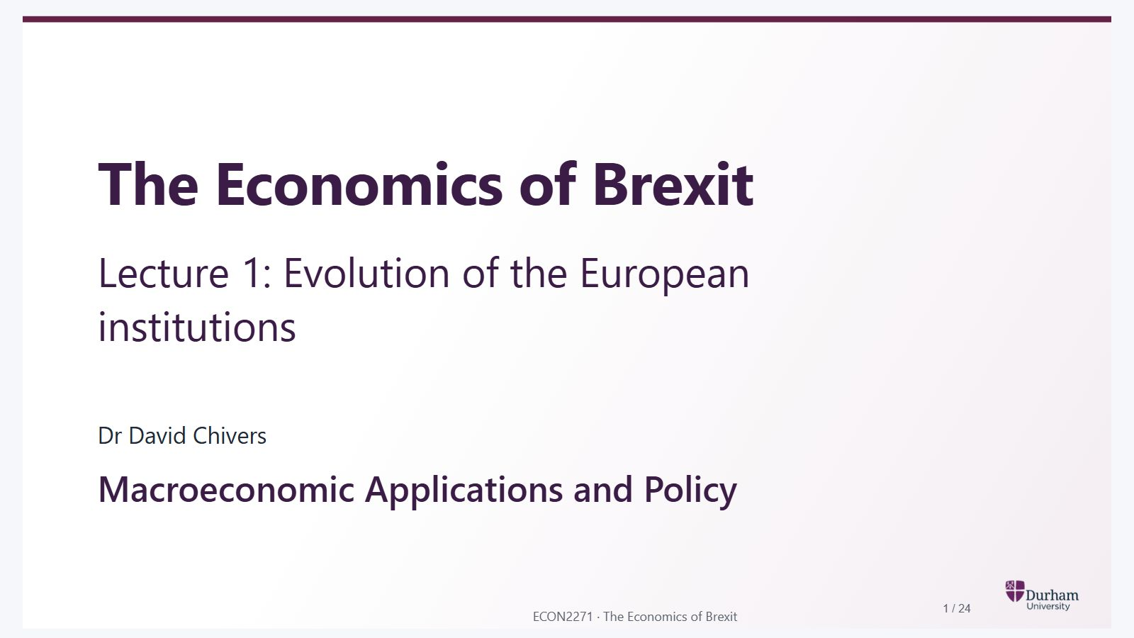
Notes:
Static student copy of the current web slide. Slide artwork is flattened; add personal notes here. Interactive explanations, playback and accessible HTML are available at:
https://davidchivers.co.uk/teaching/macro-applications/lecture_1.html#/title-slide
The Economics of Brexit Lecture 1: Evolution of the European institutions Dr David Chivers Macroeconomic Applications and Policy

Slide 2
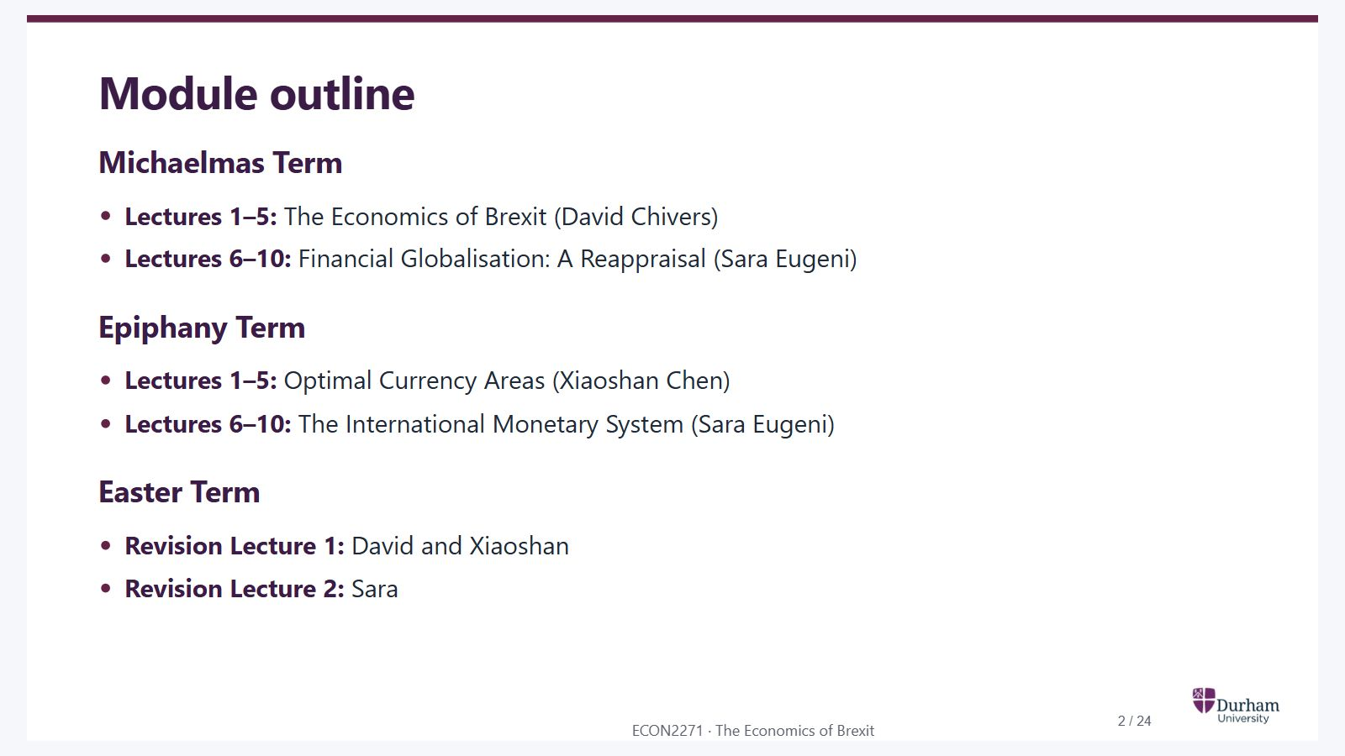
Notes:
Static student copy of the current web slide. Slide artwork is flattened; add personal notes here. Interactive explanations, playback and accessible HTML are available at:
https://davidchivers.co.uk/teaching/macro-applications/lecture_1.html#/module-outline
Module outline Michaelmas Term Lectures 1–5: The Economics of Brexit (David Chivers) Lectures 6–10: Financial Globalisation: A Reappraisal (Sara Eugeni) Epiphany Term Lectures 1–5: Optimal Currency Areas (Xiaoshan Chen) Lectures 6–10: The International Monetary System (Sara Eugeni) Easter Term Revision Lecture 1: David and Xiaoshan Revision Lecture 2: Sara

Slide 3
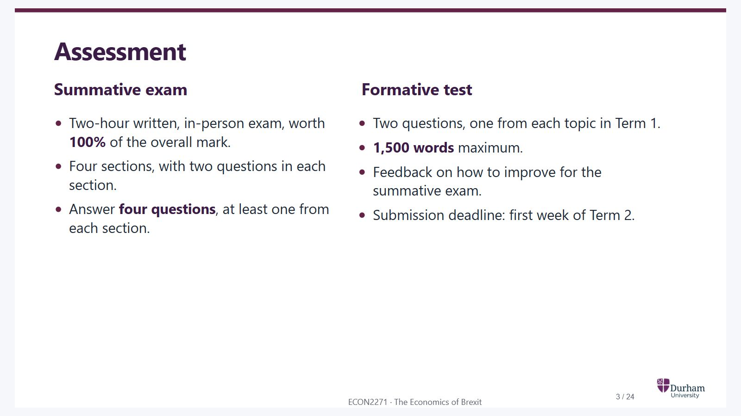
Notes:
Static student copy of the current web slide. Slide artwork is flattened; add personal notes here. Interactive explanations, playback and accessible HTML are available at:
https://davidchivers.co.uk/teaching/macro-applications/lecture_1.html#/assessment
Assessment Summative exam Two-hour written, in-person exam, worth 100% of the overall mark. Four sections, with two questions in each section. Answer four questions , at least one from each section. Formative test Two questions, one from each topic in Term 1. 1,500 words maximum. Feedback on how to improve for the summative exam. Submission deadline: first week of Term 2. Assessment information has been retained from the source PowerPoint. Check the current module handbook before delivering this lecture.

Slide 4
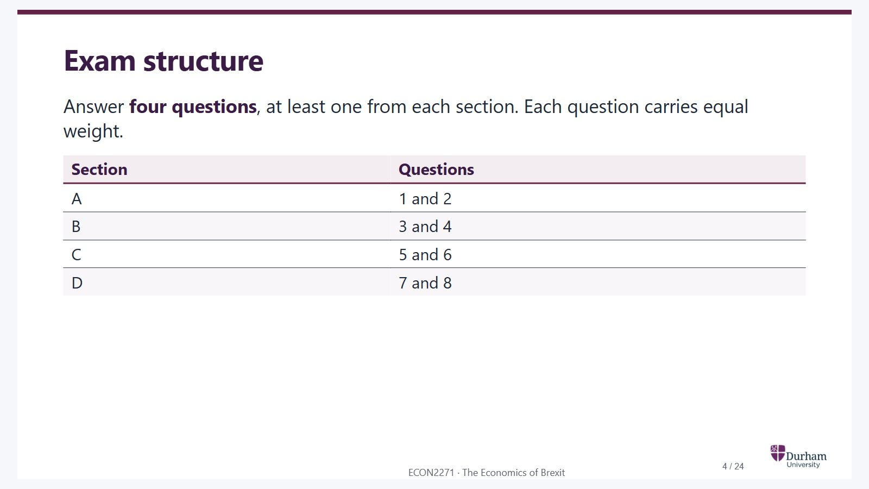
Notes:
Static student copy of the current web slide. Slide artwork is flattened; add personal notes here. Interactive explanations, playback and accessible HTML are available at:
https://davidchivers.co.uk/teaching/macro-applications/lecture_1.html#/exam-structure
Exam structure Answer four questions , at least one from each section. Each question carries equal weight. Section Questions A 1 and 2 B 3 and 4 C 5 and 6 D 7 and 8

Slide 5
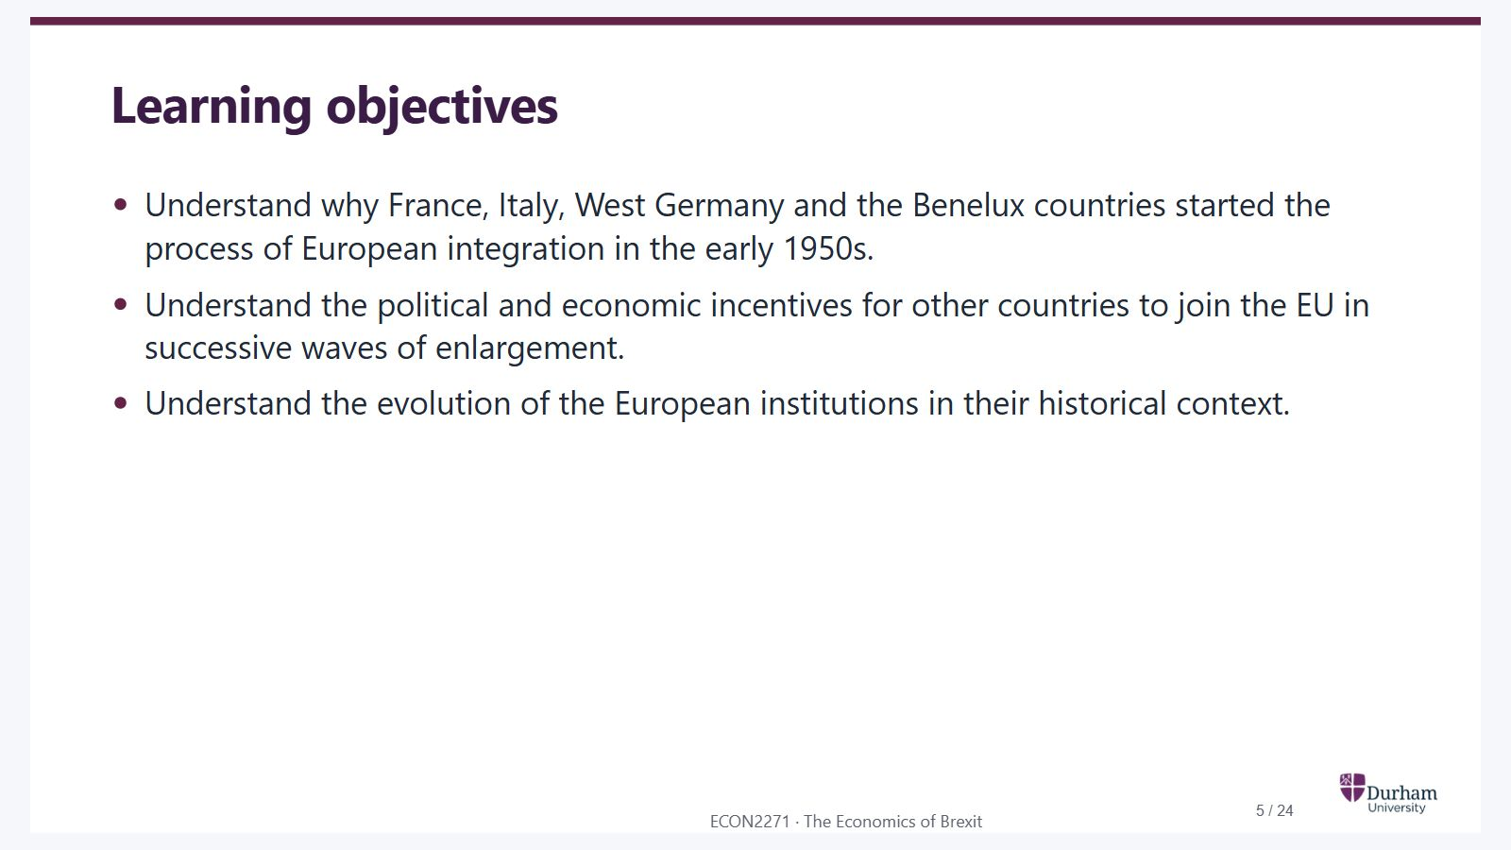
Notes:
Static student copy of the current web slide. Slide artwork is flattened; add personal notes here. Interactive explanations, playback and accessible HTML are available at:
https://davidchivers.co.uk/teaching/macro-applications/lecture_1.html#/learning-objectives
Learning objectives Understand why France, Italy, West Germany and the Benelux countries started the process of European integration in the early 1950s. Understand the political and economic incentives for other countries to join the EU in successive waves of enlargement. Understand the evolution of the European institutions in their historical context.
EU: European Union

Slide 6
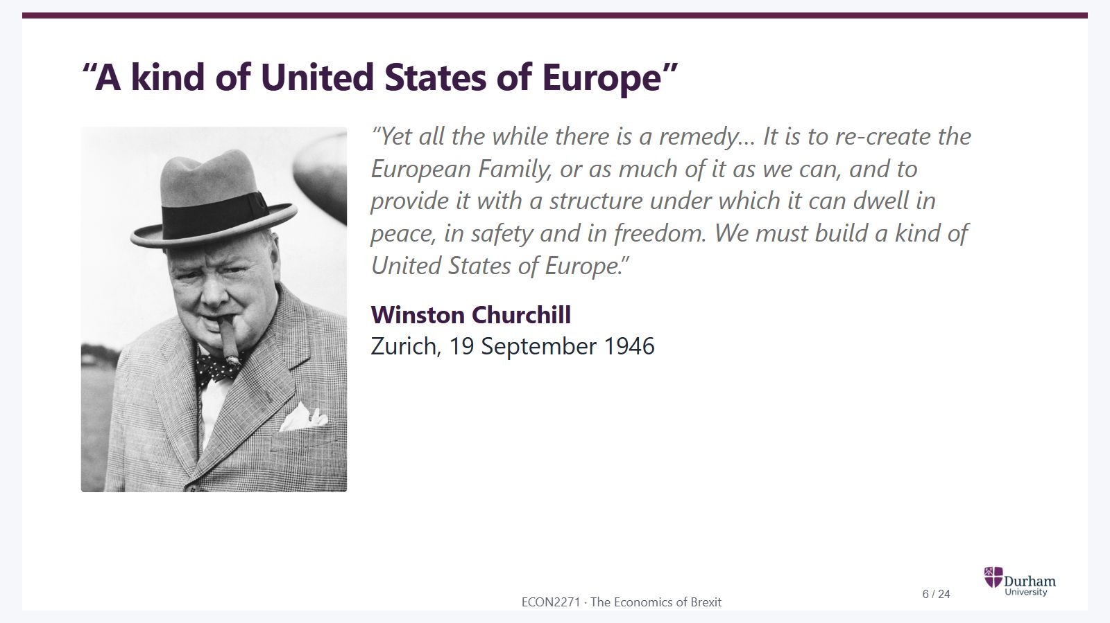
Notes:
Static student copy of the current web slide. Slide artwork is flattened; add personal notes here. Interactive explanations, playback and accessible HTML are available at:
https://davidchivers.co.uk/teaching/macro-applications/lecture_1.html#/a-kind-of-united-states-of-europe
“A kind of United States of Europe” “Yet all the while there is a remedy… It is to re-create the European Family, or as much of it as we can, and to provide it with a structure under which it can dwell in peace, in safety and in freedom. We must build a kind of United States of Europe.” Winston Churchill Zurich, 19 September 1946
Black-and-white portrait of Winston Churchill wearing a hat and overcoat.

Slide 7
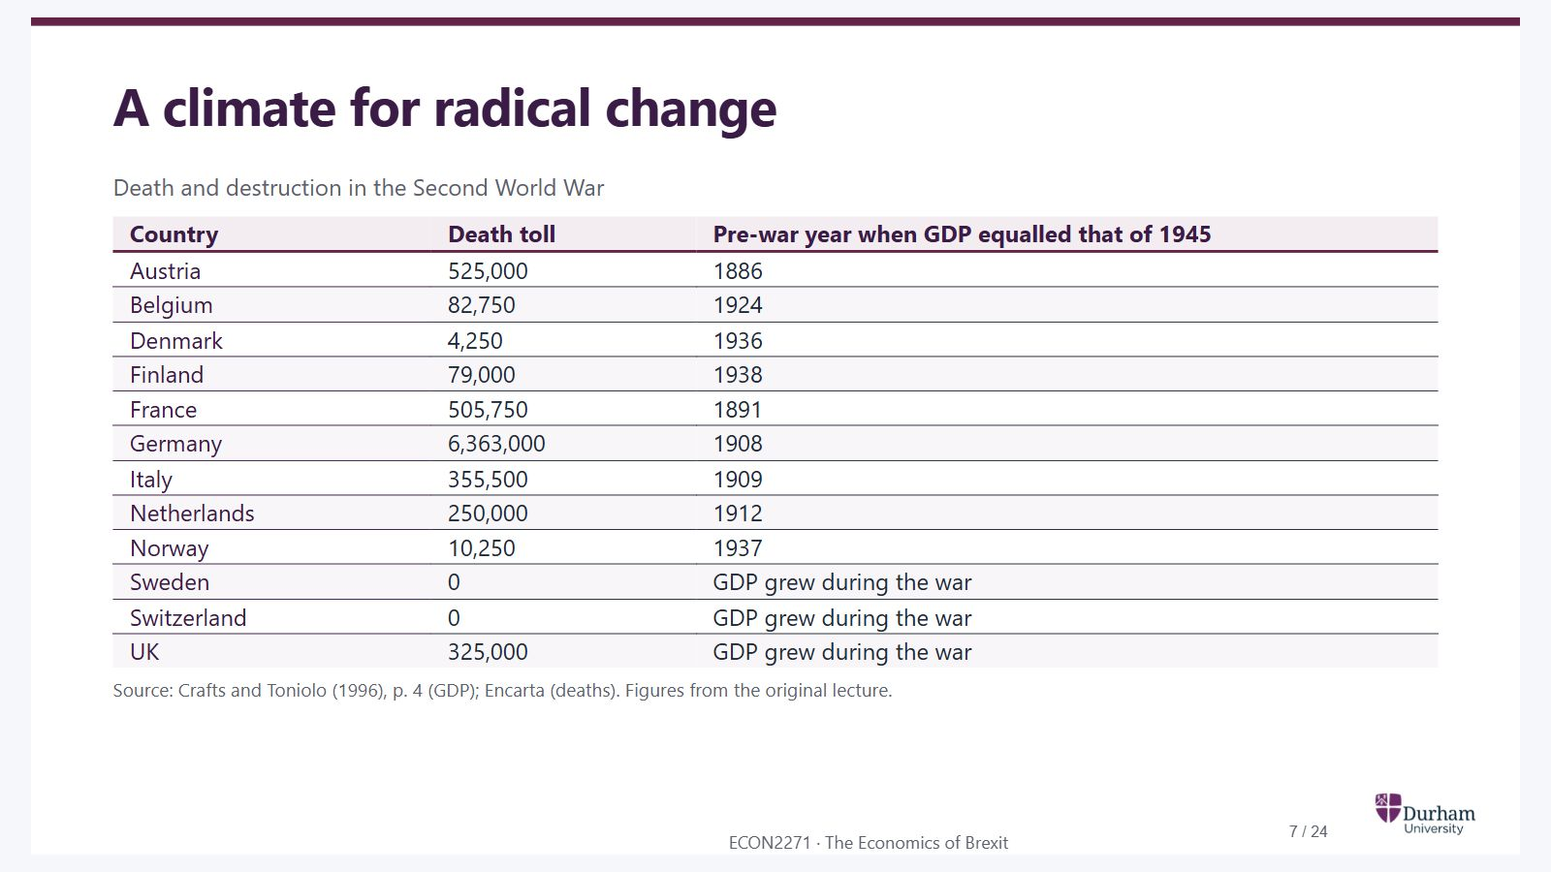
Notes:
Static student copy of the current web slide. Slide artwork is flattened; add personal notes here. Interactive explanations, playback and accessible HTML are available at:
https://davidchivers.co.uk/teaching/macro-applications/lecture_1.html#/a-climate-for-radical-change
A climate for radical change Death and destruction in the Second World War Country Death toll Pre-war year when GDP equalled that of 1945 Austria 525,000 1886 Belgium 82,750 1924 Denmark 4,250 1936 Finland 79,000 1938 France 505,750 1891 Germany 6,363,000 1908 Italy 355,500 1909 Netherlands 250,000 1912 Norway 10,250 1937 Sweden 0 GDP grew during the war Switzerland 0 GDP grew during the war UK 325,000 GDP grew during the war Source: Crafts and Toniolo (1996), p. 4 (GDP); Encarta (deaths). Figures from the original lecture.
GDP: Gross domestic product
GDP: Gross domestic product
GDP: Gross domestic product
GDP: Gross domestic product

Slide 8
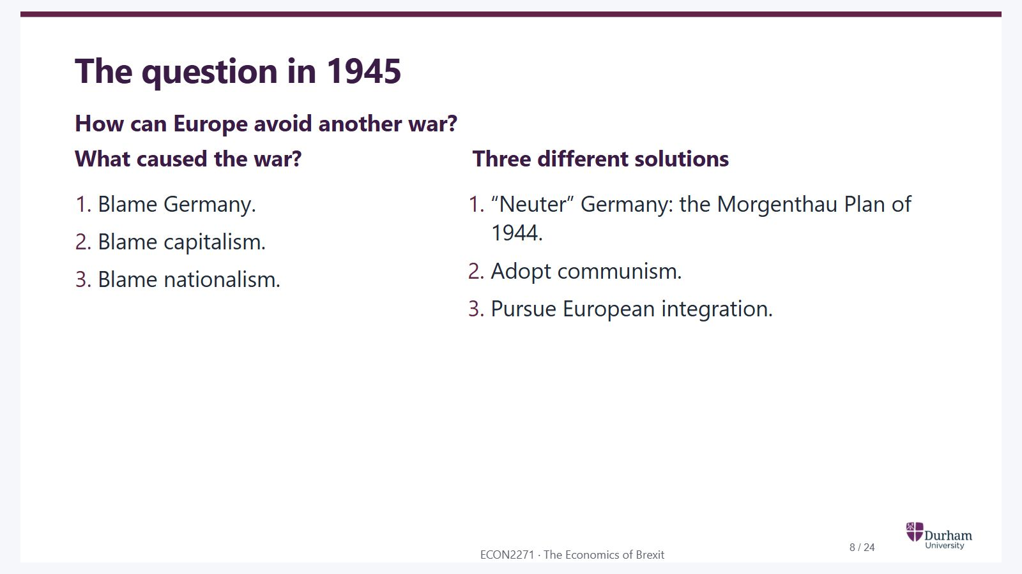
Notes:
Static student copy of the current web slide. Slide artwork is flattened; add personal notes here. Interactive explanations, playback and accessible HTML are available at:
https://davidchivers.co.uk/teaching/macro-applications/lecture_1.html#/the-question-in-1945
The question in 1945 How can Europe avoid another war? What caused the war? Blame Germany. Blame capitalism. Blame nationalism. Three different solutions “Neuter” Germany: the Morgenthau Plan of 1944. Adopt communism. Pursue European integration.

Slide 9
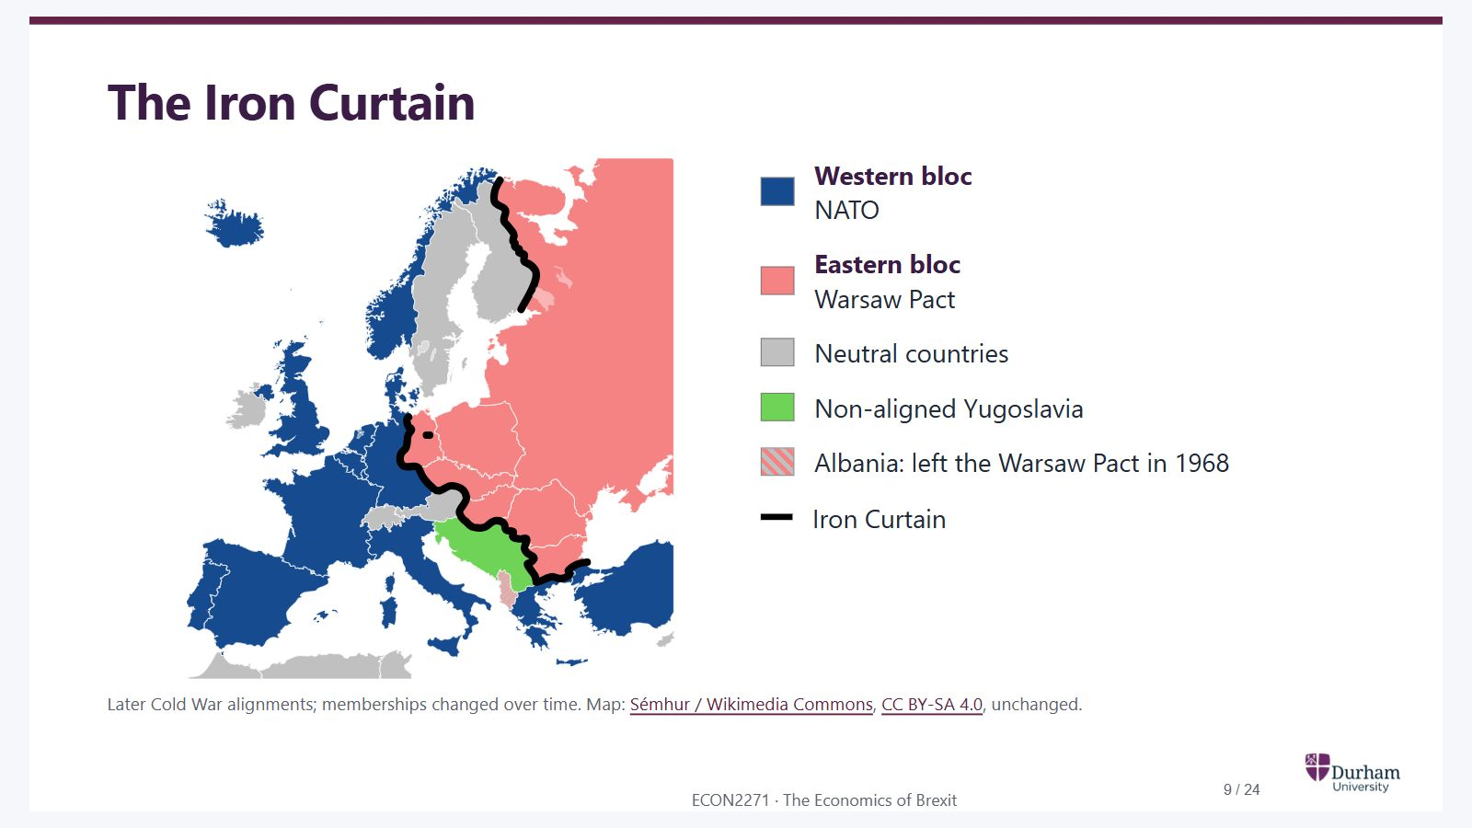
Notes:
Static student copy of the current web slide. Slide artwork is flattened; add personal notes here. Interactive explanations, playback and accessible HTML are available at:
https://davidchivers.co.uk/teaching/macro-applications/lecture_1.html#/the-iron-curtain
The Iron Curtain Western bloc NATO Eastern bloc Warsaw Pact Neutral countries Non-aligned Yugoslavia Albania: left the Warsaw Pact in 1968 Iron Curtain Later Cold War alignments; memberships changed over time. Map: Sémhur / Wikimedia Commons , CC BY-SA 4.0 , unchanged.
Vector map of Cold War Europe. NATO countries are blue and Warsaw Pact countries pink, with the Iron Curtain marked by a thick black line. Neutral countries are grey and non-aligned Yugoslavia is green. Germany is divided. Albania is striped to reflect its withdrawal from the Warsaw Pact.
NATO: North Atlantic Treaty Organization
https://commons.wikimedia.org/wiki/File:Iron_Curtain_map.svg
https://creativecommons.org/licenses/by-sa/4.0/

Slide 10
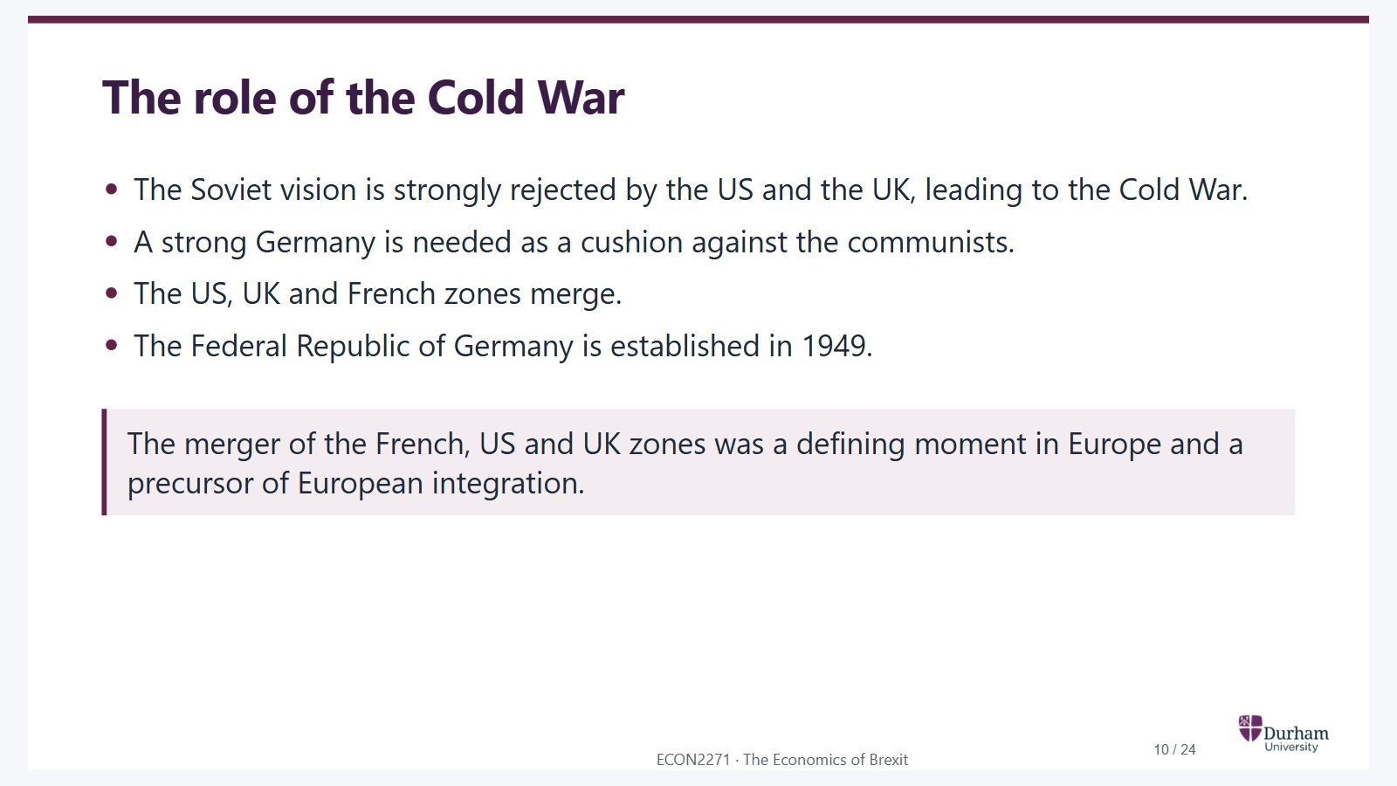
Notes:
Static student copy of the current web slide. Slide artwork is flattened; add personal notes here. Interactive explanations, playback and accessible HTML are available at:
https://davidchivers.co.uk/teaching/macro-applications/lecture_1.html#/the-role-of-the-cold-war
The role of the Cold War The Soviet vision is strongly rejected by the US and the UK, leading to the Cold War. A strong Germany is needed as a cushion against the communists. The US, UK and French zones merge. The Federal Republic of Germany is established in 1949. The merger of the French, US and UK zones was a defining moment in Europe and a precursor of European integration.

Slide 11
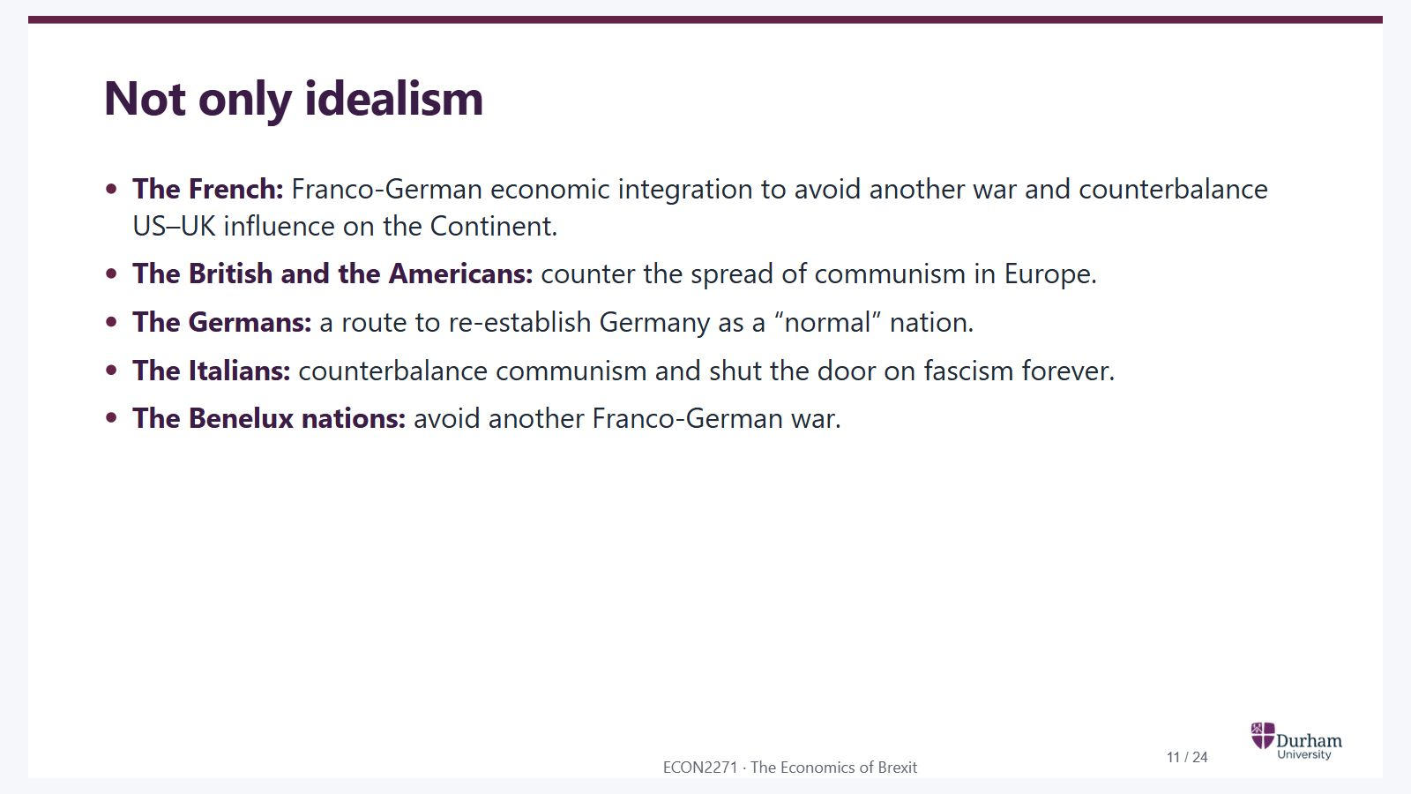
Notes:
Static student copy of the current web slide. Slide artwork is flattened; add personal notes here. Interactive explanations, playback and accessible HTML are available at:
https://davidchivers.co.uk/teaching/macro-applications/lecture_1.html#/not-only-idealism
Not only idealism The French: Franco-German economic integration to avoid another war and counterbalance US–UK influence on the Continent. The British and the Americans: counter the spread of communism in Europe. The Germans: a route to re-establish Germany as a “normal” nation. The Italians: counterbalance communism and shut the door on fascism forever. The Benelux nations: avoid another Franco-German war.

Slide 12
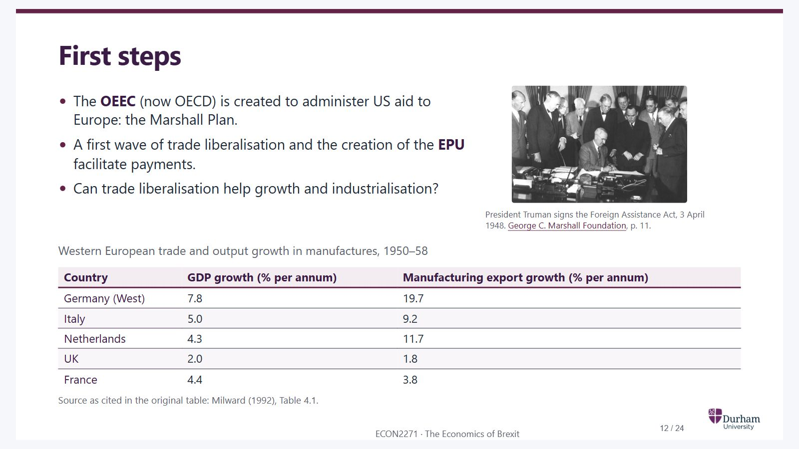
Notes:
Static student copy of the current web slide. Slide artwork is flattened; add personal notes here. Interactive explanations, playback and accessible HTML are available at:
https://davidchivers.co.uk/teaching/macro-applications/lecture_1.html#/first-steps
First steps The OEEC (now OECD) is created to administer US aid to Europe: the Marshall Plan. A first wave of trade liberalisation and the creation of the EPU facilitate payments. Can trade liberalisation help growth and industrialisation? President Truman signs the Foreign Assistance Act, 3 April 1948. George C. Marshall Foundation , p. 11. Western European trade and output growth in manufactures, 1950–58 Country GDP growth (% per annum) Manufacturing export growth (% per annum) Germany (West) 7.8 19.7 Italy 5.0 9.2 Netherlands 4.3 11.7 UK 2.0 1.8 France 4.4 3.8 Source as cited in the original table: Milward (1992), Table 4.1.
President Harry Truman sits at a desk signing the Foreign Assistance Act, surrounded by officials.
OEEC: Organisation for European Economic Co-operation
OECD: Organisation for Economic Co-operation and Development
EPU: European Payments Union
GDP: Gross domestic product
https://www.marshallfoundation.org/wp-content/uploads/2014/05/Chapter_1.pdf

Slide 13
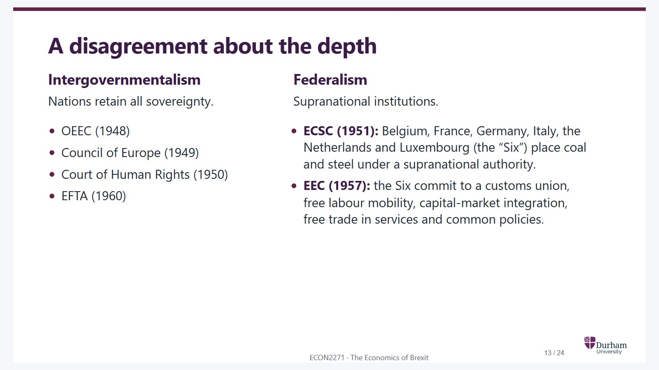
Notes:
Static student copy of the current web slide. Slide artwork is flattened; add personal notes here. Interactive explanations, playback and accessible HTML are available at:
https://davidchivers.co.uk/teaching/macro-applications/lecture_1.html#/a-disagreement-about-the-depth
A disagreement about the depth Intergovernmentalism Nations retain all sovereignty. OEEC (1948) Council of Europe (1949) Court of Human Rights (1950) EFTA (1960) Federalism Supranational institutions. ECSC (1951): Belgium, France, Germany, Italy, the Netherlands and Luxembourg (the “Six”) place coal and steel under a supranational authority. EEC (1957): the Six commit to a customs union, free labour mobility, capital-market integration, free trade in services and common policies. The institutional dates reproduce the source lecture. In particular, the source’s “Court of Human Rights (1950)” entry needs a content review before reuse.
OEEC: Organisation for European Economic Co-operation
EFTA: European Free Trade Association
ECSC: European Coal and Steel Community
EEC: European Economic Community

Slide 14
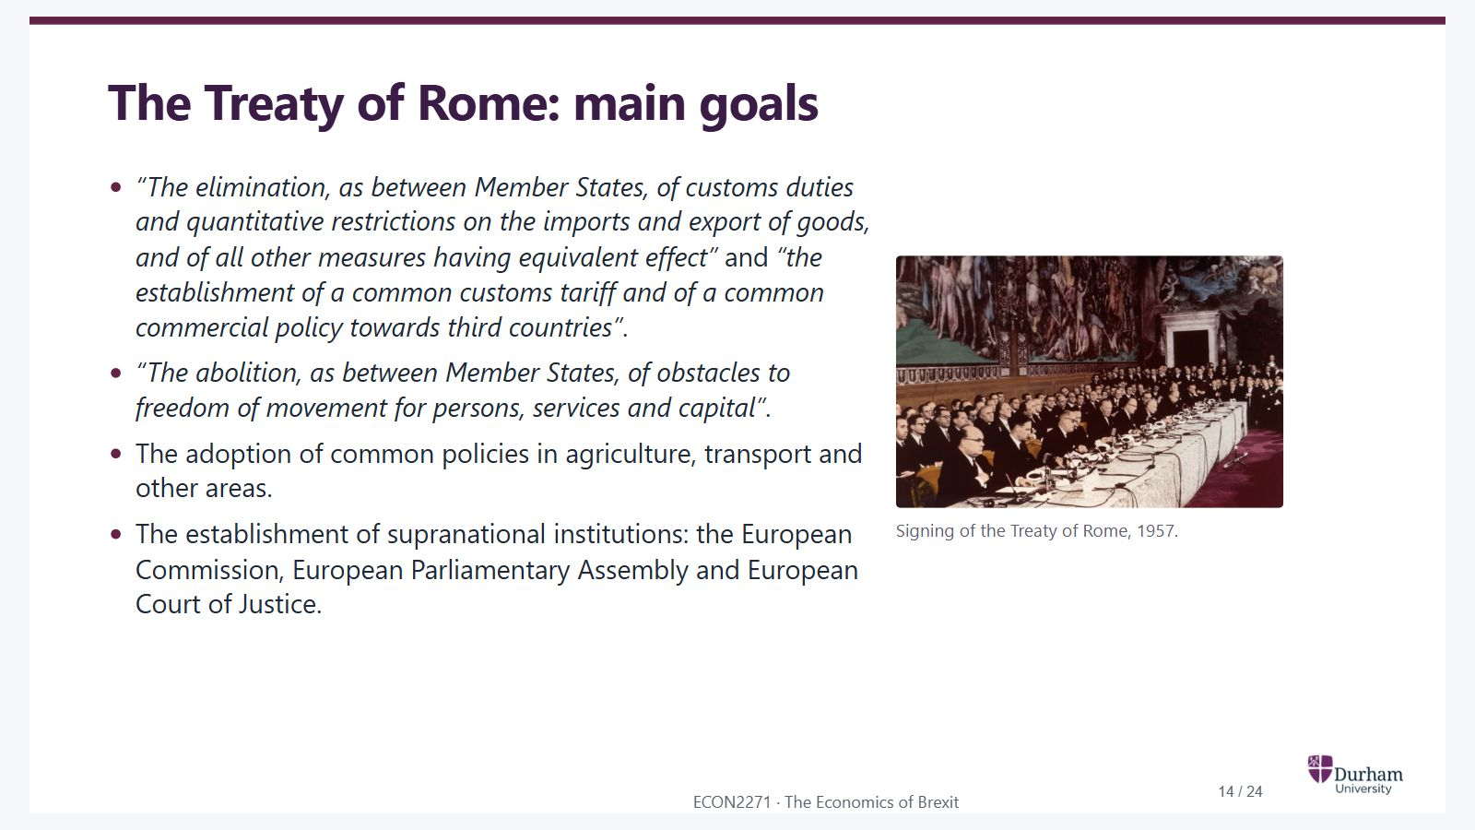
Notes:
Static student copy of the current web slide. Slide artwork is flattened; add personal notes here. Interactive explanations, playback and accessible HTML are available at:
https://davidchivers.co.uk/teaching/macro-applications/lecture_1.html#/the-treaty-of-rome-main-goals
The Treaty of Rome: main goals “The elimination, as between Member States, of customs duties and quantitative restrictions on the imports and export of goods, and of all other measures having equivalent effect” and “the establishment of a common customs tariff and of a common commercial policy towards third countries” . “The abolition, as between Member States, of obstacles to freedom of movement for persons, services and capital” . The adoption of common policies in agriculture, transport and other areas. The establishment of supranational institutions: the European Commission, European Parliamentary Assembly and European Court of Justice. Signing of the Treaty of Rome, 1957.
Historical photograph of the Treaty of Rome signing ceremony, with delegates seated around a long table in a decorated hall.

Slide 15
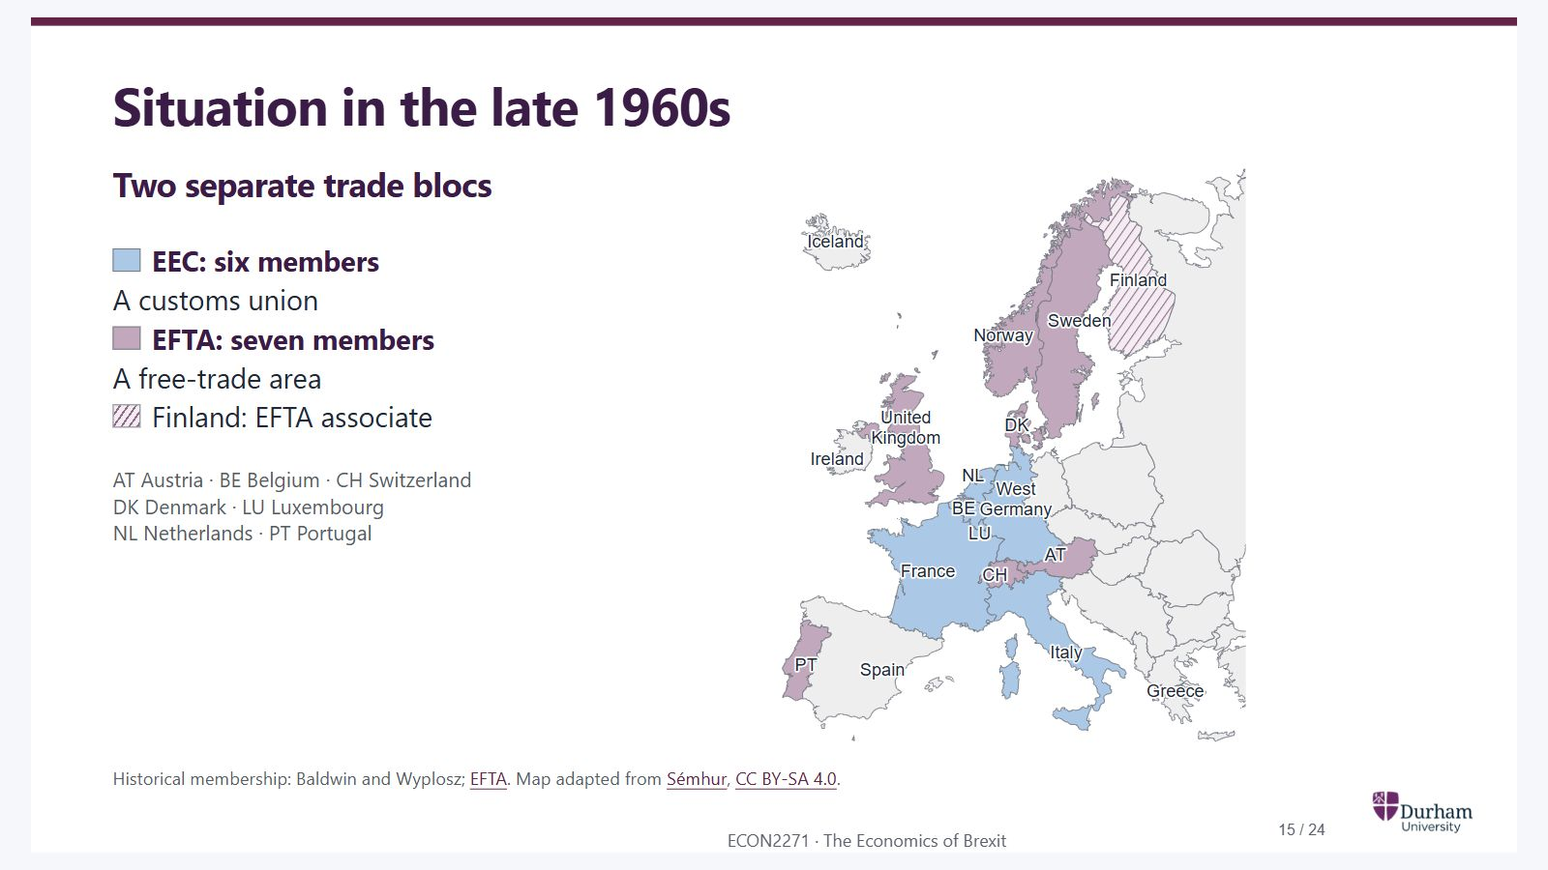
Notes:
Static student copy of the current web slide. Slide artwork is flattened; add personal notes here. Interactive explanations, playback and accessible HTML are available at:
https://davidchivers.co.uk/teaching/macro-applications/lecture_1.html#/situation-in-the-late-1960s
Situation in the late 1960s Two separate trade blocs EEC: six members A customs union EFTA: seven members A free-trade area Finland: EFTA associate AT Austria · BE Belgium · CH Switzerland DK Denmark · LU Luxembourg NL Netherlands · PT Portugal Historical membership: Baldwin and Wyplosz; EFTA . Map adapted from Sémhur , CC BY-SA 4.0 .
Geographical map of Western Europe in the late 1960s. The EEC Six are blue: Belgium, France, West Germany, Italy, Luxembourg and the Netherlands. The EFTA Seven are purple: Austria, Denmark, Norway, Portugal, Sweden, Switzerland and the UK. Finland is hatched as an EFTA associate. The historical West/East German border is shown.
EEC: European Economic Community
EFTA: European Free Trade Association
EFTA: European Free Trade Association
https://www.efta.int/about-efta/european-free-trade-association/history
https://commons.wikimedia.org/wiki/File:Iron_Curtain_map.svg
https://creativecommons.org/licenses/by-sa/4.0/

Slide 16
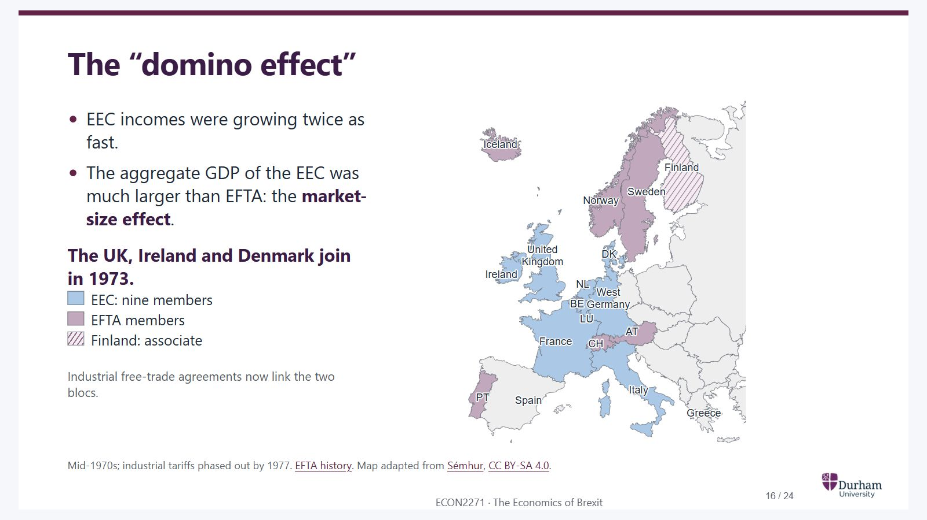
Notes:
Static student copy of the current web slide. Slide artwork is flattened; add personal notes here. Interactive explanations, playback and accessible HTML are available at:
https://davidchivers.co.uk/teaching/macro-applications/lecture_1.html#/the-domino-effect
The “domino effect” EEC incomes were growing twice as fast. The aggregate GDP of the EEC was much larger than EFTA: the market-size effect . The UK, Ireland and Denmark join in 1973. EEC: nine members EFTA members Finland: associate Industrial free-trade agreements now link the two blocs. Map Watch debate Jenkins and Benn, Panorama (1975). Open on YouTube . Mid-1970s; industrial tariffs phased out by 1977. EFTA history . Map adapted from Sémhur , CC BY-SA 4.0 .
The same geographical map in the mid-1970s. The UK, Denmark and Ireland are now blue as part of the EEC Nine. Iceland has joined EFTA, shown in purple with Austria, Norway, Portugal, Sweden and Switzerland. Finland remains an associate. Industrial free-trade agreements link EEC and EFTA countries.
EEC: European Economic Community
GDP: Gross domestic product
EEC: European Economic Community
EFTA: European Free Trade Association
EEC: European Economic Community
EFTA: European Free Trade Association
https://youtu.be/_zBFh6bpcMo?t=2046
https://www.efta.int/about-efta/european-free-trade-association/history
https://commons.wikimedia.org/wiki/File:Iron_Curtain_map.svg
https://creativecommons.org/licenses/by-sa/4.0/

Slide 17
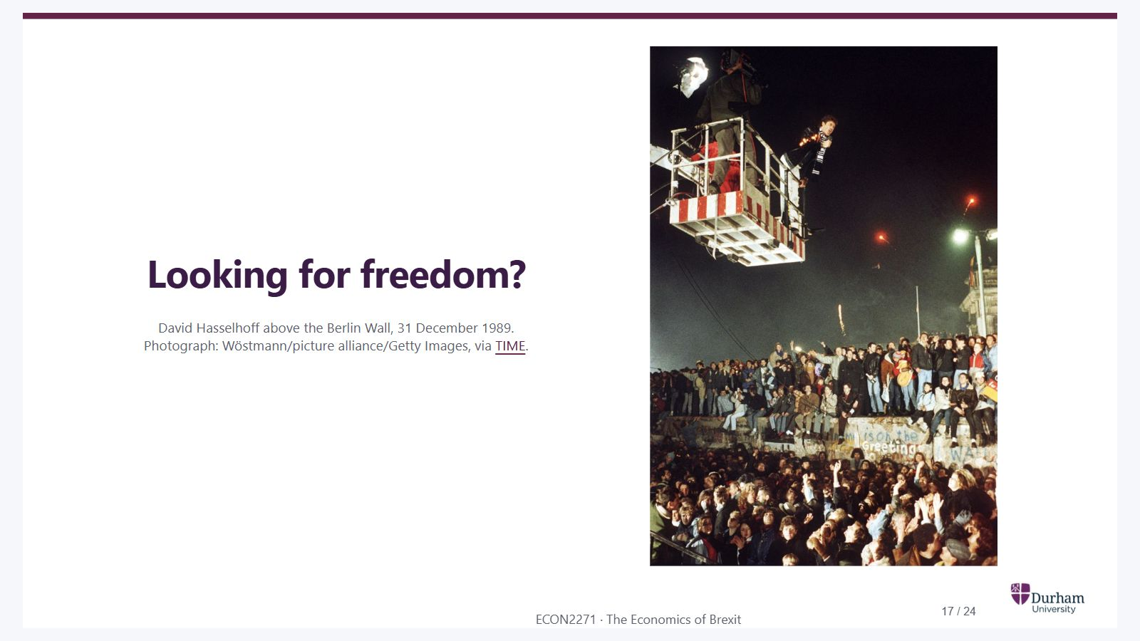
Notes:
Static student copy of the current web slide. Slide artwork is flattened; add personal notes here. Interactive explanations, playback and accessible HTML are available at:
https://davidchivers.co.uk/teaching/macro-applications/lecture_1.html#/looking-for-freedom
Looking for freedom? David Hasselhoff above the Berlin Wall, 31 December 1989. Photograph: Wöstmann/picture alliance/Getty Images, via TIME .
Wide historical photograph of David Hasselhoff singing from a crane above the Berlin Wall on New Year's Eve 1989. His light-up jacket, the camera platform, people standing on the Wall and the crowd below are all visible.
https://time.com/5714602/david-hasselhoff-berlin-wall-fall/

Slide 18
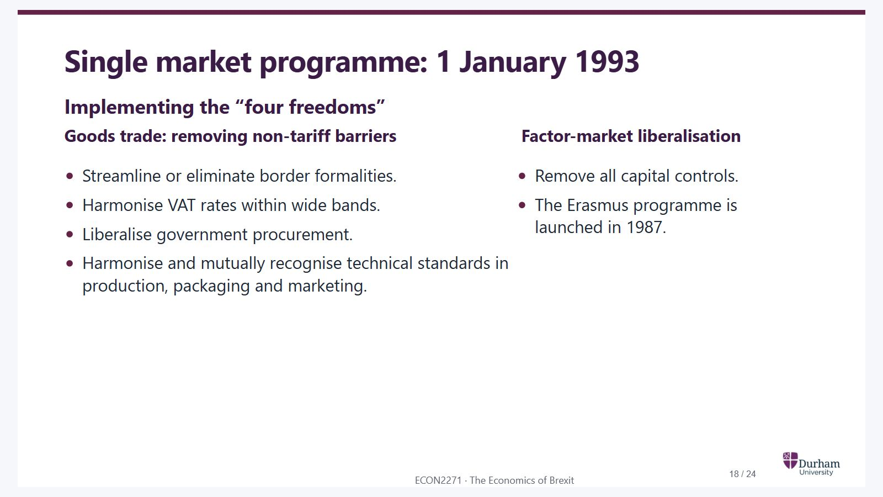
Notes:
Static student copy of the current web slide. Slide artwork is flattened; add personal notes here. Interactive explanations, playback and accessible HTML are available at:
https://davidchivers.co.uk/teaching/macro-applications/lecture_1.html#/single-market-programme-1-january-1993
Single market programme: 1 January 1993 Implementing the “four freedoms” Goods trade: removing non-tariff barriers Streamline or eliminate border formalities. Harmonise VAT rates within wide bands. Liberalise government procurement. Harmonise and mutually recognise technical standards in production, packaging and marketing. Factor-market liberalisation Remove all capital controls. The Erasmus programme is launched in 1987.
VAT: Value added tax

Slide 19
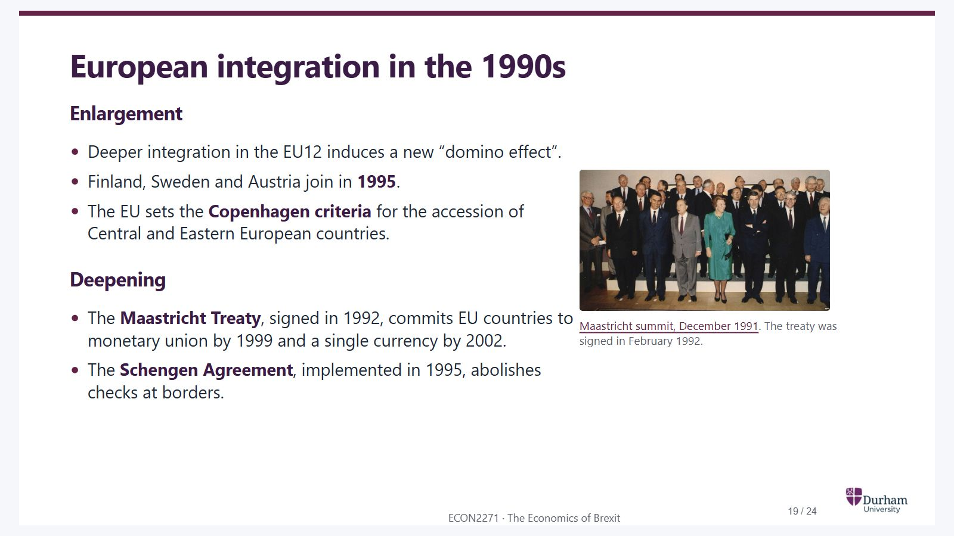
Notes:
Static student copy of the current web slide. Slide artwork is flattened; add personal notes here. Interactive explanations, playback and accessible HTML are available at:
https://davidchivers.co.uk/teaching/macro-applications/lecture_1.html#/after-1993
European integration in the 1990s Enlargement Deeper integration in the EU12 induces a new “domino effect”. Finland, Sweden and Austria join in 1995 . The EU sets the Copenhagen criteria for the accession of Central and Eastern European countries. Deepening The Maastricht Treaty , signed in 1992, commits EU countries to monetary union by 1999 and a single currency by 2002. The Schengen Agreement , implemented in 1995, abolishes checks at borders. Maastricht summit, December 1991 . The treaty was signed in February 1992.
Group photograph of European leaders and Queen Beatrix at the Maastricht summit in December 1991.
EU12: European Union of twelve member states
EU: European Union
EU: European Union
https://audiovisual.ec.europa.eu/en/media/photo/P-002371/06-1

Slide 20
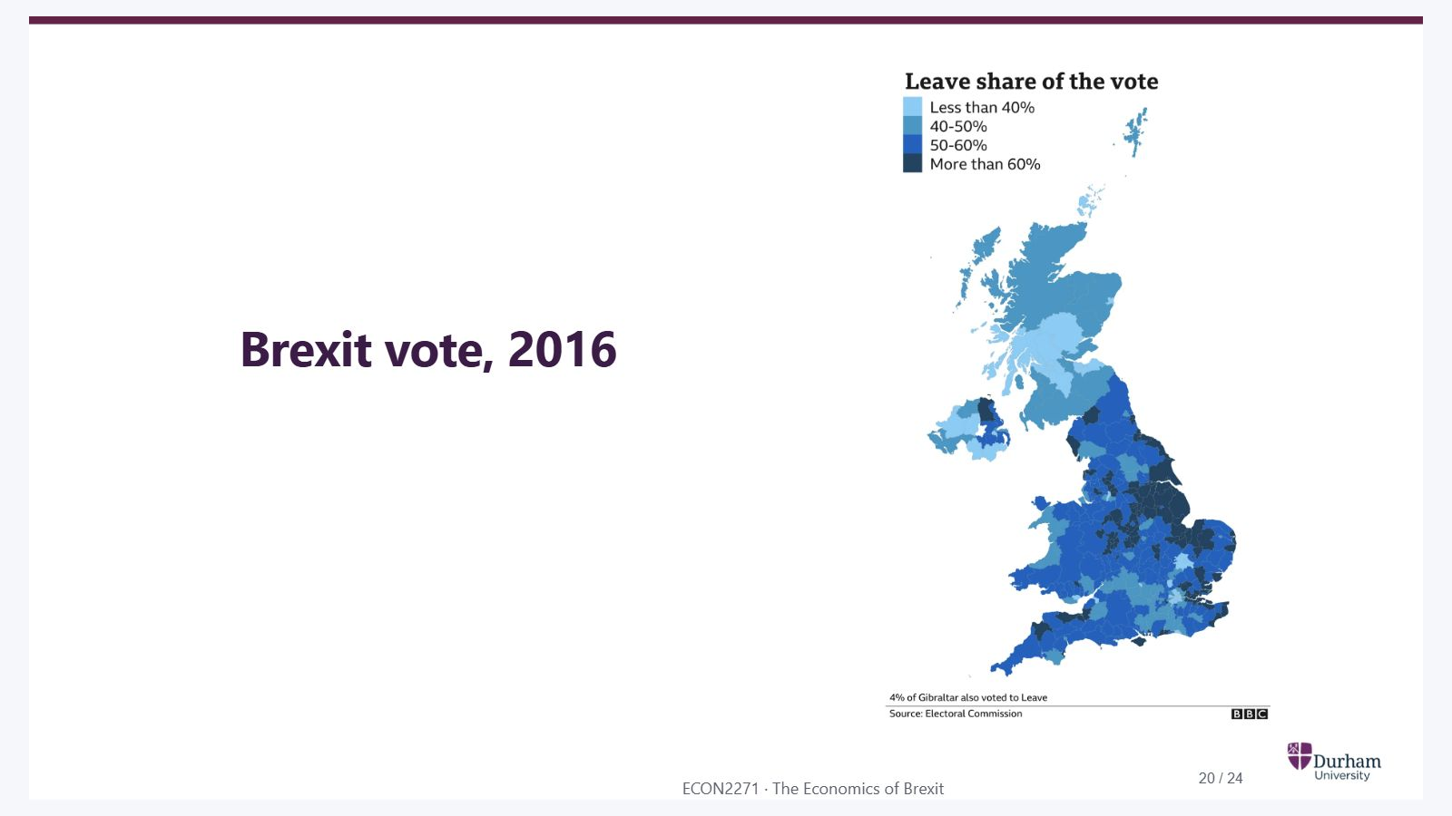
Notes:
Static student copy of the current web slide. Slide artwork is flattened; add personal notes here. Interactive explanations, playback and accessible HTML are available at:
https://davidchivers.co.uk/teaching/macro-applications/lecture_1.html#/brexit-vote-2016
Brexit vote, 2016
UK map showing the Leave share in the 2016 referendum: under 40%, 40–50%, 50–60%, and over 60%. Scotland and much of Northern Ireland are below 50%, while much of England and Wales is above 50%. Local variation is visible within countries.

Slide 21
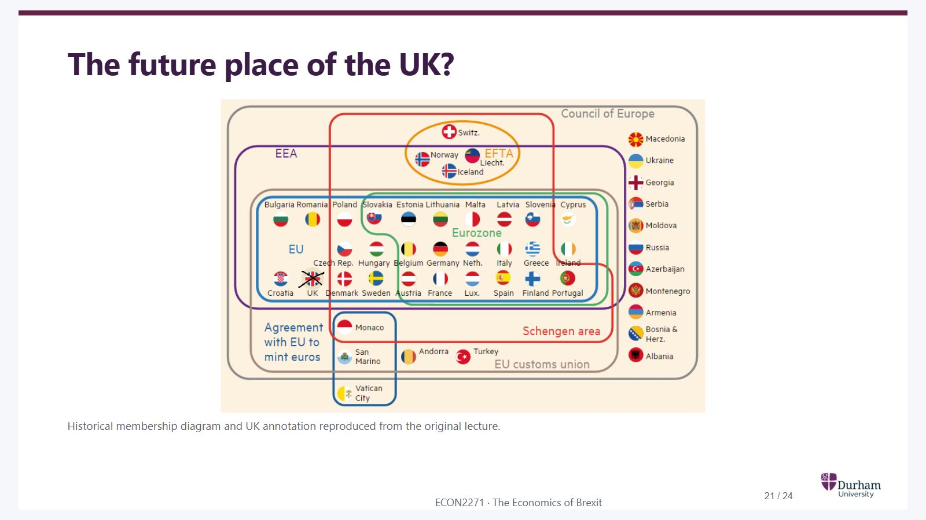
Notes:
Static student copy of the current web slide. Slide artwork is flattened; add personal notes here. Interactive explanations, playback and accessible HTML are available at:
https://davidchivers.co.uk/teaching/macro-applications/lecture_1.html#/the-future-place-of-the-uk
The future place of the UK? Historical membership diagram and UK annotation reproduced from the original lecture.
Historical diagram of overlapping European memberships: the Council of Europe, EEA, EFTA, EU, eurozone, Schengen area and customs union. The UK's flag inside the EU is crossed out, as in the original lecture annotation. The diagram illustrates differing levels of integration rather than current membership.

Slide 22
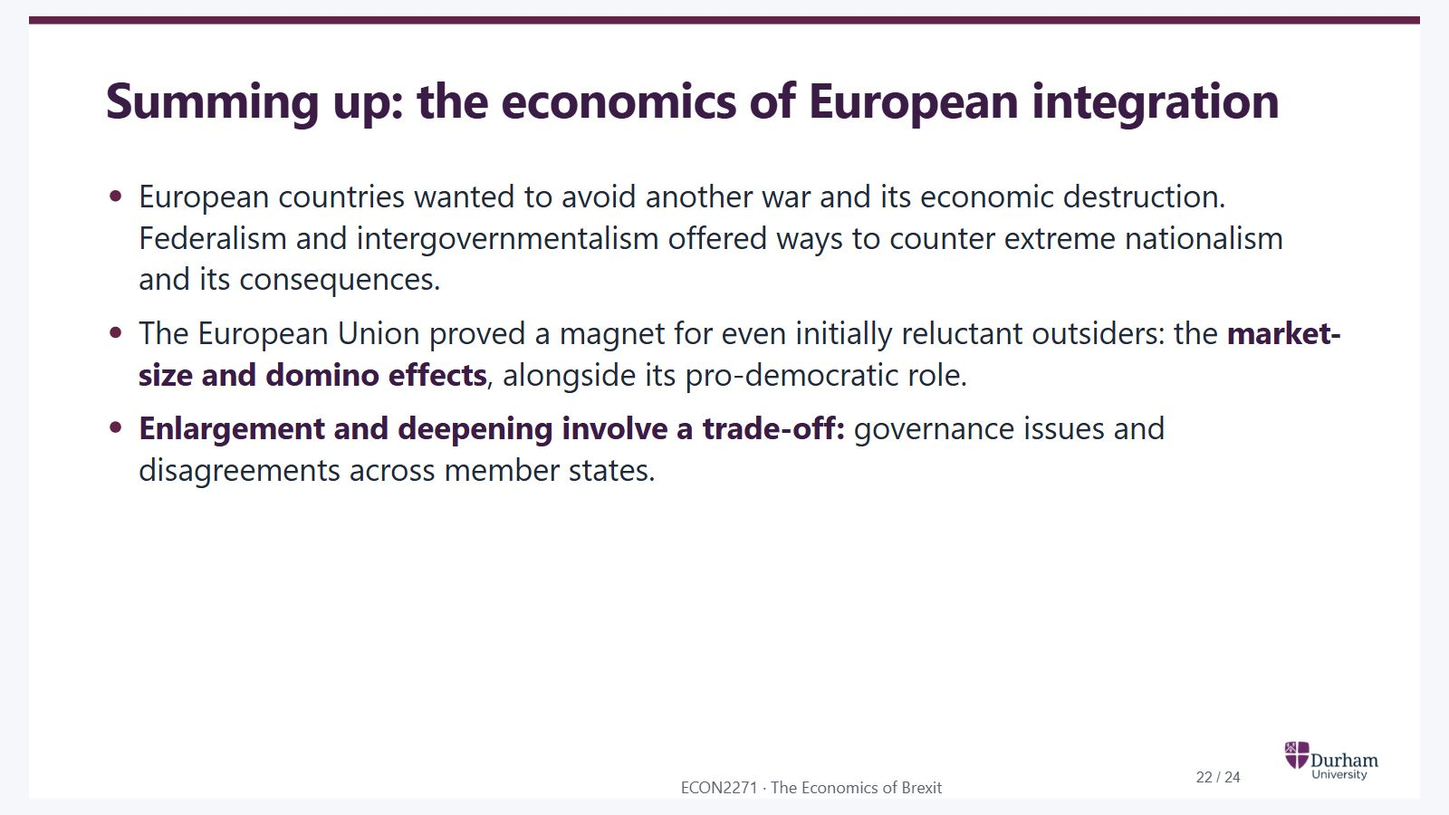
Notes:
Static student copy of the current web slide. Slide artwork is flattened; add personal notes here. Interactive explanations, playback and accessible HTML are available at:
https://davidchivers.co.uk/teaching/macro-applications/lecture_1.html#/summing-up-the-economics-of-european-integration
Summing up: the economics of European integration European countries wanted to avoid another war and its economic destruction. Federalism and intergovernmentalism offered ways to counter extreme nationalism and its consequences. The European Union proved a magnet for even initially reluctant outsiders: the market-size and domino effects , alongside its pro-democratic role. Enlargement and deepening involve a trade-off: governance issues and disagreements across member states.

Slide 23
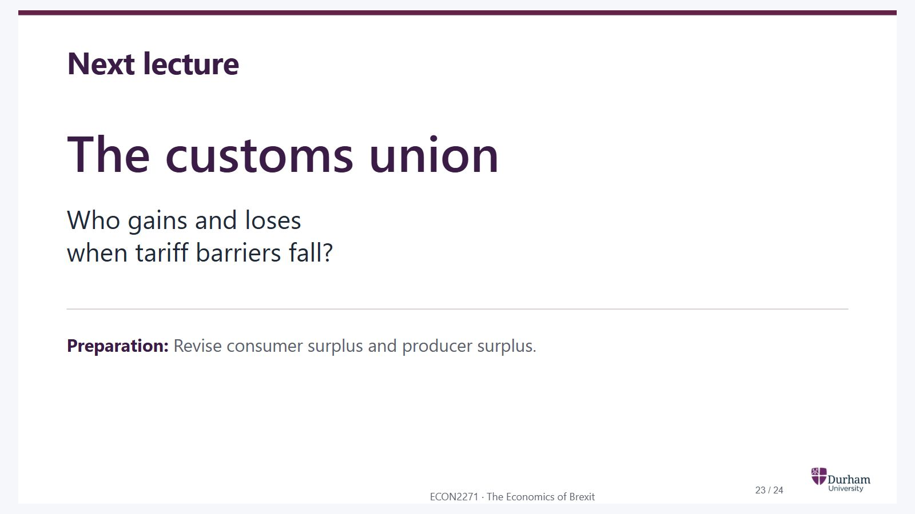
Notes:
Static student copy of the current web slide. Slide artwork is flattened; add personal notes here. Interactive explanations, playback and accessible HTML are available at:
https://davidchivers.co.uk/teaching/macro-applications/lecture_1.html#/next-lecture
Next lecture The customs union Who gains and loses when tariff barriers fall? Preparation: Revise consumer surplus and producer surplus.

Slide 24
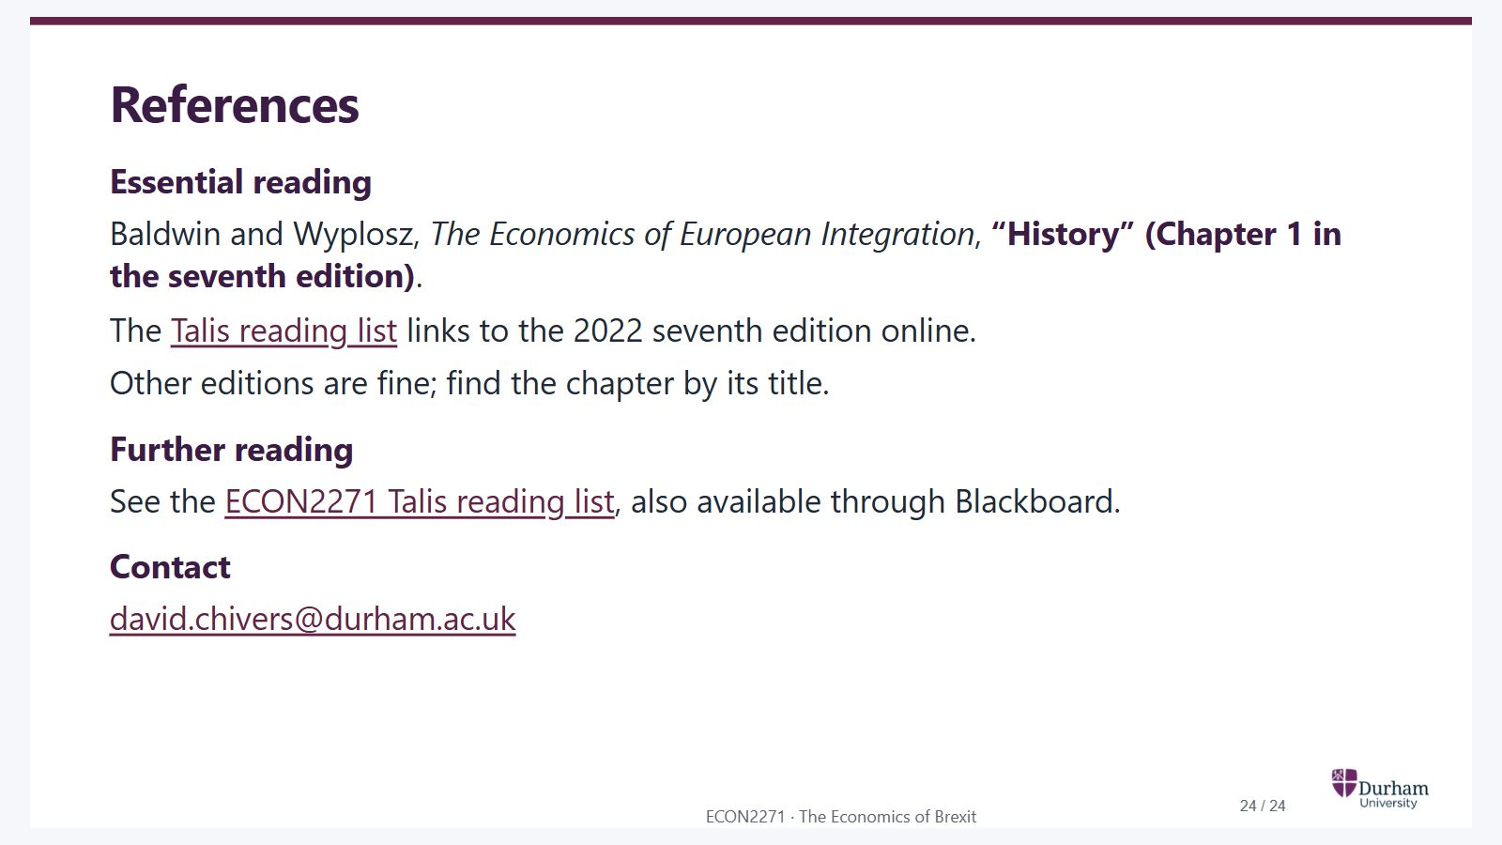
Notes:
Static student copy of the current web slide. Slide artwork is flattened; add personal notes here. Interactive explanations, playback and accessible HTML are available at:
https://davidchivers.co.uk/teaching/macro-applications/lecture_1.html#/references
References Essential reading Baldwin and Wyplosz, The Economics of European Integration , “History” (Chapter 1 in the seventh edition) . The Talis reading list links to the 2022 seventh edition online. Other editions are fine; find the chapter by its title. Further reading See the ECON2271 Talis reading list , also available through Blackboard. Contact david.chivers@durham.ac.uk
https://durham.rl.talis.com/lists/d85d1ad3-e9ac-4daf-aa66-e3ddfcf902d7.html

