Slide 1
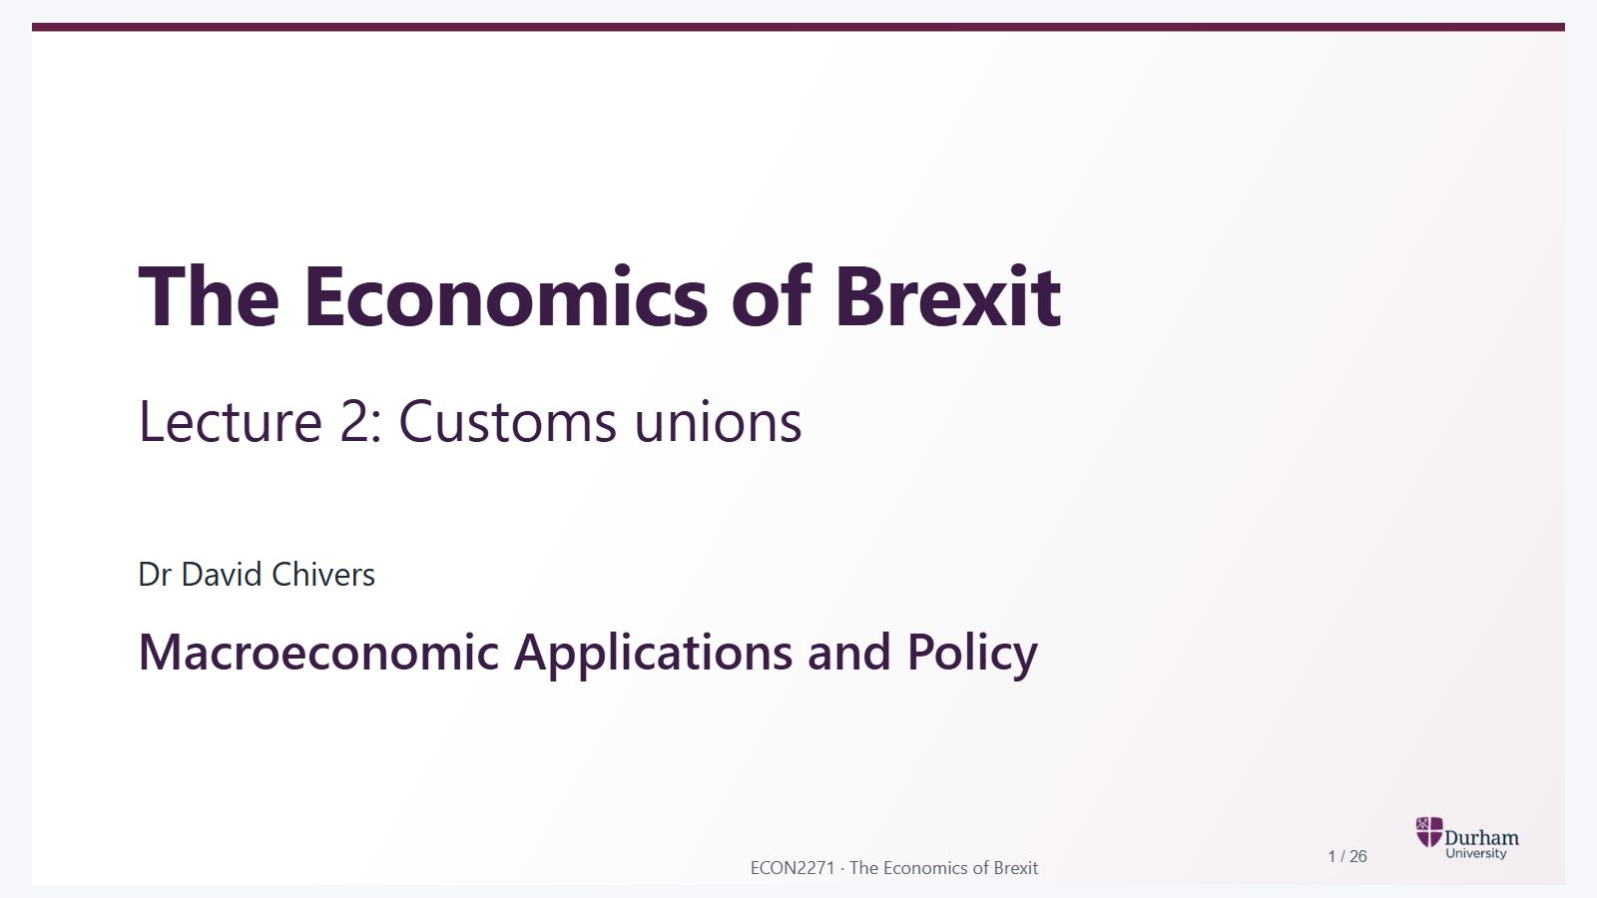
Notes:
Static student copy of the current web slide. Slide artwork is flattened; add personal notes here. Interactive explanations, playback and accessible HTML are available at:
https://davidchivers.co.uk/teaching/macro-applications/lecture_2.html#/title-slide
The Economics of Brexit Lecture 2: Customs unions Dr David Chivers Macroeconomic Applications and Policy

Slide 2
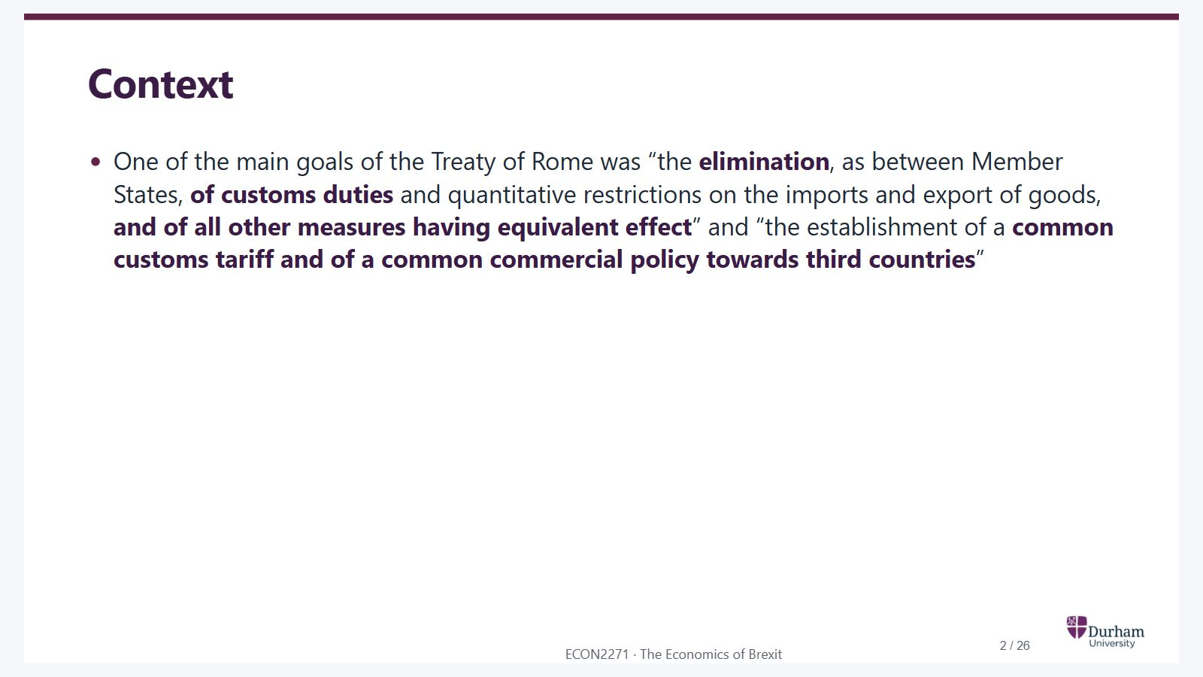
Notes:
Static student copy of the current web slide. Slide artwork is flattened; add personal notes here. Interactive explanations, playback and accessible HTML are available at:
https://davidchivers.co.uk/teaching/macro-applications/lecture_2.html#/l2-s02
Context One of the main goals of the Treaty of Rome was “the elimination , as between Member States, of customs duties and quantitative restrictions on the imports and export of goods, and of all other measures having equivalent effect ” and “the establishment of a common customs tariff and of a common commercial policy towards third countries ”

Slide 3
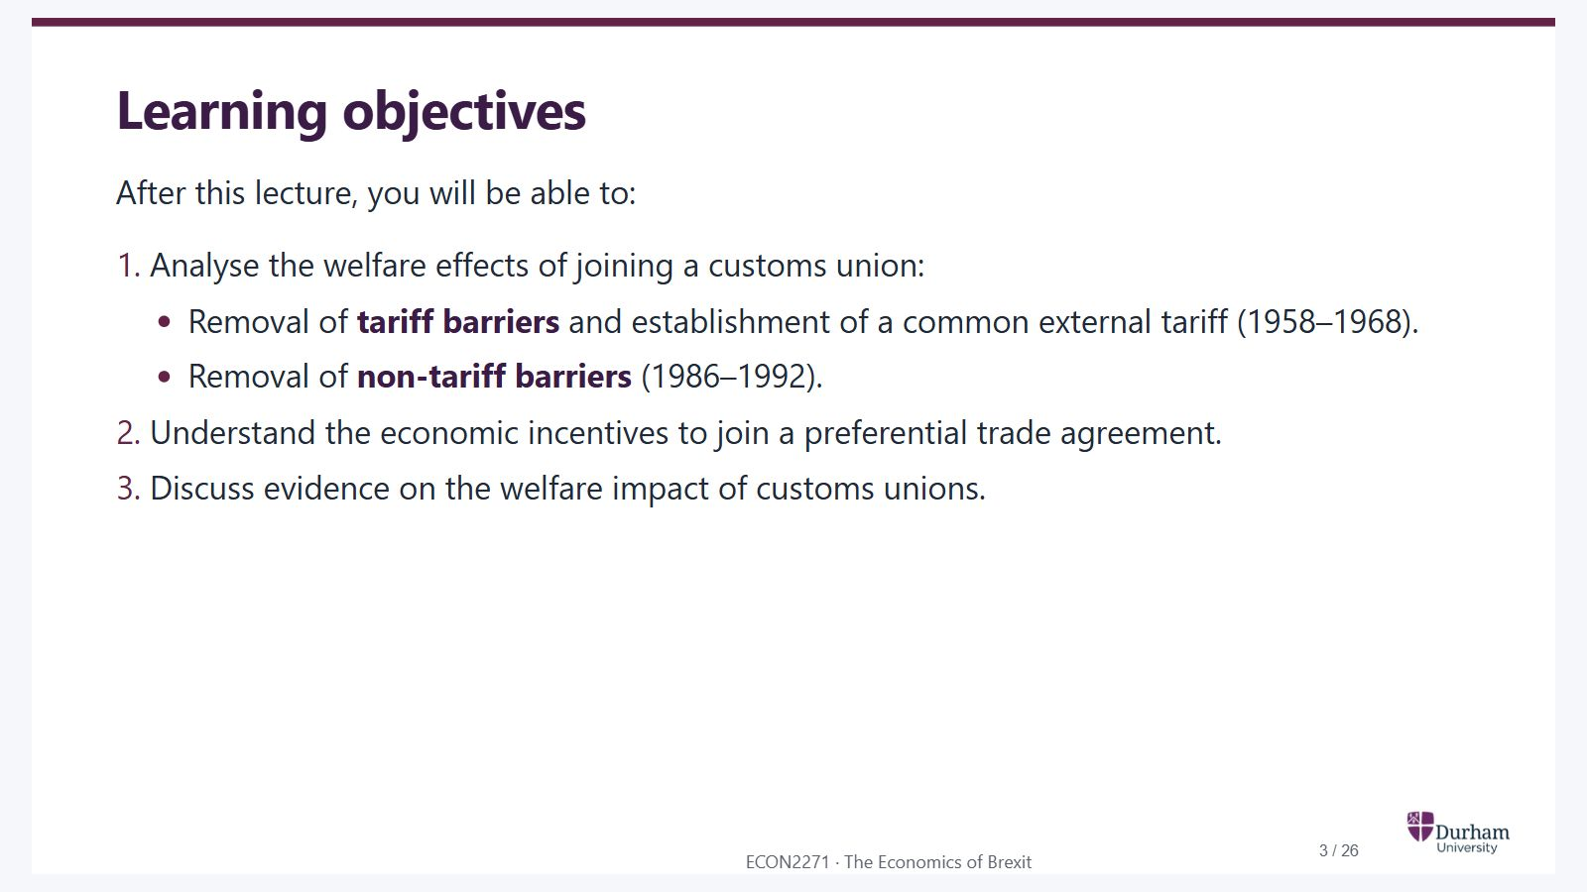
Notes:
Static student copy of the current web slide. Slide artwork is flattened; add personal notes here. Interactive explanations, playback and accessible HTML are available at:
https://davidchivers.co.uk/teaching/macro-applications/lecture_2.html#/l2-s03
Learning objectives After this lecture, you will be able to: Analyse the welfare effects of joining a customs union: Removal of tariff barriers and establishment of a common external tariff (1958–1968). Removal of non-tariff barriers (1986–1992). Understand the economic incentives to join a preferential trade agreement. Discuss evidence on the welfare impact of customs unions.

Slide 4
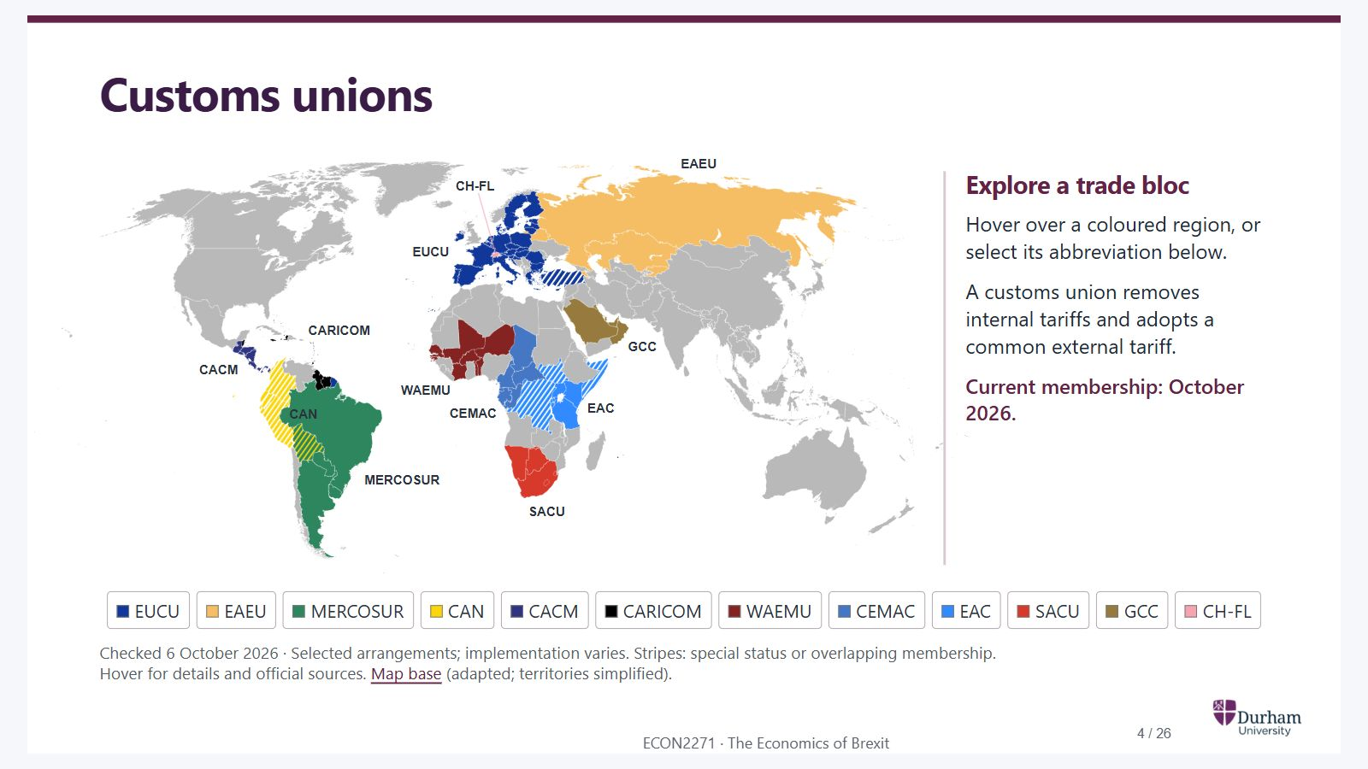
Notes:
Static student copy of the current web slide. Slide artwork is flattened; add personal notes here. Interactive explanations, playback and accessible HTML are available at:
https://davidchivers.co.uk/teaching/macro-applications/lecture_2.html#/l2-s04
Customs unions Membership checked 6 October 2026. The East African Community includes eight countries, including South Sudan, DR Congo and Somalia. Bolivia belongs to MERCOSUR and the Andean Community. Stripes identify special or transitional arrangements. Choose a bloc for current membership and qualifications; geography is simplified. Selected customs unions and regional trade blocs, October 2026 MERCOSUR CARICOM CACM CAN CH-FL EUCU EAEU GCC EAC WAEMU CEMAC SACU Explore a trade bloc Hover over a coloured region, or select its abbreviation below. A customs union removes internal tariffs and adopts a common external tariff. Current membership: October 2026. EU customs union and linked unions EU 27 and neighbouring arrangements EU 27 and Monaco share the EU customs territory. Türkiye, Andorra and San Marino have separate customs-union agreements (striped), with differing product coverage. The UK is outside. EU countries · Customs unions Eurasian Economic Union 5 members · Eurasia Armenia, Belarus, Kazakhstan, Kyrgyzstan and Russia share a customs union and common external tariff. Observer states and free-trade partners are not members and are not shaded. Official membership Southern Common Market 5 active members · South America Argentina, Bolivia, Brazil, Paraguay and Uruguay. Bolivia joined in 2024, with up to four years to adopt bloc rules. Two-colour stripes show its Andean membership too. Venezuela remains suspended. Membership and transition Andean Community 4 members · Andean South America Bolivia, Colombia, Ecuador and Peru. This is a free-trade integration bloc, without a fully operating common external tariff. Stripes flag that distinction; Bolivia also belongs to MERCOSUR. Members · Tariff status Central American economic integration 6 participants · Central America Costa Rica, El Salvador, Guatemala, Honduras, Nicaragua and Panama. Panama joined in 2013; stripes mark its distinct incorporation arrangements. Customs and tariff integration remain incomplete. Integration · Panama Caribbean Community 15 members · 8 associate members Twelve Single Market participants. Haiti and Montserrat have special arrangements (striped). The Bahamas and associates are outside this tariff shading. Martinique and French Guiana became associates in 2026. Participation · 2026 expansion West African Economic and Monetary Union 8 members · also called UEMOA Eight members, including Mali, Burkina Faso and Niger. UEMOA remains their customs and monetary union. It is a separate organisation from ECOWAS. Official membership Central African Economic and Monetary Community 6 members · Central Africa Cameroon, Central African Republic, Chad, Republic of the Congo, Equatorial Guinea and Gabon share a customs-union framework and common currency. Official membership East African Community 8 partner states · East Africa Now eight members. South Sudan joined in 2016, DR Congo in 2022 and Somalia in 2024. These three are striped because integration into EAC rules is still underway. Members and accession dates Southern African Customs Union 5 members · Southern Africa Botswana, Eswatini, Lesotho, Namibia and South Africa share a customs area, a common external tariff and a revenue-sharing arrangement. Official membership Gulf Cooperation Council 6 members · Arabian Gulf Bahrain, Kuwait, Oman, Qatar, Saudi Arabia and the United Arab Emirates. Their customs union dates from 2003; completing its remaining requirements is still an official priority. Membership · Implementation Switzerland–Liechtenstein customs union 2 countries · Central Europe Liechtenstein forms a common customs area with Switzerland under their bilateral treaty. Both countries are outside the EU customs union. Official treaty explanation Show all EUCU EAEU MERCOSUR CAN CACM CARICOM WAEMU CEMAC EAC SACU GCC CH-FL Checked 6 October 2026 · Selected arrangements; implementation varies. Stripes: special status or overlapping membership. Hover for details and official sources. Map base (adapted; territories simplified).
https://taxation-customs.ec.europa.eu/list-non-eu-countries_en
https://taxation-customs.ec.europa.eu/customs/eu-customs-reform_en
https://www.eaeunion.org/?lang=en
https://www.mercosur.int/en/about-mercosur/countries
https://www.comunidadandina.org/quienes-somos/paises-miembros/
https://www.comunidadandina.org/DocOficialesFiles/DInformativos/SGdi1053.pdf
https://www.sieca.int/faq/
https://www.sieca.int/integracion-economica-centroamericana/panama-en-el-subsistema-economico/
https://caricom.org/caricom-secretariat-wraps-up-trade-readiness-talks-with-400-stakeholders-across-12-countries/
https://caricom.org/communique-fifty-first-regular-meeting-of-the-conference-of-heads-of-government-of-the-caribbean-community-caricom-saint-lucia/
https://www.uemoa.int/index.php/en/presentation-of-uemoa
https://cemac.int/
https://www.eac.int/overview-of-eac
https://www.sacu.int/about-sacu
https://www.gcc-sg.org/en/AboutUs/Pages/FoundingDay.aspx
https://www.gcc-sg.org/en/MediaCenter/News/Pages/news2025-12-3-3.aspx
https://www.llv.li/en/national-administration/diplomatic-representations/berne-ch/bilateral-relations-liechtenstein---switzerland
https://commons.wikimedia.org/wiki/File:Customs_Unions_World.svg

Slide 5
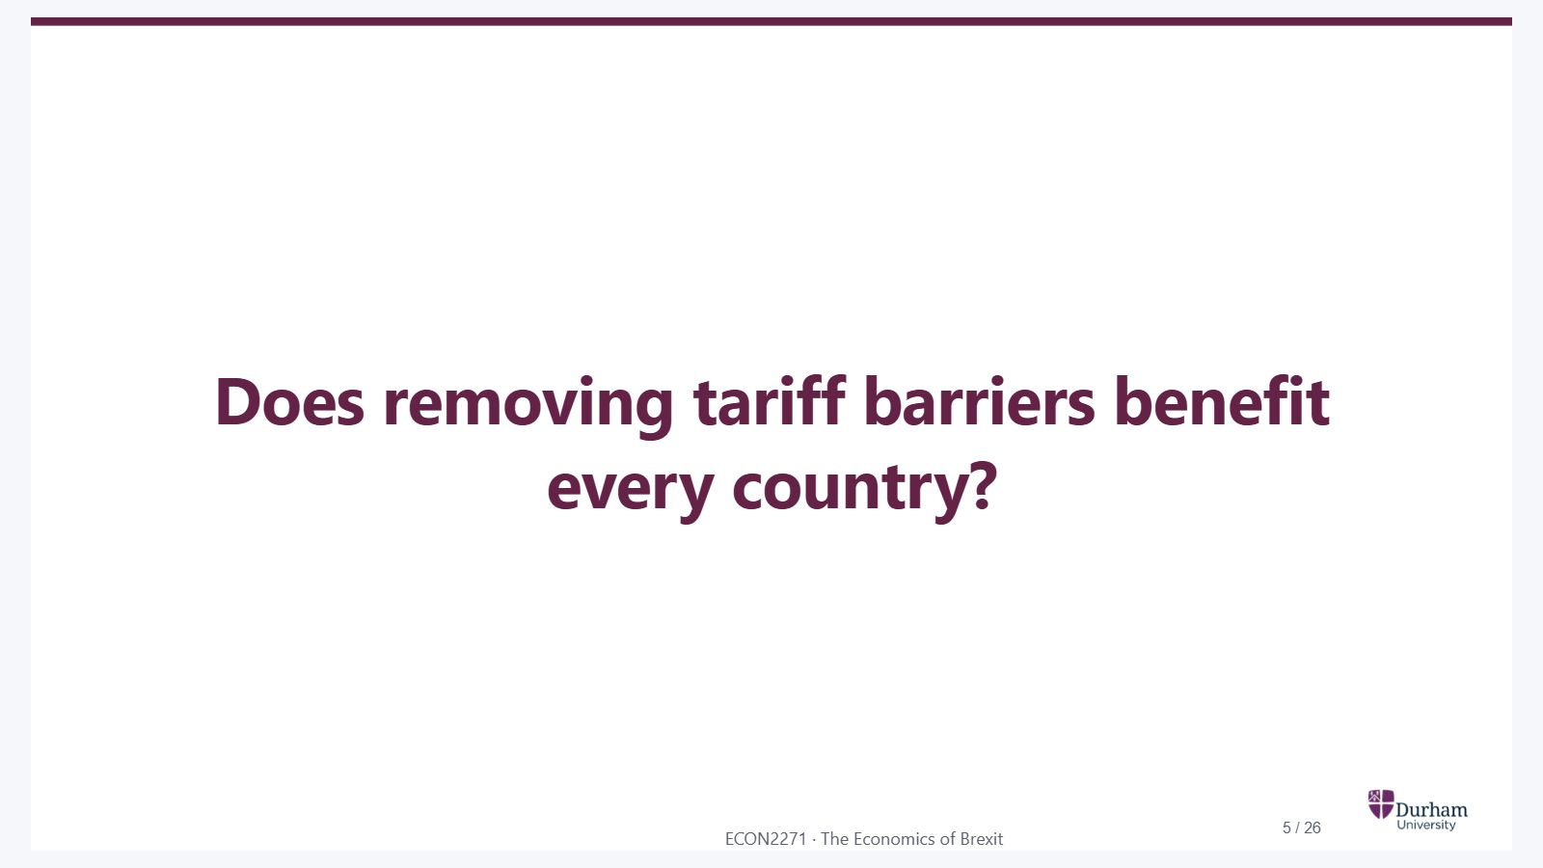
Notes:
Static student copy of the current web slide. Slide artwork is flattened; add personal notes here. Interactive explanations, playback and accessible HTML are available at:
https://davidchivers.co.uk/teaching/macro-applications/lecture_2.html#/l2-s05
Does removing tariff barriers benefit every country?

Slide 6
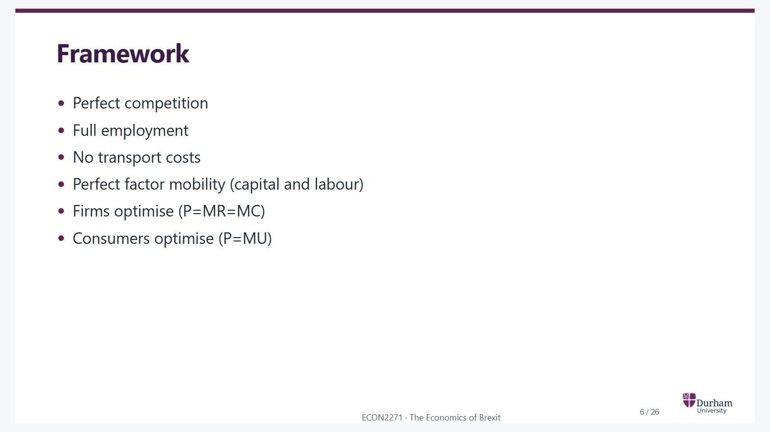
Notes:
Static student copy of the current web slide. Slide artwork is flattened; add personal notes here. Interactive explanations, playback and accessible HTML are available at:
https://davidchivers.co.uk/teaching/macro-applications/lecture_2.html#/l2-s06
Framework Perfect competition Full employment No transport costs Perfect factor mobility (capital and labour) Firms optimise (P=MR=MC) Consumers optimise (P=MU)

Slide 7
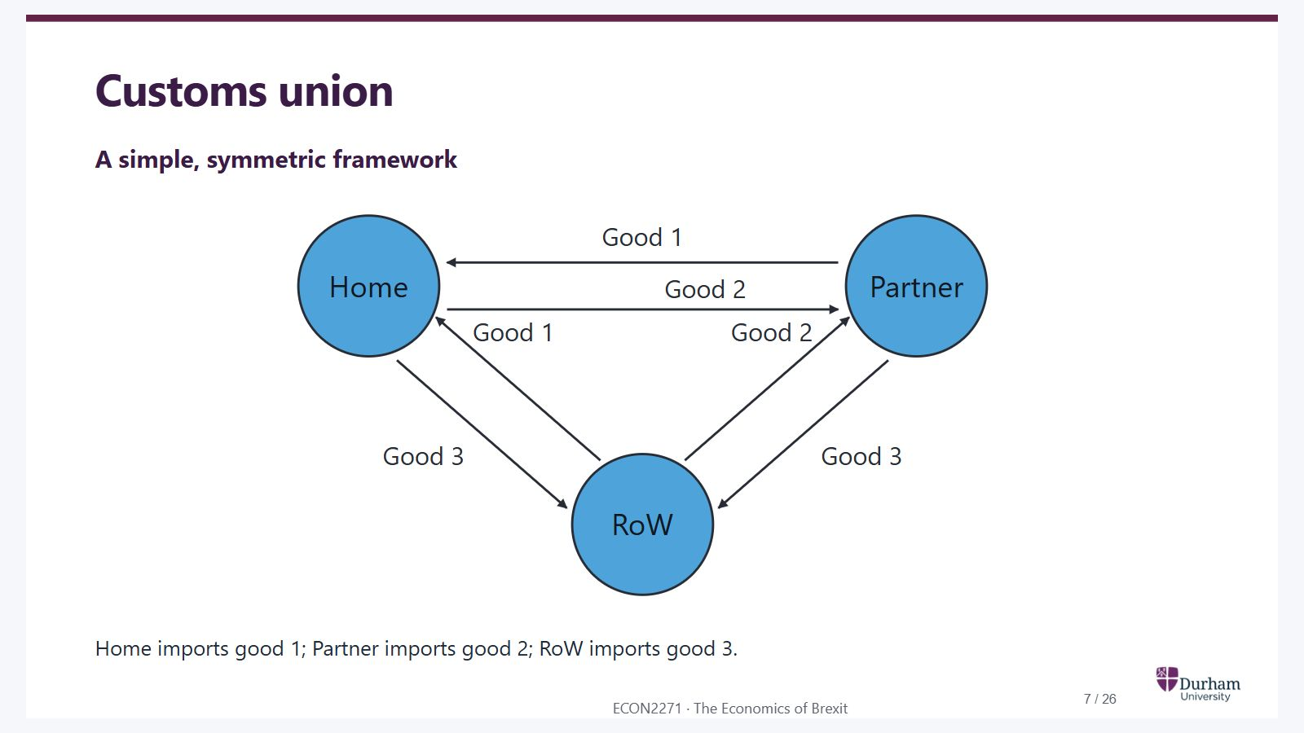
Notes:
Static student copy of the current web slide. Slide artwork is flattened; add personal notes here. Interactive explanations, playback and accessible HTML are available at:
https://davidchivers.co.uk/teaching/macro-applications/lecture_2.html#/l2-s07
Customs union A simple, symmetric framework ▶ Play Next good Show all A simple, symmetric three-country framework Home imports good 1 from Partner and the rest of the world. Partner imports good 2 from Home and the rest of the world. The rest of the world imports good 3 from Home and Partner. All six arrows are visible in the static diagram. Play highlights each pair in turn and moves a marker from each exporter towards its importer. Good 1 Good 1 Good 2 Good 2 Good 3 Good 3 Home Partner RoW Home imports good 1; Partner imports good 2; RoW imports good 3.

Slide 8
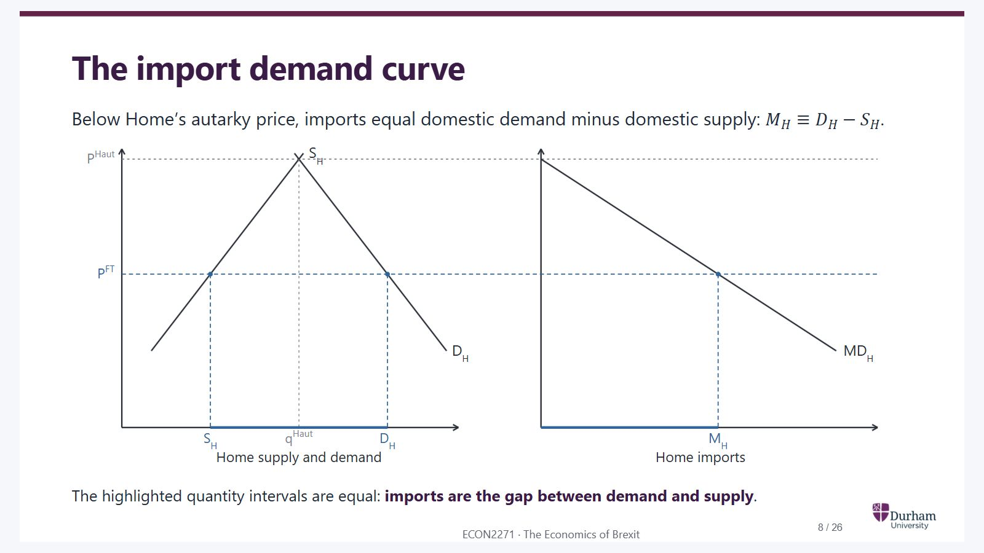
Notes:
Static student copy of the current web slide. Slide artwork is flattened; add personal notes here. Interactive explanations, playback and accessible HTML are available at:
https://davidchivers.co.uk/teaching/macro-applications/lecture_2.html#/l2-s08
The import demand curve Below Home’s autarky price, imports equal domestic demand minus domestic supply: M H ≡ D H − S H M_H \equiv D_H-S_H . The highlighted quantity intervals are equal: imports are the gap between demand and supply .
Deriving Home import demand from domestic supply and demand. Continuous horizontal guides align Home's autarky and free-trade prices across both panels. At the autarky price, domestic supply equals demand and imports are zero. At the free-trade price, the highlighted gap between domestic supply and demand has exactly the same width as Home imports in the right panel. Import demand slopes downwards.

Slide 9
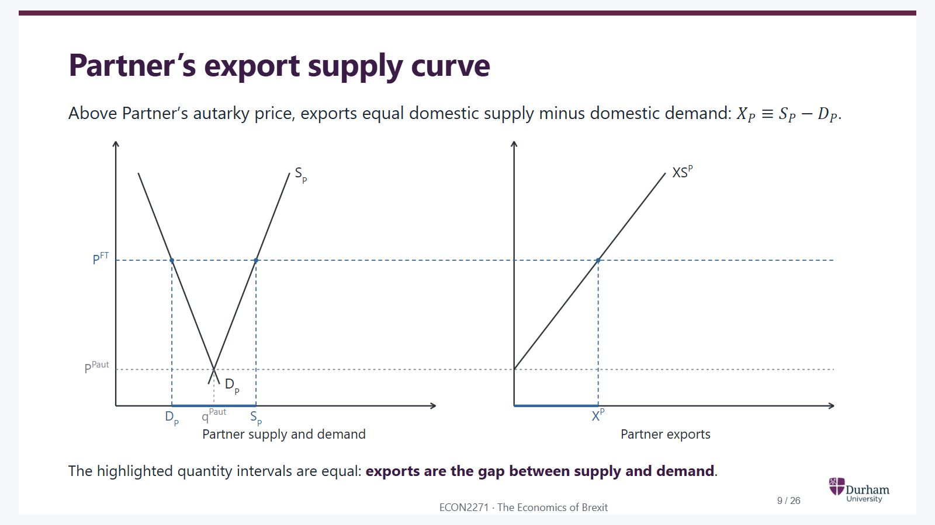
Notes:
Static student copy of the current web slide. Slide artwork is flattened; add personal notes here. Interactive explanations, playback and accessible HTML are available at:
https://davidchivers.co.uk/teaching/macro-applications/lecture_2.html#/l2-s09
Partner’s export supply curve Above Partner’s autarky price, exports equal domestic supply minus domestic demand: X P ≡ S P − D P X_P \equiv S_P-D_P . The highlighted quantity intervals are equal: exports are the gap between supply and demand .
Deriving Partner export supply from domestic supply and demand. Continuous horizontal guides align the autarky and free-trade prices across both panels. At the autarky price, exports are zero. At the free-trade price, the highlighted gap between supply and demand is exactly as wide as exports in the right panel. Export supply slopes upwards.

Slide 10
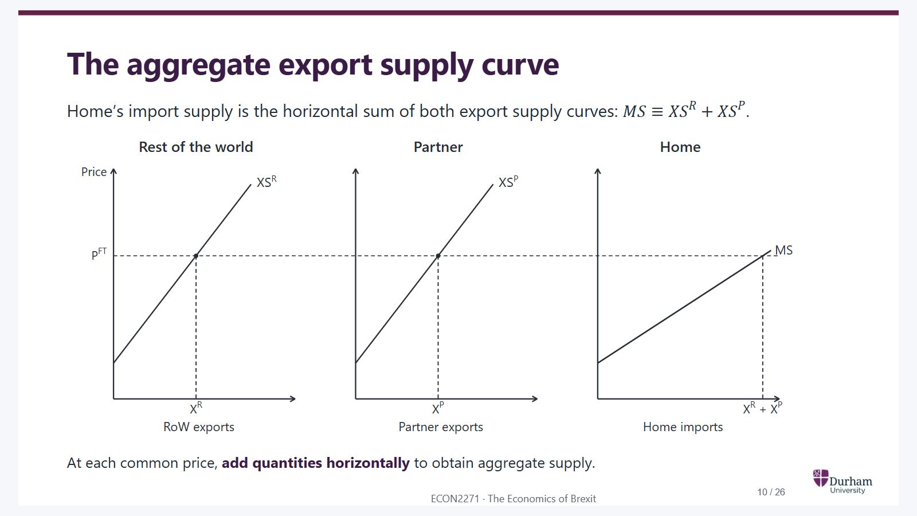
Notes:
Static student copy of the current web slide. Slide artwork is flattened; add personal notes here. Interactive explanations, playback and accessible HTML are available at:
https://davidchivers.co.uk/teaching/macro-applications/lecture_2.html#/l2-s10
The aggregate export supply curve Home’s import supply is the horizontal sum of both export supply curves: M S ≡ X S R + X S P MS \equiv XS^R + XS^P . At each common price, add quantities horizontally to obtain aggregate supply.
Three panels on common price and quantity scales. A continuous free-trade-price guide crosses both export supply panels and Home's import supply panel. The horizontal distance for aggregate supply equals the sum of the two exporter distances at that price.

Slide 11
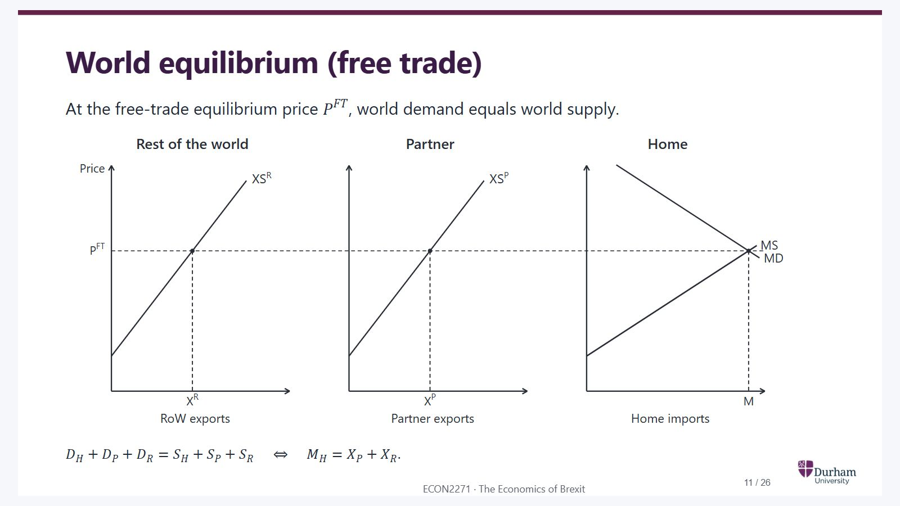
Notes:
Static student copy of the current web slide. Slide artwork is flattened; add personal notes here. Interactive explanations, playback and accessible HTML are available at:
https://davidchivers.co.uk/teaching/macro-applications/lecture_2.html#/l2-s11
World equilibrium (free trade) At the free-trade equilibrium price P F T P^{FT} , world demand equals world supply. D H + D P + D R = S H + S P + S R ⇔ M H = X P + X R D_H + D_P + D_R = S_H + S_P + S_R \quad \Longleftrightarrow \quad M_H = X_P + X_R .
The same three panels and scales as aggregate supply. Home import demand intersects aggregate import supply at the free-trade price. The continuous horizontal price guide links that intersection to both exporters. Home's import quantity equals the sum of Partner and rest-of-world exports.

Slide 12
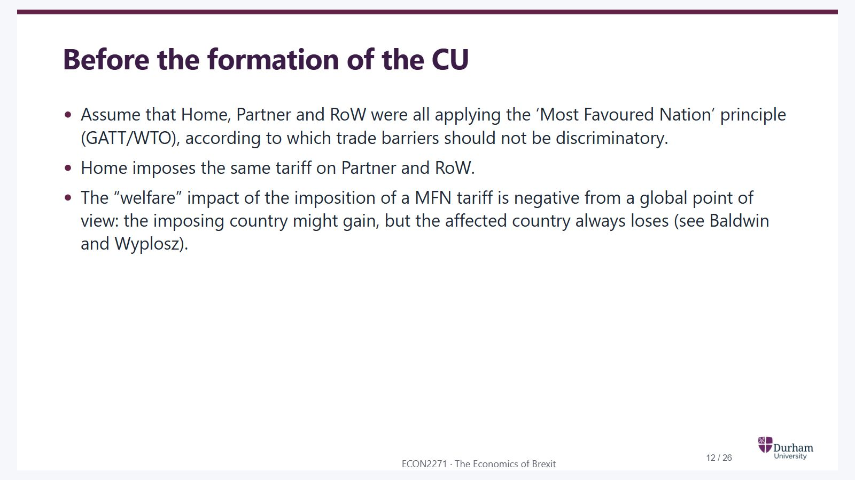
Notes:
Static student copy of the current web slide. Slide artwork is flattened; add personal notes here. Interactive explanations, playback and accessible HTML are available at:
https://davidchivers.co.uk/teaching/macro-applications/lecture_2.html#/l2-s12
Before the formation of the CU Assume that Home, Partner and RoW were all applying the ‘Most Favoured Nation’ principle (GATT/WTO), according to which trade barriers should not be discriminatory. Home imposes the same tariff on Partner and RoW. The “welfare” impact of the imposition of a MFN tariff is negative from a global point of view: the imposing country might gain, but the affected country always loses (see Baldwin and Wyplosz).

Slide 13
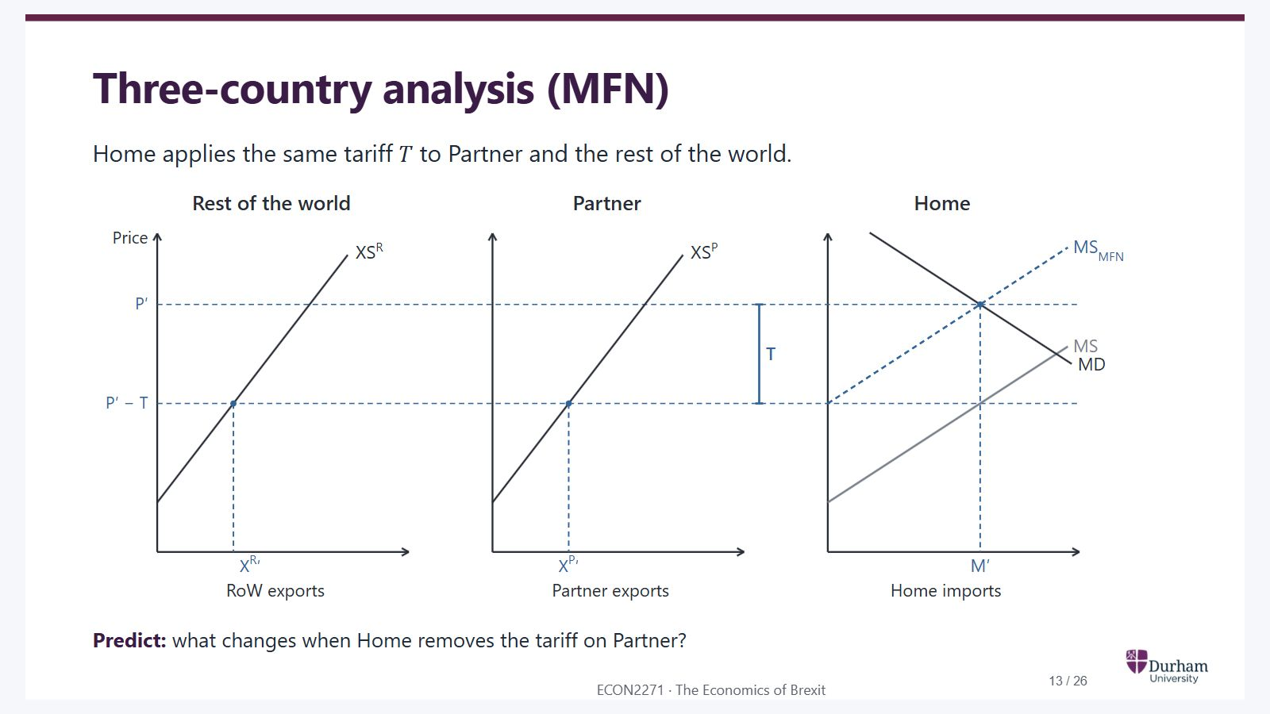
Notes:
Static student copy of the current web slide. Slide artwork is flattened; add personal notes here. Interactive explanations, playback and accessible HTML are available at:
https://davidchivers.co.uk/teaching/macro-applications/lecture_2.html#/l2-s13
Three-country analysis (MFN) Home applies the same tariff T T to Partner and the rest of the world. Predict: what changes when Home removes the tariff on Partner?
Three fixed panels: rest-of-world exports, Partner exports and Home imports. Blue dashed lines mark the initial MFN equilibrium. Home pays P prime; both exporters receive P prime minus T. Grey MS is aggregate supply under free trade.

Slide 14
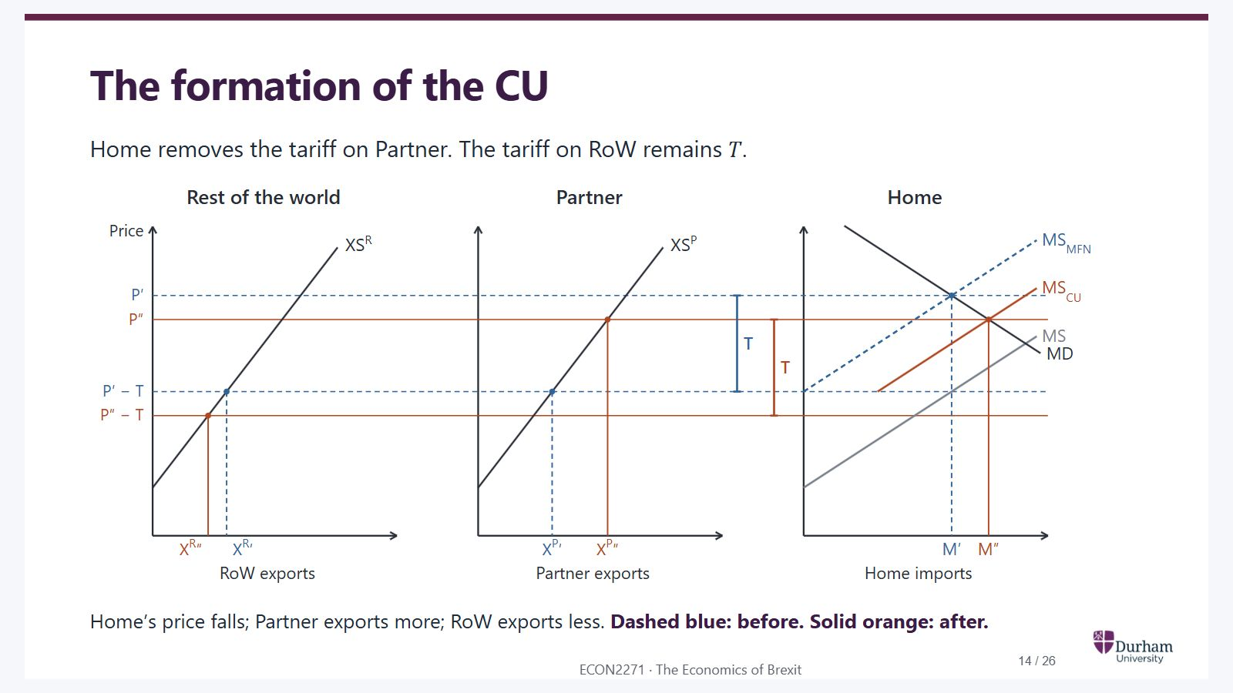
Notes:
Static student copy of the current web slide. Slide artwork is flattened; add personal notes here. Interactive explanations, playback and accessible HTML are available at:
https://davidchivers.co.uk/teaching/macro-applications/lecture_2.html#/l2-s14
The formation of the CU Home removes the tariff on Partner. The tariff on RoW remains T T . Home’s price falls; Partner exports more; RoW exports less. Dashed blue: before. Solid orange: after.
The same three panels, with axes and curves fixed. Blue dashed lines retain the MFN equilibrium; orange solid lines mark the customs-union equilibrium. Home's price falls to P double prime. Partner receives that price and exports more. RoW receives P double prime minus T and exports less. Home imports increase.

Slide 15
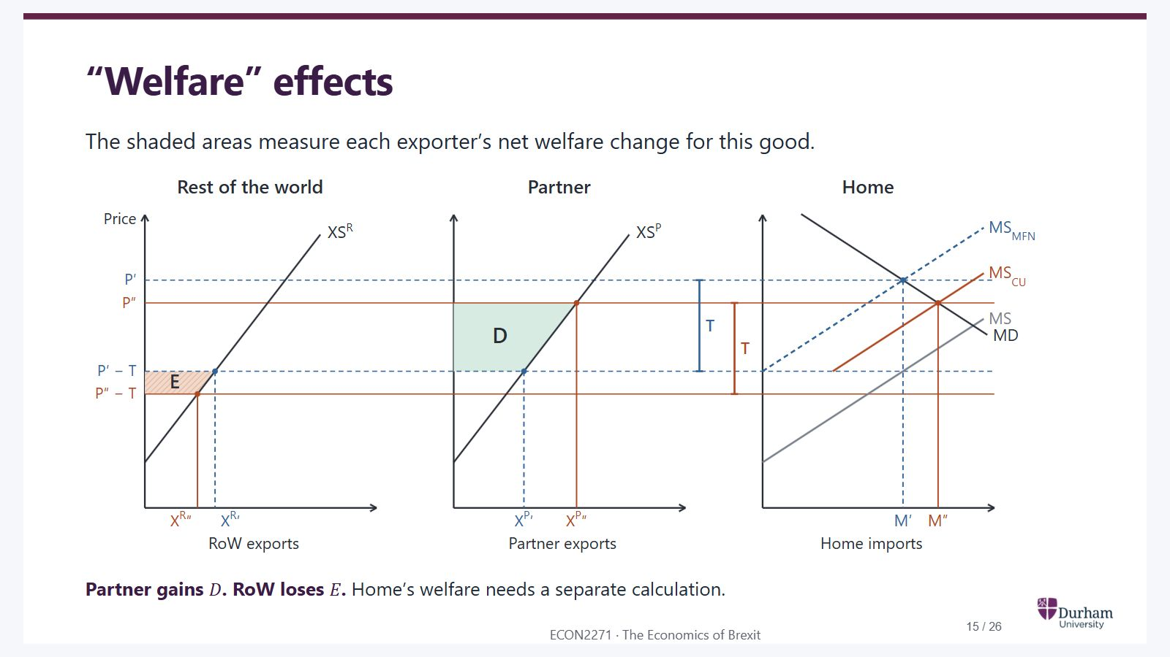
Notes:
Static student copy of the current web slide. Slide artwork is flattened; add personal notes here. Interactive explanations, playback and accessible HTML are available at:
https://davidchivers.co.uk/teaching/macro-applications/lecture_2.html#/l2-s15
“Welfare” effects The shaded areas measure each exporter’s net welfare change for this good. Area E: Rest of the world loses. RoW receives P″ − T instead of P′ − T and exports less. E is its net welfare loss for this good, combining producer and consumer surplus changes. Area D: Partner gains. Partner receives P″ instead of P′ − T and exports more. D is its net welfare gain for this good, combining producer and consumer surplus changes. Rest of the world RoW exports Partner Partner exports Home Home imports Price P′ P′ − T P″ P″ − T XS R X R ′ XS P X P ′ MS MD MS MFN M′ T X R ″ X P ″ MS CU M″ T E D × Partner gains D D . RoW loses E E . Home’s welfare needs a separate calculation.
Three-country diagram: welfare

Slide 16
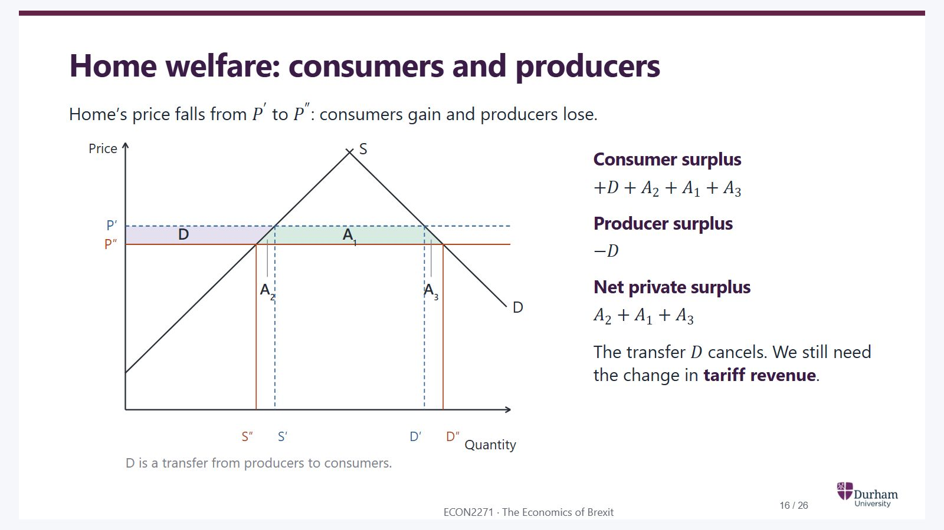
Notes:
Static student copy of the current web slide. Slide artwork is flattened; add personal notes here. Interactive explanations, playback and accessible HTML are available at:
https://davidchivers.co.uk/teaching/macro-applications/lecture_2.html#/l2-s16
Home welfare: consumers and producers Home’s price falls from P ′ P' to P ″ P'' : consumers gain and producers lose. Area D: Transfer within Home. The lower price reduces Home producer surplus by D and raises consumer surplus by the same amount. It cancels in Home’s total. This D is a local label, not Partner’s D on the previous slide. Area A₂: Production efficiency gain. Home produces less, from S′ to S″. Imports replace domestic units whose marginal cost exceeds the new price. This triangle is a net gain. Area A₁: Lower price on existing imports. Consumers gain this rectangle on the original import quantity. An equal amount of tariff revenue is lost, so A₁ cancels when we calculate Home’s total welfare on the next slide. Area A₃: Consumption efficiency gain. Home consumes more, from D′ to D″. The extra units are worth more to consumers than their new price. This triangle is a net gain. Price Quantity S D P′ P″ D A 1 A 2 A 3 S″ S′ D′ D″ D is a transfer from producers to consumers. × Consumer surplus + D + A 2 + A 1 + A 3 +D+A_2+A_1+A_3 Producer surplus − D -D Net private surplus A 2 + A 1 + A 3 A_2+A_1+A_3 The transfer D D cancels. We still need the change in tariff revenue .
Home consumers and producers: the price falls from P prime to P double prime

Slide 17
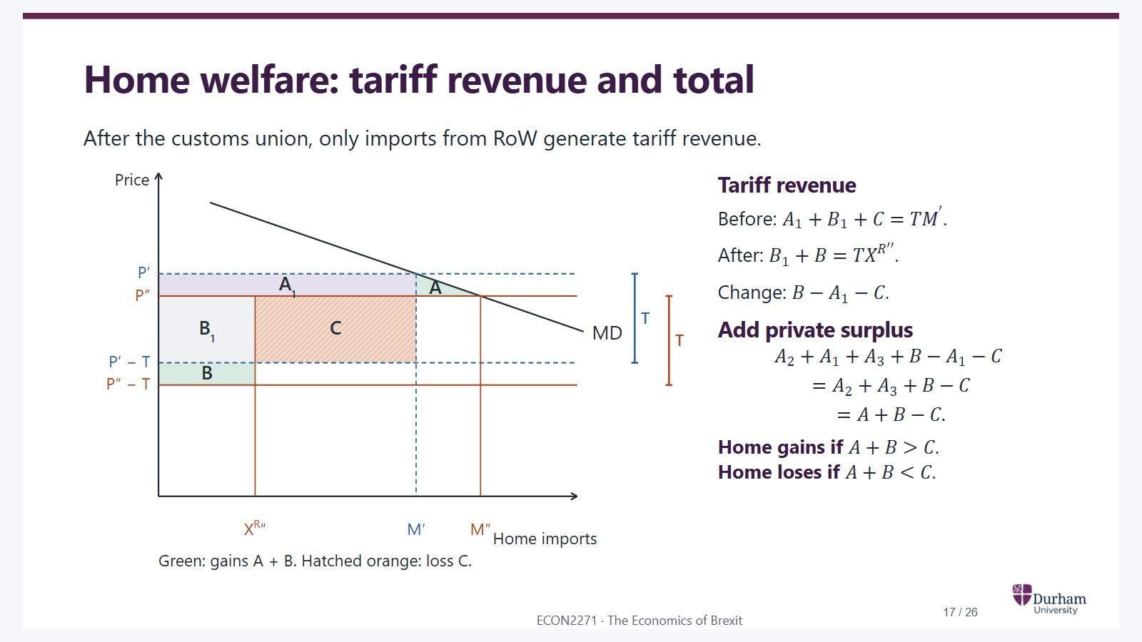
Notes:
Static student copy of the current web slide. Slide artwork is flattened; add personal notes here. Interactive explanations, playback and accessible HTML are available at:
https://davidchivers.co.uk/teaching/macro-applications/lecture_2.html#/l2-s17
Home welfare: tariff revenue and total After the customs union, only imports from RoW generate tariff revenue. Area A₁: Revenue loss offset by consumers. This part of the old tariff revenue is lost. Consumers gain the same rectangle through the lower Home price, so A₁ cancels from total welfare. Area B₁: Tariff revenue retained. This rectangle is revenue both before and after the union. Remaining RoW imports still pay the tariff T. Revenue after the union is B₁ + B. Area C: Loss from switching suppliers. Some imports switch from RoW to the tariff-free Partner. Home loses this part of its old tariff revenue without an offsetting private-surplus gain. C reduces Home’s welfare. Area B: Gain from a lower RoW export price. RoW receives a lower price on the imports Home still buys from it. This terms-of-trade gain appears as extra tariff revenue B in the diagram. Area A: Production and consumption gains. A = A₂ + A₃: replacing costly domestic production and increasing beneficial consumption. For this import market, Home gains if A + B exceeds C, loses if C exceeds A + B, and has no net change if they are equal. Price Home imports MD P′ P″ P′ − T P″ − T X R ″ M′ M″ A 1 B 1 C B A T T Green: gains A + B. Hatched orange: loss C. × Tariff revenue Before: A 1 + B 1 + C = T M ′ A_1+B_1+C = T M' . After: B 1 + B = T X R ′ ′ B_1+B = T X^{R\prime\prime} . Change: B − A 1 − C B-A_1-C . Add private surplus A 2 + A 1 + A 3 + B − A 1 − C A_2+A_1+A_3+B-A_1-C = A 2 + A 3 + B − C = A_2+A_3+B-C = A + B − C . = A+B-C. Home gains if A + B > C A+B>C . Home loses if A + B < C A+B<C .
Home tariff revenue and total welfare, decomposed into A, B and C

Slide 18
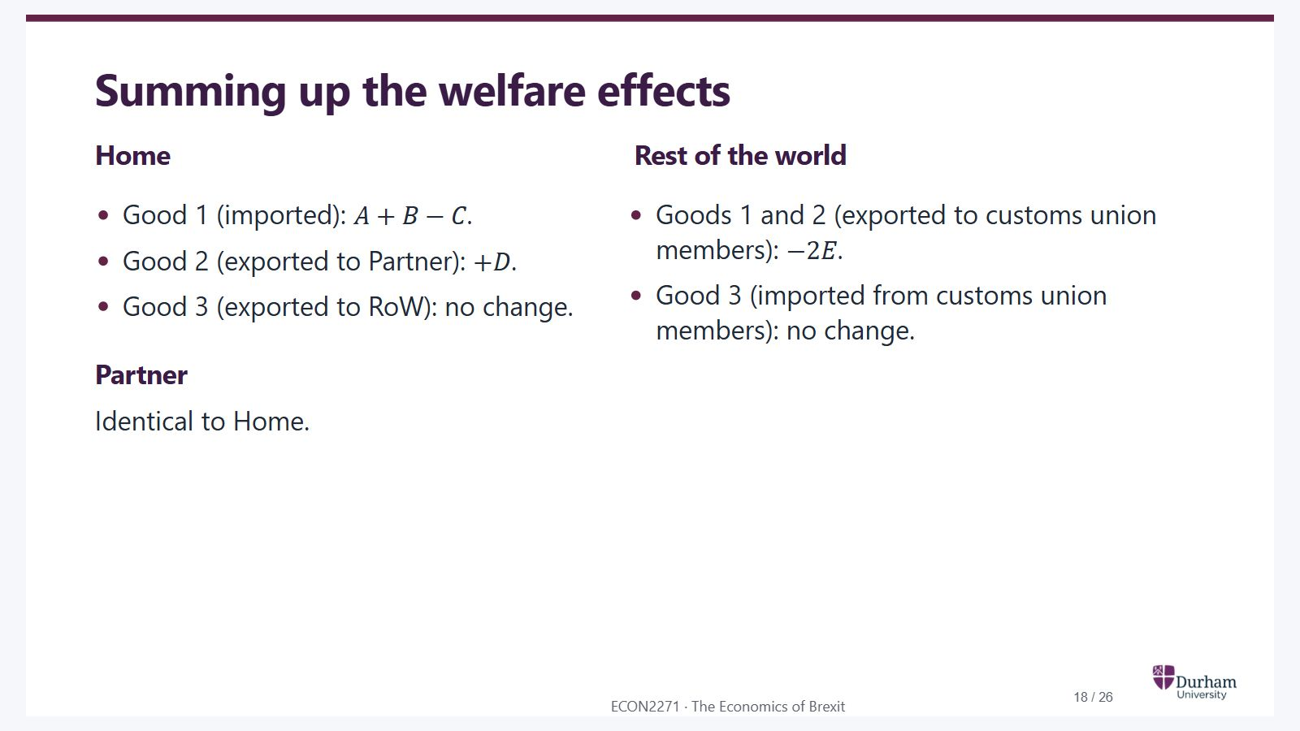
Notes:
Static student copy of the current web slide. Slide artwork is flattened; add personal notes here. Interactive explanations, playback and accessible HTML are available at:
https://davidchivers.co.uk/teaching/macro-applications/lecture_2.html#/l2-s18
Summing up the welfare effects Home Good 1 (imported): A + B − C A+B-C . Good 2 (exported to Partner): + D +D . Good 3 (exported to RoW): no change. Partner Identical to Home. Rest of the world Goods 1 and 2 (exported to customs union members): − 2 E -2E . Good 3 (imported from customs union members): no change.

Slide 19
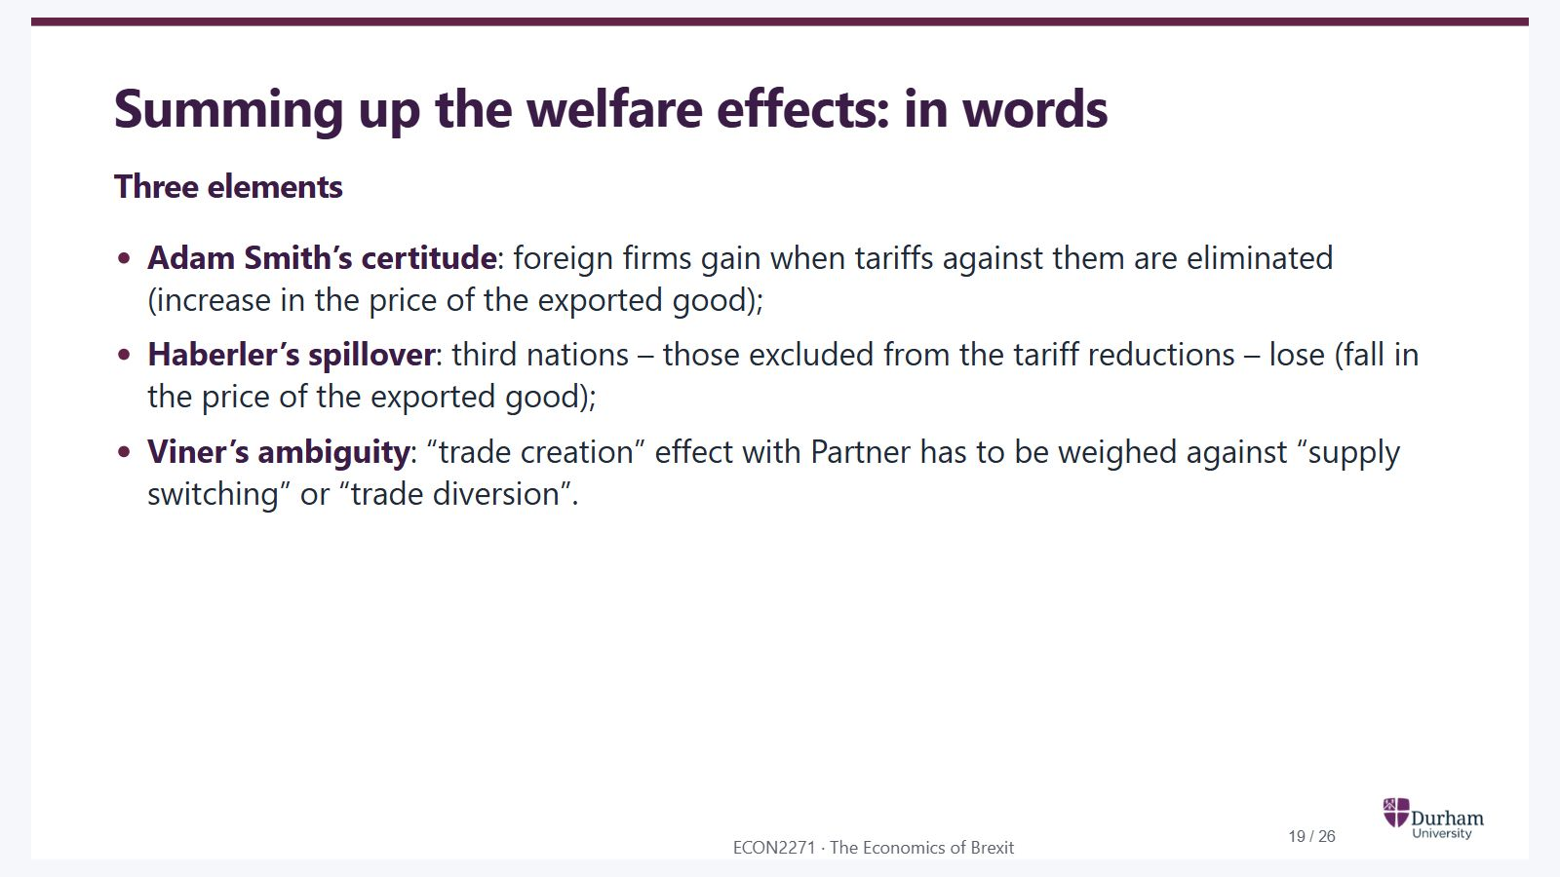
Notes:
Static student copy of the current web slide. Slide artwork is flattened; add personal notes here. Interactive explanations, playback and accessible HTML are available at:
https://davidchivers.co.uk/teaching/macro-applications/lecture_2.html#/l2-s19
Summing up the welfare effects: in words Three elements Adam Smith’s certitude : foreign firms gain when tariffs against them are eliminated (increase in the price of the exported good); Haberler’s spillover : third nations – those excluded from the tariff reductions – lose (fall in the price of the exported good); Viner’s ambiguity : “trade creation” effect with Partner has to be weighed against “supply switching” or “trade diversion”.

Slide 20

Notes:
Static student copy of the current web slide. Slide artwork is flattened; add personal notes here. Interactive explanations, playback and accessible HTML are available at:
https://davidchivers.co.uk/teaching/macro-applications/lecture_2.html#/l2-s20
What do we mean by welfare?

Slide 21
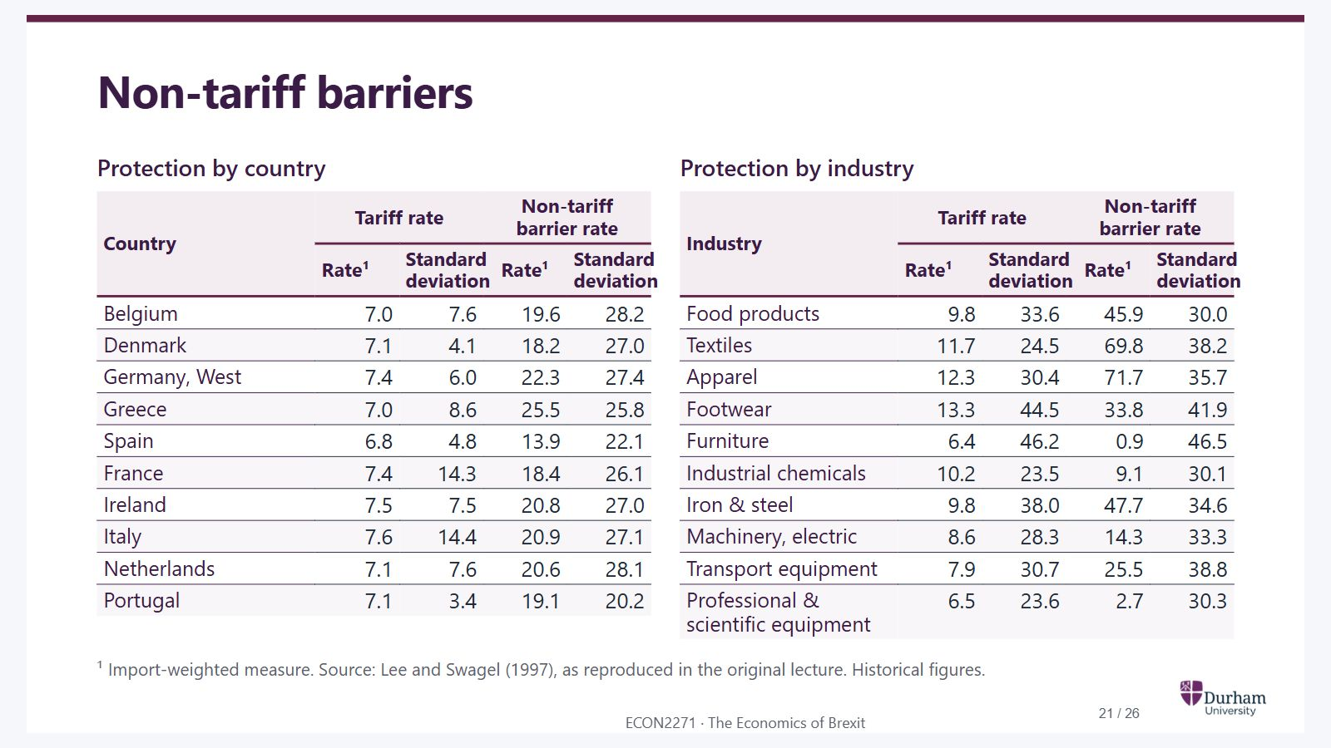
Notes:
Static student copy of the current web slide. Slide artwork is flattened; add personal notes here. Interactive explanations, playback and accessible HTML are available at:
https://davidchivers.co.uk/teaching/macro-applications/lecture_2.html#/l2-s21
Non-tariff barriers Protection by country Country Tariff rate Non-tariff barrier rate Rate¹ Standard deviation Rate¹ Standard deviation Belgium 7.0 7.6 19.6 28.2 Denmark 7.1 4.1 18.2 27.0 Germany, West 7.4 6.0 22.3 27.4 Greece 7.0 8.6 25.5 25.8 Spain 6.8 4.8 13.9 22.1 France 7.4 14.3 18.4 26.1 Ireland 7.5 7.5 20.8 27.0 Italy 7.6 14.4 20.9 27.1 Netherlands 7.1 7.6 20.6 28.1 Portugal 7.1 3.4 19.1 20.2 Protection by industry Industry Tariff rate Non-tariff barrier rate Rate¹ Standard deviation Rate¹ Standard deviation Food products 9.8 33.6 45.9 30.0 Textiles 11.7 24.5 69.8 38.2 Apparel 12.3 30.4 71.7 35.7 Footwear 13.3 44.5 33.8 41.9 Furniture 6.4 46.2 0.9 46.5 Industrial chemicals 10.2 23.5 9.1 30.1 Iron & steel 9.8 38.0 47.7 34.6 Machinery, electric 8.6 28.3 14.3 33.3 Transport equipment 7.9 30.7 25.5 38.8 Professional & scientific equipment 6.5 23.6 2.7 30.3 ¹ Import-weighted measure. Source: Lee and Swagel (1997), as reproduced in the original lecture. Historical figures.

Slide 22
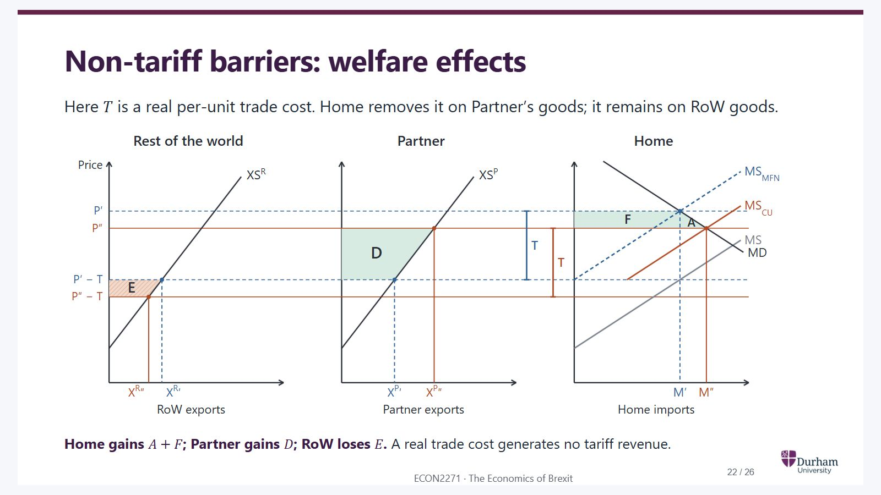
Notes:
Static student copy of the current web slide. Slide artwork is flattened; add personal notes here. Interactive explanations, playback and accessible HTML are available at:
https://davidchivers.co.uk/teaching/macro-applications/lecture_2.html#/l2-s22
Non-tariff barriers: welfare effects Here T T is a real per-unit trade cost. Home removes it on Partner’s goods; it remains on RoW goods. Area E: Rest of the world loses. RoW receives P″ − T instead of P′ − T and exports less. E is its net welfare loss for this good, combining producer and consumer surplus changes. Area D: Partner gains. Partner receives P″ instead of P′ − T and exports more. D is its net welfare gain for this good, combining producer and consumer surplus changes. Area F: Gain on existing imports. Home pays a lower price on its original imports M′. F = (P′ − P″) × M′. The barrier is a real trade cost, so there is no tariff revenue to lose. Area A: Gain from extra imports. The lower Home price expands imports from M′ to M″. This triangle is the extra net surplus from that expansion. Home gains A + F in this real-trade-cost example. Rest of the world RoW exports Partner Partner exports Home Home imports Price P′ P′ − T P″ P″ − T XS R X R ′ XS P X P ′ MS MD MS MFN M′ T X R ″ X P ″ MS CU M″ T E D F A × Home gains A + F A+F ; Partner gains D D ; RoW loses E E . A real trade cost generates no tariff revenue.
Three-country diagram: ntb

Slide 23
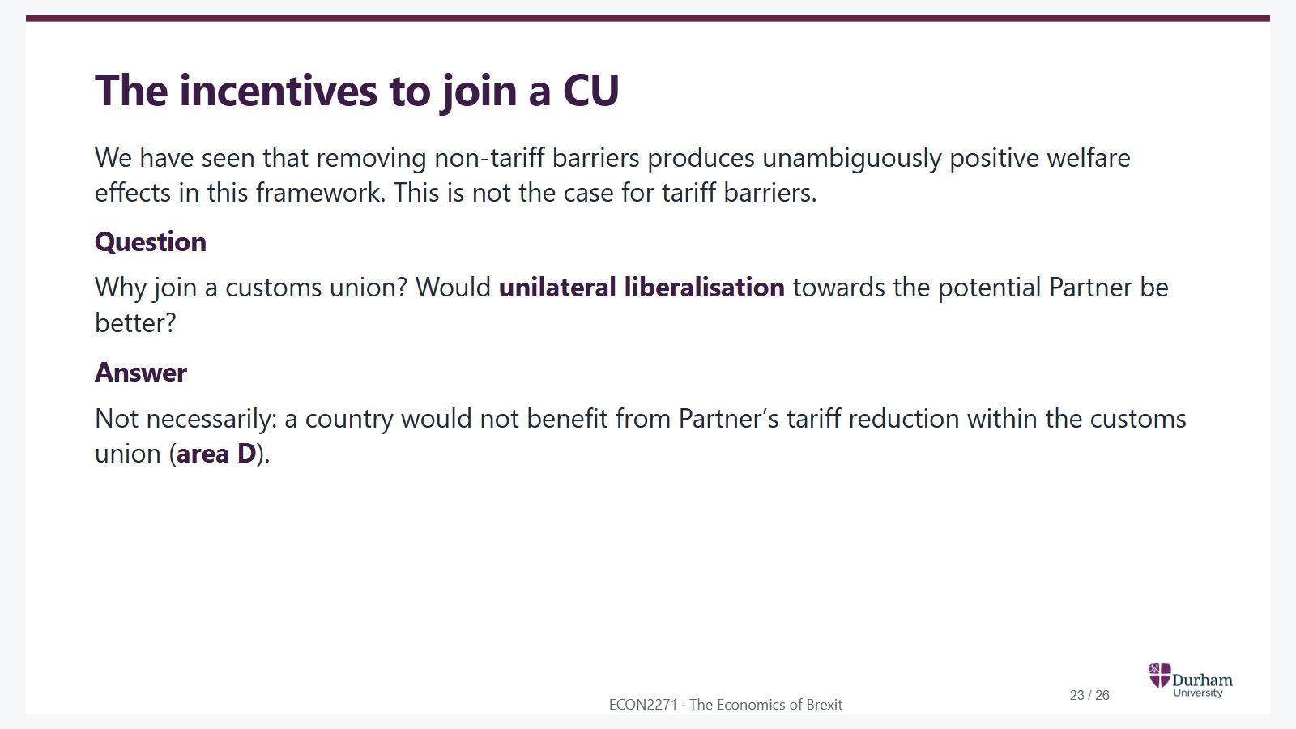
Notes:
Static student copy of the current web slide. Slide artwork is flattened; add personal notes here. Interactive explanations, playback and accessible HTML are available at:
https://davidchivers.co.uk/teaching/macro-applications/lecture_2.html#/l2-s23
The incentives to join a CU We have seen that removing non-tariff barriers produces unambiguously positive welfare effects in this framework. This is not the case for tariff barriers. Question Why join a customs union? Would unilateral liberalisation towards the potential Partner be better? Reveal answer Answer Not necessarily: a country would not benefit from Partner’s tariff reduction within the customs union ( area D ).

Slide 24
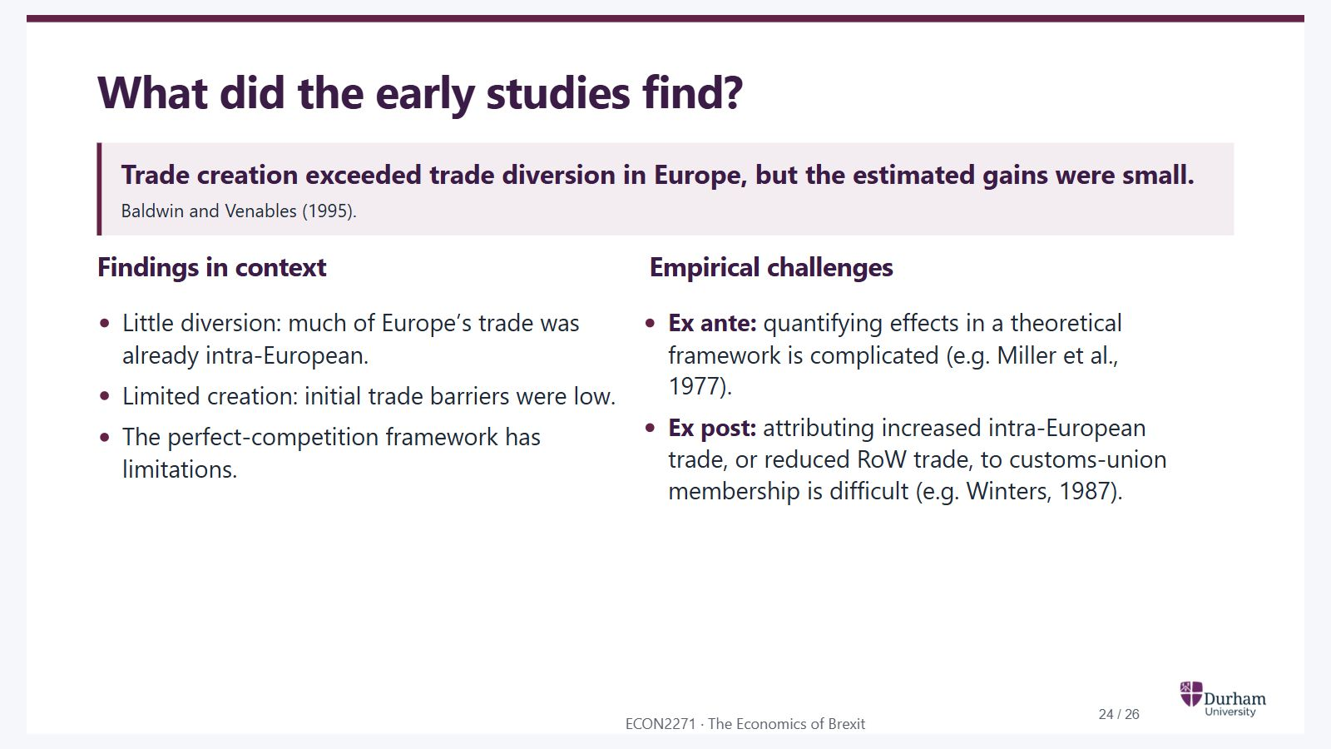
Notes:
Static student copy of the current web slide. Slide artwork is flattened; add personal notes here. Interactive explanations, playback and accessible HTML are available at:
https://davidchivers.co.uk/teaching/macro-applications/lecture_2.html#/l2-s24
What did the early studies find? Trade creation exceeded trade diversion in Europe, but the estimated gains were small. Baldwin and Venables (1995). Findings in context Little diversion: much of Europe’s trade was already intra-European. Limited creation: initial trade barriers were low. The perfect-competition framework has limitations. Empirical challenges Ex ante: quantifying effects in a theoretical framework is complicated (e.g. Miller et al., 1977). Ex post: attributing increased intra-European trade, or reduced RoW trade, to customs-union membership is difficult (e.g. Winters, 1987).

Slide 25

Notes:
Static student copy of the current web slide. Slide artwork is flattened; add personal notes here. Interactive explanations, playback and accessible HTML are available at:
https://davidchivers.co.uk/teaching/macro-applications/lecture_2.html#/l2-s25
Next lecture The Single Market How does opening a market change competition and firm size? Preparation: Revise monopoly and Cournot competition, including MR = MC.

Slide 26
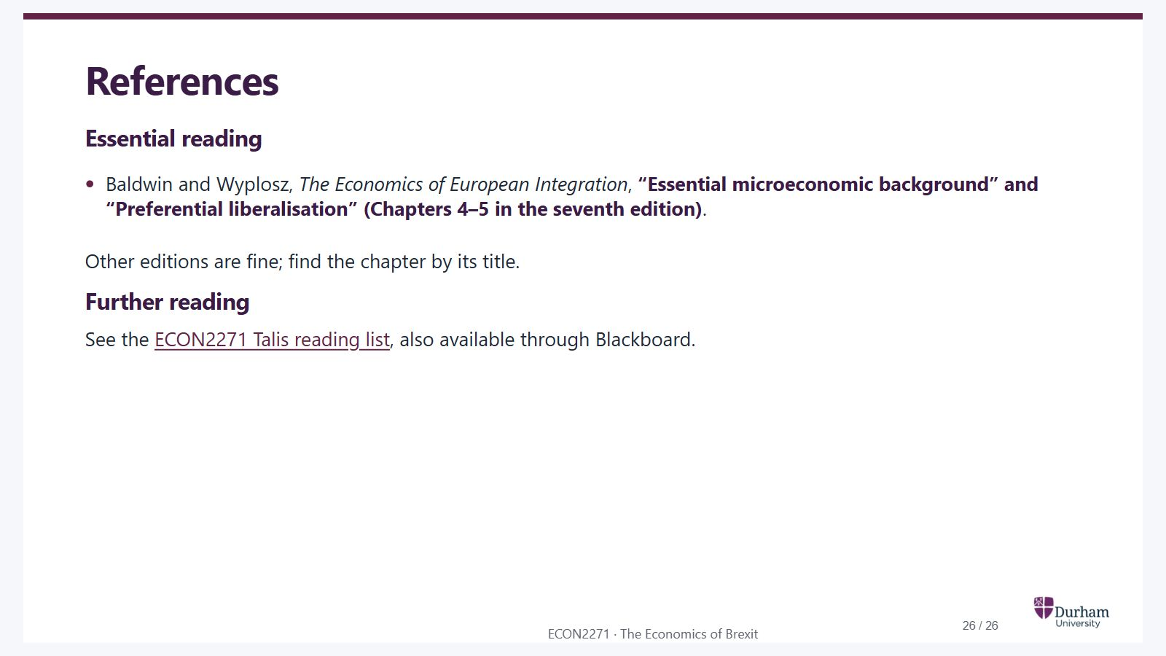
Notes:
Static student copy of the current web slide. Slide artwork is flattened; add personal notes here. Interactive explanations, playback and accessible HTML are available at:
https://davidchivers.co.uk/teaching/macro-applications/lecture_2.html#/l2-s26
References Essential reading Baldwin and Wyplosz, The Economics of European Integration , “Essential microeconomic background” and “Preferential liberalisation” (Chapters 4–5 in the seventh edition) . Other editions are fine; find the chapter by its title. Further reading See the ECON2271 Talis reading list , also available through Blackboard.
https://durham.rl.talis.com/lists/d85d1ad3-e9ac-4daf-aa66-e3ddfcf902d7.html

