Slide 1
A Beginner's Guide to AI
(Beyond ChatGPT)
david.chivers.co.uk/ai_install

Slide 2
DISCLAIMER!

Slide 3
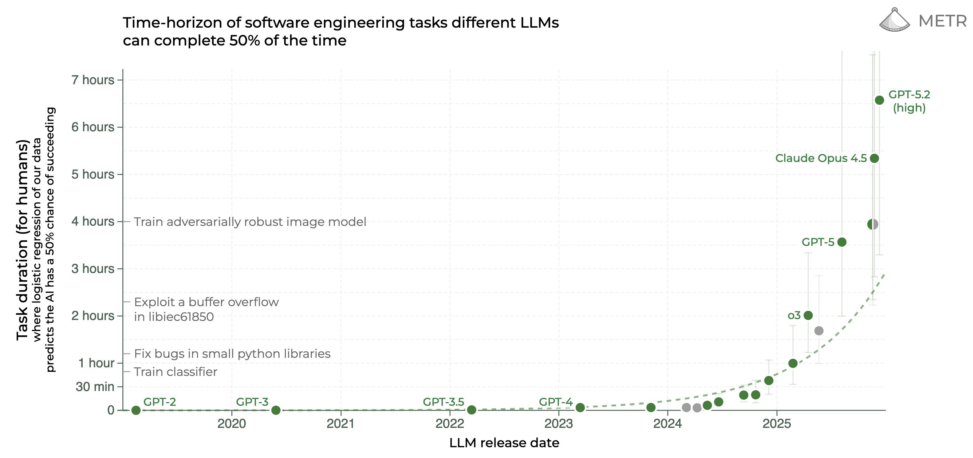
AI is getting exponentially better

Slide 4
Economists are now using AI
Chris Blattman (Chicago)
"For each of about 10 research projects, I built an automated skill where Claude Code pulls, integrates, and generates a weekly overview with priorities."
Antonio Mele (LSE)
"Workflow transformed … 50–200x productivity multiplier."
Paul Novosad (Dartmouth)
"I wrote a decent paper with AI in about 3 hours from start to finish.“
Vibe Coding
You don't need to know how to code — just give instructions in plain English

Slide 5
Example Problem with ChatGPT
Chat-only models can generate plausible but fake citations and references
Risky for academic work if outputs are not verified
Common failure: invented paper titles, authors, or journals
AI coding agents solve this by working with your actual files

Slide 6
How AI Coding Helps: Prevent, Check, Fix
Prevent — Set rules in project files (AGENTS.md, project.md)
Check — Verify outputs against local files and known sources
Fix — Update instructions and rerun with tighter constraints
Result — well written literature review without hallucinations

Slide 7
Economist Software Today
Writing — Word, Overleaf, LaTeX, Beamer
Data — Stata, R, Python, Excel
Coding – MATLAB, C++, Fortran, Julia
References — Zotero, Mendeley, EndNote, BibTeX
Storage — Local folders, cloud drives, mixed naming rules
AI coding agents connect these fragmented workflows with consistent, file-based rules.

Slide 8
What I used AI for
1. Paper Writing & Revision
LaTeX/LyX drafting, math derivations
Lit reviews w/ hallucination checks
Referee rebuttals & marked-up revisions
2. Literature & References
Scoping, synthesis & mapping by method
BibTeX management & citation verification
3. Data & Empirical Work
Auto-download from Census/BLS/FRED APIs
Harmonisation, crosswalks, panel construction
ID strategy design; pilot analysis & stats
4. Tables & Figures
Pub-ready LaTeX tables; auto-generation
Time-series, IRFs, recession shading plots
5. Modelling & Calibration
GE model design: theory, code, solver
Calibration, counterfactuals
Model extension brainstorming
6. Quality Assurance
Math audits: code vs. equations
Variable crosswalks & source documentation
Table consistency checks
7. Presentations & Slides
Beamer from paper; PPT-to-LaTeX
Figure embedding & formatting
8. Collaboration & Coauthorship
Handoff packages (code, docs, results)
Voice-to-prompt; research ideation
9. Referee Reports on Others
Structuring & drafting reports
10. Project & Repo Management
Git branching, commits, repo organisation
Folder naming conventions (01_, 02_...)
Status/memory tracking & work logs
Build artifact cleanup & backups
11. File & Document Management
Auto PDF renaming (Author, Year, Title)
Literature PDF & archive organisation
12. Teaching & Outreach
HTML/JS student tools & websites
Workshop materials & install guides
Starter packs & IDE profiles
13. Coding & Debugging
Bug fixes: C++, Python, PS, LaTeX
Data pipeline & figure scripts
Reusable AI skill packs
14. Writing this Presentation
And this bullet point
And this bullet point also

Slide 9
Key concepts of coding with AI
Memory
AI has no long-term memory — you provide context via files
Organisation
Structure your project so the AI can navigate it
Focus
One clear task per agent session gets the best results
Tokens
Everything costs tokens — keep prompts concise

Slide 10
Example Folder Structure
David / Global Folder /
├── AGENTS.md Global rules for how the AI behaves
├── project.md Goals, progress, and next steps
├── Skills/ Reusable methods for recurring tasks
├── Agents/ Defined roles — which agent does what
└── projects/ Your research projects, each with its own .md

Slide 11
Memory: Limits to Know
AI agents have no persistent memory between sessions
Working context is limited — early details fade in long chats
Every new session starts fresh — like a smart colleague reading your notes for the first time
Solution: get the AI to write good notes (.md files) so the AI picks up where it left off

Slide 12
How We Create “Memory”
AGENTS.md — Global rules: how the AI should behave
STATUS.md — Goals, progress, and next steps
Skills/ — Reusable methods (how to do recurring tasks)
Agents/ — Defined roles (which agent handles what)]
Projects/ — Each research project, with its own .md files
These files are the AI's "memory" — keep them updated and it stays on track.

Slide 13
Agents with Clear Jobs
Run multiple AI workstreams in parallel
Best results come from one clear task per session
Agent A — Literature notes
Agent B — Data cleaning
Agent C — Model write-up
Agent D — Slides and figures
Multi-agent: different chat sessions (make sure not to work on same file)
Sub-agent: within same chat session (coordinates itself)

Slide 14
Where You Work With AI
Claude Cowork
Describe a task in plain language and the AI carries it out (easiest to use)
Codex / Claude Code / Antigravity IDEs
AI coding agents that build or edit research code from instructions (easy to set up)
Cursor / VS Code IDEs
Code editors where you code with optional AI assistance (most options)
Terminal (PowerShell / macOS Terminal)
Command-line interface used to run scripts and control software directly (most direct)

Slide 15
Tips
Be persistent — Prompts are a conversation, not a one-shot
Learn by doing — Start with a small, real task from your own work
Reset when stuck — Close the session and start fresh
Ask the AI — It can suggest approaches you haven't considered
Think in automations — If you do it often, the AI can do it for you
Ask the AI to be its own critic – “you are an AER referee…”
Plan first with the AI – this helps set your AI workflow

Slide 16
Live Demo Plan
1. Overview – AI, IDE and working folders
2. Viewing – .md files and PDFs
3. Editing – documents, files and folders
4. Memory –how to make the AI sound like you
Agents – make a referee report of your own work
Skills – literature review with hallucination mitigation
Multi-agents – brainstorming new ideas
8. Data – download data, relabel automatically and make graphs
9. Modelling – check mathematics, reason through complex models

