Slide 1

Notes:
Static student copy of the current web slide. Slide artwork is flattened; add personal notes here. Interactive explanations, playback and accessible HTML are available at:
https://davidchivers.co.uk/teaching/macro-applications/lecture_4.html#/title-slide
The Economics of Brexit Lecture 4: Migration Dr David Chivers Macroeconomic Applications and Policy

Slide 2

Notes:
Static student copy of the current web slide. Slide artwork is flattened; add personal notes here. Interactive explanations, playback and accessible HTML are available at:
https://davidchivers.co.uk/teaching/macro-applications/lecture_4.html#/l4-s04
Learning objectives After this topic, you will be able to: Distinguish migration flows from population stocks. Use a simple model to explain wage changes and gains from migration. Explain why effects differ across workers and between the short and long run. Evaluate the evidence, the model’s limits and the relationship between trade and migration.

Slide 3
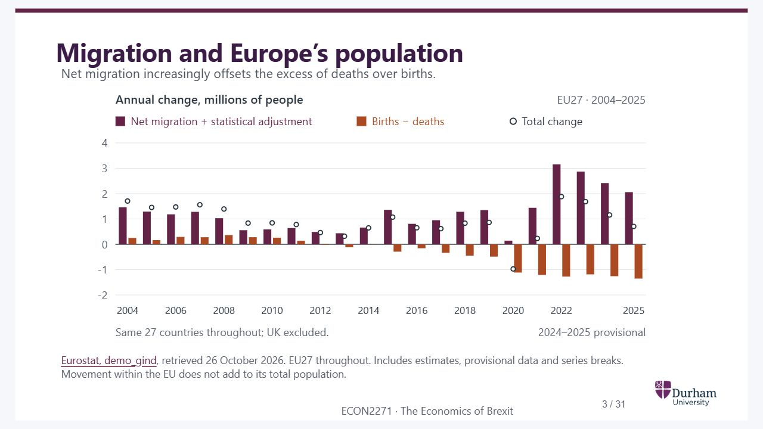
Notes:
Static student copy of the current web slide. Slide artwork is flattened; add personal notes here. Interactive explanations, playback and accessible HTML are available at:
https://davidchivers.co.uk/teaching/macro-applications/lecture_4.html#/l4-demographics
Migration and Europe’s population Net migration increasingly offsets the excess of deaths over births. Eurostat, demo_gind , retrieved 26 October 2026. EU27 throughout. Includes estimates, provisional data and series breaks. Movement within the EU does not add to its total population. Inspired by Baldwin and Wyplosz (2022), Figure 8.9, and rebuilt from current Eurostat data. The series is for the current 27 EU members throughout, excluding the UK even before Brexit. Natural change means births minus deaths among all residents, not only citizens or people born locally. Net migration includes statistical adjustment and is calculated as the residual between total and natural population change. Eurostat flags several historical breaks; compare the broad pattern rather than reading each jump as a migration-policy effect. In 2025, the three figures are +2,058,461, −1,352,705 and +705,756 respectively, with estimates/provisional flags. The 2020 decline is retained. Migration can support the working-age population, but this chart counts all ages and does not by itself show labour shortages or solve population ageing. Intra-EU mobility reallocates people across member states. The next slides ask how enlargement changed that allocation and the UK’s experience.
EU27 annual population change, 2004–2025, in millions. Bars separate natural change, births minus deaths, from net migration plus statistical adjustment. Dots show total change. Natural change has been negative since 2012. In 2025, net migration plus adjustment of 2.06 million offsets natural decline of 1.35 million, giving growth of 0.71 million. Latest data are provisional.
https://ec.europa.eu/eurostat/databrowser/view/demo_gind/default/table?lang=en

Slide 4
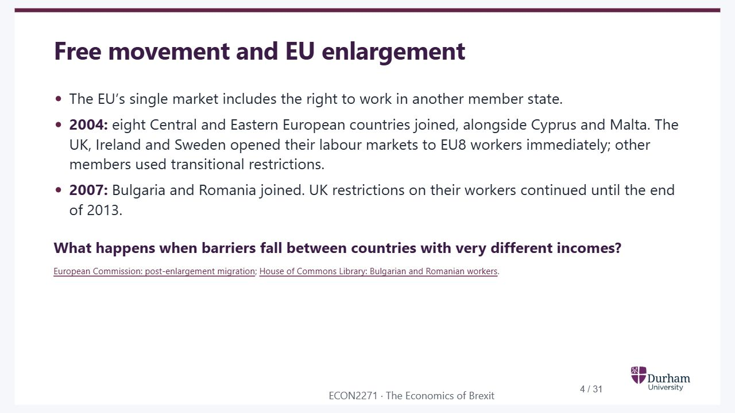
Notes:
Static student copy of the current web slide. Slide artwork is flattened; add personal notes here. Interactive explanations, playback and accessible HTML are available at:
https://davidchivers.co.uk/teaching/macro-applications/lecture_4.html#/l4-s02
Free movement and EU enlargement The EU’s single market includes the right to work in another member state. 2004: eight Central and Eastern European countries joined, alongside Cyprus and Malta. The UK, Ireland and Sweden opened their labour markets to EU8 workers immediately; other members used transitional restrictions. 2007: Bulgaria and Romania joined. UK restrictions on their workers continued until the end of 2013. What happens when barriers fall between countries with very different incomes? European Commission: post-enlargement migration ; House of Commons Library: Bulgarian and Romanian workers . EU8/A8 means Czech Republic, Estonia, Hungary, Latvia, Lithuania, Poland, Slovakia and Slovenia. EU2/A2 means Bulgaria and Romania. EU15 means the fifteen members before May 2004; EU12 means the twelve countries that joined in 2004 and 2007. EU8 access in the UK still involved the Worker Registration Scheme and restrictions on benefits. The UK did not apply the same immediate opening to the 2007 entrants.
https://ec.europa.eu/economy_finance/publications/pages/publication14287_en.pdf
https://commonslibrary.parliament.uk/research-briefings/sn06606/

Slide 5
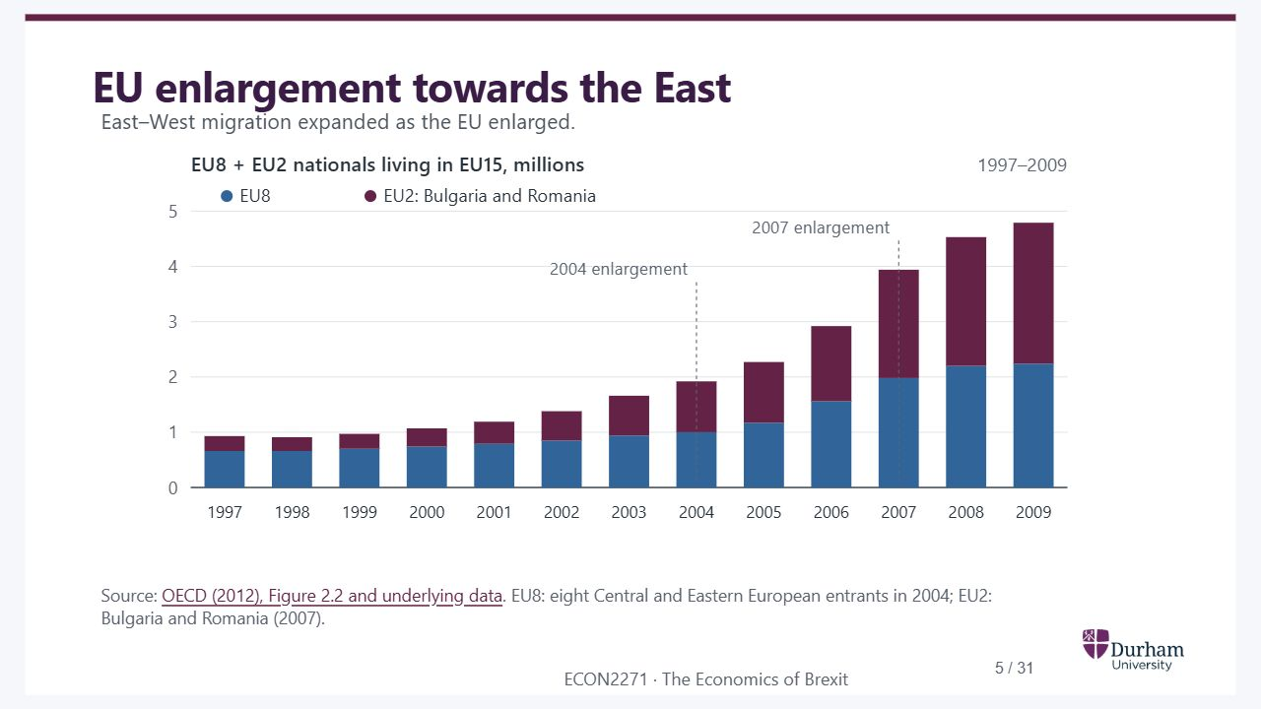
Notes:
Static student copy of the current web slide. Slide artwork is flattened; add personal notes here. Interactive explanations, playback and accessible HTML are available at:
https://davidchivers.co.uk/teaching/macro-applications/lecture_4.html#/l4-s05
EU enlargement towards the East East–West migration expanded as the EU enlarged. Source: OECD (2012), Figure 2.2 and underlying data . EU8: eight Central and Eastern European entrants in 2004; EU2: Bulgaria and Romania (2007).
OECD population stocks, 1997–2009. EU8 and EU2 nationals living in EU15 countries rise from about 0.9 million to 4.8 million; the two groups are stacked.
https://doi.org/10.1787/888932590437

Slide 6
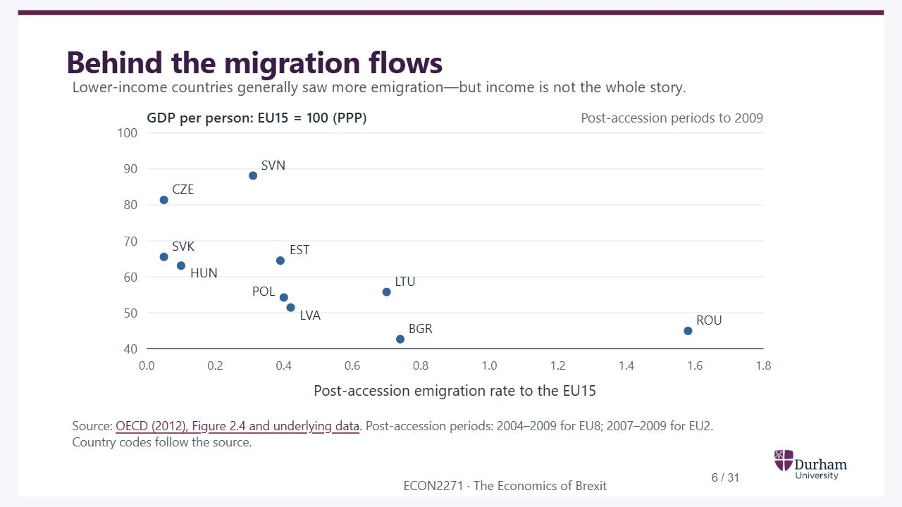
Notes:
Static student copy of the current web slide. Slide artwork is flattened; add personal notes here. Interactive explanations, playback and accessible HTML are available at:
https://davidchivers.co.uk/teaching/macro-applications/lecture_4.html#/l4-s06
Behind the migration flows Lower-income countries generally saw more emigration—but income is not the whole story. Source: OECD (2012), Figure 2.4 and underlying data . Post-accession periods: 2004–2009 for EU8; 2007–2009 for EU2. Country codes follow the source. Ask students to compare Czechia and Slovenia with Romania and Bulgaria. GDP per person is a broad income proxy, not the wage the same individual would earn. The association motivates an earnings incentive to move, but it does not identify a causal income effect. Poland and Latvia also differ from Romania: jobs, networks, language and policy can affect destinations and migration decisions. The original OECD horizontal measure and accession windows are retained; do not interpret a plotted value as a single calendar-year flow.
OECD scatter plot of post-accession emigration rates and GDP per person at purchasing-power parity, EU15 equals 100. A cross-country association, not a causal estimate.
https://doi.org/10.1787/888932590475

Slide 7
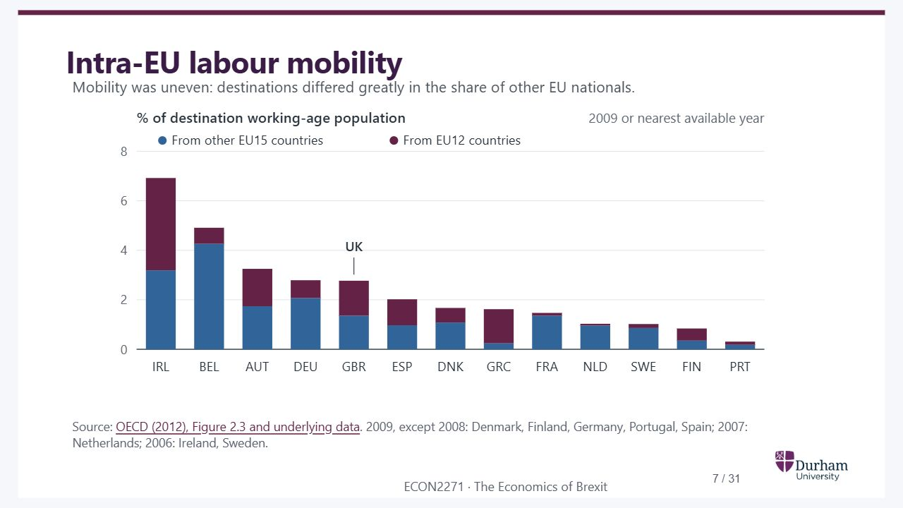
Notes:
Static student copy of the current web slide. Slide artwork is flattened; add personal notes here. Interactive explanations, playback and accessible HTML are available at:
https://davidchivers.co.uk/teaching/macro-applications/lecture_4.html#/l4-s07
Intra-EU labour mobility Mobility was uneven: destinations differed greatly in the share of other EU nationals. Source: OECD (2012), Figure 2.3 and underlying data . 2009, except 2008: Denmark, Finland, Germany, Portugal, Spain; 2007: Netherlands; 2006: Ireland, Sweden. This is a stock of foreign EU nationals, expressed relative to the destination’s working-age population. It is not the percentage moving each year or a count of people in employment. Ireland is the largest share shown; the UK is not the largest. Countries are not all measured in the same year, and Luxembourg is not in the source figure. Relate the variation to access rules and job opportunities without treating this descriptive chart as a causal comparison. EU12 includes the ten 2004 entrants and Bulgaria and Romania.
EU nationals resident in EU15 destinations as a share of the working-age population, separating other EU15 and EU12 origins. Observations are from 2009 or the nearest available year, not all from 2009.
https://doi.org/10.1787/888932590456

Slide 8
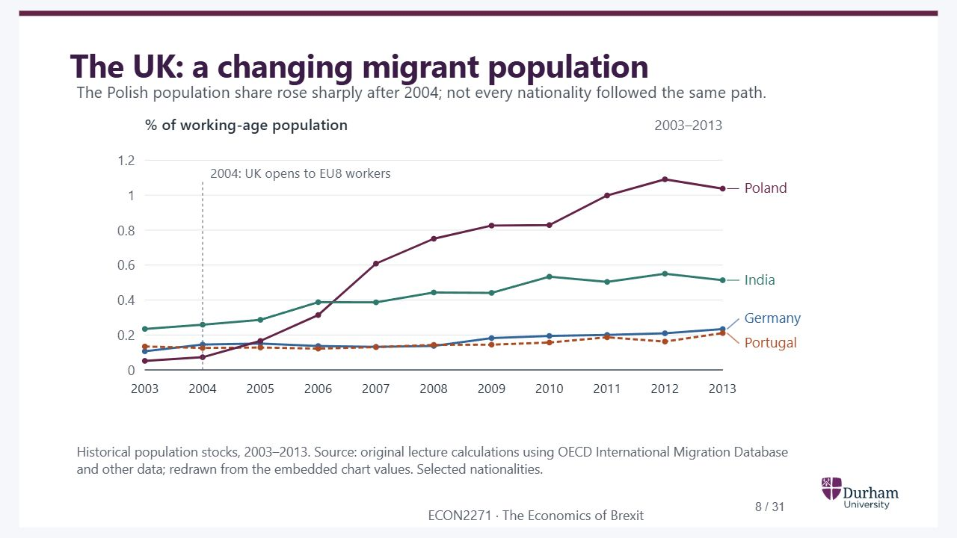
Notes:
Static student copy of the current web slide. Slide artwork is flattened; add personal notes here. Interactive explanations, playback and accessible HTML are available at:
https://davidchivers.co.uk/teaching/macro-applications/lecture_4.html#/l4-s10
The UK: a changing migrant population The Polish population share rose sharply after 2004; not every nationality followed the same path. Historical population stocks, 2003–2013. Source: original lecture calculations using OECD International Migration Database and other data; redrawn from the embedded chart values. Selected nationalities. This restores the original within-UK comparison to connect EU enlargement to the later UK debate. These are stocks of nationals, not counts of annual arrivals, and the four selected nationalities are not the whole migrant population. The series ends in 2013, before the referendum. The chart therefore supplies historical context; it cannot explain the referendum result or measure migration’s effect on wages. Values reproduce the original PowerPoint chart cache; the original calculations have not been independently reconstructed.
UK foreign-national population shares, 2003–2013: Germany, Portugal, Poland and India. The Polish share rises most strongly. All four series share the same scale and have direct labels.

Slide 9

Notes:
Static student copy of the current web slide. Slide artwork is flattened; add personal notes here. Interactive explanations, playback and accessible HTML are available at:
https://davidchivers.co.uk/teaching/macro-applications/lecture_4.html#/l4-s03
From free movement to Brexit Theresa May · 2 October 2016 “I want it to give British companies the maximum freedom to trade with and operate in the Single Market – and let European businesses do the same here.” “But let me be clear. We are not leaving the European Union only to give up control of immigration again.” Angela Merkel · 6 October 2016 “Brexit negotiations won’t be easy. If we don’t say full access to the internal market is linked to full freedom of movement, then a movement will spread in Europe where everyone just does whatever they want.” The referendum was on 23 June 2016. These October 2016 quotations set out the subsequent negotiating tension between access to the single market and control over immigration. They do not demonstrate that immigration caused the referendum result. Free movement between the UK and EU ended on 31 December 2020, with protections for existing residents under the Withdrawal Agreement. The next chart distinguishes the referendum from the later change in the immigration system.
http://www.independent.co.uk/news/uk/politics/theresa-may-hard-brexit-soft-article-free-movement-deal-single-market-access-a7341886.html
http://www.bbc.co.uk/news/world-europe-37632305

Slide 10
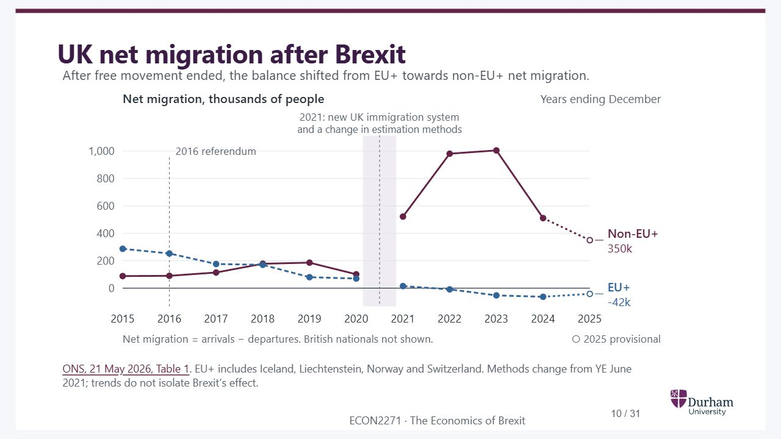
Notes:
Static student copy of the current web slide. Slide artwork is flattened; add personal notes here. Interactive explanations, playback and accessible HTML are available at:
https://davidchivers.co.uk/teaching/macro-applications/lecture_4.html#/l4-brexit-now
UK net migration after Brexit After free movement ended, the balance shifted from EU+ towards non-EU+ net migration. ONS, 21 May 2026, Table 1 . EU+ includes Iceland, Liechtenstein, Norway and Switzerland. Methods change from YE June 2021; trends do not isolate Brexit’s effect. Each observation is a calendar-year total: year ending December, not a stock of residents. Series come entirely from the May 2026 release; older releases are not spliced in. The 2024 observations were revised and 2025 is provisional. Points either side of the 2021 methods change are deliberately unconnected. Changes in migration also reflect the pandemic, visa policy, study and work patterns; the chart is not a causal estimate of Brexit. British nationals are excluded from the two plotted groups. Net migration across all nationalities in 2025 was 171,000, including negative British net migration.
Net migration of EU+ and non-EU+ nationals to the UK, 2015–2025. Non-EU+ net migration rises sharply after 2020 then falls; EU+ net migration becomes negative. The line is broken across the change in methods. 2025 is provisional. The graph does not isolate Brexit's causal effect.
https://www.ons.gov.uk/peoplepopulationandcommunity/populationandmigration/internationalmigration/datasets/longterminternationalimmigrationemigrationandnetmigrationflowsprovisional

Slide 11
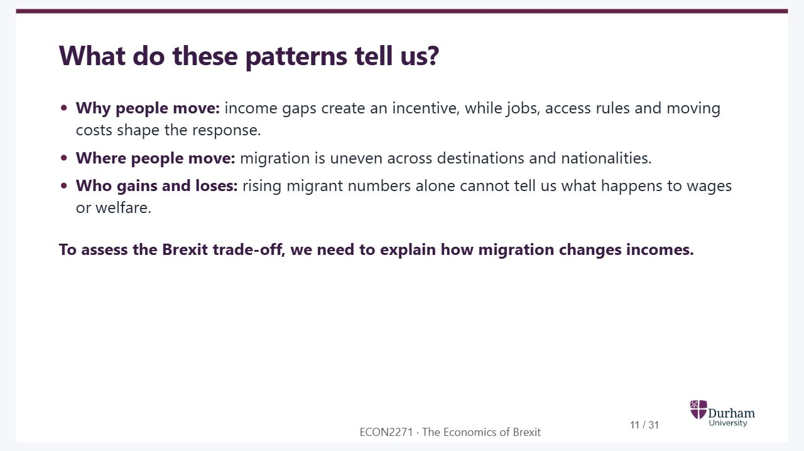
Notes:
Static student copy of the current web slide. Slide artwork is flattened; add personal notes here. Interactive explanations, playback and accessible HTML are available at:
https://davidchivers.co.uk/teaching/macro-applications/lecture_4.html#/l4-s11
What do these patterns tell us? Why people move: income gaps create an incentive, while jobs, access rules and moving costs shape the response. Where people move: migration is uneven across destinations and nationalities. Who gains and loses: rising migrant numbers alone cannot tell us what happens to wages or welfare. To assess the Brexit trade-off, we need to explain how migration changes incomes. Use this as the bridge into the diagrams. Ask what happens to the wage gap when workers move, then distinguish total gains from their distribution. The simple model deliberately abstracts from the many reasons why actual migration is uneven. Return to these limitations when discussing skill differences, capital adjustment and moving costs later in the lecture.

Slide 12
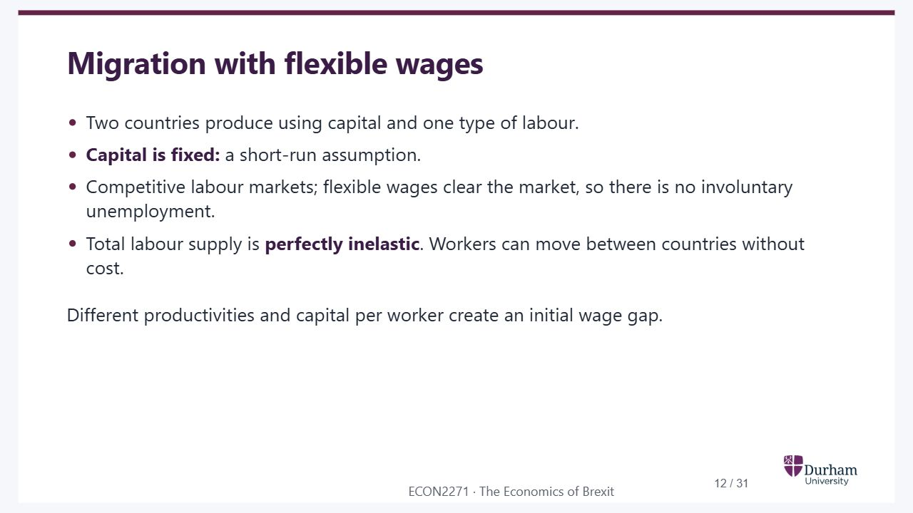
Notes:
Static student copy of the current web slide. Slide artwork is flattened; add personal notes here. Interactive explanations, playback and accessible HTML are available at:
https://davidchivers.co.uk/teaching/macro-applications/lecture_4.html#/l4-s12
Migration with flexible wages Two countries produce using capital and one type of labour. Capital is fixed: a short-run assumption. Competitive labour markets; flexible wages clear the market, so there is no involuntary unemployment. Total labour supply is perfectly inelastic . Workers can move between countries without cost. Different productivities and capital per worker create an initial wage gap. The model abstracts from taxes, public services, housing and non-monetary moving costs. A common good-price normalisation makes real wages comparable. Fixed capital creates a downward-sloping marginal product of labour in each country. Later slides relax the assumption that all workers are interchangeable.

Slide 13
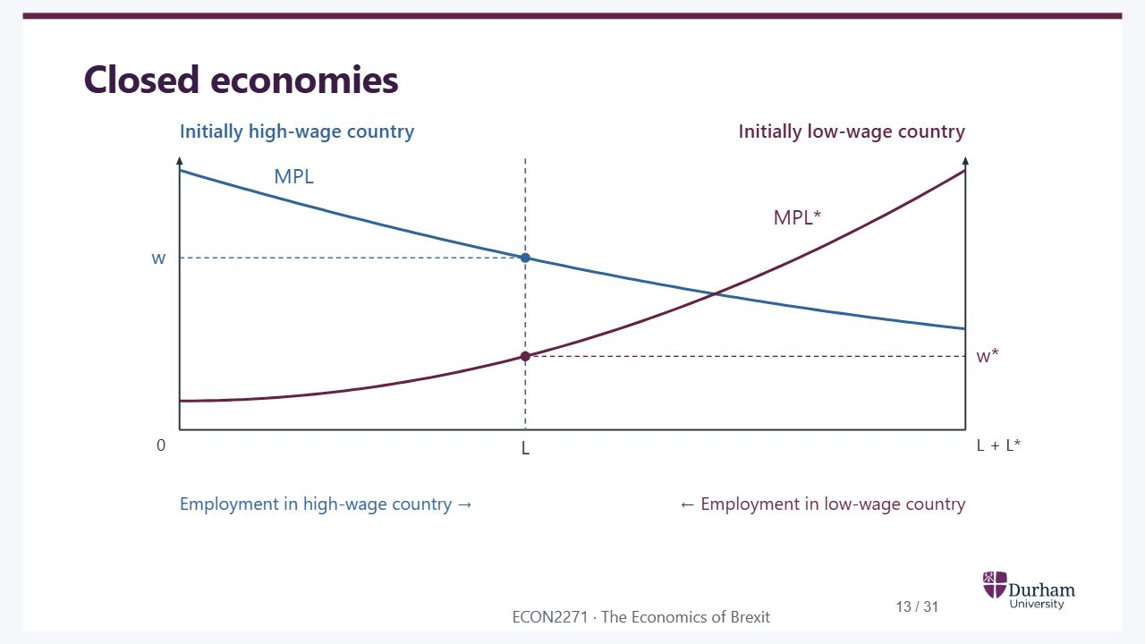
Notes:
Static student copy of the current web slide. Slide artwork is flattened; add personal notes here. Interactive explanations, playback and accessible HTML are available at:
https://davidchivers.co.uk/teaching/macro-applications/lecture_4.html#/l4-s13
Closed economies
Two-country labour allocation with fixed capital. Marginal product of labour falls as employment rises in each country. Initially the high-wage country has wage w and the low-wage country wage w star.

Slide 14
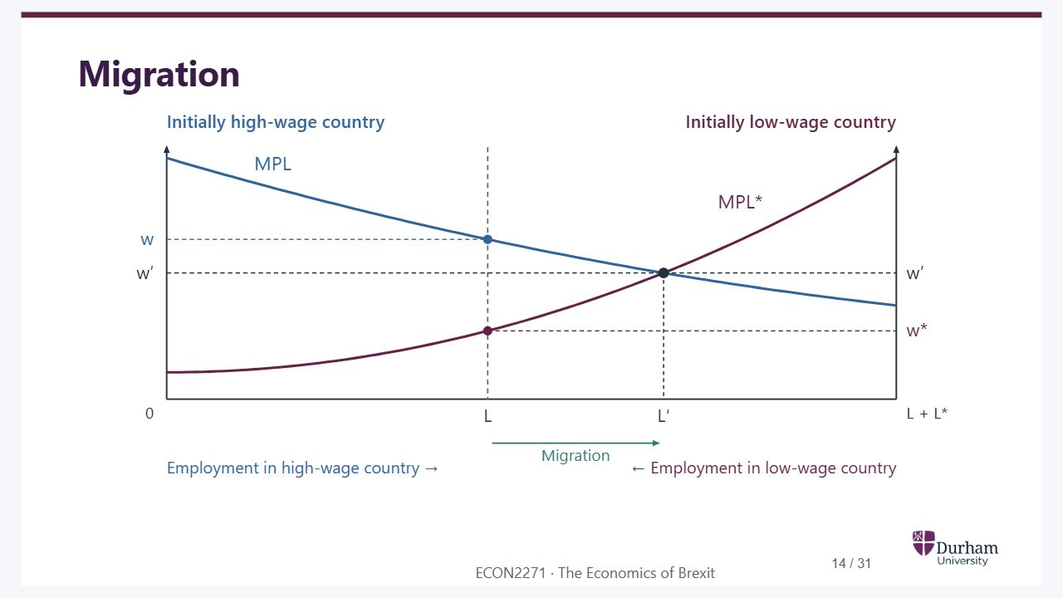
Notes:
Static student copy of the current web slide. Slide artwork is flattened; add personal notes here. Interactive explanations, playback and accessible HTML are available at:
https://davidchivers.co.uk/teaching/macro-applications/lecture_4.html#/l4-s14
Migration
Migration reallocates labour from the low-wage country to the high-wage country. Employment moves from L to L prime, lowering the high wage and raising the low wage towards a common wage. Axes and curves remain in the same positions as on the previous slide.

Slide 15
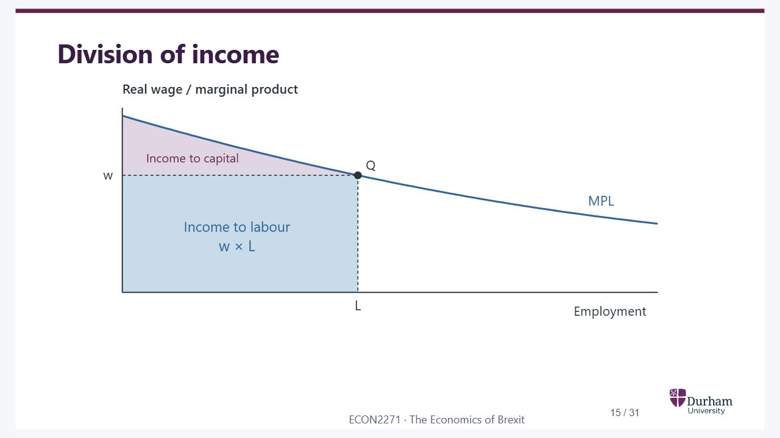
Notes:
Static student copy of the current web slide. Slide artwork is flattened; add personal notes here. Interactive explanations, playback and accessible HTML are available at:
https://davidchivers.co.uk/teaching/macro-applications/lecture_4.html#/l4-s15
Division of income
Division of income under the marginal-product curve. The wage times employment rectangle goes to labour; the area above the wage and below marginal product goes to fixed capital in this competitive model.

Slide 16
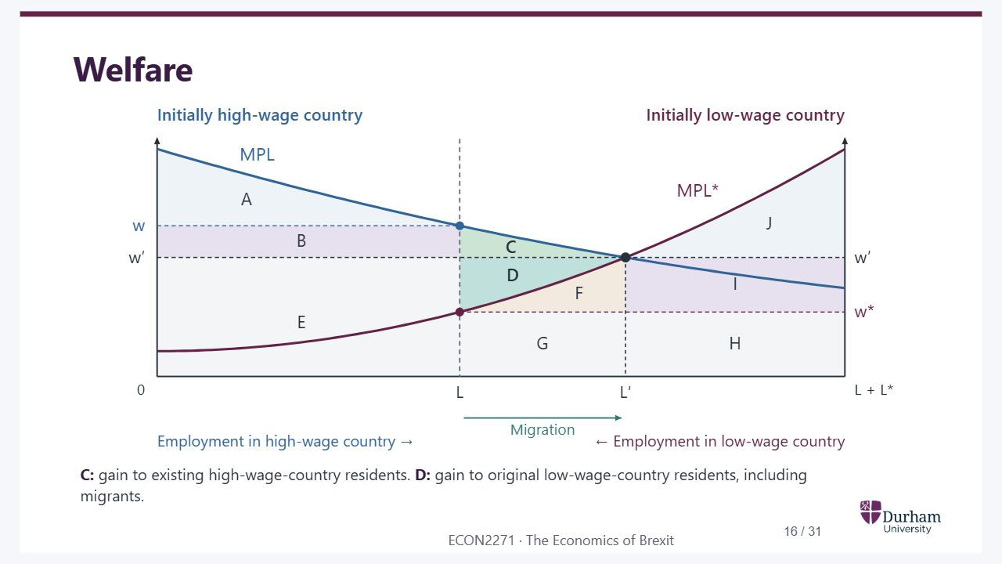
Notes:
Static student copy of the current web slide. Slide artwork is flattened; add personal notes here. Interactive explanations, playback and accessible HTML are available at:
https://davidchivers.co.uk/teaching/macro-applications/lecture_4.html#/l4-s16
Welfare C: gain to existing high-wage-country residents. D: gain to original low-wage-country residents, including migrants.
Migration welfare diagram with areas A to J. C is the net income gain to existing high-wage-country residents; D is the gain to original low-wage-country residents, including emigrants. Their combined gain is C plus D. Distributional effects differ.

Slide 17
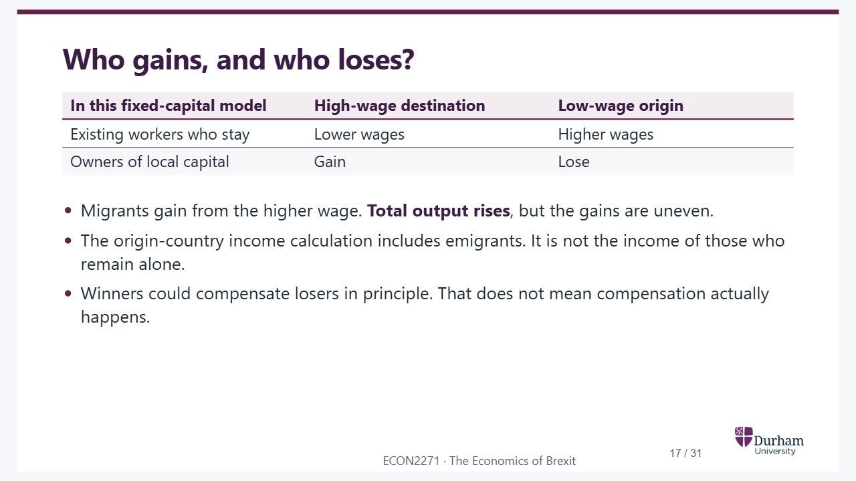
Notes:
Static student copy of the current web slide. Slide artwork is flattened; add personal notes here. Interactive explanations, playback and accessible HTML are available at:
https://davidchivers.co.uk/teaching/macro-applications/lecture_4.html#/l4-s17
Who gains, and who loses? In this fixed-capital model High-wage destination Low-wage origin Existing workers who stay Lower wages Higher wages Owners of local capital Gain Lose Migrants gain from the higher wage. Total output rises , but the gains are uneven. The origin-country income calculation includes emigrants. It is not the income of those who remain alone. Winners could compensate losers in principle. That does not mean compensation actually happens.

Slide 18

Notes:
Static student copy of the current web slide. Slide artwork is flattened; add personal notes here. Interactive explanations, playback and accessible HTML are available at:
https://davidchivers.co.uk/teaching/macro-applications/lecture_4.html#/l4-s18
What about skilled and unskilled immigration? Think it through Which workers might migrants substitute for? Which workers might they complement?

Slide 19

Notes:
Static student copy of the current web slide. Slide artwork is flattened; add personal notes here. Interactive explanations, playback and accessible HTML are available at:
https://davidchivers.co.uk/teaching/macro-applications/lecture_4.html#/l4-labour-types
Workers need not be interchangeable Substitutes A hotel hires more cleaners who can perform the same tasks as its existing cleaners. Existing cleaners may face more competition for jobs and downward pressure on wages. Complements More cleaning staff allow the hotel to serve more guests and expand. Demand for managers and maintenance staff may rise, helping those workers. The tasks matter, not just the label “skilled” or “unskilled”. These are possible mechanisms, not predictions for every migrant. Illustrative hotel example, adapted from Baldwin and Wyplosz (2022), Section 8.4.4. The effects depend on demand, capacity and how workers’ tasks fit together.

Slide 20
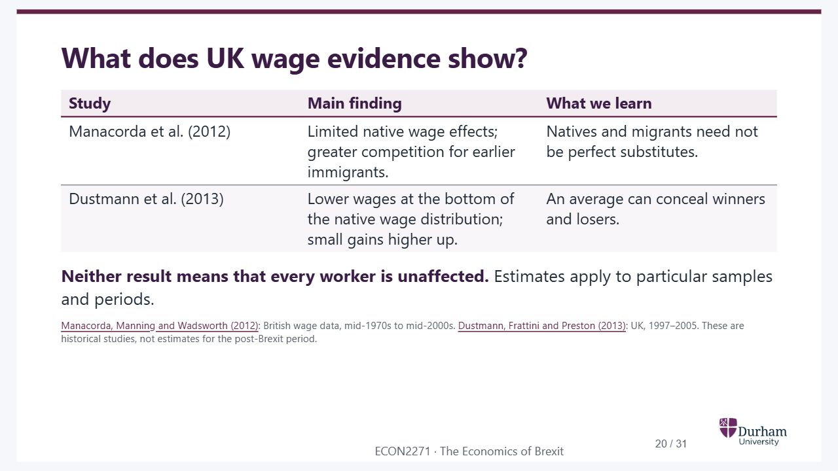
Notes:
Static student copy of the current web slide. Slide artwork is flattened; add personal notes here. Interactive explanations, playback and accessible HTML are available at:
https://davidchivers.co.uk/teaching/macro-applications/lecture_4.html#/l4-wage-evidence
What does UK wage evidence show? Study Main finding What we learn Manacorda et al. (2012) Limited native wage effects; greater competition for earlier immigrants. Natives and migrants need not be perfect substitutes. Dustmann et al. (2013) Lower wages at the bottom of the native wage distribution; small gains higher up. An average can conceal winners and losers. Neither result means that every worker is unaffected. Estimates apply to particular samples and periods. Manacorda, Manning and Wadsworth (2012) : British wage data, mid-1970s to mid-2000s. Dustmann, Frattini and Preston (2013) : UK, 1997–2005. These are historical studies, not estimates for the post-Brexit period. Manacorda and colleagues find imperfect substitution between natives and immigrants; the wage pressure is greater on previous immigrants, particularly more recent arrivals. Dustmann and colleagues find negative native-wage effects below the twentieth percentile and small positive effects higher up. Nickell and Saleheen (2015), Bank of England Working Paper 574, provide a complementary occupational comparison, with a small negative average effect and greater effects in semi/unskilled services. Different samples and estimands should not be treated as interchangeable estimates. Do not infer that the native wage-distribution result applies to every member of a particular education group.
https://doi.org/10.1111/j.1542-4774.2011.01049.x
https://doi.org/10.1093/restud/rds019

Slide 21
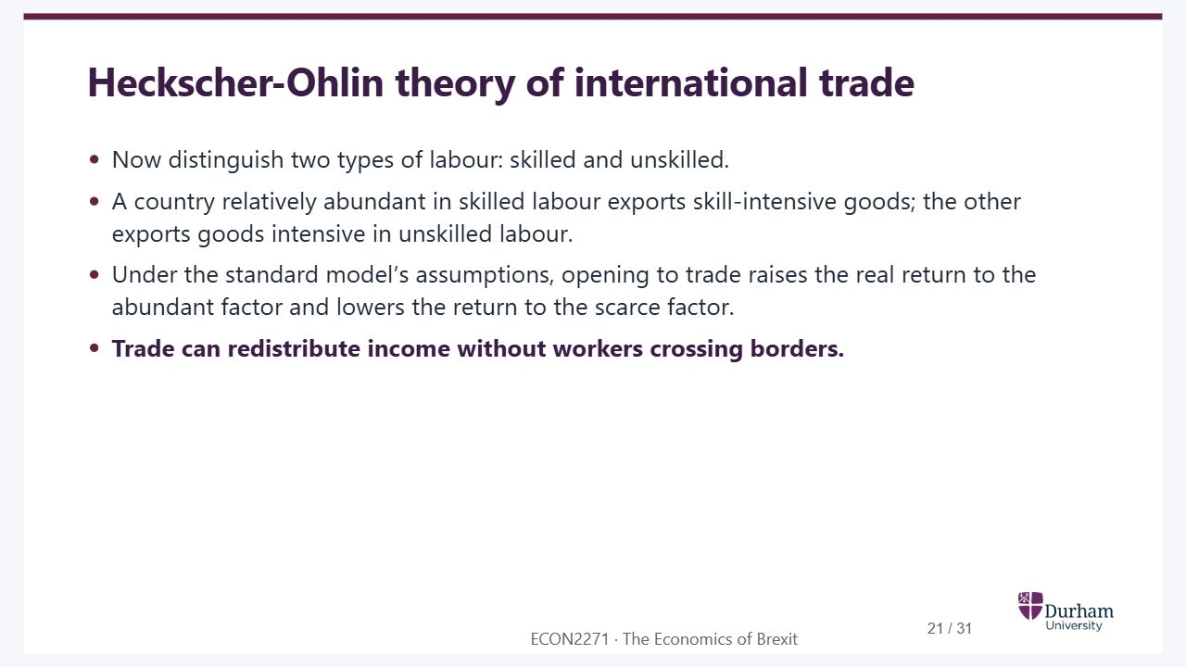
Notes:
Static student copy of the current web slide. Slide artwork is flattened; add personal notes here. Interactive explanations, playback and accessible HTML are available at:
https://davidchivers.co.uk/teaching/macro-applications/lecture_4.html#/l4-s19
Heckscher-Ohlin theory of international trade Now distinguish two types of labour: skilled and unskilled. A country relatively abundant in skilled labour exports skill-intensive goods; the other exports goods intensive in unskilled labour. Under the standard model’s assumptions, opening to trade raises the real return to the abundant factor and lowers the return to the scarce factor. Trade can redistribute income without workers crossing borders. The factor-return result uses the standard two-good, two-factor model with competitive markets and both goods produced. This is a conditional Stolper–Samuelson prediction, not a claim that all workers in an observed education group necessarily experience the same change.

Slide 22
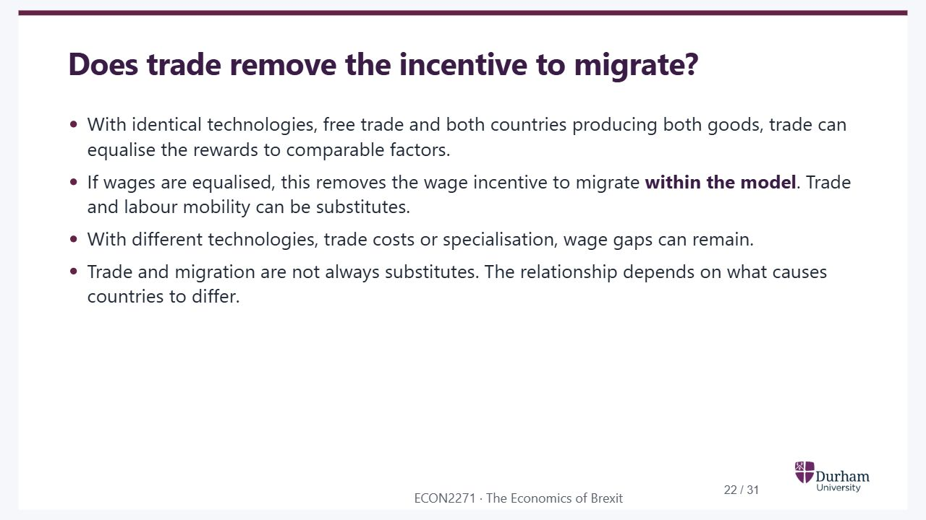
Notes:
Static student copy of the current web slide. Slide artwork is flattened; add personal notes here. Interactive explanations, playback and accessible HTML are available at:
https://davidchivers.co.uk/teaching/macro-applications/lecture_4.html#/l4-s20
Does trade remove the incentive to migrate? With identical technologies, free trade and both countries producing both goods, trade can equalise the rewards to comparable factors. If wages are equalised, this removes the wage incentive to migrate within the model . Trade and labour mobility can be substitutes. With different technologies, trade costs or specialisation, wage gaps can remain. Trade and migration are not always substitutes. The relationship depends on what causes countries to differ.

Slide 23
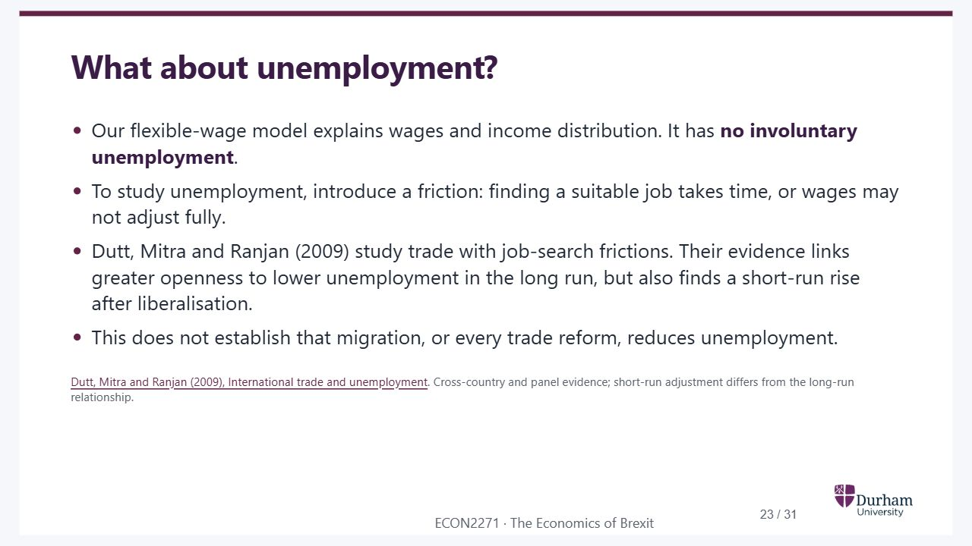
Notes:
Static student copy of the current web slide. Slide artwork is flattened; add personal notes here. Interactive explanations, playback and accessible HTML are available at:
https://davidchivers.co.uk/teaching/macro-applications/lecture_4.html#/l4-unemployment
What about unemployment? Our flexible-wage model explains wages and income distribution. It has no involuntary unemployment . To study unemployment, introduce a friction: finding a suitable job takes time, or wages may not adjust fully. Dutt, Mitra and Ranjan (2009) study trade with job-search frictions. Their evidence links greater openness to lower unemployment in the long run, but also finds a short-run rise after liberalisation. This does not establish that migration, or every trade reform, reduces unemployment. Dutt, Mitra and Ranjan (2009), International trade and unemployment . Cross-country and panel evidence; short-run adjustment differs from the long-run relationship.
https://www.insead.edu/sites/insead/files/assets/faculty-personal-site/pushan-dutt/documents/Paper7.pdf

Slide 24
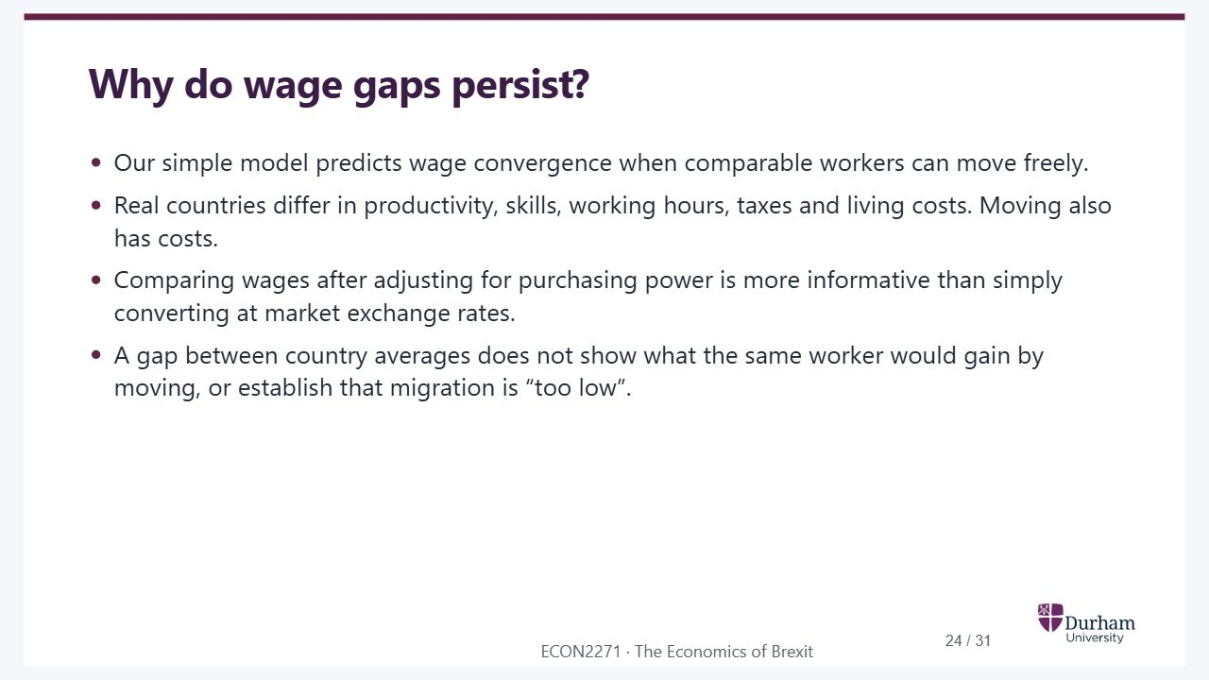
Notes:
Static student copy of the current web slide. Slide artwork is flattened; add personal notes here. Interactive explanations, playback and accessible HTML are available at:
https://davidchivers.co.uk/teaching/macro-applications/lecture_4.html#/l4-s21
Why do wage gaps persist? Our simple model predicts wage convergence when comparable workers can move freely. Real countries differ in productivity, skills, working hours, taxes and living costs. Moving also has costs. Comparing wages after adjusting for purchasing power is more informative than simply converting at market exchange rates. A gap between country averages does not show what the same worker would gain by moving, or establish that migration is “too low”.

Slide 25
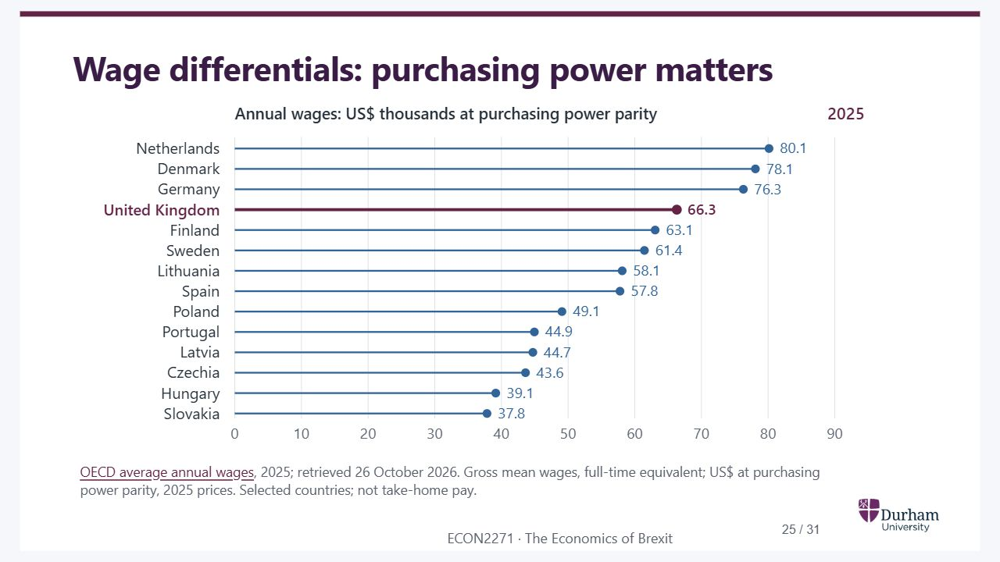
Notes:
Static student copy of the current web slide. Slide artwork is flattened; add personal notes here. Interactive explanations, playback and accessible HTML are available at:
https://davidchivers.co.uk/teaching/macro-applications/lecture_4.html#/l4-s22
Wage differentials: purchasing power matters OECD average annual wages , 2025; retrieved 26 October 2026. Gross mean wages, full-time equivalent; US$ at purchasing power parity, 2025 prices. Selected countries; not take-home pay.
2025 gross mean annual wages per full-time-equivalent employee in 14 selected European OECD countries, in US dollars at purchasing power parity and 2025 prices. UK highlighted at about 66,300 dollars. Country averages still differ substantially after price adjustment; they do not compare identical workers.
https://www.oecd.org/en/data/indicators/average-annual-wages.html

Slide 26

Notes:
Static student copy of the current web slide. Slide artwork is flattened; add personal notes here. Interactive explanations, playback and accessible HTML are available at:
https://davidchivers.co.uk/teaching/macro-applications/lecture_4.html#/l4-s23
Barriers to intra-EU labour mobility Language, family ties, housing and information about suitable jobs make moving costly. Qualifications may need formal recognition; administration can remain difficult. EU rules protect and coordinate state-pension rights across countries, although national systems differ. EU nationals generally have equal access to public-sector jobs. Only specific public-authority roles may be reserved for nationals. European Commission: public-sector employment ; Your Europe: state pensions across borders . These are intra-EU rules; UK–EU movement now has a different legal framework.
https://employment-social-affairs.ec.europa.eu/policies-and-activities/moving-working-europe/working-another-eu-country/free-movement-eu-nationals/employment-public-sector_en
https://europa.eu/youreurope/citizens/work/retire-abroad/state-pensions-abroad/index_en.htm

Slide 27
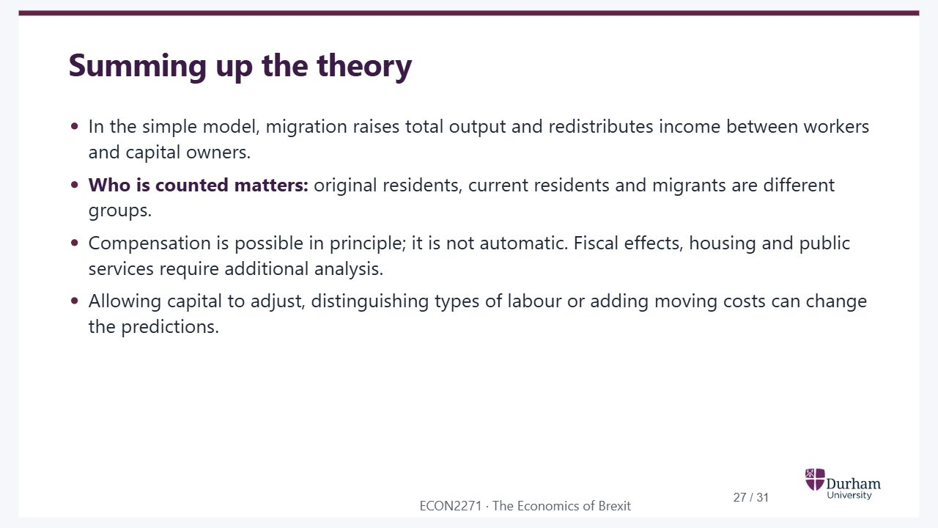
Notes:
Static student copy of the current web slide. Slide artwork is flattened; add personal notes here. Interactive explanations, playback and accessible HTML are available at:
https://davidchivers.co.uk/teaching/macro-applications/lecture_4.html#/l4-s24
Summing up the theory In the simple model, migration raises total output and redistributes income between workers and capital owners. Who is counted matters: original residents, current residents and migrants are different groups. Compensation is possible in principle; it is not automatic. Fiscal effects, housing and public services require additional analysis. Allowing capital to adjust, distinguishing types of labour or adding moving costs can change the predictions.

Slide 28

Notes:
Static student copy of the current web slide. Slide artwork is flattened; add personal notes here. Interactive explanations, playback and accessible HTML are available at:
https://davidchivers.co.uk/teaching/macro-applications/lecture_4.html#/l4-s25
Summing up the evidence UK studies often find small average wage effects, with different effects across workers and occupations. Earlier migrants and some lower-paid workers may face greater competition. A small average effect does not mean nobody loses. Wage comparisons and migration trends are descriptive evidence; they do not by themselves identify causal effects. Seminar 2 considers fiscal effects and innovation. Keep each paper’s population, period and assumptions in view. Manacorda, Manning and Wadsworth (2012) ; Dustmann, Frattini and Preston (2013) ; Nickell and Saleheen (2015) .
https://doi.org/10.1111/j.1542-4774.2011.01049.x
https://doi.org/10.1093/restud/rds019
https://www.bankofengland.co.uk/working-paper/2015/the-impact-of-immigration-on-occupational-wages-evidence-from-britain

Slide 29

Notes:
Static student copy of the current web slide. Slide artwork is flattened; add personal notes here. Interactive explanations, playback and accessible HTML are available at:
https://davidchivers.co.uk/teaching/macro-applications/lecture_4.html#/l4-next
Next lecture Regional disparities Why can integration benefit some regions more than others? Preparation: Revise the Solow model, economies of scale and agglomeration.

Slide 30
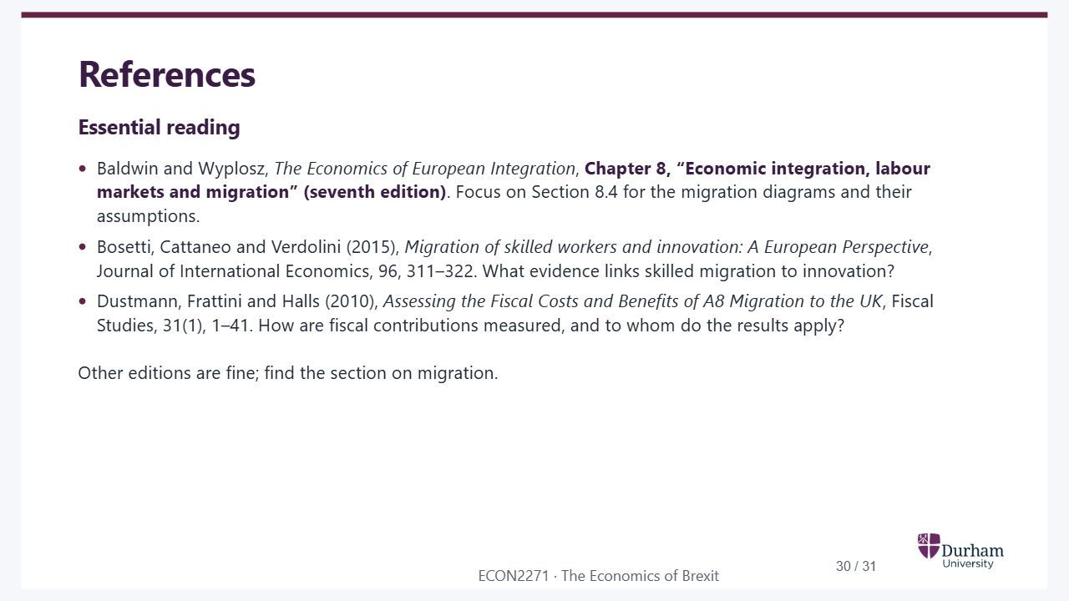
Notes:
Static student copy of the current web slide. Slide artwork is flattened; add personal notes here. Interactive explanations, playback and accessible HTML are available at:
https://davidchivers.co.uk/teaching/macro-applications/lecture_4.html#/l4-s26
References Essential reading Baldwin and Wyplosz, The Economics of European Integration , Chapter 8, “Economic integration, labour markets and migration” (seventh edition) . Focus on Section 8.4 for the migration diagrams and their assumptions. Bosetti, Cattaneo and Verdolini (2015), Migration of skilled workers and innovation: A European Perspective , Journal of International Economics, 96, 311–322. What evidence links skilled migration to innovation? Dustmann, Frattini and Halls (2010), Assessing the Fiscal Costs and Benefits of A8 Migration to the UK , Fiscal Studies, 31(1), 1–41. How are fiscal contributions measured, and to whom do the results apply? Other editions are fine; find the section on migration.

Slide 31

Notes:
Static student copy of the current web slide. Slide artwork is flattened; add personal notes here. Interactive explanations, playback and accessible HTML are available at:
https://davidchivers.co.uk/teaching/macro-applications/lecture_4.html#/l4-s27
Further reading See the ECON2271 Talis reading list , also available through Blackboard.
https://durham.rl.talis.com/lists/d85d1ad3-e9ac-4daf-aa66-e3ddfcf902d7.html

