Slide 1

Notes:
Static student copy of the current web slide. Slide artwork is flattened; add personal notes here. Interactive explanations, playback and accessible HTML are available at:
https://davidchivers.co.uk/teaching/macro-applications/lecture_5.html#/title-slide
The Economics of Brexit Lecture 5: Regional disparities Dr David Chivers Macroeconomic Applications and Policy

Slide 2

Notes:
Static student copy of the current web slide. Slide artwork is flattened; add personal notes here. Interactive explanations, playback and accessible HTML are available at:
https://davidchivers.co.uk/teaching/macro-applications/lecture_5.html#/l5-s02
Learning objectives After this topic, you will be able to: Distinguish differences between countries from differences within countries . Use the Solow model and New Economic Geography to explain income and location. Explain how integration changes dispersion and agglomeration forces. Assess the case for regional policy and the regional consequences of Brexit.

Slide 3

Notes:
Static student copy of the current web slide. Slide artwork is flattened; add personal notes here. Interactive explanations, playback and accessible HTML are available at:
https://davidchivers.co.uk/teaching/macro-applications/lecture_5.html#/l5-question
If integration makes Europe richer, why do some places fall behind? Start the discussion Higher average income can coexist with very uneven gains. We need to explain where activity takes place and who benefits .

Slide 4
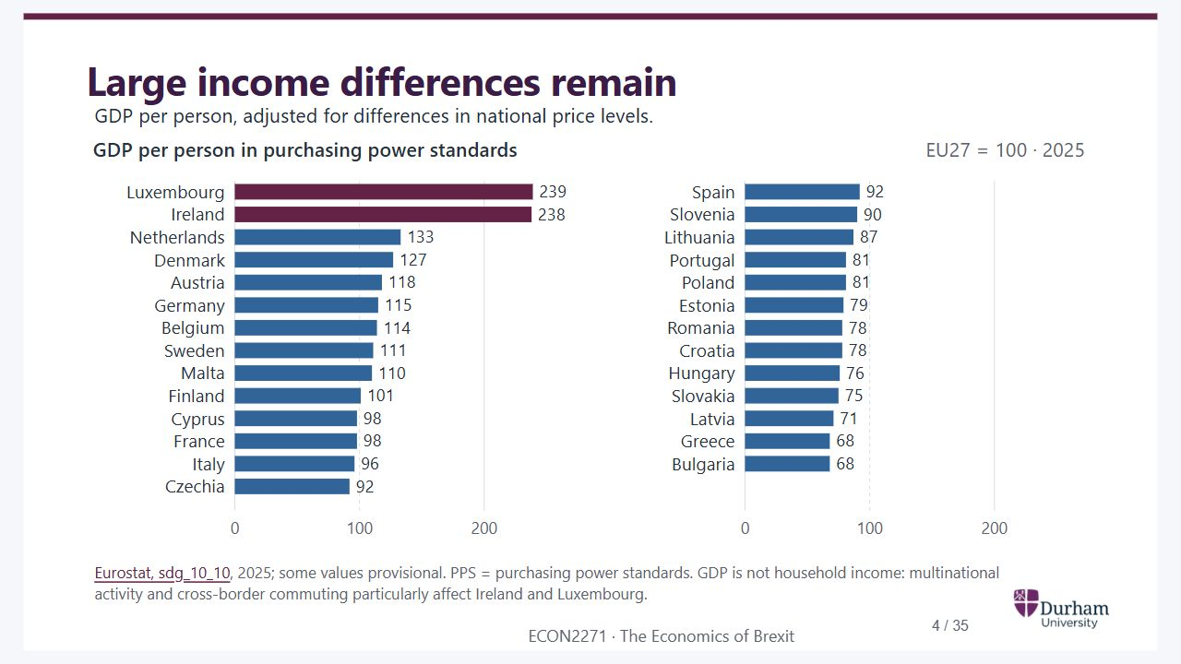
Notes:
Static student copy of the current web slide. Slide artwork is flattened; add personal notes here. Interactive explanations, playback and accessible HTML are available at:
https://davidchivers.co.uk/teaching/macro-applications/lecture_5.html#/l5-s03
Large income differences remain GDP per person, adjusted for differences in national price levels. Eurostat, sdg_10_10 , 2025; some values provisional. PPS = purchasing power standards. GDP is not household income: multinational activity and cross-border commuting particularly affect Ireland and Luxembourg.
GDP per person in 2025, EU27 equals 100. Luxembourg and Ireland are highest; Bulgaria and Greece are lowest. All 27 countries use the same scale.
https://ec.europa.eu/eurostat/databrowser/view/sdg_10_10/default/table

Slide 5
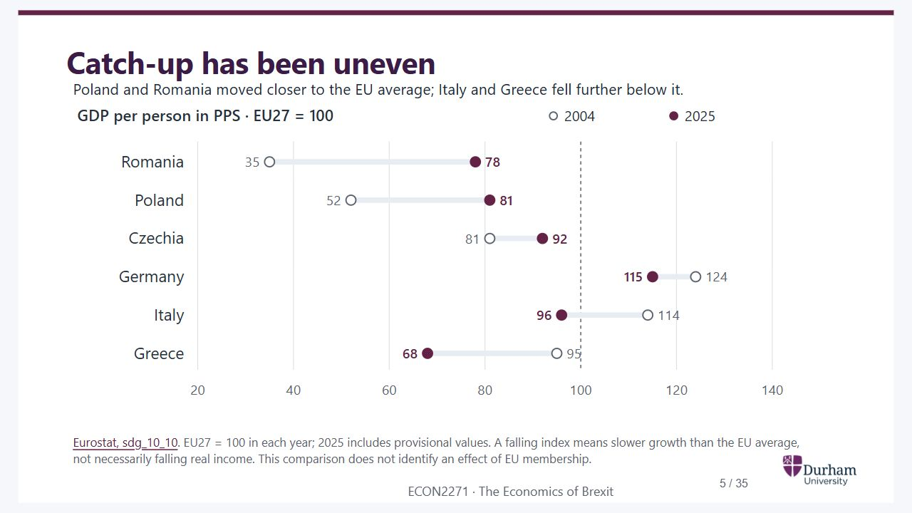
Notes:
Static student copy of the current web slide. Slide artwork is flattened; add personal notes here. Interactive explanations, playback and accessible HTML are available at:
https://davidchivers.co.uk/teaching/macro-applications/lecture_5.html#/l5-s04
Catch-up has been uneven Poland and Romania moved closer to the EU average; Italy and Greece fell further below it. Eurostat, sdg_10_10 . EU27 = 100 in each year; 2025 includes provisional values. A falling index means slower growth than the EU average, not necessarily falling real income. This comparison does not identify an effect of EU membership.
Selected countries, GDP per person relative to EU27: Romania 35 to 78, Poland 52 to 81, Czechia 81 to 92, Germany 124 to 115, Italy 114 to 96 and Greece 95 to 68, from 2004 to 2025.
https://ec.europa.eu/eurostat/databrowser/view/sdg_10_10/default/table

Slide 6
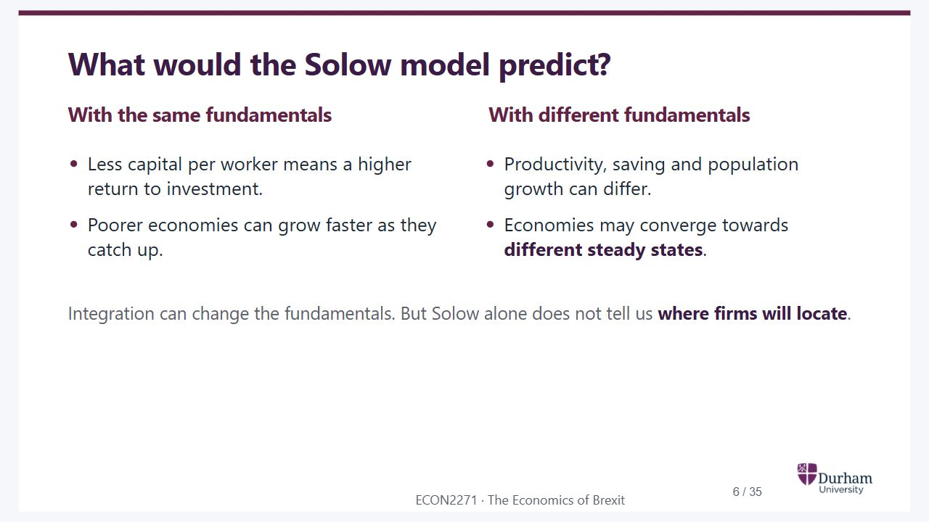
Notes:
Static student copy of the current web slide. Slide artwork is flattened; add personal notes here. Interactive explanations, playback and accessible HTML are available at:
https://davidchivers.co.uk/teaching/macro-applications/lecture_5.html#/l5-s05
What would the Solow model predict? With the same fundamentals Less capital per worker means a higher return to investment. Poorer economies can grow faster as they catch up. With different fundamentals Productivity, saving and population growth can differ. Economies may converge towards different steady states . Integration can change the fundamentals. But Solow alone does not tell us where firms will locate .

Slide 7
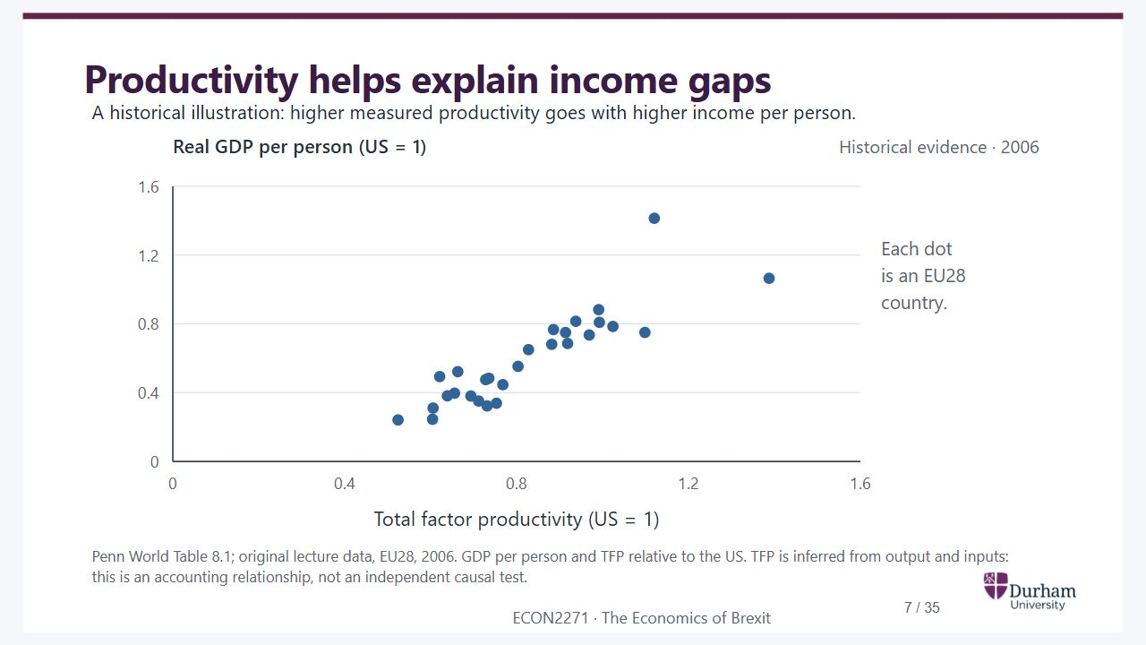
Notes:
Static student copy of the current web slide. Slide artwork is flattened; add personal notes here. Interactive explanations, playback and accessible HTML are available at:
https://davidchivers.co.uk/teaching/macro-applications/lecture_5.html#/l5-s06
Productivity helps explain income gaps A historical illustration: higher measured productivity goes with higher income per person. Penn World Table 8.1; original lecture data, EU28, 2006. GDP per person and TFP relative to the US. TFP is inferred from output and inputs: this is an accounting relationship, not an independent causal test.
The original 28 EU-country observations from 2006, redrawn. GDP per person is positively associated with total factor productivity; both axes are relative to the United States.

Slide 8
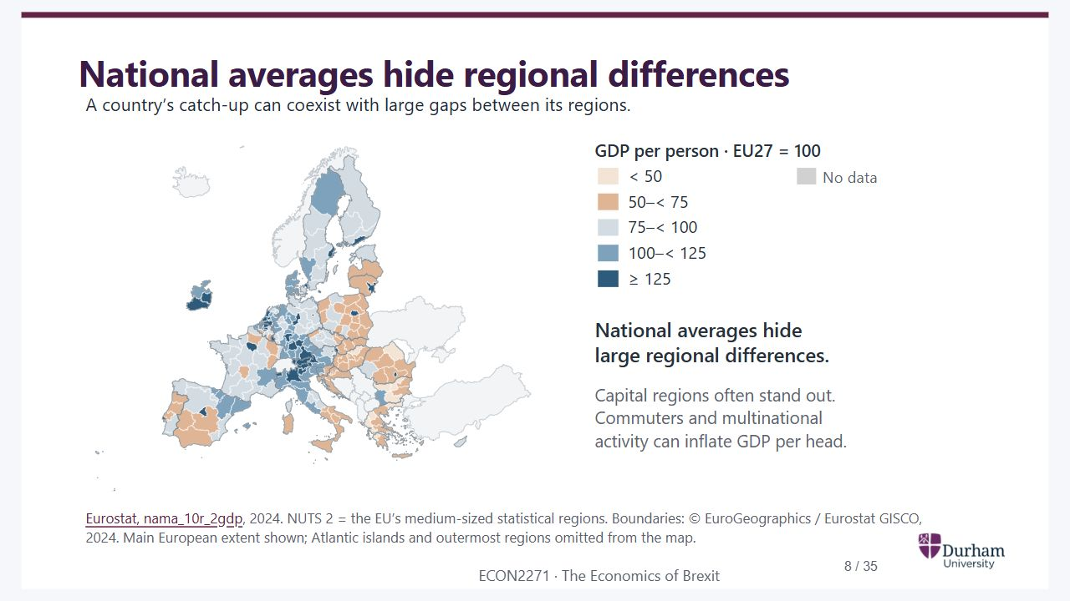
Notes:
Static student copy of the current web slide. Slide artwork is flattened; add personal notes here. Interactive explanations, playback and accessible HTML are available at:
https://davidchivers.co.uk/teaching/macro-applications/lecture_5.html#/l5-s07
National averages hide regional differences A country’s catch-up can coexist with large gaps between its regions. Eurostat, nama_10r_2gdp , 2024. NUTS 2 = the EU’s medium-sized statistical regions. Boundaries: © EuroGeographics / Eurostat GISCO, 2024. Main European extent shown; Atlantic islands and outermost regions omitted from the map.
Map of GDP per person across all 244 EU NUTS2 regions in 2024, relative to EU27 equals 100. Capitals and other centres of activity stand out from many surrounding regions.
https://ec.europa.eu/eurostat/databrowser/view/nama_10r_2gdp/default/table

Slide 9
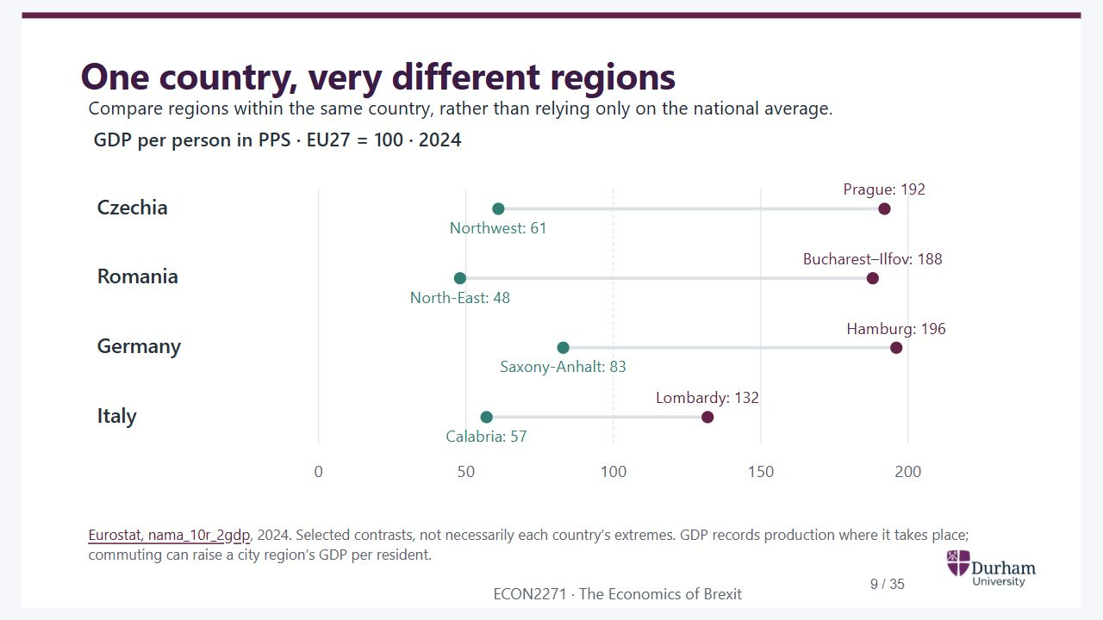
Notes:
Static student copy of the current web slide. Slide artwork is flattened; add personal notes here. Interactive explanations, playback and accessible HTML are available at:
https://davidchivers.co.uk/teaching/macro-applications/lecture_5.html#/l5-regions
One country, very different regions Compare regions within the same country, rather than relying only on the national average. Eurostat, nama_10r_2gdp , 2024. Selected contrasts, not necessarily each country’s extremes. GDP records production where it takes place; commuting can raise a city region’s GDP per resident.
Selected 2024 regional contrasts, EU27 equals 100: Czech Northwest 61 versus Prague 192; Romanian Northeast 48 versus Bucharest 188; Saxony-Anhalt 83 versus Hamburg 196; Calabria 57 versus Lombardy 132.
https://ec.europa.eu/eurostat/databrowser/view/nama_10r_2gdp/default/table

Slide 10
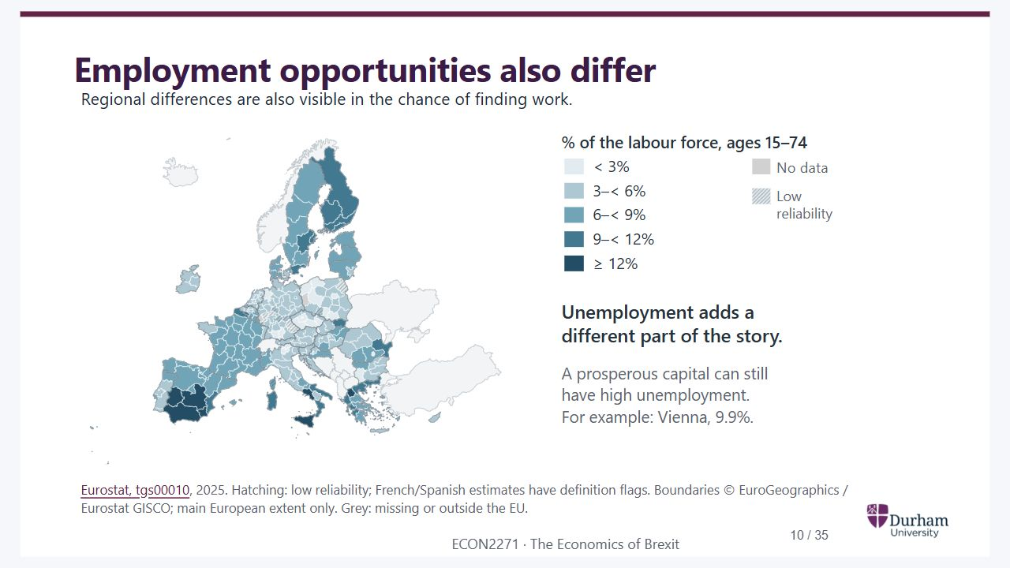
Notes:
Static student copy of the current web slide. Slide artwork is flattened; add personal notes here. Interactive explanations, playback and accessible HTML are available at:
https://davidchivers.co.uk/teaching/macro-applications/lecture_5.html#/l5-s08
Employment opportunities also differ Regional differences are also visible in the chance of finding work. Eurostat, tgs00010 , 2025. Hatching: low reliability; French/Spanish estimates have definition flags. Boundaries © EuroGeographics / Eurostat GISCO; main European extent only. Grey: missing or outside the EU.
EU NUTS2 unemployment rates in 2025 on the same map boundaries as the GDP map. Several southern European regions have higher rates, but national borders do not fully explain the pattern.
https://ec.europa.eu/eurostat/databrowser/view/tgs00010/default/table

Slide 11
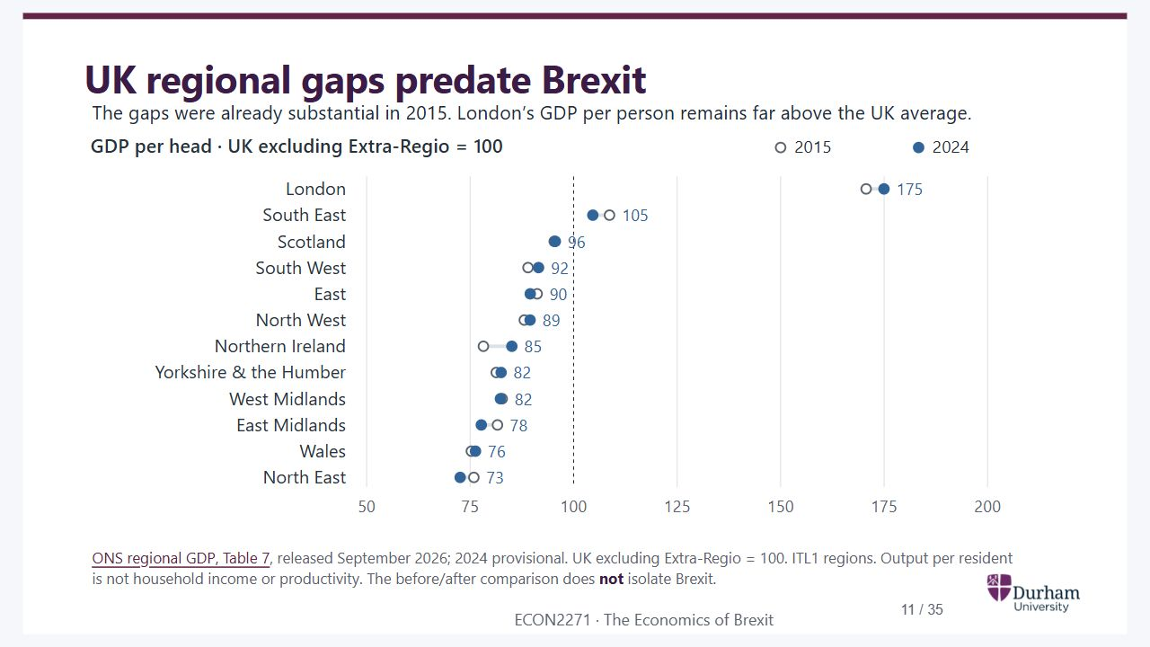
Notes:
Static student copy of the current web slide. Slide artwork is flattened; add personal notes here. Interactive explanations, playback and accessible HTML are available at:
https://davidchivers.co.uk/teaching/macro-applications/lecture_5.html#/l5-s09
UK regional gaps predate Brexit The gaps were already substantial in 2015. London’s GDP per person remains far above the UK average. ONS regional GDP, Table 7 , released September 2026; 2024 provisional. UK excluding Extra-Regio = 100. ITL1 regions. Output per resident is not household income or productivity. The before/after comparison does not isolate Brexit.
GDP per person in the UK's twelve large regions, indexed to the UK excluding Extra-Regio in each year. London rises from about 171 in 2015 to 175 in 2024; the Northeast falls from about 76 to 73. The graph is descriptive, not an estimate of Brexit's effect.
https://www.ons.gov.uk/economy/grossdomesticproductgdp/bulletins/regionaleconomicactivitybygrossdomesticproductuk/1998to2024

Slide 12

Notes:
Static student copy of the current web slide. Slide artwork is flattened; add personal notes here. Interactive explanations, playback and accessible HTML are available at:
https://davidchivers.co.uk/teaching/macro-applications/lecture_5.html#/l5-s10
Why does economic activity cluster? Show the two forces Firms benefit from nearby customers, suppliers and workers. But competition, land costs and congestion can make other locations attractive.

Slide 13
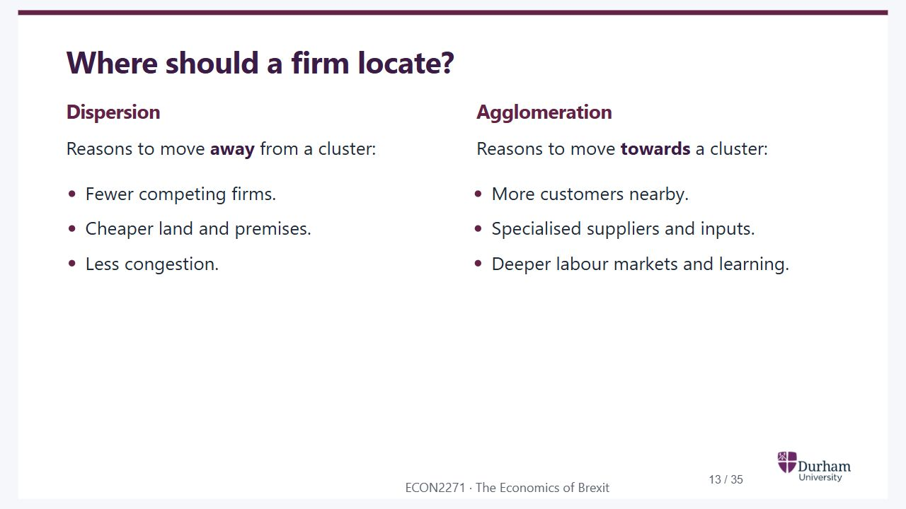
Notes:
Static student copy of the current web slide. Slide artwork is flattened; add personal notes here. Interactive explanations, playback and accessible HTML are available at:
https://davidchivers.co.uk/teaching/macro-applications/lecture_5.html#/l5-s11
Where should a firm locate? Dispersion Reasons to move away from a cluster: Fewer competing firms. Cheaper land and premises. Less congestion. Agglomeration Reasons to move towards a cluster: More customers nearby. Specialised suppliers and inputs. Deeper labour markets and learning.

Slide 14
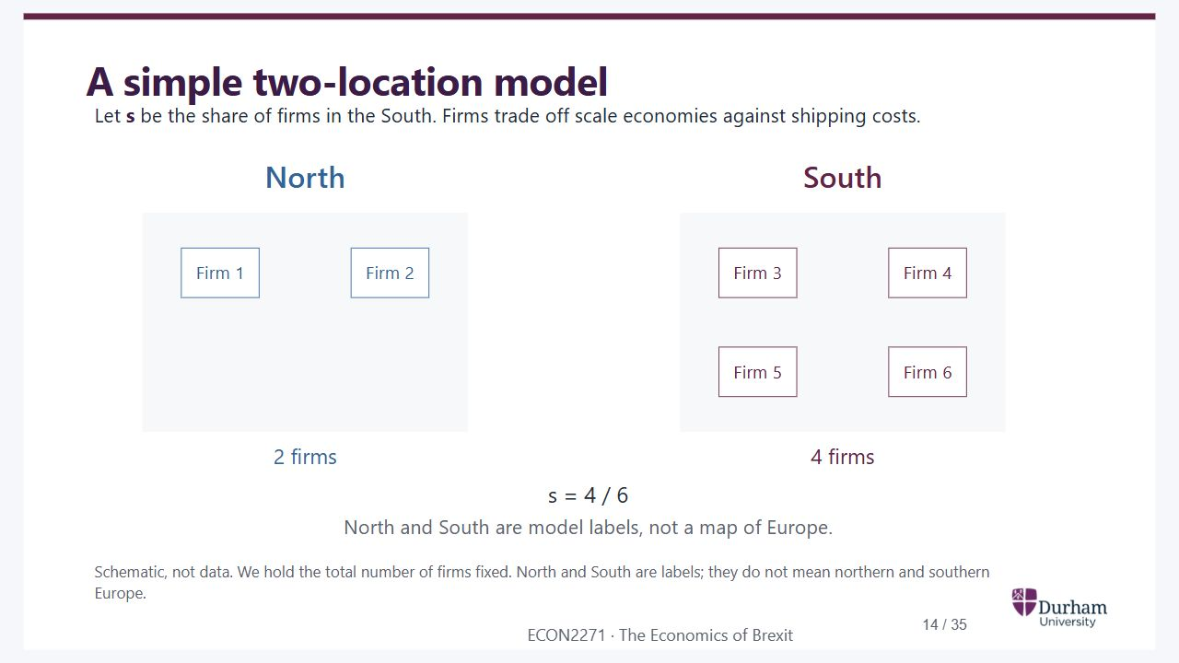
Notes:
Static student copy of the current web slide. Slide artwork is flattened; add personal notes here. Interactive explanations, playback and accessible HTML are available at:
https://davidchivers.co.uk/teaching/macro-applications/lecture_5.html#/l5-s12
A simple two-location model Let s be the share of firms in the South. Firms trade off scale economies against shipping costs. Schematic, not data. We hold the total number of firms fixed. North and South are labels; they do not mean northern and southern Europe.
Two abstract locations with two firms in North and four in South. The illustrative Southern share is four sixths. The number of firms is held fixed; their location can change.

Slide 15
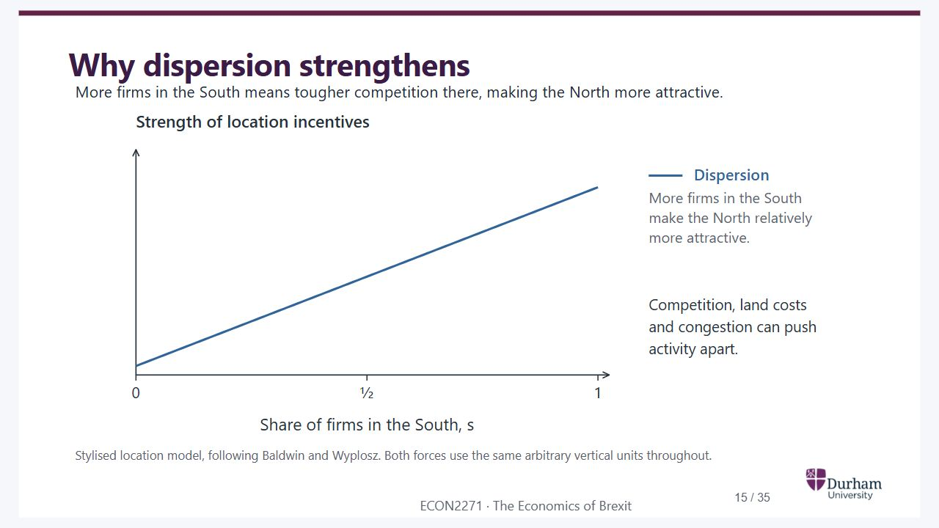
Notes:
Static student copy of the current web slide. Slide artwork is flattened; add personal notes here. Interactive explanations, playback and accessible HTML are available at:
https://davidchivers.co.uk/teaching/macro-applications/lecture_5.html#/l5-s13
Why dispersion strengthens More firms in the South means tougher competition there, making the North more attractive. Stylised location model, following Baldwin and Wyplosz. Both forces use the same arbitrary vertical units throughout.
Dispersion incentives favouring North rise with the share of firms in South. The horizontal axis runs from zero to one; the vertical axis is the strength of location incentives.

Slide 16
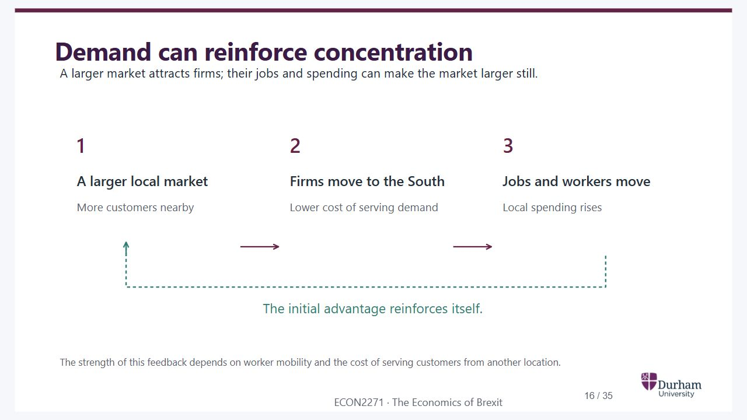
Notes:
Static student copy of the current web slide. Slide artwork is flattened; add personal notes here. Interactive explanations, playback and accessible HTML are available at:
https://davidchivers.co.uk/teaching/macro-applications/lecture_5.html#/l5-s14
Demand can reinforce concentration A larger market attracts firms; their jobs and spending can make the market larger still. The strength of this feedback depends on worker mobility and the cost of serving customers from another location.
Demand feedback: a larger local market attracts firms; jobs and workers move; local spending rises, reinforcing the initial market advantage.

Slide 17
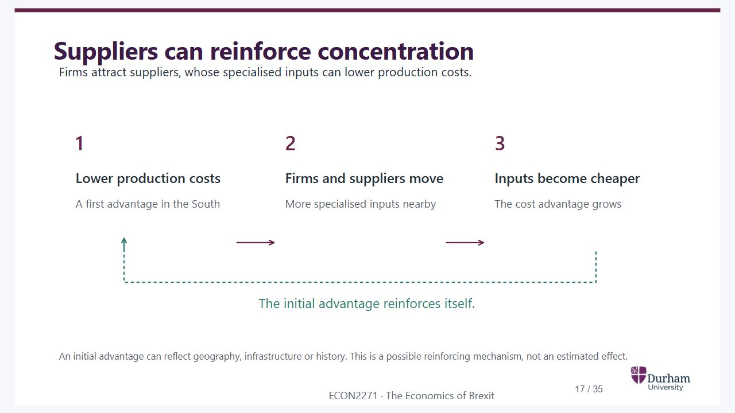
Notes:
Static student copy of the current web slide. Slide artwork is flattened; add personal notes here. Interactive explanations, playback and accessible HTML are available at:
https://davidchivers.co.uk/teaching/macro-applications/lecture_5.html#/l5-s15
Suppliers can reinforce concentration Firms attract suppliers, whose specialised inputs can lower production costs. An initial advantage can reflect geography, infrastructure or history. This is a possible reinforcing mechanism, not an estimated effect.
Supply feedback: lower costs attract firms and suppliers; specialised inputs become cheaper or easier to obtain, reinforcing the initial cost advantage.

Slide 18
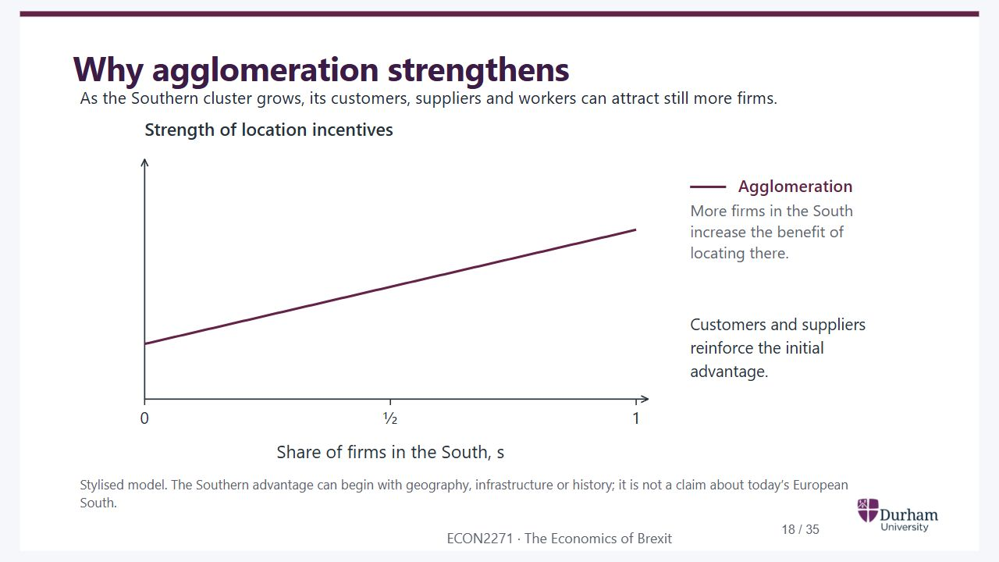
Notes:
Static student copy of the current web slide. Slide artwork is flattened; add personal notes here. Interactive explanations, playback and accessible HTML are available at:
https://davidchivers.co.uk/teaching/macro-applications/lecture_5.html#/l5-s16
Why agglomeration strengthens As the Southern cluster grows, its customers, suppliers and workers can attract still more firms. Stylised model. The Southern advantage can begin with geography, infrastructure or history; it is not a claim about today’s European South.
Agglomeration incentives favouring South rise with the Southern share. The axes have the same position and scale as the preceding dispersion diagram.

Slide 19
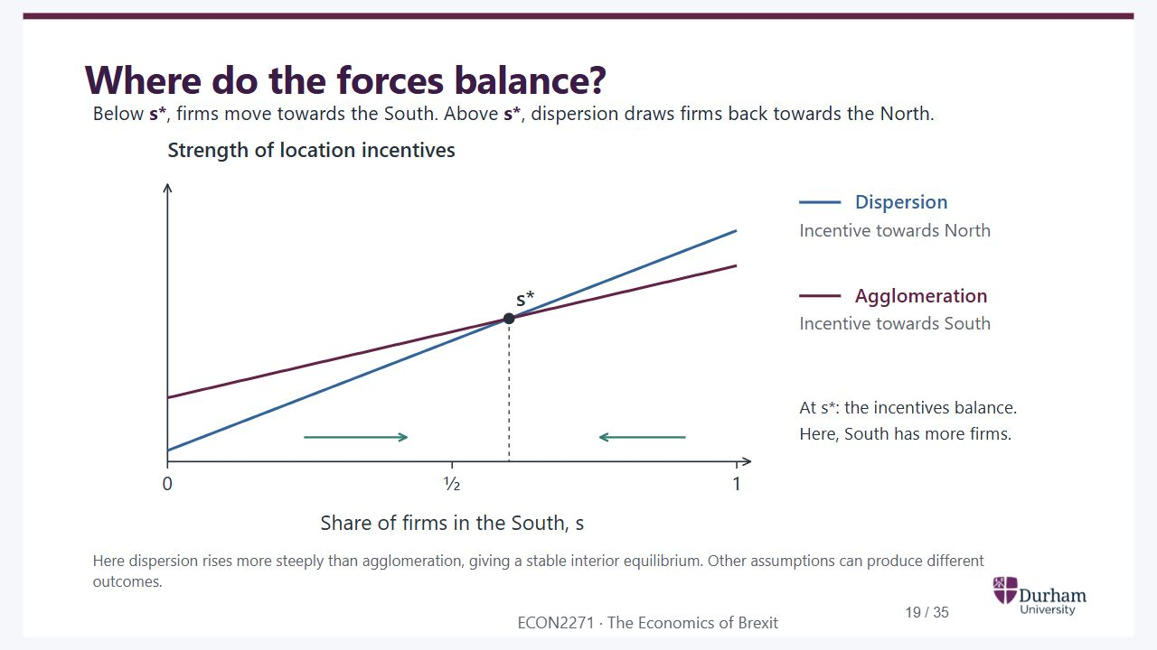
Notes:
Static student copy of the current web slide. Slide artwork is flattened; add personal notes here. Interactive explanations, playback and accessible HTML are available at:
https://davidchivers.co.uk/teaching/macro-applications/lecture_5.html#/l5-s17
Where do the forces balance? Below s* , firms move towards the South. Above s* , dispersion draws firms back towards the North. Here dispersion rises more steeply than agglomeration, giving a stable interior equilibrium. Other assumptions can produce different outcomes.
The two curves intersect at s star equals 0.6. Agglomeration exceeds dispersion below this share; dispersion exceeds agglomeration above it. Arrows point towards the stable interior equilibrium.

Slide 20

Notes:
Static student copy of the current web slide. Slide artwork is flattened; add personal notes here. Interactive explanations, playback and accessible HTML are available at:
https://davidchivers.co.uk/teaching/macro-applications/lecture_5.html#/l5-s18
What changes when trade gets easier? A weaker reason to disperse Firms in the North lose some protection from distant competitors. Being away from the cluster becomes less attractive. A weaker reason to cluster Firms can reach Southern customers and suppliers from further away. Being inside the cluster becomes less essential. We will separate these two effects before putting them together.

Slide 21
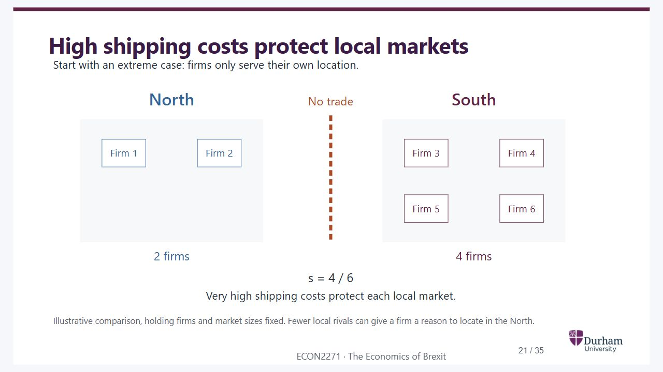
Notes:
Static student copy of the current web slide. Slide artwork is flattened; add personal notes here. Interactive explanations, playback and accessible HTML are available at:
https://davidchivers.co.uk/teaching/macro-applications/lecture_5.html#/l5-s19
High shipping costs protect local markets Start with an extreme case: firms only serve their own location. Illustrative comparison, holding firms and market sizes fixed. Fewer local rivals can give a firm a reason to locate in the North.
The same two Northern and four Southern firms, separated by very high shipping costs. Each firm only competes in its local market.

Slide 22
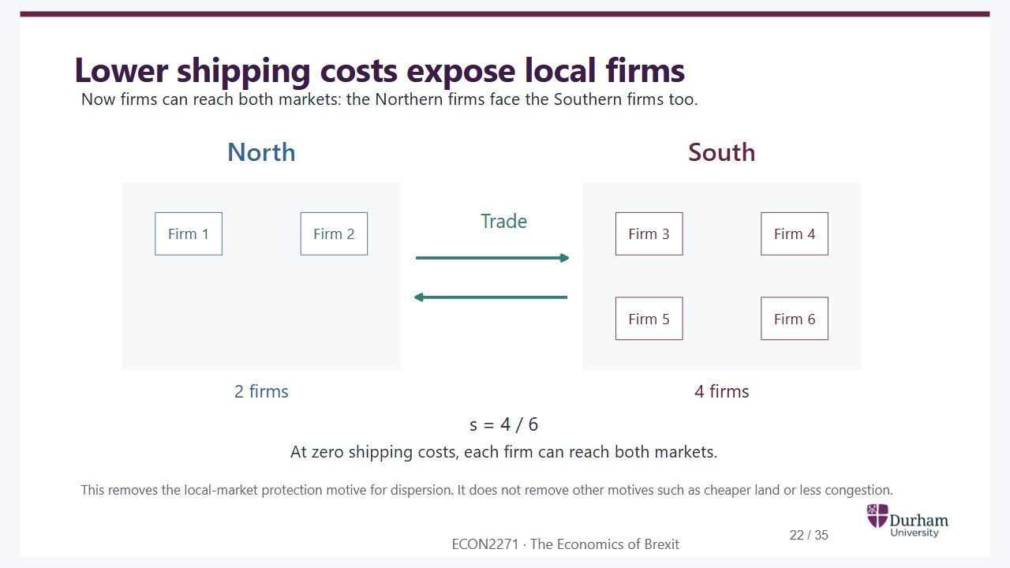
Notes:
Static student copy of the current web slide. Slide artwork is flattened; add personal notes here. Interactive explanations, playback and accessible HTML are available at:
https://davidchivers.co.uk/teaching/macro-applications/lecture_5.html#/l5-s20
Lower shipping costs expose local firms Now firms can reach both markets: the Northern firms face the Southern firms too. This removes the local-market protection motive for dispersion. It does not remove other motives such as cheaper land or less congestion.
The same firms in the same positions, with trade arrows now joining the two markets. At zero shipping costs, all firms can compete across both locations.

Slide 23
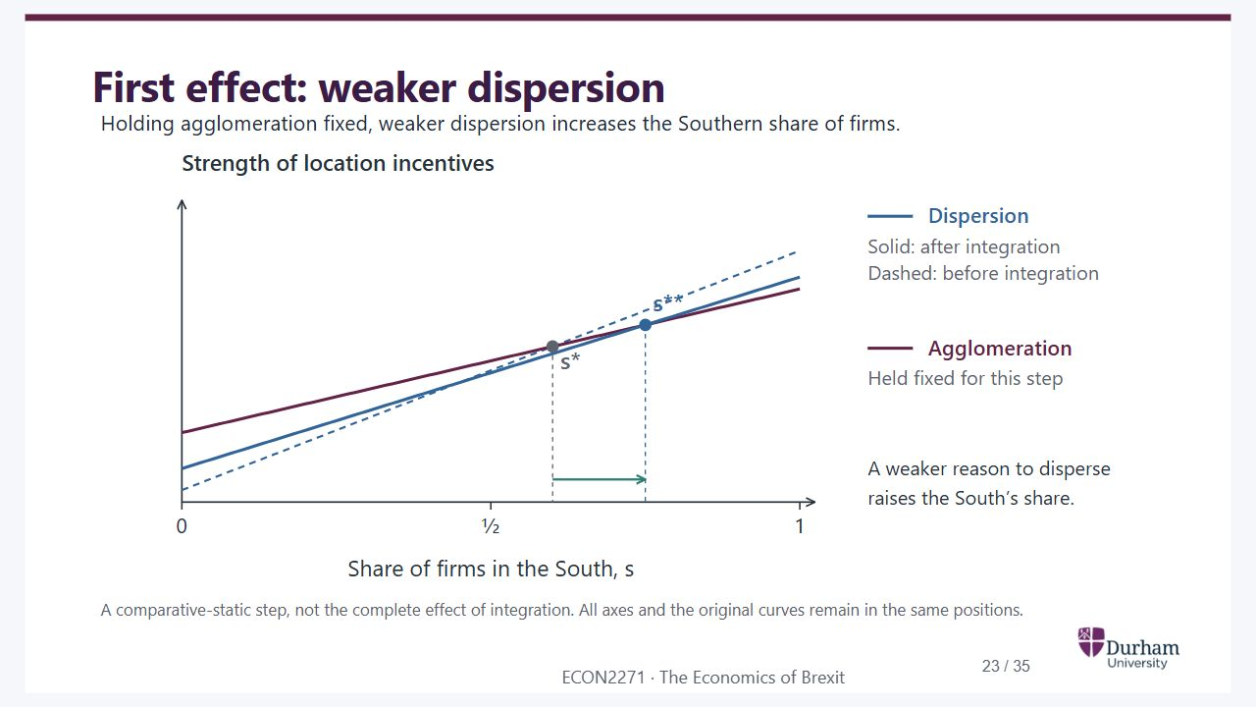
Notes:
Static student copy of the current web slide. Slide artwork is flattened; add personal notes here. Interactive explanations, playback and accessible HTML are available at:
https://davidchivers.co.uk/teaching/macro-applications/lecture_5.html#/l5-s21
First effect: weaker dispersion Holding agglomeration fixed, weaker dispersion increases the Southern share of firms. A comparative-static step, not the complete effect of integration. All axes and the original curves remain in the same positions.
The dispersion curve falls over the relevant range. Holding agglomeration fixed, the intersection moves from s star 0.6 to s double star 0.75, so activity becomes more concentrated in South.

Slide 24
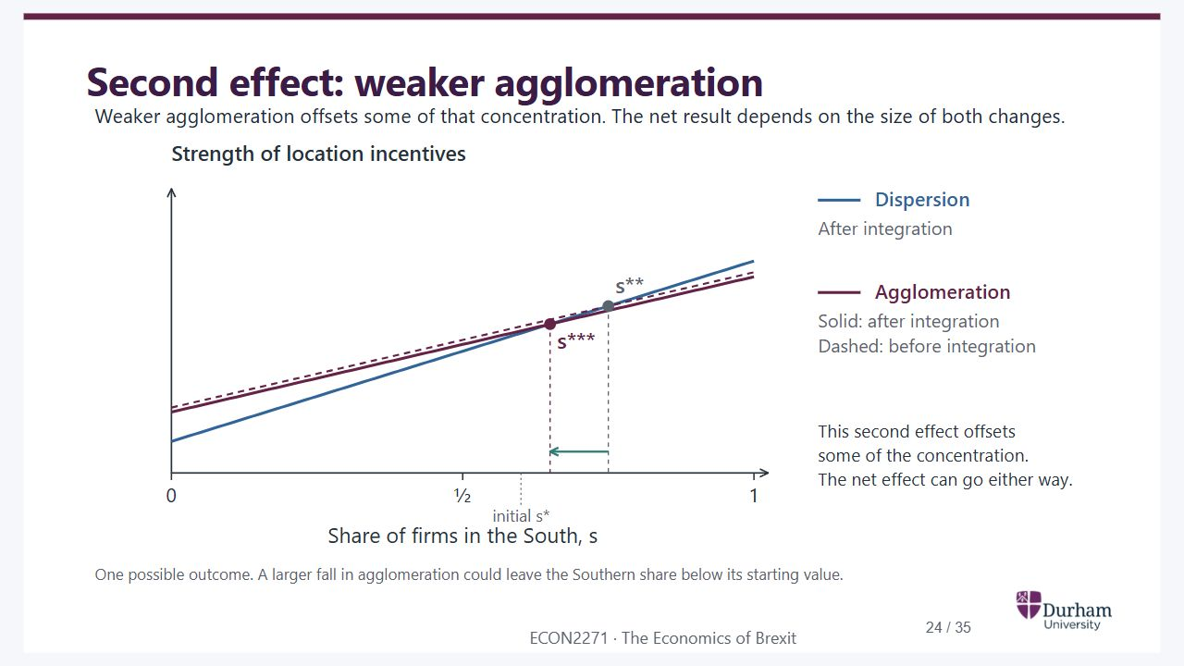
Notes:
Static student copy of the current web slide. Slide artwork is flattened; add personal notes here. Interactive explanations, playback and accessible HTML are available at:
https://davidchivers.co.uk/teaching/macro-applications/lecture_5.html#/l5-s22
Second effect: weaker agglomeration Weaker agglomeration offsets some of that concentration. The net result depends on the size of both changes. One possible outcome. A larger fall in agglomeration could leave the Southern share below its starting value.
Agglomeration also falls. The final share is 0.65 in this illustration, below the dispersion-only result of 0.75 but above the starting share of 0.6. A larger fall in agglomeration could instead put the share below its starting value.

Slide 25
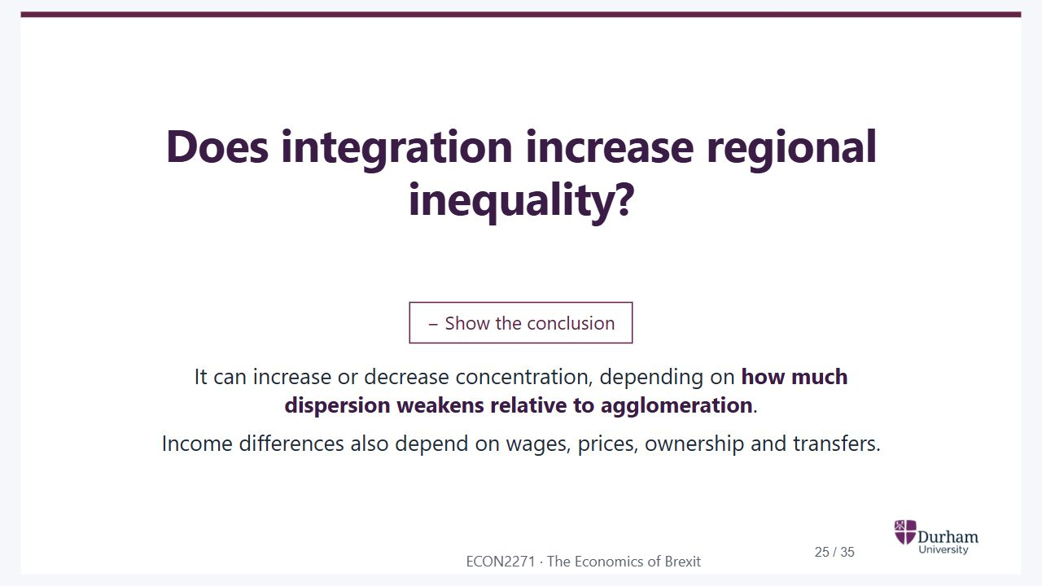
Notes:
Static student copy of the current web slide. Slide artwork is flattened; add personal notes here. Interactive explanations, playback and accessible HTML are available at:
https://davidchivers.co.uk/teaching/macro-applications/lecture_5.html#/l5-s23
Does integration increase regional inequality? Show the conclusion It can increase or decrease concentration, depending on how much dispersion weakens relative to agglomeration . Income differences also depend on wages, prices, ownership and transfers. The model predicts firm location, not a complete welfare ranking. Observing rising regional inequality does not establish which curve shifted or prove an effect of integration. Avoid inferring that incentives in the periphery “must” have fallen more from an inequality trend alone.

Slide 26
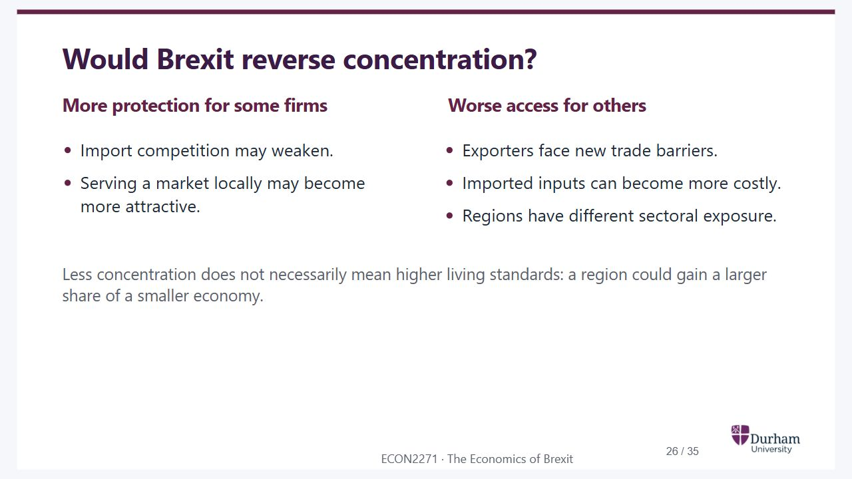
Notes:
Static student copy of the current web slide. Slide artwork is flattened; add personal notes here. Interactive explanations, playback and accessible HTML are available at:
https://davidchivers.co.uk/teaching/macro-applications/lecture_5.html#/l5-brexit
Would Brexit reverse concentration? More protection for some firms Import competition may weaken. Serving a market locally may become more attractive. Worse access for others Exporters face new trade barriers. Imported inputs can become more costly. Regions have different sectoral exposure. Less concentration does not necessarily mean higher living standards: a region could gain a larger share of a smaller economy.

Slide 27
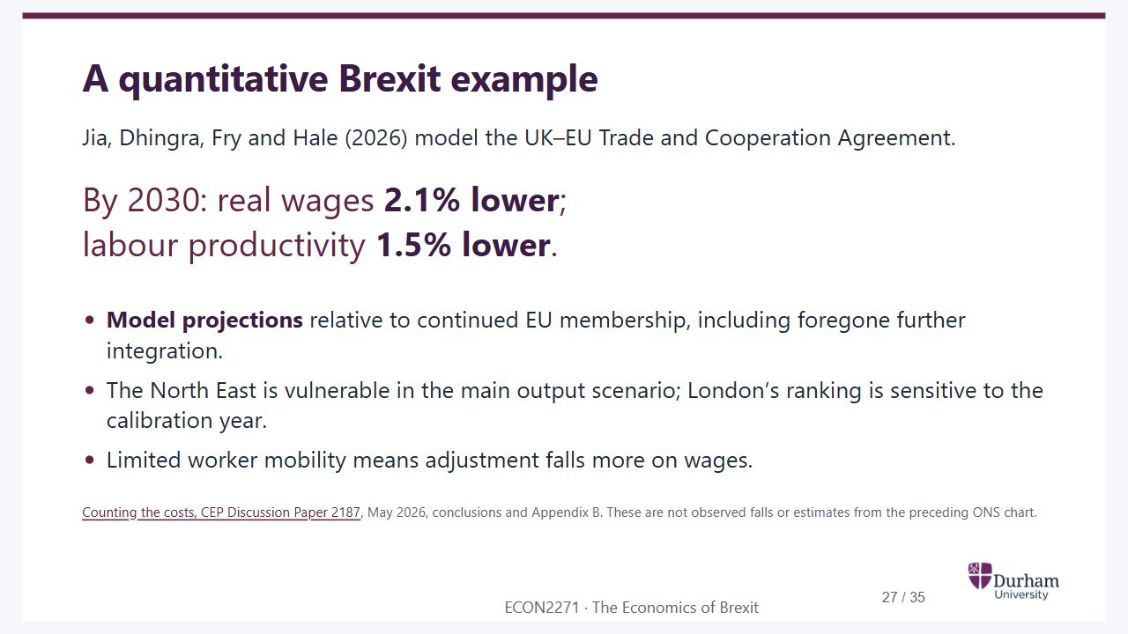
Notes:
Static student copy of the current web slide. Slide artwork is flattened; add personal notes here. Interactive explanations, playback and accessible HTML are available at:
https://davidchivers.co.uk/teaching/macro-applications/lecture_5.html#/l5-brexit-model
A quantitative Brexit example Jia, Dhingra, Fry and Hale (2026) model the UK–EU Trade and Cooperation Agreement. By 2030: real wages 2.1% lower ; labour productivity 1.5% lower . Model projections relative to continued EU membership, including foregone further integration. The North East is vulnerable in the main output scenario; London’s ranking is sensitive to the calibration year. Limited worker mobility means adjustment falls more on wages. Counting the costs, CEP Discussion Paper 2187 , May 2026, conclusions and Appendix B. These are not observed falls or estimates from the preceding ONS chart. The model combines trade, location and labour-market mechanisms. Almost half of the aggregate projected loss reflects missed future EU integration. The baseline uses 2014 calibration; Appendix B uses 2018 and changes regional rankings, notably London. The experiment isolates the modelled Brexit policy change, not Covid or all other subsequent shocks. This illustrates how assumptions and data turn qualitative mechanisms into a quantitative counterfactual.
https://cep.lse.ac.uk/pubs/download/dp2187.pdf

Slide 28
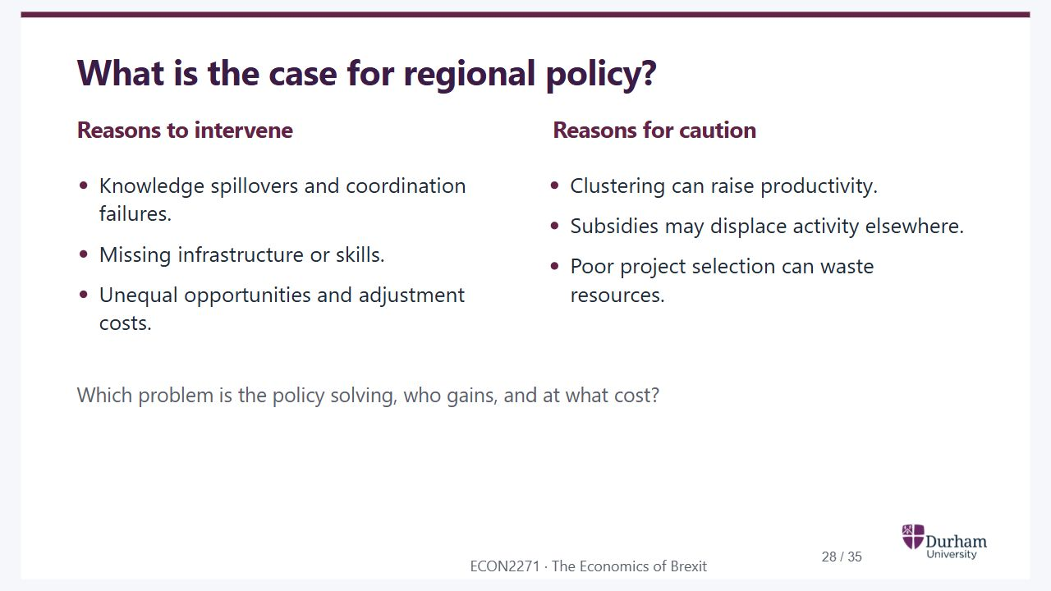
Notes:
Static student copy of the current web slide. Slide artwork is flattened; add personal notes here. Interactive explanations, playback and accessible HTML are available at:
https://davidchivers.co.uk/teaching/macro-applications/lecture_5.html#/l5-s24
What is the case for regional policy? Reasons to intervene Knowledge spillovers and coordination failures. Missing infrastructure or skills. Unequal opportunities and adjustment costs. Reasons for caution Clustering can raise productivity. Subsidies may displace activity elsewhere. Poor project selection can waste resources. Which problem is the policy solving, who gains, and at what cost?

Slide 29
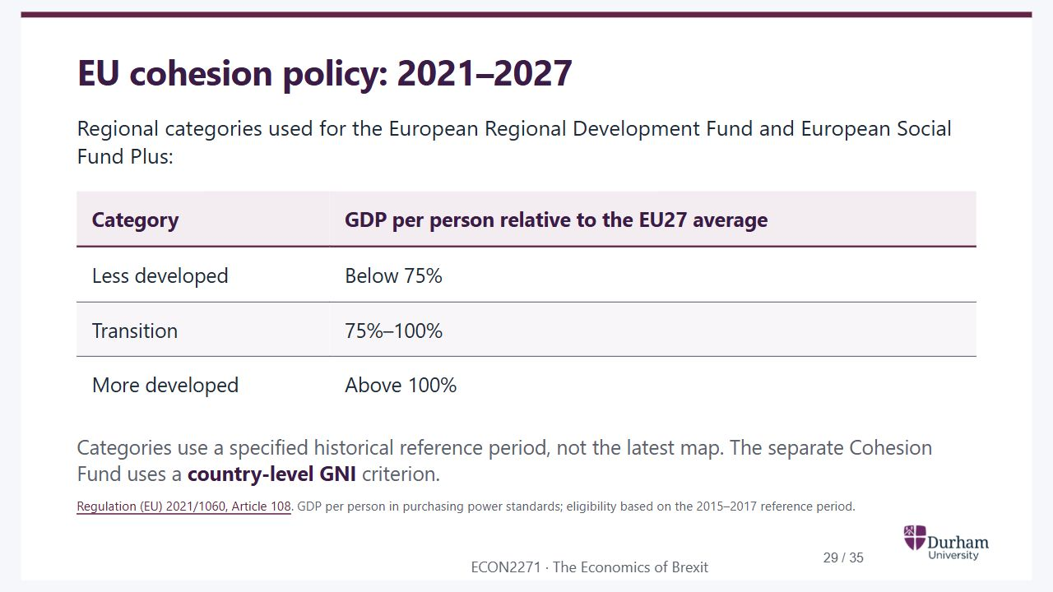
Notes:
Static student copy of the current web slide. Slide artwork is flattened; add personal notes here. Interactive explanations, playback and accessible HTML are available at:
https://davidchivers.co.uk/teaching/macro-applications/lecture_5.html#/l5-s25
EU cohesion policy: 2021–2027 Regional categories used for the European Regional Development Fund and European Social Fund Plus: Category GDP per person relative to the EU27 average Less developed Below 75% Transition 75%–100% More developed Above 100% Categories use a specified historical reference period, not the latest map. The separate Cohesion Fund uses a country-level GNI criterion. Regulation (EU) 2021/1060, Article 108 . GDP per person in purchasing power standards; eligibility based on the 2015–2017 reference period.
https://eur-lex.europa.eu/eli/reg/2021/1060/oj/eng

Slide 30

Notes:
Static student copy of the current web slide. Slide artwork is flattened; add personal notes here. Interactive explanations, playback and accessible HTML are available at:
https://davidchivers.co.uk/teaching/macro-applications/lecture_5.html#/l5-policy-question
Should policy help places, people, or both? Show the trade-off Local investment can improve opportunities where people live. Training, income support and mobility can help people directly. Judge employment, real incomes and spillovers against a credible without-policy comparison .

Slide 31
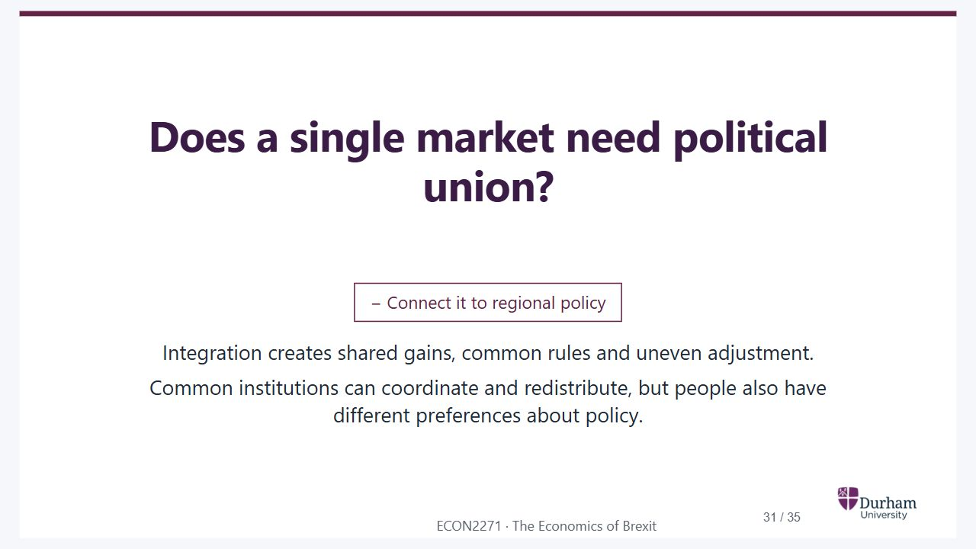
Notes:
Static student copy of the current web slide. Slide artwork is flattened; add personal notes here. Interactive explanations, playback and accessible HTML are available at:
https://davidchivers.co.uk/teaching/macro-applications/lecture_5.html#/l5-s26
Does a single market need political union? Connect it to regional policy Integration creates shared gains, common rules and uneven adjustment. Common institutions can coordinate and redistribute, but people also have different preferences about policy.

Slide 32
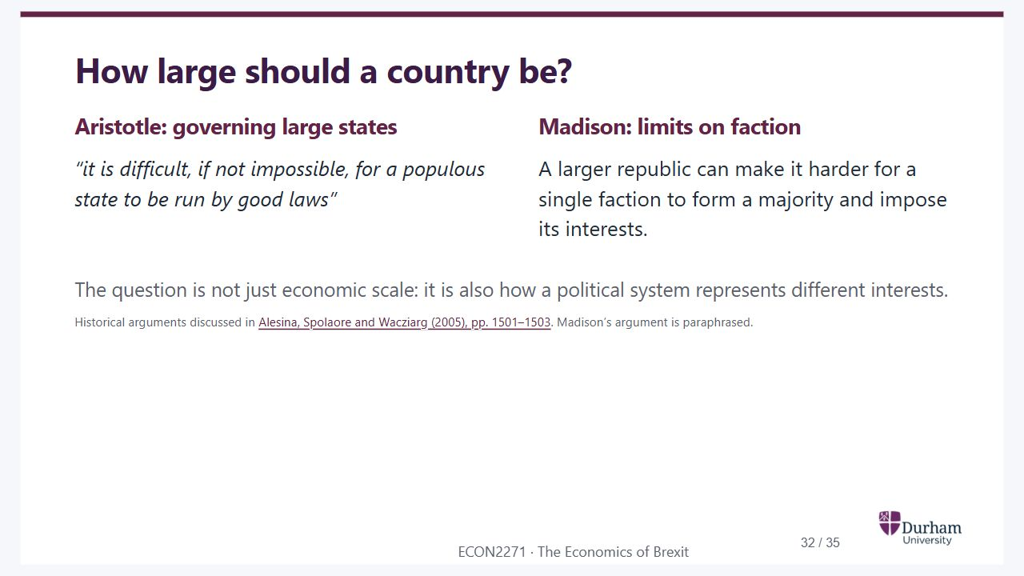
Notes:
Static student copy of the current web slide. Slide artwork is flattened; add personal notes here. Interactive explanations, playback and accessible HTML are available at:
https://davidchivers.co.uk/teaching/macro-applications/lecture_5.html#/l5-s27
How large should a country be? Aristotle: governing large states “it is difficult, if not impossible, for a populous state to be run by good laws” Madison: limits on faction A larger republic can make it harder for a single faction to form a majority and impose its interests. The question is not just economic scale: it is also how a political system represents different interests. Historical arguments discussed in Alesina, Spolaore and Wacziarg (2005), pp. 1501–1503 . Madison’s argument is paraphrased.
https://bpb-us-e1.wpmucdn.com/sites.tufts.edu/dist/6/1020/files/2012/08/2005_handbook.pdf

Slide 33
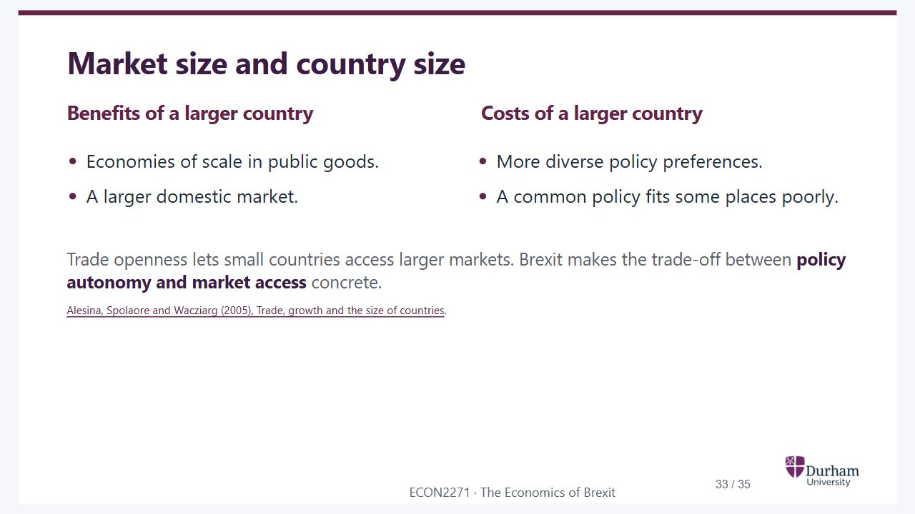
Notes:
Static student copy of the current web slide. Slide artwork is flattened; add personal notes here. Interactive explanations, playback and accessible HTML are available at:
https://davidchivers.co.uk/teaching/macro-applications/lecture_5.html#/l5-s28
Market size and country size Benefits of a larger country Economies of scale in public goods. A larger domestic market. Costs of a larger country More diverse policy preferences. A common policy fits some places poorly. Trade openness lets small countries access larger markets. Brexit makes the trade-off between policy autonomy and market access concrete. Alesina, Spolaore and Wacziarg (2005), Trade, growth and the size of countries .
https://bpb-us-e1.wpmucdn.com/sites.tufts.edu/dist/6/1020/files/2012/08/2005_handbook.pdf

Slide 34

Notes:
Static student copy of the current web slide. Slide artwork is flattened; add personal notes here. Interactive explanations, playback and accessible HTML are available at:
https://davidchivers.co.uk/teaching/macro-applications/lecture_5.html#/l5-revision
Revision Bringing it together When does integration raise welfare, and who gains or loses? Preparation: Practise linking each diagram to an argument and a piece of evidence.

Slide 35

Notes:
Static student copy of the current web slide. Slide artwork is flattened; add personal notes here. Interactive explanations, playback and accessible HTML are available at:
https://davidchivers.co.uk/teaching/macro-applications/lecture_5.html#/l5-s29
References Essential reading Baldwin and Wyplosz, The Economics of European Integration , “Location effects and regional policy” (Chapter 10 in the seventh edition) . Other editions are fine; find the chapter by its title. Further reading See the ECON2271 Talis reading list , also available through Blackboard.
https://durham.rl.talis.com/lists/d85d1ad3-e9ac-4daf-aa66-e3ddfcf902d7.html

