Slide 1
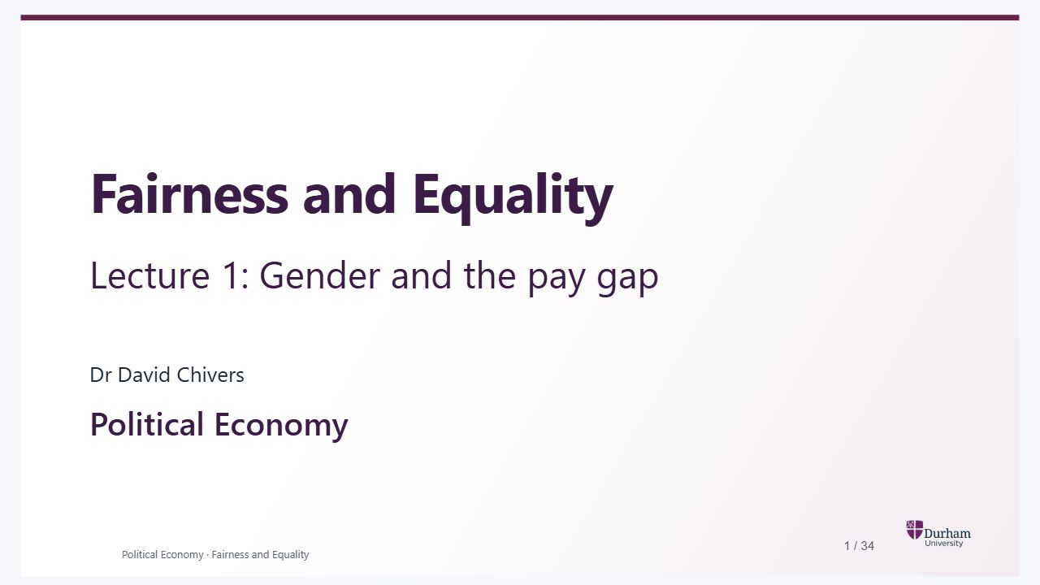
Notes:
Static student copy of the current web slide. Slide artwork is flattened; add personal notes here. Interactive explanations, playback and accessible HTML are available at:
https://davidchivers.co.uk/teaching/political-economy/lecture_1.html#/title-slide
Fairness and Equality Lecture 1: Gender and the pay gap Dr David Chivers Political Economy

Slide 2

Notes:
Static student copy of the current web slide. Slide artwork is flattened; add personal notes here. Interactive explanations, playback and accessible HTML are available at:
https://davidchivers.co.uk/teaching/political-economy/lecture_1.html#/course-outline
The course Gender and the pay gap Discrimination Technology, AI and work Fairness Redistribution

Slide 3
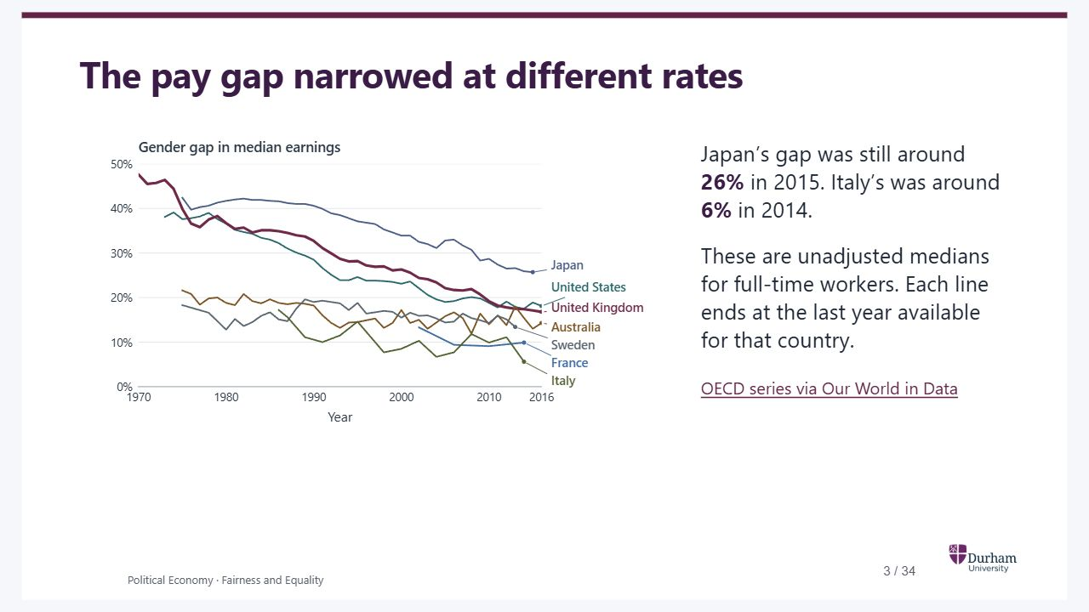
Notes:
Static student copy of the current web slide. Slide artwork is flattened; add personal notes here. Interactive explanations, playback and accessible HTML are available at:
https://davidchivers.co.uk/teaching/political-economy/lecture_1.html#/pe2-s02
The pay gap narrowed at different rates Add six countries Show the UK alone In the UK, women’s median earnings were 48% below men’s in 1970. By 2016 the gap was 17% . Did the gap narrow at the same pace elsewhere? Japan’s gap was still around 26% in 2015. Italy’s was around 6% in 2014. These are unadjusted medians for full-time workers. Each line ends at the last year available for that country. OECD series via Our World in Data The historical OECD series covers full-time employees and self-employed workers. The gap compares the middle earner in each group. Changing who participates in full-time work can change the measured gap. Show the other countries to compare paths on the same axes.
The historical OECD series covers full-time employees and self-employed workers. The gap compares the middle earner in each group. Changing who participates in full-time work can change the measured gap. Show the other countries to compare paths on the same axes.
UK unadjusted median earnings gap among full-time workers, 1970–2016. It falls from 47.6% to 16.8%.
The same UK series alongside Australia, France, Italy, Japan, Sweden and the United States. Countries differ in both levels and rates of catch-up. The lines end at their own last observations.
https://ourworldindata.org/grapher/gender-wage-gap-oecd

Slide 4
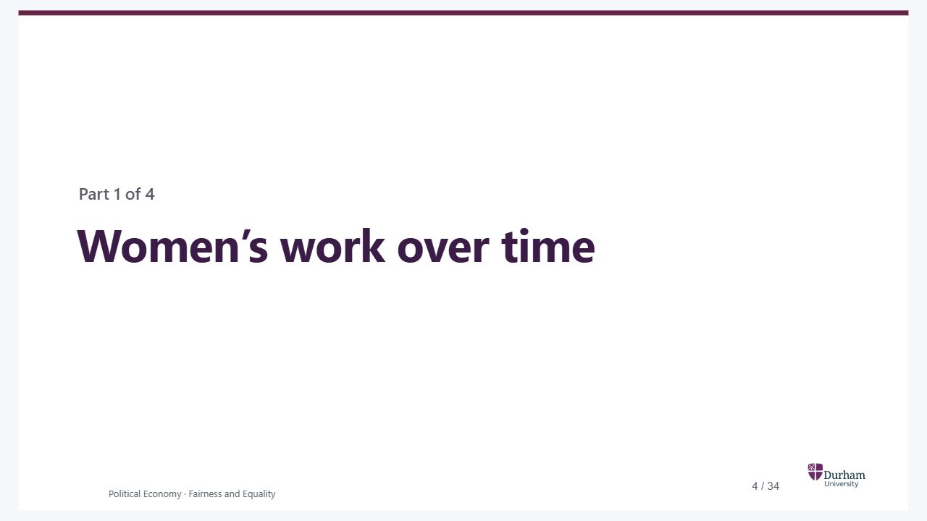
Notes:
Static student copy of the current web slide. Slide artwork is flattened; add personal notes here. Interactive explanations, playback and accessible HTML are available at:
https://davidchivers.co.uk/teaching/political-economy/lecture_1.html#/womens-work
Women’s work over time Part 1 of 4 The opening graph showed a narrowing pay gap. Start with a change behind that history. Where could married women find paid work, and what made it possible to train for a career?
The opening graph showed a narrowing pay gap. Start with a change behind that history. Where could married women find paid work, and what made it possible to train for a career?

Slide 5
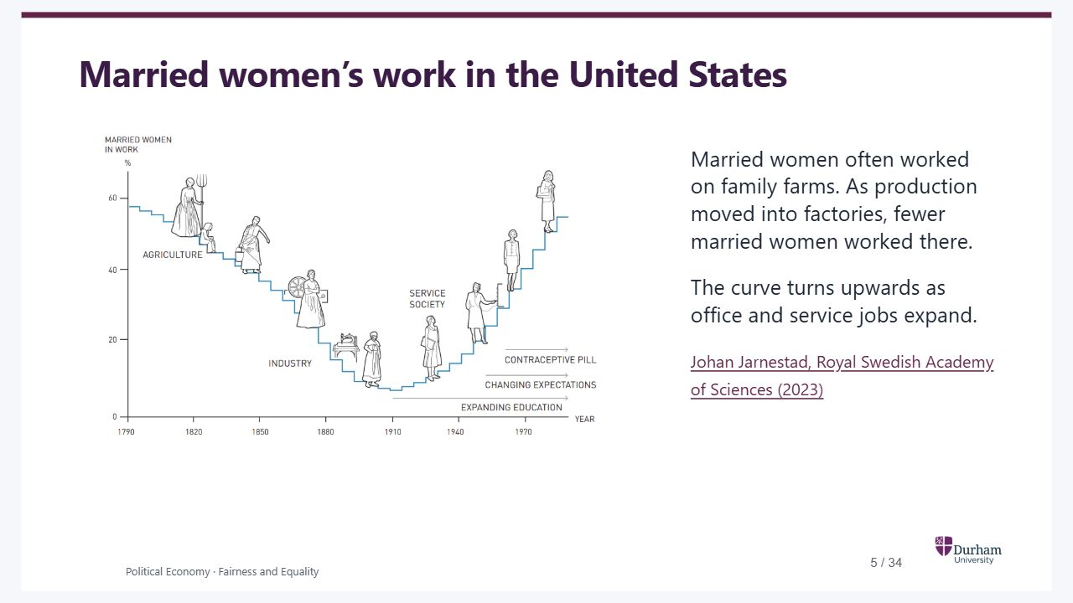
Notes:
Static student copy of the current web slide. Slide artwork is flattened; add personal notes here. Interactive explanations, playback and accessible HTML are available at:
https://davidchivers.co.uk/teaching/political-economy/lecture_1.html#/pe2-s04
Married women’s work in the United States Married women often worked on family farms. As production moved into factories, fewer married women worked there. The curve turns upwards as office and service jobs expand. Johan Jarnestad, Royal Swedish Academy of Sciences (2023)
Illustrated U-shaped curve. The share of married US women in work falls as the economy moves away from agriculture, reaches its low near 1910, then rises with the expansion of service work.
https://www.nobelprize.org/uploads/2023/10/fig2_ek_en_23.pdf

Slide 6
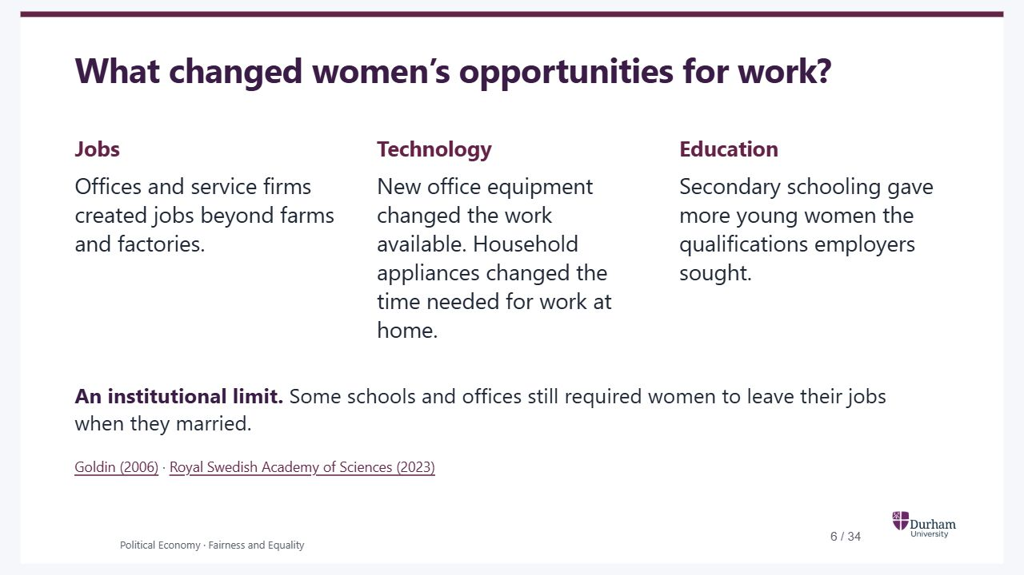
Notes:
Static student copy of the current web slide. Slide artwork is flattened; add personal notes here. Interactive explanations, playback and accessible HTML are available at:
https://davidchivers.co.uk/teaching/political-economy/lecture_1.html#/pe2-s05
What changed women’s opportunities for work? Jobs Offices and service firms created jobs beyond farms and factories. Technology New office equipment changed the work available. Household appliances changed the time needed for work at home. Education Secondary schooling gave more young women the qualifications employers sought. An institutional limit. Some schools and offices still required women to leave their jobs when they married. Goldin (2006) · Royal Swedish Academy of Sciences (2023)
https://www.nber.org/papers/w11953
https://www.nobelprize.org/prizes/economic-sciences/2023/popular-information/

Slide 7
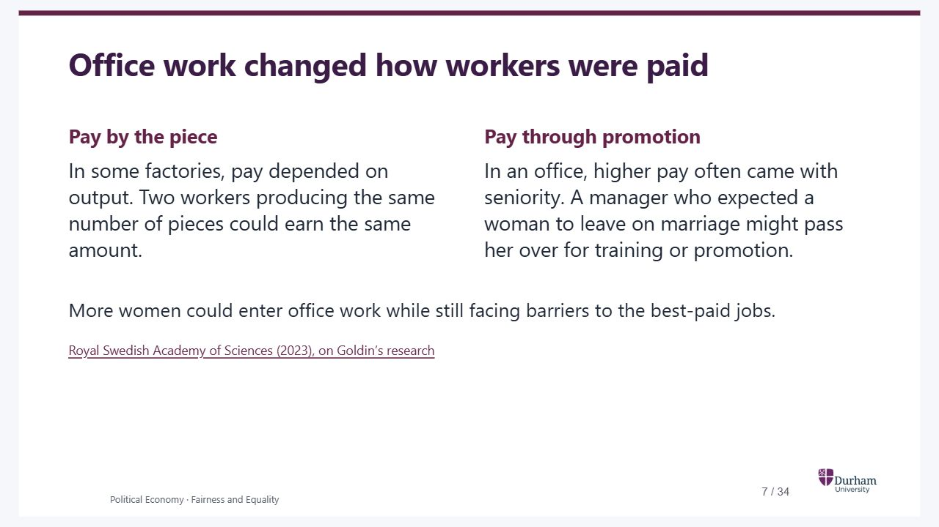
Notes:
Static student copy of the current web slide. Slide artwork is flattened; add personal notes here. Interactive explanations, playback and accessible HTML are available at:
https://davidchivers.co.uk/teaching/political-economy/lecture_1.html#/pe2-s06
Office work changed how workers were paid Pay by the piece In some factories, pay depended on output. Two workers producing the same number of pieces could earn the same amount. Pay through promotion In an office, higher pay often came with seniority. A manager who expected a woman to leave on marriage might pass her over for training or promotion. More women could enter office work while still facing barriers to the best-paid jobs. Royal Swedish Academy of Sciences (2023), on Goldin’s research
https://www.nobelprize.org/prizes/economic-sciences/2023/popular-information/

Slide 8
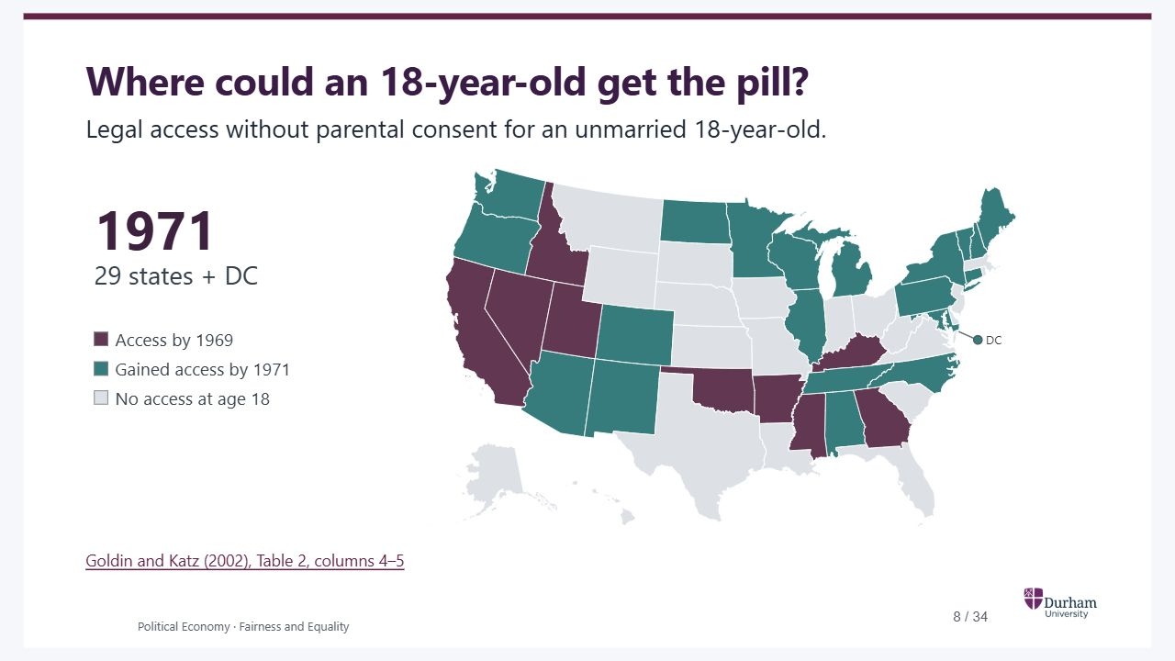
Notes:
Static student copy of the current web slide. Slide artwork is flattened; add personal notes here. Interactive explanations, playback and accessible HTML are available at:
https://davidchivers.co.uk/teaching/political-economy/lecture_1.html#/pe2-s07
Where could an 18-year-old get the pill? Legal access without parental consent for an unmarried 18-year-old. 1969 9 states 1971 29 states + DC Show 1971 → ← Back to 1969 Access by 1969 Gained access by 1971 No access at age 18 DC Goldin and Katz (2002), Table 2, columns 4–5 Take two neighbours. Illinois and Indiana both required age 21 in 1969. By 1971 the authors code Illinois at 14 and Indiana at 21. An unmarried 18-year-old could therefore obtain the pill without parental consent in Illinois. This is the kind of variation across states and birth cohorts that the paper uses. What might it change for someone deciding whether to start a professional degree? The map follows the authors’ historical coding of the earliest legal age. Some rules had conditions, discussed in the table notes (for example, Alabama’s provision for high school graduates). Actual access also depended on providers. The authors’ count of 30 includes DC. State boundaries from US Atlas, based on US Census Bureau cartographic boundaries .
Take two neighbours. Illinois and Indiana both required age 21 in 1969. By 1971 the authors code Illinois at 14 and Indiana at 21. An unmarried 18-year-old could therefore obtain the pill without parental consent in Illinois. This is the kind of variation across states and birth cohorts that the paper uses. What might it change for someone deciding whether to start a professional degree? The map follows the authors’ historical coding of the earliest legal age. Some rules had conditions, discussed in the table notes (for example, Alabama’s provision for high school graduates). Actual access also depended on providers. The authors’ count of 30 includes DC. State boundaries from US Atlas, based on US Census Bureau cartographic boundaries .
https://inequality.stanford.edu/sites/default/files/media/_media/pdf/Reference%20Media/Goldin%20and%20Katz_2002_Gender.pdf#page=11
https://github.com/topojson/us-atlas

Slide 9
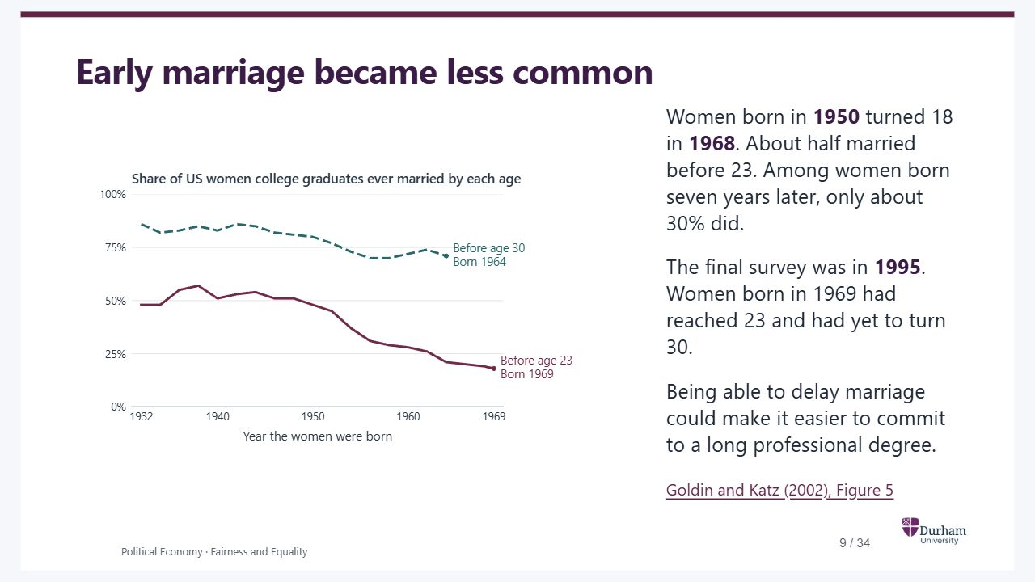
Notes:
Static student copy of the current web slide. Slide artwork is flattened; add personal notes here. Interactive explanations, playback and accessible HTML are available at:
https://davidchivers.co.uk/teaching/political-economy/lecture_1.html#/pe2-marriage-timing
Early marriage became less common Women born in 1950 turned 18 in 1968 . About half married before 23. Among women born seven years later, only about 30% did. The final survey was in 1995 . Women born in 1969 had reached 23 and had yet to turn 30. Being able to delay marriage could make it easier to commit to a long professional degree. Goldin and Katz (2002), Figure 5 Each line follows successive birth cohorts of US women college graduates. Figure 5 uses the 1990 and 1995 US Current Population Survey and three-year centred moving averages. The chart traces alternate birth years and includes each line’s final reported cohort, rounded to the nearest percentage point. The national trend describes marriage timing. Reliable contraception could make it easier to plan several years of training before marriage. To investigate the pill’s contribution, Goldin and Katz compare cohorts facing different state access laws. The next figure shows entry into professional training.
Each line follows successive birth cohorts of US women college graduates. Figure 5 uses the 1990 and 1995 US Current Population Survey and three-year centred moving averages. The chart traces alternate birth years and includes each line’s final reported cohort, rounded to the nearest percentage point. The national trend describes marriage timing. Reliable contraception could make it easier to plan several years of training before marriage. To investigate the pill’s contribution, Goldin and Katz compare cohorts facing different state access laws. The next figure shows entry into professional training.
The horizontal axis is birth year. Among US women college graduates, about half of those born in 1950 married before 23, compared with about 30% of those born in 1957. The before-23 line ends with women born in 1969. The before-30 line falls less and ends with women born in 1964.
https://inequality.stanford.edu/sites/default/files/media/_media/pdf/Reference%20Media/Goldin%20and%20Katz_2002_Gender.pdf#page=22

Slide 10
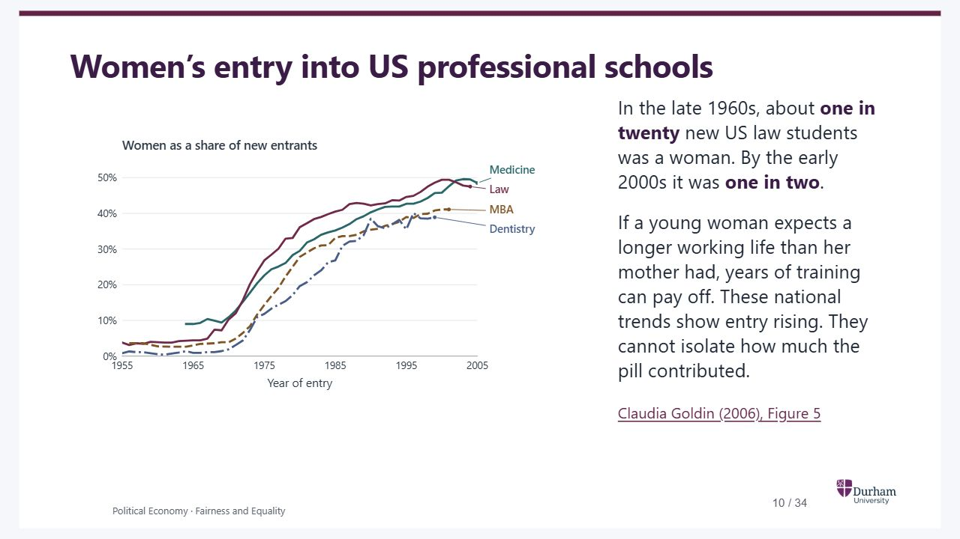
Notes:
Static student copy of the current web slide. Slide artwork is flattened; add personal notes here. Interactive explanations, playback and accessible HTML are available at:
https://davidchivers.co.uk/teaching/political-economy/lecture_1.html#/pe2-s08
Women’s entry into US professional schools In the late 1960s, about one in twenty new US law students was a woman. By the early 2000s it was one in two . If a young woman expects a longer working life than her mother had, years of training can pay off. These national trends show entry rising. They cannot isolate how much the pill contributed. Claudia Goldin (2006), Figure 5 The four lines are traced from Goldin’s plotted series. Each stops at its own last reported year. Law and medicine use entrant counts. Goldin infers entry for dentistry and MBA programmes from degrees awarded four and two years later, respectively. The simultaneous rise alone does not identify the effect of access to the pill.
The four lines are traced from Goldin’s plotted series. Each stops at its own last reported year. Law and medicine use entrant counts. Goldin infers entry for dentistry and MBA programmes from degrees awarded four and two years later, respectively. The simultaneous rise alone does not identify the effect of access to the pill.
Women’s share of new US entrants in medicine, law, dentistry and MBA programmes, 1955–2005. All four series turn upwards around 1970. Law and medicine reach roughly half by the early 2000s.
https://www.nber.org/system/files/working_papers/w11953/w11953.pdf#page=40

Slide 11
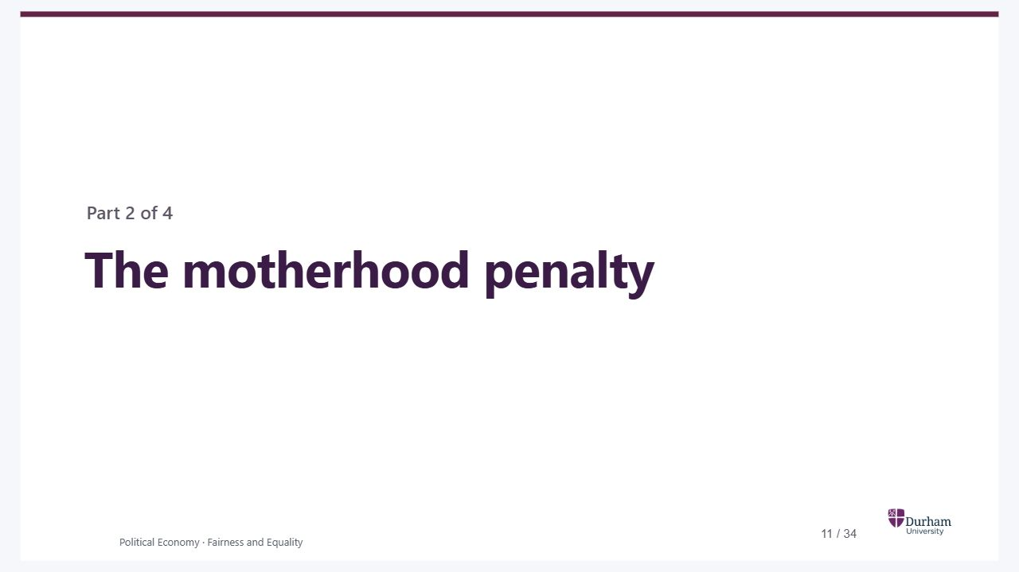
Notes:
Static student copy of the current web slide. Slide artwork is flattened; add personal notes here. Interactive explanations, playback and accessible HTML are available at:
https://davidchivers.co.uk/teaching/political-economy/lecture_1.html#/motherhood-penalty
The motherhood penalty Part 2 of 4 We have seen more women entering professional training. Now follow what happens to earnings when workers become parents for the first time.
We have seen more women entering professional training. Now follow what happens to earnings when workers become parents for the first time.

Slide 12
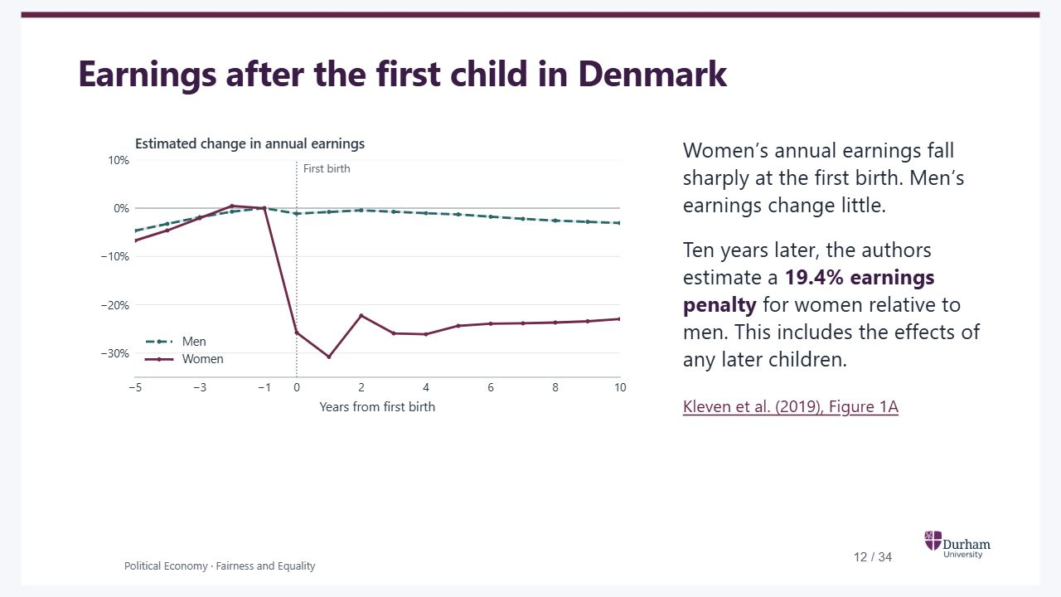
Notes:
Static student copy of the current web slide. Slide artwork is flattened; add personal notes here. Interactive explanations, playback and accessible HTML are available at:
https://davidchivers.co.uk/teaching/political-economy/lecture_1.html#/pe2-s10
Earnings after the first child in Denmark Reveal earnings after birth Show only the years before birth Year 0 is the first birth. Both lines use the previous year as their reference. Before the birth, the two paths look similar. What would you expect by the child’s tenth birthday? Women’s annual earnings fall sharply at the first birth. Men’s earnings change little. Ten years later, the authors estimate a 19.4% earnings penalty for women relative to men. This includes the effects of any later children. Kleven et al. (2019), Figure 1A The figures are event-study estimates from Danish administrative data with age and calendar-year controls. The authors’ ten-year penalty is a relative counterfactual earnings measure. Reading the vertical distance between the plotted points only approximates it. Annual earnings combine employment, hours and hourly pay. Tutorial 3 uses the other panels to distinguish these margins.
The figures are event-study estimates from Danish administrative data with age and calendar-year controls. The authors’ ten-year penalty is a relative counterfactual earnings measure. Reading the vertical distance between the plotted points only approximates it. Annual earnings combine employment, hours and hourly pay. Tutorial 3 uses the other panels to distinguish these margins.
Danish women’s and men’s estimated earnings paths in the five years before first birth. Both series are measured relative to the year before birth. Later years are still hidden.
The same series through ten years after the first birth. Women’s annual earnings fall sharply, while men’s change little. Shaded bands show 95% confidence intervals.
https://jenni.uchicago.edu/Fertility/Kleven_Landais_Sogaaard_2019_AEJAE_v11_n4.pdf#page=10

Slide 13
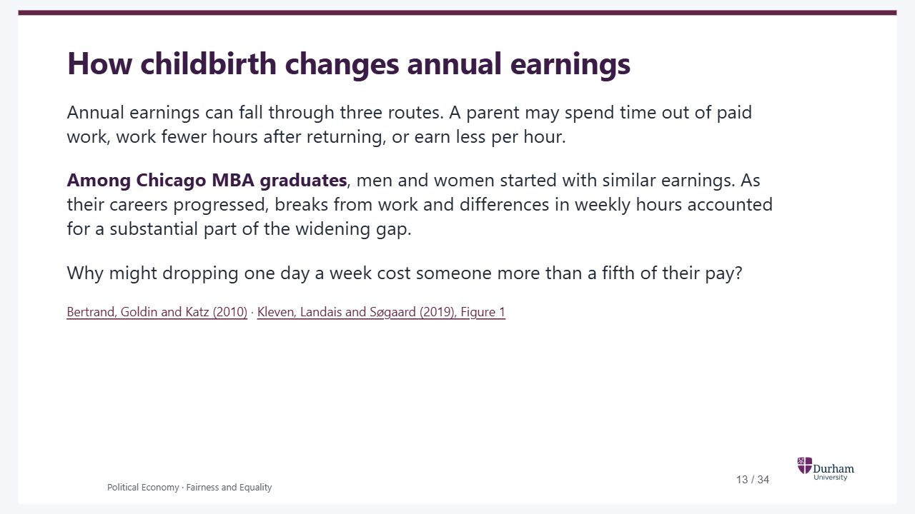
Notes:
Static student copy of the current web slide. Slide artwork is flattened; add personal notes here. Interactive explanations, playback and accessible HTML are available at:
https://davidchivers.co.uk/teaching/political-economy/lecture_1.html#/pe2-s11
How childbirth changes annual earnings Annual earnings can fall through three routes. A parent may spend time out of paid work, work fewer hours after returning, or earn less per hour. Among Chicago MBA graduates , men and women started with similar earnings. As their careers progressed, breaks from work and differences in weekly hours accounted for a substantial part of the widening gap. Why might dropping one day a week cost someone more than a fifth of their pay? Bertrand, Goldin and Katz (2010) · Kleven, Landais and Søgaard (2019), Figure 1
https://doi.org/10.1257/app.2.3.228
https://jenni.uchicago.edu/Fertility/Kleven_Landais_Sogaaard_2019_AEJAE_v11_n4.pdf#page=10

Slide 14
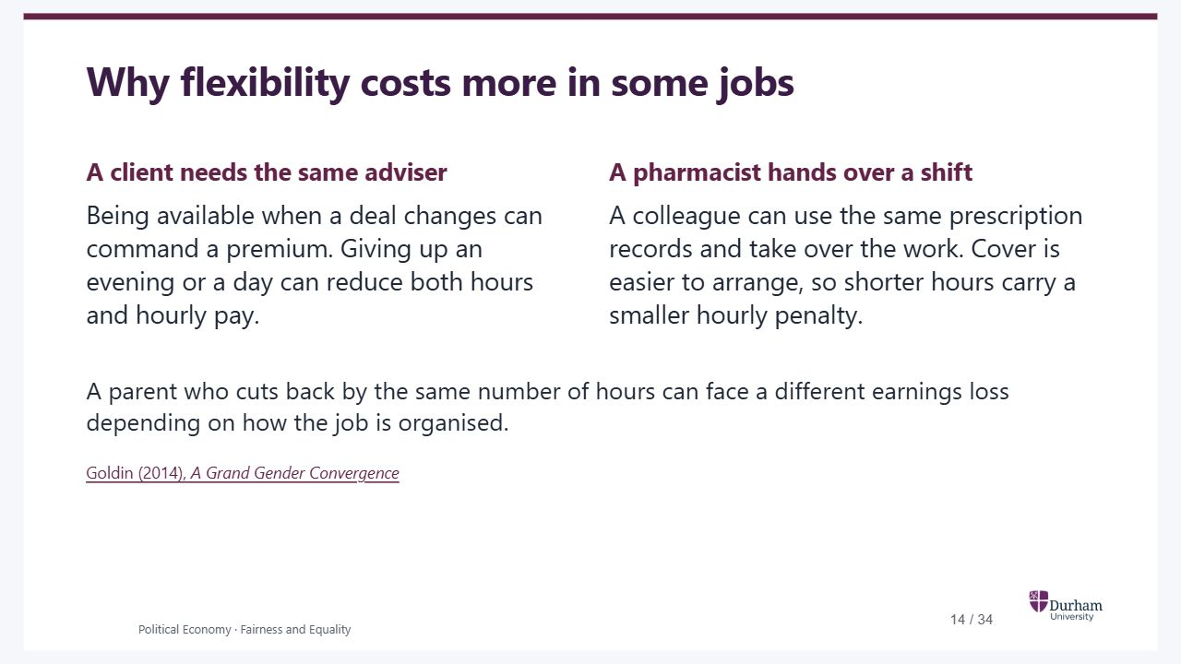
Notes:
Static student copy of the current web slide. Slide artwork is flattened; add personal notes here. Interactive explanations, playback and accessible HTML are available at:
https://davidchivers.co.uk/teaching/political-economy/lecture_1.html#/pe2-s12
Why flexibility costs more in some jobs A client needs the same adviser Being available when a deal changes can command a premium. Giving up an evening or a day can reduce both hours and hourly pay. A pharmacist hands over a shift A colleague can use the same prescription records and take over the work. Cover is easier to arrange, so shorter hours carry a smaller hourly penalty. A parent who cuts back by the same number of hours can face a different earnings loss depending on how the job is organised. Goldin (2014), A Grand Gender Convergence Use the adviser as an illustration of a job with costly handovers. An intervention aimed at hours, such as childcare, and one aimed at the hourly premium, such as redesigning cover, address different mechanisms. The Danish event study does not estimate either intervention’s effect.
Use the adviser as an illustration of a job with costly handovers. An intervention aimed at hours, such as childcare, and one aimed at the hourly premium, such as redesigning cover, address different mechanisms. The Danish event study does not estimate either intervention’s effect.
https://doi.org/10.1257/aer.104.4.1091

Slide 15

Notes:
Static student copy of the current web slide. Slide artwork is flattened; add personal notes here. Interactive explanations, playback and accessible HTML are available at:
https://davidchivers.co.uk/teaching/political-economy/lecture_1.html#/pay-comparisons
Pay comparisons and DAGs Part 3 of 4 We have seen how parenthood and the way jobs reward availability can change earnings. The education comparison motivates why comparing similar workers still needs care. Introduce how to read a DAG, then a mediator, then prior experience as an observed or missing common cause. The next section adds selection and colliders. Place the Google pay audit after the education comparison: does comparing similar workers establish that there is no discrimination? Use this as the motivating question for the DAGs and return to it verbally after the job-level example.
We have seen how parenthood and the way jobs reward availability can change earnings. The education comparison motivates why comparing similar workers still needs care. Introduce how to read a DAG, then a mediator, then prior experience as an observed or missing common cause. The next section adds selection and colliders. Place the Google pay audit after the education comparison: does comparing similar workers establish that there is no discrimination? Use this as the motivating question for the DAGs and return to it verbally after the job-level example.

Slide 16
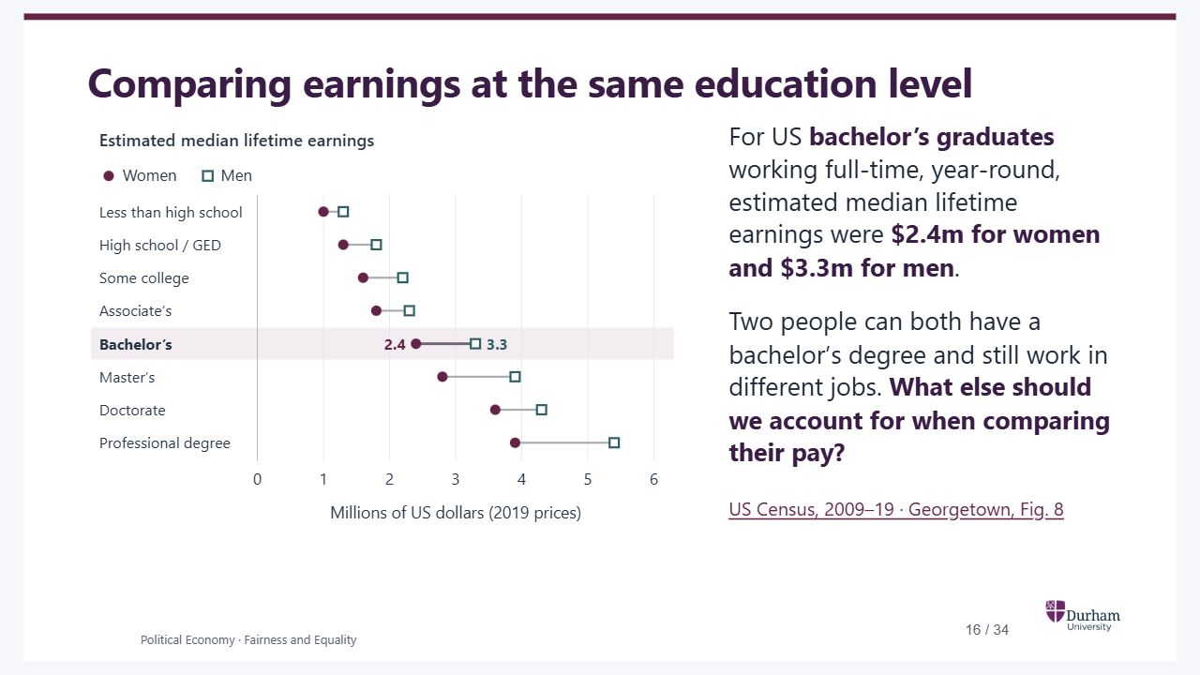
Notes:
Static student copy of the current web slide. Slide artwork is flattened; add personal notes here. Interactive explanations, playback and accessible HTML are available at:
https://davidchivers.co.uk/teaching/political-economy/lecture_1.html#/pe2-s15
Comparing earnings at the same education level For US bachelor’s graduates working full-time, year-round, estimated median lifetime earnings were $2.4m for women and $3.3m for men . Two people can both have a bachelor’s degree and still work in different jobs. What else should we account for when comparing their pay? US Census, 2009–19 · Georgetown, Fig. 8 The report combines age-specific earnings across ages 25–64 for people working full-time, full-year to estimate a working lifetime in 2019 US dollars. It does not track the same people for forty years. The highlighted difference is approximate because Figure 8 rounds both estimates. The comparison cannot identify discrimination or give the causal return to education. The underlying distributions overlap.
The report combines age-specific earnings across ages 25–64 for people working full-time, full-year to estimate a working lifetime in 2019 US dollars. It does not track the same people for forty years. The highlighted difference is approximate because Figure 8 rounds both estimates. The comparison cannot identify discrimination or give the causal return to education. The underlying distributions overlap.
Estimated US median lifetime earnings rise with education for women and men. At all eight education levels the median is lower for women. For a bachelor’s degree the estimates are $2.4 million for women and $3.3 million for men.
https://files.eric.ed.gov/fulltext/ED615605.pdf#page=13

Slide 17
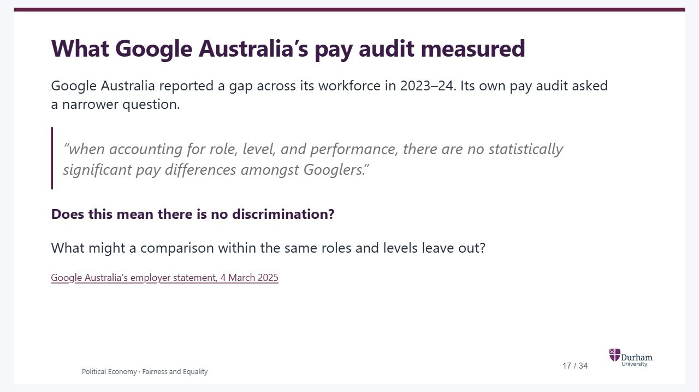
Notes:
Static student copy of the current web slide. Slide artwork is flattened; add personal notes here. Interactive explanations, playback and accessible HTML are available at:
https://davidchivers.co.uk/teaching/political-economy/lecture_1.html#/pe2-s14
What Google Australia’s pay audit measured Google Australia reported a gap across its workforce in 2023–24. Its own pay audit asked a narrower question. “when accounting for role, level, and performance, there are no statistically significant pay differences amongst Googlers.” Does this mean there is no discrimination? What might a comparison within the same roles and levels leave out? Google Australia’s employer statement, 4 March 2025 Use this to raise the question immediately after the education comparison and before introducing DAGs. Ask students what the adjusted result does and does not establish; return to it verbally once the job-level example has supplied the tools. Attribute the adjusted finding to the employer. A statistically insignificant difference does not establish that the true difference is zero. Performance ratings may stand in for skill, but if discrimination affects ratings, controlling for them can also exclude part of its effect. This is a possible mechanism, not a finding about Google’s ratings. The later model will explain why conditioning on job level can leave out a promotion route and, under its assumptions, induce selection on skill. It does not establish that those mechanisms explain Google’s result. To assess access to senior roles, ask who was eligible, who applied, who was promoted and how long they waited. A within-role audit answers a narrower question than an assessment of all unequal opportunities.
Use this to raise the question immediately after the education comparison and before introducing DAGs. Ask students what the adjusted result does and does not establish; return to it verbally once the job-level example has supplied the tools. Attribute the adjusted finding to the employer. A statistically insignificant difference does not establish that the true difference is zero. Performance ratings may stand in for skill, but if discrimination affects ratings, controlling for them can also exclude part of its effect. This is a possible mechanism, not a finding about Google’s ratings. The later model will explain why conditioning on job level can leave out a promotion route and, under its assumptions, induce selection on skill. It does not establish that those mechanisms explain Google’s result. To assess access to senior roles, ask who was eligible, who applied, who was promoted and how long they waited. A within-role audit answers a narrower question than an assessment of all unequal opportunities.
https://blog.google/intl/en-au/company-news/google-australia-wgea-2024-employer-statement/

Slide 18
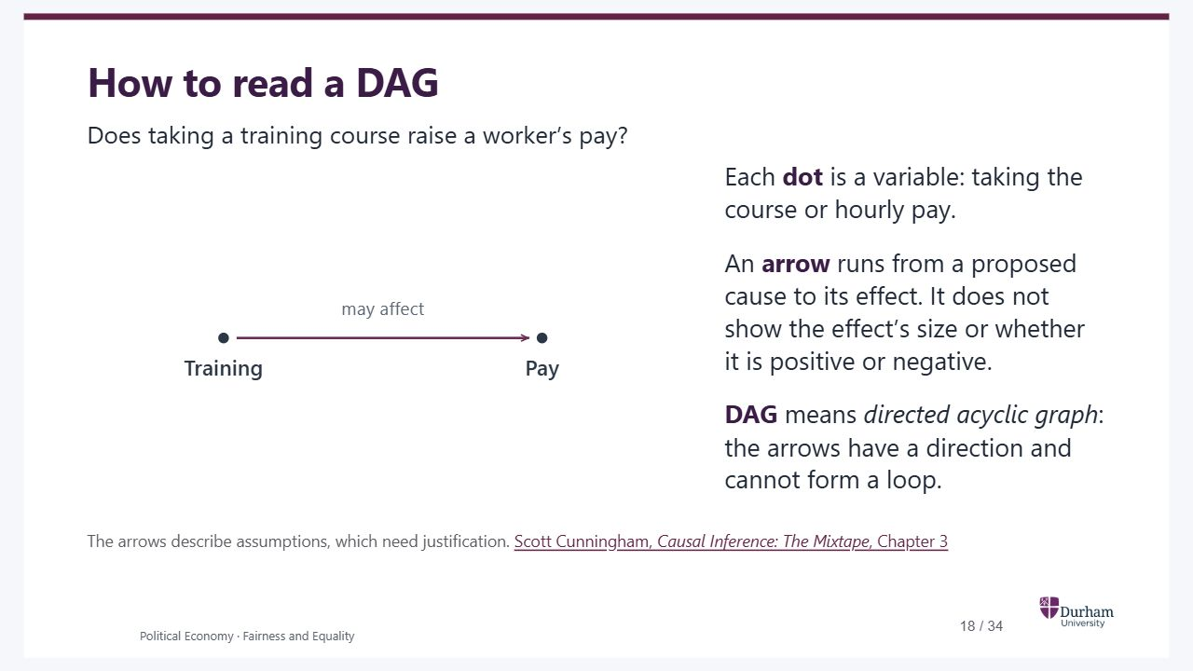
Notes:
Static student copy of the current web slide. Slide artwork is flattened; add personal notes here. Interactive explanations, playback and accessible HTML are available at:
https://davidchivers.co.uk/teaching/political-economy/lecture_1.html#/pe2-s17
How to read a DAG Does taking a training course raise a worker’s pay? Each dot is a variable: taking the course or hourly pay. An arrow runs from a proposed cause to its effect. It does not show the effect’s size or whether it is positive or negative. DAG means directed acyclic graph : the arrows have a direction and cannot form a loop. The arrows describe assumptions, which need justification. Scott Cunningham, Causal Inference: The Mixtape , Chapter 3 This hypothetical training course gives us a familiar question with a clear intervention before returning to gender and pay. Read the one arrow aloud first: taking the course may change someone’s pay. It is a causal assumption, not an observed correlation or an estimate. The next slide opens up the training-to-pay arrow to show one possible mechanism. We then introduce prior experience as a common cause, before considering what happens if that experience is missing from the data. In a complete DAG we aim to include the relevant common causes; an omitted arrow rules out that direct link, not every indirect connection. A path is a route along connected arrows. Following arrows all the way forward traces a causal mechanism. Acyclic means that following arrows cannot bring us back to the same variable. Feedback over time needs separate variables for different times. Do not introduce formal path-blocking rules here.
This hypothetical training course gives us a familiar question with a clear intervention before returning to gender and pay. Read the one arrow aloud first: taking the course may change someone’s pay. It is a causal assumption, not an observed correlation or an estimate. The next slide opens up the training-to-pay arrow to show one possible mechanism. We then introduce prior experience as a common cause, before considering what happens if that experience is missing from the data. In a complete DAG we aim to include the relevant common causes; an omitted arrow rules out that direct link, not every indirect connection. A path is a route along connected arrows. Following arrows all the way forward traces a causal mechanism. Acyclic means that following arrows cannot bring us back to the same variable. Feedback over time needs separate variables for different times. Do not introduce formal path-blocking rules here.
Two dots represent training and pay. An arrow from training to pay represents the assumption that taking a course can affect pay.
https://mixtape-1ed.netlify.app/03-directed_acyclical_graphs

Slide 19
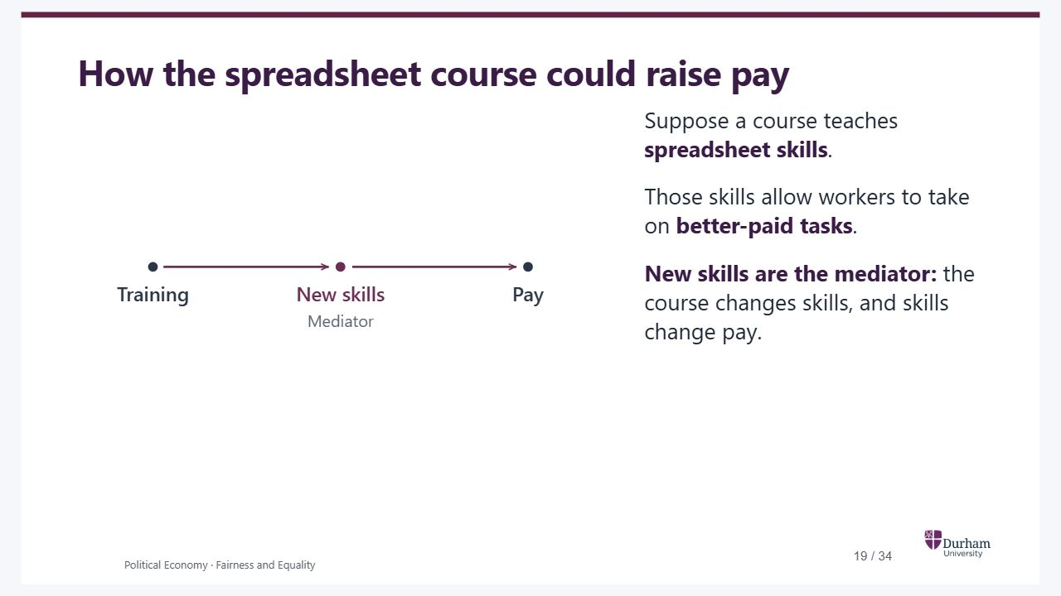
Notes:
Static student copy of the current web slide. Slide artwork is flattened; add personal notes here. Interactive explanations, playback and accessible HTML are available at:
https://davidchivers.co.uk/teaching/political-economy/lecture_1.html#/training-skills
How the spreadsheet course could raise pay Suppose a course teaches spreadsheet skills . Those skills allow workers to take on better-paid tasks . New skills are the mediator: the course changes skills, and skills change pay. Read the chain from left to right: taking the course changes spreadsheet skills; those skills affect pay by allowing better-paid work. This is a hypothetical causal mechanism, not an estimated effect. A mediator is an intermediate cause on a particular causal path. It describes how the effect is transmitted. It is not inherently a bias or a problem, and it is not simply a proxy: a proxy measures or stands in for something else, whereas the mediator has a causal role in the proposed mechanism. Do not introduce total-versus-direct regressions here. The later job-level example explains what changes when we condition on a mediator, and why job level can also be a collider on a different path.
Read the chain from left to right: taking the course changes spreadsheet skills; those skills affect pay by allowing better-paid work. This is a hypothetical causal mechanism, not an estimated effect. A mediator is an intermediate cause on a particular causal path. It describes how the effect is transmitted. It is not inherently a bias or a problem, and it is not simply a proxy: a proxy measures or stands in for something else, whereas the mediator has a causal role in the proposed mechanism. Do not introduce total-versus-direct regressions here. The later job-level example explains what changes when we condition on a mediator, and why job level can also be a collider on a different path.
Training points to new skills, and new skills point to pay. New skills are the intermediate step through which training affects pay in this example.

Slide 20
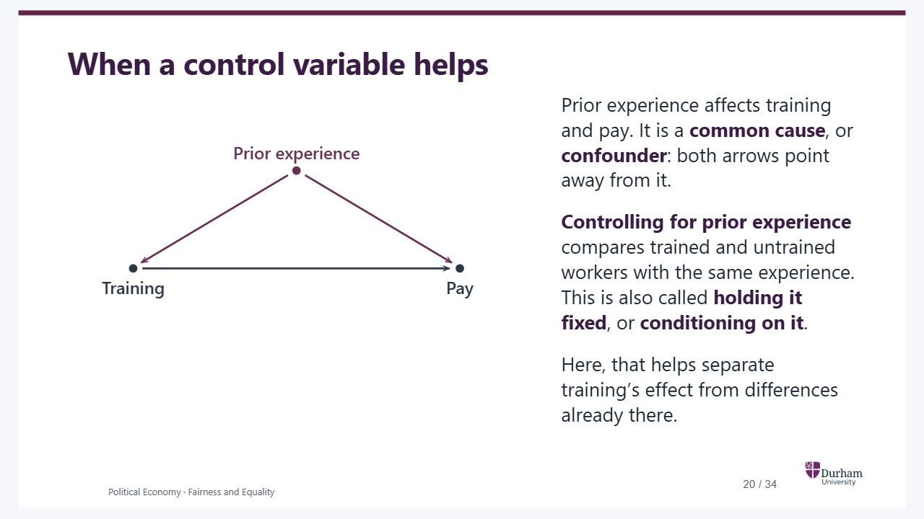
Notes:
Static student copy of the current web slide. Slide artwork is flattened; add personal notes here. Interactive explanations, playback and accessible HTML are available at:
https://davidchivers.co.uk/teaching/political-economy/lecture_1.html#/pe2-s18
When a control variable helps Prior experience affects training and pay. It is a common cause , or confounder : both arrows point away from it. Controlling for prior experience compares trained and untrained workers with the same experience. This is also called holding it fixed , or conditioning on it . Here, that helps separate training’s effect from differences already there. Controlling for a variable means making comparisons at the same value, for example comparing workers who each had five years of experience before the course. Regression adjustment is one way to do this; restricting the sample or comparing within groups are others. A control variable describes what we do in the analysis. A confounder describes a variable’s causal role. They are not synonyms: later examples show why some controls are unhelpful. Trace training back to experience and then forward to pay. Under this diagram, adjusting for experience closes that noncausal route. This requires adequate measurement, comparable trained and untrained workers, and no other unaccounted-for common causes. Conditioning does not physically remove arrows or prevent experience affecting pay.
Controlling for a variable means making comparisons at the same value, for example comparing workers who each had five years of experience before the course. Regression adjustment is one way to do this; restricting the sample or comparing within groups are others. A control variable describes what we do in the analysis. A confounder describes a variable’s causal role. They are not synonyms: later examples show why some controls are unhelpful. Trace training back to experience and then forward to pay. Under this diagram, adjusting for experience closes that noncausal route. This requires adequate measurement, comparable trained and untrained workers, and no other unaccounted-for common causes. Conditioning does not physically remove arrows or prevent experience affecting pay.
Prior experience points to both training and pay. Training also points to pay.

Slide 21
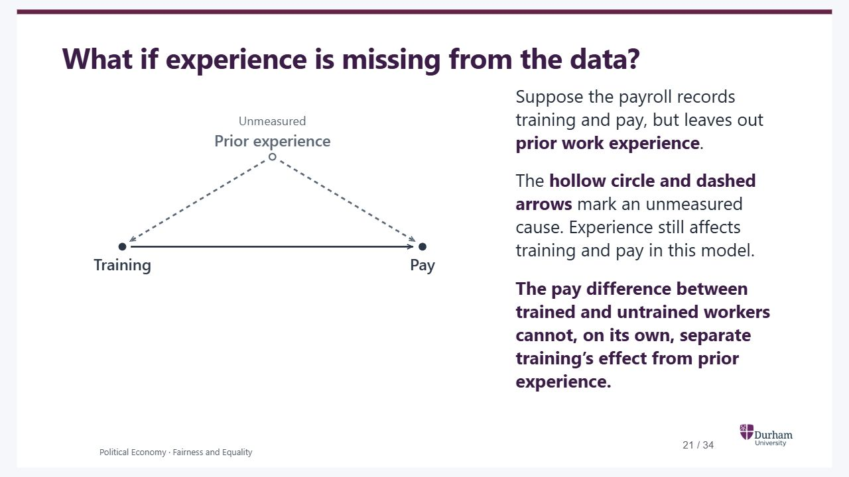
Notes:
Static student copy of the current web slide. Slide artwork is flattened; add personal notes here. Interactive explanations, playback and accessible HTML are available at:
https://davidchivers.co.uk/teaching/political-economy/lecture_1.html#/pe2-s19
What if experience is missing from the data? Suppose the payroll records training and pay, but leaves out prior work experience . The hollow circle and dashed arrows mark an unmeasured cause. Experience still affects training and pay in this model. The pay difference between trained and untrained workers cannot, on its own, separate training’s effect from prior experience. The causal assumptions are unchanged; what changes is the information available. An absent experience measure cannot be used as a control. If trained workers earn more, the raw pay difference does not separate training from prior experience under this model. We need to measure and adjust for relevant common causes, or use a credible alternative design. Random assignment to an offer of training balances prior characteristics in expectation and identifies the effect of the offer under its assumptions; participation requires further compliance assumptions. This is a hypothetical identification problem, not an estimated programme effect. This conclusion replaces the separate pay-comparison slide.
The causal assumptions are unchanged; what changes is the information available. An absent experience measure cannot be used as a control. If trained workers earn more, the raw pay difference does not separate training from prior experience under this model. We need to measure and adjust for relevant common causes, or use a credible alternative design. Random assignment to an offer of training balances prior characteristics in expectation and identifies the effect of the offer under its assumptions; participation requires further compliance assumptions. This is a hypothetical identification problem, not an estimated programme effect. This conclusion replaces the separate pay-comparison slide.
Prior experience is labelled unmeasured. Its dashed arrows still point to both training and pay. Training also points to pay.

Slide 22

Notes:
Static student copy of the current web slide. Slide artwork is flattened; add personal notes here. Interactive explanations, playback and accessible HTML are available at:
https://davidchivers.co.uk/teaching/political-economy/lecture_1.html#/selection-into-jobs
Selection into jobs Part 4 of 4 Comparing workers with similar prior experience helped in the training example. What happens when the comparison is restricted to people who have already passed a selection hurdle? Use the casting decision, then return to promotion and pay.
Comparing workers with similar prior experience helped in the training example. What happens when the comparison is restricted to people who have already passed a selection hurdle? Use the casting decision, then return to promotion and pay.

Slide 23
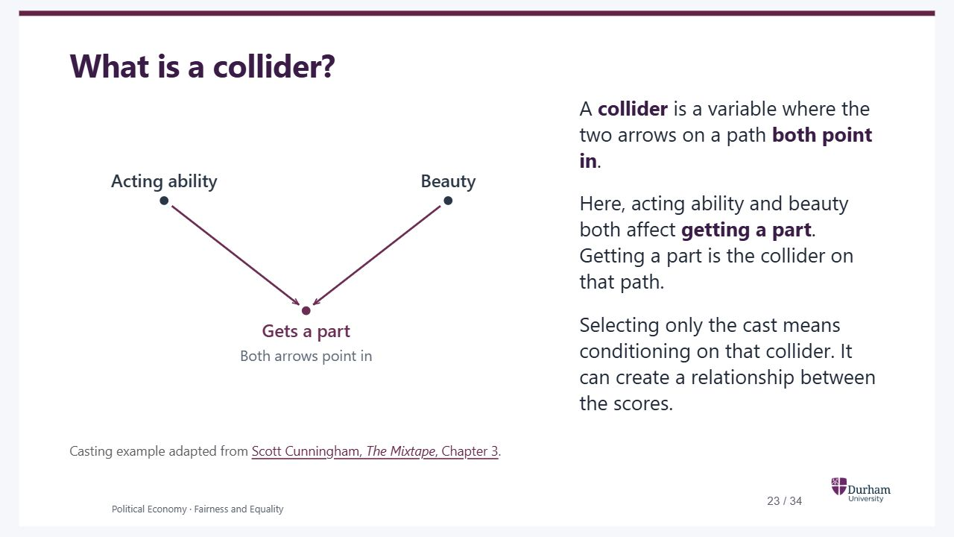
Notes:
Static student copy of the current web slide. Slide artwork is flattened; add personal notes here. Interactive explanations, playback and accessible HTML are available at:
https://davidchivers.co.uk/teaching/political-economy/lecture_1.html#/what-is-a-collider
What is a collider? A collider is a variable where the two arrows on a path both point in . Here, acting ability and beauty both affect getting a part . Getting a part is the collider on that path. Selecting only the cast means conditioning on that collider. It can create a relationship between the scores. Casting example adapted from Scott Cunningham, The Mixtape , Chapter 3 . Contrast the arrowheads with prior experience: a common cause sends arrows out to two variables; a collider receives arrows from them. The term describes a variable’s position along a particular path. We assume the two scores are independent in the applicant pool. Selecting the cast conditions on their common outcome. Conditioning can mean choosing a subsample, not just including a variable in a regression. A collider need not always induce a negative association: the direction depends on the selection mechanism. The next example uses a combined-score threshold. These are invented scores for teaching, not evidence about actual actors.
Contrast the arrowheads with prior experience: a common cause sends arrows out to two variables; a collider receives arrows from them. The term describes a variable’s position along a particular path. We assume the two scores are independent in the applicant pool. Selecting the cast conditions on their common outcome. Conditioning can mean choosing a subsample, not just including a variable in a regression. A collider need not always induce a negative association: the direction depends on the selection mechanism. The next example uses a combined-score threshold. These are invented scores for teaching, not evidence about actual actors.
Acting ability and beauty both have arrows pointing into getting a part. Getting a part is a collider on the path between those two scores.
https://mixtape-1ed.netlify.app/03-directed_acyclical_graphs

Slide 24
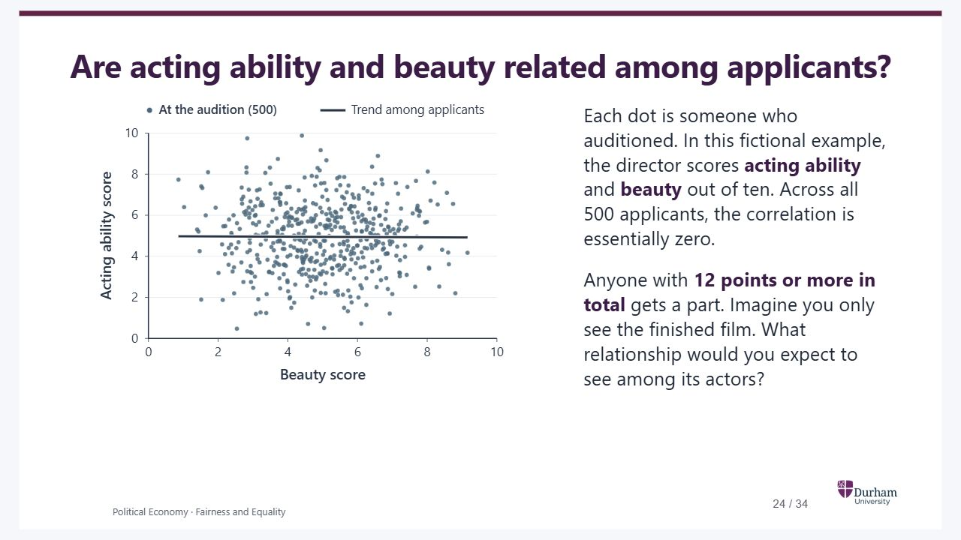
Notes:
Static student copy of the current web slide. Slide artwork is flattened; add personal notes here. Interactive explanations, playback and accessible HTML are available at:
https://davidchivers.co.uk/teaching/political-economy/lecture_1.html#/pe2-s20
Are acting ability and beauty related among applicants? Each dot is someone who auditioned. In this fictional example, the director scores acting ability and beauty out of ten. Across all 500 applicants, the correlation is essentially zero. Anyone with 12 points or more in total gets a part. Imagine you only see the finished film. What relationship would you expect to see among its actors?
All 500 fictional applicants. The director’s scores for beauty and acting ability form a cloud with an almost flat trend line.

Slide 25
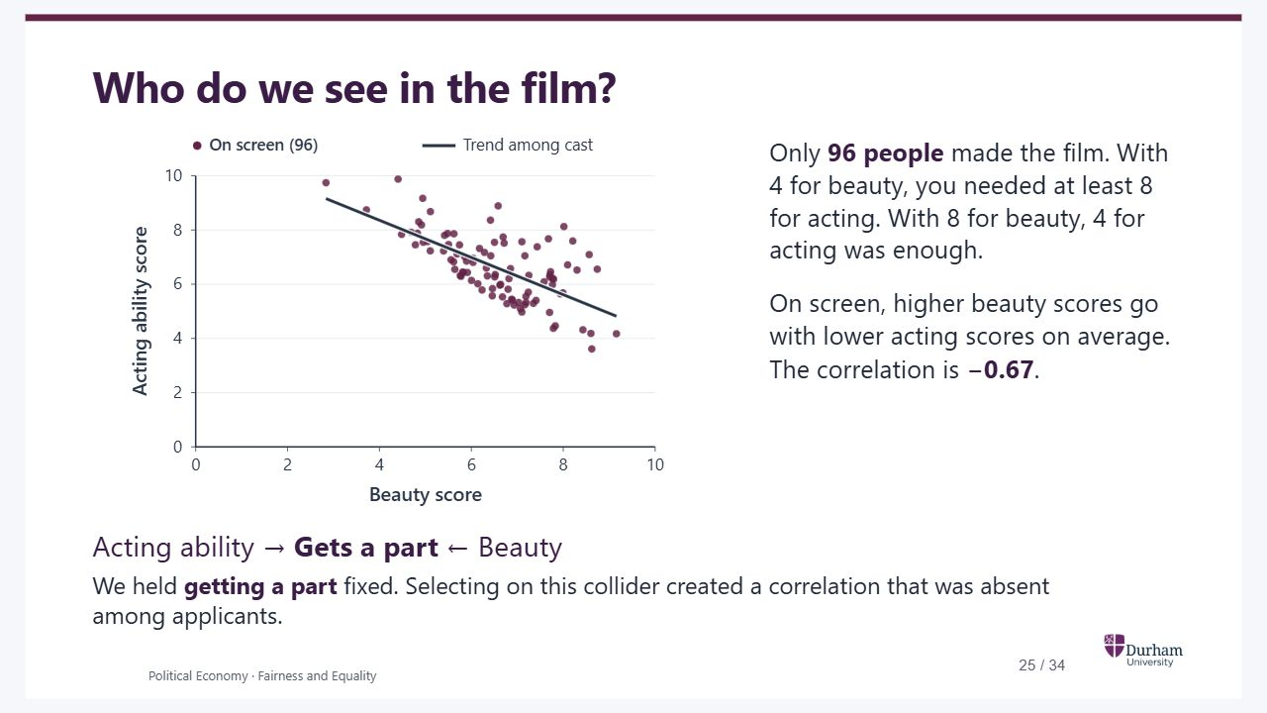
Notes:
Static student copy of the current web slide. Slide artwork is flattened; add personal notes here. Interactive explanations, playback and accessible HTML are available at:
https://davidchivers.co.uk/teaching/political-economy/lecture_1.html#/pe2-s21
Who do we see in the film? Show only the cast Show all applicants All 500 applicants are back. Their scores were generated independently. Knowing an applicant’s beauty score tells us little about their acting score. Only 96 people made the film. With 4 for beauty, you needed at least 8 for acting. With 8 for beauty, 4 for acting was enough. On screen, higher beauty scores go with lower acting scores on average. The correlation is −0.67 . Acting ability → Gets a part ← Beauty We held getting a part fixed. Selecting on this collider created a correlation that was absent among applicants. Ask the audience whether watching more films cast by the same rule would reveal the relationship among all applicants. The people who auditioned and never got a part are still missing. Both high scores can go together in the cast. The downward slope arises because a low score on one dimension has to be offset by a high score on the other to get past the cut-off. The simulation gives correlations of −0.006 for the 500 applicants and −0.667 for the 96 cast. Beauty here is the director’s judgement. The next example asks whom we see if we look only at employees who were promoted.
Ask the audience whether watching more films cast by the same rule would reveal the relationship among all applicants. The people who auditioned and never got a part are still missing. Both high scores can go together in the cast. The downward slope arises because a low score on one dimension has to be offset by a high score on the other to get past the cut-off. The simulation gives correlations of −0.006 for the 500 applicants and −0.667 for the 96 cast. Beauty here is the director’s judgement. The next example asks whom we see if we look only at employees who were promoted.
All 500 applicants. Acting ability and beauty are essentially uncorrelated.
Only the 96 people who got parts remain. The fitted line slopes down. Among the cast, the correlation between beauty and acting ability is minus 0.67.

Slide 26
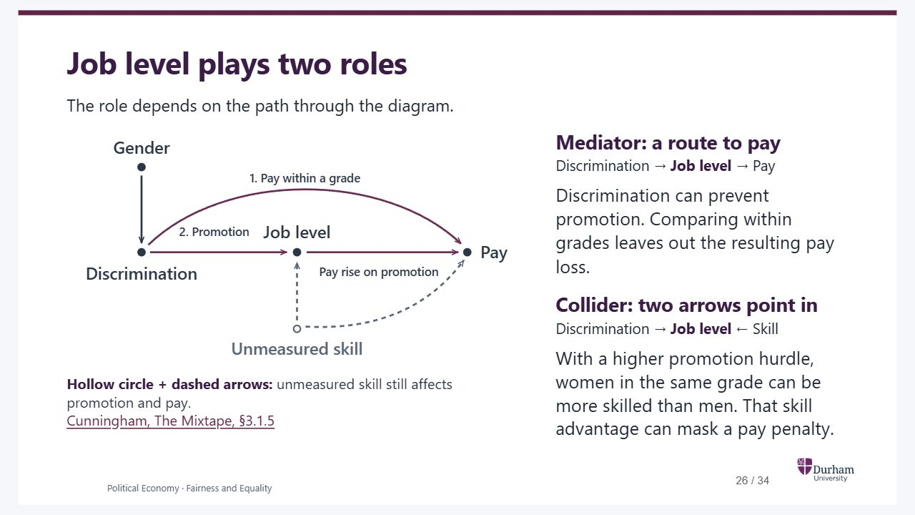
Notes:
Static student copy of the current web slide. Slide artwork is flattened; add personal notes here. Interactive explanations, playback and accessible HTML are available at:
https://davidchivers.co.uk/teaching/political-economy/lecture_1.html#/pe2-s23
Job level plays two roles The role depends on the path through the diagram. Hollow circle + dashed arrows: unmeasured skill still affects promotion and pay. Cunningham, The Mixtape, §3.1.5 Mediator: a route to pay Discrimination → Job level → Pay Discrimination can prevent promotion. Comparing within grades leaves out the resulting pay loss. Collider: two arrows point in Discrimination → Job level ← Skill With a higher promotion hurdle, women in the same grade can be more skilled than men. That skill advantage can mask a pay penalty. A simplified version of the causal model in Cunningham’s discrimination example. Skill is independent of gender in this example and affects both job level and pay. Read the two numbered routes before considering selection. The hollow circle and dashed lines are our convention for an unmeasured variable and its outgoing effects. They do not mean those effects have disappeared, are smaller or are statistically insignificant. The two slashes in the salary example have a different meaning: a route left out of the comparison. Job level is a mediator along the promotion route and a collider on the path between discrimination and skill; these labels refer to a position on a particular path. Return to the earlier education comparison: choosing what else to account for requires a causal story, not simply a longer list of worker characteristics. Checked against Cunningham’s first-edition Mixtape §3.1.5 on 5 November 2026, and the corresponding discrimination section in The Remix. Cunningham explicitly distinguishes D → O → Y from D → O ← A → Y. In the first, occupation carries part of discrimination’s effect to earnings. In the second, occupation is a shared outcome of discrimination and ability; holding it fixed induces an association, and ability also affects earnings. Our figure calls these occupation/job level and ability/skill. The full second path continues from Skill to Pay: do not omit that link when explaining why selection matters for the pay comparison. These are two distinct reasons that adjusting only for job level can mislead. If the aim is the total effect, the promotion route belongs in it. If the aim is the direct pay effect, holding job level fixed alone is insufficient in this model because skill is unmeasured. A positive adjusted coefficient is not evidence that discrimination benefits women. Teach the economic consequences before requiring the terminology: (1) lost promotions disappear from the comparison; (2) the people remaining in a grade can differ in skills. A mediator on one path can be a collider on another; the labels are not mutually exclusive categories of variables. The within-grade salary example isolates the first issue; Cunningham’s regression table adds skill differences and the second issue. This is an illustrative model, not evidence establishing the mechanism at Google.
A simplified version of the causal model in Cunningham’s discrimination example. Skill is independent of gender in this example and affects both job level and pay. Read the two numbered routes before considering selection. The hollow circle and dashed lines are our convention for an unmeasured variable and its outgoing effects. They do not mean those effects have disappeared, are smaller or are statistically insignificant. The two slashes in the salary example have a different meaning: a route left out of the comparison. Job level is a mediator along the promotion route and a collider on the path between discrimination and skill; these labels refer to a position on a particular path. Return to the earlier education comparison: choosing what else to account for requires a causal story, not simply a longer list of worker characteristics. Checked against Cunningham’s first-edition Mixtape §3.1.5 on 5 November 2026, and the corresponding discrimination section in The Remix. Cunningham explicitly distinguishes D → O → Y from D → O ← A → Y. In the first, occupation carries part of discrimination’s effect to earnings. In the second, occupation is a shared outcome of discrimination and ability; holding it fixed induces an association, and ability also affects earnings. Our figure calls these occupation/job level and ability/skill. The full second path continues from Skill to Pay: do not omit that link when explaining why selection matters for the pay comparison. These are two distinct reasons that adjusting only for job level can mislead. If the aim is the total effect, the promotion route belongs in it. If the aim is the direct pay effect, holding job level fixed alone is insufficient in this model because skill is unmeasured. A positive adjusted coefficient is not evidence that discrimination benefits women. Teach the economic consequences before requiring the terminology: (1) lost promotions disappear from the comparison; (2) the people remaining in a grade can differ in skills. A mediator on one path can be a collider on another; the labels are not mutually exclusive categories of variables. The within-grade salary example isolates the first issue; Cunningham’s regression table adds skill differences and the second issue. This is an illustrative model, not evidence establishing the mechanism at Google.
Route 1 goes directly from discrimination to pay within a grade. Route 2 goes through promotion to a higher job level. A hollow skill node and dashed arrows mean skill is unmeasured, but is still assumed to affect both job level and pay.
https://mixtape-1ed.netlify.app/03-directed_acyclical_graphs#discrimination-and-collider-bias

Slide 27
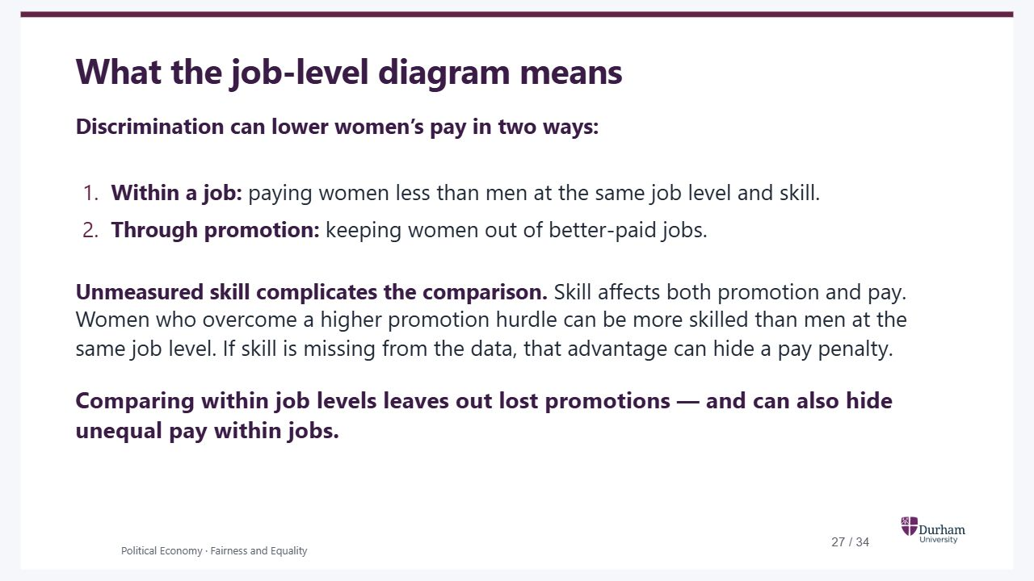
Notes:
Static student copy of the current web slide. Slide artwork is flattened; add personal notes here. Interactive explanations, playback and accessible HTML are available at:
https://davidchivers.co.uk/teaching/political-economy/lecture_1.html#/job-level-summary
What the job-level diagram means Discrimination can lower women’s pay in two ways: Within a job: paying women less than men at the same job level and skill. Through promotion: keeping women out of better-paid jobs. Unmeasured skill complicates the comparison. Skill affects both promotion and pay. Women who overcome a higher promotion hurdle can be more skilled than men at the same job level. If skill is missing from the data, that advantage can hide a pay penalty. Comparing within job levels leaves out lost promotions — and can also hide unequal pay within jobs. Written summary of the preceding DAG before the salary example. The two causal routes are discrimination directly affecting pay, and discrimination affecting job level, which affects pay. Job level mediates the second route. Skill affects both job level and pay; it need not itself be caused by discrimination. Holding job level fixed can induce a skill difference between the women and men being compared because they face different promotion hurdles. This is the collider mechanism on Discrimination → Job level ← Skill → Pay. Unmeasured means absent from the data used for this comparison, not inherently impossible to measure. The skill advantage refers to the comparison group; discrimination has not made anyone more skilled. It can mask a direct pay penalty, while the missed-promotion loss is excluded by construction. These are possible mechanisms in this model, not an empirical claim that every employer behaves this way. Source and assumptions remain with the preceding diagram (Cunningham, Mixtape §3.1.5).
Written summary of the preceding DAG before the salary example. The two causal routes are discrimination directly affecting pay, and discrimination affecting job level, which affects pay. Job level mediates the second route. Skill affects both job level and pay; it need not itself be caused by discrimination. Holding job level fixed can induce a skill difference between the women and men being compared because they face different promotion hurdles. This is the collider mechanism on Discrimination → Job level ← Skill → Pay. Unmeasured means absent from the data used for this comparison, not inherently impossible to measure. The skill advantage refers to the comparison group; discrimination has not made anyone more skilled. It can mask a direct pay penalty, while the missed-promotion loss is excluded by construction. These are possible mechanisms in this model, not an empirical claim that every employer behaves this way. Source and assumptions remain with the preceding diagram (Cunningham, Mixtape §3.1.5).

Slide 28
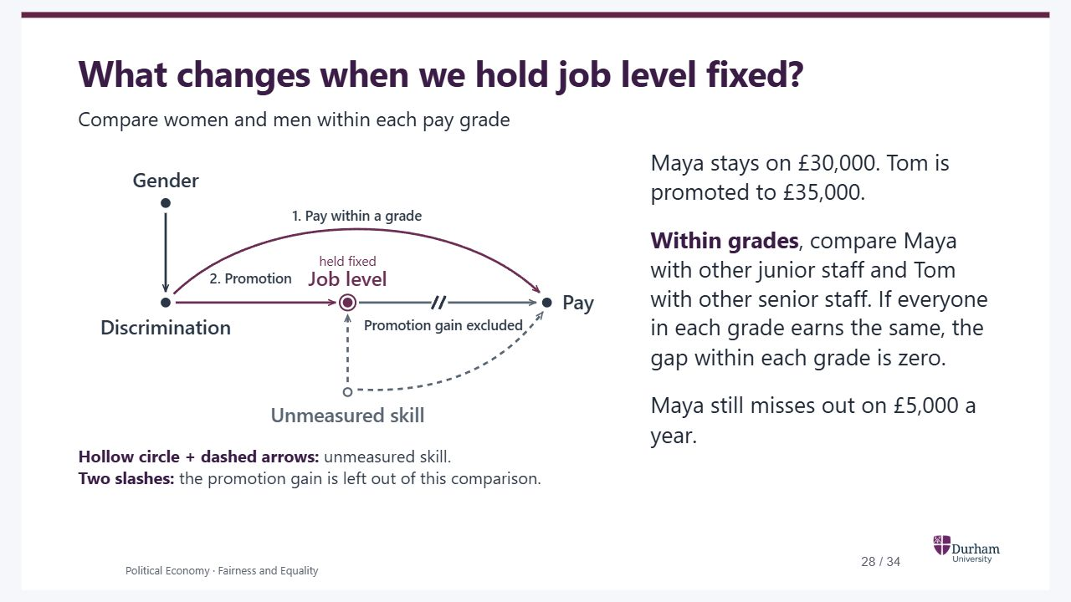
Notes:
Static student copy of the current web slide. Slide artwork is flattened; add personal notes here. Interactive explanations, playback and accessible HTML are available at:
https://davidchivers.co.uk/teaching/political-economy/lecture_1.html#/pe2-s24
What changes when we hold job level fixed? Compare women and men within each pay grade Hollow circle + dashed arrows: skill is missing from the data. Its effects on promotion and pay are still in the model. Suppose junior staff earn £30,000 and senior staff earn £35,000. Maya is passed over for promotion. Tom gets the senior job. Across grades , Tom earns £5,000 more. That difference counts in the overall pay gap. Hollow circle + dashed arrows: unmeasured skill. Two slashes: the promotion gain is left out of this comparison. Maya stays on £30,000. Tom is promoted to £35,000. Within grades , compare Maya with other junior staff and Tom with other senior staff. If everyone in each grade earns the same, the gap within each grade is zero. Maya still misses out on £5,000 a year. The two salaries are illustrative. Assume Maya would have received the senior salary had she been promoted. Start with the overall comparison, then tick the box to compare within grades. The broken arrow marks an effect excluded from this comparison. Promotion still affects pay. Cunningham’s table on the next slide adds variation in skill and pay within occupations. If women face a higher hurdle for promotion, the women who make it to senior roles can be more skilled on average, just as casting selected on two scores.
The two salaries are illustrative. Assume Maya would have received the senior salary had she been promoted. Start with the overall comparison, then tick the box to compare within grades. The broken arrow marks an effect excluded from this comparison. Promotion still affects pay. Cunningham’s table on the next slide adds variation in skill and pay within occupations. If women face a higher hurdle for promotion, the women who make it to senior roles can be more skilled on average, just as casting selected on two scores.
Overall comparison. Both the direct pay route and the route through job level contribute to the gap. Dashed arrows from the hollow skill node represent effects of skill that is missing from the data.
Two slashes mark the promotion route excluded when comparing pay within each grade. The direct route from discrimination to pay remains. A hollow circle and dashed arrows mark unmeasured skill, which still affects promotion and pay.

Slide 29
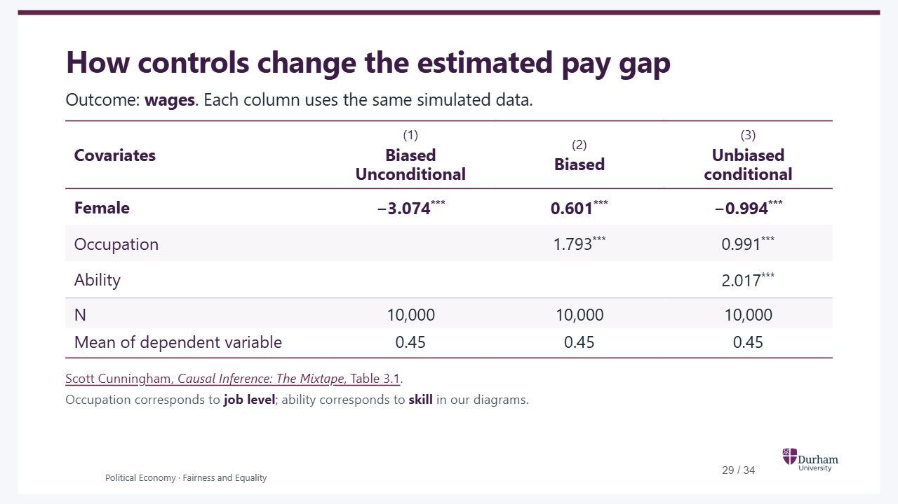
Notes:
Static student copy of the current web slide. Slide artwork is flattened; add personal notes here. Interactive explanations, playback and accessible HTML are available at:
https://davidchivers.co.uk/teaching/political-economy/lecture_1.html#/pe2-s25
How controls change the estimated pay gap Outcome: wages . Each column uses the same simulated data. Covariates (1) Biased Unconditional (2) Biased (3) Unbiased conditional Female −3.074 *** 0.601 *** −0.994 *** Occupation 1.793 *** 0.991 *** Ability 2.017 *** N 10,000 10,000 10,000 Mean of dependent variable 0.45 0.45 0.45 Scott Cunningham, Causal Inference: The Mixtape , Table 3.1 . Occupation corresponds to job level ; ability corresponds to skill in our diagrams. Adapted as an editable HTML table from the author’s first-edition online text, Table 3.1 in section 3.1.5, checked 6 November 2026. The exact column labels, all coefficient rows, significance stars, sample sizes and outcome means are retained. Column numbers (1)–(3) are added for discussion. At David’s request, the repeated parenthesised (0.000) rows have been omitted: the online table does not label those entries, and they are unnecessary for this comparison of coefficients. Do not describe them as verified standard errors or p-values. The online source has broken dollar-sign markup around some stars; this transcription restores the displayed superscripts without altering values. All six coefficients have three stars in the source. The slide uses a substantive heading, with the textbook attribution in the source line. These are Cunningham’s simulated results, not observations of a real employer and not the separate Tutorial 3 pay-audit simulation. Do not introduce the previous 2,400-worker example or its pay points. The book creates ability independently of gender, then assigns discrimination to women. Occupation = 1 + 2 × ability − 2 × discrimination + noise; wage = 1 − discrimination + occupation + 2 × ability + noise. Therefore the direct effect is −1 and the occupational route contributes −2, yielding total effect −3. The reported female coefficients −3.074, +0.601 and −0.994 are copied from the published table, not regenerated. Crucial interpretation of the original headers: ‘Biased Unconditional’ in column (1) is biased for the direct effect of −1, not for the total effect of −3 under this simulation. Column (2) excludes the occupational route and induces an association with ability through the collider. Column (3) controls for both occupation and ability, recovering the direct wage effect while still excluding the occupational route. The next slide states this explicitly. Ability is observed to the simulation’s author, so column (3) can be computed; in real payroll data it may be missing. A raw gender pay gap need not identify discrimination in real data, and adjusting for measured ability does not generally guarantee identification.
Adapted as an editable HTML table from the author’s first-edition online text, Table 3.1 in section 3.1.5, checked 6 November 2026. The exact column labels, all coefficient rows, significance stars, sample sizes and outcome means are retained. Column numbers (1)–(3) are added for discussion. At David’s request, the repeated parenthesised (0.000) rows have been omitted: the online table does not label those entries, and they are unnecessary for this comparison of coefficients. Do not describe them as verified standard errors or p-values. The online source has broken dollar-sign markup around some stars; this transcription restores the displayed superscripts without altering values. All six coefficients have three stars in the source. The slide uses a substantive heading, with the textbook attribution in the source line. These are Cunningham’s simulated results, not observations of a real employer and not the separate Tutorial 3 pay-audit simulation. Do not introduce the previous 2,400-worker example or its pay points. The book creates ability independently of gender, then assigns discrimination to women. Occupation = 1 + 2 × ability − 2 × discrimination + noise; wage = 1 − discrimination + occupation + 2 × ability + noise. Therefore the direct effect is −1 and the occupational route contributes −2, yielding total effect −3. The reported female coefficients −3.074, +0.601 and −0.994 are copied from the published table, not regenerated. Crucial interpretation of the original headers: ‘Biased Unconditional’ in column (1) is biased for the direct effect of −1, not for the total effect of −3 under this simulation. Column (2) excludes the occupational route and induces an association with ability through the collider. Column (3) controls for both occupation and ability, recovering the direct wage effect while still excluding the occupational route. The next slide states this explicitly. Ability is observed to the simulation’s author, so column (3) can be computed; in real payroll data it may be missing. A raw gender pay gap need not identify discrimination in real data, and adjusting for measured ability does not generally guarantee identification.
https://mixtape-1ed.netlify.app/03-directed_acyclical_graphs#tbl-screening

Slide 30
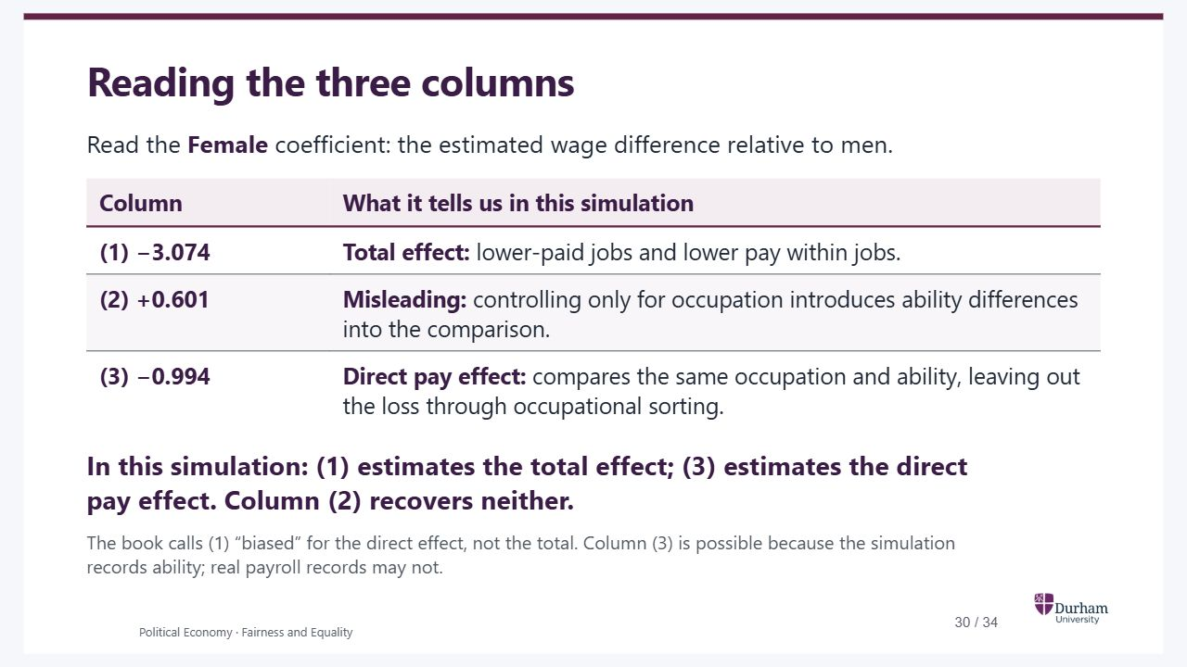
Notes:
Static student copy of the current web slide. Slide artwork is flattened; add personal notes here. Interactive explanations, playback and accessible HTML are available at:
https://davidchivers.co.uk/teaching/political-economy/lecture_1.html#/pay-selection-explained
Reading the three columns Read the Female coefficient: the estimated wage difference relative to men. Column What it tells us in this simulation (1) −3.074 Total effect: lower-paid jobs and lower pay within jobs. (2) +0.601 Misleading: controlling only for occupation introduces ability differences into the comparison. (3) −0.994 Direct pay effect: compares the same occupation and ability, leaving out the loss through occupational sorting. In this simulation: (1) estimates the total effect; (3) estimates the direct pay effect. Column (2) recovers neither. The book calls (1) “biased” for the direct effect, not the total. Column (3) is possible because the simulation records ability; real payroll records may not. Connect the numbers to the preceding DAG, rather than asking students to memorise a preferred set of controls. Here discrimination affects wages directly and through occupation. Ability is independent of gender before conditioning. Under these assumptions, column (1) estimates both routes together. Holding occupation fixed excludes the occupational route and also selects a comparison in which women tend to have greater ability, because they face a higher hurdle. Ability raises wages directly, so that selected advantage can mask the direct pay penalty and reverse the sign in column (2). It does not mean discrimination benefits women. Controlling for both occupation and ability in column (3) addresses the induced ability difference in this constructed model, recovering the direct wage penalty, but still does not recover losses through occupational sorting. The known population effects are −3 overall and −1 directly; the sample estimates differ slightly. Occupation is the book’s term corresponding to the earlier job-level diagram, and ability corresponds to skill. The original table labels are retained for fidelity and qualified on this slide to avoid suggesting that (1) is intrinsically wrong. All causal interpretations depend on the stipulated model. Source: Cunningham, The Mixtape, Table 3.1 and §3.1.5.
Connect the numbers to the preceding DAG, rather than asking students to memorise a preferred set of controls. Here discrimination affects wages directly and through occupation. Ability is independent of gender before conditioning. Under these assumptions, column (1) estimates both routes together. Holding occupation fixed excludes the occupational route and also selects a comparison in which women tend to have greater ability, because they face a higher hurdle. Ability raises wages directly, so that selected advantage can mask the direct pay penalty and reverse the sign in column (2). It does not mean discrimination benefits women. Controlling for both occupation and ability in column (3) addresses the induced ability difference in this constructed model, recovering the direct wage penalty, but still does not recover losses through occupational sorting. The known population effects are −3 overall and −1 directly; the sample estimates differ slightly. Occupation is the book’s term corresponding to the earlier job-level diagram, and ability corresponds to skill. The original table labels are retained for fidelity and qualified on this slide to avoid suggesting that (1) is intrinsically wrong. All causal interpretations depend on the stipulated model. Source: Cunningham, The Mixtape, Table 3.1 and §3.1.5.

Slide 31
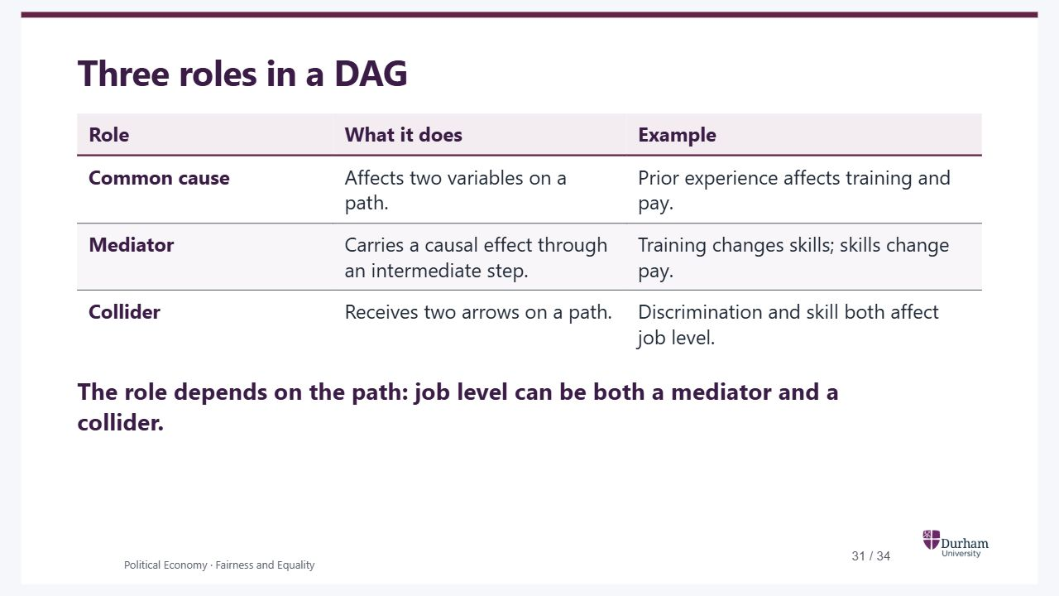
Notes:
Static student copy of the current web slide. Slide artwork is flattened; add personal notes here. Interactive explanations, playback and accessible HTML are available at:
https://davidchivers.co.uk/teaching/political-economy/lecture_1.html#/choosing-controls
Three roles in a DAG Role What it does Example Common cause Affects two variables on a path. Prior experience affects training and pay. Mediator Carries a causal effect through an intermediate step. Training changes skills; skills change pay. Collider Receives two arrows on a path. Discrimination and skill both affect job level. The role depends on the path: job level can be both a mediator and a collider. Recap the three patterns without treating a mediator as something that has gone wrong. A common cause sends arrows towards both variables. A mediator has an arrow coming in from the cause and another going out towards the outcome along the causal path. A collider receives two arrowheads on the path. These are causal roles, not labels that automatically tell us to control for every variable of one type. If a reminder of the comparison is useful, prior experience helped explain pre-existing differences in the training example. New skills described how the course could work. Conditioning on job level could both exclude missed promotions and create an association with unmeasured skill in the discrimination example. Job level is a mediator on Discrimination → Job level → Pay, and a collider on Discrimination → Job level ← Skill → Pay. The analysis depends on the question and the whole diagram. Keep the numerical regression interpretation on the preceding slide rather than repeating it here. Return to the earlier Google pay-audit question: an adjusted comparison does not by itself establish equal promotion opportunities. These models show possible mechanisms, not evidence establishing what happened at Google. Sources: Cunningham, Causal Inference: The Mixtape, Chapter 3, especially section 3.1.5; Chivers and Chivers, How to Read Numbers, Chapter 21. Both checked 5 November 2026 against the available full text.
Recap the three patterns without treating a mediator as something that has gone wrong. A common cause sends arrows towards both variables. A mediator has an arrow coming in from the cause and another going out towards the outcome along the causal path. A collider receives two arrowheads on the path. These are causal roles, not labels that automatically tell us to control for every variable of one type. If a reminder of the comparison is useful, prior experience helped explain pre-existing differences in the training example. New skills described how the course could work. Conditioning on job level could both exclude missed promotions and create an association with unmeasured skill in the discrimination example. Job level is a mediator on Discrimination → Job level → Pay, and a collider on Discrimination → Job level ← Skill → Pay. The analysis depends on the question and the whole diagram. Keep the numerical regression interpretation on the preceding slide rather than repeating it here. Return to the earlier Google pay-audit question: an adjusted comparison does not by itself establish equal promotion opportunities. These models show possible mechanisms, not evidence establishing what happened at Google. Sources: Cunningham, Causal Inference: The Mixtape, Chapter 3, especially section 3.1.5; Chivers and Chivers, How to Read Numbers, Chapter 21. Both checked 5 November 2026 against the available full text.

Slide 32
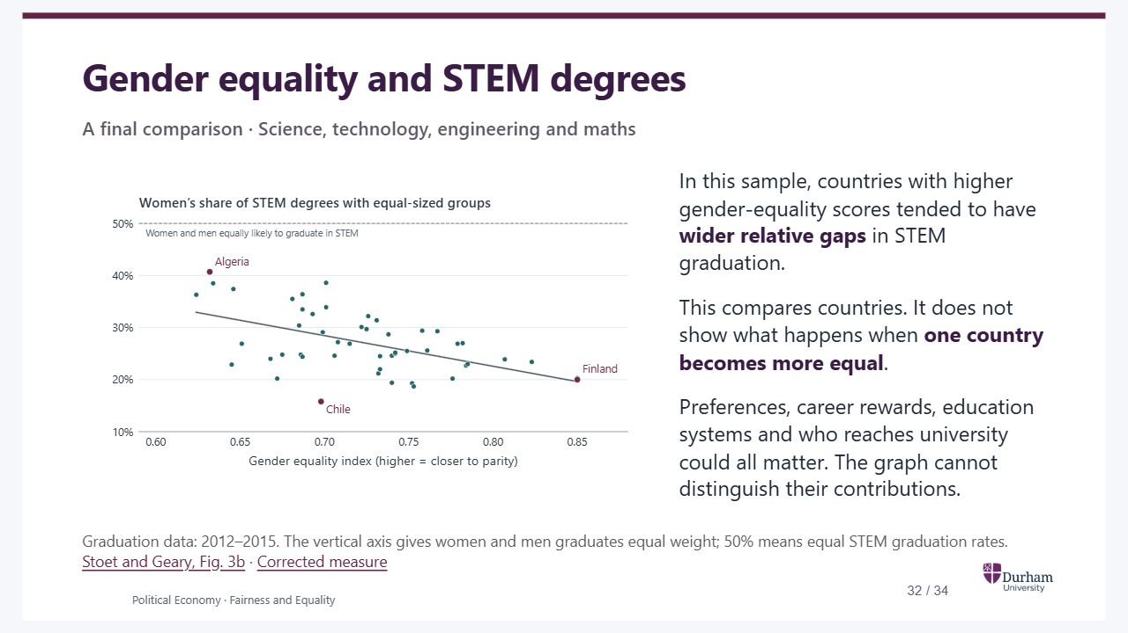
Notes:
Static student copy of the current web slide. Slide artwork is flattened; add personal notes here. Interactive explanations, playback and accessible HTML are available at:
https://davidchivers.co.uk/teaching/political-economy/lecture_1.html#/pe2-s26
Gender equality and STEM degrees A final comparison · Science, technology, engineering and maths In this sample, countries with higher gender-equality scores tended to have wider relative gaps in STEM graduation. This compares countries. It does not show what happens when one country becomes more equal . Preferences, career rewards, education systems and who reaches university could all matter. The graph cannot distinguish their contributions. Graduation data: 2012–2015. The vertical axis gives women and men graduates equal weight; 50% means equal STEM graduation rates. Stoet and Geary, Fig. 3b · Corrected measure Use this as an application of the lecture’s tools to another gender gap. It does not require a new theory of why Finland and Algeria differ. Ask what comparison the graph makes, then distinguish a hypothesis from evidence that identifies it. The relationship concerns degree subjects among graduates, not a direct measure of individual preferences or freedom of choice. Women’s and men’s subject choices both affect the plotted measure. Reading the graph. Imagine 100 women graduates and 100 men graduates in each country, with each group keeping its observed STEM graduation rate. What share of the resulting STEM degrees would women hold? At 50% the two rates are equal. Below 50%, a lower dot means a wider relative gap. The horizontal axis is the World Economic Forum’s Global Gender Gap Index, covering gaps in education, health, the economy and politics. It does not directly measure the opportunities available to an individual pupil. The points were digitised from Figure 3b and the axes transposed. The line is a descriptive fit. The paper reports a Spearman rank correlation of −0.47. If the denominator needs explaining: Algeria, 2015. Women earned 54% of all STEM degrees, while men were more likely to study STEM among graduates of each gender. Both statements can hold: Out of every… Earned a STEM degree 100 women graduates 27 100 men graduates 39 Women were 62.7% of all graduates. The actual counts were 48,135 STEM degrees among 180,554 women graduates and 41,752 among 107,360 men graduates. Women earned 53.55% of STEM degrees. Within-group rates of 26.66% and 38.89%, given equal group sizes, yield the graph’s 40.7%. The rounded calculation is 27/(27+39), about 41%. This explains the measure for one country; it does not explain the slope across countries. Algerian counts . If selection needs another example: Ontario. Card and Payne followed 2005 Grade 9 entrants to Ontario public schools who took Grade 12 courses within five years. Their STEM-readiness measure uses specified senior maths and science courses. Pupils compared Girls Boys All pupils in the study 18% 19% Only those who entered university 33% 47% Among pupils without that preparation, 35.3% of girls and 20.9% of boys enrolled at university. Non-STEM-ready girls were more likely to enter, leaving a higher share of boys with STEM preparation in the university sample. The exact first-row figures are 17.9% and 18.8%; the second row is 33.3% and 47.4%. This documents selection at university entry in Ontario. It does not establish how selection explains Finland versus Algeria, and preparation is a different outcome from completing a degree. Card and Payne (2021) · Working paper, Table 7 . Other explanations and tests. Greater freedom may allow people to pursue different interests. Subject availability, anticipated job rewards, social expectations and who enters and completes university can also differ. Interests themselves may reflect prior opportunities and social influences. These mechanisms can operate together. Comparable pupil histories and evidence around changes in specific constraints would help distinguish them; simply adding country-level controls would not automatically identify the effect of equality. Robustness. The authors’ reply reports −0.42 for actual shares with their original index. Richardson and colleagues used another index and a broader sample of 77 countries and found essentially no association. Those comparisons change several things at once; they do not prove either that the original pattern is universally robust or that it disappears whenever the denominator changes. Authors’ reply · Richardson et al. · Dynomight’s illustrated comparison . The wider review is in notes/stem-equality-literature-review.md.
Use this as an application of the lecture’s tools to another gender gap. It does not require a new theory of why Finland and Algeria differ. Ask what comparison the graph makes, then distinguish a hypothesis from evidence that identifies it. The relationship concerns degree subjects among graduates, not a direct measure of individual preferences or freedom of choice. Women’s and men’s subject choices both affect the plotted measure. Reading the graph. Imagine 100 women graduates and 100 men graduates in each country, with each group keeping its observed STEM graduation rate. What share of the resulting STEM degrees would women hold? At 50% the two rates are equal. Below 50%, a lower dot means a wider relative gap. The horizontal axis is the World Economic Forum’s Global Gender Gap Index, covering gaps in education, health, the economy and politics. It does not directly measure the opportunities available to an individual pupil. The points were digitised from Figure 3b and the axes transposed. The line is a descriptive fit. The paper reports a Spearman rank correlation of −0.47. If the denominator needs explaining: Algeria, 2015. Women earned 54% of all STEM degrees, while men were more likely to study STEM among graduates of each gender. Both statements can hold: Out of every… Earned a STEM degree 100 women graduates 27 100 men graduates 39 Women were 62.7% of all graduates. The actual counts were 48,135 STEM degrees among 180,554 women graduates and 41,752 among 107,360 men graduates. Women earned 53.55% of STEM degrees. Within-group rates of 26.66% and 38.89%, given equal group sizes, yield the graph’s 40.7%. The rounded calculation is 27/(27+39), about 41%. This explains the measure for one country; it does not explain the slope across countries. Algerian counts . If selection needs another example: Ontario. Card and Payne followed 2005 Grade 9 entrants to Ontario public schools who took Grade 12 courses within five years. Their STEM-readiness measure uses specified senior maths and science courses. Pupils compared Girls Boys All pupils in the study 18% 19% Only those who entered university 33% 47% Among pupils without that preparation, 35.3% of girls and 20.9% of boys enrolled at university. Non-STEM-ready girls were more likely to enter, leaving a higher share of boys with STEM preparation in the university sample. The exact first-row figures are 17.9% and 18.8%; the second row is 33.3% and 47.4%. This documents selection at university entry in Ontario. It does not establish how selection explains Finland versus Algeria, and preparation is a different outcome from completing a degree. Card and Payne (2021) · Working paper, Table 7 . Other explanations and tests. Greater freedom may allow people to pursue different interests. Subject availability, anticipated job rewards, social expectations and who enters and completes university can also differ. Interests themselves may reflect prior opportunities and social influences. These mechanisms can operate together. Comparable pupil histories and evidence around changes in specific constraints would help distinguish them; simply adding country-level controls would not automatically identify the effect of equality. Robustness. The authors’ reply reports −0.42 for actual shares with their original index. Richardson and colleagues used another index and a broader sample of 77 countries and found essentially no association. Those comparisons change several things at once; they do not prove either that the original pattern is universally robust or that it disappears whenever the denominator changes. Authors’ reply · Richardson et al. · Dynomight’s illustrated comparison . The wider review is in notes/stem-equality-literature-review.md.
A snapshot of 50 countries using graduation data from 2012–2015. Countries with higher gender-equality scores tended to have lower female shares of STEM degrees after giving women and men graduates equal weight. Algeria is around 41% and Finland around 20%; 50% means equal within-group STEM graduation rates. This is not a comparison of changes within countries.
https://doi.org/10.1177/0956797617741719
https://doi.org/10.1177/0956797619892892
https://www.genderscilab.org/blog/gender-equality-paradox-monkey-business-or-how-to-tell-spurious-causal-stories-about-nation-level-achievement-by-women-in-stem
https://doi.org/10.1111/ecin.12934
https://www.nber.org/system/files/working_papers/w23769/w23769.pdf
https://doi.org/10.1177/0956797620904134
https://doi.org/10.1177/0956797619872762
https://dynomight.substack.com/p/does-the-gender-equality-paradox

Slide 33

Notes:
Static student copy of the current web slide. Slide artwork is flattened; add personal notes here. Interactive explanations, playback and accessible HTML are available at:
https://davidchivers.co.uk/teaching/political-economy/lecture_1.html#/pe2-s29
When does a difference in outcomes tell us that opportunities are unequal? Choices respond to the opportunities and rewards people face. Comparisons can hide unequal opportunities—or attribute differences to discrimination that have other causes. We need evidence that distinguishes those explanations . Bring the question back to what the lecture has established. The historical UK gap narrowed, but that alone does not identify changes in discrimination. Denmark gives evidence of a sharp earnings divergence after parenthood, through participation, hours and hourly pay. The pharmacy comparison explains why the cost of reducing hours depends on how work is organised. The job-level model and Cunningham’s simulation show how holding job level fixed can hide lost promotions and select workers with different skills. A within-role comparison describes pay within roles; it does not by itself identify discriminatory pay-setting. The lesson is not that all evidence is equally uninformative. Different comparisons support different conclusions. Ask students to use a specific finding to defend an argument in Tutorial 3, and to say which part remains uncertain. Choices and discrimination can interact: unequal access to experience or promotion may change which work and family decisions are attractive or feasible. Unequal outcomes alone neither establish nor rule out unequal opportunities.
Bring the question back to what the lecture has established. The historical UK gap narrowed, but that alone does not identify changes in discrimination. Denmark gives evidence of a sharp earnings divergence after parenthood, through participation, hours and hourly pay. The pharmacy comparison explains why the cost of reducing hours depends on how work is organised. The job-level model and Cunningham’s simulation show how holding job level fixed can hide lost promotions and select workers with different skills. A within-role comparison describes pay within roles; it does not by itself identify discriminatory pay-setting. The lesson is not that all evidence is equally uninformative. Different comparisons support different conclusions. Ask students to use a specific finding to defend an argument in Tutorial 3, and to say which part remains uncertain. Choices and discrimination can interact: unequal access to experience or promotion may change which work and family decisions are attractive or feasible. Unequal outcomes alone neither establish nor rule out unequal opportunities.

Slide 34
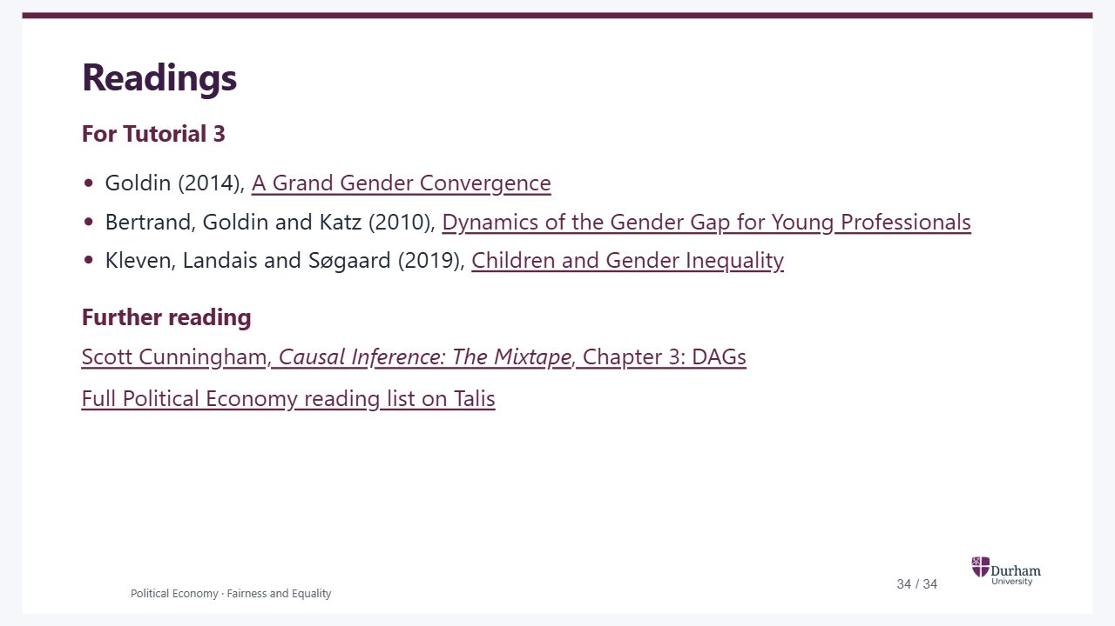
Notes:
Static student copy of the current web slide. Slide artwork is flattened; add personal notes here. Interactive explanations, playback and accessible HTML are available at:
https://davidchivers.co.uk/teaching/political-economy/lecture_1.html#/how-to-read
Readings For Tutorial 3 Goldin (2014), A Grand Gender Convergence Bertrand, Goldin and Katz (2010), Dynamics of the Gender Gap for Young Professionals Kleven, Landais and Søgaard (2019), Children and Gender Inequality Further reading Scott Cunningham, Causal Inference: The Mixtape , Chapter 3: DAGs Full Political Economy reading list on Talis Students can start with each paper’s introduction and conclusion, then read a specific figure or comparison closely. Ask which claim the evidence helps them make. They do not need to reproduce unfamiliar econometric methods.
Students can start with each paper’s introduction and conclusion, then read a specific figure or comparison closely. Ask which claim the evidence helps them make. They do not need to reproduce unfamiliar econometric methods.
https://doi.org/10.1257/aer.104.4.1091
https://doi.org/10.1257/app.2.3.228
https://jenni.uchicago.edu/Fertility/Kleven_Landais_Sogaaard_2019_AEJAE_v11_n4.pdf#page=10
https://mixtape-1ed.netlify.app/03-directed_acyclical_graphs
https://rl.talis.com/3/durham/lists/f1dc9e61-05b3-4492-bc70-6c7de2ba9ea2.html

