Slide 1

Notes:
Static student copy of the current web slide. Slide artwork is flattened; add personal notes here. Interactive explanations, playback and accessible HTML are available at:
https://davidchivers.co.uk/teaching/macro-applications/lecture_3.html#/title-slide
The Economics of Brexit Lecture 3: The Single Market Dr David Chivers Macroeconomic Applications and Policy

Slide 2
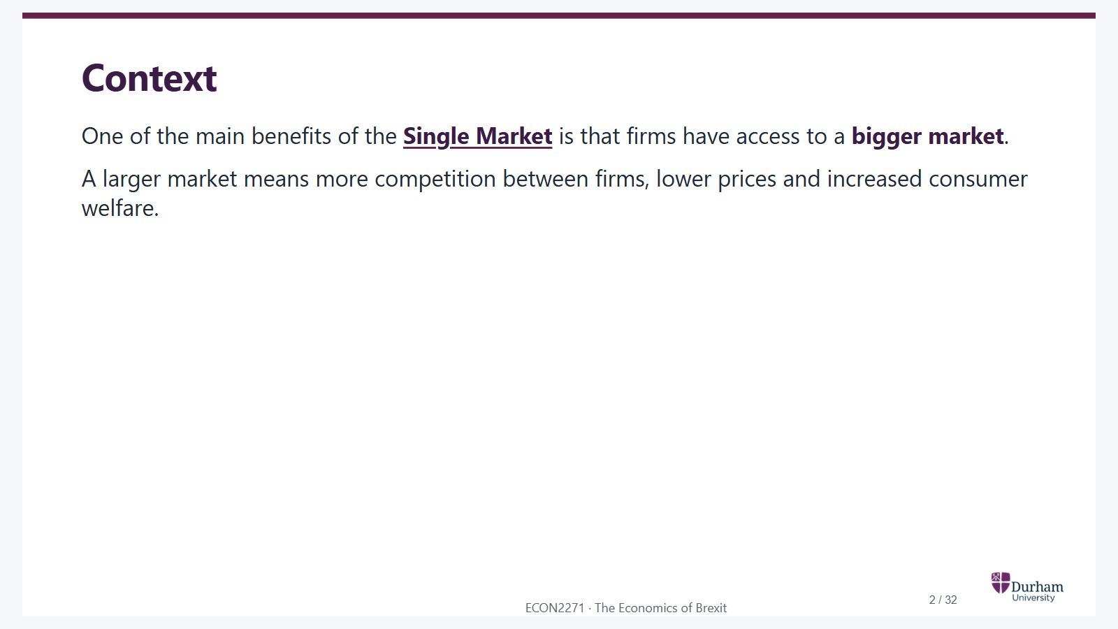
Notes:
Static student copy of the current web slide. Slide artwork is flattened; add personal notes here. Interactive explanations, playback and accessible HTML are available at:
https://davidchivers.co.uk/teaching/macro-applications/lecture_3.html#/l3-s02
Context One of the main benefits of the Single Market is that firms have access to a bigger market . A larger market means more competition between firms, lower prices and increased consumer welfare.
http://ec.europa.eu/growth/single-market/index_en.htm

Slide 3

Notes:
Static student copy of the current web slide. Slide artwork is flattened; add personal notes here. Interactive explanations, playback and accessible HTML are available at:
https://davidchivers.co.uk/teaching/macro-applications/lecture_3.html#/l3-s03
Learning objectives At the end of this topic, you will be able to: Analyse how increased market size affects: Competitiveness: the pro-competitive effect . The scale of firms: industrial restructuring . Welfare. Discuss the empirical evidence on the effects of the Single Market Programme on European price-cost margins.

Slide 4
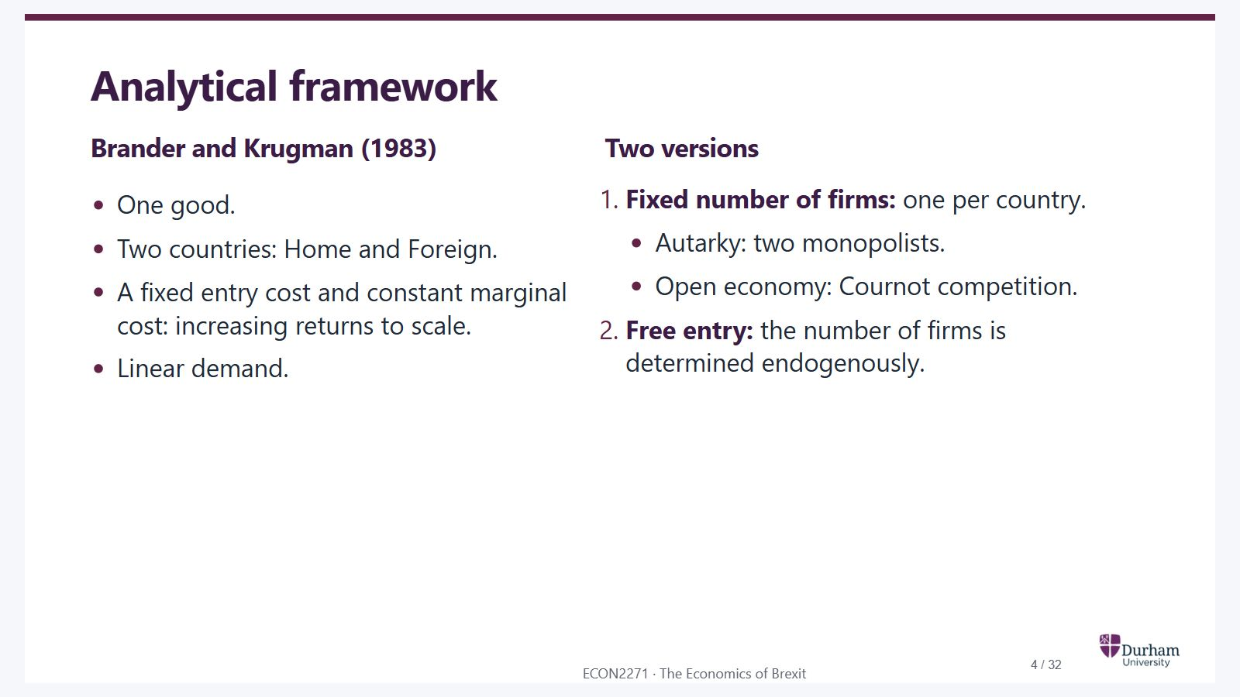
Notes:
Static student copy of the current web slide. Slide artwork is flattened; add personal notes here. Interactive explanations, playback and accessible HTML are available at:
https://davidchivers.co.uk/teaching/macro-applications/lecture_3.html#/l3-s04
Analytical framework Brander and Krugman (1983) One good. Two countries: Home and Foreign. A fixed entry cost and constant marginal cost: increasing returns to scale. Linear demand. Two versions Fixed number of firms: one per country. Autarky: two monopolists. Open economy: Cournot competition. Free entry: the number of firms is determined endogenously.

Slide 5
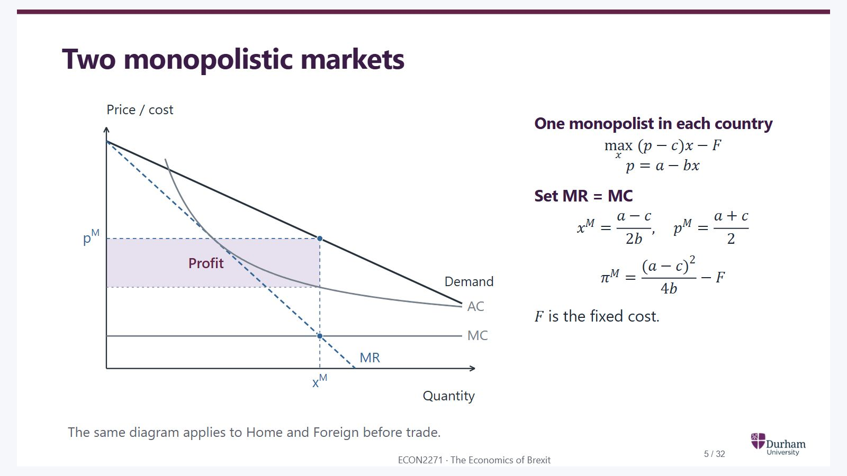
Notes:
Static student copy of the current web slide. Slide artwork is flattened; add personal notes here. Interactive explanations, playback and accessible HTML are available at:
https://davidchivers.co.uk/teaching/macro-applications/lecture_3.html#/l3-s05
Two monopolistic markets One monopolist in each country max x ( p − c ) x − F \max_x\;(p-c)x-F p = a − b x p=a-bx Set MR = MC x M = a − c 2 b , p M = a + c 2 x^M=\frac{a-c}{2b},\quad p^M=\frac{a+c}{2} π M = ( a − c ) 2 4 b − F \pi^M=\frac{(a-c)^2}{4b}-F F F is the fixed cost. The same diagram applies to Home and Foreign before trade.
Each country has a monopolist. Marginal revenue equals marginal cost at x M; demand determines p M. The shaded rectangle is profit after fixed costs.

Slide 6
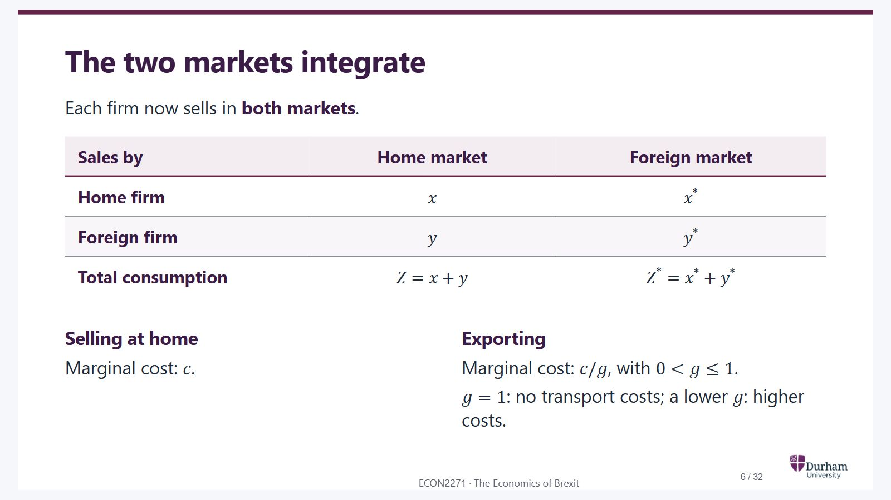
Notes:
Static student copy of the current web slide. Slide artwork is flattened; add personal notes here. Interactive explanations, playback and accessible HTML are available at:
https://davidchivers.co.uk/teaching/macro-applications/lecture_3.html#/l3-s06
The two markets integrate Each firm now sells in both markets . Sales by Home market Foreign market Home firm x x x * x^* Foreign firm y y y * y^* Total consumption Z = x + y Z=x+y Z * = x * + y * Z^*=x^*+y^* Selling at home Marginal cost: c c . Exporting Marginal cost: c / g c/g , with 0 < g ≤ 1 0<g\leq1 . g = 1 g=1 : no transport costs; a lower g g : higher costs.

Slide 7
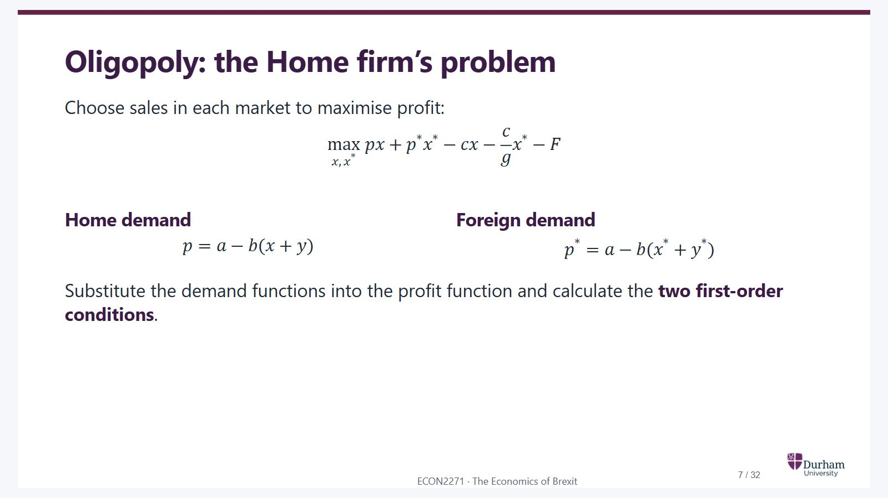
Notes:
Static student copy of the current web slide. Slide artwork is flattened; add personal notes here. Interactive explanations, playback and accessible HTML are available at:
https://davidchivers.co.uk/teaching/macro-applications/lecture_3.html#/l3-s07
Oligopoly: the Home firm’s problem Choose sales in each market to maximise profit: max x , x * p x + p * x * − c x − c g x * − F \max_{x,x^*}\;px+p^*x^*-cx-\frac{c}{g}x^*-F Home demand p = a − b ( x + y ) p=a-b(x+y) Foreign demand p * = a − b ( x * + y * ) p^*=a-b(x^*+y^*) Substitute the demand functions into the profit function and calculate the two first-order conditions .

Slide 8
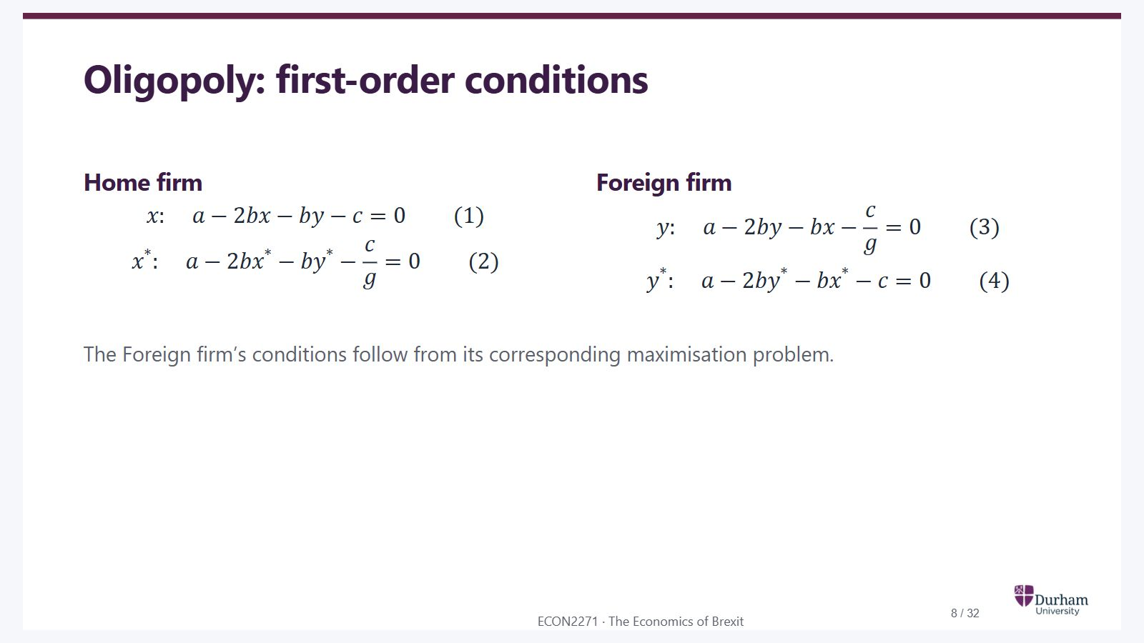
Notes:
Static student copy of the current web slide. Slide artwork is flattened; add personal notes here. Interactive explanations, playback and accessible HTML are available at:
https://davidchivers.co.uk/teaching/macro-applications/lecture_3.html#/l3-s08
Oligopoly: first-order conditions Home firm x : a − 2 b x − b y − c = 0 ( 1 ) x:\quad a-2bx-by-c=0 \qquad(1) x * : a − 2 b x * − b y * − c g = 0 ( 2 ) x^*:\quad a-2bx^*-by^*-\frac{c}{g}=0 \qquad(2) Foreign firm y : a − 2 b y − b x − c g = 0 ( 3 ) y:\quad a-2by-bx-\frac{c}{g}=0 \qquad(3) y * : a − 2 b y * − b x * − c = 0 ( 4 ) y^*:\quad a-2by^*-bx^*-c=0 \qquad(4) The Foreign firm’s conditions follow from its corresponding maximisation problem.

Slide 9
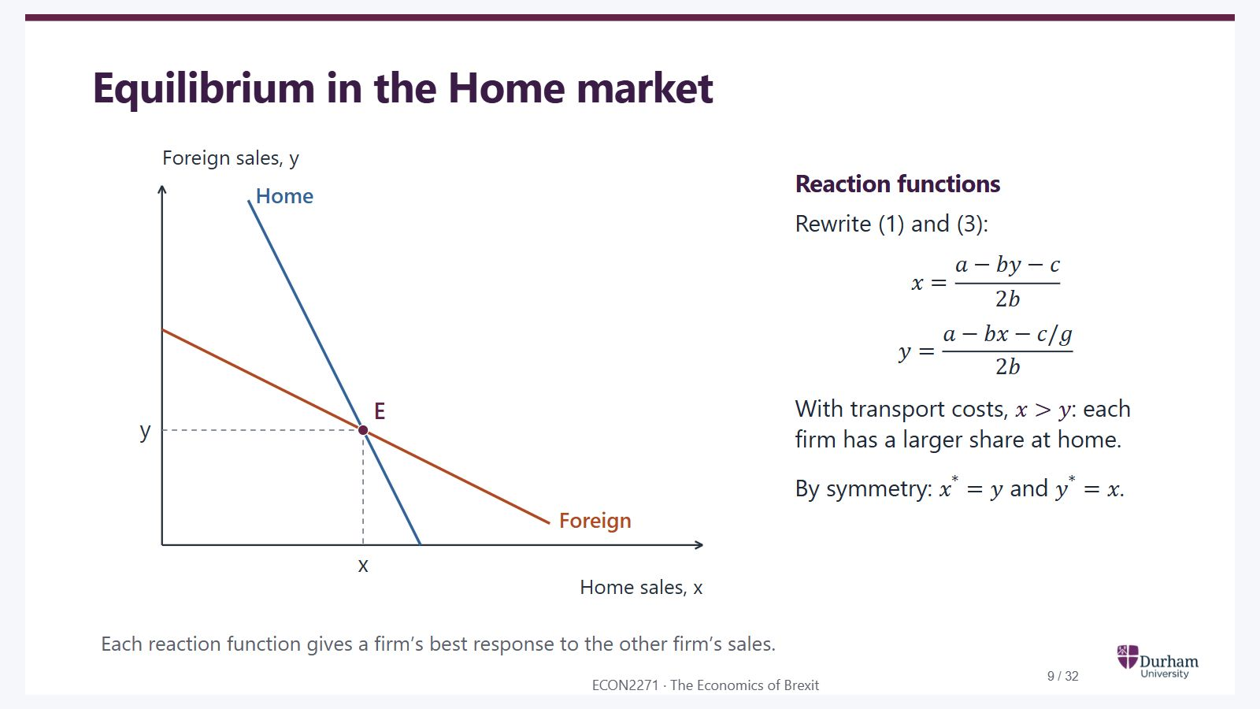
Notes:
Static student copy of the current web slide. Slide artwork is flattened; add personal notes here. Interactive explanations, playback and accessible HTML are available at:
https://davidchivers.co.uk/teaching/macro-applications/lecture_3.html#/l3-s10
Equilibrium in the Home market Reaction functions Rewrite (1) and (3): x = a − b y − c 2 b x=\frac{a-by-c}{2b} y = a − b x − c / g 2 b y=\frac{a-bx-c/g}{2b} With transport costs, x > y x>y : each firm has a larger share at home. By symmetry: x * = y x^*=y and y * = x y^*=x . Each reaction function gives a firm’s best response to the other firm’s sales.
Home and Foreign reaction functions intersect at E. Home sales x exceed imports y when transport costs are positive.

Slide 10
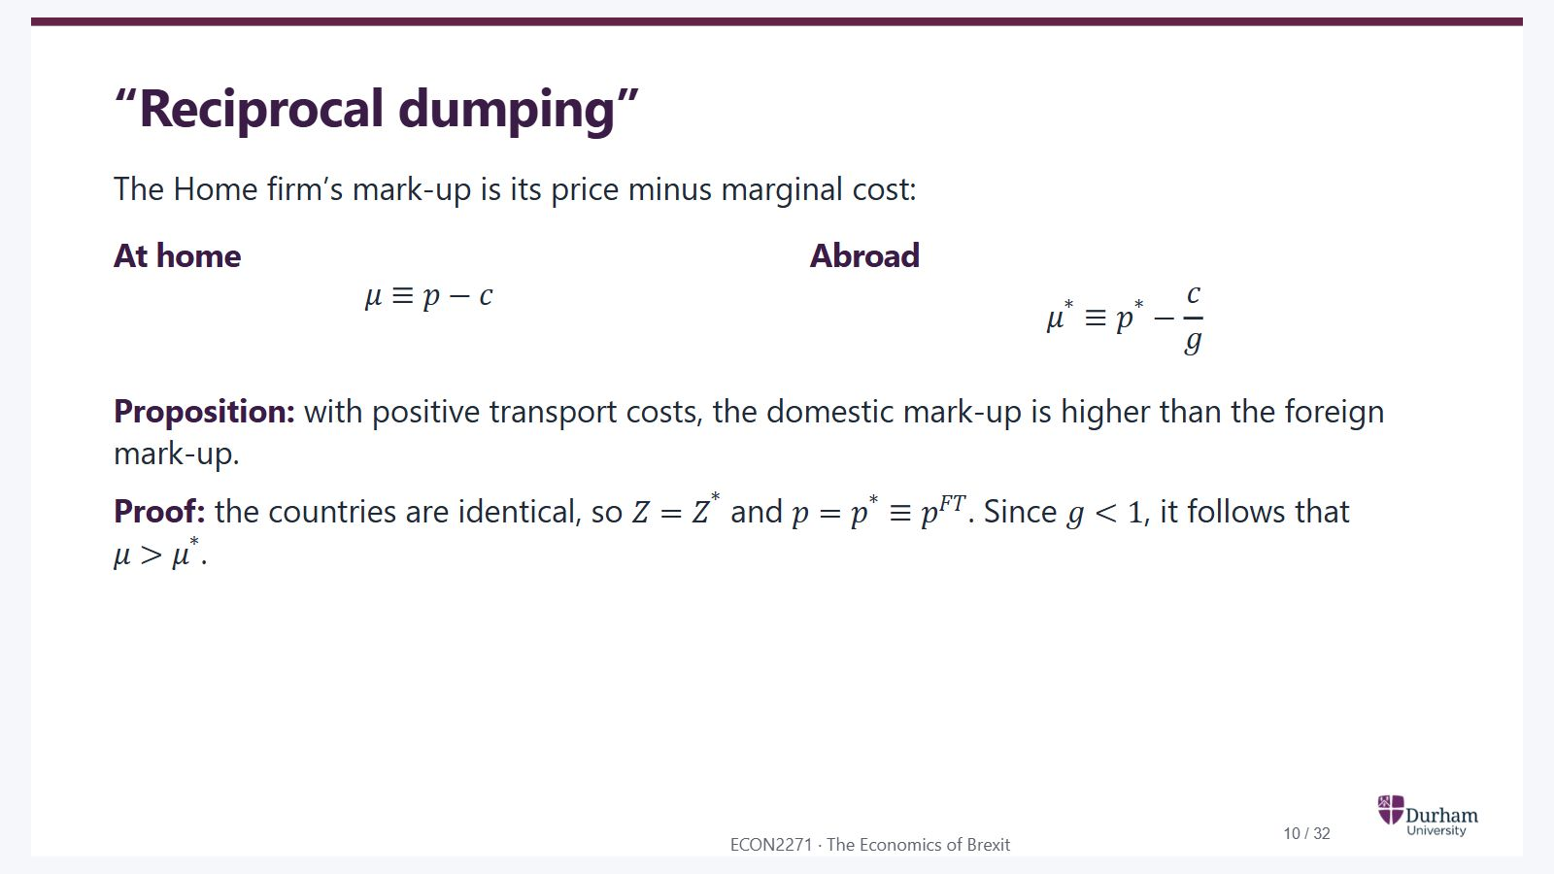
Notes:
Static student copy of the current web slide. Slide artwork is flattened; add personal notes here. Interactive explanations, playback and accessible HTML are available at:
https://davidchivers.co.uk/teaching/macro-applications/lecture_3.html#/l3-s11
“Reciprocal dumping” The Home firm’s mark-up is its price minus marginal cost: At home μ ≡ p − c \mu\equiv p-c Abroad μ * ≡ p * − c g \mu^*\equiv p^*-\frac{c}{g} Proposition: with positive transport costs, the domestic mark-up is higher than the foreign mark-up. Proof: the countries are identical, so Z = Z * Z=Z^* and p = p * ≡ p F T p=p^*\equiv p^{FT} . Since g < 1 g<1 , it follows that μ > μ * \mu>\mu^* .

Slide 11

Notes:
Static student copy of the current web slide. Slide artwork is flattened; add personal notes here. Interactive explanations, playback and accessible HTML are available at:
https://davidchivers.co.uk/teaching/macro-applications/lecture_3.html#/l3-s12
Consequences of international trade Is there a pro-competitive effect? If so, does it increase welfare in all countries?

Slide 12
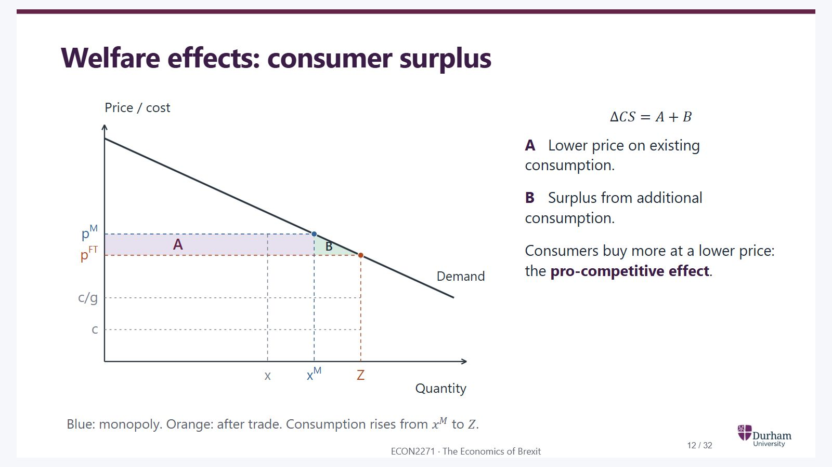
Notes:
Static student copy of the current web slide. Slide artwork is flattened; add personal notes here. Interactive explanations, playback and accessible HTML are available at:
https://davidchivers.co.uk/teaching/macro-applications/lecture_3.html#/l3-s13
Welfare effects: consumer surplus Δ C S = A + B \Delta CS=A+B A Lower price on existing consumption. B Surplus from additional consumption. Consumers buy more at a lower price: the pro-competitive effect . Blue: monopoly. Orange: after trade. Consumption rises from x M x^M to Z Z .
Consumer surplus rises by A plus B as the price falls from p M to p FT. A is the saving on original consumption; B is the surplus from additional consumption.

Slide 13
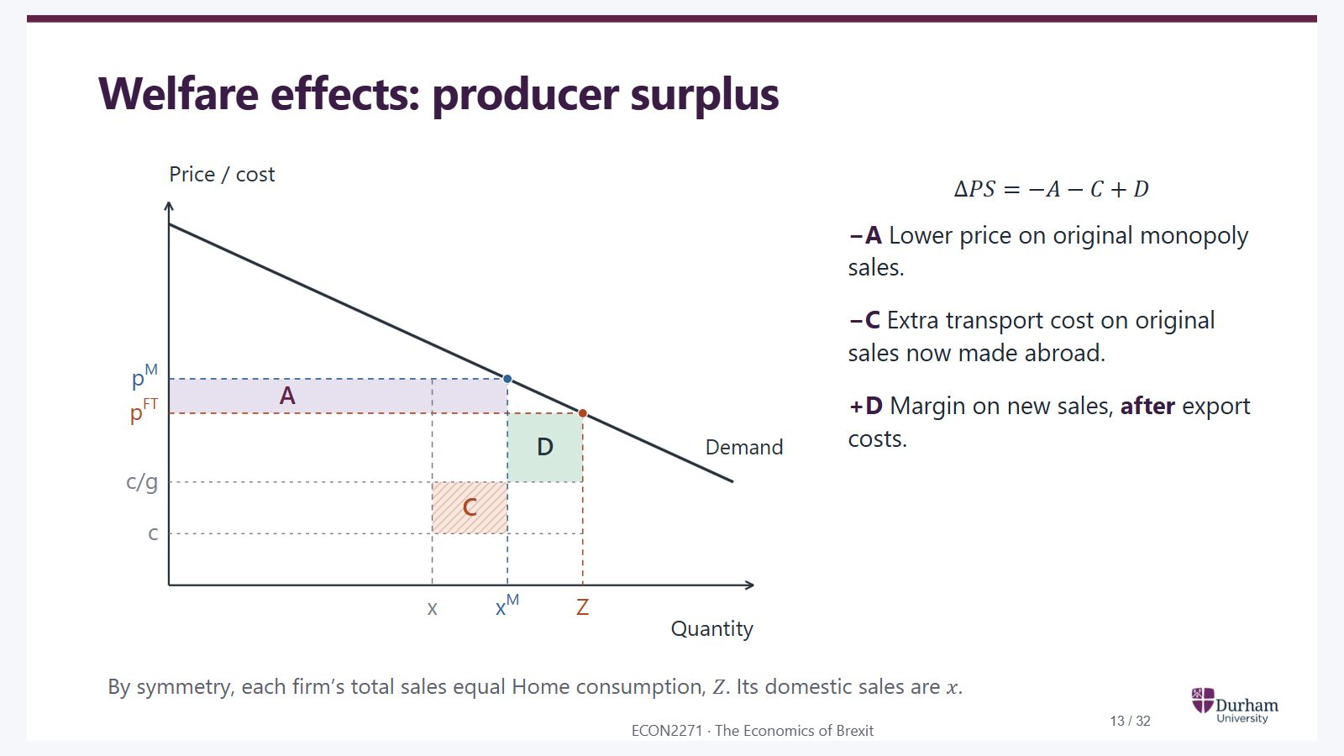
Notes:
Static student copy of the current web slide. Slide artwork is flattened; add personal notes here. Interactive explanations, playback and accessible HTML are available at:
https://davidchivers.co.uk/teaching/macro-applications/lecture_3.html#/l3-s14
Welfare effects: producer surplus Δ P S = − A − C + D \Delta PS=-A-C+D −A Lower price on original monopoly sales. −C Extra transport cost on original sales now made abroad. +D Margin on new sales, after export costs. By symmetry, each firm’s total sales equal Home consumption, Z Z . Its domestic sales are x x .
Producer surplus changes by minus A minus C plus D. C is extra transport cost on original monopoly sales shifted abroad; D is the margin on additional sales after export costs.

Slide 14
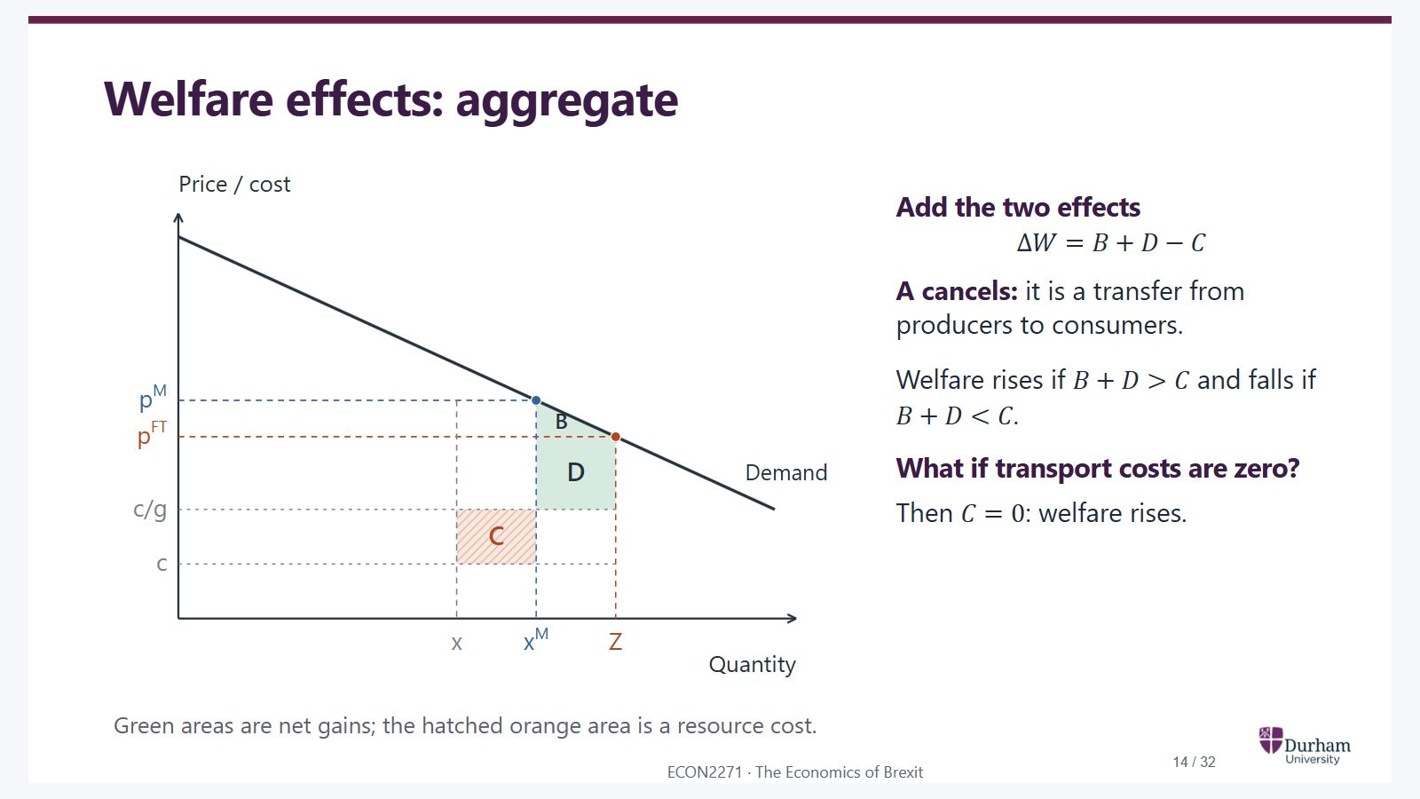
Notes:
Static student copy of the current web slide. Slide artwork is flattened; add personal notes here. Interactive explanations, playback and accessible HTML are available at:
https://davidchivers.co.uk/teaching/macro-applications/lecture_3.html#/l3-s15
Welfare effects: aggregate Add the two effects Δ W = B + D − C \Delta W=B+D-C A cancels: it is a transfer from producers to consumers. Welfare rises if B + D > C B+D>C and falls if B + D < C B+D<C . What if transport costs are zero? Then C = 0 C=0 : welfare rises. Green areas are net gains; the hatched orange area is a resource cost.
Area A cancels between consumers and producers. Net welfare is B plus D minus C. With no transport costs C is zero.

Slide 15

Notes:
Static student copy of the current web slide. Slide artwork is flattened; add personal notes here. Interactive explanations, playback and accessible HTML are available at:
https://davidchivers.co.uk/teaching/macro-applications/lecture_3.html#/l3-s16
Market size and industrial restructuring Questions What is the effect of an increased market size on the industry itself? Can some firms leave the market because of the increased competition? If so, is this beneficial for the countries involved?

Slide 16
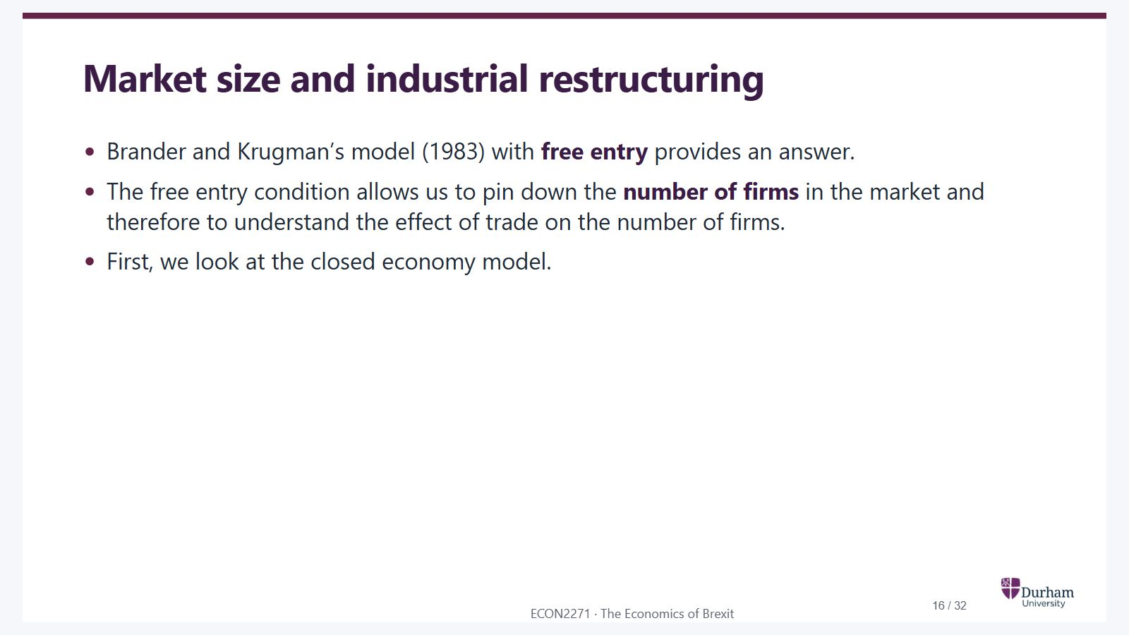
Notes:
Static student copy of the current web slide. Slide artwork is flattened; add personal notes here. Interactive explanations, playback and accessible HTML are available at:
https://davidchivers.co.uk/teaching/macro-applications/lecture_3.html#/l3-s17
Market size and industrial restructuring Brander and Krugman’s model (1983) with free entry provides an answer. The free entry condition allows us to pin down the number of firms in the market and therefore to understand the effect of trade on the number of firms. First, we look at the closed economy model.

Slide 17
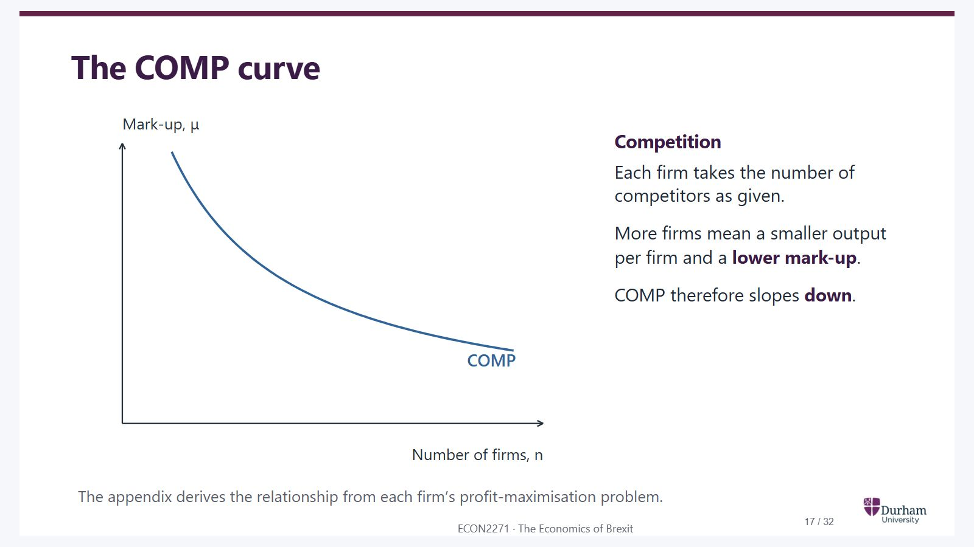
Notes:
Static student copy of the current web slide. Slide artwork is flattened; add personal notes here. Interactive explanations, playback and accessible HTML are available at:
https://davidchivers.co.uk/teaching/macro-applications/lecture_3.html#/l3-s18
The COMP curve Competition Each firm takes the number of competitors as given. More firms mean a smaller output per firm and a lower mark-up . COMP therefore slopes down . The appendix derives the relationship from each firm’s profit-maximisation problem.
COMP slopes down: as the number of firms rises, competition reduces the mark-up.

Slide 18
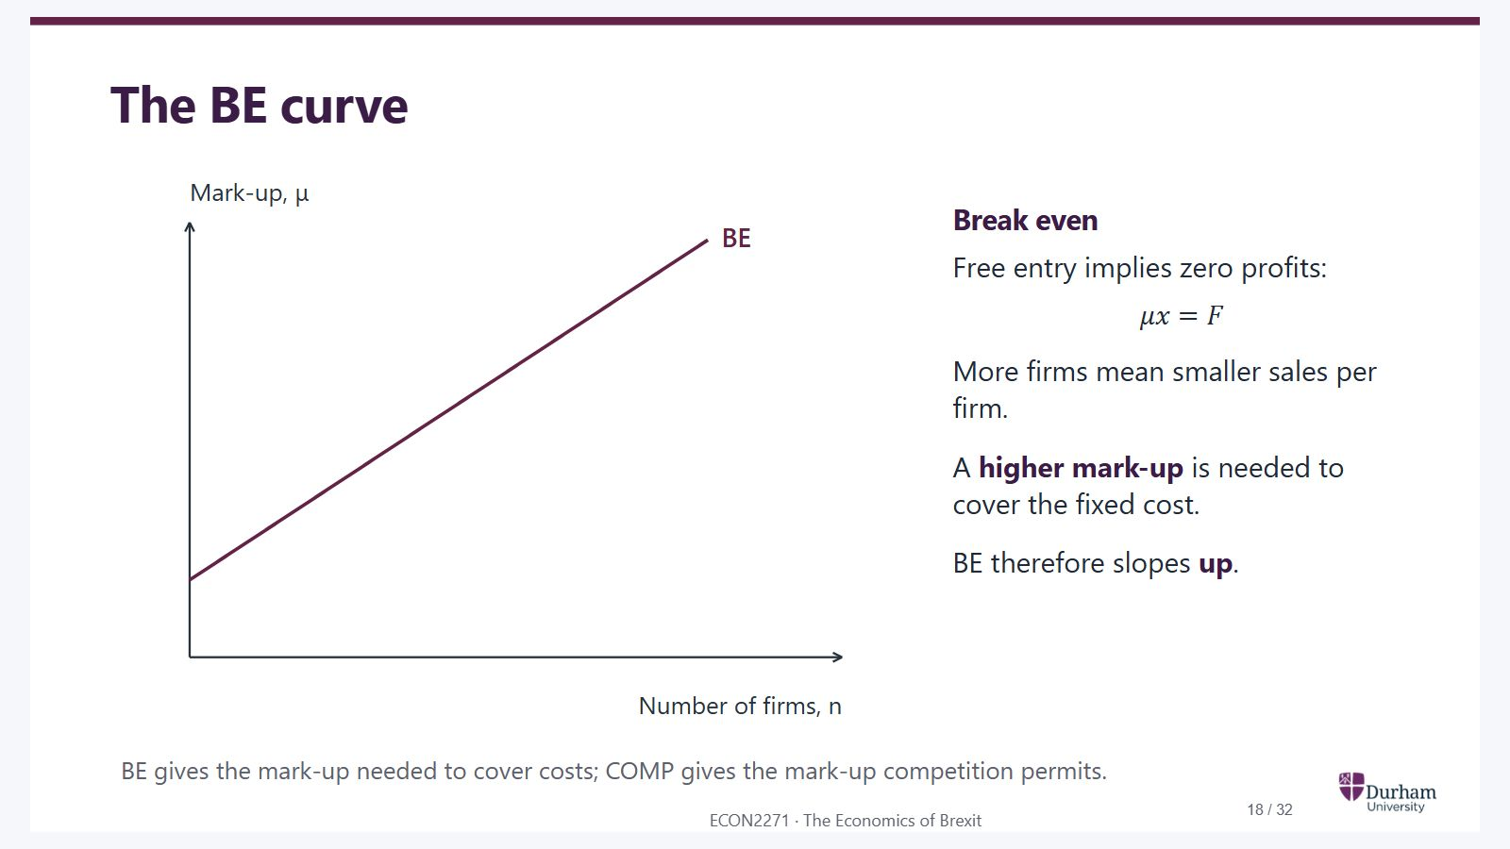
Notes:
Static student copy of the current web slide. Slide artwork is flattened; add personal notes here. Interactive explanations, playback and accessible HTML are available at:
https://davidchivers.co.uk/teaching/macro-applications/lecture_3.html#/l3-s19
The BE curve Break even Free entry implies zero profits: μ x = F \mu x=F More firms mean smaller sales per firm. A higher mark-up is needed to cover the fixed cost. BE therefore slopes up . BE gives the mark-up needed to cover costs; COMP gives the mark-up competition permits.
BE slopes up: with more firms, each firm is smaller and needs a higher mark-up to cover its fixed cost.

Slide 19
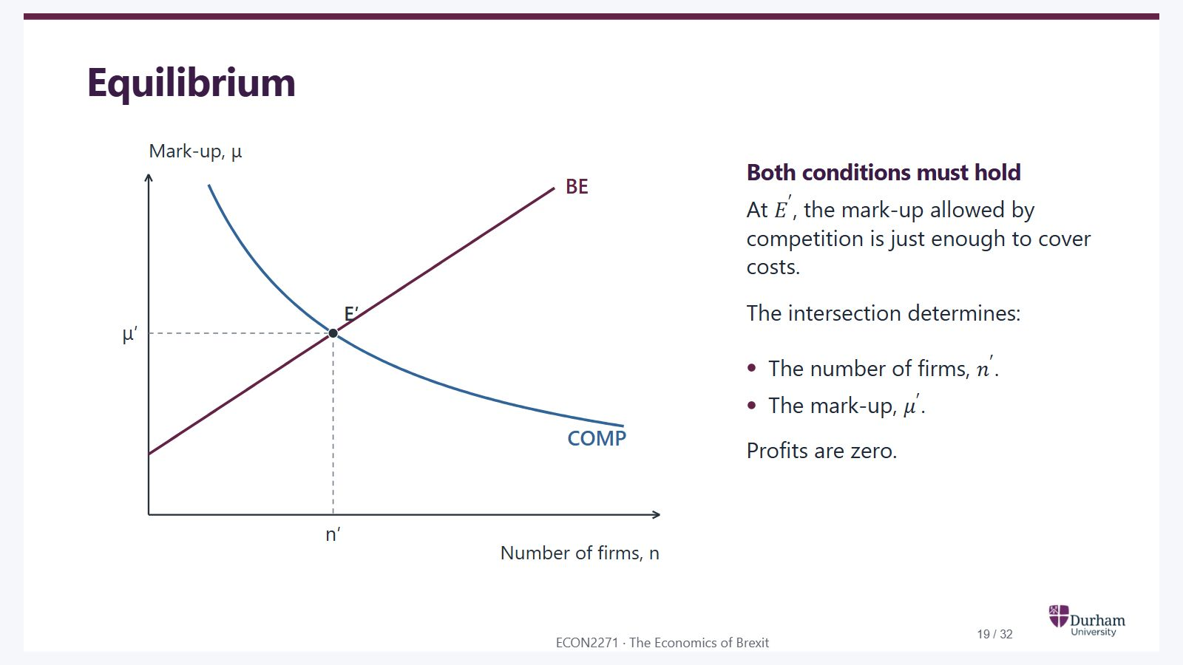
Notes:
Static student copy of the current web slide. Slide artwork is flattened; add personal notes here. Interactive explanations, playback and accessible HTML are available at:
https://davidchivers.co.uk/teaching/macro-applications/lecture_3.html#/l3-s20
Equilibrium Both conditions must hold At E ′ E' , the mark-up allowed by competition is just enough to cover costs. The intersection determines: The number of firms, n ′ n' . The mark-up, μ ′ \mu' . Profits are zero.
COMP and BE intersect at E prime. This determines the equilibrium number of firms n prime and mark-up mu prime.

Slide 20
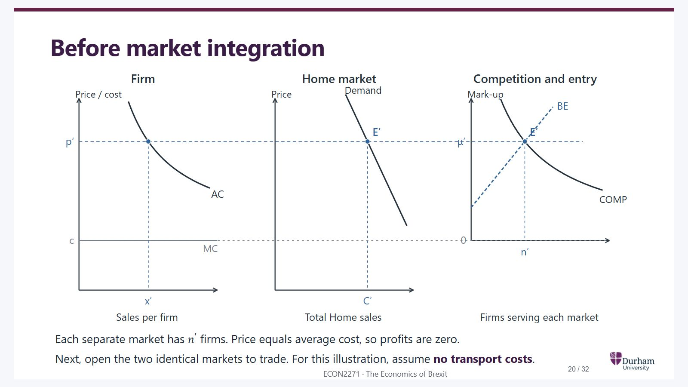
Notes:
Static student copy of the current web slide. Slide artwork is flattened; add personal notes here. Interactive explanations, playback and accessible HTML are available at:
https://davidchivers.co.uk/teaching/macro-applications/lecture_3.html#/l3-s21
Before market integration Each separate market has n ′ n' firms. Price equals average cost, so profits are zero. Next, open the two identical markets to trade. For this illustration, assume no transport costs .
Before integration, each country has n prime firms. The linked panels show output per firm x prime, Home consumption C prime, price p prime equal to average cost, and mark-up mu prime.

Slide 21
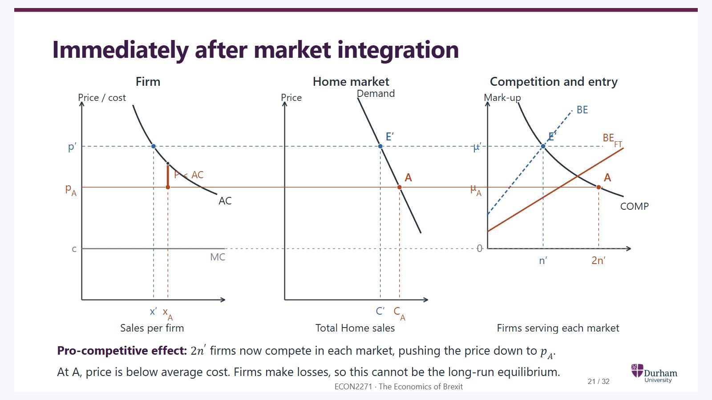
Notes:
Static student copy of the current web slide. Slide artwork is flattened; add personal notes here. Interactive explanations, playback and accessible HTML are available at:
https://davidchivers.co.uk/teaching/macro-applications/lecture_3.html#/l3-s22
Immediately after market integration Pro-competitive effect: 2 n ′ 2n' firms now compete in each market, pushing the price down to p A p_A . At A, price is below average cost. Firms make losses, so this cannot be the long-run equilibrium.
With 2 n prime firms competing in the integrated market, the economy moves to A. The price falls below average cost and firms make losses. The larger market shifts BE down to BE FT.

Slide 22
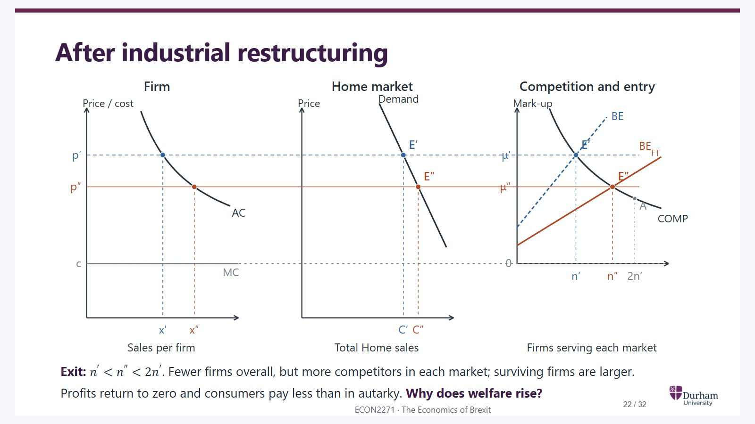
Notes:
Static student copy of the current web slide. Slide artwork is flattened; add personal notes here. Interactive explanations, playback and accessible HTML are available at:
https://davidchivers.co.uk/teaching/macro-applications/lecture_3.html#/l3-s23
After industrial restructuring Exit: n ′ < n ″ < 2 n ′ n'<n''<2n' . Fewer firms overall, but more competitors in each market; surviving firms are larger. Profits return to zero and consumers pay less than in autarky. Why does welfare rise?
Exit moves the economy from A to E double prime. There are fewer firms overall but more competitors in each market than before trade: n prime is less than n double prime, which is less than 2 n prime. Surviving firms are larger and the price is below autarky.

Slide 23
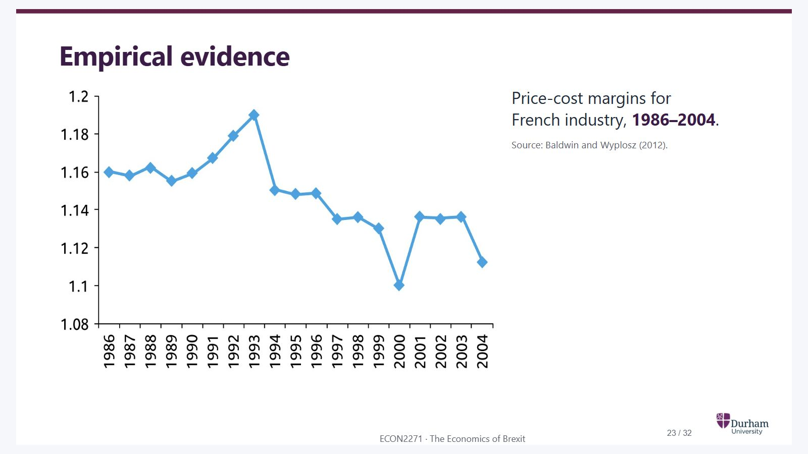
Notes:
Static student copy of the current web slide. Slide artwork is flattened; add personal notes here. Interactive explanations, playback and accessible HTML are available at:
https://davidchivers.co.uk/teaching/macro-applications/lecture_3.html#/l3-s24
Empirical evidence Price-cost margins for French industry, 1986–2004 . Source: Baldwin and Wyplosz (2012).
Line chart of French industrial price-cost margins, 1986 to 2004. Margins fluctuate but are lower at the end of the period than at the beginning. Source: Baldwin and Wyplosz, 2012.

Slide 24
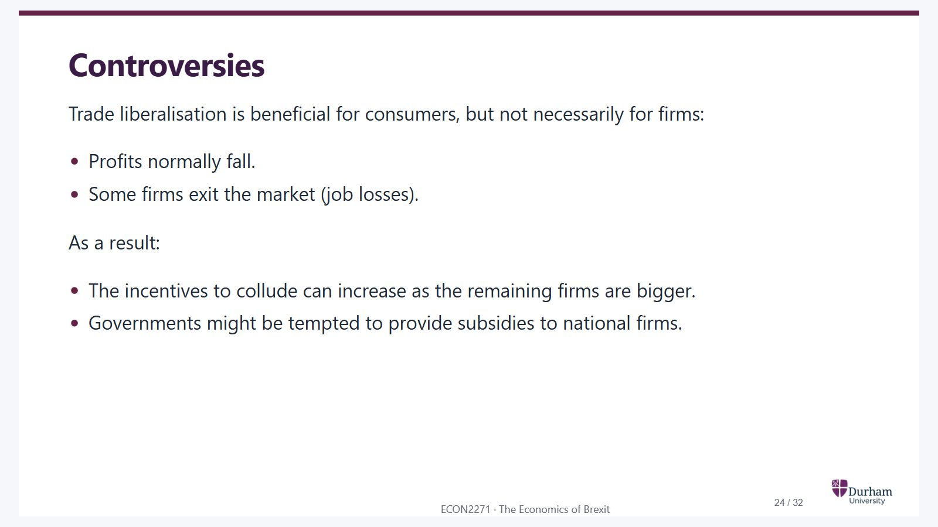
Notes:
Static student copy of the current web slide. Slide artwork is flattened; add personal notes here. Interactive explanations, playback and accessible HTML are available at:
https://davidchivers.co.uk/teaching/macro-applications/lecture_3.html#/l3-s25
Controversies Trade liberalisation is beneficial for consumers, but not necessarily for firms: Profits normally fall. Some firms exit the market (job losses). As a result: The incentives to collude can increase as the remaining firms are bigger. Governments might be tempted to provide subsidies to national firms.

Slide 25

Notes:
Static student copy of the current web slide. Slide artwork is flattened; add personal notes here. Interactive explanations, playback and accessible HTML are available at:
https://davidchivers.co.uk/teaching/macro-applications/lecture_3.html#/l3-s26
Summing up Free mobility of goods is beneficial as consumers benefit from the higher competition triggered by the increased market size. Market integration also leads to a process of industrial restructuring (job losses if labour mobility across sectors and countries is not perfect).

Slide 26

Notes:
Static student copy of the current web slide. Slide artwork is flattened; add personal notes here. Interactive explanations, playback and accessible HTML are available at:
https://davidchivers.co.uk/teaching/macro-applications/lecture_3.html#/l3-s27
Next lecture We will talk about migration.

Slide 27
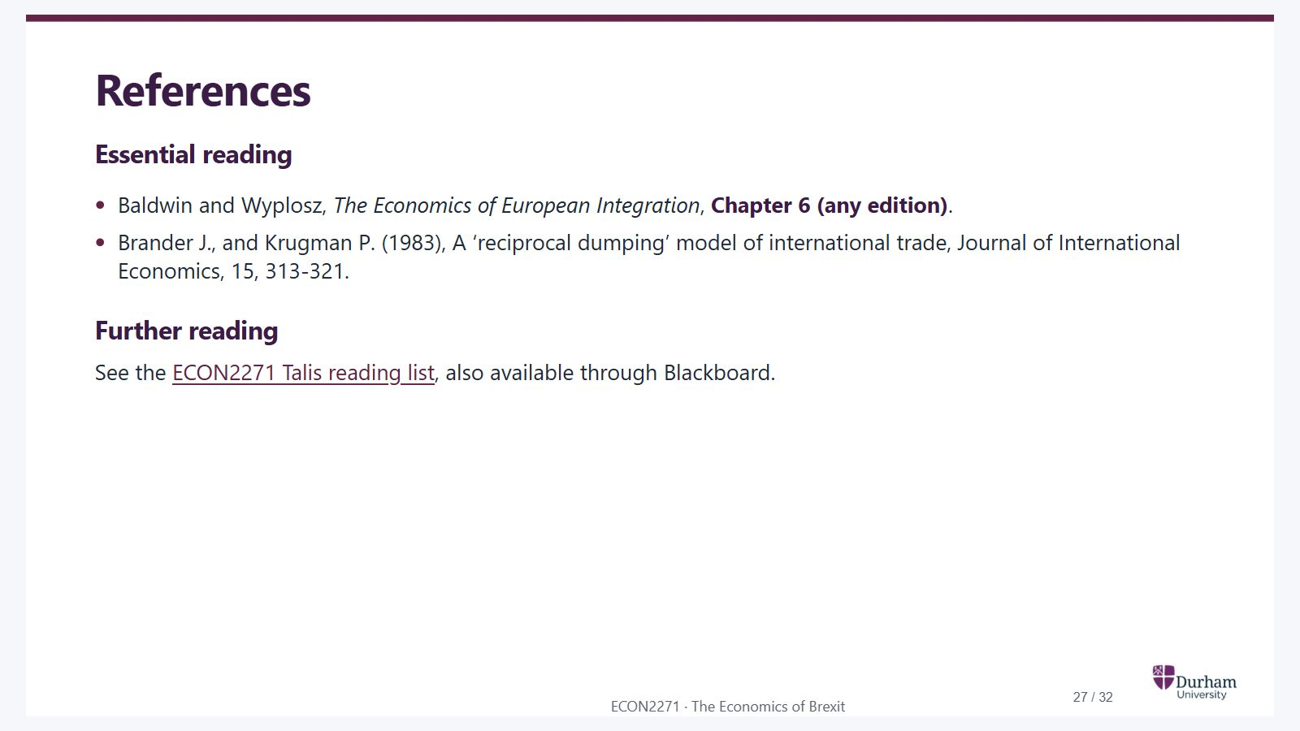
Notes:
Static student copy of the current web slide. Slide artwork is flattened; add personal notes here. Interactive explanations, playback and accessible HTML are available at:
https://davidchivers.co.uk/teaching/macro-applications/lecture_3.html#/l3-s28
References Essential reading Baldwin and Wyplosz, The Economics of European Integration , Chapter 6 (any edition) . Brander J., and Krugman P. (1983), A ‘reciprocal dumping’ model of international trade, Journal of International Economics, 15, 313-321. Further reading See the ECON2271 Talis reading list , also available through Blackboard.
https://durham.rl.talis.com/lists/d85d1ad3-e9ac-4daf-aa66-e3ddfcf902d7.html

Slide 28
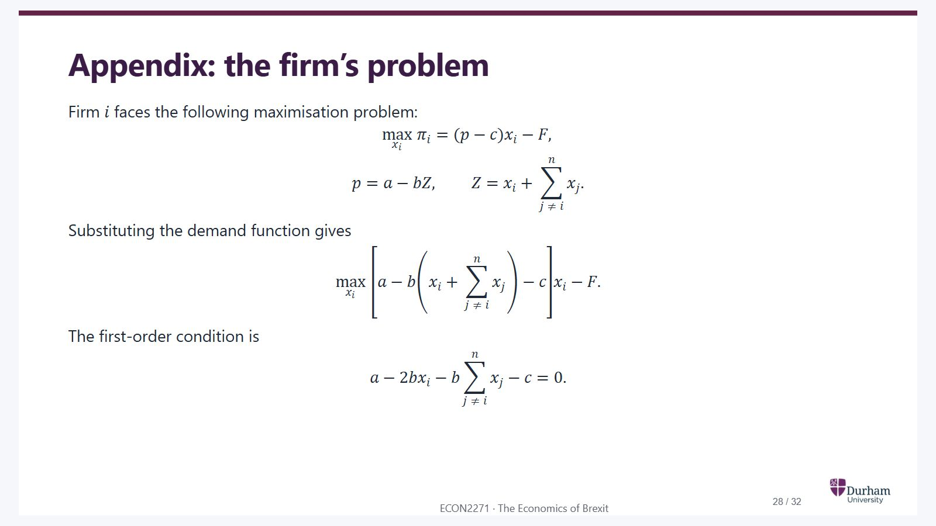
Notes:
Static student copy of the current web slide. Slide artwork is flattened; add personal notes here. Interactive explanations, playback and accessible HTML are available at:
https://davidchivers.co.uk/teaching/macro-applications/lecture_3.html#/l3-s29
Appendix: the firm’s problem Firm i i faces the following maximisation problem: max x i π i = ( p − c ) x i − F , \max_{x_i}\;\pi_i=(p-c)x_i-F, p = a − b Z , Z = x i + ∑ j ≠ i n x j . p=a-bZ,\qquad Z=x_i+\sum_{j\ne i}^{n}x_j. Substituting the demand function gives max x i [ a − b ( x i + ∑ j ≠ i n x j ) − c ] x i − F . \max_{x_i}\;\left[a-b\left(x_i+\sum_{j\ne i}^{n}x_j\right)-c\right]x_i-F. The first-order condition is a − 2 b x i − b ∑ j ≠ i n x j − c = 0 . a-2bx_i-b\sum_{j\ne i}^{n}x_j-c=0.

Slide 29
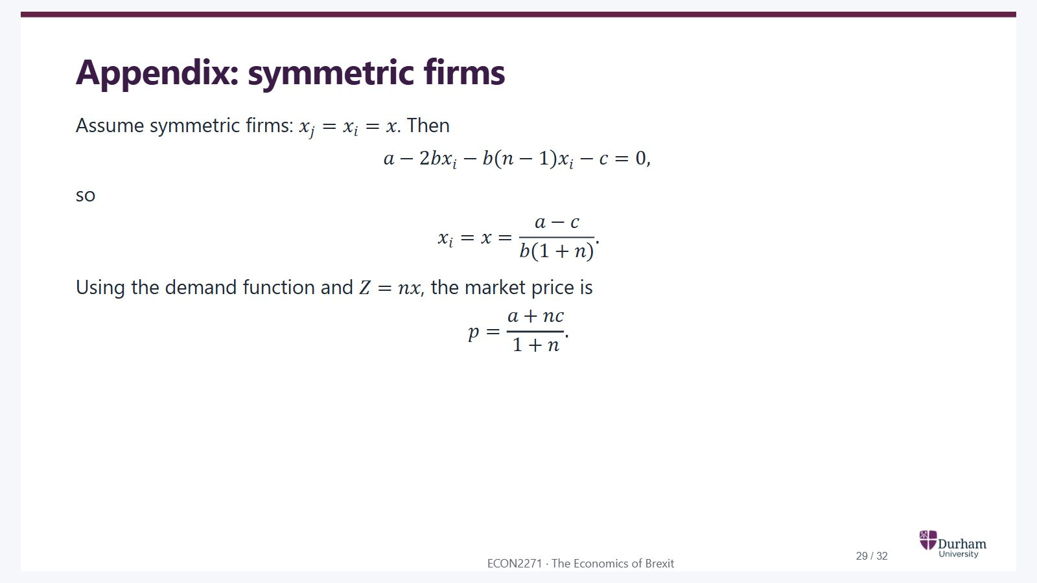
Notes:
Static student copy of the current web slide. Slide artwork is flattened; add personal notes here. Interactive explanations, playback and accessible HTML are available at:
https://davidchivers.co.uk/teaching/macro-applications/lecture_3.html#/l3-s30
Appendix: symmetric firms Assume symmetric firms: x j = x i = x x_j=x_i=x . Then a − 2 b x i − b ( n − 1 ) x i − c = 0 , a-2bx_i-b(n-1)x_i-c=0, so x i = x = a − c b ( 1 + n ) . x_i=x=\frac{a-c}{b(1+n)}. Using the demand function and Z = n x Z=nx , the market price is p = a + n c 1 + n . p=\frac{a+nc}{1+n}.

Slide 30
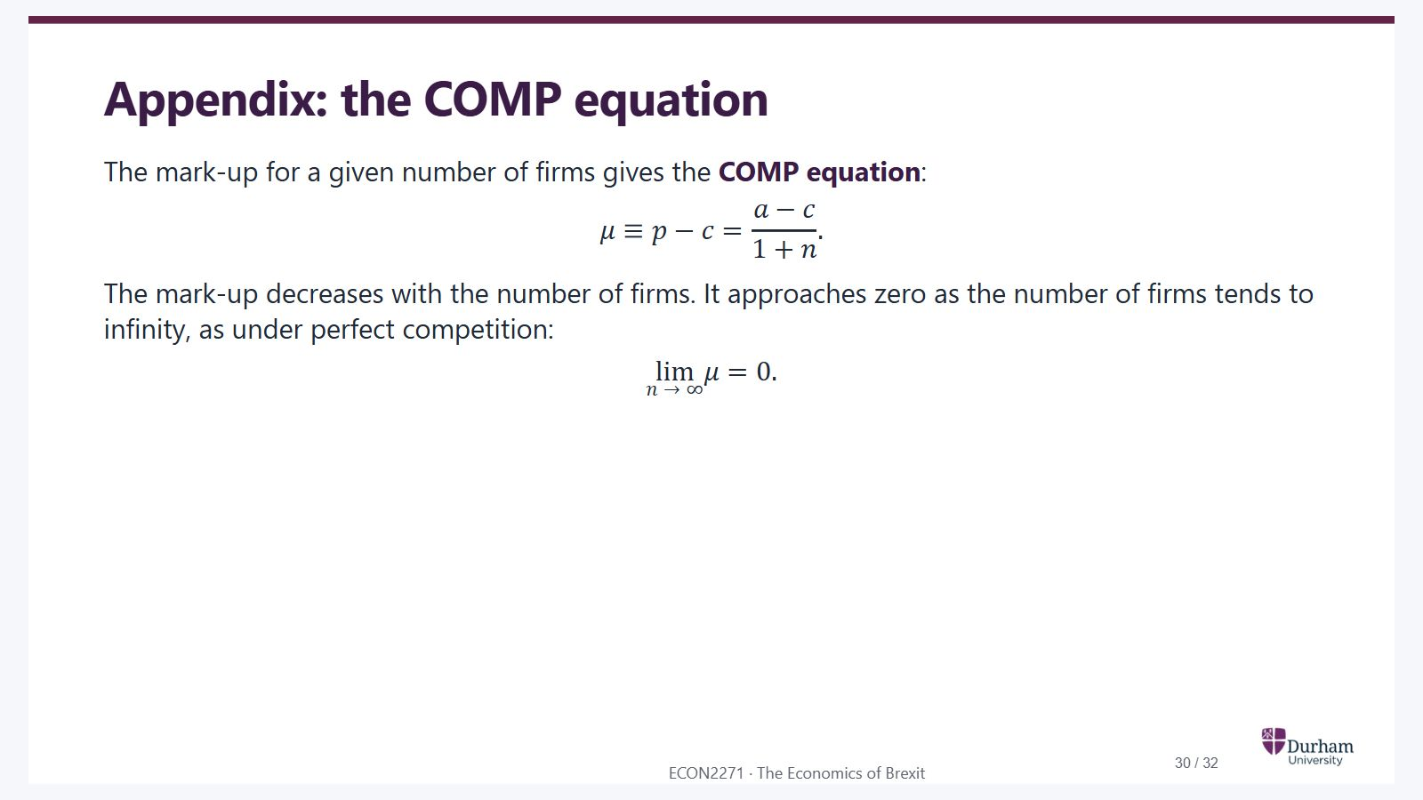
Notes:
Static student copy of the current web slide. Slide artwork is flattened; add personal notes here. Interactive explanations, playback and accessible HTML are available at:
https://davidchivers.co.uk/teaching/macro-applications/lecture_3.html#/l3-s31
Appendix: the COMP equation The mark-up for a given number of firms gives the COMP equation : μ ≡ p − c = a − c 1 + n . \mu\equiv p-c=\frac{a-c}{1+n}. The mark-up decreases with the number of firms. It approaches zero as the number of firms tends to infinity, as under perfect competition: lim n → ∞ μ = 0 . \lim_{n\to\infty}\mu=0.

Slide 31
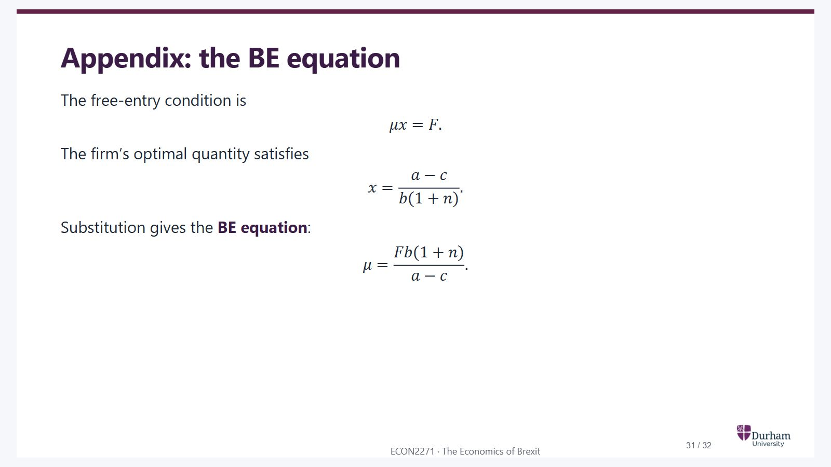
Notes:
Static student copy of the current web slide. Slide artwork is flattened; add personal notes here. Interactive explanations, playback and accessible HTML are available at:
https://davidchivers.co.uk/teaching/macro-applications/lecture_3.html#/l3-s32
Appendix: the BE equation The free-entry condition is μ x = F . \mu x=F. The firm’s optimal quantity satisfies x = a − c b ( 1 + n ) . x=\frac{a-c}{b(1+n)}. Substitution gives the BE equation : μ = F b ( 1 + n ) a − c . \mu=\frac{Fb(1+n)}{a-c}.

Slide 32
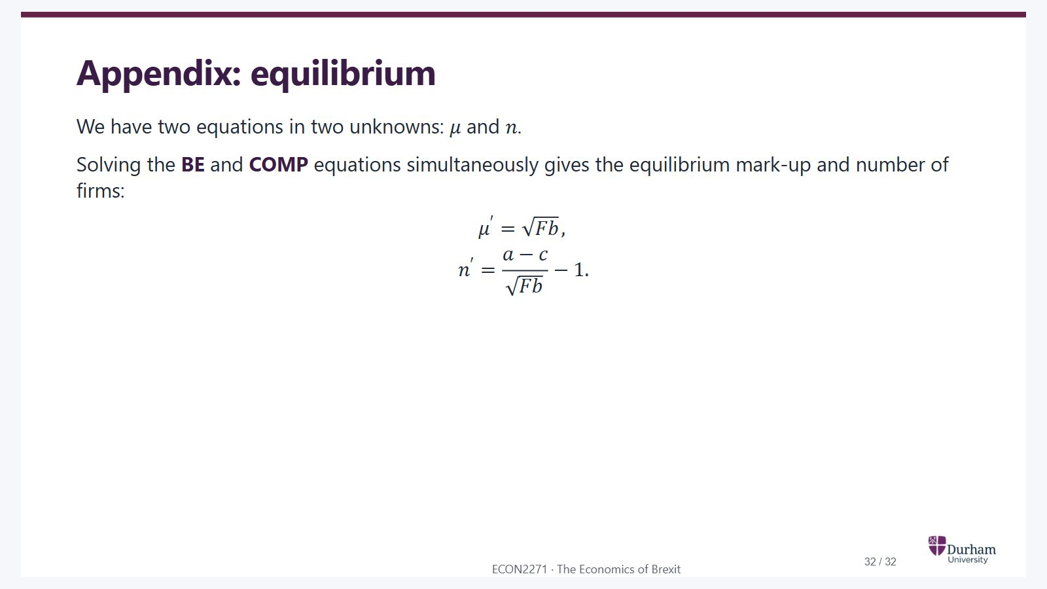
Notes:
Static student copy of the current web slide. Slide artwork is flattened; add personal notes here. Interactive explanations, playback and accessible HTML are available at:
https://davidchivers.co.uk/teaching/macro-applications/lecture_3.html#/l3-s33
Appendix: equilibrium We have two equations in two unknowns: μ \mu and n n . Solving the BE and COMP equations simultaneously gives the equilibrium mark-up and number of firms: μ ′ = F b , \mu'=\sqrt{Fb}, n ′ = a − c F b − 1 . n'=\frac{a-c}{\sqrt{Fb}}-1.

