Slide 1

PROPOSAL DEFENSE · JULY, 2026
NEXIAM
A Role-Based College Admission Testing System for the Guidance
and Registrar Offices at ISPSC Tagudin
SARMIENTO, D. D. · PAGADUAN, J. G. · LOPEZ, C. M.
BSIT — ISPSC Tagudin Campus | Adviser: Dr. Zeus Vincent Mendoza
Notes:
Not timed — stays up during Opening Prayer + Researcher Introductions. No script needed.
1

Slide 2




NEXIAM
THE PROBLEM — GLOBAL & NATIONAL
Next-Generation Examinations and
X(Cross)-Role
Intelligent
Admissions
Management
A Worldwide Shift, A Familiar Strain
Paper-based testing → slow, integrity risks, equity gaps
02
1
Global shift to AI-assisted, cloud-based admission platforms
→ ML applicant assessment validated (Lira et al., Science Advances)
/ 14
2
RA 10931 increased admission volumes, strained staff and infrastructure
→ Unified platforms proven deployable across institutions (Adwan et al., 97% usability)
3
RA 10173 — Data Privacy Act — data protection is a legal duty
→ Regulatory floor governing all system design
PROBLEM
Notes:
David · ~0:45 · 3 builds.
Manual, paper-based admission testing isn't just slow — it creates real integrity risks and equity gaps for applicants who can't afford repeat trips to campus.
[Build 1] Globally, higher ed institutions are already shifting to AI-assisted, cloud-based admission platforms.
[Build 2] Here in the Philippines, RA 10931 — the Free Higher Education Act — pushed public college applications up nationwide.
[Build 3] RA 10173, the Data Privacy Act, makes protecting applicant data a legal duty, not just good practice. That's the backdrop our problem sits in.
2

Slide 3


NEXIAM
THE PROBLEM — AT ISPSC TAGUDIN
Next-Generation Examinations and
X(Cross)-Role
Intelligent
Admissions
Management
Same Pressure, Paper Process
700–1,000
applicants processed every year —
entirely on paper
Hand-scoring delay — five days, sometimes up to two full weeks per cycle.
03
1
Results posted on a Facebook page, monitored during office hours only.
2
/ 14
Inter-office coordination runs on text messages — no shared system or visibility.
3
Gap: components proven independently, integration missing
→ RAG chatbot: Dayata & Yap (IEEE COMNETSAT)
→ OMR scoring: Cuerdo (PH public schools)
→ ML-based decision-support: Tan (ACM)
* No unified admission platform exists *
4
PROBLEM
Notes:
David · ~0:45 · 4 builds.
At ISPSC Tagudin specifically, we're processing 700 to 1,000 applicants a year — completely on paper.
[Build 1] Hand-scoring alone takes five days, sometimes up to two full weeks.
[Build 2] Results get posted on a Facebook page, and applicants can only follow up during office hours.
[Build 3] Guidance and Registrar coordinate through text messages — no shared system, no shared visibility.
[Build 4] Local studies touch pieces of this, but nothing pulls it into one role-governed system. That's the gap NEXIAM fills.
3

Slide 4

NEXIAM
OBJECTIVES OF THE STUDY
One General Objective, Four Specific Objectives
Next-Generation Examinations and
X(Cross)-Role
Intelligent
Admissions
Management
To Develop NEXIAM: A Role-Based College Admission Testing System for the Guidance and Registrar Offices at ISPSC Tagudin Campus.
SO1
Analyze the existing admission process and pinpoint its gaps.
04
SO2
Determine the system requirements those gaps demand.
/ 14
SO3
Evaluate user acceptance of NEXIAM using the Technology Acceptance Model.
SO4
Test whether NEXIAM performs measurably better than the manual process it replaces.
OBJECTIVES
Notes:
David · ~0:45 · 4 builds.
Our general objective is straightforward: develop NEXIAM, a web-based, role-governed admission testing platform for ISPSC Tagudin.
[Build 1 — SO1] Analyze the existing admission process and pinpoint its gaps.
[Build 2 — SO2] Determine the system requirements those gaps actually demand.
[Build 3 — SO3] Evaluate user acceptance of NEXIAM using the Technology Acceptance Model.
[Build 4 — SO4] Test whether NEXIAM performs measurably better than the manual process it replaces.
4

Slide 5
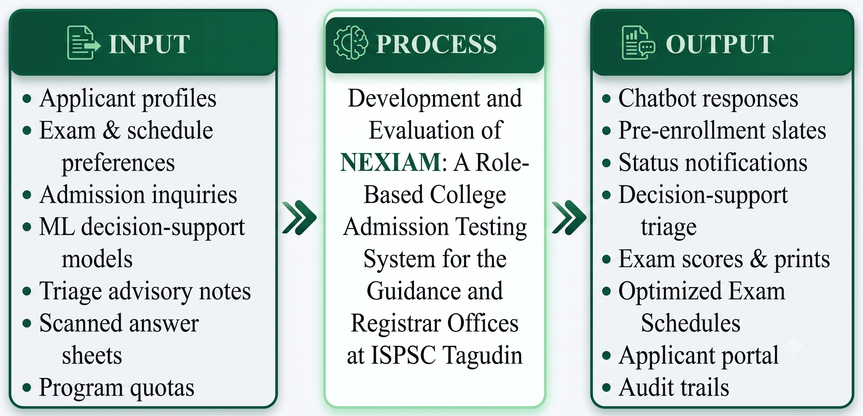
NEXIAM
CONCEPTUAL FRAMEWORK
Input-Process-Output (IPO) Diagram
Next-Generation Examinations and
X(Cross)-Role
Intelligent
Admissions
Management
05
/ 14
FRAMEWORK
Notes:
David · ~1:45 · 7 builds.
NEXIAM's conceptual framework centers on six computational layers, all resting on a foundational layer. I'll walk through them as they appear.
[Build 1 — Foundational Layer] Before the six computational layers even activate, NEXIAM maintains a foundational layer: core admission configuration, applicant status tracking, and proctor-logged exam attendance, kept as structured, persistent records instead of staff memory and informal coordination.
[Build 2 — RBAC] On top of that, Role-Based Access Control determines what each user type — Guidance staff, Registrar staff, or an applicant — is allowed to see and do.
[Build 3 — OMR] Computer-vision OMR scoring automates exam checking — no more hand-scoring backlog.
[Build 4 — K-Means] K-Means clustering groups applicant aptitude patterns into descriptive clusters. To be clear — this is descriptive only, not a recommendation engine. It doesn't decide who gets admitted.
[Build 5 — RAG Chatbot] A hybrid RAG chatbot handles applicant FAQs using the institution's own admission data.
[Build 6 — AI Scheduling] AI-assisted scheduling coordinates exam slots and proctor assignments automatically.
[Build 7 — HMAC Audit] HMAC-SHA256 audit logging keeps a tamper-evident trail of every action, for accountability. Together, the six computational layers and their foundation move admission testing from a manual, siloed process into one governed, role-aware system.
5

Slide 6




NEXIAM
SCOPE AND LIMITATION
What NEXIAM Covers — And What It Doesn't
Next-Generation Examinations and
X(Cross)-Role
Intelligent
Admissions
Management
SCOPE
LIMITATION
Admission testing workflow only — June to September 2026.
No enrollment, tuition, or long-term records.
06
Seven user roles, full web-based application intake.
Cloud-hosted — proctoring interface alone keeps offline resilience via service-worker caching.
/ 14
≥95% target OMR scoring accuracy.
Free-tier OpenRouter inference caps request volume.
RAG chatbot, K-Means aptitude dashboard (extensible ML model support), and AI-assisted scheduling — all active.
September evaluation uses proxy evaluators, not live applicants.
No formal NPC certification — protection is application-layer, not regulatory-certified.
The proctoring interface- cloud-connected but offline-resilience caching for intermittent connectivity.
SCOPE
Notes:
Jaypee · ~1:15 · 2 builds (column reveals).
Let's be precise about what NEXIAM covers, and what it doesn't.
[Build 1 — SCOPE] The admission testing workflow only, running June to September 2026, across seven user roles. Targeting roughly 95% OMR scoring accuracy, with the RAG chatbot, K-Means dashboard, and AI-assisted scheduling all active.
[Build 2 — LIMITATION] NEXIAM doesn't touch enrollment, tuition, or permanent records. Hosting is cloud-only, no offline mode. AI components run on OpenRouter's free tier, capping request volume. Because evaluation happens in September, outside the active admission cycle, we're using proxy evaluators instead of live applicants. And we have no formal NPC certification — our data protection is app-level, not regulatory-certified.
6

Slide 7


NEXIAM
BENEFICIARIES
Who NEXIAM Serves
Next-Generation Examinations and
X(Cross)-Role
Intelligent
Admissions
Management
ISPSC, Registrar, Guidance, and Program Heads gain a faster, more compliant, real-time admission process.
A 24/7 portal — no repeat trips to campus just to check a result.
Hands-on AI development experience and a blueprint other campuses can replicate.
Institution & Offices
Applicants & Students
Research Community
07
/ 14
IMPACT
Notes:
David · ~0:45 · 3 builds.
NEXIAM benefits three groups.
[Build 1] The institution and its offices — ISPSC, Registrar, Guidance, Program Heads — get a faster, more compliant, real-time admission process.
[Build 2] Applicants and students get a 24/7 portal, so they're not making repeat trips to campus just to check a result.
[Build 3] The research community — us and future researchers — gain hands-on AI development experience and a replicable blueprint.
7

Slide 8

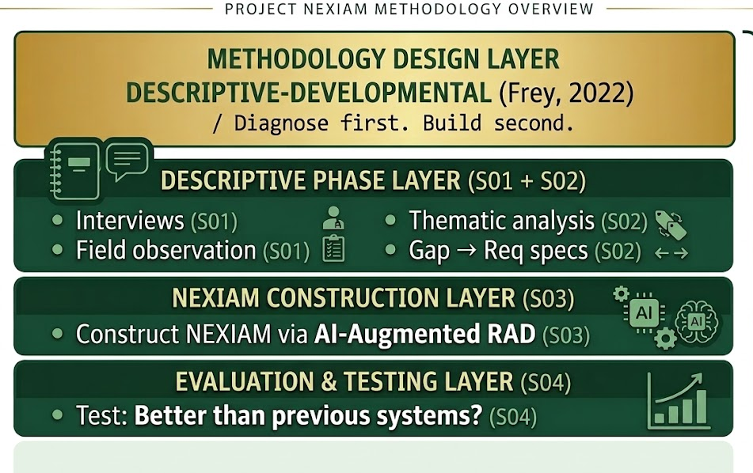
NEXIAM
RESEARCH DESIGN
Descriptive-Developmental, Built Through AI-Augmented RAD
Next-Generation Examinations and
X(Cross)-Role
Intelligent
Admissions
Management
Diagnose the existing process first, then build and evaluate the solution against it.
08
/ 14
METHOD
Notes:
Jaypee · ~1:15 · 5 builds.
We used a descriptive-developmental research design — diagnose the current process first, then build and evaluate the solution against it.
[Build 1] For development, we followed an AI-augmented Rapid Application Development model, in four phases.
[Build 2 — Requirements Planning] Mapped the existing process and gathered system requirements.
[Build 3 — User Design] Structured the interface and workflows around each user role.
[Build 4 — Rapid Construction] Our active build phase — the OMR engine, chatbot, and other modules get coded.
[Build 5 — Cutover] Deploy, run the TAM evaluation, finalize documentation. RAD fit because it lets us iterate quickly with our adviser and our Guidance and Registrar contacts at each stage.
8

Slide 9



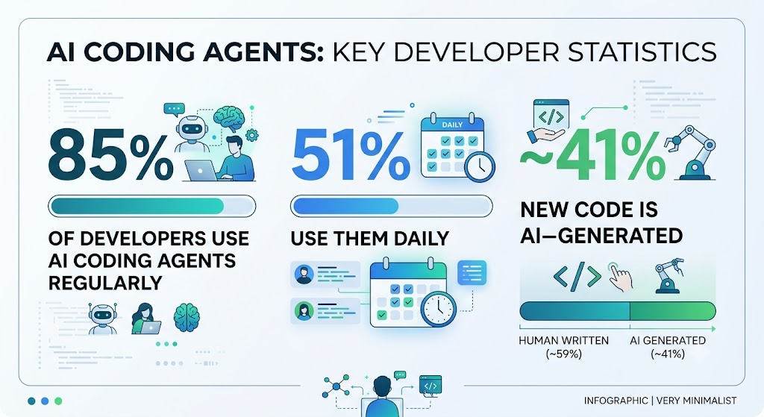




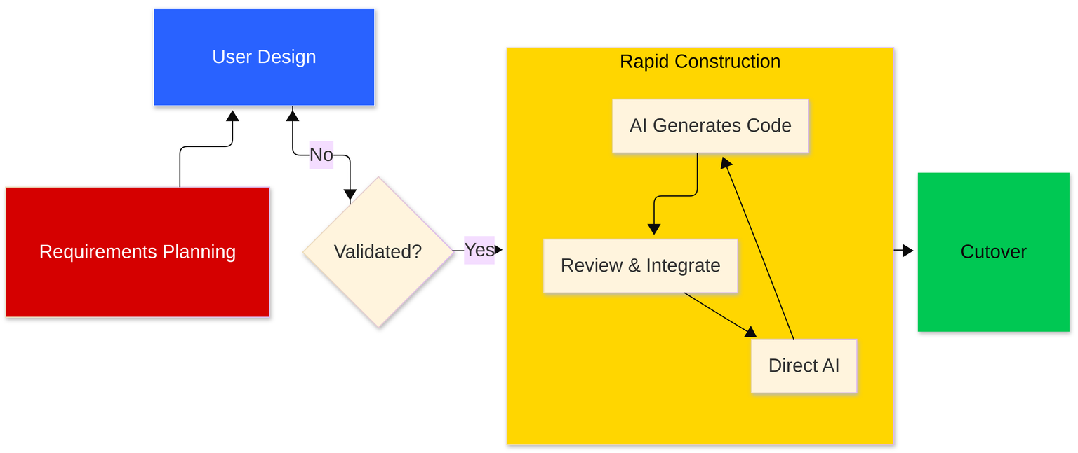
NEXIAM
SOFTWARE MODEL
AI-Augmented Rapid Application Development (RAD)
Next-Generation Examinations and
X(Cross)-Role
Intelligent
Admissions
Management
1
Requirements Planning
2
User Design
3
Rapid Construction
4
Cutover
09
Map the existing process, gather system requirements.
Structure interfaces and workflows around each role.
Build the OMR engine, chatbot, and remaining modules.
Deploy, run TAM evaluation, finalize documentation.
/ 14
METHOD
Notes:
Jaypee · ~1:15 · 5 builds.
We used a descriptive-developmental research design — diagnose the current process first, then build and evaluate the solution against it.
[Build 1] For development, we followed an AI-augmented Rapid Application Development model, in four phases.
[Build 2 — Requirements Planning] Mapped the existing process and gathered system requirements.
[Build 3 — User Design] Structured the interface and workflows around each user role.
[Build 4 — Rapid Construction] Our active build phase — the OMR engine, chatbot, and other modules get coded.
[Build 5 — Cutover] Deploy, run the TAM evaluation, finalize documentation. RAD fit because it lets us iterate quickly with our adviser and our Guidance and Registrar contacts at each stage.
8

Slide 10


NEXIAM
PROJECT PLAN
June – September 2026
Next-Generation Examinations and
X(Cross)-Role
Intelligent
Admissions
Management
June
July
Aug
Sept
Requirements Planning
10
User Design
/ 14
Rapid Construction
Cutover
On track against this schedule as of today.
TIMELINE
Notes:
Jaypee · ~0:30 · 0 builds (single full-slide Gantt visual).
Here's the full timeline. Four phases run June through September 2026 — Requirements Planning this month, User Design through early July, Rapid Construction carrying us through August, and Cutover in September, where deployment and evaluation happen. We're on track against this schedule as of today.
9

Slide 11

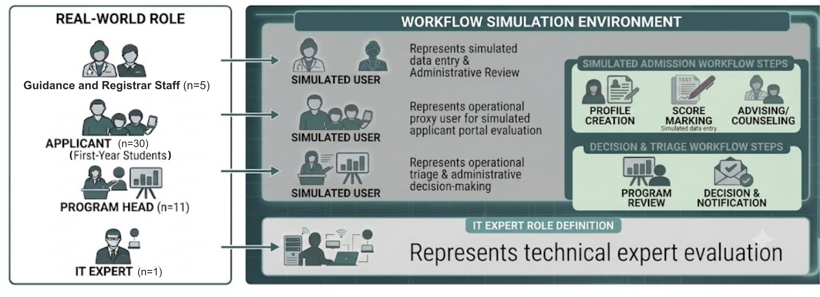

NEXIAM
POPULATION AND LOCALE
47 Purposive Evaluators
Next-Generation Examinations and
X(Cross)-Role
Intelligent
Admissions
Management
30
11
3
2
1
47
First-Year
Students
Program
Heads
Registrar
Staff
Guidance
Staff
IT
Expert
Total
11
/ 14
NO ACTIVE ADMISSION CYCLE
SAMPLE
Notes:
Christine · ~0:45 · 2 builds.
Our study is located at ISPSC Tagudin Campus.
[Build 1] We're working with 49 purposive evaluators total: 30 first-year students, 11 Program Heads, 3 Registrar staff, 2 Guidance staff, and 3 IT experts.
[Build 2] Since our evaluation period in September falls outside the school's active admission cycle, there are no live applicants to test with — so proxy evaluators step into role-based scenarios instead, simulating how a real Guidance staffer, Registrar staffer, or applicant would use the system.
10

Slide 12

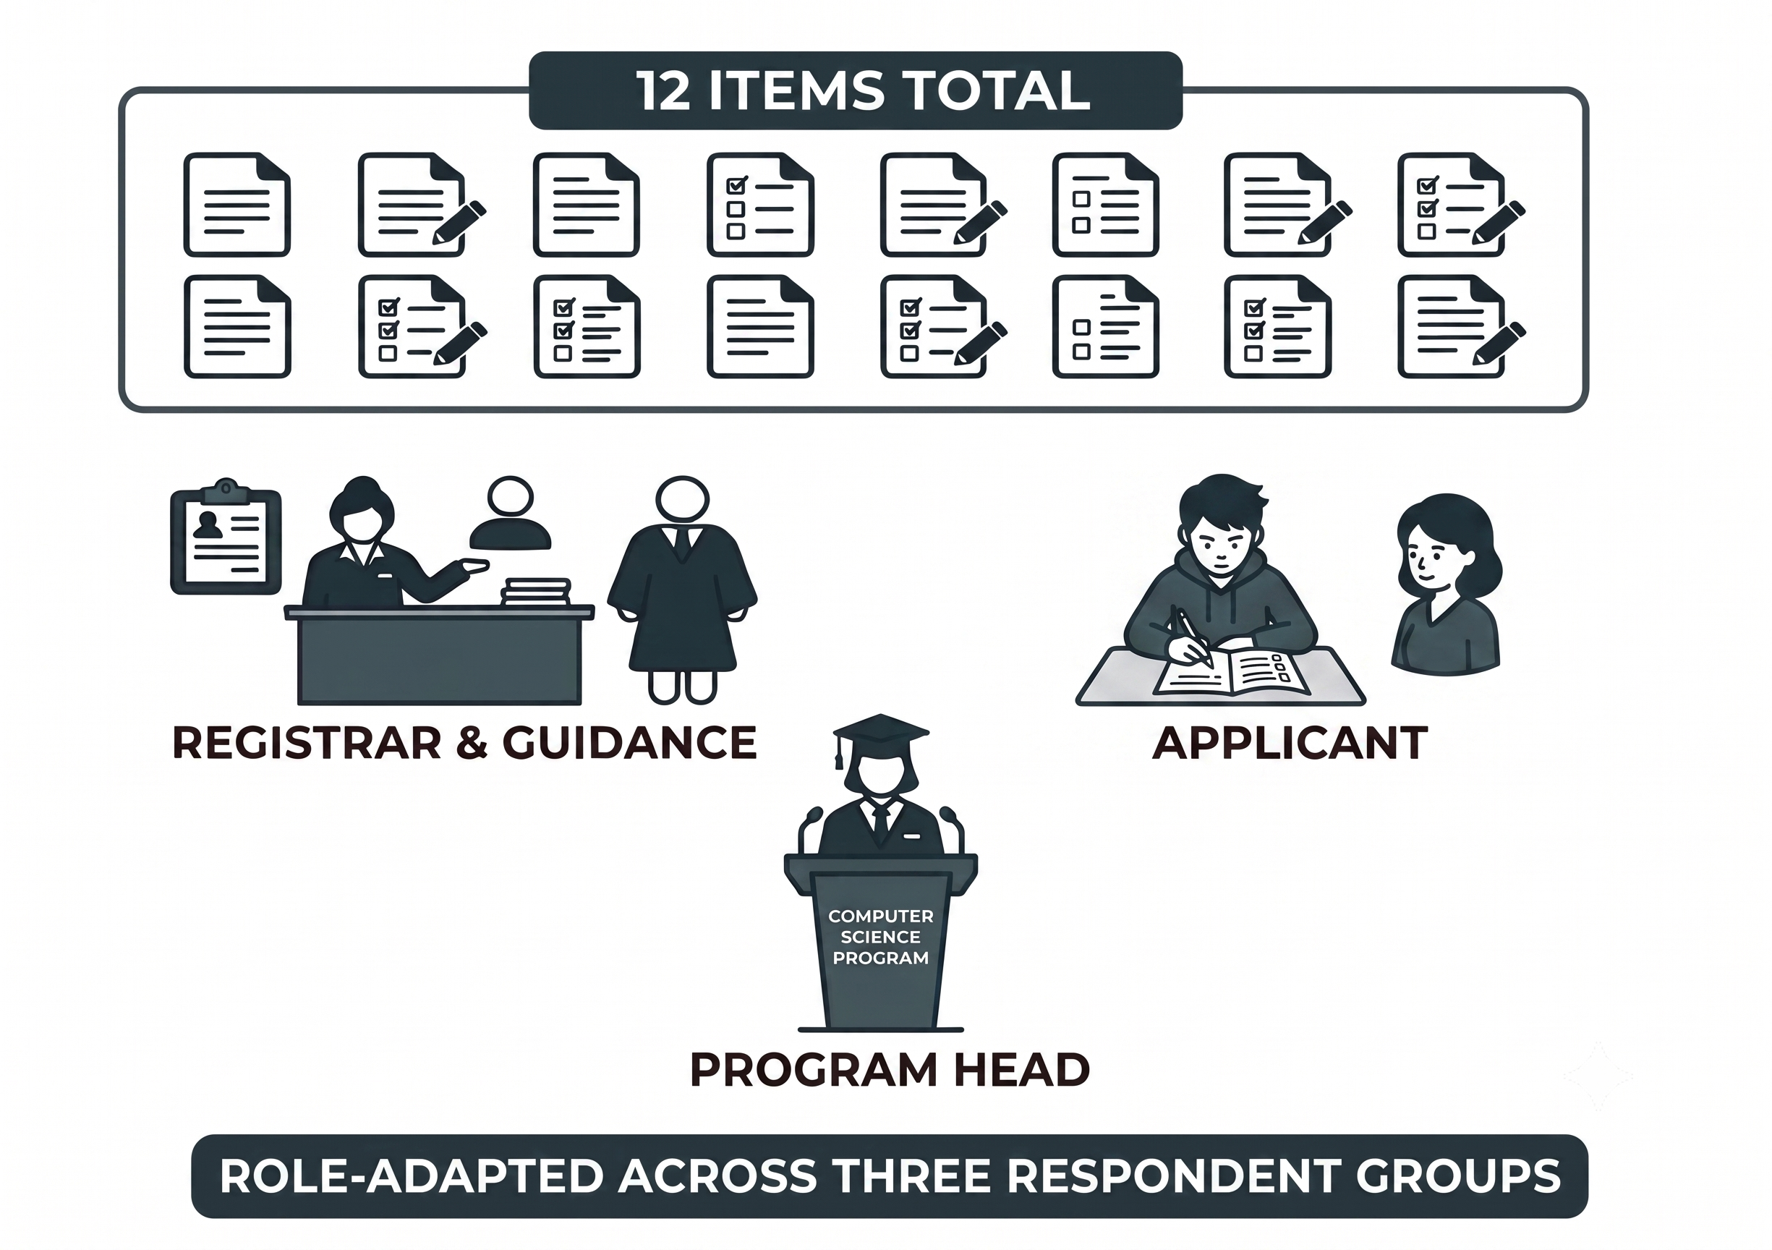
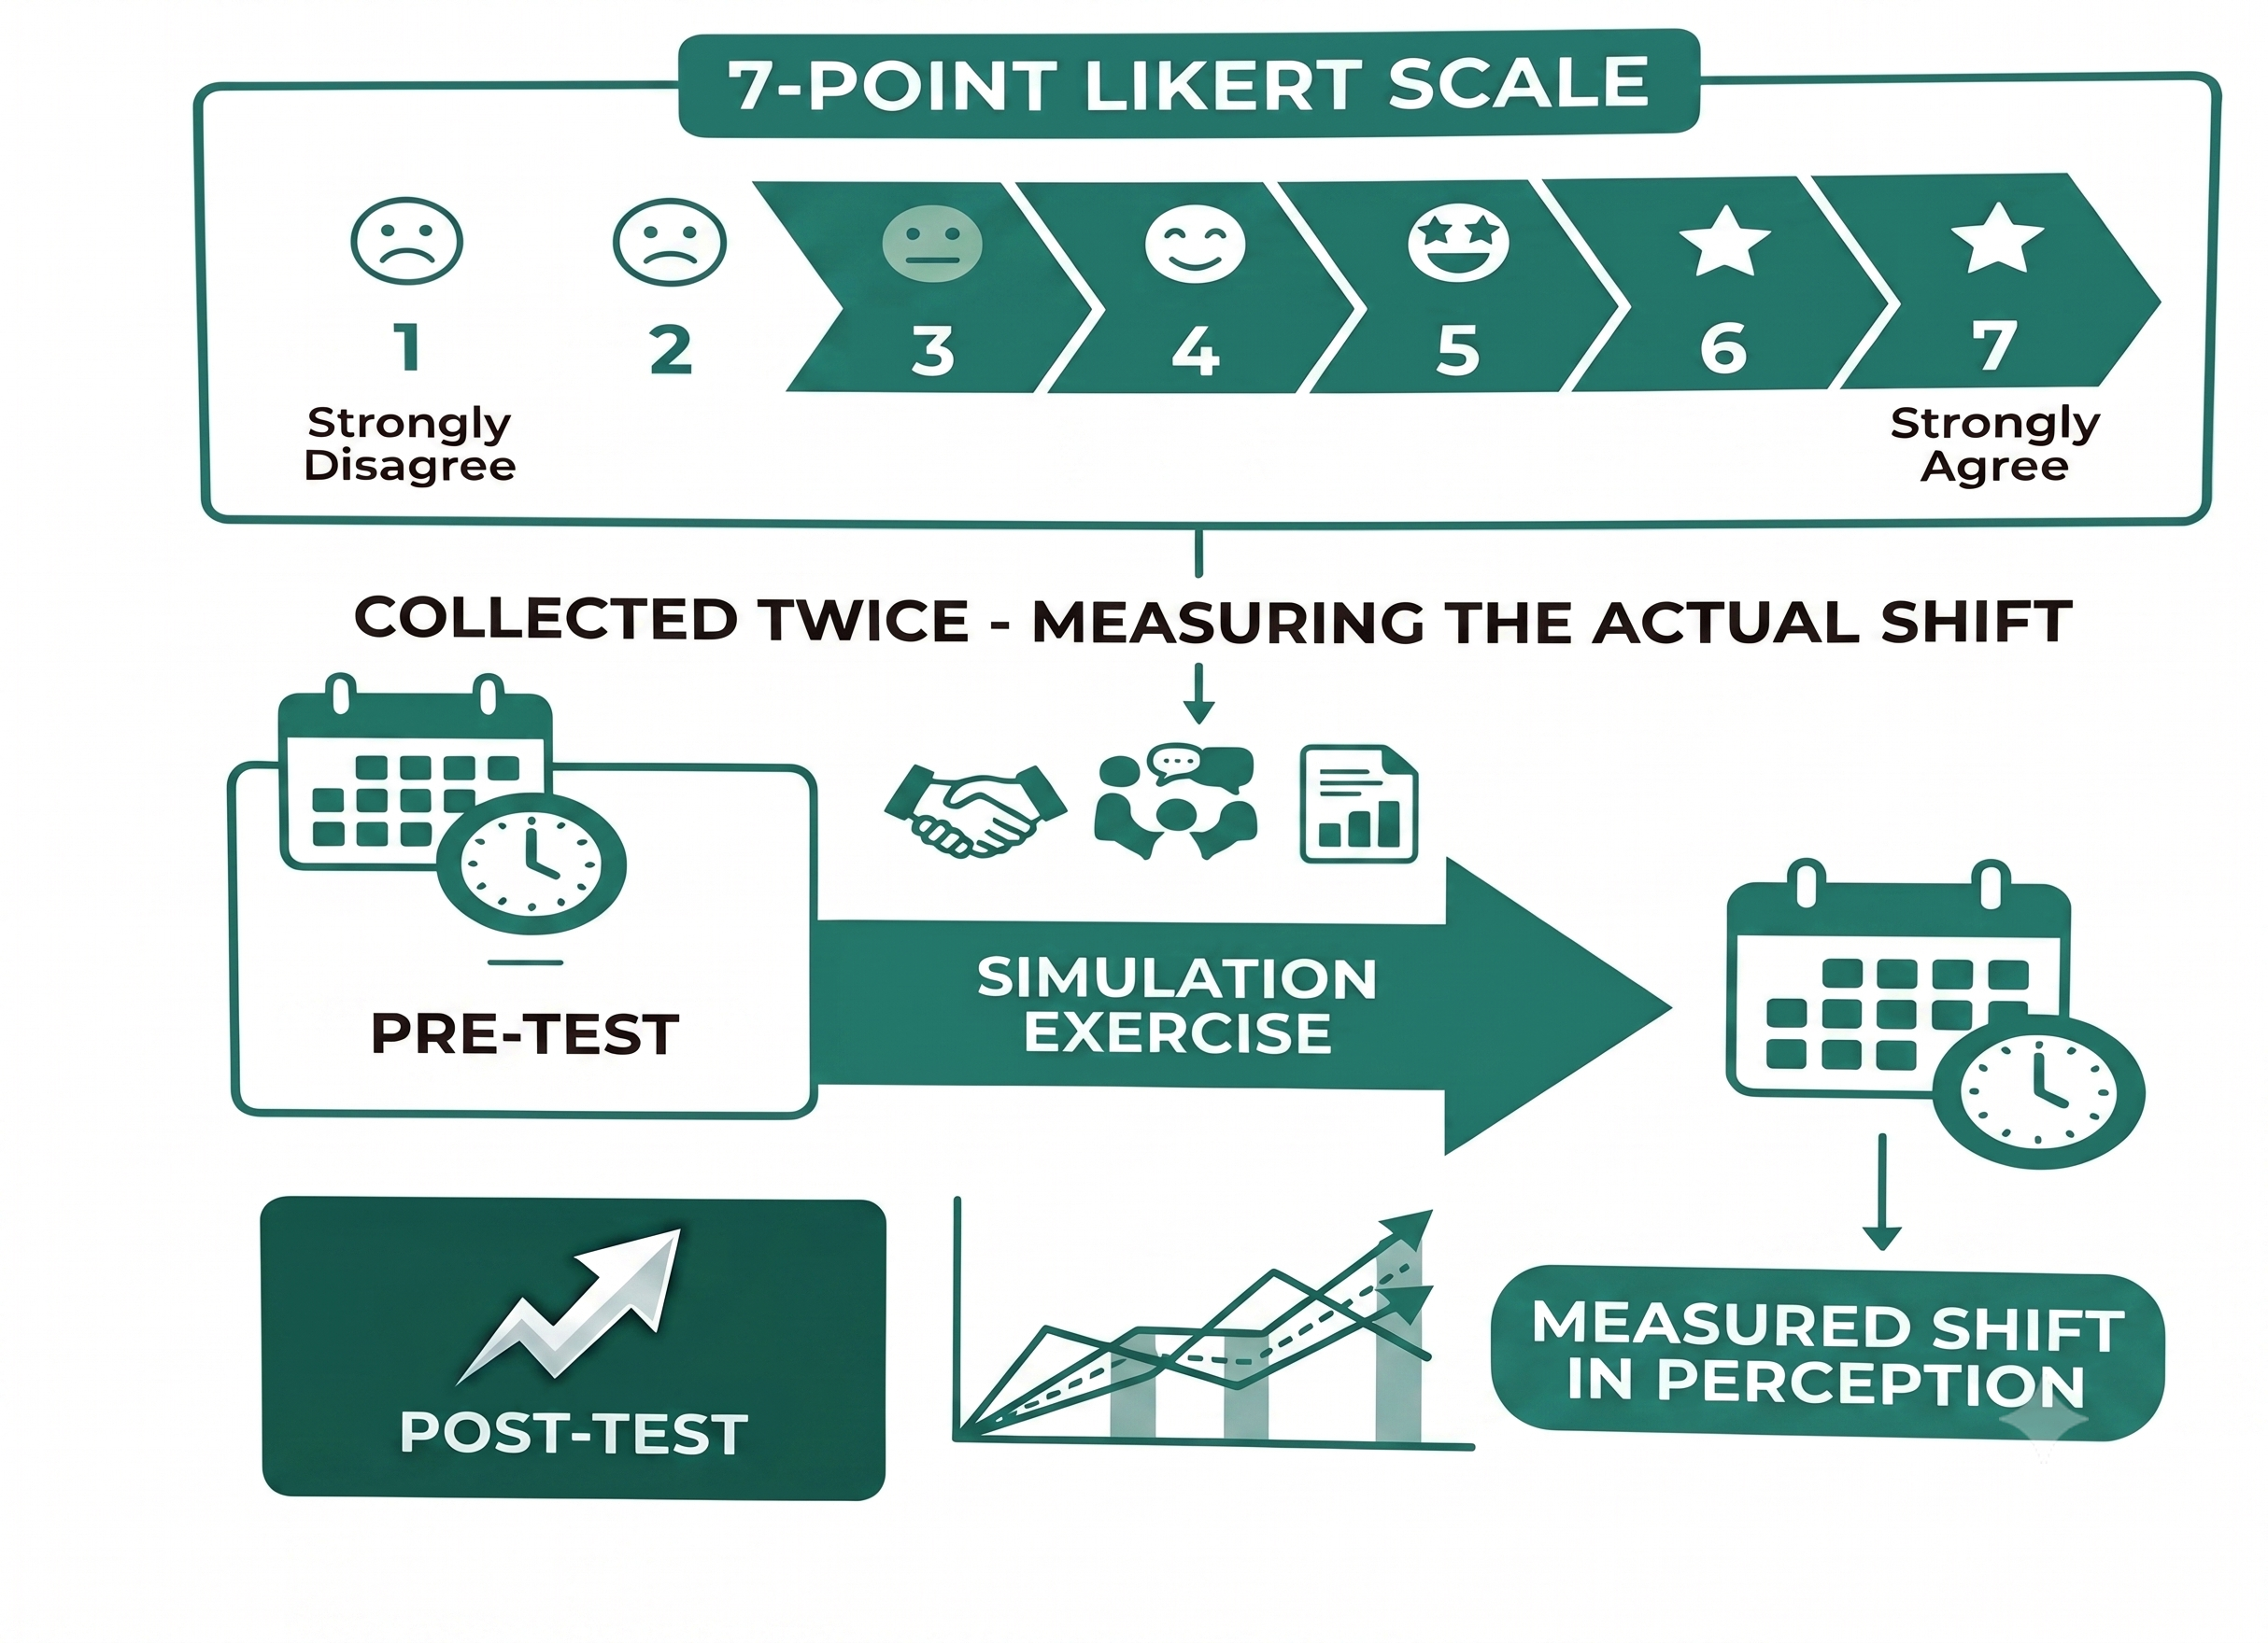
NEXIAM
RESEARCH INSTRUMENT
Technology Acceptance Model (Davis, 1989)
Next-Generation Examinations and
X(Cross)-Role
Intelligent
Admissions
Management
PU
PEOU
ATU
BIU
Perceived Usefulness
Perceived Ease of Use
Attitude Toward Use
Behavioral Intention to Use
12
16
/ 14
INSTRUMENT
Notes:
Christine · ~0:45 · 3 builds.
We measured acceptance using the Technology Acceptance Model, from Davis, 1989.
[Build 1] It covers four constructs — Perceived Usefulness, Perceived Ease of Use, Attitude, and Behavioral Intention.
[Build 2] Our instrument has 16 items total, adapted by role — separate versions for Registrar and Guidance staff, applicants, Program Heads, and IT expert evaluators.
[Build 3] Everyone answers on a 7-point Likert scale, and we collect responses twice — before and after they use NEXIAM — so we can measure the actual shift in perception.
11

Slide 13


NEXIAM
DATA ANALYSIS TECHNIQUES
Mapped Directly to the Four Specific Objectives
Next-Generation Examinations and
X(Cross)-Role
Intelligent
Admissions
Management
SO1 — Thematic Analysis
SO2 — Iterative Validation
SO3 — TAM Means
SO4 — Shapiro-Wilk → Test
Surfaces the actual pain-point themes from interview and survey responses.
Proposed requirements confirmed with Registrar and Guidance staff against real workflow.
Pooled and per-role construct means, checked against acceptance benchmarks.
Normality check first, then paired t-test or Wilcoxon at α=.05, with effect size.
13
/ 14
ANALYSIS
Notes:
Christine · ~1:00 · 4 builds.
Our analysis maps directly onto our four specific objectives.
[Build 1 — SO1] Thematic analysis on interview and survey responses to surface the actual pain-point themes in the current process.
[Build 2 — SO2] Iterative validation of proposed system requirements with Registrar and Guidance staff, until confirmed against real workflow.
[Build 3 — SO3] TAM means, pooled and broken down per role, checked against acceptance benchmarks.
[Build 4 — SO4] Shapiro-Wilk test for normality first, then a paired t-test or Wilcoxon signed-rank test at α=.05, with effect size, to measure the actual improvement from manual to NEXIAM.
12

Slide 14
NEXIAM · PROPOSAL DEFENSE
Thank You
We're ready for your questions.
SARMIENTO, D. D. · PAGADUAN, J. G. · LOPEZ, C. M.
Notes:
David closes · not counted in the 10:00.
Thank you. We're ready for your questions.
13

