Slide 1

Groovy Micro Services using
Spring Boot

Slide 2
David Dawson
CEO, Principal Consultant
david.dawson@simplicityitself.com
@davidthecoder

Slide 3
A Story ….

Slide 4
A Story ….
… of Noodles

Slide 5
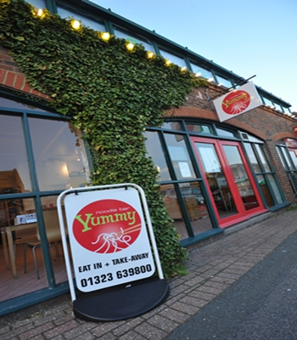
Yummy Noodle Bar
Eastbourne
Notes:
Friendly staff
Good spicy sauce
Comfortable plastic chairs that may be red.
Ambitious

Slide 6
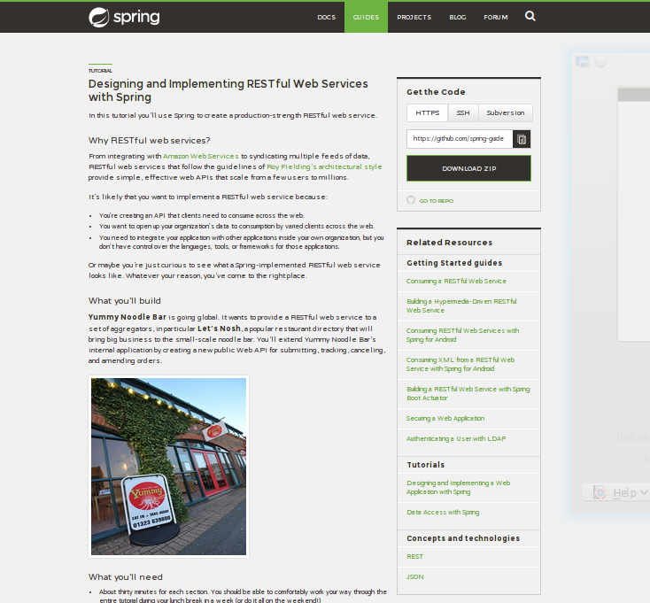
https://spring.io
Notes:
New home of all things spring

Slide 7
2013
Yummy Noodle
Global Launch!

Slide 8
Awesome Consulting, Inc
“Because We're Awesome”

Slide 9
The Task

Slide 10
The Task
Add a new Order submission REST
Interface at
/orders

Slide 11

Notes:
Straightforward is good
What if you could get back some of that Green Field feeling?

Slide 12
“where do I do that?”

Slide 13
“how do I do that?”

Slide 14
“how long will it take?”

Slide 15
2 weeks
Notes:
prediction

Slide 16
30 Minutes

Slide 17
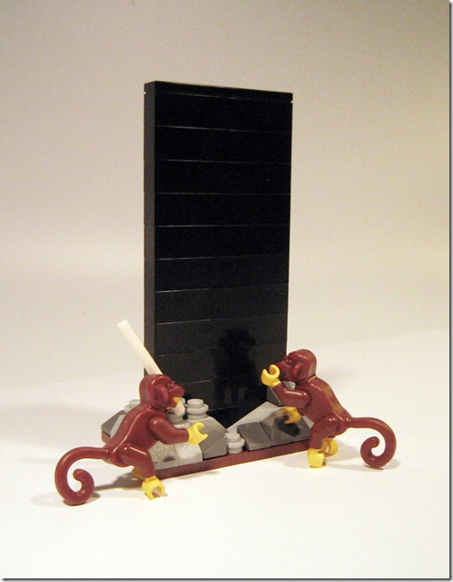
Notes:
Multiple rest interfaces
Web UI
Integration with the kitchen.
Having some issues with their current system.
Slower to develop.
Requiring more manpower to provide maintenance
Extend system!.

Slide 18


Slide 19
Green Field is for Kids …
The real pros work in brown field
Pete Suggitt - 2013
Notes:
Straightforward is good
What if you could get back some of that Green Field feeling?

Slide 20

Notes:
Lego is awesome.
Figure out what went wrong...

Slide 21
My Green Field Project

Slide 22
My Green Field Project
Web/ MVC Layer

Slide 23
My Green Field Project
Web/ MVC Layer
Service Layer

Slide 24
My Green Field Project
Web/ MVC Layer
Service Layer
Data Layer

Slide 25
My Green Field Project
Web/ MVC Layer
DataController
UserController
AuthController
DataService
UserService
Service Layer
User
Data Layer

Slide 26
My Green Field Project
Web/ MVC Layer
DataController
UserController
AuthController
DataService
UserService
Service Layer
User
Data Layer
1.0

Slide 27
My Green Field Project
Web/ MVC Layer
DataController
UserController
AuthController
OAuthController
Service Layer
DataService
UserService
RandomService
Data Layer
User
Point
UserSupport
1.1

Slide 28
My Green Field Project
Web/ MVC Layer
DataController
UserController
AuthController
OAuthController
DataController
UserController
AuthController
OAuthController
Service Layer
DataService
UserService
RandomService
DataService
UserService
RandomService
Data Layer
User
Point
UserSupport
User
Point
UserSupport
1.2

Slide 29
My Green Field Project
Web/ MVC Layer
DataController
UserController
AuthController
OAuthController
DataController
UserController
AuthController
OAuthController
DataService
RandomService
RandomService
Service Layer
DataService
UserService
DataService
UserService
DataService
BlahService
MehServ ice
GahService
DataService
DataService
DoWorkService
Data Layer
User
Point
UserSupport
User
Point
UserSupport
1.3

Slide 30
My Green Field Project
VIEWS
Web/ MVC Layer
DataController
UserController
AuthController
OAuthController
DataController
UserController
AuthController
OAuthController
DataService
RandomService
RandomService
Service Layer
DataService
UserService
DataService
UserService
DataService
BlahService
MehServ ice
GahService
DataService
DataService
DoWorkService
Data Layer
User
Point
UserSupport
User
Point
UserSupport
1.3

Slide 31
Where's the Yummy Noodle
Green Field?

Slide 32
Notes:
This is where you get someone like Pete in to be the discipline
To take a slightly different view of the app...

Slide 33
Anonymised, Generic Applicaton

Slide 34
Anonymised, Generic Applicaton
Service 1
Subscription
Endpoint
“Container”

Slide 35
Anonymised, Generic Applicaton
Service 1
Subscription
Endpoint
“Container”
Domain
Mapping
Class
ORM
“Domain Model”

Slide 36
Anonymised, Generic Applicaton
Service 1
Subscription
Endpoint
“Container”
Domain
Mapping
Class
ORM
“Domain Model”
Database (s)

Slide 37
Anonymised, Generic Applicaton
Service 1
Subscription
Endpoint
“Container”
Domain
Mapping
Class
ORM
“Domain Model”
Database (s)
Notes:
The pressures on the data model to support every permutation of sevice need is COMPLEX
A lot of engineering will go into this model

Slide 38
Anonymised, Generic Applicaton
Service 1
Subscription
Endpoint
“Container”
Domain
Mapping
Class
ORM
“Domain Model”
Database (s)
Notes:
Your service layer, the business logic, is important.
Your data is important.

Slide 39
Notes:
The Green Field Feeling.

Slide 40
Micro Services

Slide 41
Anonymised, Generic Applicaton
Service 1
Database (s)
Notes:
Your service layer, the business logic, is important.
Your data is important.

Slide 42
Share
Functionality
Not Code
Notes:
Services access fucntionality by calling another service, not by borrowing classes
Reducing code level coupling, replacing with runtime coupling

Slide 43
Short,
Easy to Understand
Notes:
A few hundred lines of code, max.
Minimal infrastructure/ support code.

Slide 44
Disposable
Notes:
If something is only a few hundred lines long, it can be thrown away at little cost.
It might be easier to just rewrite it than try to understand it....

Slide 45
HTTP
or
Message Bus
Notes:
HTTP as an integraton mechanism is awesome.
Caching, proxying,

Slide 46
Focus on
Data Flow
With thanks to Tareq Abedrabbo
http://www.terminalstate.net
Notes:
Seperation of concerns at the data level
Supermarket example from tareq , loading dock, shop floor

Slide 47
Minimal
Abstraction
Notes:
You know the database, and the data model
Your service is only 100s of lines long, why abstract anything?
Just transform and read/ write the data
Abstractions are useful to help you conceptualise a system. If they aren't needed, they are noise and shouldn't exist

Slide 48
Notes:
The Green Field Feeling.

Slide 49
How?
Notes:
Make a coherent application from multiple parts..?

Slide 50
Use HTTP/
URLs
Notes:
How can we have multiple, independent applications appear to be a single one?

Slide 51
HTTP Requests
HTTP Requests
Monolith
Notes:
Ever created a full spring app from scratch?

Slide 52
HTTP Requests
Front Controller/
HTTP Reverse Proxy
(NGINX)
HTTP Requests
Monolith
Notes:
Ever created a full spring app from scratch?

Slide 53
HTTP Requests
Front Controller/
HTTP Reverse Proxy
(NGINX)
HTTP Requests
/orders
Micro Services
New Micro Service
Monolith
Notes:
Creates a coherent URL space from multiple services

Slide 54
/orders
Micro Services
New Micro Service
Notes:
Creates a coherent URL space from multiple services

Slide 55
/orders
Micro Services
New Micro Service
Notes:
Creates a coherent URL space from multiple services

Slide 56
/orders [POST]
/orders [GET]
/auth
Order Post
Order Query
Authentication
Notes:
Creates a coherent URL space from multiple services

Slide 57
/orders [POST]
/orders [GET]
/auth
Order Post
Order Query
Authentication
MongoDB
Notes:
Creates a coherent URL space from multiple services

Slide 58
/orders [POST]
/orders [GET]
/auth
Order Post
Order Query
Authentication
MongoDB
LDAP
Notes:
Creates a coherent URL space from multiple services

Slide 59
/orders [POST]
/orders [GET]
/auth
Order Post
Order Query
Authentication
Event/ RabbitMQ
MongoDB
LDAP
Notes:
Creates a coherent URL space from multiple services

Slide 60
Notes:
The Green Field Feeling.

Slide 61
How do we make these?

Slide 62
Lightweight Frameworks

Slide 63
Lightweight Frameworks
Sinatra - Ruby

Slide 64
Lightweight Frameworks
Sinatra - Ruby
Scalatra - Scala

Slide 65
Lightweight Frameworks
Sinatra - Ruby
Scalatra - Scala
Ring - Clojure

Slide 66
Lightweight Frameworks
Sinatra - Ruby
Scalatra - Scala
Ring - Clojure
Ratpack - Groovy

Slide 67
Spring?
Notes:
Ever created a full spring app from scratch?

Slide 68
Minutes Left?

Slide 69
Spring Boot
http://projects.spring.io/spring-boot
Notes:
Frist released earlier.
GA along with Spring 4
Becoming the focus of spring documentation and seen as 'the default way' to do spring development.

Slide 70
Spring

Slide 71
Spring
with an Opinion
Notes:
Intelligent defaults
Conventional behaviour.
Sees whats on the classpath and configures beans in the application context

Slide 72
Opinions on ...
Notes:
Intelligent defaults
Conventional behaviour.
Sees whats on the classpath and configures beans in the application context

Slide 73
Opinions on ...
Tomcat/ Jetty
Notes:
Intelligent defaults
Conventional behaviour.
Sees whats on the classpath and configures beans in the application context

Slide 74
Opinions on ...
JPA/ Databases
Tomcat/ Jetty
Notes:
Intelligent defaults
Conventional behaviour.
Sees whats on the classpath and configures beans in the application context

Slide 75
Opinions on ...
JPA/ Databases
Tomcat/ Jetty
REST/ Spring MVC
Notes:
Intelligent defaults
Conventional behaviour.
Sees whats on the classpath and configures beans in the application context

Slide 76
Opinions on ...
JPA/ Databases
Tomcat/ Jetty
Validation
REST/ Spring MVC
Notes:
Intelligent defaults
Conventional behaviour.
Sees whats on the classpath and configures beans in the application context

Slide 77
Opinions on ...
JPA/ Databases
Tomcat/ Jetty
Validation
REST/ Spring MVC
Logging
Notes:
Intelligent defaults
Conventional behaviour.
Sees whats on the classpath and configures beans in the application context

Slide 78
Opinions on ...
JPA/ Databases
Tomcat/ Jetty
Validation
REST/ Spring MVC
Logging
Spring Integration
Notes:
Intelligent defaults
Conventional behaviour.
Sees whats on the classpath and configures beans in the application context

Slide 79
Opinions on ...
JPA/ Databases
Tomcat/ Jetty
Validation
REST/ Spring MVC
Logging
Spring Integration
Spring Data
Notes:
Intelligent defaults
Conventional behaviour.
Sees whats on the classpath and configures beans in the application context

Slide 80
Opinions on ...
JPA/ Databases
Tomcat/ Jetty
Validation
REST/ Spring MVC
Logging
Spring Integration
Spring Data
Your own...
Notes:
Intelligent defaults
Conventional behaviour.
Sees whats on the classpath and configures beans in the application context

Slide 81
Create a REST
Service on
MongoDB
In 10 Minutes
Notes:
Use spring boot to accelerate the setup of a spring app

Slide 82
Create a REST
Service on
MongoDB
In 5 Minutes
Notes:
And now for extra awesome

Slide 83
Benefits
Scalability
Seperation of
Concerns
Comprehension
Deployment
Options
Development
Speed
Robustness

Slide 84
Costs
Potential Code
Duplication
Extra HTTP / latency
Monitoring
Deployment
Complexity
Context Harder to See

Slide 85
?
Notes:
The Green Field Feeling.

Slide 86
Questions?

Slide 87
Blatant Promo
www.skillsmatter.com

Slide 88
Thank you!
@davidthecoder

