Slide 1
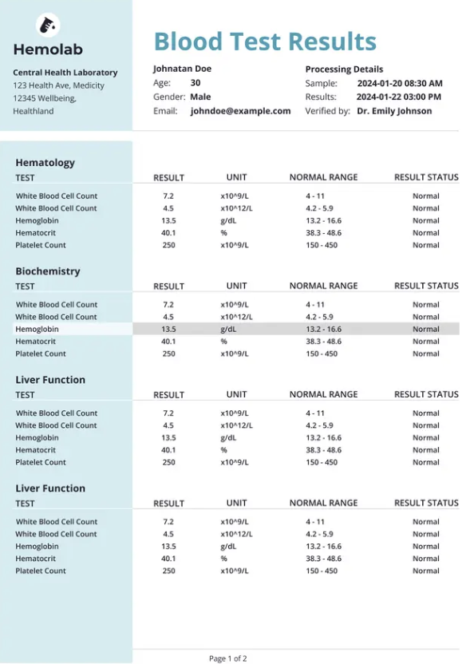
Social security 651 44 4231

