Slide 1
Software Developer
a.k.a. Computer programmer

Slide 2
What does a programmer do?

Slide 3

What friends think I do

Slide 4

What my family thinks I do

Slide 5
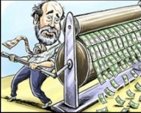
What the boss thinks I do

Slide 6

What I think I do

Slide 7

What I really do

Slide 8
My background
4 years in US NAVY- Communications (sending and receiving radio and electronic messages from ships and other navy stations)
One correspondence computer programming course while in the Navy and hated it
Wanted to be a Medical Lab Tech when I started college at LSUS, spent first year taking chemistry and biology courses
Summer prior to 2nd year, took a introductory programming course and switched majors to computer science
Started work at S&S part-time my last year in college

