Slide 1
Software Career Day Agenda

Slide 2
Software Career Day Agenda
Vice President Introduction

Slide 3
Software Career Day Agenda
Vice President Introduction
Todd Nichols- RCS Manager

Slide 4
Software Career Day Agenda
Vice President Introduction
Todd Nichols- RCS Manager
Career Fields Overview

Slide 5
Software Career Day Agenda
Vice President Introduction
Todd Nichols- RCS Manager
Career Fields Overview
David – Software Development Discussion
Lab- Web Programming
Lab- Windows Programming

Slide 6
Vice President- Deanna May

Slide 7

Todd Nichols- RCS Market Manager

Slide 8
Career Fields at S&S

Slide 9
Software Developer
Write code (build software applications)

Slide 10
Software Developer
Write code (build software applications)
Troubleshoot issues and fix bugs

Slide 11
Software Developer
Write code (build software applications)
Troubleshoot issues and fix bugs
Design applications and databases

Slide 12
Software Developer
Write code (build software applications)
Troubleshoot issues and fix bugs
Design applications and databases
Little interaction with clients

Slide 13
Software Developer
Write code (build software applications)
Troubleshoot issues and fix bugs
Design applications and databases
Little interaction with clients
Work on team projects (3-4) and also individual projects (more independent work)

Slide 14
Systems Engineer
Maintain networks

Slide 15
Systems Engineer
Maintain networks
Maintain servers (e.g. email server)

Slide 16
Systems Engineer
Maintain networks
Maintain servers (e.g. email server)
Install new hardware (memory, hard drives, printers)

Slide 17
Systems Engineer
Maintain networks
Maintain servers (e.g. email server)
Install new hardware (memory, hard drives, printers)
Troubleshoot hardware issues and general computer issues

Slide 18
Systems Engineer
Maintain networks
Maintain servers (e.g. email server)
Install new hardware (memory, hard drives, printers)
Troubleshoot hardware issues and general computer issues
Travel to client sites and setup networks and servers

Slide 19
Client support analyst
Technical Support for one or more applications

Slide 20
Client support analyst
Technical Support for one or more applications
Train clients on how to use the software

Slide 21
Client support analyst
Technical Support for one or more applications
Train clients on how to use the software
Travel to client sites for installation and training

Slide 22
Client support analyst
Technical Support for one or more applications
Train clients on how to use the software
Travel to client sites for installation and training
Lead user group meetings

Slide 23
Client support analyst
Technical Support for one or more applications
Train clients on how to use the software
Travel to client sites for installation and training
Lead user group meetings
Assist programmers in understanding software requirements

Slide 24
Client support analyst
Technical Support for one or more applications
Train clients on how to use the software
Travel to client sites for installation and training
Lead user group meetings
Assist programmers in understanding software requirements
Assist with testing new software or updates to existing software

Slide 25
Market Manager
Manages the support and development of one or more major applications

Slide 26
Market Manager
Manages the support and development of one or more major applications
Direct supervisory role over client support analysts

Slide 27
Market Manager
Manages the support and development of one or more major applications
Direct supervisory role over client support analysts
Prepares budgets and responsible for the overall profitability of the market

Slide 28
Market Manager
Manages the support and development of one or more major applications
Direct supervisory role over client support analysts
Prepares budgets and responsible for the overall profitability of the market
Assists with the design of new software or changes to existing software

Slide 29
Market Manager
Manages the support and development of one or more major applications
Direct supervisory role over client support analysts
Prepares budgets and responsible for the overall profitability of the market
Assists with the design of new software or changes to existing software
Many start out as support analysts and are promoted to this role

Slide 30
Other Supporting Careers
Accounting/Payroll
Business Administration
CEO
Vice President
Executive Assistant/Human Resources
Sales/Marketing
Purchasing Agent

Slide 31
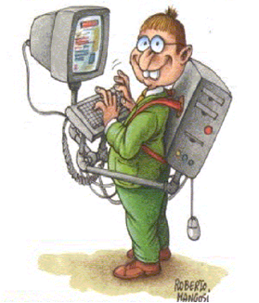
Software Developer
a.k.a. Computer programmer

Slide 32
What does a programmer do?

Slide 33

What friends think I do

Slide 34

What my family thinks I do

Slide 35

What the boss thinks I do

Slide 36

What I think I do

Slide 37

What I really do

Slide 38
My background
4 years in US NAVY- Communications (sending and receiving radio and electronic messages from ships and other navy stations)

Slide 39
My background
4 years in US NAVY- Communications (sending and receiving radio and electronic messages from ships and other navy stations)
One correspondence computer programming course while in the Navy and hated it

Slide 40
My background
4 years in US NAVY- Communications (sending and receiving radio and electronic messages from ships and other navy stations)
One correspondence computer programming course while in the Navy and hated it
Wanted to be a Medical Lab Tech when I started college at LSUS, spent first year taking chemistry and biology courses

Slide 41
My background
4 years in US NAVY- Communications (sending and receiving radio and electronic messages from ships and other navy stations)
One correspondence computer programming course while in the Navy and hated it
Wanted to be a Medical Lab Tech when I started college at LSUS, spent first year taking chemistry and biology courses
Summer prior to 2nd year, took a introductory programming course and switched majors to computer science

Slide 42
My background
4 years in US NAVY- Communications (sending and receiving radio and electronic messages from ships and other navy stations)
One correspondence computer programming course while in the Navy and hated it
Wanted to be a Medical Lab Tech when I started college at LSUS, spent first year taking chemistry and biology courses
Summer prior to 2nd year, took a introductory programming course and switched majors to computer science
Started work at S&S part-time my last year in college in 2000, went full-time in January 2001

Slide 43
Computer Science Major
Lots of Math
Algebra
Trigonometry
2 semesters of Calculus
Linear Algebra
Statistics
Computer Science Courses
Basic Programming
Operating Systems
Computer Architecture
Computer Algorithms
Object Oriented Programming
Senior Project

Slide 44
Entry Level Jobs
4 year CS degree is helpful but not required:
Associates Degree
Technical Training
On-the-job training like the military

Slide 45
Entry Level Jobs
4 year CS degree is helpful but not required:
Associates Degree
Technical Training
On-the-job training like the military
One of the highest starting salaries in United States

Slide 46
Entry Level Jobs
4 year CS degree is helpful but not required:
Associates Degree
Technical Training
On-the-job training like the military
One of the highest starting salaries in United States
Plenty of opportunities all across the US

Slide 47
Type of Jobs in Software Development
Web Programming
Web Sites- cnn.com, yahoo.com
Web Apps- gmail, google spreadsheets
Windows Desktop programming
Apps that run on windows
.NET - vb, C#

Slide 48
Software Development Jobs..
Mobile Development
Android Apps
Iphone Apps
Database Developer or Administrator

Slide 49
Software Development Jobs
Systems Programmer
Operating systems
Robotics
C/C++
Games Programmer
Research (Phd)

Slide 50
Non-Programming Jobs
Tech Support
Network Administrator
IT Manager
Computer Repair Technician
Graphic Design
Quality Assurance (Tester)

Slide 51
Is PROGRAMMING right for you?
Ability to focus and solve complex problems

Slide 52
Is PROGRAMMING right for you?
Ability to focus and solve complex problems
Doesn’t mind being isolated most of the day

Slide 53
Is PROGRAMMING right for you?
Ability to focus and solve complex problems
Doesn’t mind being isolated most of the day
Good written communication skills

Slide 54
Is PROGRAMMING right for you?
Ability to focus and solve complex problems
Doesn’t mind being isolated most of the day
Good written communication skills
Patience

Slide 55
Is PROGRAMMING right for you?
Ability to focus and solve complex problems
Doesn’t mind being isolated most of the day
Good written communication skills
Patience
Loves to learn new technologies

Slide 56
My Day at Software & Services
In the office between 7:30-8:00am (I am also work a little from home in the mornings remotely)

Slide 57
My Day at Software & Services
In the office between 7:30-8:00am (I am also work a little from home in the mornings remotely)
Start the coffee as soon as I walk into the building

Slide 58
My Day at Software & Services
In the office between 7:30-8:00am (I am also work a little from home in the mornings remotely)
Start the coffee as soon as I walk into the building
Get caught up on email (while drinking coffee)

Slide 59
My Day at Software & Services
In the office between 7:30-8:00am (I am also work a little from home in the mornings remotely)
Start the coffee as soon as I walk into the building
Get caught up on email (while drinking coffee)
Review my task/work list (while drinking coffee)

Slide 60
My Day at Software & Services
In the office between 7:30-8:00am (I am also work a little from home in the mornings remotely)
Start the coffee as soon as I walk into the building
Get caught up on email (while drinking coffee)
Review my task/work list (while drinking coffee)
If no support issues, continue working on major programming projects (while drinking coffee)

Slide 61
My Day at Software & Services
In the office between 7:30-8:00am (I am also work a little from home in the mornings remotely)
Start the coffee as soon as I walk into the building
Get caught up on email (while drinking coffee)
Review my task/work list (while drinking coffee)
If no support issues, continue working on major programming projects (while drinking coffee)
Support Issues normally take priority (we call it putting out fires)

Slide 62
My Day at Software & Services
In the office between 7:30-8:00am (I am also work a little from home in the mornings remotely)
Start the coffee as soon as I walk into the building
Get caught up on email (while drinking coffee)
Review my task/work list (while drinking coffee)
If no support issues, continue working on major programming projects (while drinking coffee)
Support Issues normally take priority (we call it putting out fires)
Not uncommon to Read/Send around 50 emails each day

Slide 63
My Day at Software & Services
In the office between 7:30-8:00am (I am also work a little from home in the mornings remotely)
Start the coffee as soon as I walk into the building
Get caught up on email (while drinking coffee)
Review my task/work list (while drinking coffee)
If no support issues, continue working on major programming projects (while drinking coffee)
Support Issues normally take priority (we call it putting out fires)
Not uncommon to Read/Send around 50 emails each day
10% troubleshooting/support, 60% design/analysis (thinking), 30% coding

Slide 64
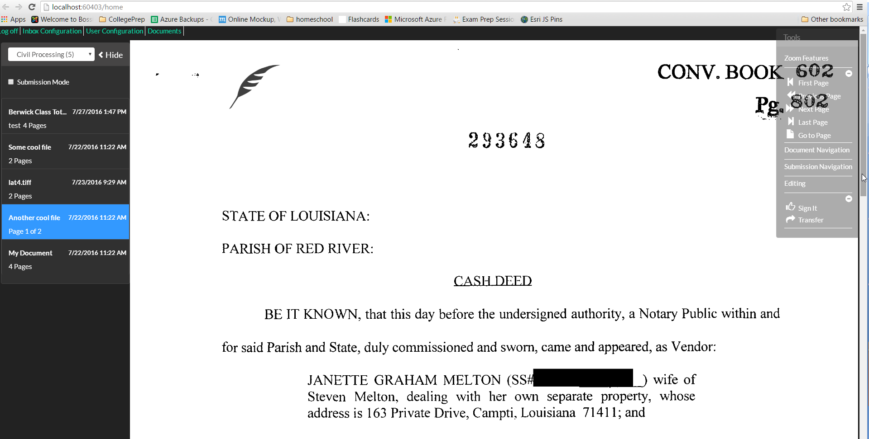

Slide 65
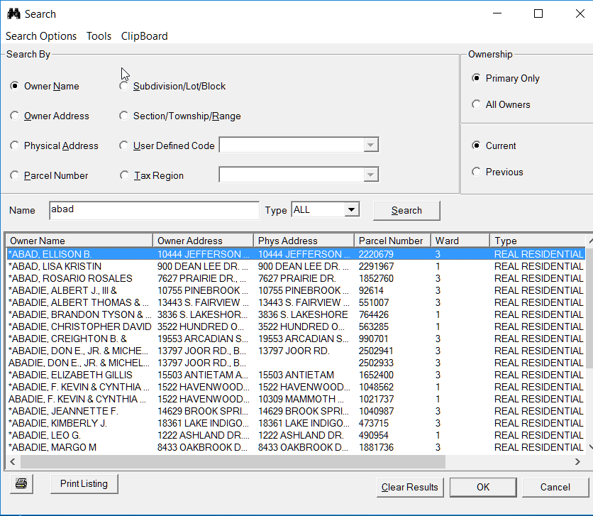
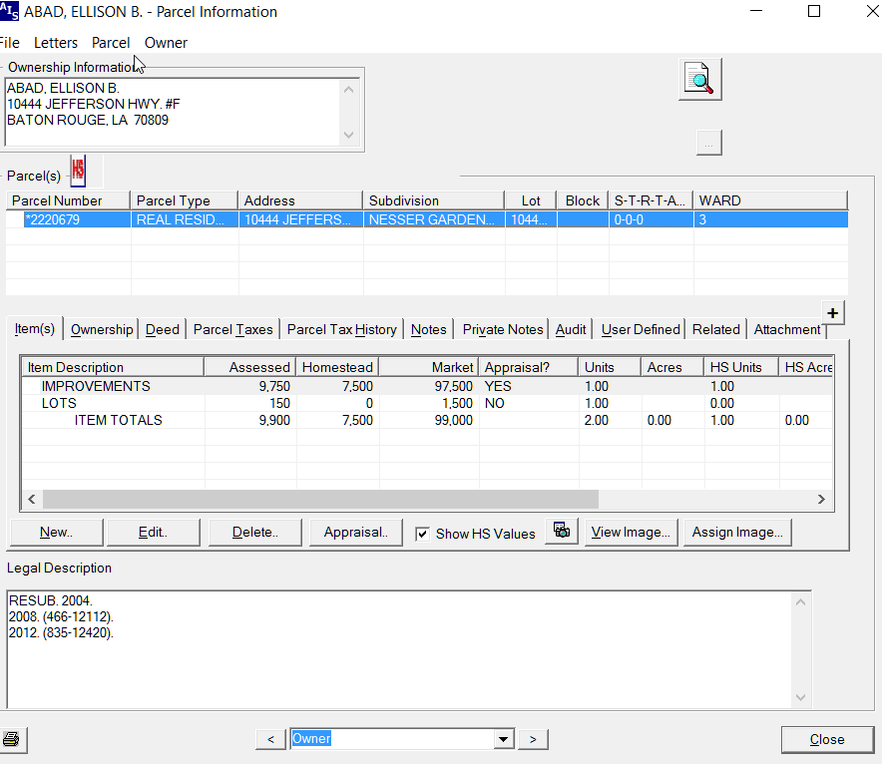

Slide 66
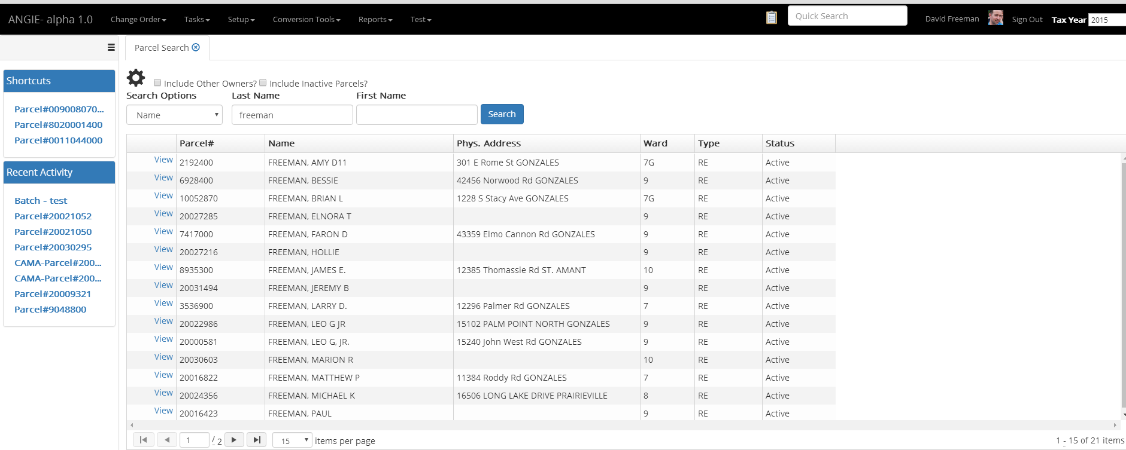

Slide 67
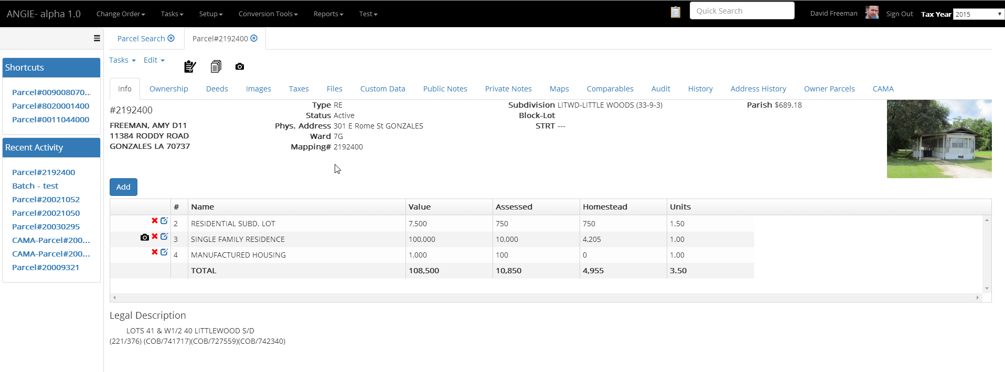

Slide 68
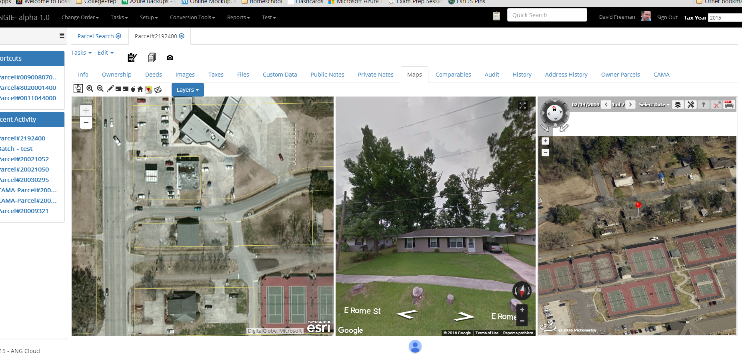

Slide 69
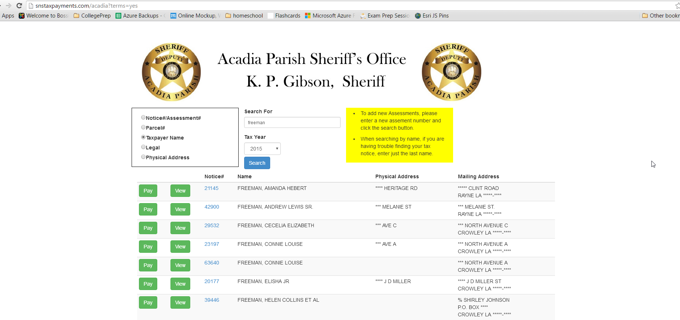

Slide 70
