Slide 1
Development of a Nonlinear Finite
Element Program for Seismic
Analysis of Simple Structures
Fraser Allan and David de Koning
April 20th, 2005
NON LINEAR FEM

Slide 2

Goals
Prediction of behaviour of complex structures under various loads
Flexible analysis framework
Control of entire modelling process
NON LINEAR FEM

Slide 3
Method
Develop Finite Element Method (FEM) program
Develop and validate a non linear plastic hinge element
Model non linear behaviour of a multi story structure
NON LINEAR FEM

Slide 4
FEM Validation
Linear, SDOF system
Constant, instantaneous load
Calculated and theoretical responses compared
NON LINEAR FEM

Slide 5
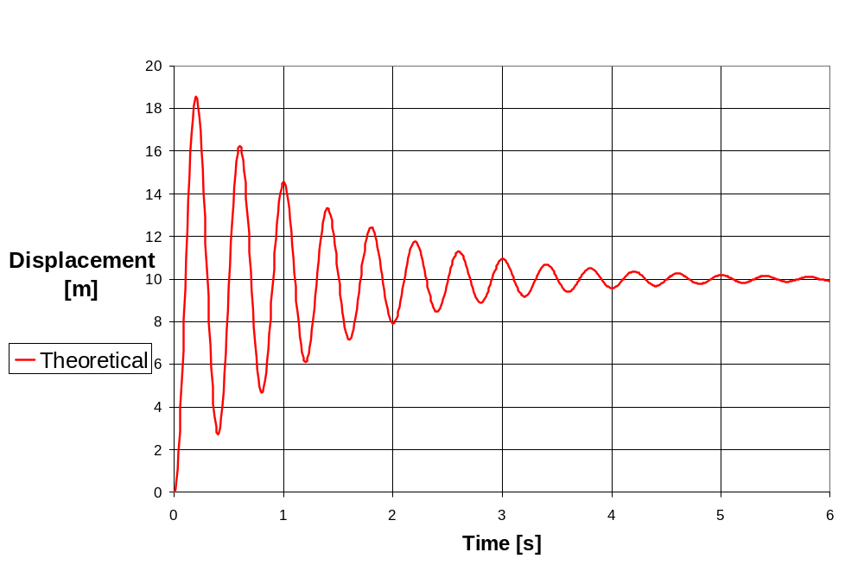
FEM Validation
NON LINEAR FEM

Slide 6
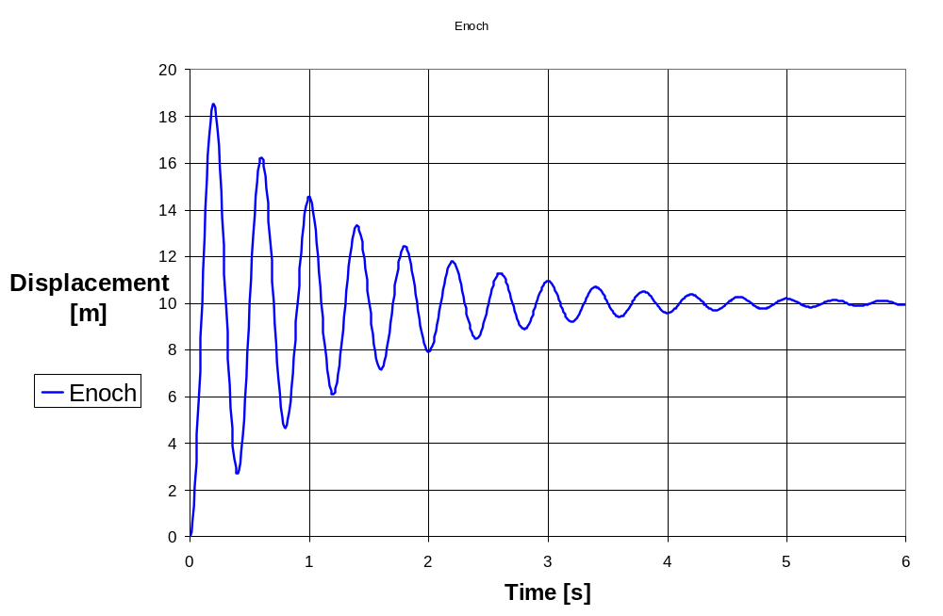
FEM Validation
NON LINEAR FEM

Slide 7
Plastic Hinge Validation
SDOF system
Monotonic loading
  Expected response observed
Cyclic loading compared to NonLin
  Excellent correlation
NON LINEAR FEM

Slide 8
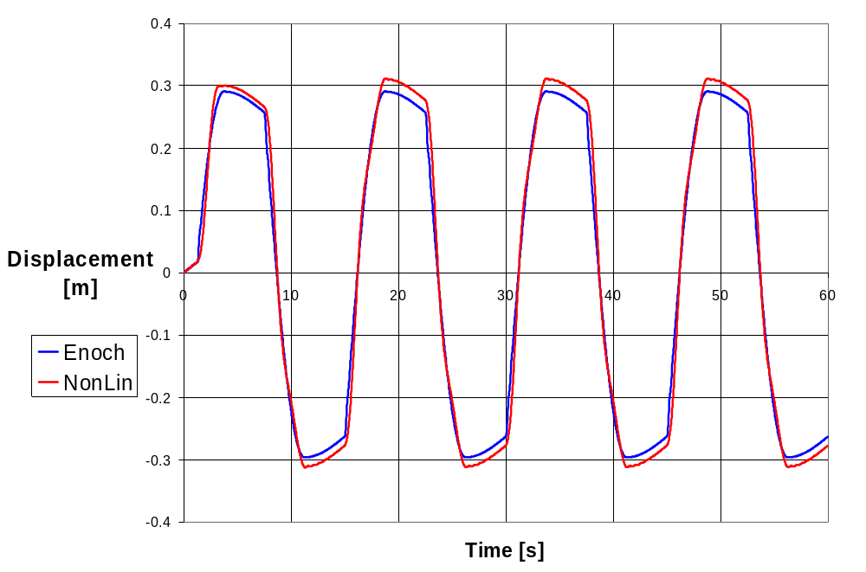
Plastic Hinge Validation
NON LINEAR FEM

Slide 9
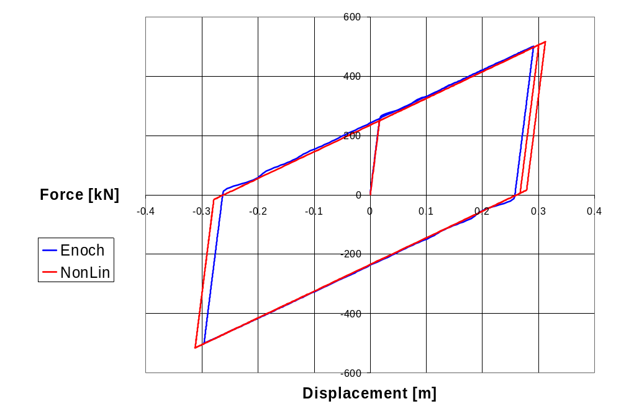
Plastic Hinge Validation
NON LINEAR FEM

Slide 10
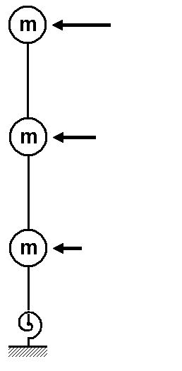
Shear Wall Response
Three story structure
  Equal masses and story stiffness
  Plastic hinge at base
Push-pull analysis
  Single linear cycle
NON LINEAR FEM

Slide 11
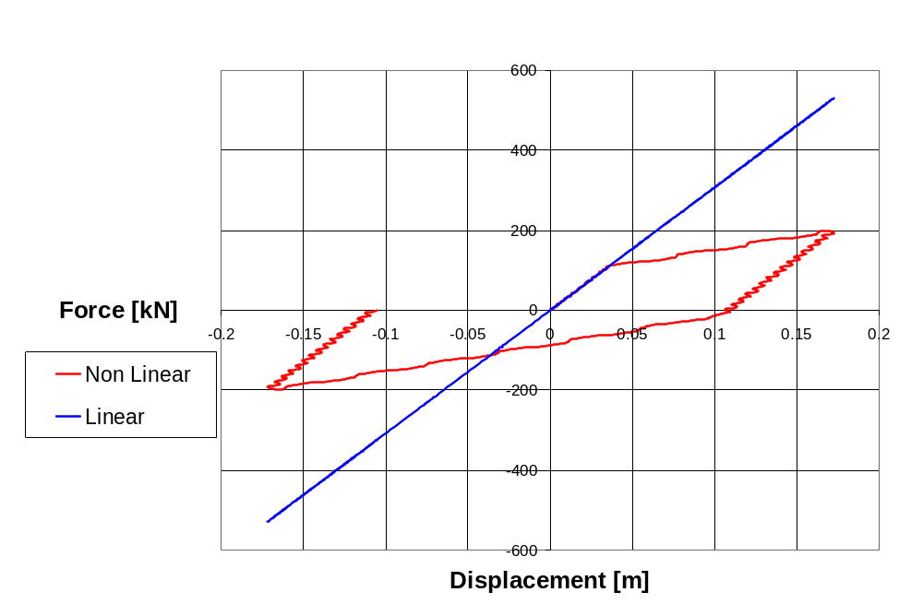
Shear Wall Response
NON LINEAR FEM

Slide 12
Limitations
Enoch does not check units
Damping sometimes causes convergence problems
Validation is time-consuming
Flexibility increases complexity
NON LINEAR FEM

Slide 13
Conclusions
Enoch analysis of linear and non linear systems is accurate
Plastic hinge behaves as expected
Writing custom FEM software is a feasible option
NON LINEAR FEM

Slide 14
Development of a Nonlinear Finite
Element Program for Seismic
Analysis of Simple Structures
Fraser Allan and David de Koning
April 20th, 2005
NON LINEAR FEM

