Slide 1

README Post-bop modal-tonal AI jazz improvisation Program(me) Notes
David De Roure
david.deroure@wolfson.ox.ac.uk

Slide 2
Now’s the time
Back in the late 1900s I was part of a jazz workshop helping people learn to play jazz.
﻿﻿One of the exercises was called "slick licks" – we would sit in a circle and “trade licks” on our instruments.
A big barrier for jazz learners can be finding people to play with.
﻿﻿Q. Can I build a software system to enable people to practice their slick licks? And specifically… can a bass player use this?!
It should listen and respond, sometimes lead, be realistic enough to be useful.
NB This interactive “robot” is designed for practice purposes, and it's not intended to replace a human player. Human interaction was key to slick licks!

Slide 3
Program(me) Note
README* is a live conversation between a human bassist and an artificial musician that listens, responds, and remembers. Wolfson is a computer system trained on hundreds of jazz saxophone solos; it hears each bass phrase, analyses its character – the notes, the rhythm, the energy – and improvises a reply in real time. Over five minutes the music traces a journey through jazz history: an exploratory, chromatic opening gives way to the modal sound of Miles Davis and Herbie Hancock, builds to a hard-driving peak, and settles into a meditative close. No two performances are identical — the music that emerges depends entirely on what the bassist chooses to play.
* The title works on three levels: the README file is the first thing you read when you encounter a piece of software; the software reads me, the bassist, responding to whatever I play; and it is a sideways glance at Recorda Me ("remember me”) a jazz standard, and a reminder that all improvisation is, in some sense, an act of memory.

Slide 4
All the things I have been* thinking about
Phrase analysis
Question and answer
Leadership & role
Opening echo
Contour steering
Chord conditioning
Harmonic modes
Scale pitch bias
Pitch range
Swing / triplet feel
Live tempo tracking Dynamics Generation temperature
Phrase-shape dynamics
Articulation
Bass pitch-class tracking Scale mode detection
Energy arc
Motivic development
Rhythmic displacement
Lyrical motif re-use
Voice leading
Modal leap bonus
Stochastic thinning
Phrase breathing Singable duration bias
Rhythmic density
Rhythmic complementarity
Register contrast
Phrase length control
Beat-matching / trading bars
Repetition control
Sax riff / insistence
Proactive mode
Live phrase peeking Beat-synchronised entry Turn-taking
Loop mode Arc timing
* Good name for a song?

Slide 5
Fly me to the moon
The five giant steps in the performance arc…
Sparse | Exploratory, establish motifs slowly
Building | Groove warming up, modal
Peak | Fast, active, max rhythmic intensity
Recapitulation | Lyrical return, motifs recalled
Resolution | Slowest, long tones, fading out

Slide 6
Sentimental journeys
This is inspired by:
Post-bop modal-tonal hybrids like:
Milestones (Miles Davis), Little Sunflower (Freddie Hubbard), Maiden Voyage (Herbie Hancock), Footprints (Wayne Shorter), and the atmosphere of In a Silent Way (Miles Davis). These songs are my favourite things*.
The arc also traces a journey through jazz history :
Sparse opening resembles the chromatic freedom of free jazz,
Modal building stage reflects the Miles/Coltrane modal period,
Peak combines hard bop drive with modal intensity,
Pedal resolution has the meditative quality of late Coltrane e.g. A Love Supreme.
* John Coltrane

Slide 7
Bass (pitch-to-MIDI)
MidiListener
PhraseDetector
Input Pipeline
filter · routing
note dur min · min phrase notes · monophony · watchdog
BeatEstimator
live tempo · beat sync
PhraseAnalyzer
PhraseMemory
contour · density · Q&A type · swing · dynamics · energy profile ·
pitch classes · interval motifs · lyrical motifs
stores phrases + motifs ·
stores lyrical motifs ·
both voices (bass + sax)
ArcController
Display
Proactive Loop
5-min performance arc · leadership · proactive mode · bass pitch-class tracking · energy arc selection · motif + lyrical motif selection · register contrast scheduling · rhythmic density + complementarity · stage swing baseline · opening echo
fires when bass paused
Dashboard · web · OSC

Slide 8
Generation
ArcController
HarmonyController
modal · progression · pedal · tritone substitution
PhraseGenerator
LSTM · chord conditioning · pitch range limits · register gravity ·
register contrast · scale pitch bias · contour steering · swing/triplet bias · energy arc shaping · long-note penalty · singable duration bias · motivic development · voice leading · modal leap · bonus (P4/P5) · repetition penalty · rest injection · beat accumulator · rhythmic displacement
LSTM
WJD sax solos · 49-token chord vocab
PhraseMemory
MidiOutput
sax voice
motifs · recall ·
self-play seed
energy arc · peak accent · end taper
chord hint

Slide 9
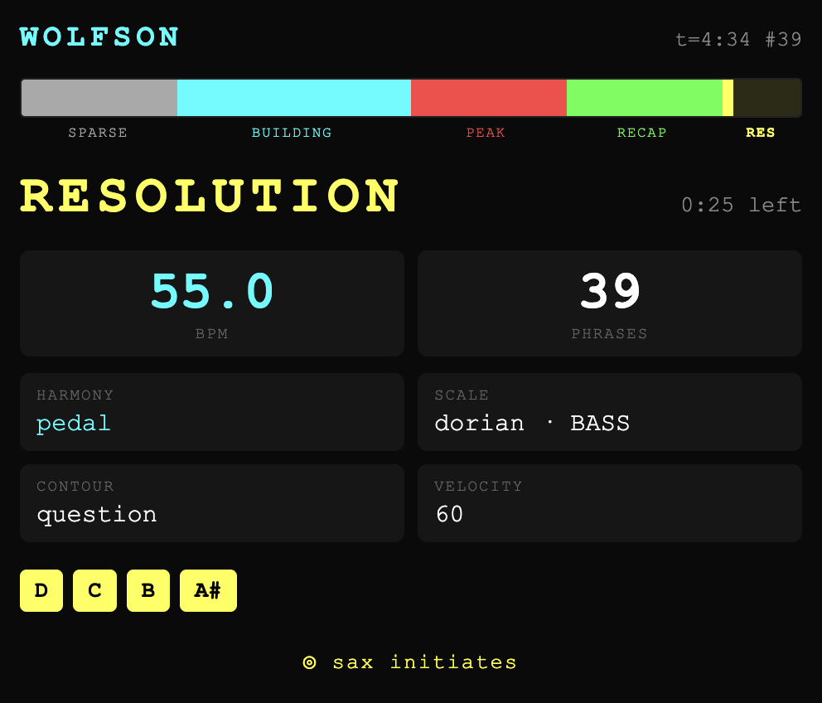
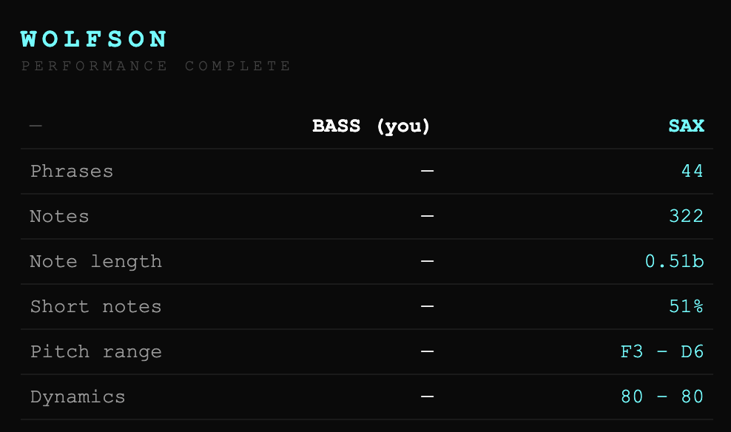
Soul A-eyes
Watch live during the performance on wolfson.numbersintonotes.net

Slide 10





Repo is on github.com/davidderoure/wolfson
Acknowledgement:
Ray d’Inverno (for jazz, Lisp, AI, slick licks)
Mark d’Inverno (for jazz, AI, creativity, slick licks)
George E Lewis (for Voyager and Forager)
Robert Laidlow (for Alter-ing Ada Lovelace, and sax)
Hongshuo Fan (for Music Gesture Recognition)
Bofan Ma (for always enabling musicality)
Maria Kallionpää (for Climb!)
Ada Lovelace & Emily Howard (for Numbers into Notes)
Wolfson Digital Research Cluster, DiSc & TORCH (for AIMC 2024)
Grand Challenges for Computing Research – Tony Hoare

Slide 11

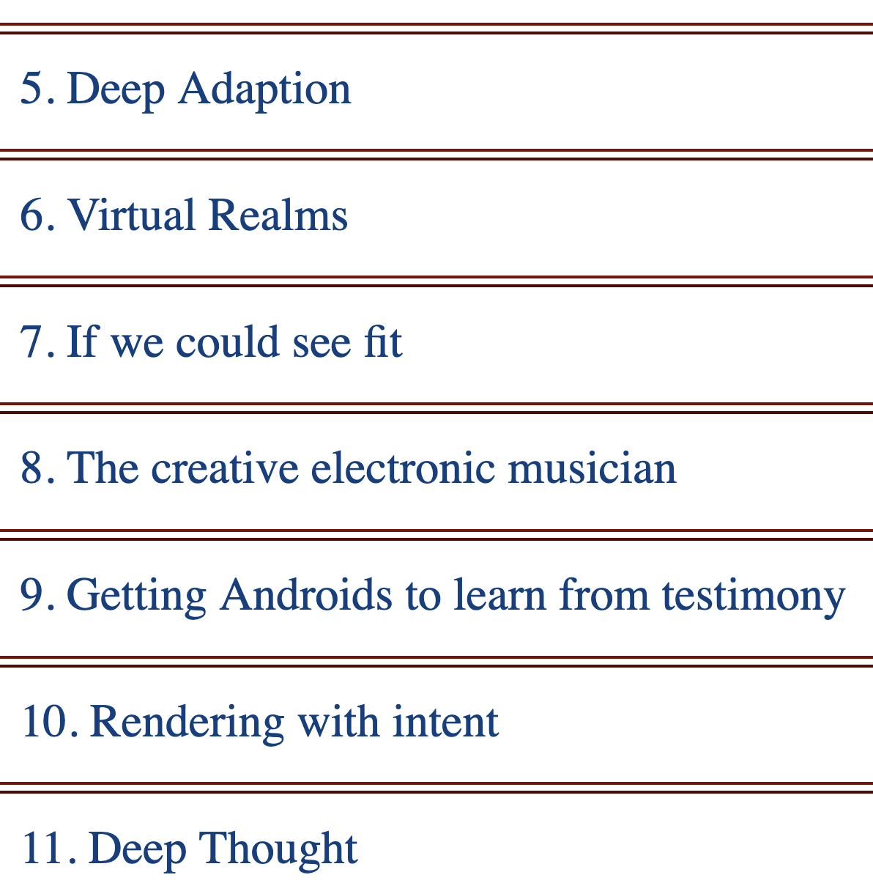
Radar of the lost archive
“The Grand Challenges Exercise of the UK Computing Research Committee”
A workshop held in Edinburgh in November 2002, considered 109 submissions.
Archival research suggests my submission was “The creative electronic musician”. Or maybe “Interactive Electronic Musician”.
Sir Tony Hoare, Wolfson Emeritus Fellow, was Chair of the programme committee.

Slide 12
Someday my footprints will come but we might not be quite there yet:
It uses MIDI: no pitch inflection, vibrato, or continuous dynamics within notes – every note is a rectangle.
Time feel is mechanical within phrases: no microtiming, no laying back or pushing the beat.
Conversation is polite by design – complementary, never confrontational, doesn't interrupt, crowd the register, or refuse to listen..
It’s pretty much in 4/4, no waltzes or take 5 – the tempo estimator assumes equal beats.
No personal voice – an amalgam across an era rather than any one player's sound.
The arc is clock-driven, not music-driven – deliberately for this performance (but see Climb!)
Motivic development might feel like repetition – because it is.
Trained on solos not melodies – no quoting, no playing off the tune.
Trained on one era and school – the bebop/hard-bop vocabulary of the Weimar Jazz Database; no awareness of what came before or after.
Inside/outside distinction and narrative arc within a phrase could be designed more explicitly – the model has learned some of this from transcriptions.
It only listens to one instrument (but see Forager).
Audiences may find fixed, familiar harmony more immediately satisfying – responsiveness to the bassist means harmony is earned rather than given.

Slide 13
